Slide 1
Mobile App Group Project
Submitted to: Dr. Wenyun Dai
Done By: Qian Feng, Harsh Shah, Ujjwal Shah

Slide 2
Introduction
Our project is a sample app for a mobile store. The app contains different mobile phones and their details.
It has various functions such as:
Add Function
Edit Function
Delete Function
Search Function

Slide 3
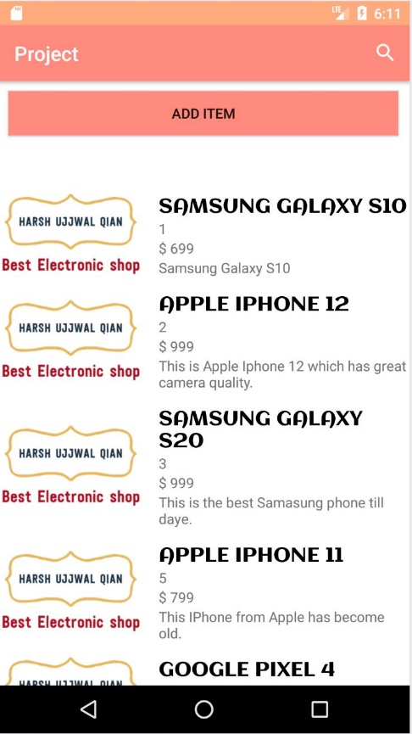
Main Activity
This is the first activity that users see when they first open the app.
This is where all the products of our store are listed in a recycler view improving speed and saving memory.
The list item contains name, ID, price and description of each product

Slide 4
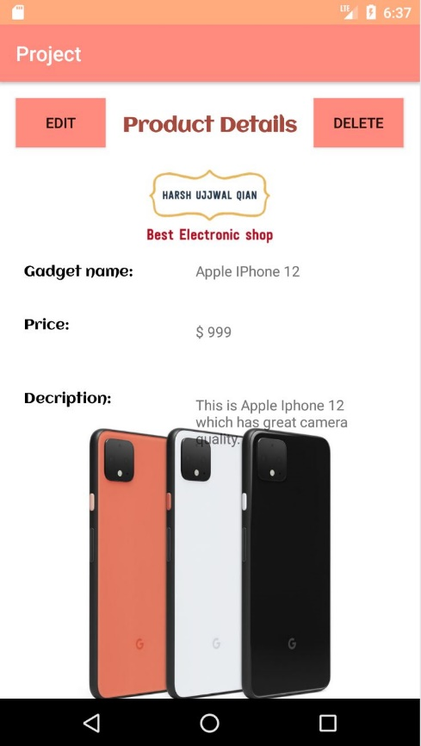
Details Activity
This activity shows various
details of a product such as:
Name
Price
Description
The details activity can be called by clicking on any of the products on the main activity.

Slide 5
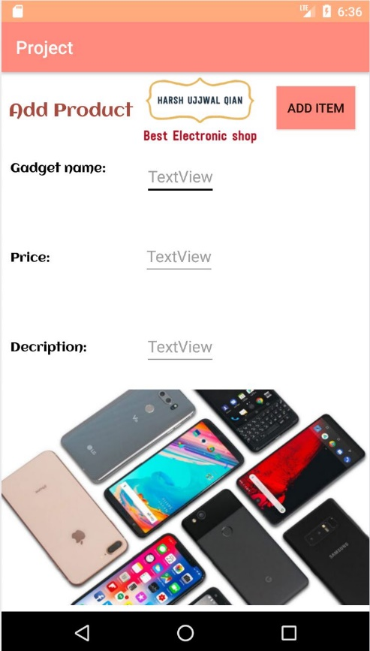
Add Function
This function is used to add products into the store with their details.
Add function can be activated using the “Add” button on the top of main activity

Slide 6
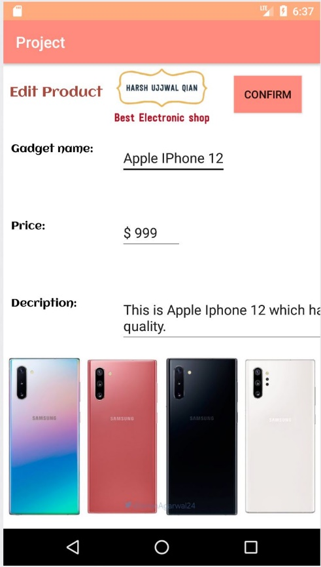
Edit Function
This function is used to edit the details of products already in the application.
Edit function can be activated through the “Edit” button on the bottom left corner of the screen on the details activity.

Slide 7
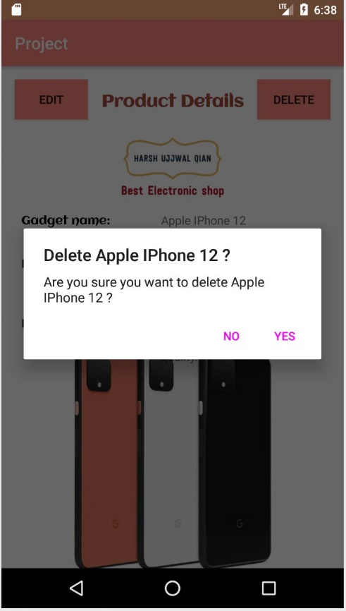
Delete Function
This function is used to delete any product already in the application.
On calling it will show an alert message confirming user’s delete request.
The delete function can be called by clicking on the “Delete” button present on the bottom right corner of the details screen.

Slide 8
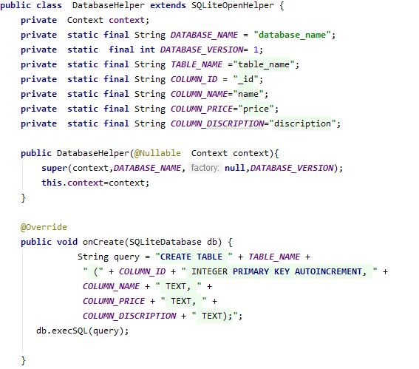
Database Usage
In this application we have used SQLite database to store all the product information.
All the functions are directly connected to the database and make changes in the database.

Slide 9
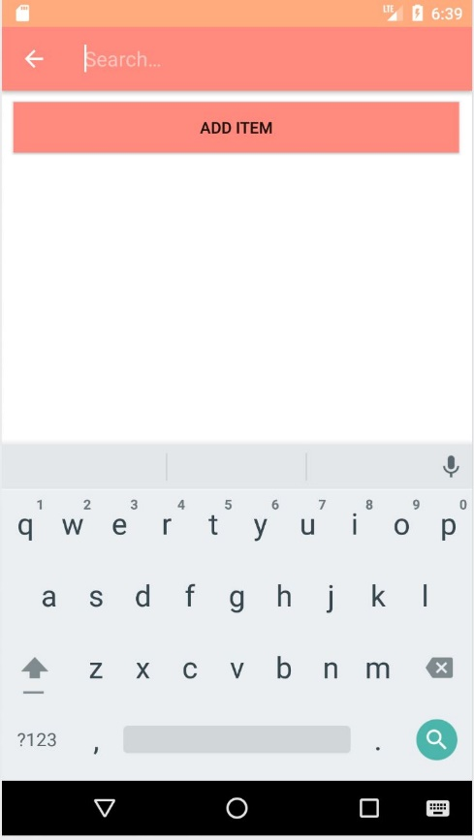
Search Function
This function is used to search for a product using the search view.
The search view is embed in the top bar on the main activity.
We tried to implement a fully functional search but for some reason it does not display the result list.

Slide 10
Contributions
Qian Feng:
Database and Backend
Harsh Shah & Ujjwal Shah:
Layouts, User Interface, Resources and Documentation

