Slide 1
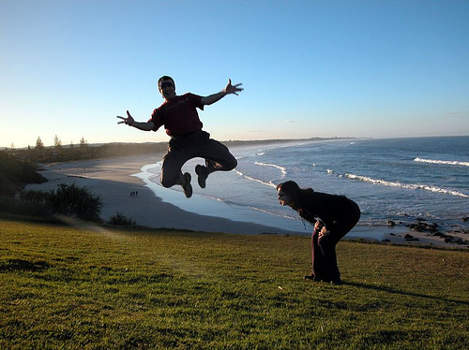

Controllable
Parameters
Weight Learning Network
I-CNN
Controllable
Parameters

