Slide 1


The Impact of Environmental Variability on
Fishers' Harvest Decisions in Chile
A multi-species structural approach
Felipe J. Quezada-Escalona
Departamento de Economía, Universidad de Concepción
ICES/PICES Small Pelagic Symposium · La Paz, México · May 8, 2026
Funded by ANID-Chile, FONDECYT Iniciación N° 11250223.

Slide 2
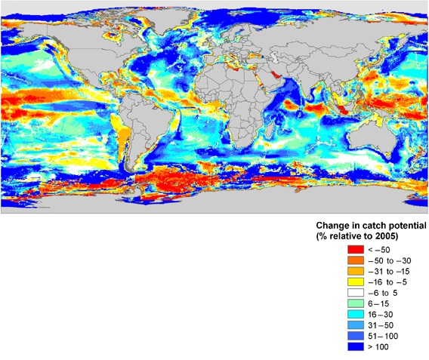
Motivation
Small pelagic stocks fluctuate sharply with climate variability.
Standard projection tools assume constant fishing rates or full quota uptake — the human decision is assumed away.
But fishers choose which species to target, how many trips, how much to land.
Source: Cheung et al. (2010)
Project goal: propagate climate-driven biomass shifts into fisher-side responses — participation today (Paper 1), optimal harvest decisions in the full structural model (Paper 2).
ICES/PICES SPF · La Paz · May 2026
2

Slide 3
The project — two papers, one structural pipeline
Paper 1 (today's results)
Paper 2 (today's roadmap)
Welfare counterfactuals
Reduced-form effort + identified stock dynamics
Negative binomial trip equation, estimated separately by fleet.
Bayesian state-space stock dynamics with structural climate shifters (in appendix).
Comparative statics under future climate scenarios.
Translog cost function (trip-level, by fleet).
Inverse demand (IAIDS, 3SLS).
Dynamic vessel optimization ⇒ optimal T_g, h_gτ under different climate scenarios.
Welfare, prices, species substitution.
The two papers share the same identified stock dynamics. Paper 1 stops at participation; Paper 2 closes the loop through prices, cost and profits to estimate optimal harvest and quota allocation.
ICES/PICES SPF · La Paz · May 2026
3

Slide 4
Setting and observed heterogeneity

Slide 5
Chile's Small Pelagic Fishery (Centro-Sur)
Stocks & sectors
Fleet portfolios are very different
Anchoveta (Engraulis ringens), sardine (Strangomera bentincki), jack mackerel (Trachurus murphyi).
~94% of national landings; mostly purse seiners.
Two sectors: artisanal (ART), industrial (IND).
ART: ~ {anchoveta, sardine}. Concentrated.
IND: ~ 95% jack mackerel + 5% sardine.
Mobility
Quota regime
IND: offshore purse-seiners.
ART: port-anchored, RAE binds spatially.
TAC split between sectors with limited cross-sector transferability.
IND quotas partially tradable within sector; ART under spatial collective-property rights (RAE).
⇒ Same shock, different choices.
ICES/PICES SPF · La Paz · May 2026
5

Slide 6
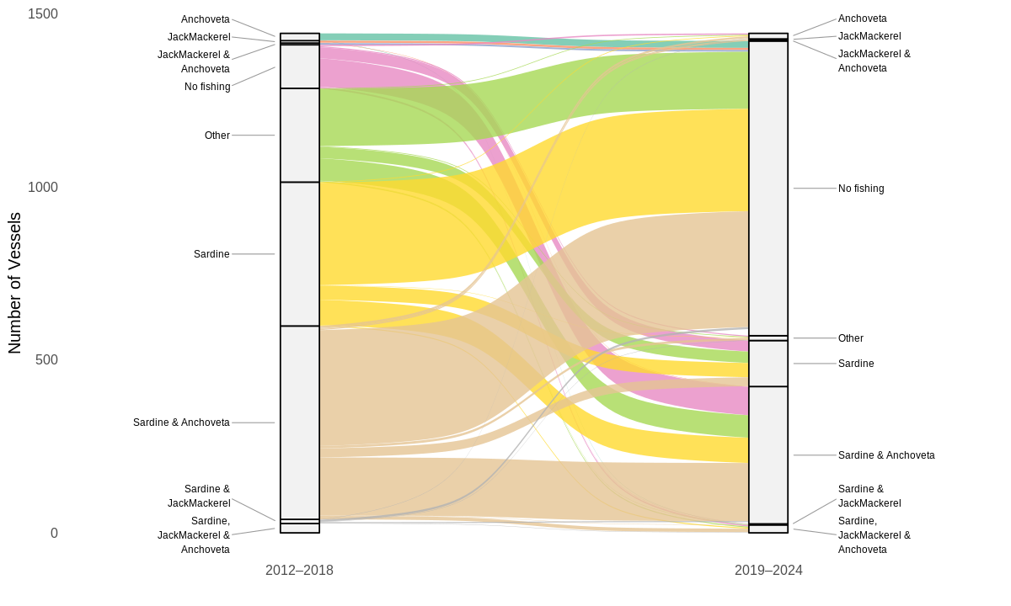
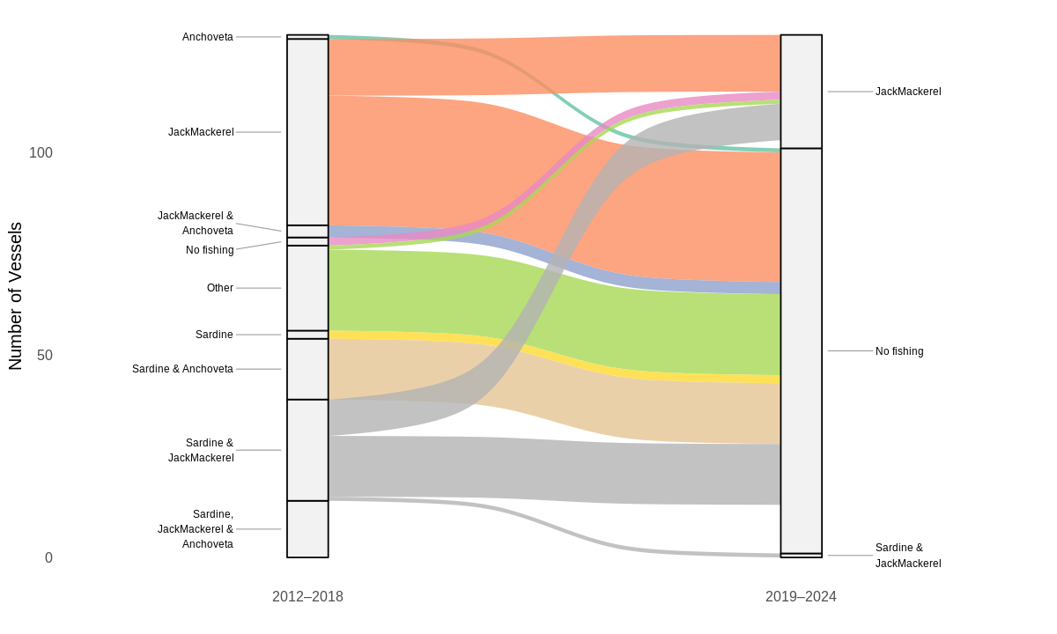
Observed strategy switching — ART vs IND
Artisanal
Industrial
Trip-level target-species transitions, IFOP logbooks 2013–2024.
ART: anchoveta↔sardine dominates; jack mackerel essentially absent. IND: rotation across all three. Same fishery, very different revealed choice sets.
ICES/PICES SPF · La Paz · May 2026
6

Slide 7
Paper 1 — The NB trip equation

Slide 8
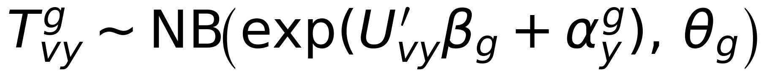
A negative binomial model of annual trips
Specification, by fleet g (ART, IND)
Why NB by fleet?
Overdispersion σ²/μ: 22.4 (ART), 4.9 (IND). Poisson rejected at p < 0.001.
Two fleets, two technologies, two choice sets — no pooling.
with U_vy = [ p_sy, H^alloc_vy, Z_v, O_vy ]:
p_sy: ex-vessel prices, by species.
H^alloc_vy: vessel-level quota allocation.
Z_v: hold capacity, vessel type.
O_vy: bad-weather days, closures.
α_y^g: year FE (absorbs 2019–22 shocks).
Vessel-clustered robust SEs.
Two channels to projections
Indirect: structural shifters ρ_SST, ρ_CHL → B_i,t → H^alloc_vy. (Jurel: ρ_ENSO over Niño 3.4 also not identified — App. D-ter.)
Direct: vessel-specific Δbad-weather days from CMIP6 winds.
ICES/PICES SPF · La Paz · May 2026
8

Slide 9
What drives fisher participation?
Variable | Industrial | Artisanal | Reads as
H^alloc (quota allocation) | (+)*** | (+)*** | Quota = binding budget constraint, both fleets.
Price — jack mackerel | (+)*** | 0 | IND oriented to jack mackerel; ART has no exposure.
Price — sardine | 0 | (+)*** | Sardine is ART's primary target.
Price — anchoveta | 0 | (−)*** | Simultaneity sign.
Hold capacity (log) | 0 | (+)*** | Heterogeneity is within the artisanal fleet.
Bad-weather days | 0 | (−)*** | ART vulnerable; IND insulated by vessel size.
Closure days | (−)*** | (+)***† | IND: largest single coef. ART: zone FE collinear (†).
Negative binomial with year FE, vessel-clustered robust SEs. Sign and significance shown. *** p < 0.01. † zone-FE collinear (not causally interpretable).
Two fleets, completely different participation models.
ICES/PICES SPF · La Paz · May 2026
9

Slide 10
Comparative statics — the fleet asymmetry
Fleet | Counterfactual | %ΔT marginal | %ΔT conditional | Pr(portfolio loss > 50%)
Artisanal | mid-century, moderate (SSP2-4.5) | −8.1% | −2.1% | 0.95
 | end-century, severe (SSP5-8.5) | −10.2% | −2.7% | 0.99
Industrial | mid-century, moderate (SSP2-4.5) | −0.7% | −0.7% | 0.12
 | end-century, severe (SSP5-8.5) | −0.9% | −0.8% | 0.12
%ΔT: change in annual trips vs baseline. Marginal averages over all posterior draws. Conditional restricts to draws with f^H_v > 0.5. Cross-median across a 6-model CMIP6 ensemble. NB with year FE.
Marginal asymmetry ~11:1 ART:IND; conditional ~3.4:1.
ART portfolio collapse near-certain by SSP5-8.5 end.
⇒ Asymmetry runs through probability of portfolio collapse × direct weather (β_w^ART < 0, β_w^IND ≈ 0); quota cross-sector limits lock it in.
IND's protection rests on jack mackerel — long-run shifter n.i. at both local and basin scales (App. D-ter).
ICES/PICES SPF · La Paz · May 2026
10

Slide 11
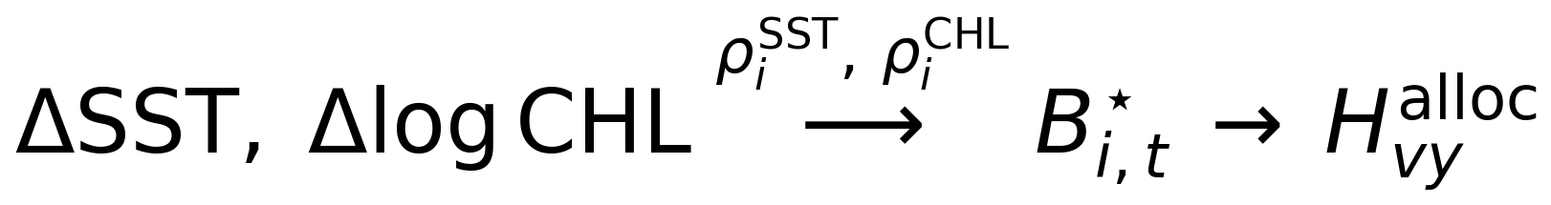
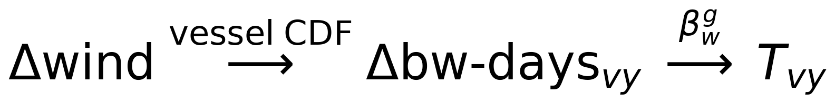
Two channels: direct vs indirect
Decomposition
End-century SSP5-8.5
Indirect (biomass → allocation):
Fleet | Indirect | Direct | Total
Artisanal | −9.0 pp | −1.2 pp | −10.2%
Industrial | −0.8 pp | −0.1 pp | −0.9%
Jurel: ρ_ENSO over Niño 3.4 also not identified (App. D-ter).
Direct (weather → trips):
Indirect (biomass) carries most of the asymmetry; direct (weather) reinforces it where vessels are exposed (ART). Both channels point the same way.
ICES/PICES SPF · La Paz · May 2026
11

Slide 12
Paper 2 — closing the loop

Slide 13
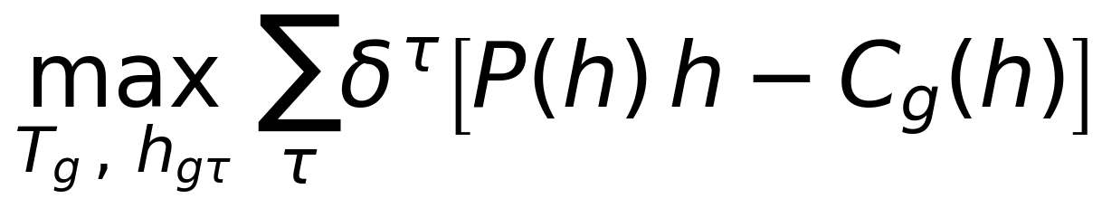
Three structural extensions ⇒ welfare
What gets added on top of Paper 1
Optimization model allows for
(i) Trip-level cost function — translog C_vg(w, h, x, Z, Env), SUR by fleet. Recovers input demands (fuel, labor, ice) and elasticities of input substitution under climate shocks.
(ii) Inverse demand (IAIDS) — log p_iy as a function of all species' landings, instrumented by SST, CHL, fuel prices. Resolves the simultaneity observed in Paper 1.
(iii) Vessel dynamic optimization — see equation below. (T*_g, h*_gτ) under each scenario.
(i) Prediction under a changing climate of: Equilibrium prices and species substitution
(ii) Define optimal quota allocation
(iii) Study policy reforms (counterfactuals) as adaptation:
Cross-sector quota transferability.
RAE redesign (multi-zone permits).
State-contingent TACs.
ICES/PICES SPF · La Paz · May 2026
13

Slide 14
Takeaways
1. Paper 1: fleet-specific NB model of annual trips reveals two completely different participation technologies in the same fishery.
2. Paper 1: under counterfactual shocks, the marginal ART:IND participation asymmetry is ~11:1 (conditional ~3.4:1), running through (i) the probability of portfolio collapse in the indirect biomass channel and (ii) direct weather exposure (β_w^ART < 0, β_w^IND ≈ 0); quota cross-sector limits lock it in.
3. Paper 2: closes the loop — input demand, inverse demand, vessel × social-planner joint optimization — to deliver welfare counterfactuals: equilibrium prices, species substitution & optimal quota allocation, and policy reforms.
Adaptive capacity is not a property of fishers; it is a property of the bundle (portfolio × permit × institution × market) they sit in. Identifying adaptation requires modeling all four dimensions jointly — pooling, fixed prices, or aggregate effort all bias the answer.
ICES/PICES SPF · La Paz · May 2026
14

Slide 15
¡Gracias! / Thank you
Questions?
Felipe J. Quezada-Escalona
felipequezada@udec.cl · felipequezada.com
Funded by ANID-Chile, FONDECYT Iniciación N° 11250223.

Slide 16
Appendix

Slide 17
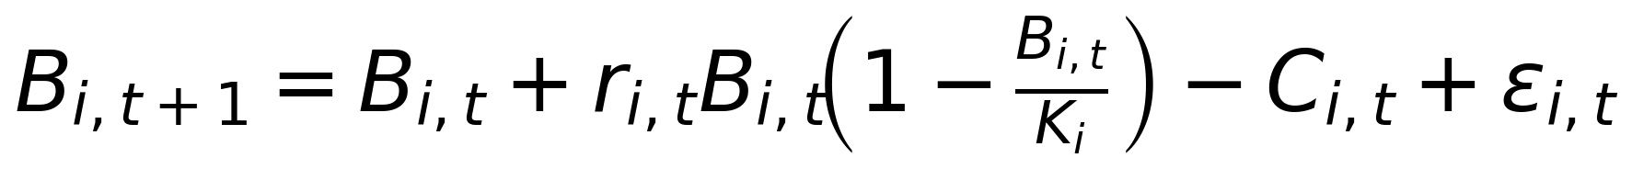
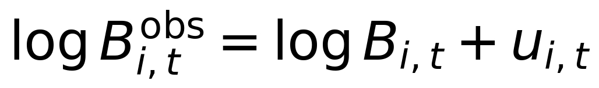
Appendix A · Stock dynamics — spec & priors
Process (Schaefer with shifter on r):
Priors:
r_i^0, K_i, σ_proc, σ_obs from IFOP / SPRFMO single-species assessments.
ρ_i^SST, ρ_i^CHL ~ N(ρ̂_i^stress, 1).
Ω: LKJ.
with r_{i,t} = r_i^0 · exp(ρ_i^SST ΔSST_{t-1} + ρ_i^CHL Δlog CHL_{t-1}).
Stock-specific extension executed: jurel forced by ρ_ENSO over Niño 3.4 also not identified (σ_post/σ_prior = 0.98, lag 1) — see App. D-ter.
Observation (log-normal):
Estimation:
Stan / HMC, 4 chains × 2000 post-warmup; R̂ < 1.01, ESS > 400.
Three nested specs: ind, omega, full.
ICES/PICES SPF · La Paz · May 2026
17

Slide 18
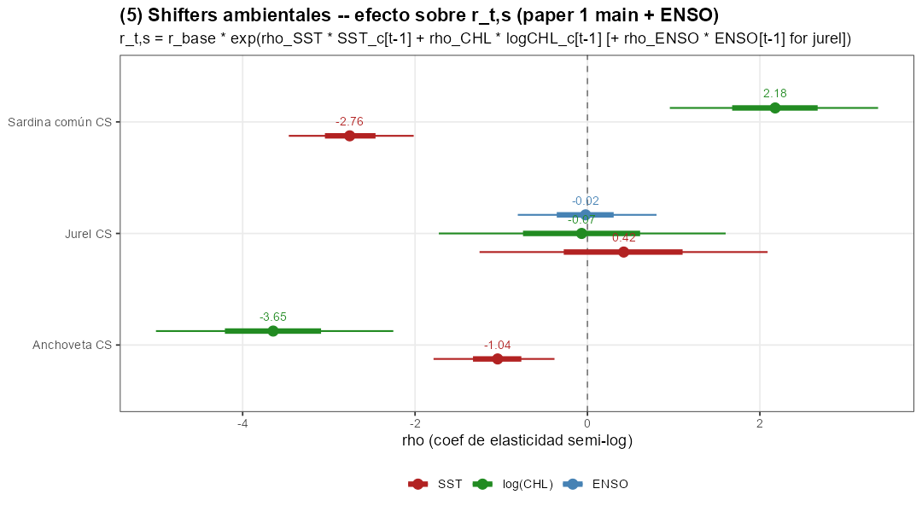
Appendix B · Climate shifters
Posterior densities of ρ^SST and ρ^CHL, full multi-species specification. Anchoveta and common sardine: priors dominated by data. Jack mackerel: posteriors track priors → n.i. at the local coastal and basin scale (App. D-bis).
ICES/PICES SPF · La Paz · May 2026
18

Slide 19
Appendix C · Stock productivity comparative statics
Stock | Scenario | Δr/r₀ (cross-median) | 90% CI | Pr(Δ < 0)
Anchoveta | SSP2-4.5, mid-century | −51% | [−68%, −27%] | 1.00
 | SSP5-8.5, end-century | −90% | [−98%, −54%] | 0.99
Sardine | SSP2-4.5, mid-century | −79% | [−86%, −67%] | 1.00
 | SSP5-8.5, end-century | −100% | [−100%, −99%] | 1.00
Jack mackerel | all scenarios | n.i. | n.i. | n.i.
Cross-median across CMIP6 ensemble of 6 GCMs (CESM2, CNRM-ESM2-1, GFDL-ESM4, IPSL-CM6A-LR, MPI-ESM1-2-HR, UKESM1-0-LL); 90% CI is the within-posterior credible interval averaged across models. Jurel: local (SST_D1, log CHL_D1) shifter and basin-scale ENSO both n.i. (App. D-ter).
ICES/PICES SPF · La Paz · May 2026
19

Slide 20
Appendix D · Jack mackerel — non-identification ≠ no climate effect
Two readings to keep separate:
Non-identification at the CS scale — what the structural fit reports. With N = 16 informative obs and σ̂_SST,D1 ≈ 0.26°C, only large local elasticities would be detectable.
Climate insensitivity of jack mackerel — not what the result implies. Peña-Torres et al. (2017) (ENSO & location choices) and Arcos et al. (2001) (SPRFMO-scale dynamics) document that climate does affect this stock at scales beyond local Chilean coastal anomalies.
ICES/PICES SPF · La Paz · May 2026
20

Slide 21
Appendix D · Jack mackerel — three convergent tests of the local null
(CS scale, coastal forcing)
(i) Spatial-domain robustness. Re-fits over 3 nested coastal domains: σ_post/σ_prior for ρ^SST_jurel stays in [0.998, 1.014]. Anch & sard stable (CV < 0.03).
(ii) Dual-source biomass. Augment with IFOP Northern Chile acoustic series (2010–24, r_log = 0.88): σ_post/σ_prior ∈ {0.94, 0.99}. Bottleneck is structural, not N.
(iii) OROP-PS coherence. SPRFMO transzonal index correlates with CS at r = 0.11 over N = 17 — range-wide forcing cannot pin it down either.
⇒ The local null is robust. Natural reading: relevant climatic drivers operate at scales beyond CS coastal forcing — consistent with a transboundary species. Tested on the obvious basin-scale candidate next (App. D-bis/ter).
ICES/PICES SPF · La Paz · May 2026
21

Slide 22
Appendix D-bis — ENSO as basin-scale shifter (spec)
Hypothesis
Pipeline
Jurel CS responds to ENSO via teleconnections, not local CS coastal anomalies.
Historical Niño 3.4: OISST / ERSST.
CMIP6: 6-GCM ensemble re-extracted over Niño 3.4.
Same Stan architecture as App. E (stock-specific shifters).
Prior: ρ_ENSO ~ N(0, 0.5) — 1σ_ENSO shock ⇒ ≤ 65% change in r.
Anch / sard: unchanged.
Jurel: replace (SST_D1, log CHL_D1) by single shifter ρ_ENSO over Niño 3.4.
Lags t-1 (main), t-2 (sensitivity).
Status: executed — lag 1, lag 2, joint sensitivity. All converging on null. Result in App. D-ter.
ICES/PICES SPF · La Paz · May 2026
22

Slide 23
Appendix D-ter — ENSO: result of the asymmetric bet
Scenario B materialised — null reinforced
Prior-propagation projection
Posterior σ / prior σ for ρ_ENSO,jurel at N(0, 0.5):
Factor on r*_jur under SSP5-8.5 end-of-century, combining 16k posterior draws with the 6-GCM ensemble of ΔENSO Niño 3.4 (+3.65 ± 0.88 °C):
Lag 1: ρ = −0.022, 90% CI [−0.81, +0.80], ratio = 0.979.
Lag 2: ρ = +0.021, 90% CI [−0.79, +0.87], ratio = 1.014.
Joint (SST_D1 + log CHL_D1 + ENSO active): all three ratios ∈ {0.98, 1.00, 1.03}.
90% predictive interval: [0.05, 19.5].
Median: 0.93. log-factor SD: 1.83.
⇒ Envelope spans 3 orders of magnitude ⇒ not informative for policy ⇒ r*_jurel held fixed in Tab. of fleet response.
⇒ 5 converging tests of the null (vs. 3 pre-ENSO).
→ Climate effects on jurel operate on margins (location, behaviour, range) — NOT on annual productivity elasticity at this aggregation.
ICES/PICES SPF · La Paz · May 2026
23

Slide 24
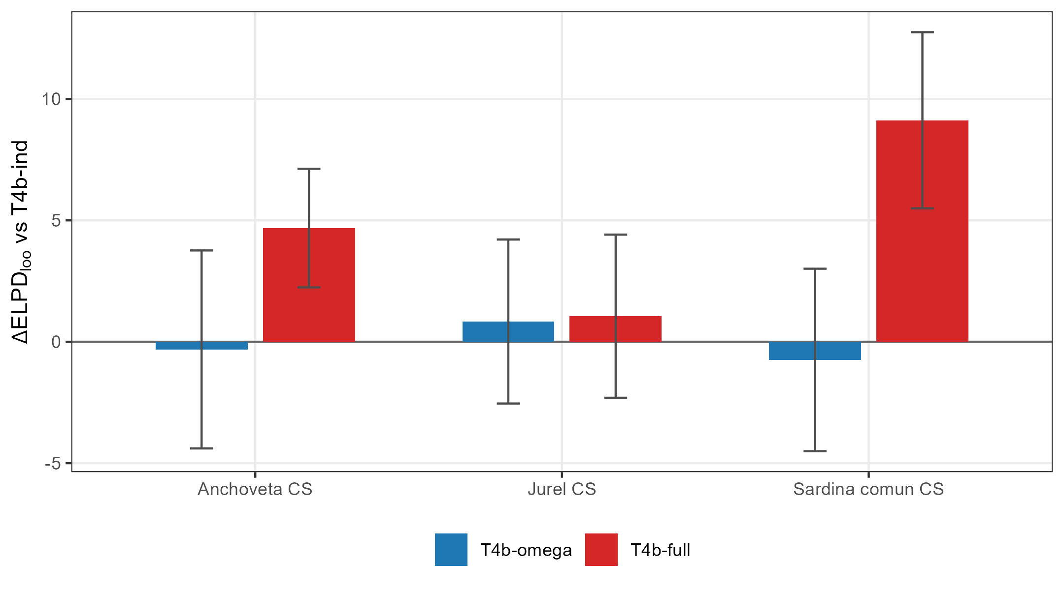
Appendix E · Model comparison (LOO)
LOO ELPD across specs: ind (Ω diagonal, ρ=0), omega (Ω full, ρ=0), full (Ω full, ρ ≠ 0). Full wins at ΔELPD ≈ 14–18; LFO one-step-ahead essentially tied.
ICES/PICES SPF · La Paz · May 2026
24

Slide 25
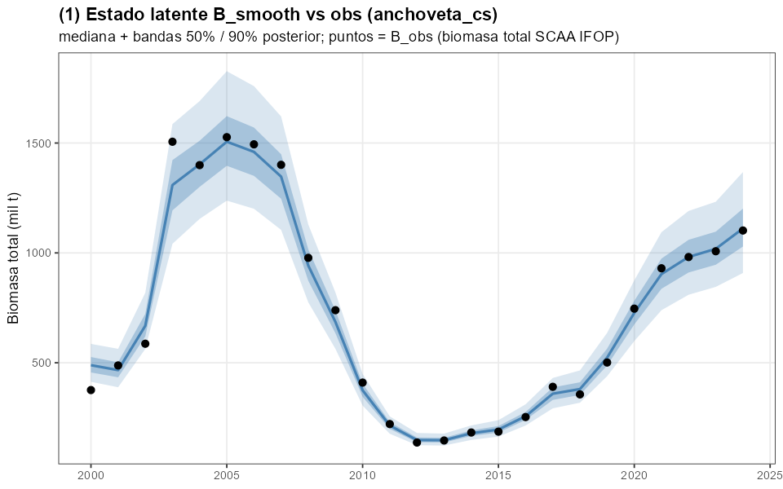
Appendix F · Posterior predictive check
Smoothed posterior of biomass vs observed acoustic estimates, full model.
ICES/PICES SPF · La Paz · May 2026
25

Slide 26
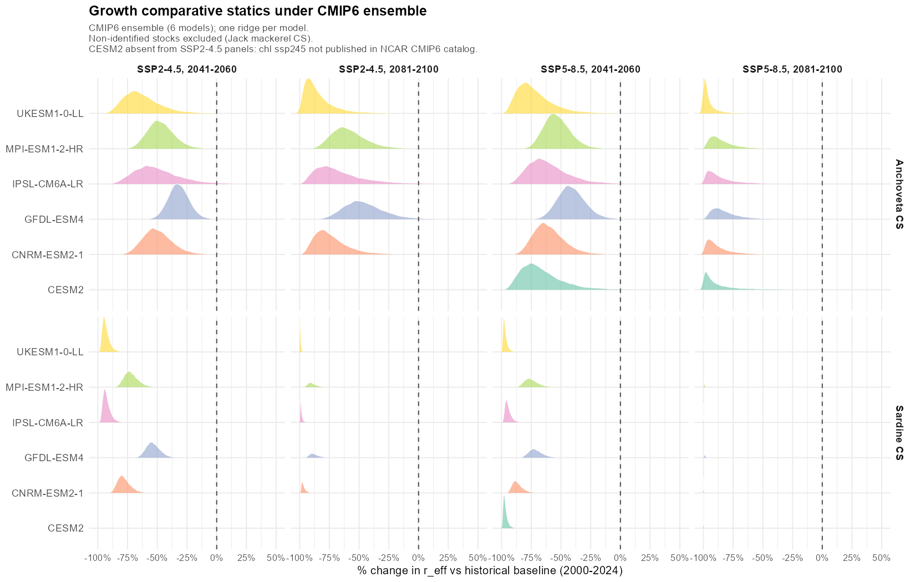
Appendix G · CMIP6 ensemble — ridgeline
Posterior Δr/r₀ across SSP × period combinations, one ridge per CMIP6 model (6-GCM ensemble).
ICES/PICES SPF · La Paz · May 2026
26

Slide 27
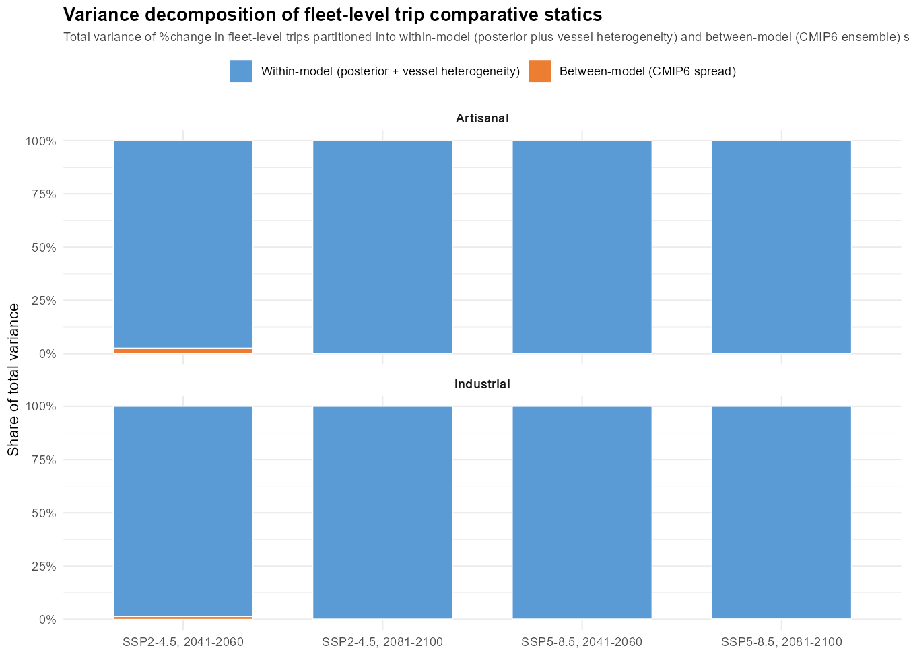
Appendix H · Variance decomposition of trip response
Within-model (posterior + vessel heterogeneity) dominates: 97%–100% across all SSP × period × fleet cells (re-computed after the direct weather channel was added).
Between-model (CMIP6 ensemble): at most 3%, often ≈ 0.
The narrow cross-IQR in Table 5 is NOT climate-model consensus — it is a floor effect: once f^H_v → 0, %ΔT → exp(−β_g · H^alloc_v) — a fleet-mechanical quantity, not a climate magnitude.
ICES/PICES SPF · La Paz · May 2026
27

Slide 28
Appendix I · Paper 2 — data inputs
Trip-level catch and price data (IFOP logbooks, 2013–2024).
All-gear official catch series (SERNAPESCA).
Vessel characteristics & ports of operation.
Environmental covariates (Copernicus, GlobColour, CMIP6 6-GCM ensemble).
Caveat — IFOP panel coverage covers the purse-seine artisanal subset; non-PS gears (lampara, lines) excluded.
ICES/PICES SPF · La Paz · May 2026
28

