Slide 1

IoT Yourself
Hack your home!

Slide 2
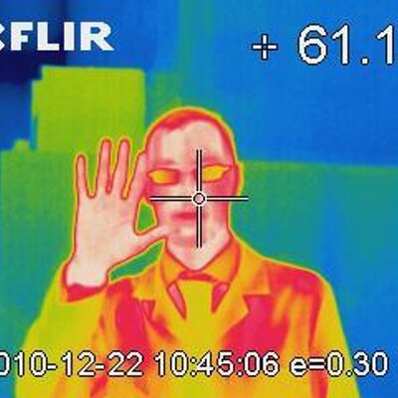
whoami
Fran Quinto
  B. Eng. Technical Industrial Electronics
  Electronic Engineering
  Master Eng. Electronic Engineering (EHEA)
  PhP Student: Automatic Control, Robotics and Computer Vision (ARV)
  Interest areas: hardware design & embedded soft. security analyst, reverse engineering, PLC developer, scada audit, FPGAs, RTOs, GNU/Linux, IoT, RaspberryPi, drones, Arduino, AI

Slide 3
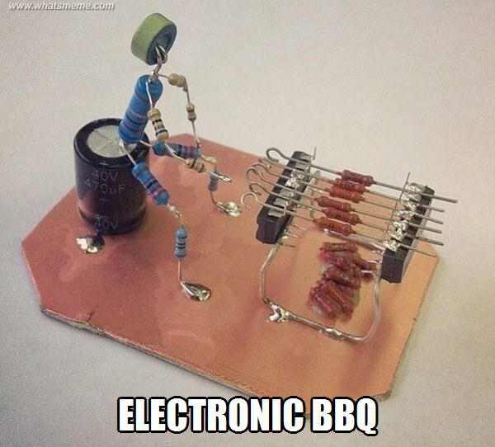
Electronics?

Slide 4
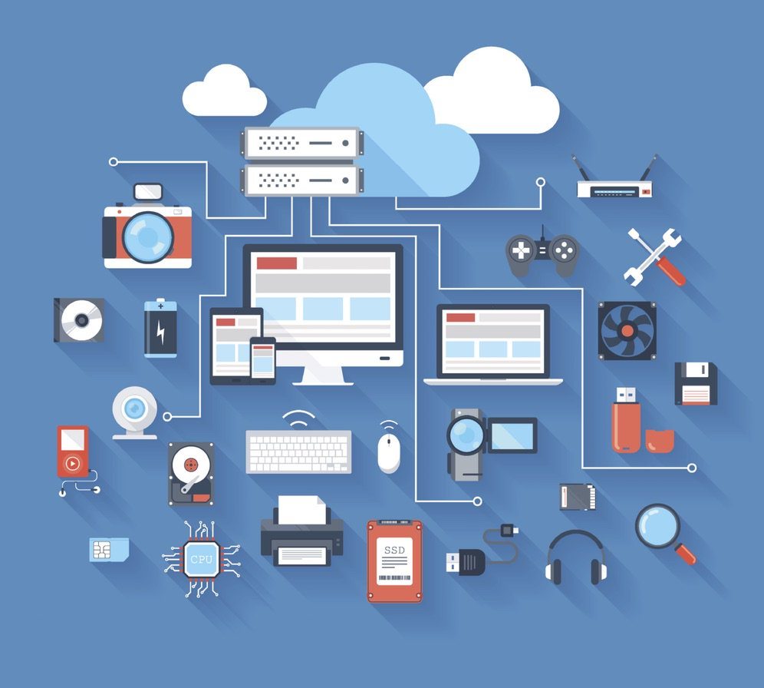
Electronics?

Slide 5
ÍNDICE
Encuestas + KITS
IoT
Hardware
Práctica 1
Práctica 2
Práctica 3
Práctica 4

Slide 6
ENCUESTAS

Slide 7
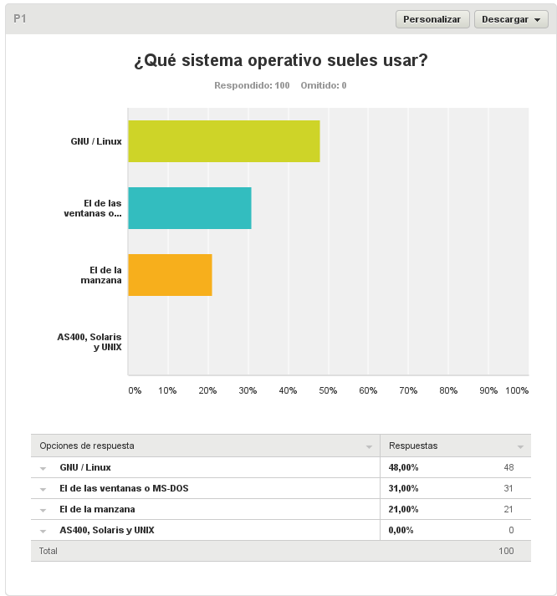
Encuestas

Slide 8
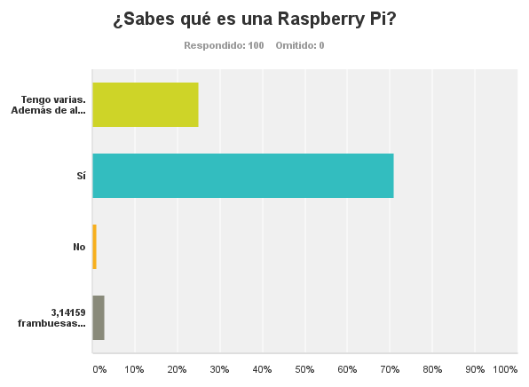
Encuestas

Slide 9
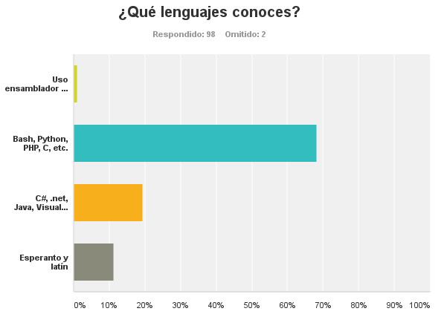
Encuestas

Slide 10
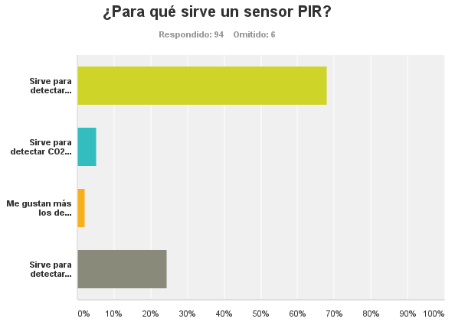
Encuestas

Slide 11
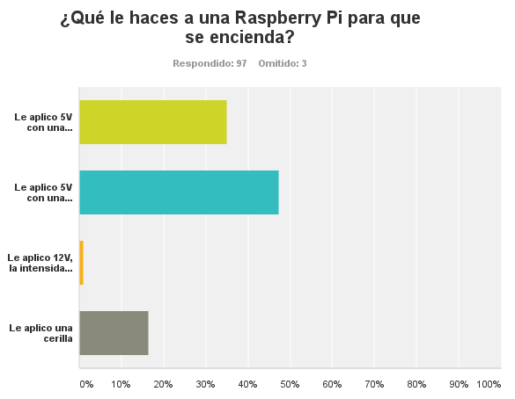
Encuestas

Slide 12
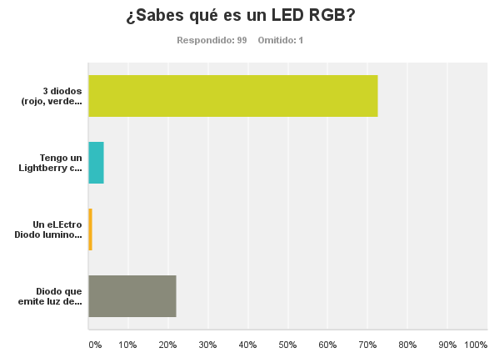
Encuestas

Slide 13
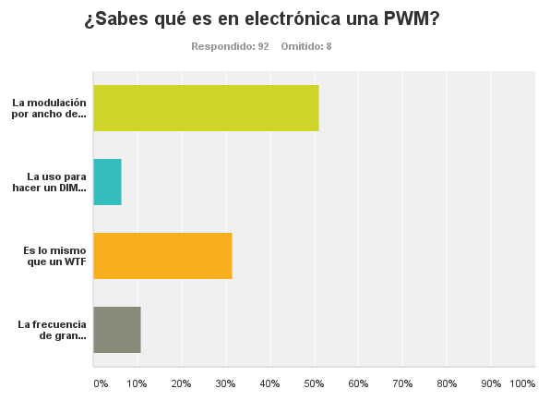
Encuestas

Slide 14
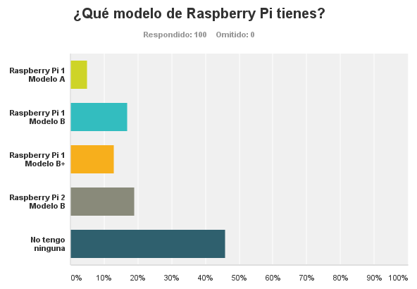
Encuestas

Slide 15
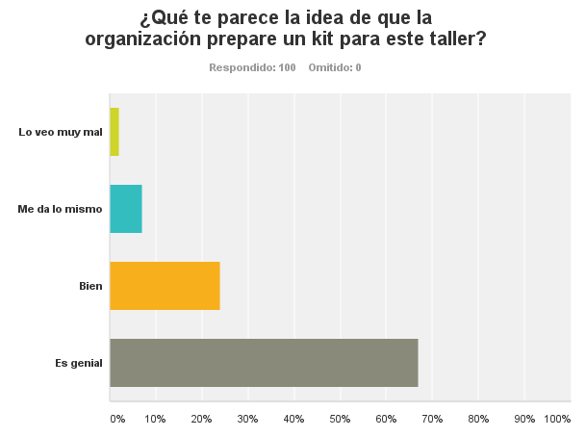
Encuestas

Slide 16
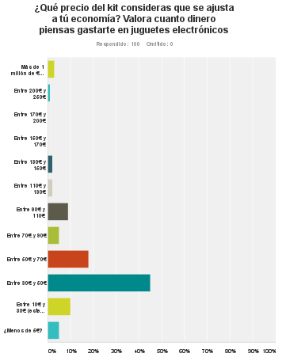
Encuestas

Slide 17
IoT

Slide 18
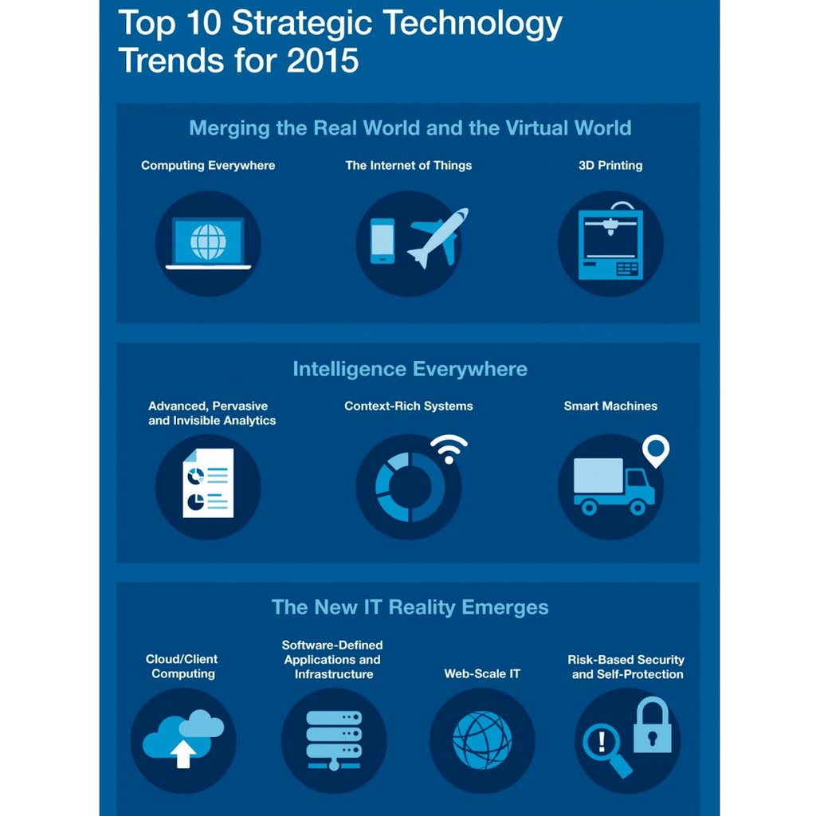
IoT
Notes:
Desde hace un tiempo se está oyendo hablar en multitud de ocasiones del término IoT, y os preguntaréis ¿A qué se refiere este término? IoT proviene de las siglas anglosajonas “Internet of things” y se refiere a la interconexión digital de objetos de ámbito cotidiano a internet.
IoT -IKORIoT persigue que, una gran variedad de cosas u objetos (sistemas de identificación por radiofrecuencia RFID, sensores, actuadores, teléfonos móviles, etc.) sean capaces de interactuar y cooperar con los demás para alcanzar objetivos comunes. De esta forma, todas estas soluciones dejarían de ser aplicaciones “stand-alone” pasando a convertirse en aplicaciones “en red”.

Slide 19

IoT
Notes:
Desde hace un tiempo se está oyendo hablar en multitud de ocasiones del término IoT, y os preguntaréis ¿A qué se refiere este término? IoT proviene de las siglas anglosajonas “Internet of things” y se refiere a la interconexión digital de objetos de ámbito cotidiano a internet.
IoT -IKORIoT persigue que, una gran variedad de cosas u objetos (sistemas de identificación por radiofrecuencia RFID, sensores, actuadores, teléfonos móviles, etc.) sean capaces de interactuar y cooperar con los demás para alcanzar objetivos comunes. De esta forma, todas estas soluciones dejarían de ser aplicaciones “stand-alone” pasando a convertirse en aplicaciones “en red”.

Slide 20

IoT
Notes:
Desde hace un tiempo se está oyendo hablar en multitud de ocasiones del término IoT, y os preguntaréis ¿A qué se refiere este término? IoT proviene de las siglas anglosajonas “Internet of things” y se refiere a la interconexión digital de objetos de ámbito cotidiano a internet.
IoT -IKORIoT persigue que, una gran variedad de cosas u objetos (sistemas de identificación por radiofrecuencia RFID, sensores, actuadores, teléfonos móviles, etc.) sean capaces de interactuar y cooperar con los demás para alcanzar objetivos comunes. De esta forma, todas estas soluciones dejarían de ser aplicaciones “stand-alone” pasando a convertirse en aplicaciones “en red”.

Slide 21
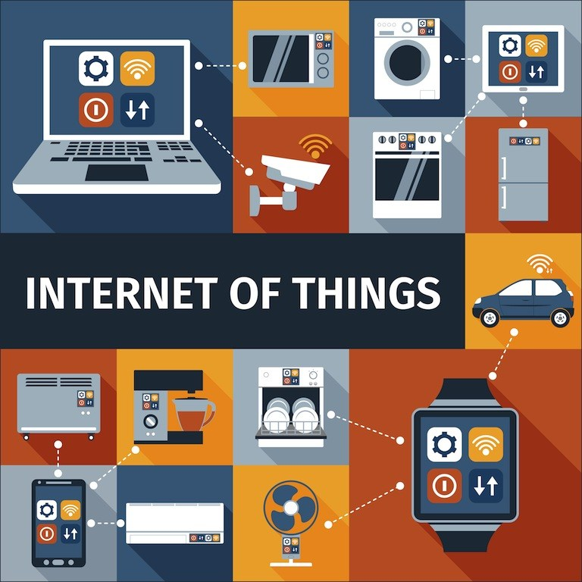
IoT
Notes:
Básicamente, IoT consiste en una “evolución” de lo que hasta ahora se conocía como comunicación “Machine-to-machine” (M2M), expandiéndolo hacia sistemas “Machine-to-Infrastructure” e incorporando otros conceptos como;
-Comunicación entre redes de diferente naturaleza mediante uso de protocolos de comunicación estándar.
-Acceso de la información a través de la “nube”, donde podrá ser tratada a nivel de aplicación.

Slide 22

IoT

Slide 23

IoT

Slide 24
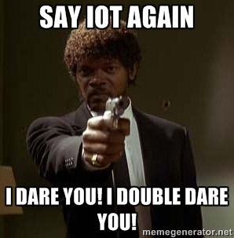
IoT

Slide 25

IoT

Slide 26

IoT

Slide 27

IoT

Slide 28
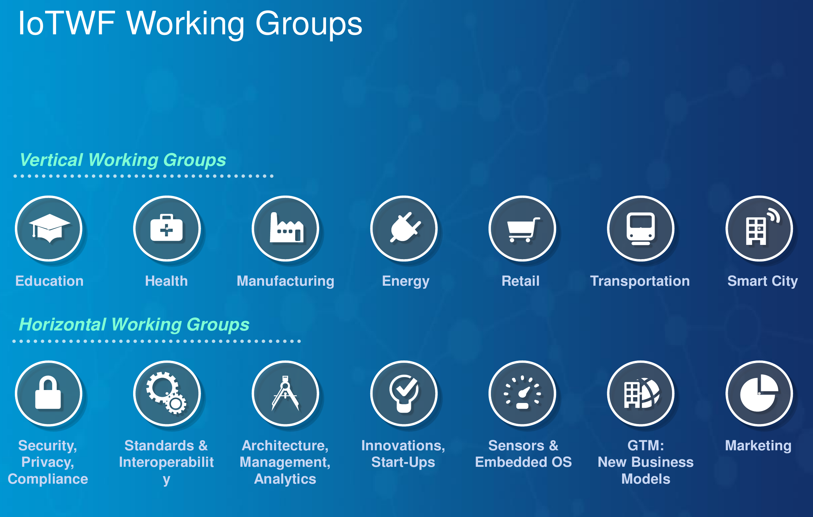
IoT

Slide 29
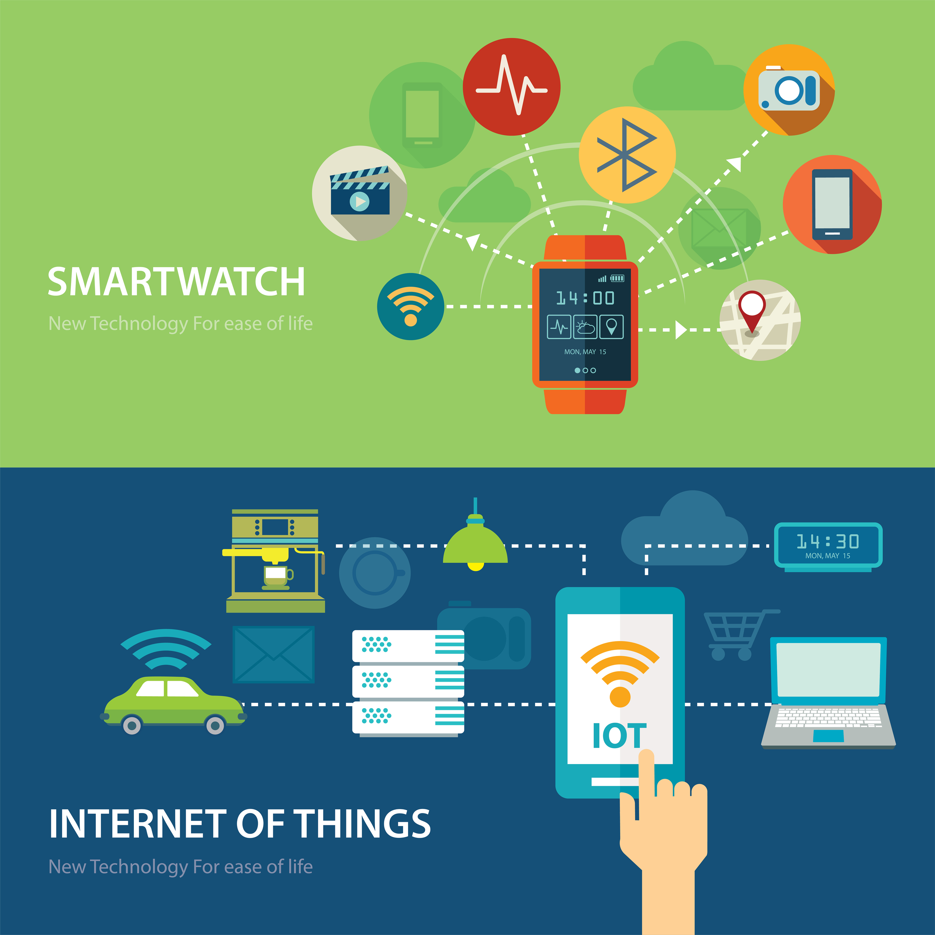
IoT

Slide 30
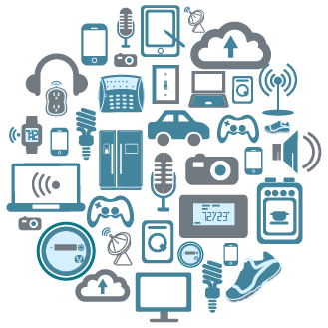
IoT

Slide 31
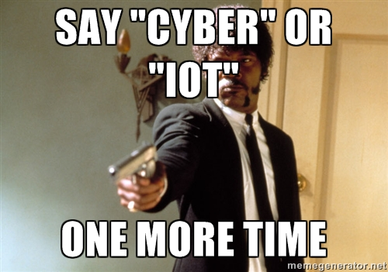
IoT

Slide 32
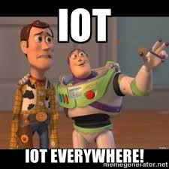
IoT

Slide 33
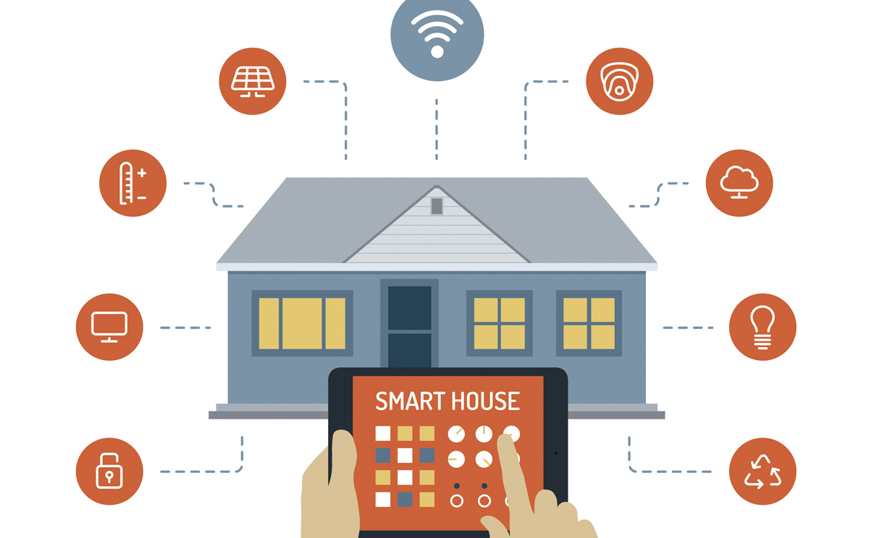
IoT

Slide 34
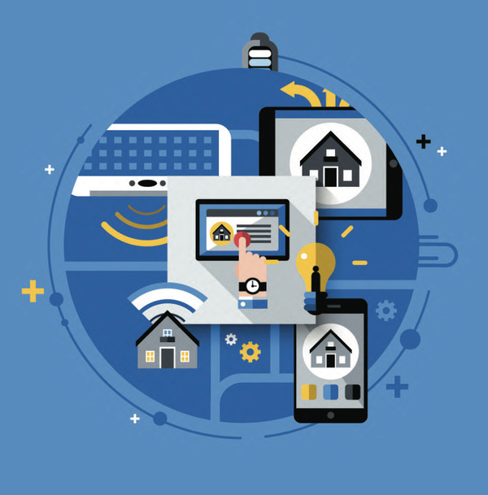
IoT

Slide 35
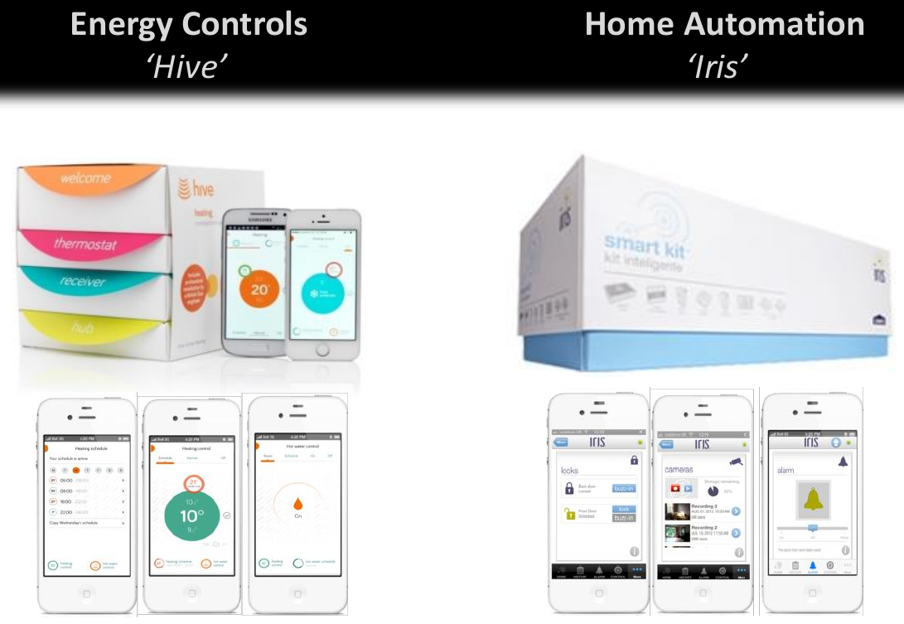
IoT

Slide 36
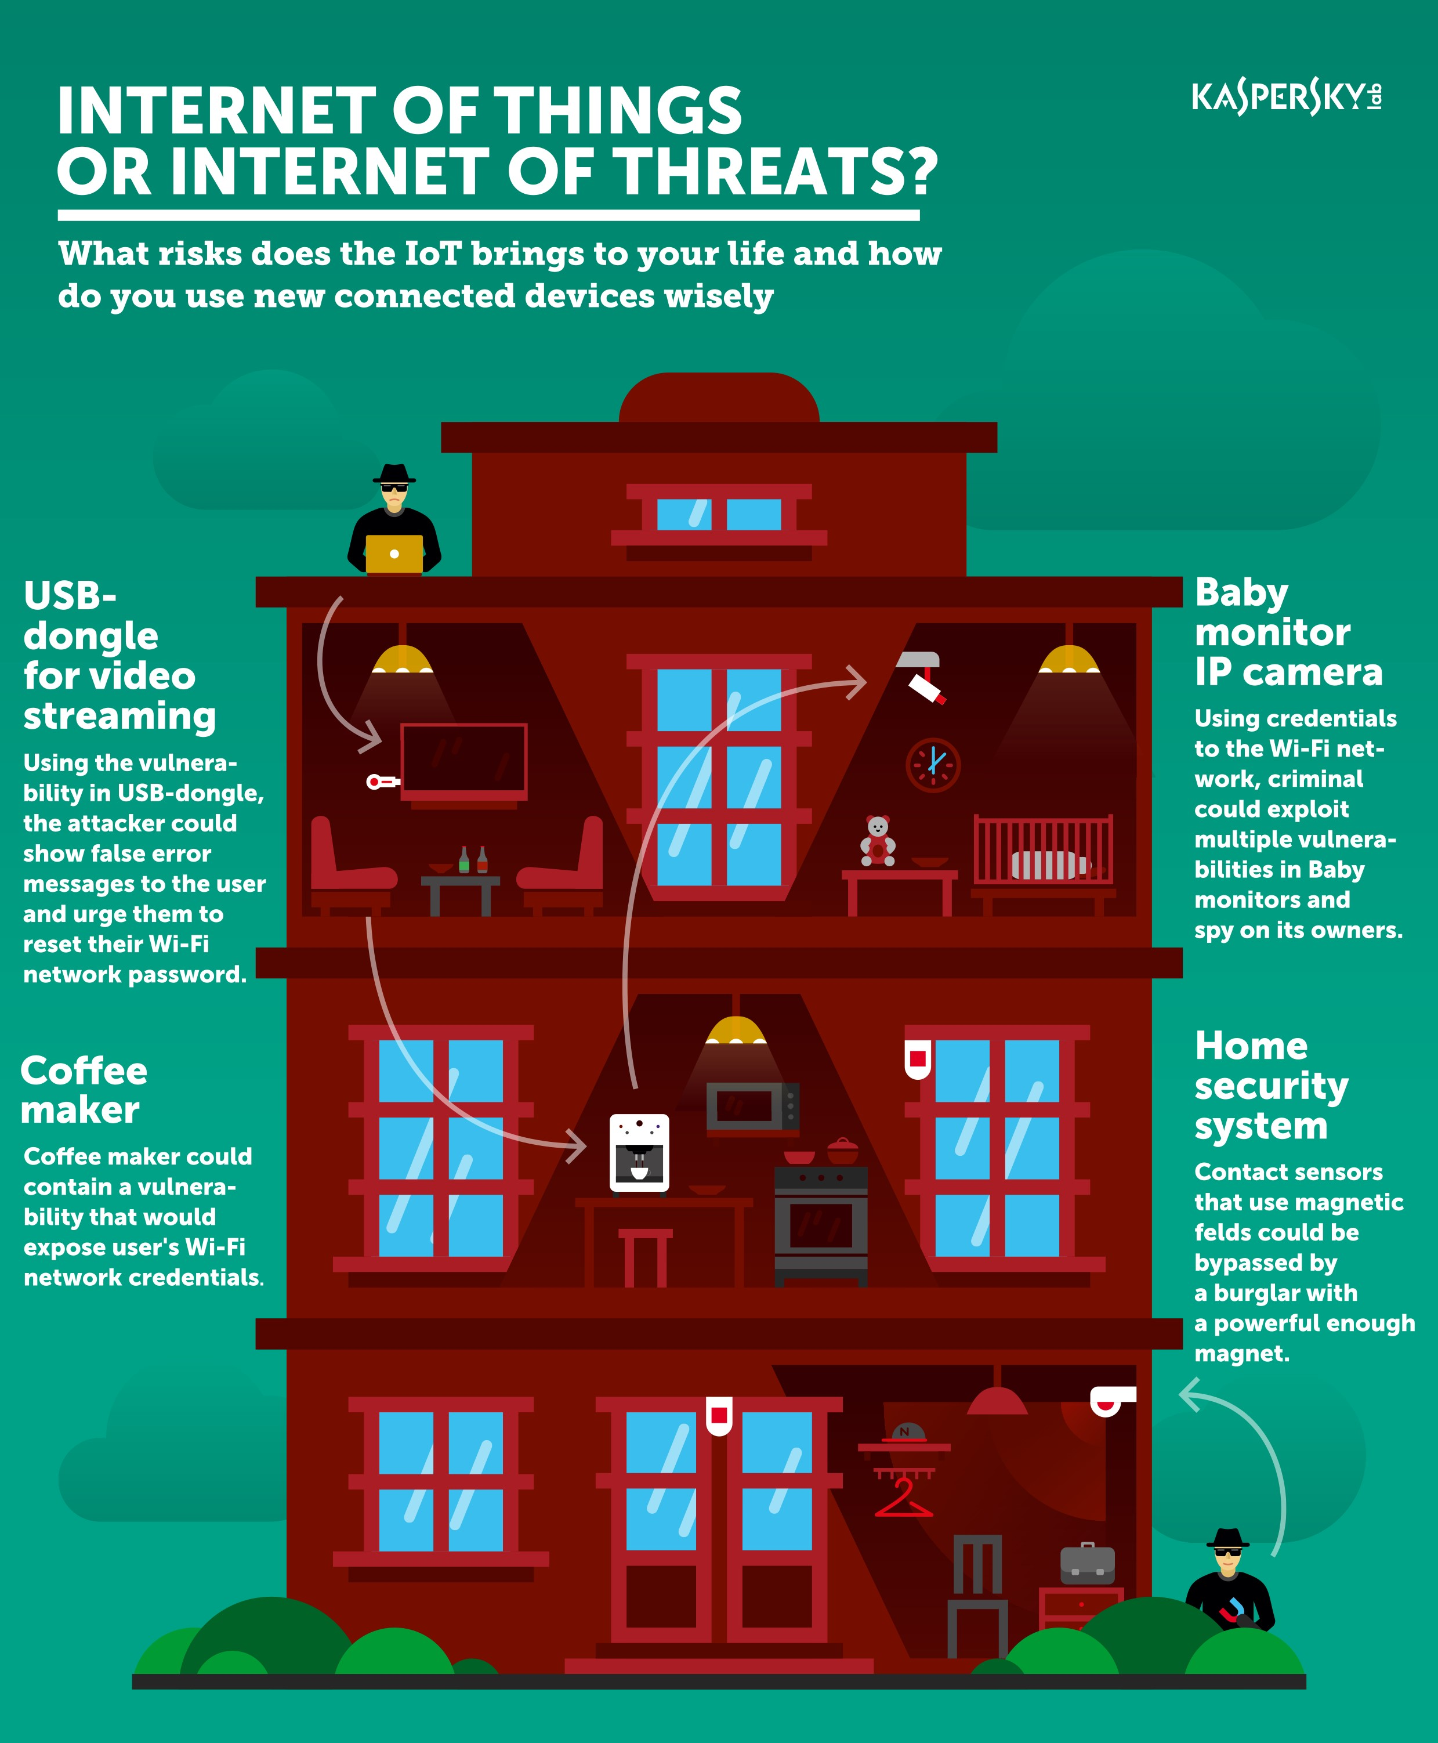
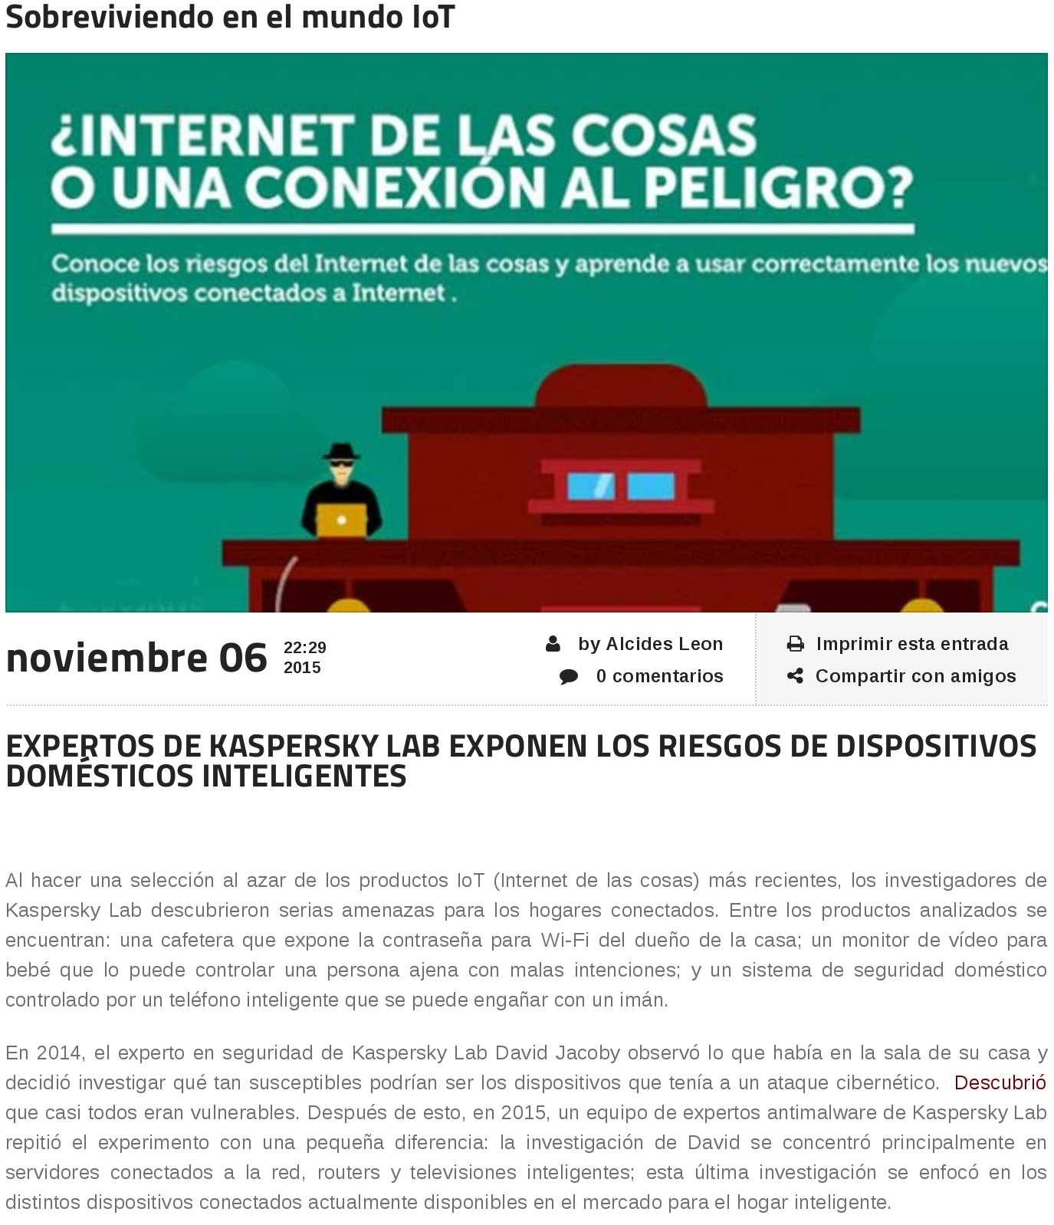
IoT
http://www.kaspersky.com/about/news/press/2015/Surviving-in-the-IoT-world-Kaspersky-Lab-Experts-Discover-the-Risks-of-Smart-Home-Devices

Slide 37
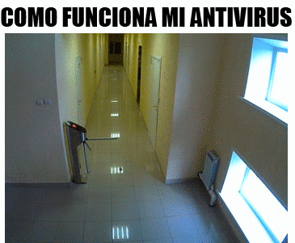
IoT

Slide 38
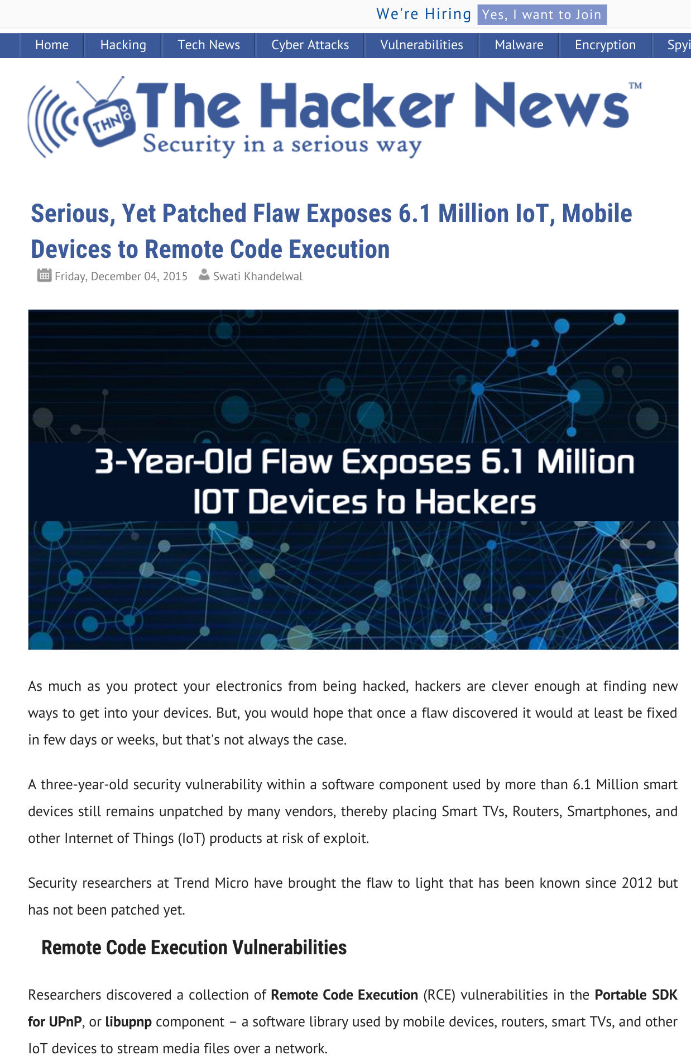
IoT

Slide 39
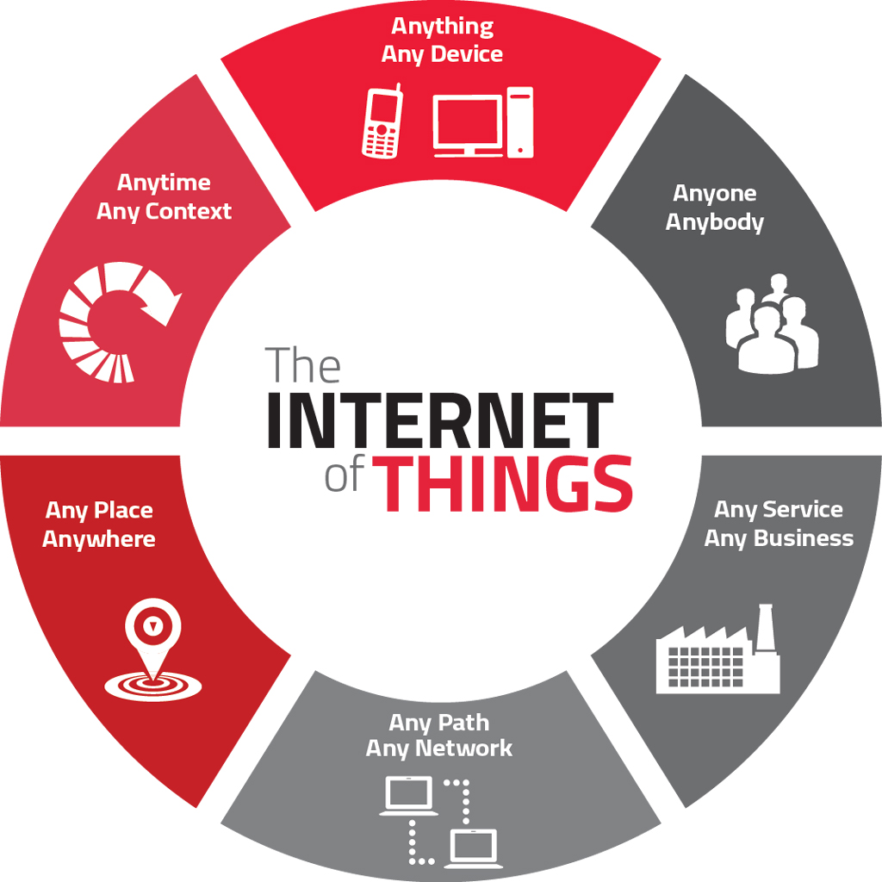
IoT

Slide 40
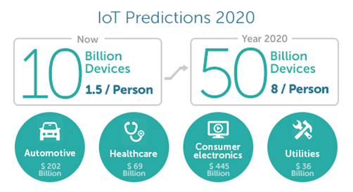
IoT

Slide 41
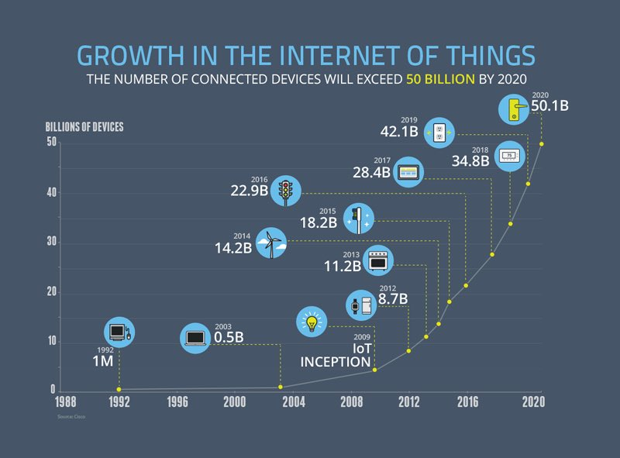
IoT

Slide 42
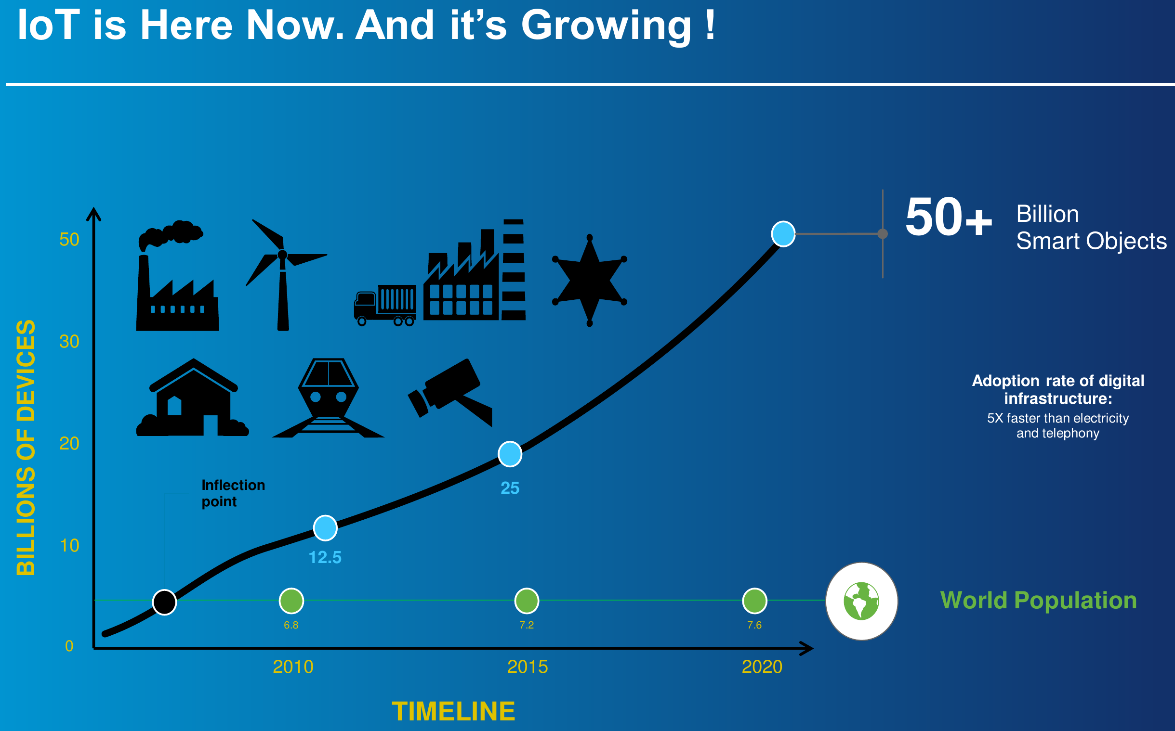
IoT

Slide 43
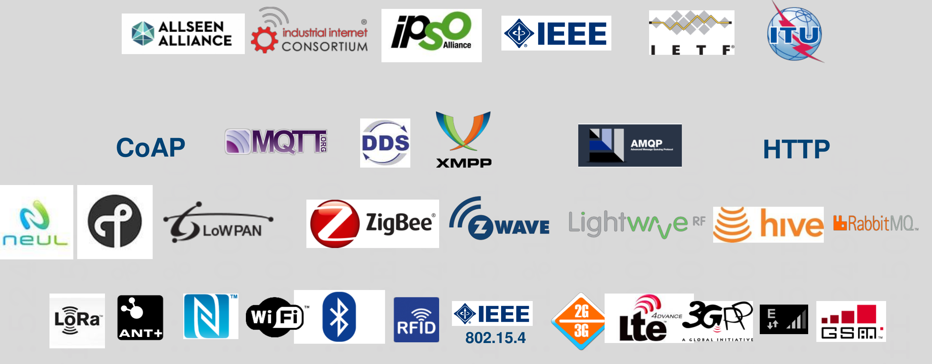
Ejemplos de estándar IoT

Slide 44
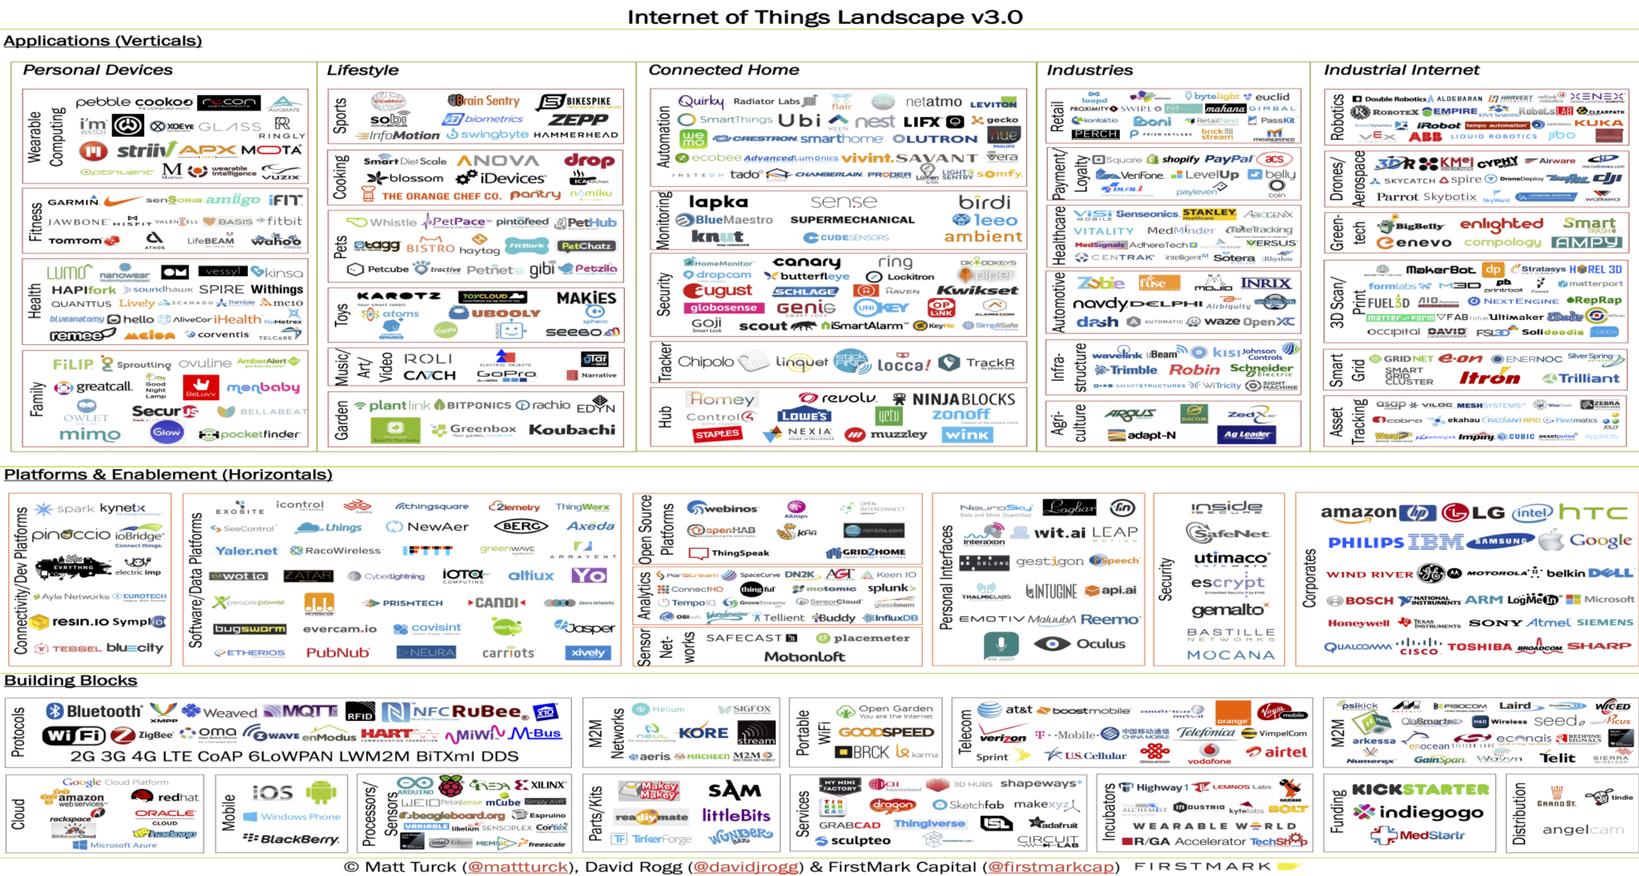
IoT everywhere

Slide 45

Y esto?

Slide 46
Hardware

Slide 47

Y esto?

Slide 48
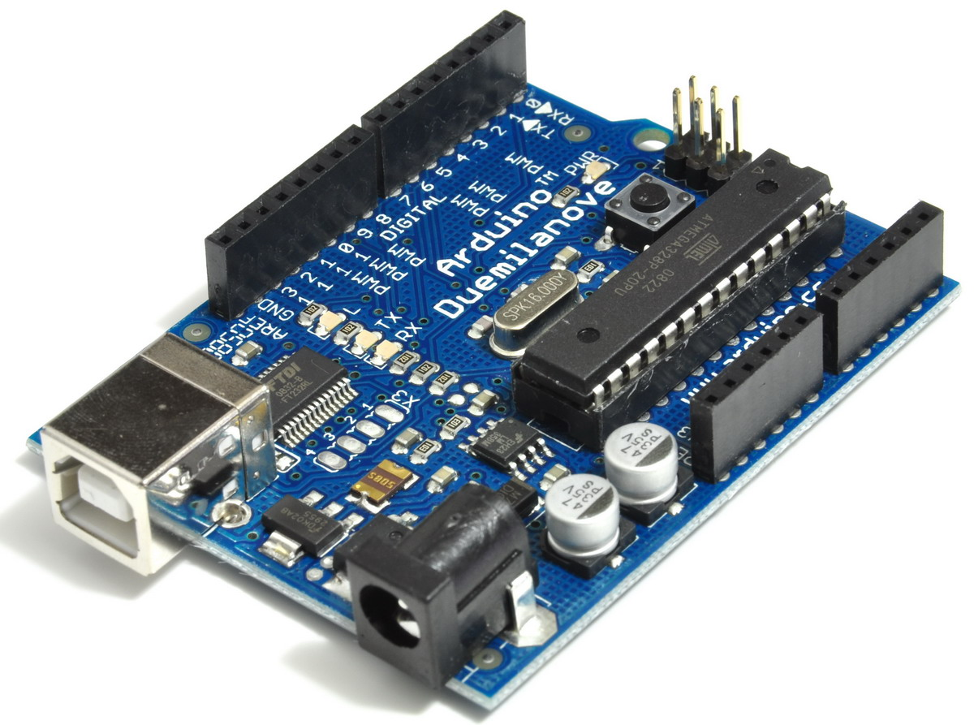
Raspberry Pi?
Notes:
The Raspberry Pi has been the object of a great deal of nerdy affection since its initial release in 2012. A mousetrap-sized, self-contained single-board computer, the Pi is designed to serve as both an educational tool and a handy option for hobbyists – who have turned it into, well, pretty much anything you can think of. Here’s a look back through the brief but illustrious history of the Pi.

Slide 49
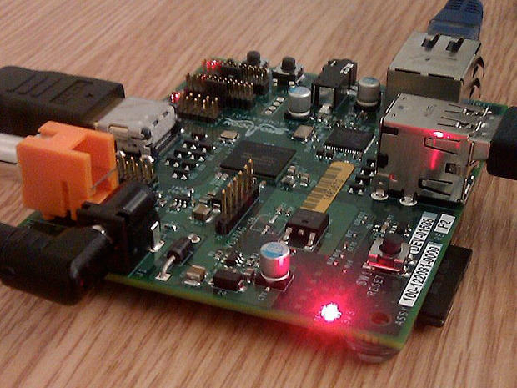
Raspberry Pi
Notes:
The Raspberry Pi has been the object of a great deal of nerdy affection since its initial release in 2012. A mousetrap-sized, self-contained single-board computer, the Pi is designed to serve as both an educational tool and a handy option for hobbyists – who have turned it into, well, pretty much anything you can think of. Here’s a look back through the brief but illustrious history of the Pi.

Slide 50
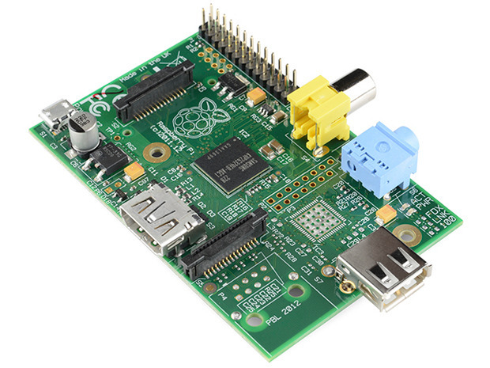
Raspberry Pi
Notes:
Model A
Interestingly, the Model A was not the first Raspberry Pi to hit general availability – that distinction went to the Model B. The A was, nevertheless, the truest to the bare-bones ethos of the Pi project, retailing for $25 and initially packing just 128MB of memory. (Later raised to 256MB.)

Slide 51
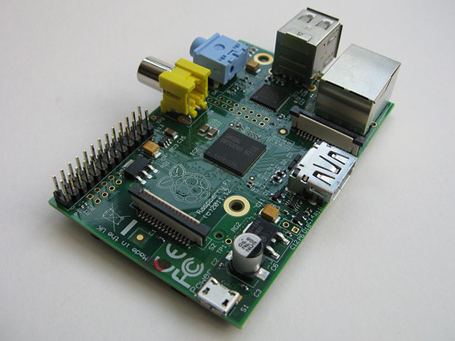
Raspberry Pi
Notes:
MODEL B
The flagship model, selling for $35, was the first to really hit the mainstream, boasting additional memory and I/O ports and helping to propel the Raspberry Pi to the forefront of the little-tiny-computing industry.

Slide 52
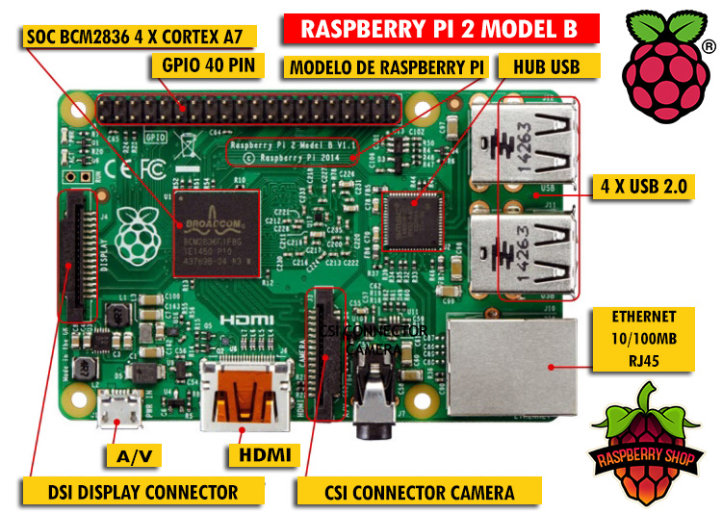
Raspberry Pi
Notes:
MODEL B+
The upgraded Raspberry Pi Model B+ packs additional RAM (a total of 512MB), 4 USB ports, and an expanded GPIO for more input/output flexibility. The B+ launched this summer, and can be had for the same price as the earlier Model B.

Slide 53
Raspberry Pi
Model A and Model B versions available
700 MHz ARM11 processor
256MB RAM, shared with GPU
Model B has 2 USB ports, Model A has 1
Ethernet port, no wireless
HDMI output, can play 1080p video
5V Micro USB power source
8 General Purpose Input Output (GPIO) chips on board
SD card slot, requires SD card to be bought separately
Notes:
MODEL B+
The upgraded Raspberry Pi Model B+ packs additional RAM (a total of 512MB), 4 USB ports, and an expanded GPIO for more input/output flexibility. The B+ launched this summer, and can be had for the same price as the earlier Model B.

Slide 54
Raspberry Pi
Requires bootable Linux image on SD card
Current recommended distribution is Debian Squeeze
Arch Linux ARM distribution
Original supported distribution was Raspberry Pi Fedora 14 Remix
Fedora 17 Raspberry Pi remix currently being worked upon
Qton Pi is Embedded Linux platform and SDK for developing Qt5 applications on Raspberry Pi
Notes:
MODEL B+
The upgraded Raspberry Pi Model B+ packs additional RAM (a total of 512MB), 4 USB ports, and an expanded GPIO for more input/output flexibility. The B+ launched this summer, and can be had for the same price as the earlier Model B.

Slide 55


Raspberry Pi
Why Python and Raspberry Pi?
Python is main supported language on Raspberry Pi
Python available by default on Linux
Python is clear and human-readable
Python already popular for teaching programming
Python can be run from command-line, so does not require IDE
Rpi.GPIO package available on pypi for Raspberry Pi
Active helpful Python community available
Notes:
MODEL B+
The upgraded Raspberry Pi Model B+ packs additional RAM (a total of 512MB), 4 USB ports, and an expanded GPIO for more input/output flexibility. The B+ launched this summer, and can be had for the same price as the earlier Model B.

Slide 56
Raspberry Pi
Python environments
Debian Squeeze has Python 2.6
Fedora Remix has Python 2.7
Python 3 supported and available through apt-get or yum
Debian Squeeze uses SPE (Stani's Python Editor) and Geany
IDLE available through yum
Eclipse PyDev not supported through Fedora
Eclipse PyDev available for Debian Squeeze but slow
Vim always available!
Notes:
MODEL B+
The upgraded Raspberry Pi Model B+ packs additional RAM (a total of 512MB), 4 USB ports, and an expanded GPIO for more input/output flexibility. The B+ launched this summer, and can be had for the same price as the earlier Model B.

Slide 57
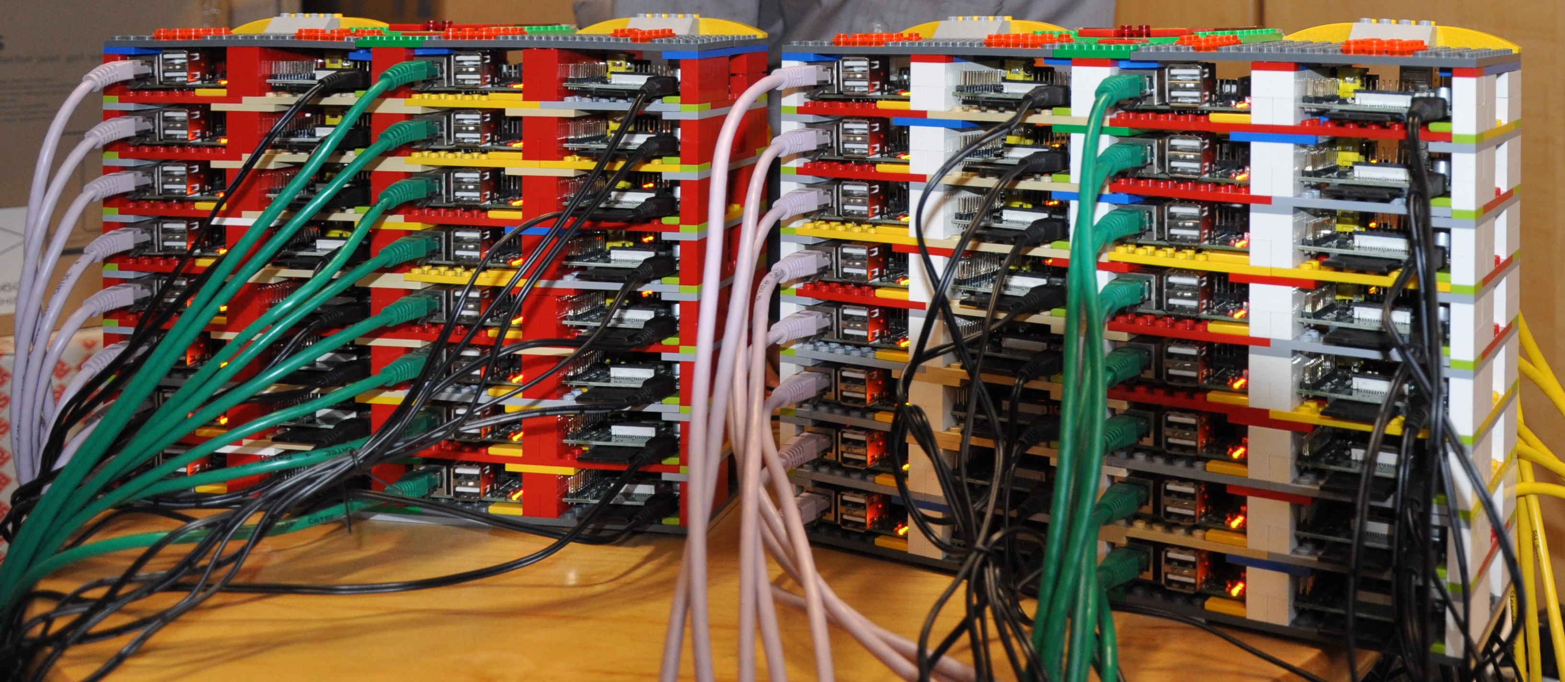
Raspberry Pi
Notes:
MODEL B+
The upgraded Raspberry Pi Model B+ packs additional RAM (a total of 512MB), 4 USB ports, and an expanded GPIO for more input/output flexibility. The B+ launched this summer, and can be had for the same price as the earlier Model B.

Slide 58

Raspberry Pi
Notes:
MODEL B+
The upgraded Raspberry Pi Model B+ packs additional RAM (a total of 512MB), 4 USB ports, and an expanded GPIO for more input/output flexibility. The B+ launched this summer, and can be had for the same price as the earlier Model B.

Slide 59
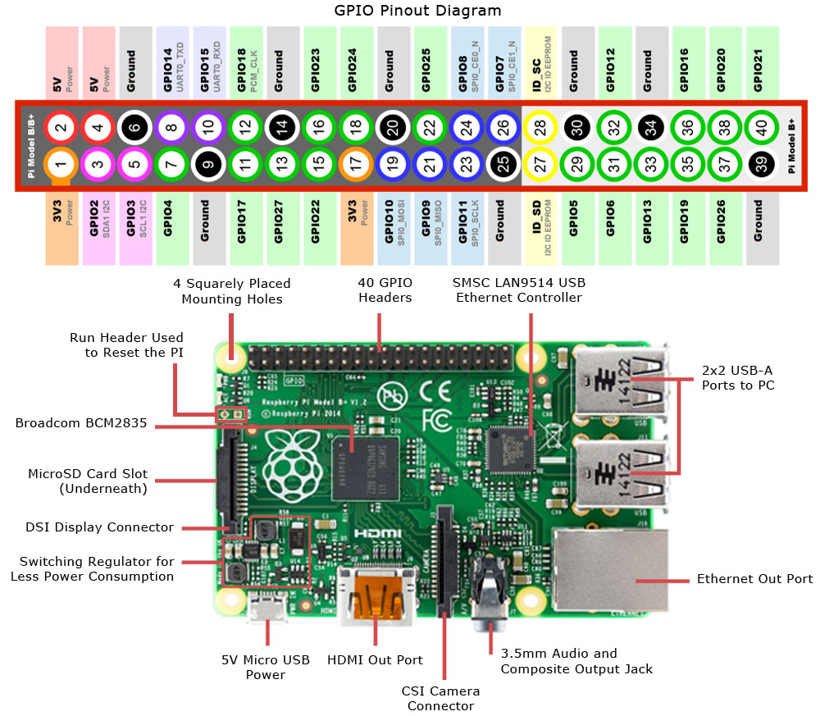
GPIOs

Slide 60
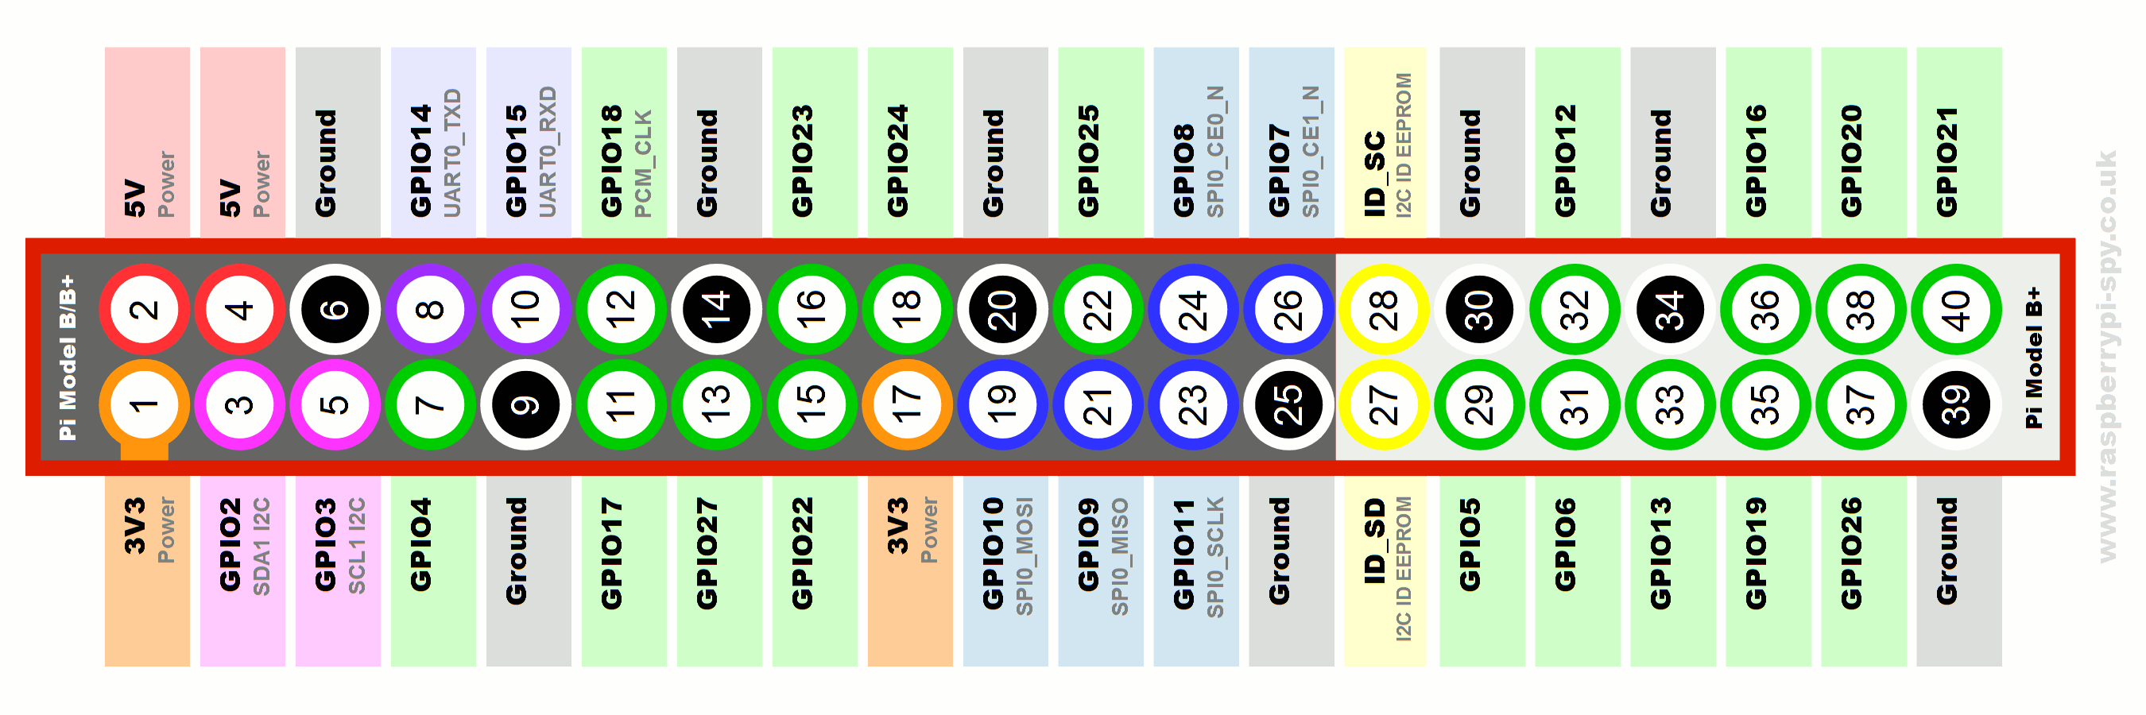
GPIOs

Slide 61
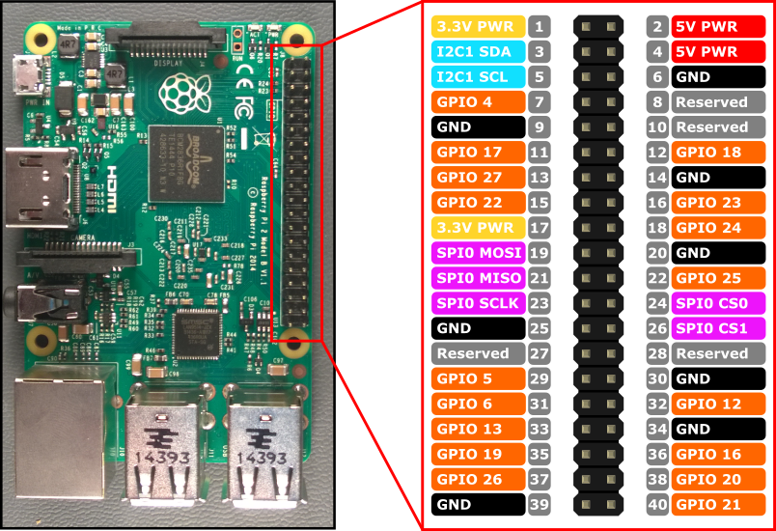
GPIOs

Slide 62
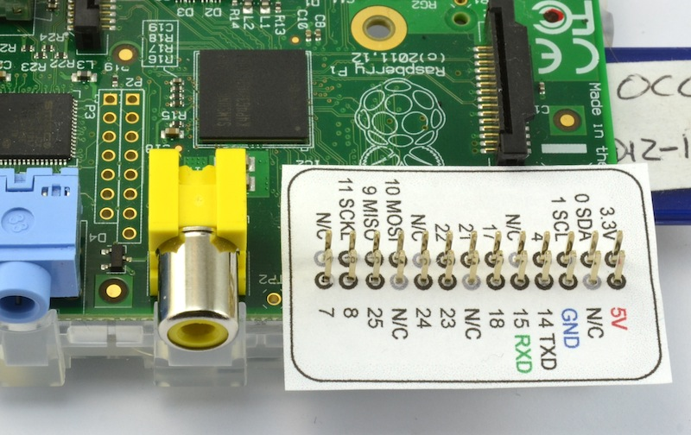
GPIOs

Slide 63
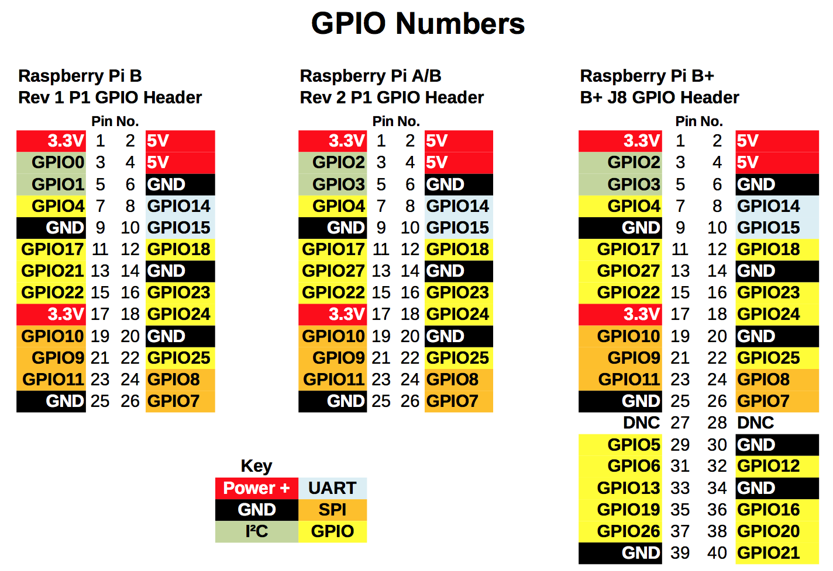
GPIOs

Slide 64
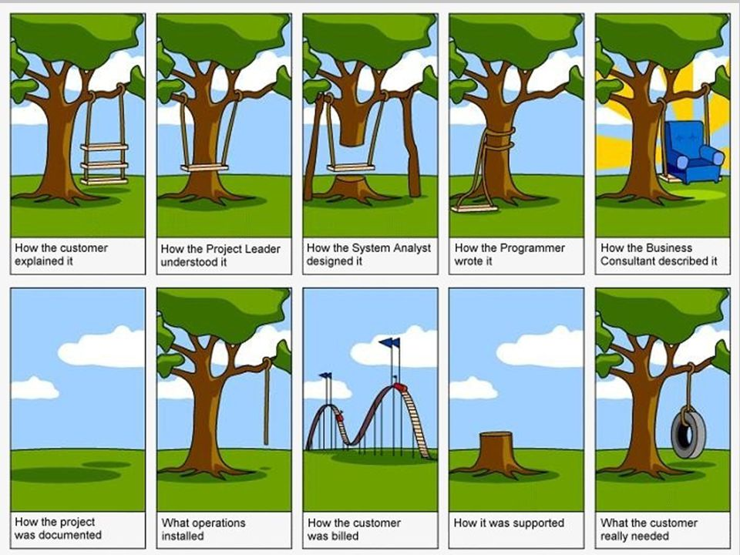
Circuitos electrónicos

Slide 65

Circuitos electrónicos

Slide 66

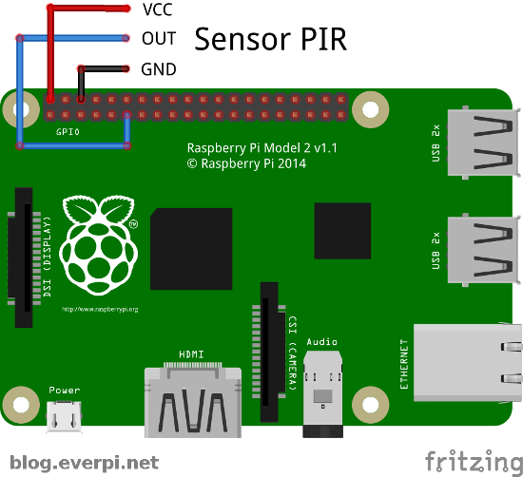
Circuitos electrónicos

Slide 67
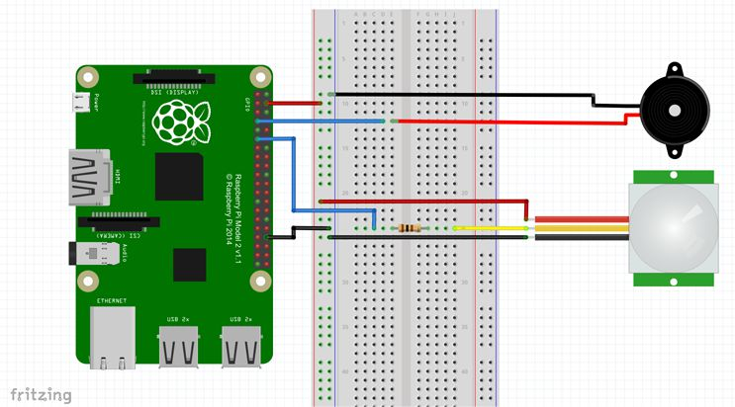
Circuitos electrónicos

Slide 68
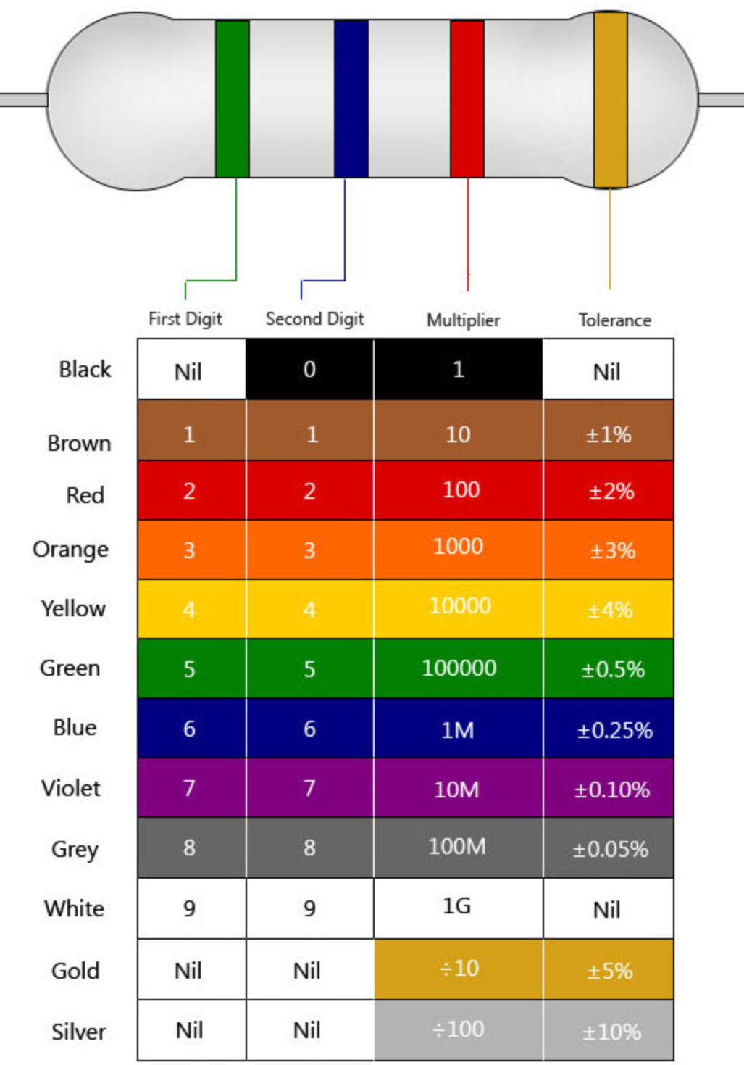
Tabla colores resistencias

Slide 69


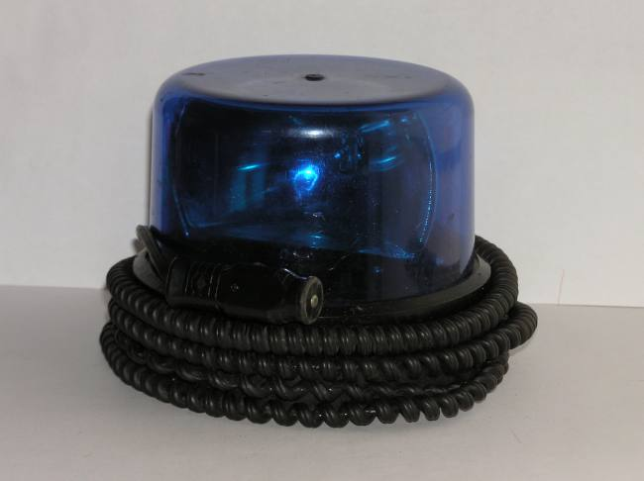
Circuitos electrónicos

Slide 70


Circuitos electrónicos

Slide 71

Circuitos electrónicos

Slide 72
P1

Slide 73


Slide 74
P2

Slide 75


Slide 76

PIR y webcam + MQTT

Slide 77

PIR y webcam + MQTT

Slide 78

PIR y webcam + MQTT

Slide 79

PIR y webcam + MQTT

Slide 80

PIR y webcam + MQTT

Slide 81

PIR y webcam + MQTT

Slide 82
P3

Slide 83


Slide 84


IFTTT + Blink
+

Slide 85

IFTTT + Blink

Slide 86

IFTTT + Blink

Slide 87

IFTTT + Blink

Slide 88
P4

Slide 89


Whatsapp: Yowsup
+

Slide 90

Whatsapp: Yowsup

Slide 91


Slide 92


Slide 93


Slide 94

Face palm

Slide 95


Slide 96
¿Preguntas?

Slide 97

Contact
@Fran_Quinto
In association with @enelago

