Slide 1







Incremental Learning in Network Traffic Management: A Fixed-Representation Rehearsal Approach
Francisco Rau (MaxLinear, Inc. & Universitat de València)
Petia Georgieva (Instituto de Telecomunicações / IEETA, University of Aveiro), Carlos Herranz (MaxLinear, Inc.),
Iñaki Val (MaxLinear, Inc.), Joaquin Perez (Universitat de València)

Slide 2
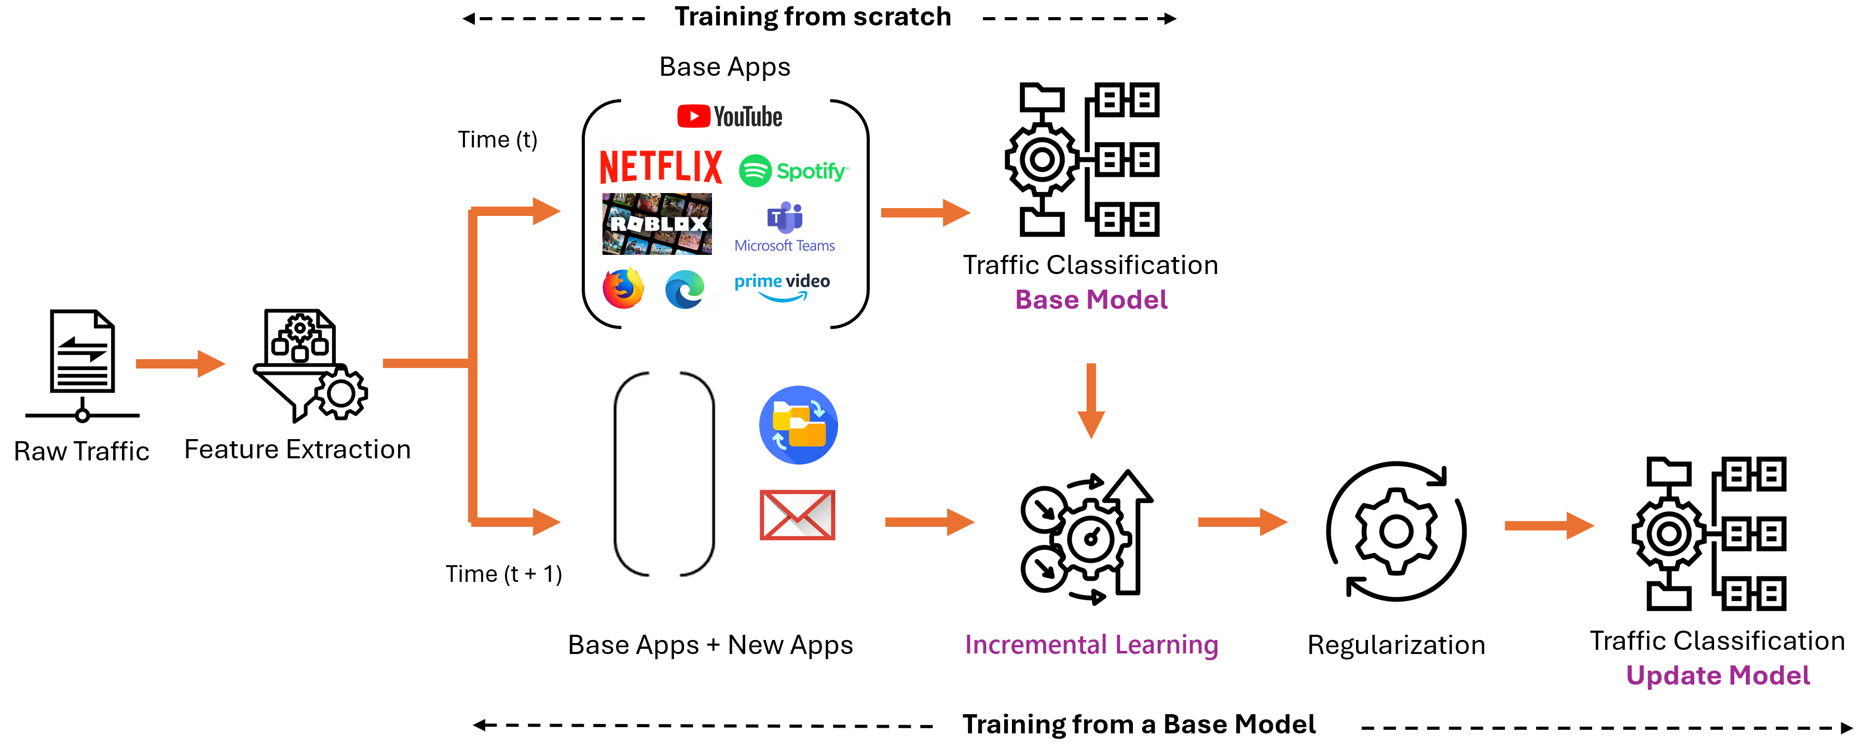
Fixed-Representation Rehearsal — Approach & Results
The Problem
Network traffic management systems must continuously evolve to new applications without degrading the performance of previously learned categories.
But traffic never sits still: new apps keep appearing — the model must be updated.
Retrain from scratch: best accuracy, but costly and requires all historical data.
Fine-tune on new apps only: low cost but forgets the old ones.
Our Approach
Freeze the FCNN backbone, retrain only the classification head, replay a 10% buffer.
A bounded-cost update — no full retrain, no forgetting. Stages below ↓
Results — from scratch vs incremental
Training time
Time to train the model
from scratch → incremental : reduction
7 → 6 + 1 classes : 1,696 s → 133 s : 92.16%
8 → 6 + 2 classes : 1,872 s → 192 s : 89.72%
Storage
Memory of the training data
from scratch → incremental : reduction
7 → 6 + 1 classes : 9.2 MB → 2.1 MB : 76.88%
8 → 6 + 2 classes : 10.6 MB → 3.4 MB : 67.50%
Forgetting
Accuracy lost on old classes when adding new
old-class accuracy, from scratch → incremental : gap
7 → 6 + 1 classes : 86.4% → 85.8% : 0.56%
8 → 6 + 2 classes : 86.0% → 84.9% : 1.13%
From-scratch training (top) vs the incremental update (bottom).

Slide 3

Find Out More!
Come and see how we update traffic classifiers without full retraining!!
Correspondence Author
Francisco Rau
MaxLinear, Inc.
Universitat de València, Spain
frau@maxlinear.com
Additional Authors
Petia Georgieva (Instituto de Telecomunicações / IEETA, Univ. of Aveiro)
Carlos Herranz, Iñaki Val (MaxLinear, Inc.)
Joaquin Perez (Universitat de València)
Acknowledgements
EU Horizon Europe MSCA-DN project OWIN6G (Grant Agreement No. 101119624).
Grant PID2023-148671OB-I00 (MICIU/AEI/ERDF-EU); EU–NextGenerationEU (Bulgaria RRP, BG-RRP-2.004-0005).
References
[1] Z. Wu, Y. ning Dong, X. Qiu, and J. Jin, “Online multimedia traffic classification from the qos perspective using deep learning,” Computer Networks, vol. 204, 2 2022.
[2] G. Bovenzi, A. Nascita, L. Yang, A. Finamore, G. Aceto, D. Ciuonzo, A. Pescape, and D. Rossi, “Benchmarking class incremental learning in deep learning traffic classification,”
IEEE Transactions on Network and Service Management, vol. 21, pp. 51–69, 2 2024.
[3] W. Zhu, X. Ma, Y. Jin, and R. Wang, “Iletc: Incremental learning for encrypted traffic classification using generative replay and exemplar,” Computer Networks, vol. 224, 4 2023.
QR code to poster

