Slide 1


SFTP Migration Analysis
Customer Z001 namespace · 13-seed stakeholder list · 19 confirmed SFTP-using objects · +46% scope expansion
EPAM
April 2026
Notes:
[PITCH NOTES]
Welcome — thank you for making time today. I'm here from EPAM to share how we help SAP customers cut delivery time and lift code quality using our Cloud LLM Hub — a set of AI accelerators built specifically for the ABAP/SAP SDLC. Our goal in the next ~25 minutes is three things: first, show four concrete use cases where AI is already producing measurable results with SAP customers; second, walk you through three deployment options we can stand up inside Medartis' landscape; and third, open up for Q&A and agree next steps. Before I start — please stop me any time with questions; this is meant to be a dialogue, not a monologue.

Slide 2
Findings & scope
Section 01
Notes:
[PITCH NOTES]
Let's start with the four use cases. Our Cloud LLM Hub is designed for one very specific audience — SAP customers who have been running the platform for years and carry accumulated technical debt. On the next few slides I'll walk through four use cases: understanding legacy code, generating technical specifications, reviewing code for performance, and accelerating mass ABAP development during migrations. Each one stands on its own, but together they form a full SDLC accelerator.

Slide 3
Bottom line
Z001 customer namespace
19
ABAP objects
1
mechanism
SXPG→SM69→OS sftp
+46%
scope expansion
HEADLINE NUMBERS
Total: 19 objects
Reports: 16 PROG
Wrappers: 3 FUGR
SM69: 11
Auth: key + password
Endpoints: 8
SCOPE EXPANSION
+46% vs seed list
• 16 ABAP reports (PROG) call SFTP — 14 directly via SXPG_COMMAND_EXECUTE, 2 via Z wrapper FMs.
• 3 wrapper function groups (ZMEDICARE, ZERX, ZDMS_SEND_FILE) wrap the same SXPG call.
• 11 distinct SM69 commands (3 shared by ≥2 callers) — coordinate cutover.
• 2 auth modes the new layer must support: key-based (PRIVATE_KEY_PATH) and password-based (FTP_PSWD).
• 8 counter-party endpoints: BNP Paribas, Citi, JPMorgan, Caparío, Patientco, Ceridian, internal DMS, internal eRx/Medicare.
• Completeness ≈ 97% (7 independent SearchSource scans, no truncation).
Notes:
[PITCH NOTES]
This is the umbrella view. The business problem is familiar to anyone running a long-lived SAP landscape: custom ABAP developed over many years, sparse documentation, inconsistent coding standards, and large migration backlogs — all of which slow maintenance and raise risk. The Cloud LLM Hub brings AI automation into this picture. It powers AI-based analysis, multi-language documentation of custom and standard reports, enhancement analysis, dependency and architecture checks, performance bottleneck detection, and best-practice recommendations. The stakeholders are Business Solution Architects, Solution Architects and Functional Leads; the daily users are developers and functional consultants. Technology-wise, we use LLMs, MCP (Model Context Protocol), CLine, Python and TypeScript — all proven patterns we re-use from project to project. Bottom line: one AI backbone, four use cases, measurable acceleration.
[ORIGINAL NOTES]
The Cloud LLM Hub AI-based automation into complex SAP development landscape analysis and architectural governance,
The accelerator automates a variety of use cases, incl. nd multi-language documentation of custom code and standard reports, enhancements, analysis and resolution of architectural issues (such as dependencies), detection of performance and scalability bottlenecks, and best-practice recommendations for system optimization.

Slide 4
Consumers
Z001 customer namespace
Domain | Report | SM69 / wrapper | Dir | Auth
Banking | ZSFTP_BNP_PARIBAS_PULL | ZFTP_BNPP_PULL | pull | hybrid
Banking | ZSFTP_BNP_PARIBAS | ZFTP_BNPP | push | password
Banking | ZSFTP_BNP_PARIBAS_WITH_PGP | ZFTP_BNPP (PGP) | push | key
Banking | ZSFTP_CITI_PULL | ZSFTP_CITI_PULL | pull | key
Banking | ZSFTP_CITI_SEND | ZSFTP_CITI_SEND | push | key
Banking | ZSFTP_JPM | ZFTP_JPM | push | key
Banking | ZSFTP_JPM_PULL | ZFTP_JPM_PULL | pull | key
Healthcare | ZSFTP_CAPARIO_PULL | ZFTP_EOB_PULL | pull | key
Healthcare | ZSFTP_CAPARIO | ZFTP_837 | push | key
Healthcare | ZSFTP_PATIENTCO_PULL | ZSFTP_PATCO_PULL | pull | key
Payroll | ZFFIU_ACC_POST | ZSFTP_CERIDIAN_GET (shared) | pull | key
Payroll | ZSFTP_CERIDIAN_PULL | ZSFTP_CERIDIAN_GET (shared) | pull | key
DMS | ZDMS_UPLOAD_FILES | ZSFTP_DMS_GET + _PUT | both | key
DMS | ZDMS_REPLACE_FILES | ZSFTP_DMS_GET + _PUT (shared) | both | key
Medicare | ZSD_MEDICARE_PDF_PROCESS | ZMEDI_GET/PUT_FROM_SFTP (FM) | both | key
eRx/DMS | ZSD_ERX_DMS_FILE_PROCESS | ZERX_GET/PUT_FROM_SFTP (FM) | both | key
BY DOMAIN
Banking: 7
Healthcare: 3
Payroll: 2
DMS: 2
Medicare: 1
eRx/DMS: 1
TOTAL
16 reports
Source: SM69 names from literal `PARAMETERS p_comm ... DEFAULT '...'` or `lv_comm = '...'` in each report's main source.
Notes:
[PITCH NOTES]
Use case one: Undocumented Legacy Code. The pain: consultants spend weeks on reverse engineering every time a change request touches a custom enhancement no one remembers writing. What we do: our Agentic SAP Code Documentation Assistant connects via the standard SAP ADT APIs, reads the ABAP, and generates business-level and technical descriptions using the LLM of your choice — EPAM DIAL, your own DIAL tenant, or any other provider. The impact so far on SAP clients: up to 70% reduction in code analysis time, around two-thirds interpretation accuracy on first pass (consultants still validate), and 20–30% shorter development cycles once it's integrated into the team's workflow. This is the use case that usually pays for the whole program within the first quarter.

Slide 5
Parameters
Z001 customer namespace
✓ = `READ TABLE i_constants WITH KEY fnam = '...'` after `SELECT FROM zfi_constants WHERE pname = '<consumer pname>'`
Report | USER | PSWD | DOMAIN | PORT | KEY | PRIV_KEY | PASS | Other
ZSFTP_CITI_PULL | ✓ |  | ✓ |  | ✓ | ✓ | ✓ | SRC_FOLDER
ZSFTP_CITI_SEND | ✓ |  | ✓ |  | ✓ | ✓ | ✓ | ✓
ZSFTP_BNP_PARIBAS_PULL | ✓ | ✓ | ✓ | ✓ | ✓ |  |  | ✓
ZSFTP_BNP_PARIBAS (pswd) | ✓ | ✓ | ✓ | ✓ | ✓ |  |  | ✓
ZSFTP_BNP_PARIBAS_WITH_PGP | ✓ |  | ✓ |  | ✓ | ✓ | ✓ | ✓
ZSFTP_CAPARIO_PULL | ✓ |  | ✓ |  | ✓ | ✓ | ✓ | FOLDER_PATH
ZSFTP_CAPARIO | ✓ |  | ✓ |  | ✓ | ✓ | ✓ | ✓
ZSFTP_PATIENTCO_PULL | ✓ |  | ✓ |  | ✓ | ✓ | ✓ | ✓
ZSFTP_JPM / _PULL | ✓ |  | ✓ |  | ✓ | ✓ | ✓ | ✓
ZFFIU_ACC_POST / CERIDIAN | ✓ |  | ✓ |  | ✓ | ✓ | ✓ | SRC_FOLDER
ZDMS_UPLOAD / REPLACE | ✓ |  | ✓ |  | ✓ | ✓ | ✓ | SRC+ZDEST
ZSD_MEDICARE (ZMEDI FM) | ✓ |  | ✓ |  | ✓ | ✓ | ✓ | SRC_PATH+ZDEST
ZSD_ERX_DMS (ZERX FM) | ✓ |  | ✓ |  | ✓ | ✓ | ✓ | via wrapper
MATRIX
Reports rows: 13
fnam columns: 8
KEY AUTH
12 reports
PASSWORD AUTH
1 report (BNP)
HYBRID
several read both
1 of 16 uses pure password auth (ZSFTP_BNP_PARIBAS); rest are key or hybrid. New layer must support both.
Notes:
[PITCH NOTES]
Use case two: Technical Specifications for standard reports and custom enhancements. This is the flip side of use case one — instead of documenting your legacy, it documents what SAP ships plus your modifications. The scenario: you're planning an S/4HANA upgrade or localizing for a new market and nobody on the team really knows what the original report does or what your enhancement did to it. We analyze the ABAP logic, map dependencies, and produce multilingual technical and business documentation. The net effect: faster onboarding of new consultants, safer modifications, and consistent quality across global delivery teams — with measurable drops in upgrade regression and manual analysis time.

Slide 6
Where values live
Z001 customer namespace
Every consumer follows this shape — pname literal changes per endpoint:
SELECT * FROM zfi_constants INTO TABLE i_constants
WHERE pname = '<consumer-specific pname>'.
READ TABLE i_constants WITH KEY fnam = 'FTP_USER'. " then 'FTP_DOMAIN', 'HOST_KEY'...
SQL SHAPE
Table: zfi_constants
Columns: PNAME, FNAM, FVAL
ACCESS PATTERN
SELECT by pname
READ TABLE by fnam
VALUE STORAGE
Not in git — SE16 / SecureStorage on SAP system
Consumer | pname literal | fnam keys read
ZSFTP_CITI_PULL / SEND | 'ZSFTP_CITI' / 'ZSFTP_CITI_SEND' | FTP_USER, FTP_DOMAIN, HOST_KEY, PRIVATE_KEY_PATH, PASSPHRASE
ZSFTP_BNP_PARIBAS variants | 'ZSFTP_BNP_PARIBAS' | FTP_USER, FTP_PSWD/PRIVATE_KEY_PATH, FTP_DOMAIN, FTP_PORT, HOST_KEY
ZSFTP_CAPARIO_PULL / CAPARIO | 'ZSFTP_835_PULL' / 'ZSFTP_837' | Standard key bundle + FOLDER_PATH
ZSFTP_PATIENTCO_PULL | 'ZSFTP_835_PATIENTCO' | FTP_USER, FTP_DOMAIN, HOST_KEY, FTP_PSWD, FOLDER_PATH
ZSFTP_JPM / _PULL | 'ZSFTP_JPM' | Standard key bundle
ZFFIU_ACC_POST / CERIDIAN | 'ZSFTP_CERIDIAN' | FTP_USER, FTP_DOMAIN, HOST_KEY, PASSPHRASE, SOURCE_FOLDER
ZDMS_UPLOAD / REPLACE | 'ZSFTP_DMS_IN' / 'ZSFTP_DMS_OUT' | Standard + SOURCE_FOLDER + ZDEST_FOLD
ZSD_MEDICARE (ZMEDI FM) | 'ZSFTP_MEDICARE_IN/OUT' | Standard + SOURCE_PATH + ZDEST_FOLD
Migration handoff: extract zfi_constants rows for these pnames via SE16 / SecureStorage — not committed to git.
Notes:
[PITCH NOTES]
Use case three: Code Review — performance and maintainability. This is where the Cloud LLM Hub actively improves your codebase rather than just describing it. The problem: ABAP projects pick up inconsistent patterns, redundant logic, and inefficient data access over years. Traditional performance tuning is manual, expensive, and hard to scale. Our approach: AI-driven static and dynamic analysis that flags inefficiencies, proposes refactoring options, and recommends Clean Core-aligned practices for cloud-ready ABAP. Result: better maintainability scores, shorter execution times for ABAP services, and fewer performance bottlenecks shipping to production.
[ORIGINAL NOTES]
https://kb.epam.com/display/ESAPCC/04.02.03.01+Use+cases#id-04.02.03.01Usecases-Case03:SAPBTPABAPPackageOptimization
Let’s imagine situation when we need to …
The Agentic SAP Code Documentation approach might help you to …
As usual we aim to reduce time on code and solution analysis to save costs
!!! slide 35 - relevant not only for BTP

Slide 7
Schema
Z001 customer namespace
All values in DDIC table `zfi_constants` (PNAME, FNAM, FVAL). FVAL retrieved via SE16 / SecureStorage.
fnam (literal key) | Holds | Used as
'FTP_USER' | SFTP username | Login user in sftp/scp command
'FTP_PSWD' | Password (legacy) | When key auth not used
'FTP_DOMAIN' | Remote hostname | Host portion of user@host[:port]
'FTP_PORT' | TCP port (default 22) | ':port' suffix after host
'HOST_KEY' | Server fingerprint | Identity verification
'PRIVATE_KEY_PATH' | Path to private key file | '-i <path>' for sftp
'PASSPHRASE' | Unlocks PRIVATE_KEY_PATH | Decrypts the key at runtime
'SOURCE_FOLDER' / 'SOURCE_PATH' | Remote folder to read from | Source path argument
'FOLDER_PATH' | Local AL11 folder | Destination (pull) / source (push)
'FILE_EXT' / 'SFTP_FILE_EXT' | File-name pattern | Filter for which files
'ZDEST_FOLD' / 'DESTINATION_FOLDER' | Remote target folder | Destination path argument
'PUBLIC_KEY_ID' / 'PRIVATE_KEY_US|NONUS' | PGP key IDs (BNP only) | PGP layer atop SFTP
CREDENTIAL KEYS
Total keys: 12
KEY-AUTH SET
FTP_USER, FTP_DOMAIN,
HOST_KEY, PRIVATE_KEY_PATH,
PASSPHRASE
PASSWORD-AUTH SET
FTP_USER, FTP_PSWD,
FTP_DOMAIN, HOST_KEY
Notes:
[PITCH NOTES]
Use case four: Accelerating mass ABAP development — the classic BTP cloud migration scenario. When you move an on-premise function to BTP Cloud ABAP, you often need to regenerate hundreds of Domains, Data Elements, and RAP services from functional specs. That's repetitive, error-prone work. We automate it using MCP-driven calls over the ABAP Development Tools API. Functional specs go in, ABAP artifacts come out. Numbers: 23–55 times faster object creation, 70–90% less manual effort, repeatable across migration waves. This is the use case where the ROI is easiest to quantify — if you have a migration roadmap, we can put a number against it in a couple of days.

Slide 8

Migration & code
Section 02
Notes:
[PITCH NOTES]
That's the value story. Now the practical question — where does this thing live? In the next section I'll walk through three deployment options, ranging from fully EPAM-hosted on one end to fully Medartis-hosted on the other, plus a hybrid option in between. The right answer depends on your data-classification appetite, your BTP capacity, and how much of the operations you want to take on internally.

Slide 9
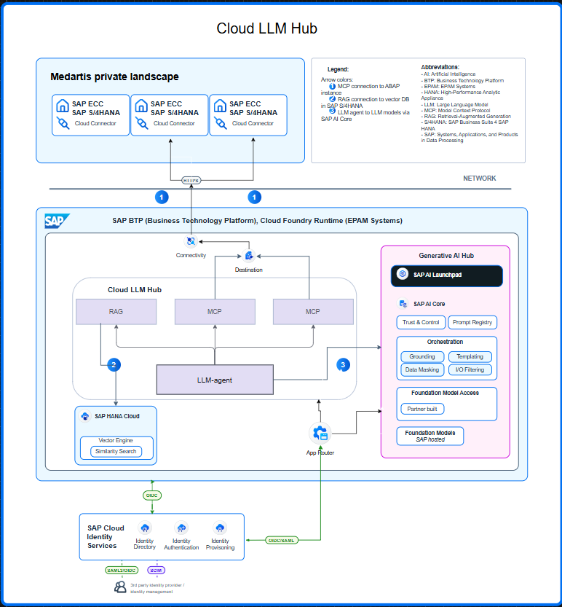
Migration proposal
Z001 SFTP scope
Replace CALL FUNCTION 'SXPG_COMMAND_EXECUTE' (with SM69 + OS sftp) with a released ABAP SFTP layer.
# | Target replacement | Why | Coverage
A | Native ABAP SSH/SFTP client class | Removes OS-script dependency; runs in-ABAP | All 16 reports + 3 wrappers
B | BTP Integration Suite SFTP adapter | Cleanest separation; aligns with BTP roadmap | Same; needs BTP connectivity
C | Keep SXPG, rewrite OS-side script | Minimal ABAP change | Doesn't remove technical debt
Recommended: A or B. Both replace SXPG call site uniformly — same FORM scaffolding, same zfi_constants reads.
Acceptance per consumer:
1. Read same zfi_constants rows (pname + fnam) — or 1:1 shim.
2. Reach same host with same credentials.
3. Support both auth modes (key + password).
4. Preserve PGP encryption for ZSFTP_BNP_PARIBAS_WITH_PGP.
5. Coordinate cutover for the 3 shared SM69 entries.
Notes:
[PITCH NOTES]
Option 1 in detail. The Cloud LLM Hub is deployed in EPAM's BTP Cloud Foundry tenant. The vector database for RAG is also in EPAM. On-prem ABAP systems reach us through Medartis' Cloud Connector into an EPAM destination. The LLM provider is called from EPAM runtime. Pros: horizontal scaling is on us, your BTP tenant stays lightly loaded, and EPAM runs the environment. Cons: technical data — not business data, but metadata like code fingerprints — crosses into EPAM's perimeter. You'll want a data-processing agreement and clear governance. Typical fit: customers who want the fastest time to value and are comfortable with EPAM as a processor.

Slide 10
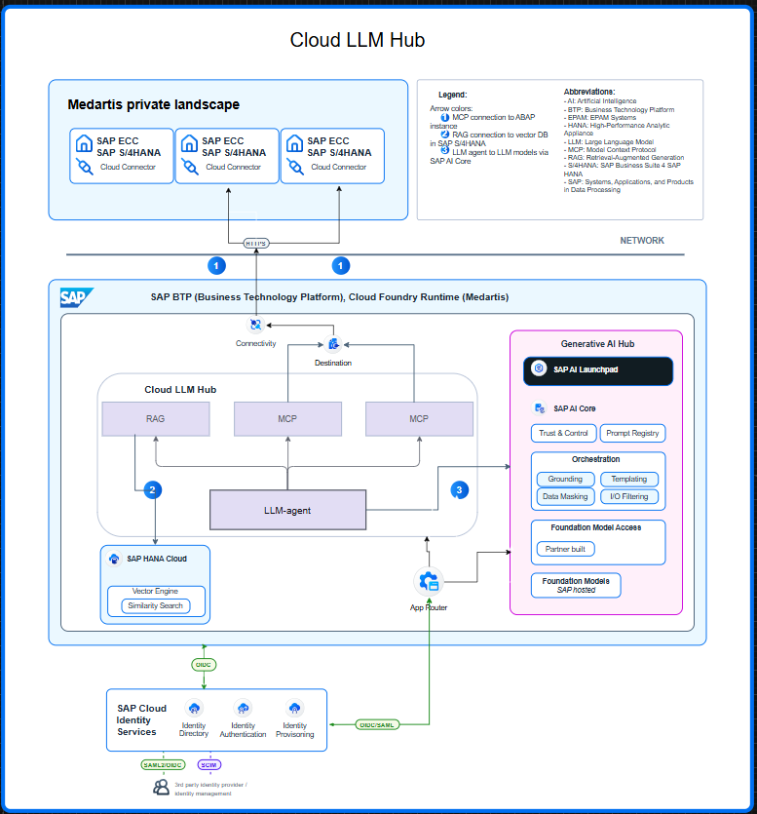
Tutorial: docs/tutorials/codebase-analysis/ (5-stage pipeline + skills + worked example)
Pipeline:
Stage 1 — Formalize task (goal, scope, severity scale, tools)
Stage 2 — Per-seed verdict with source evidence (02-methods.md)
Stage 2b — Open-ended method enumeration per 'yes' seed (02b-methods-deep.md)
Stage 2c — Verbatim code per distinct mechanism (02c-code-extracts.md)
Stage 3 — Usage map: 7 SearchSource scans across Z001 (03-usage-map.md)
Stage 4 — Per-business-domain analysis + completeness (04-analysis.md)
Stage 5 — Migration handoff (05-result.md)
Wall-clock end-to-end: ~2.5 hours.
Token cost — two layers (sFTP share = 70% of combined session):
Executor (cloud-llm-hub, gpt-5.2 + embedder): ~1,054,000 tokens across 264 requests.
Controller (Claude Opus 4.7, this CLI session): ~363,000 output + ~12.5k input + ~97M cache-read tokens — ≈ $66 of $94.53 combined session.
Reference: comparable manual UI analysis estimated at 4-12 hours by senior reviewer.
Notes:
[PITCH NOTES]
Option 2 — everything in Medartis BTP. The Cloud LLM Hub runs inside your tenant, the vector DB is yours, the Cloud Connector is local, and the LLM provider is accessed from your BTP. Pros: full control, everything stays inside your security perimeter, simple compliance story. Cons: you carry the scale — limited by your BTP capacity — and your team carries the ops load. Less flexibility for large workloads. Typical fit: regulated environments or cases where even metadata must not leave Medartis.

Slide 11

Method & cost
Section 04
Notes:
[PITCH NOTES]
That's the tour. I'll pause here — I'd love to hear your questions. A few things we usually get asked: where does the data go, how long does a pilot take, and what does the cost look like. Happy to dig into any of those now, and to any part of the use cases or architecture.

Slide 12

Thank you!
Tutorial: docs/tutorials/codebase-analysis/ — replay or apply to other ABAP packages.
Notes:
[PITCH NOTES]
Thank you. To summarize: the Cloud LLM Hub gives you four proven AI accelerators for the SAP SDLC, three deployment options so you control where data lives, and a compounding support assistant on top. We can stand up a proof of value in about four weeks, focused on the use case that matters most to you. If it helps, I can draft a short scoping document for Medartis this week. Thanks for your time — looking forward to the next step.

