Slide 1
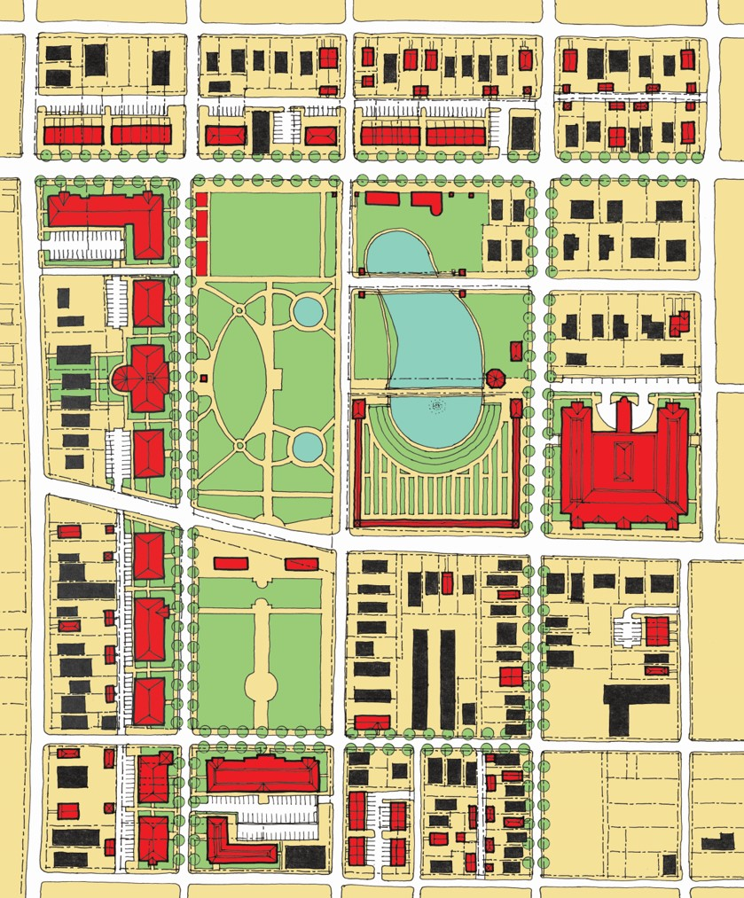
Historic Mims Park

