Slide 1
Extended Essay
Final Formatting Advice &
Assessment

Slide 2
Required Elements
1.Title page 2.Contents page 3.Introduction 4.Body of the essay 5.Conclusion
6.References

Slide 3
Title Page
•
The title and research question of the essay
•
The subject for which the essay is registered
•
The word count – not to exceed 4000 words
Only this, nothing more!

Slide 4
Title
Clear, focused summative statement of your research, not your research question.
Title | Research Question
The negative effects of social media on mental health | To what extent does research support that social media plays a significant role in adolescent depression?
The effectiveness of self-talk in improving tennis performance. | Is self-talk an effective strategy for decreasing anxiety in tennis players?

Slide 5
Table of Contents
•
At the beginning
•
Number all pages
•
Make sure it’s accurate
•
Generate a table of contents; don’t just create your own. In Word – use “document elements.”

Slide 6
Introduction
•
Make clear the focus of the essay
•
Make clear the scope of the research - specifically, identify the key sources to be used
•
Outline the line of argument to be taken
•
While students should have a sense of the direction and key focus of their essay, it is sometimes advisable to finalize the introduction once the body of the essay is complete

Slide 7
Body
•
Research, analysis, discussion and evaluation
•
A reasoned argument.
•
Evidence must be relevant to the research question.
•
It must be explicitly linked to the question.
•
Can use sub-headings within the main body of the essay to help the reader understand the argument

Slide 8
Conclusion
•
Must follow your line of argument.
•
Explain any limitations of the argument
•
Identify questions that have not been resolved
•
While students might draw conclusions throughout the essay based on their findings, it is important that there is a final, summative conclusion at the end. This conclusion(s) must relate to the research question posed.

Slide 9
References
•
Choose a system - APA, MLA – Do not use footnotes
•
Citations in text must match Works cited listings.
•
Cite all ideas that came from someone else
•
Cite all quotes with page numbers
•
Cite illustrations
•
Include URLs
•
Works cited list - at end, alphabetical, hanging indent

Slide 10
Other
The following formatting is required:
•
the use of 12-point, readable font
•
double spacing
•
page numbering
•
no candidate or school name on the title page or page headers.

Slide 11
4000 word limit
Include in word count | Do not include in word count
Introduction | Contents page
Body | Diagrams and graphs
Conclusion | Tables
Footnotes or endnotes that are NOT citations | Works cited
 | RPPF form
 | Title page

Slide 12
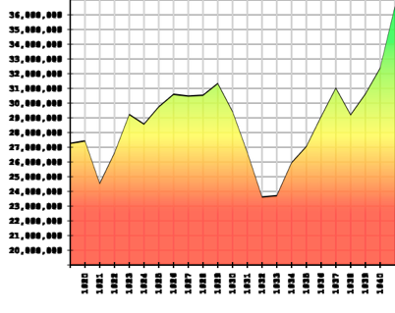
Illustrations
(maps, diagrams, charts, tables, pictures)
•
neat
•
readable
•
clearly labelled
•
“interpreted with ease”
•
directly relevant and appropriate
•
cited!!!

Slide 13
Appendices
NOT ASSESSED!!!!!
•
There is no valid reason to include appendices for a psychology EE. They should not be included in the final submission.

Slide 14
Academic Honesty
•
All citations must appear in the works cited.
•
All works in the works cited must be cited in the essay.

Slide 15
Final Tips
•
Proofread (you must do it yourself)
•
Check all citations for accuracy
•
TOC - page numbers accurate
•
Make copies and back up copies
•
Save all working material and drafts

Slide 16
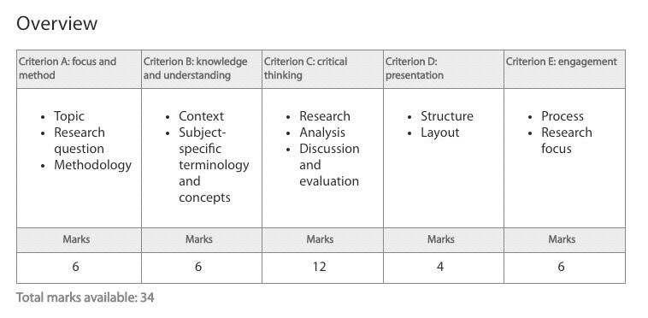
Assessment
Refer to “Assessment Criteria” and “Unpacking the Assessment Criteria”

