Slide 1

Language and Literature
Paper 1
© Tim Pruzinsky, InThinking 2022
www.thinkib.net/englishlanglit

Slide 2
What is Paper 1?
Paper 1 is an exam you sit in May or November of your final IB year.
For SL students, it is a 75 minute exam.
For HL students, it is a 2 hour and 15 minute exam.
All students also get 5 minutes of “reading time” at the start of the exam.

Slide 3
What kind of exam is it?
It is an exam in which you write a guided textual analysis.
The exam has two unseen non-literary texts or extracts.
SL students write a guided textual analysis based on one of the texts.
HL students write two guided textual analyses. HL students get no choice.

Slide 4
How will I be graded?
At SL, you are graded using 4 criterion each worth 5 points for a total of 20 points.
They are:
Understanding and interpretation
Analysis and evaluation
Focus and organization
Language
At HL, both guided textual analyses are graded separately using the same criteria. It’s out of 40 points, in other words, for HL.

Slide 5
How much is Paper 1 worth?
Paper 1 is worth 35% of your final IB grade.

Slide 6
Can I write about anything?
No! There is a guiding question.
Our recommendation is to focus your response on the guiding question.

Slide 7
Can you tell me more about the guiding question?
The guiding question is a question at the bottom of the exam paper, under the actual text itself.
The IB has stated that “a guiding question “ will “[ask] the students to consider a technical or formal aspect of the passage.”

Slide 8
Do you have any examples of guiding questions?
How is the narrative structure used to explore ideas about identity?
How do text and image work together to convey the comic's message?

Slide 9
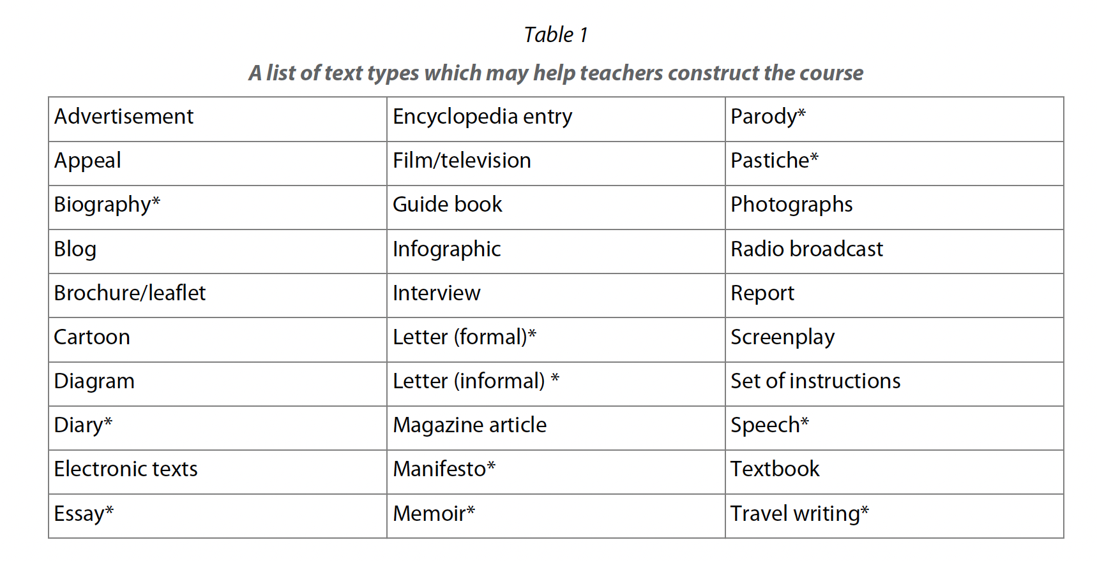
What text types might appear?
Technically, the IB says only the ones taken from this chart below:

Slide 10
Really, only those text types will appear on the exam?
Be careful! “Electronic texts” is pretty ambiguous and so you will need to be prepared to analyze any non-literary text you might come across.
The point – in many respects – of Paper 1 is to show your ability to analyze an unseen non-literary text, so in reality, it doesn’t matter what text type it is. Can you analyze it well?

Slide 11
So how do I organize my Paper 1?
Use the guiding question to frame your response!
Think about how you answer the guiding question, or creating an an argument about the text using the guiding question to frame your thinking (or a thesis, if you prefer).
The more focused your response is, the better it is likely to be.

Slide 12
Can you tell me more?
While not an essay (it’s a guided textual analysis), this is a formal and academic piece of writing.
To that end, you should have an introduction, body paragraphs, and a conclusion/synthesis.
It must be continuous writing (not bullet points or disjointed).
And you need to have direct references from the text in the analysis.

Slide 13
How long should Paper 1 be?
The standard teacher response is “how long is a piece of string?”
But, we advise you to write a bunch! Look at the model examples (exemplars) to get a feel for how many paragraphs, how many words, and overall how much you should write in the exam.

Slide 14
Can you study for Paper 1?
YES!
Some students incorrectly assume that since Paper 1 is based on an unseen non-literary text, you can’t study for the exam. They are wrong!

Slide 15
So how do you study for Paper 1?
Read widely! This should start ideally before you even begin the IB, but once you are in the course, you should be reading as much as you can.
Longer works of fiction (even though literary works won’t appear on the exam).
Newspapers – pick on online newspaper and read it everyday.
Longer works of nonfiction from magazines like The Economist, The Atlantic, Time Magazine and so on.
And don’t be afraid to deep dive into your own personal interests. Read about them too!

Slide 16
Is there anything else I can do besides reading?
Of course! You should be doing some or all of the following:
Reading model examples (exemplars);
Writing practice papers under timed conditions using past exams;
Comparing and contrasting your writing/work to the model examples;
Practicing your annotation and outlining skills;
Memorizing your terms and definitions. Just like you know the parts of a cell in Biology, you should be fluent in identifying and analyzing the writer’s choices.
And more! Your teacher will have further advice for your particular context as needed.

Slide 17
I have more questions. Where can I find answers?
Ask your teacher! They are super knowledgeable about the course!
The “For Students” section of InThinking also has a wealth of information to support you in the process!

