Slide 1

Factors of production
How goods and services are made?
All images accessed from google images athttps://images.google.com/
© Mark Johnson,
InThinking www.thinkib.net/Economics

Slide 2
What are factors of production?
There are 4 factors of production, without which a country cannot produce goods and services. The production process requires each of the following:
Land
Labour
Capital
Entrepreneurship

Slide 3
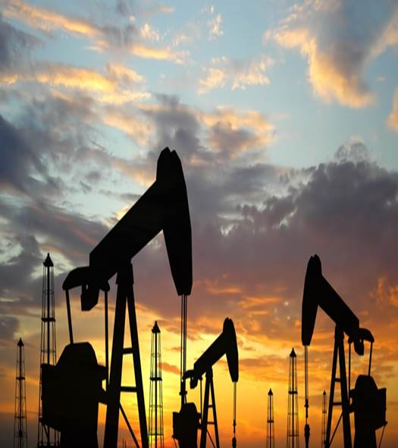
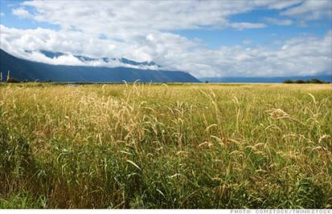
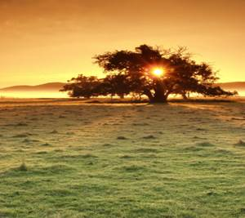

Land
Land includes the natural production resources of a country as well as the available farmland, factory space and office space

Slide 4
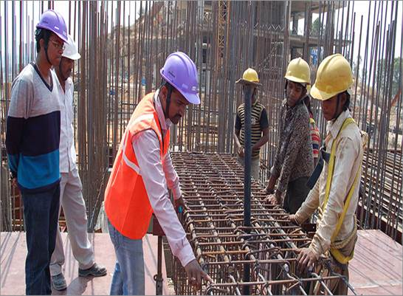
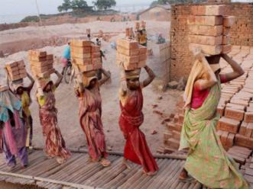
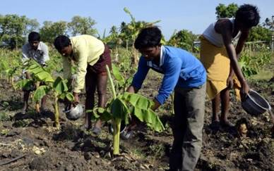
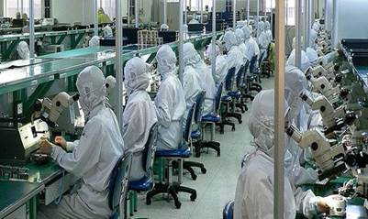
Labour
Labour is probably the most important factor or at least the one that is easiest for a government to improve. It includes the number of workers as well as their skill level

Slide 5
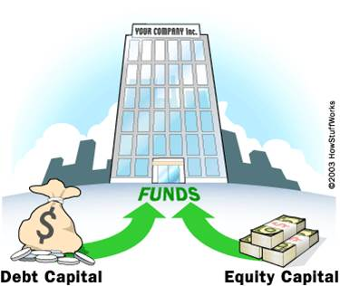



Capital
Capital includes the factories, machinery and equipment owned by a business and used in production. Most wealthy nations have an abundance of capital

Slide 6




Entrepreneurship
Entrepreneurs are the individuals who run the businesses, or control the other factors of production.

Slide 7

Question?
Which factor resource is most abundant in your country?

