Slide 1

Welcome to IB economics

Slide 2
What were the characteristics of:
Higher Income Countries?
Medium Income Countries?
Low Income Countries?

Slide 3
Success?
How do your lists compare with the list generated after investigating via the website?
Are there any surprises on the list?
Are there countries that are wealthier than you expected?
What about nations that had a lower income than you thought?
How did the wealthy nations achieve your success?
What explains the relative success between different nations and different continents of the world?

Slide 4
Have a think…
Compare the strategies of successful countries with those of relatively unsuccessful countries, why didn’t the less successful countries just copy them?
And what does this activity have to do with the IB economics course? There are a several connections with the course and these include:

Slide 5
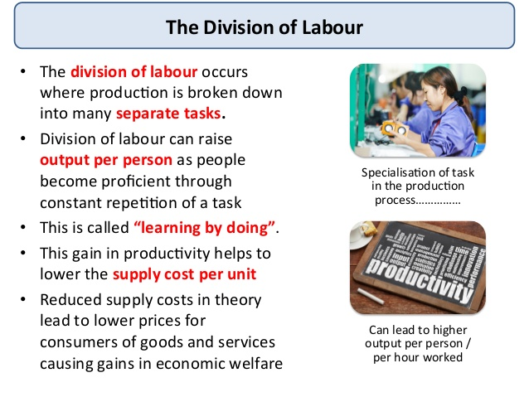
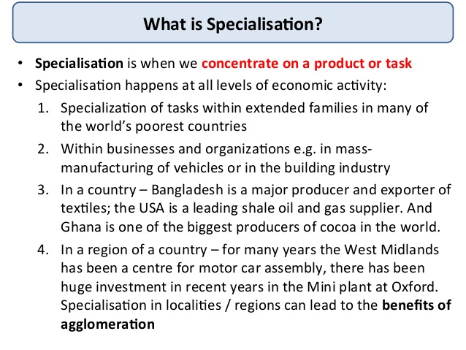
Specialisation + Division of Labour

Slide 6
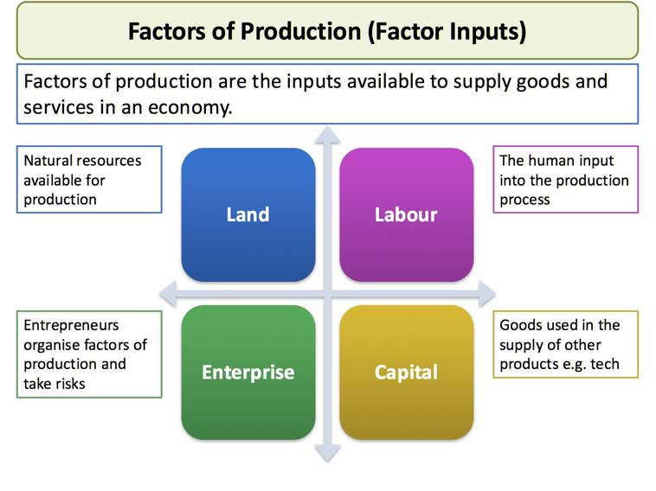
Factors of Production

Slide 7
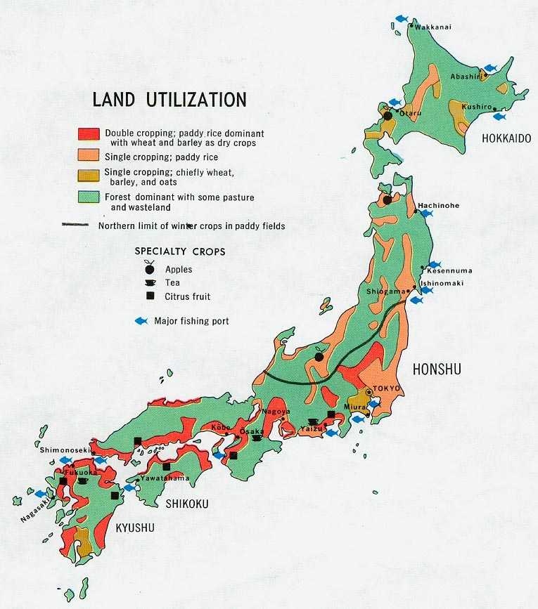
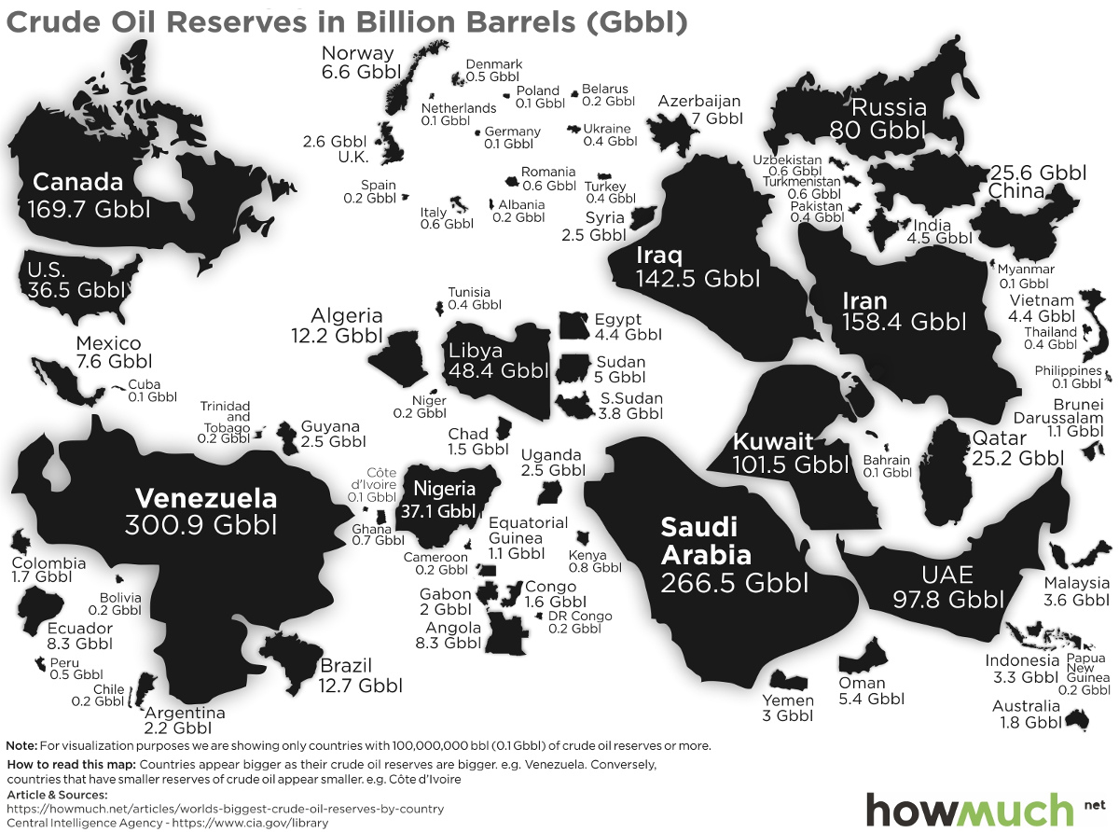
Resource Endowments
We’ve just looked at what Factors of Production are, but some of you had differing levels of those. How did that affect your performance?

Slide 8
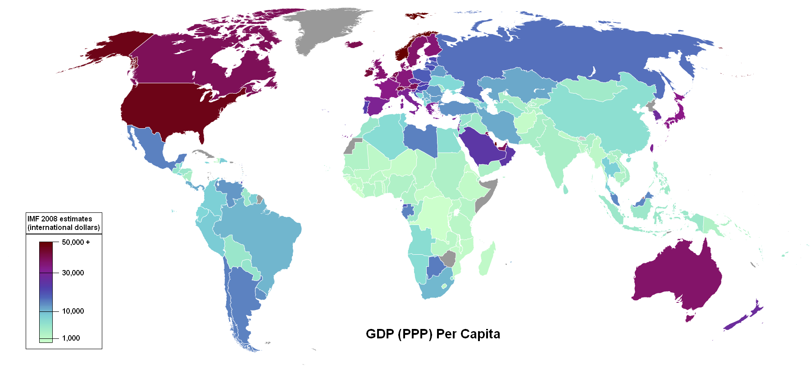
Global Inequality

Slide 9
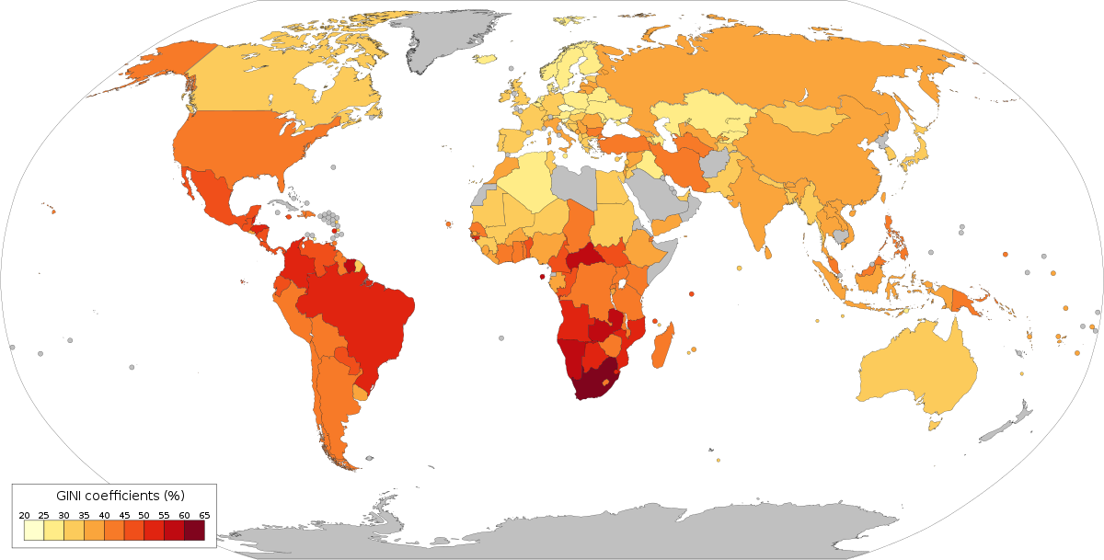
Global Inequality

Slide 10
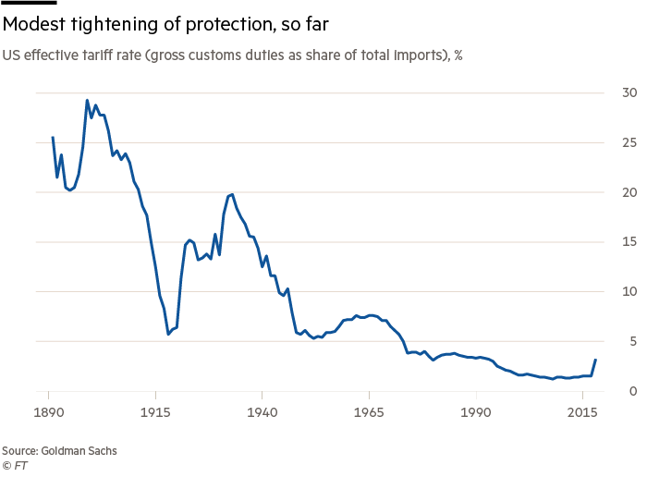
Free Trade and Protectionism

Slide 11
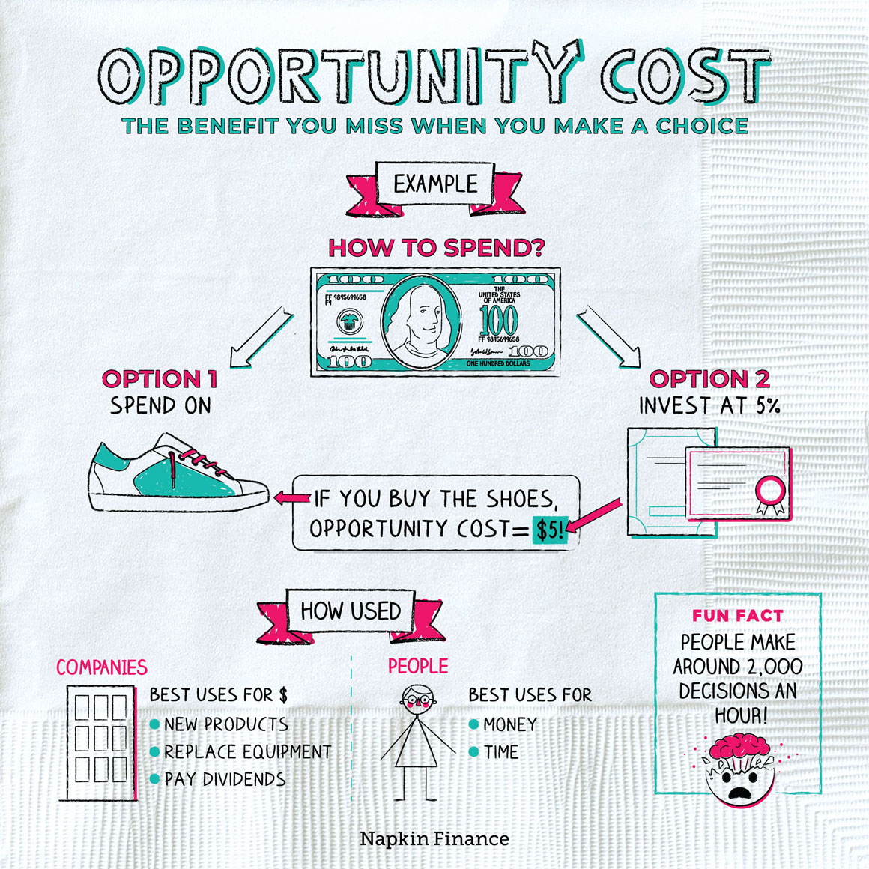
Opportunity Cost
“The benefit of the next best alternative forgone when making a decision”

Slide 12
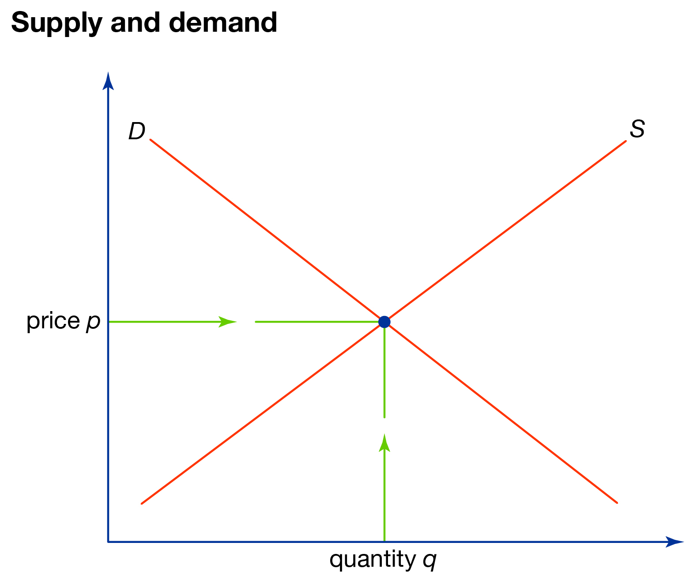
Supply and Demand

Slide 13
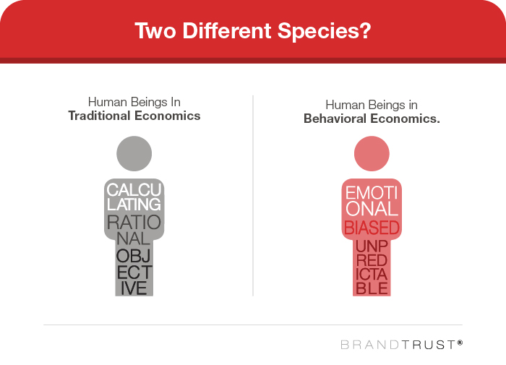
Rational Behaviour

Slide 14
Why does any of this matter?

Slide 15
Economics affects our daily life,
in most everything we do!

Slide 16
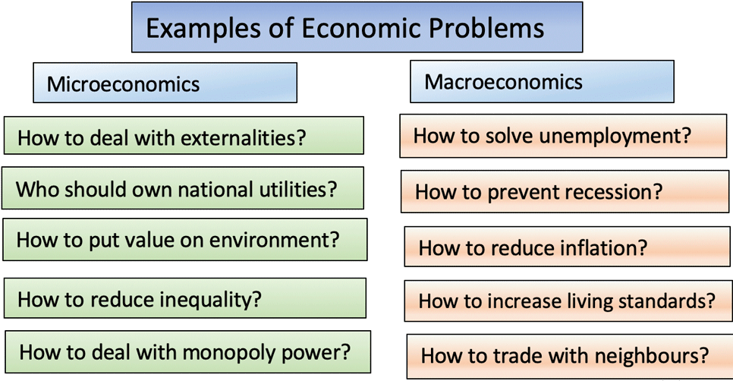

Slide 17
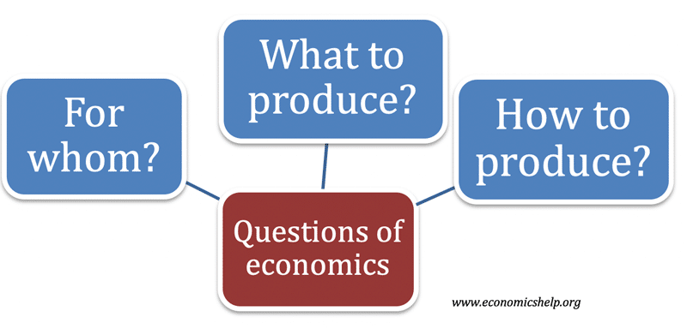

Slide 18
How do these ideas relate
to your daily life?
Specialisation/Division of Labour
Factors of Production
Resource Endowments
Global Inequality
Free Trade and Protectionism
Risk + Uncertainty
Opportunity Cost
Supply and Demand
Rational Behaviour
Market Power

