Slide 1

Economic Development in Dubai
A story of rapid growth and development
© Mark Johnson,
InThinking www.thinkib.net/Economics

Slide 2
The photographs included in this presentation were taken from the UK telegraph on October 9, 2014 at
http://www.telegraph.co.uk/travel/destinations

Slide 3
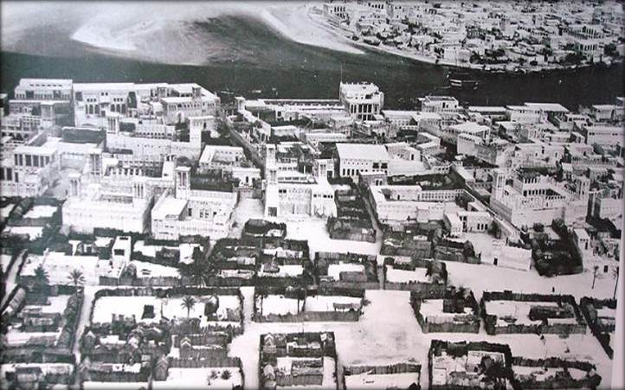
This photo was taken in the 1950s, before the discovery of oil. By Lizzie Porter Dubai city guide

Slide 4
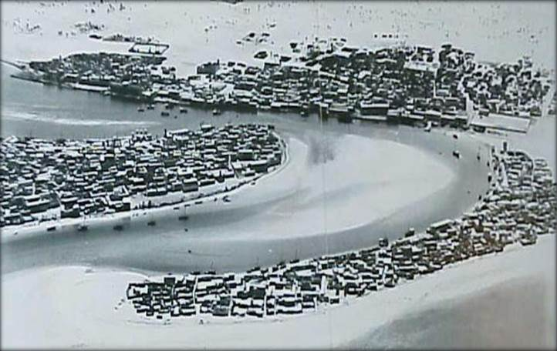
Another pre-oil photograph of Dubai

Slide 5
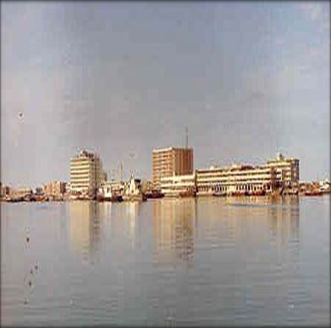
Oil was discovered in 1966 and rapid development took place

Slide 6
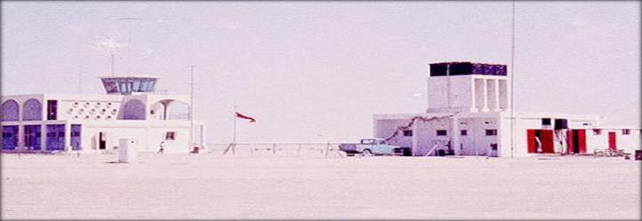
The airport was built in 1959 out of sand and asphalt

Slide 7
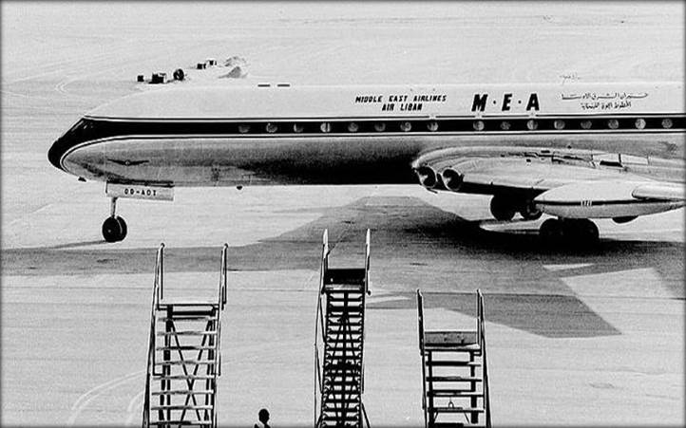
A new runway was added in 1965

Slide 8
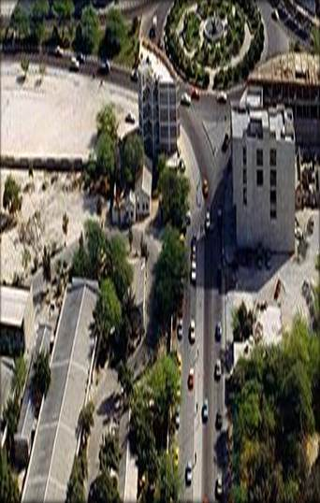
1980’s Dubai – a modern city is already beginning

Slide 9
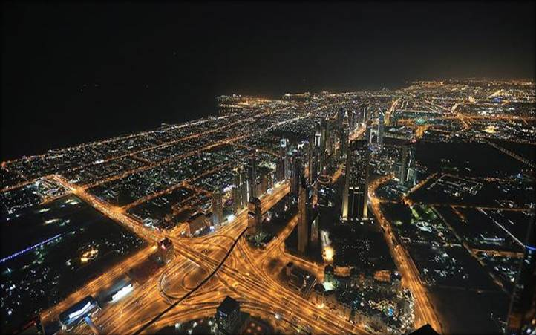
A modern Dubai

Slide 10
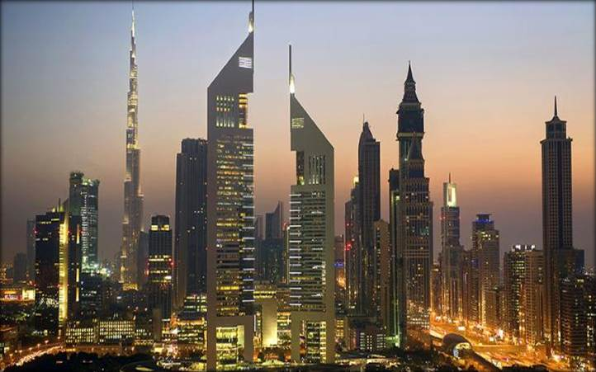
The Emirates towers complex was built in 2000

Slide 11
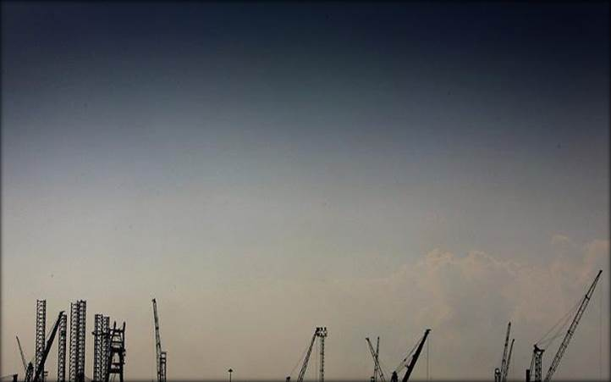
2006 and development is at full speed. The financial crisis slowed the rate of development in the city

Slide 12
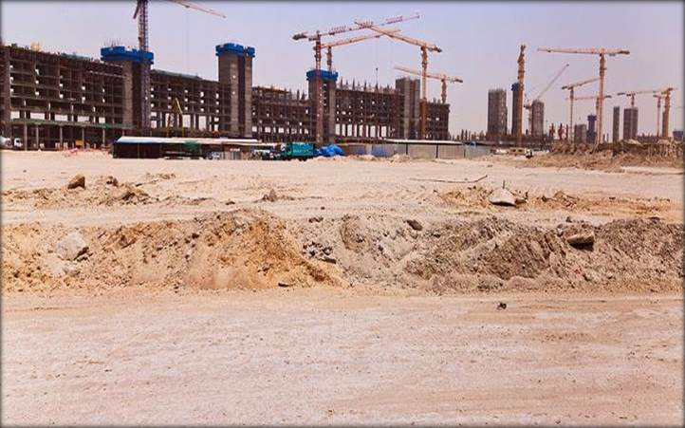
Following the financial crisis many new developments were halted

Slide 13
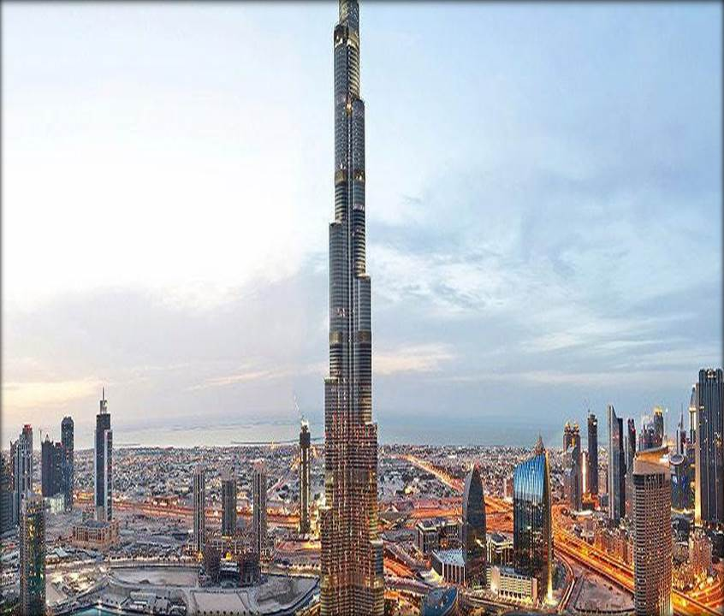
Development quickly picked up again after 2010

Slide 14
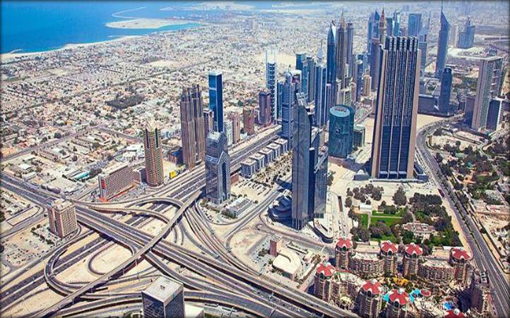
Dubai 2014

Slide 15
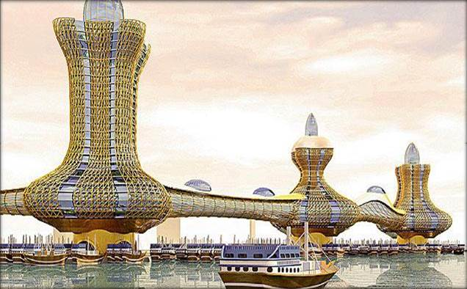
The Aladdin City

Slide 16
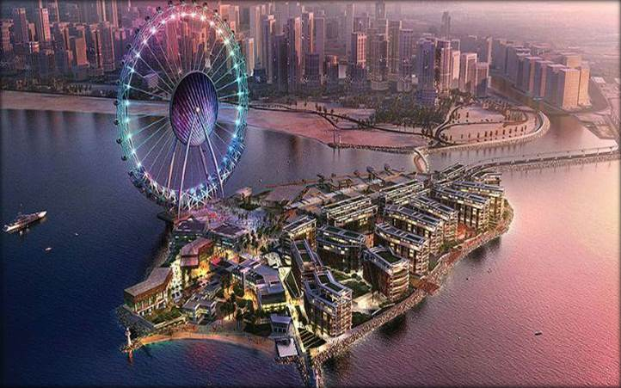
A very modern Dubai

Slide 17


