Slide 1
Non price determinants of demand
What else changes demand?
© Mark Johnson,
InThinking www.thinkib.net/Economics

Slide 2
Changes in demand not quantity demanded
The starting point for this short presentation is the realisation that price does not actually change demand, it merely changes the level of quantity demanded.
Look at the following definition of demand again and note the importance of the word capitalised.
The quantity of goods and services that consumers are willing and able to purchase at a time, at a GIVEN PRICE, ceteris parabus.
This means that when the price changes it is not the demand that changes but the given price. So following a fall in price I am still equally willing and able to purchase the good or service , at the same price, but now the price has changed.

Slide 3
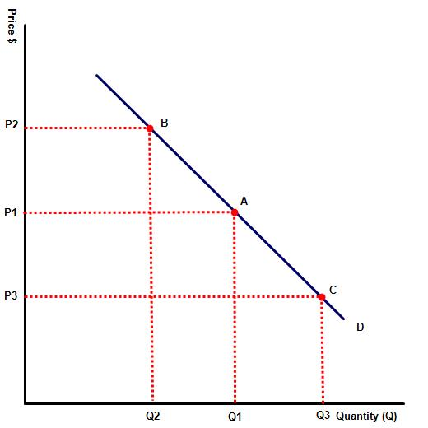
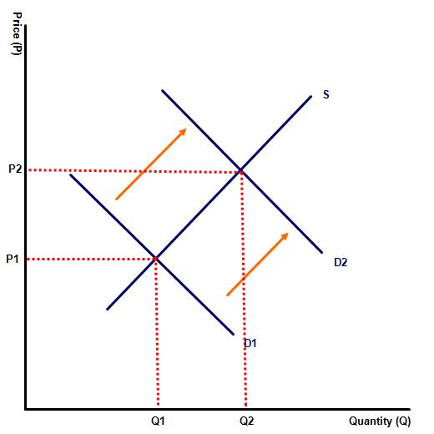
Compare the two diagrams
Change in quantity demanded
Change in the demand curve

Slide 4
The difference explained
The diagram on the right shows a movement along the demand curve, a change in quantity demanded but not a change in DEMAND. Price goes from P1 to P3 and more goods are consumed

Slide 5
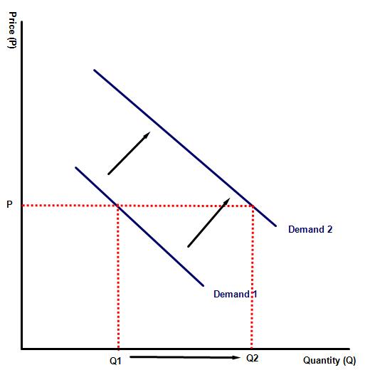
Shift in Demand
By contrast, this diagram shows an actual shift in demand. At the same price MORE of the good is consumed

Slide 6
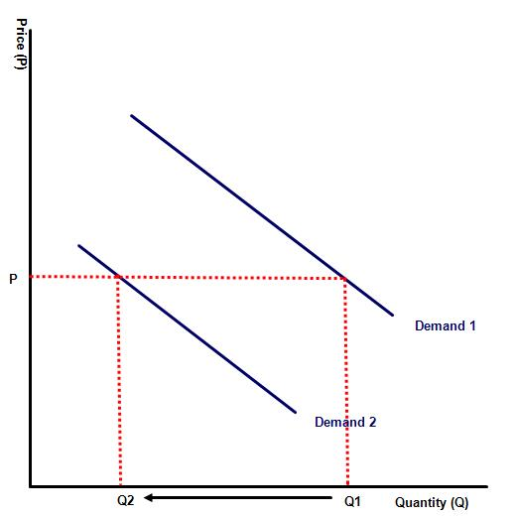
Shift in Demand continued
This time the diagram on the right shows a fall in demand. At every price less goods and services are demanded

Slide 7
So what factors cause the demand line to shift?
Changes in demand for a good or service can be influenced by any of the following:
A change in the popularity of the good or service
Seasonal changes
A change in population / demographic changes
Changes in the income distribution of the population
Changes in the popularity or price of a substitute good, such as coke and Pepsi
Changes in the popularity or price of a complimentary good such as golf club membership and golf equipment

Slide 8
Thank you for watching, it is now time to attempt the
questions attached to this exercise

