Slide 1
Price controls
Manipulating the equilibrium price
© Mark Johnson,
InThinking www.thinkib.net/Economics

Slide 2
Price floor
Price ceiling
This is a government set minimum price for a good or service that producers are not permitted to charge below. The minimum price will be set above the equilibrium price level
Where a government sets a maximum price, below the equilibrium price. This forms a price ceiling for the good or service

Slide 3
A comparison of minimum and maximum prices

Slide 4
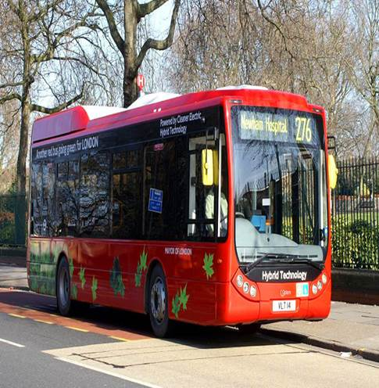
Many governments subsidise bus travel
Maximum prices are usually applied to basic necessities or merit goods which might otherwise be under supplied by the market. Examples include basic food stuffs, public transport and other essential services

Slide 5
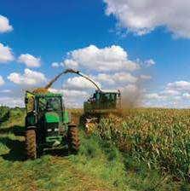
Minimum prices are applied to labour as well as agricultural products. They are designed to protect workers (minimum wage) as well as guarantee food supplies and farming incomes

Slide 6
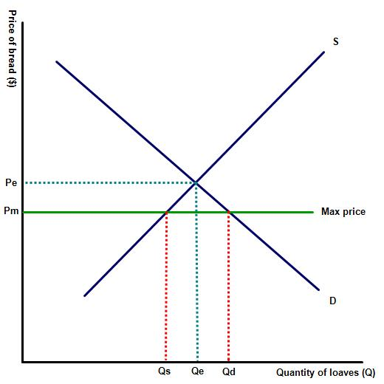
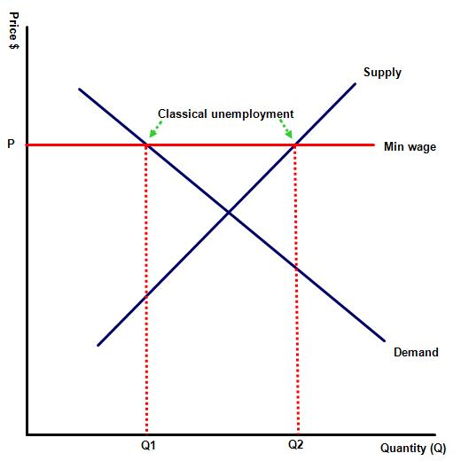
Both price ceilings and price floors will change the equilibrium point

Slide 7
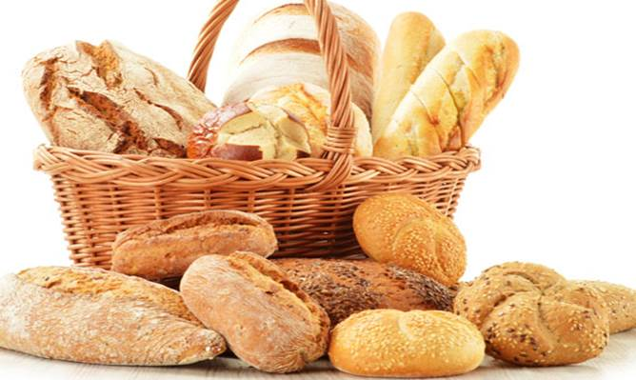
Student questions?
Which products in your country are subject to a maximum price?

Slide 8

Many nations impose a minimum wage on labour
Which products in your country are subject to a minimum price?

Slide 9
Outline the arguments for and against your government implementing price controls?
Thank you for watching

