Slide 1

Breakeven
What is the breakeven point?
© Mark Johnson,
InThinking www.thinkib.net/Economics

Slide 2

What is the Breakeven point?
This is equal to the level of output where total revenue equals total cost
or how many units must the firm sell to cover all their costs

Slide 3

How do we calculate the breakeven point?

Slide 4

How to calculate breakeven?
This is calculated by the formulae
FC / contribution
Where contribution is equal to selling price minus variable costs

Slide 5
Lets start with a simple break-even question:
A firm in one year has the following costs:
Fixed Costs of $ 500 000
raw material / supply costs per unit are $20 and the selling price is $30
In this simple example the contribution is $ 10 because every time the business sells one unit they make $ 10 gross profit, which goes towards covering their fixed costs of $ 200 000

Slide 6
The question then becomes how many $ 10 would the company need to cover all of their fixed costs?

Slide 7
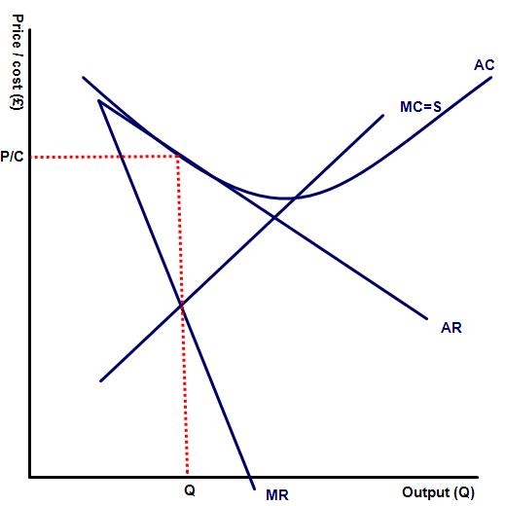
How to draw a breakeven chart
The breakeven chart consists of the average revenue curve and the average cost curves.
Where the average cost and average revenue lines meet is the BE point.

Slide 8
Thank you for watching

