Slide 1
What is an oligopoly?
© Mark Johnson,
InThinking www.thinkib.net/Economics

Slide 2
Characteristics of an oligopoly?
Oligopolies are industries defined by just a small number of dominant firms, perhaps 2 – 8. This means that oligopolies have a high concentration ratio. In other words the largest 4 firms in the industry enjoy a very large market share
Examples include:

Slide 3
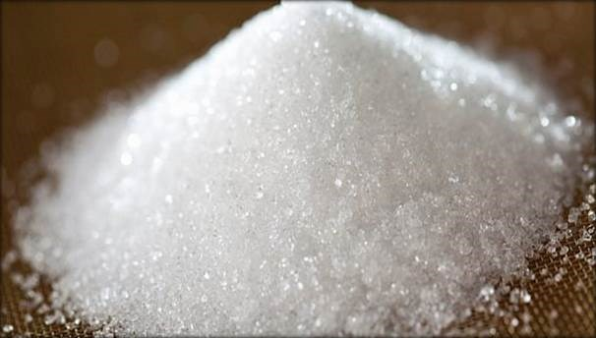
Sugar concentration ratio 99%

Slide 4

Tobacco products concentration ratio 99%

Slide 5

Gas distribution concentration ratio 82%

Slide 6

Confectionery concentration ratio 81%

Slide 7
Characteristics of an oligopoly?
Interdependence of firms – this means that firms must consider the actions of their competitors when making price and output decisions
Barriers to entry and exit – this means that the industry is difficult to enter due to high start up costs and strong brand loyalty. High start up costs also make leaving the industry difficult

Slide 8
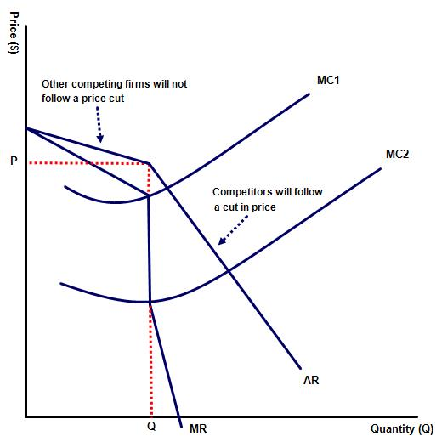
Sticky prices
Firms in oligopoly are generally associated with sticky prices, making price competition between businesses in oligopolies difficult.

Slide 9
Why are prices sticky?
This can be explained by the interdependence of firms. Suppose there are 5 petrol stations in a town. Should one station independently decide to raise their prices then they will quickly lose market share as the other firms keep their prices unchanged

Slide 10


Slide 11
By contrast when the petrol station then lowers prices we presume that the competing firms will also reduce their prices, for fear of losing market share. The net effect, therefore, will be a small rise in quantity sold only and lower profits made
The result is that oligopolies will be reluctant to change their prices for fear of losing revenue – unless forced to do so by a change in external conditions such as a rise in raw material prices

Slide 12
So how do firms act in oligopoly?
Faced with limited ability to compete on price they are more likely to employ non-price competitive measures including improved customer service
Alternatively they may decide to collude and work together

Slide 13
Colluding
Firms may decide to collude by agreeing to set the same price
They may also decide collectively to restrict supply so that prices are forced up
Or they may decide to reduce marketing or research spending to cut costs

Slide 14

More information on collusion can be gained by studying game theory, developed by John Nash

