Slide 1
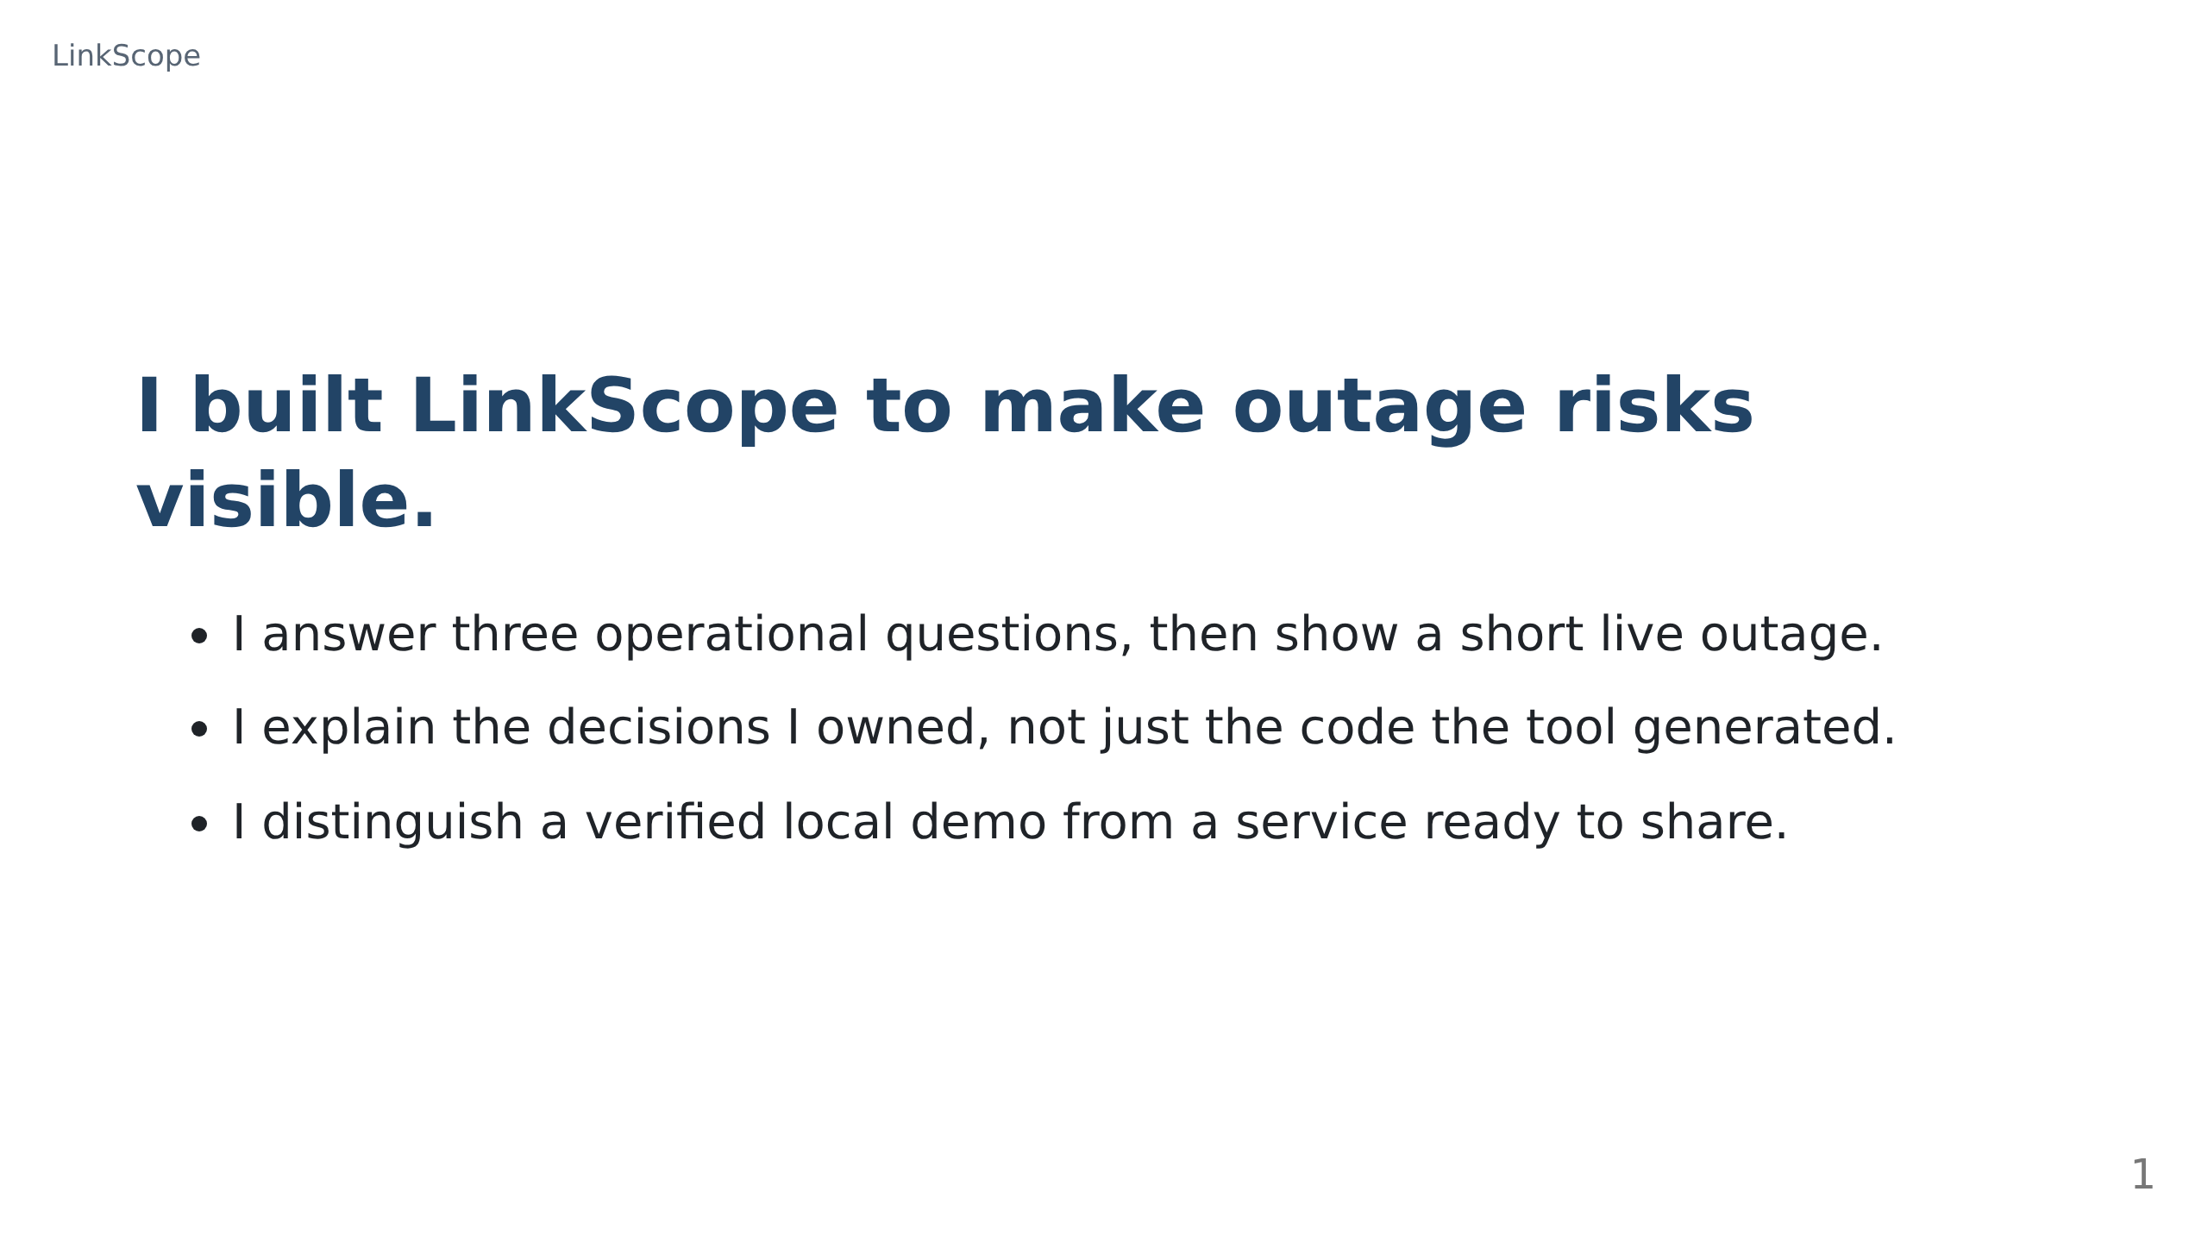
Notes:
LinkScope panel presentation (Marp Markdown). About 10 slides for a 15-minute
slot that includes a live demo. Export PDF and PPTX with:
docs/slideshow/regenerate-presentation.sh
Export needs a local Chrome, Chromium, or Edge.
I will spend about 15 minutes on this presentation, including the live demonstration, leaving the implementation and full history for questions.
My focus is engineering judgment: choosing scope, steering the tool, checking its work, and owning the remaining risks.

Slide 2
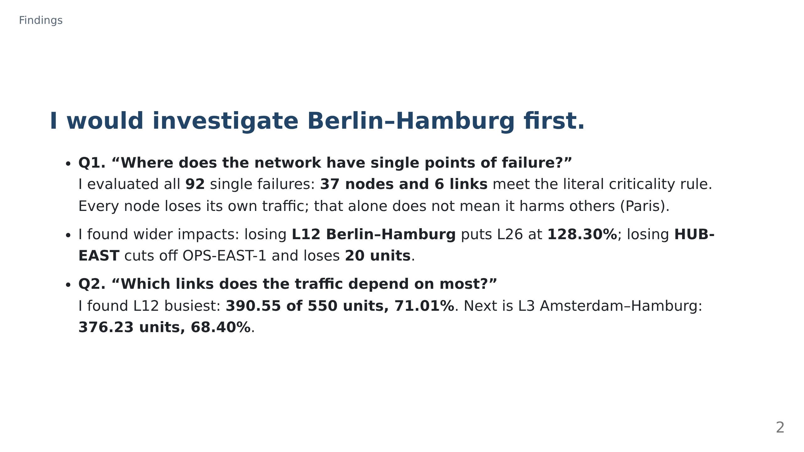
Notes:
The remaining baseline top five are L26 Frankfurt–Munich at 341.69 units and 62.13%, L30 Milan–Munich at 323.48 units and 58.81%, and L13 Berlin–Munich at 278.46 units and 50.63%; each has capacity 550.
The six critical links are L12, L26, the single access links from OPS-WEST to Dublin, OPS-SOUTHEAST to Athens, OPS-EAST-1 to HUB-EAST, and HUB-EAST to Warsaw; losing L26 puts L12 at 112.36%.
Hamburg and Berlin failures put L26 at 117.06% and 113.30%; Athens and Dublin each cut off a site with 20 units, while Warsaw loses 20 units even though OPS-EAST-2 remains physically connected because it cannot relay.
Every other node failure loses only its own traffic, so I distinguish that from harm to other demands rather than treating all critical labels as equally actionable.

Slide 3
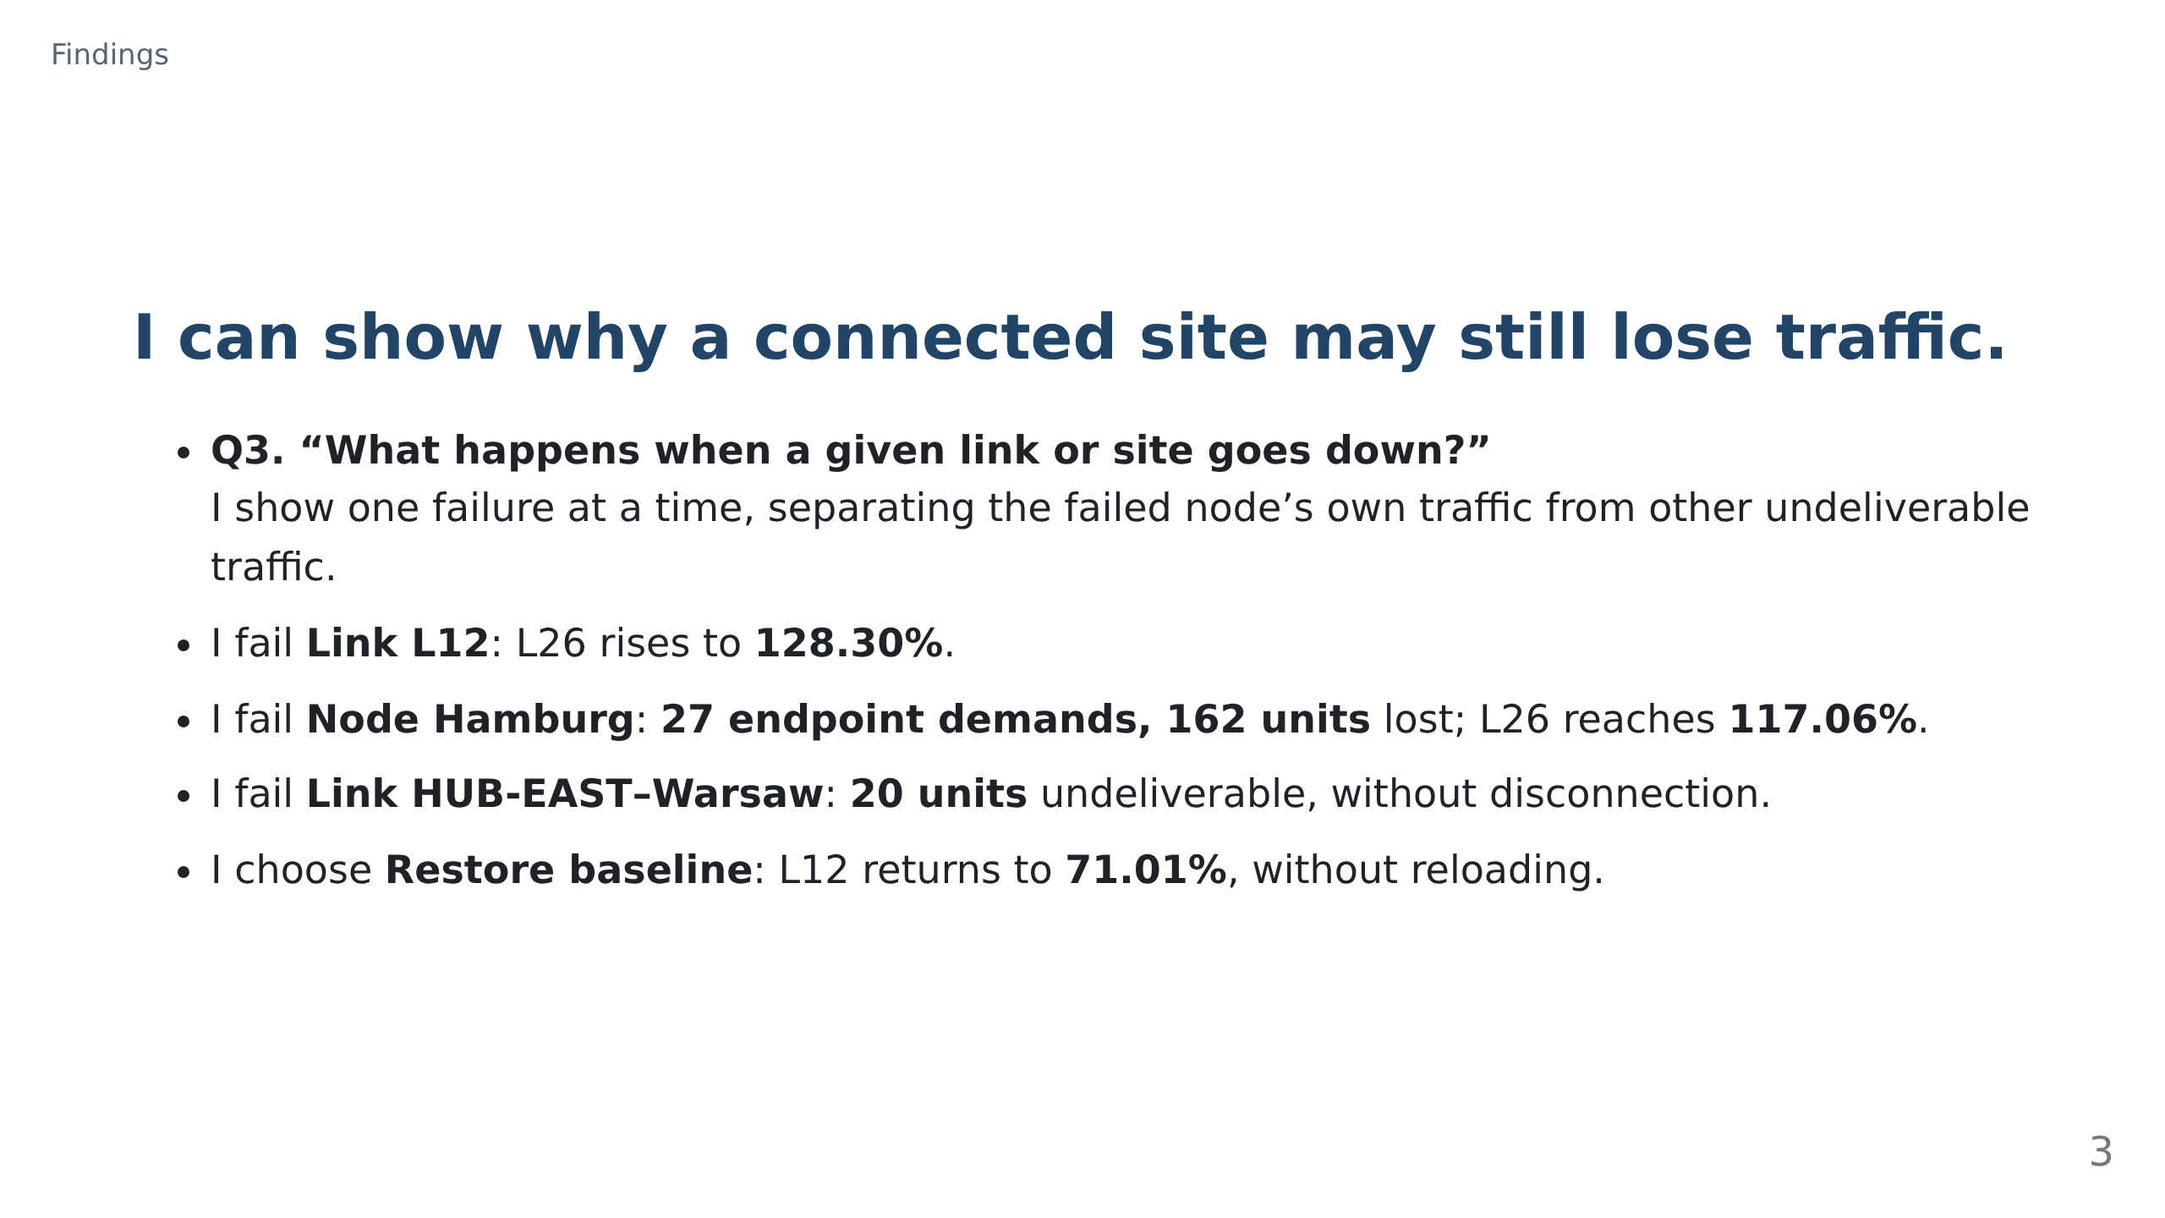
Notes:
Before presenting, I run `docker compose up -d` and open http://localhost:2158; I keep this demonstration to about two minutes.
I choose Link in the Node/Link selector, choose L12 in the Element selector, click Fail selected, and point to L26 at 128.30%.
I choose Node, select Hamburg in the Element selector, click Fail selected, and read the separate endpoint loss and overload figures; then I choose Link, select HUB-EAST–Warsaw, and click Fail selected to show loss without disconnection.
I click Restore baseline and point to L12 at 71.01%, explaining that a physically connected operations site cannot forward other traffic.

Slide 4
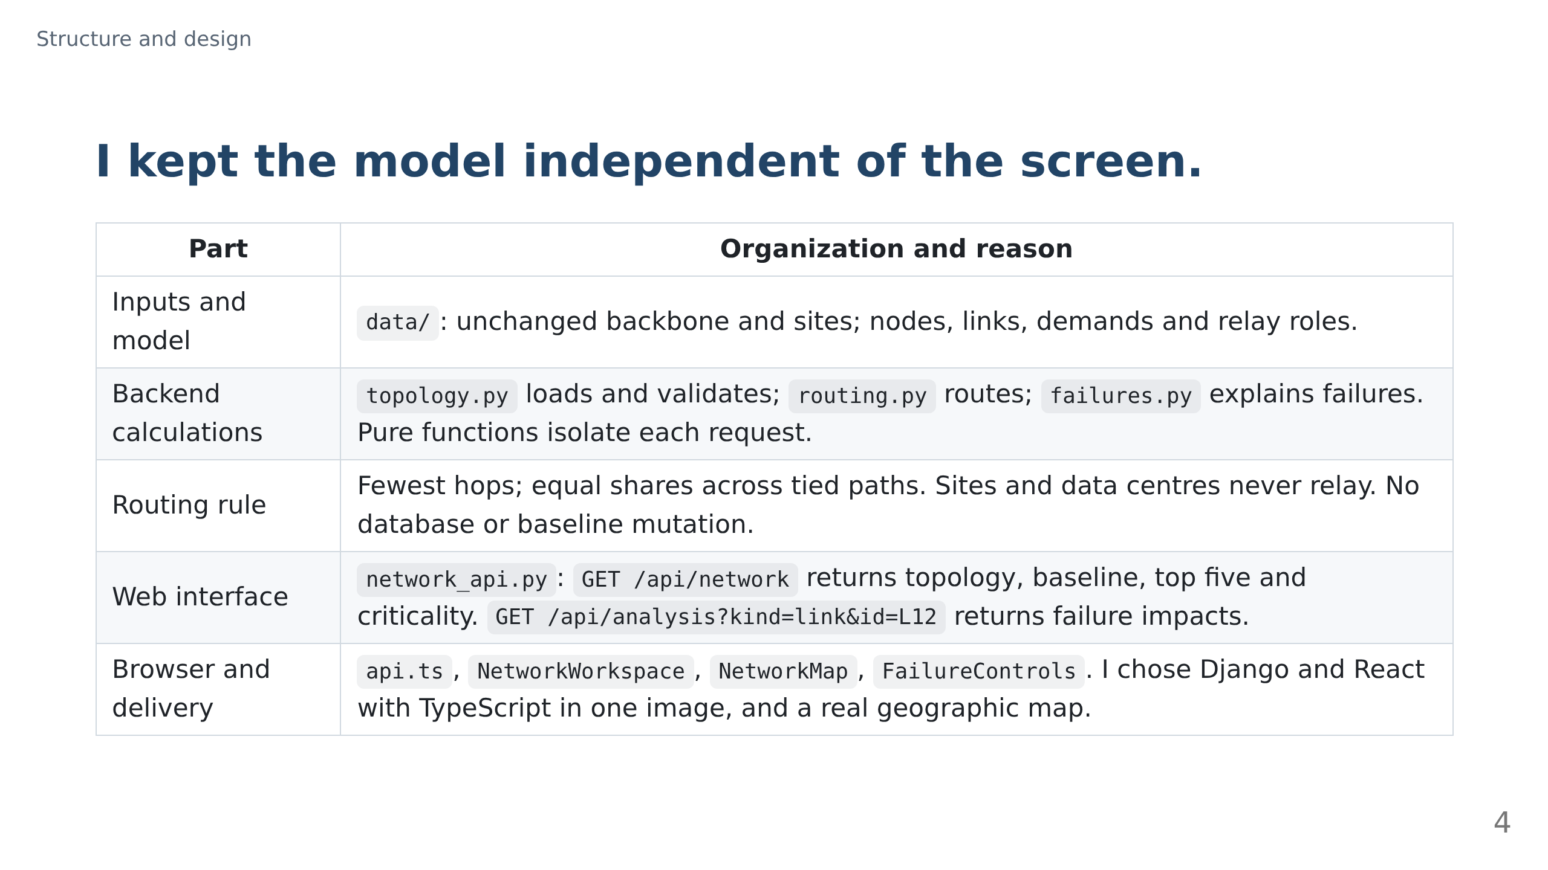
Notes:
The merged model has 37 nodes, 55 links, 391 demands and 2,068 units, matching the brief; the source backbone has 28 nodes, 41 links and 378 demands, with 14 access links added.
The analysis interface also accepts kind=node and separates undeliverable demands, failed endpoint demands, disconnection and overload; Gunicorn serves the React page and the interface from the same origin, keeping startup to one command.
I chose the stack, single image, Leaflet with OpenStreetMap, friendly public errors and restoration of the validated baseline; I accepted the tool’s equal-split path-counting algorithm, test fixtures and stale-response guards after review: confirm this split before presenting.
The boundaries let me test network rules without a browser, while per-request calculations avoid one user’s simulation changing another’s baseline.

Slide 5
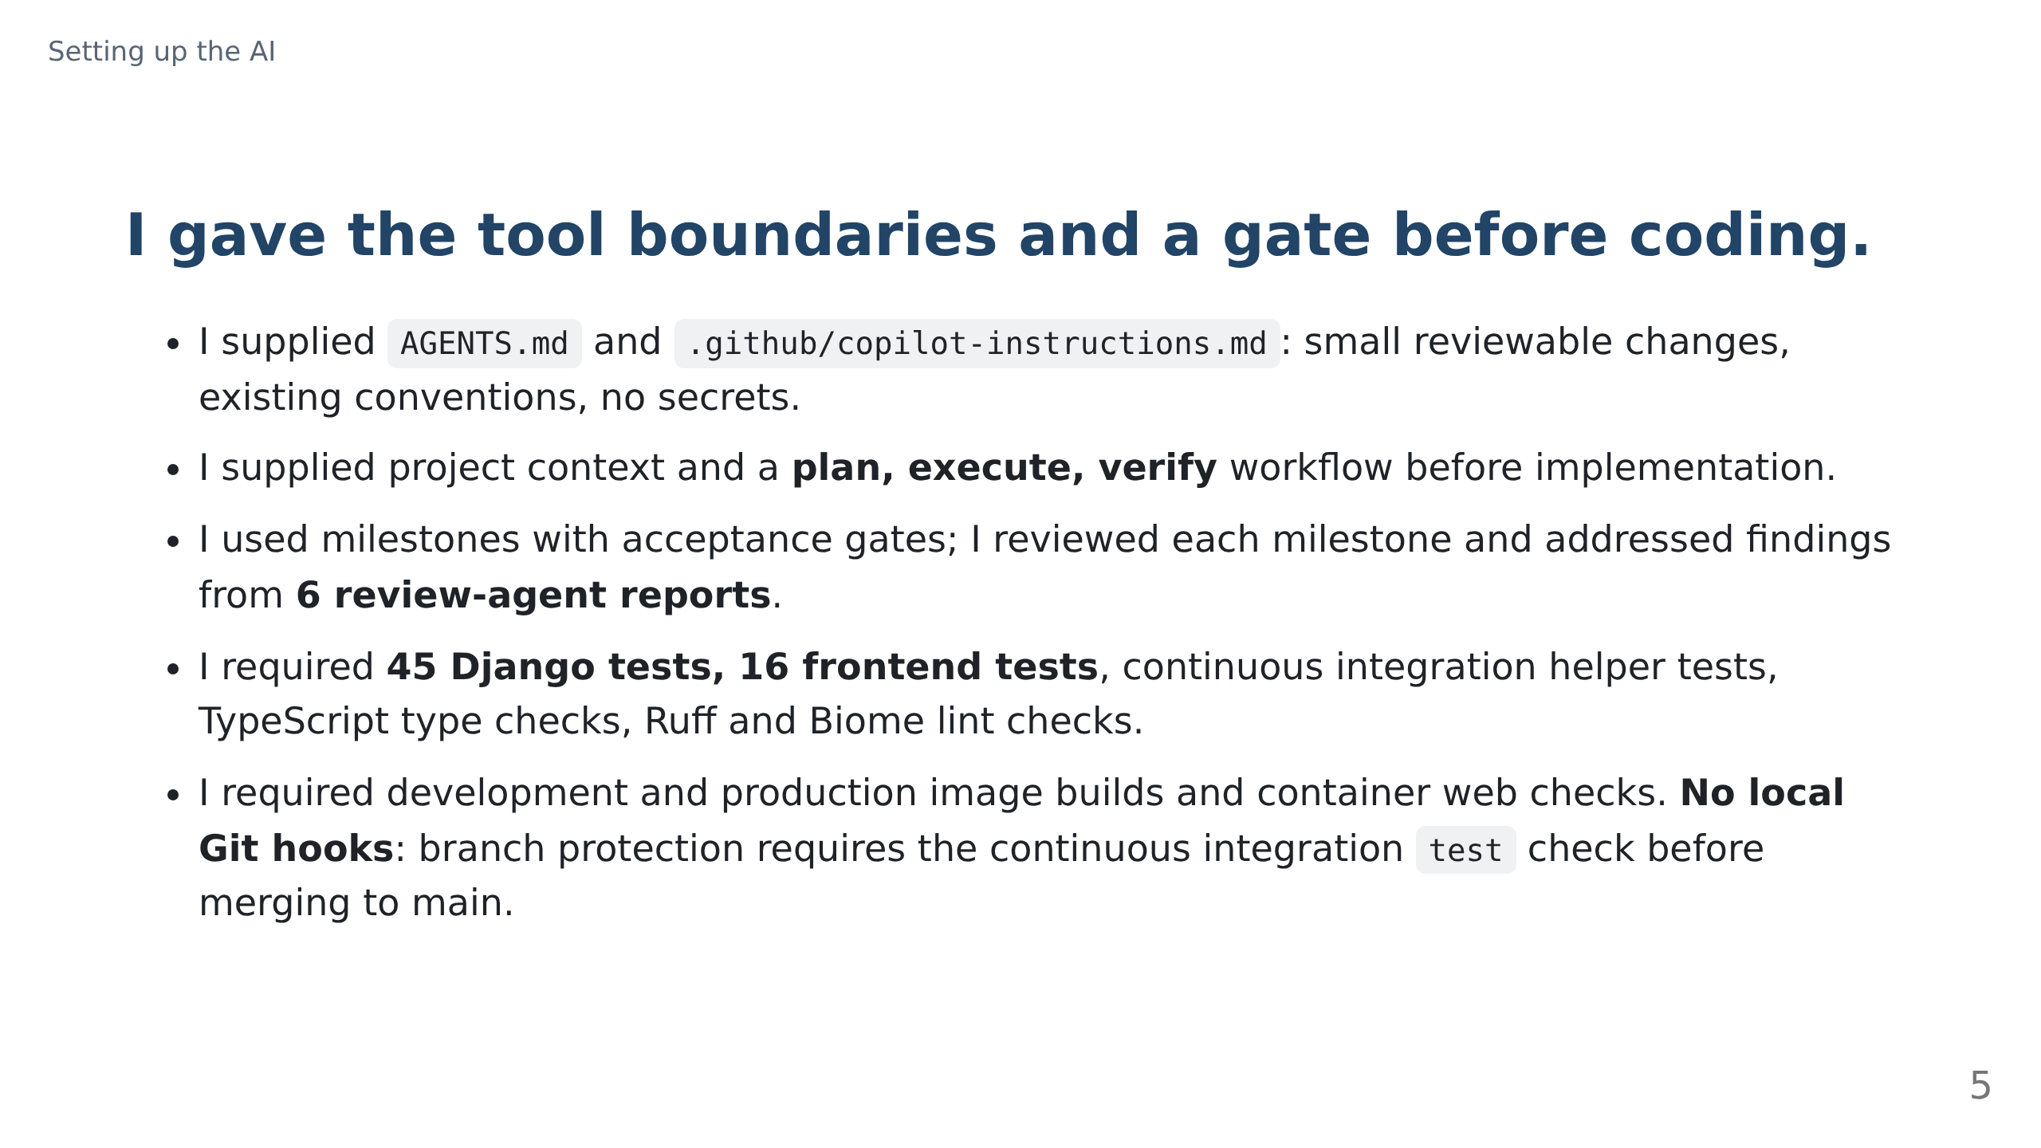
Notes:
The context and workflow live in .github/project-context.md and .github/workflow-orchestration.md, with milestone gates in .github/tasks/todo.md.
The review agent is defined in .github/agents/Review.agent.md and its six reports are in .github/review/; automated review supported, rather than replaced, my milestone reviews.
TypeScript uses tsc, Ruff checks Python lint and formatting, and Biome checks TypeScript; I accepted this tooling and the image smoke-test scripts after review, but confirm this attribution before presenting.
The enforced merge gate is branch protection, not an invented local hook or a promise that every tool suggestion is correct.

Slide 6
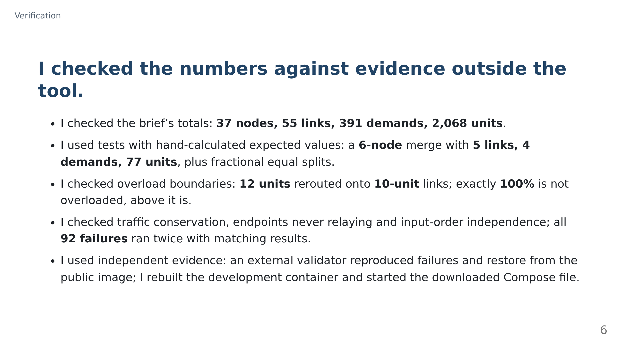
Notes:
The acceptance totals come from the brief, while the small-network expectations come from arithmetic rather than generated real-network snapshots.
The external validator pulled the image anonymously and reproduced L12, Hamburg, Warsaw, Dublin and restore in a browser; my separate startup check used docker compose up -d.
I must confirm which of these I specified before presenting; I am not claiming personal authorship of every test.
These checks support the stated routing model, not a claim that fewest-hop routing predicts every real network’s behaviour.

Slide 7
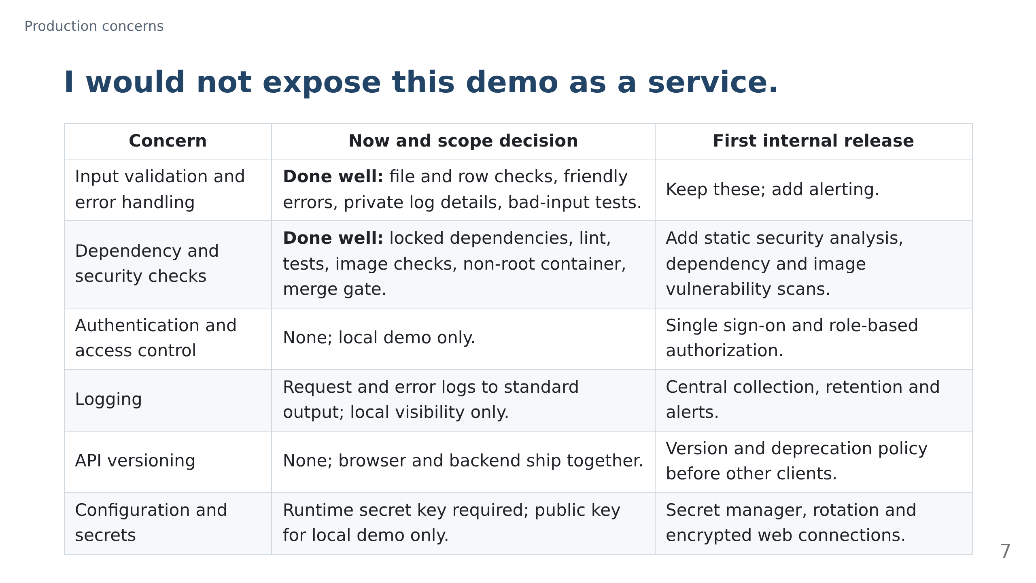
Notes:
I concentrated on rejecting bad data safely and making the build repeatable, rather than claiming six production concerns were fully solved.
The security foundation is useful but incomplete: lint and image smoke tests are not vulnerability scanning, and a non-root container is not access control.
The remaining controls were deferred for this local demonstration; shared access, external clients and retained operational evidence change those requirements.
I would require identity, private runtime secrets and encrypted connections before sharing the service, then centralize logs and add the listed security checks.

Slide 8
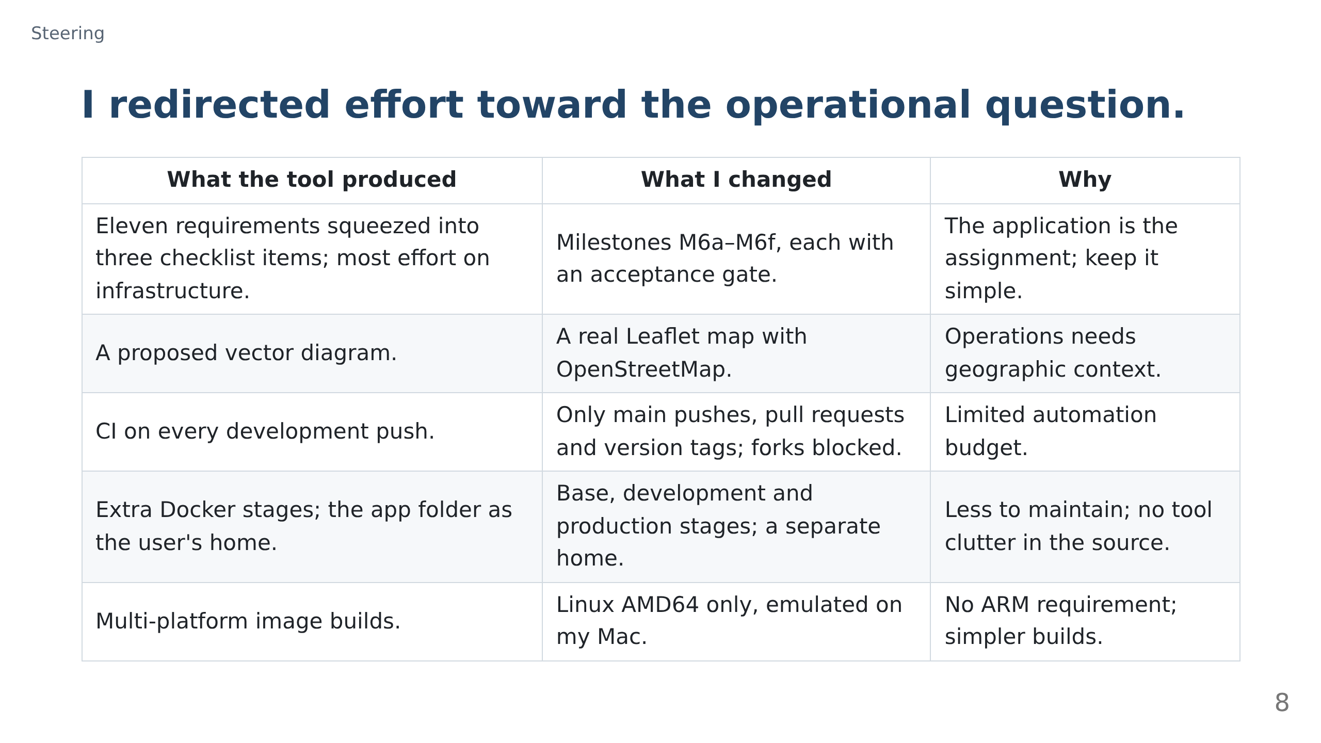
Notes:
These are interventions where I changed the tool’s direction, not a list of features it generated.
The milestone split restored attention to input validation, routing, failure analysis and the usable screen instead of letting container work dominate.
The budget and platform decisions have costs: fork contributions cannot use that pipeline, and my Mac needs emulation.
I can discuss those trade-offs against the full commit history rather than presenting them as universal best practices.

Slide 9
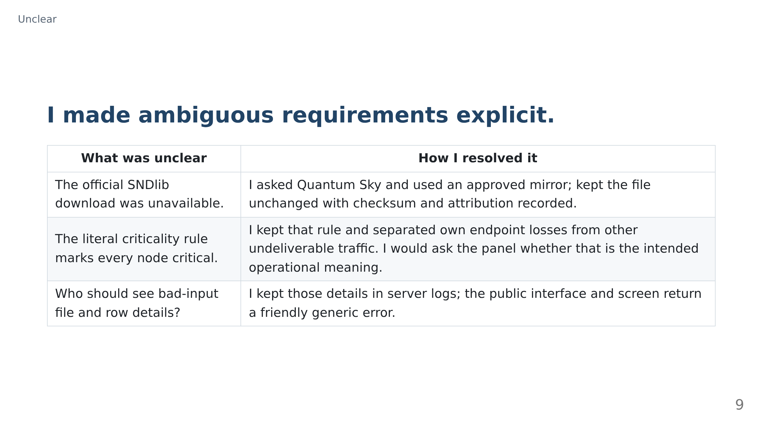
Notes:
The approved mirror resolved a blocked dependency without silently substituting invented data.
For criticality I preserved the acceptance rule, but made the impact categories useful for an operator instead of quietly redefining the requirement.
For errors I treated file and row diagnostics as operator information; I would make that interpretation explicit because the brief asks for those details without naming the audience.

Slide 10
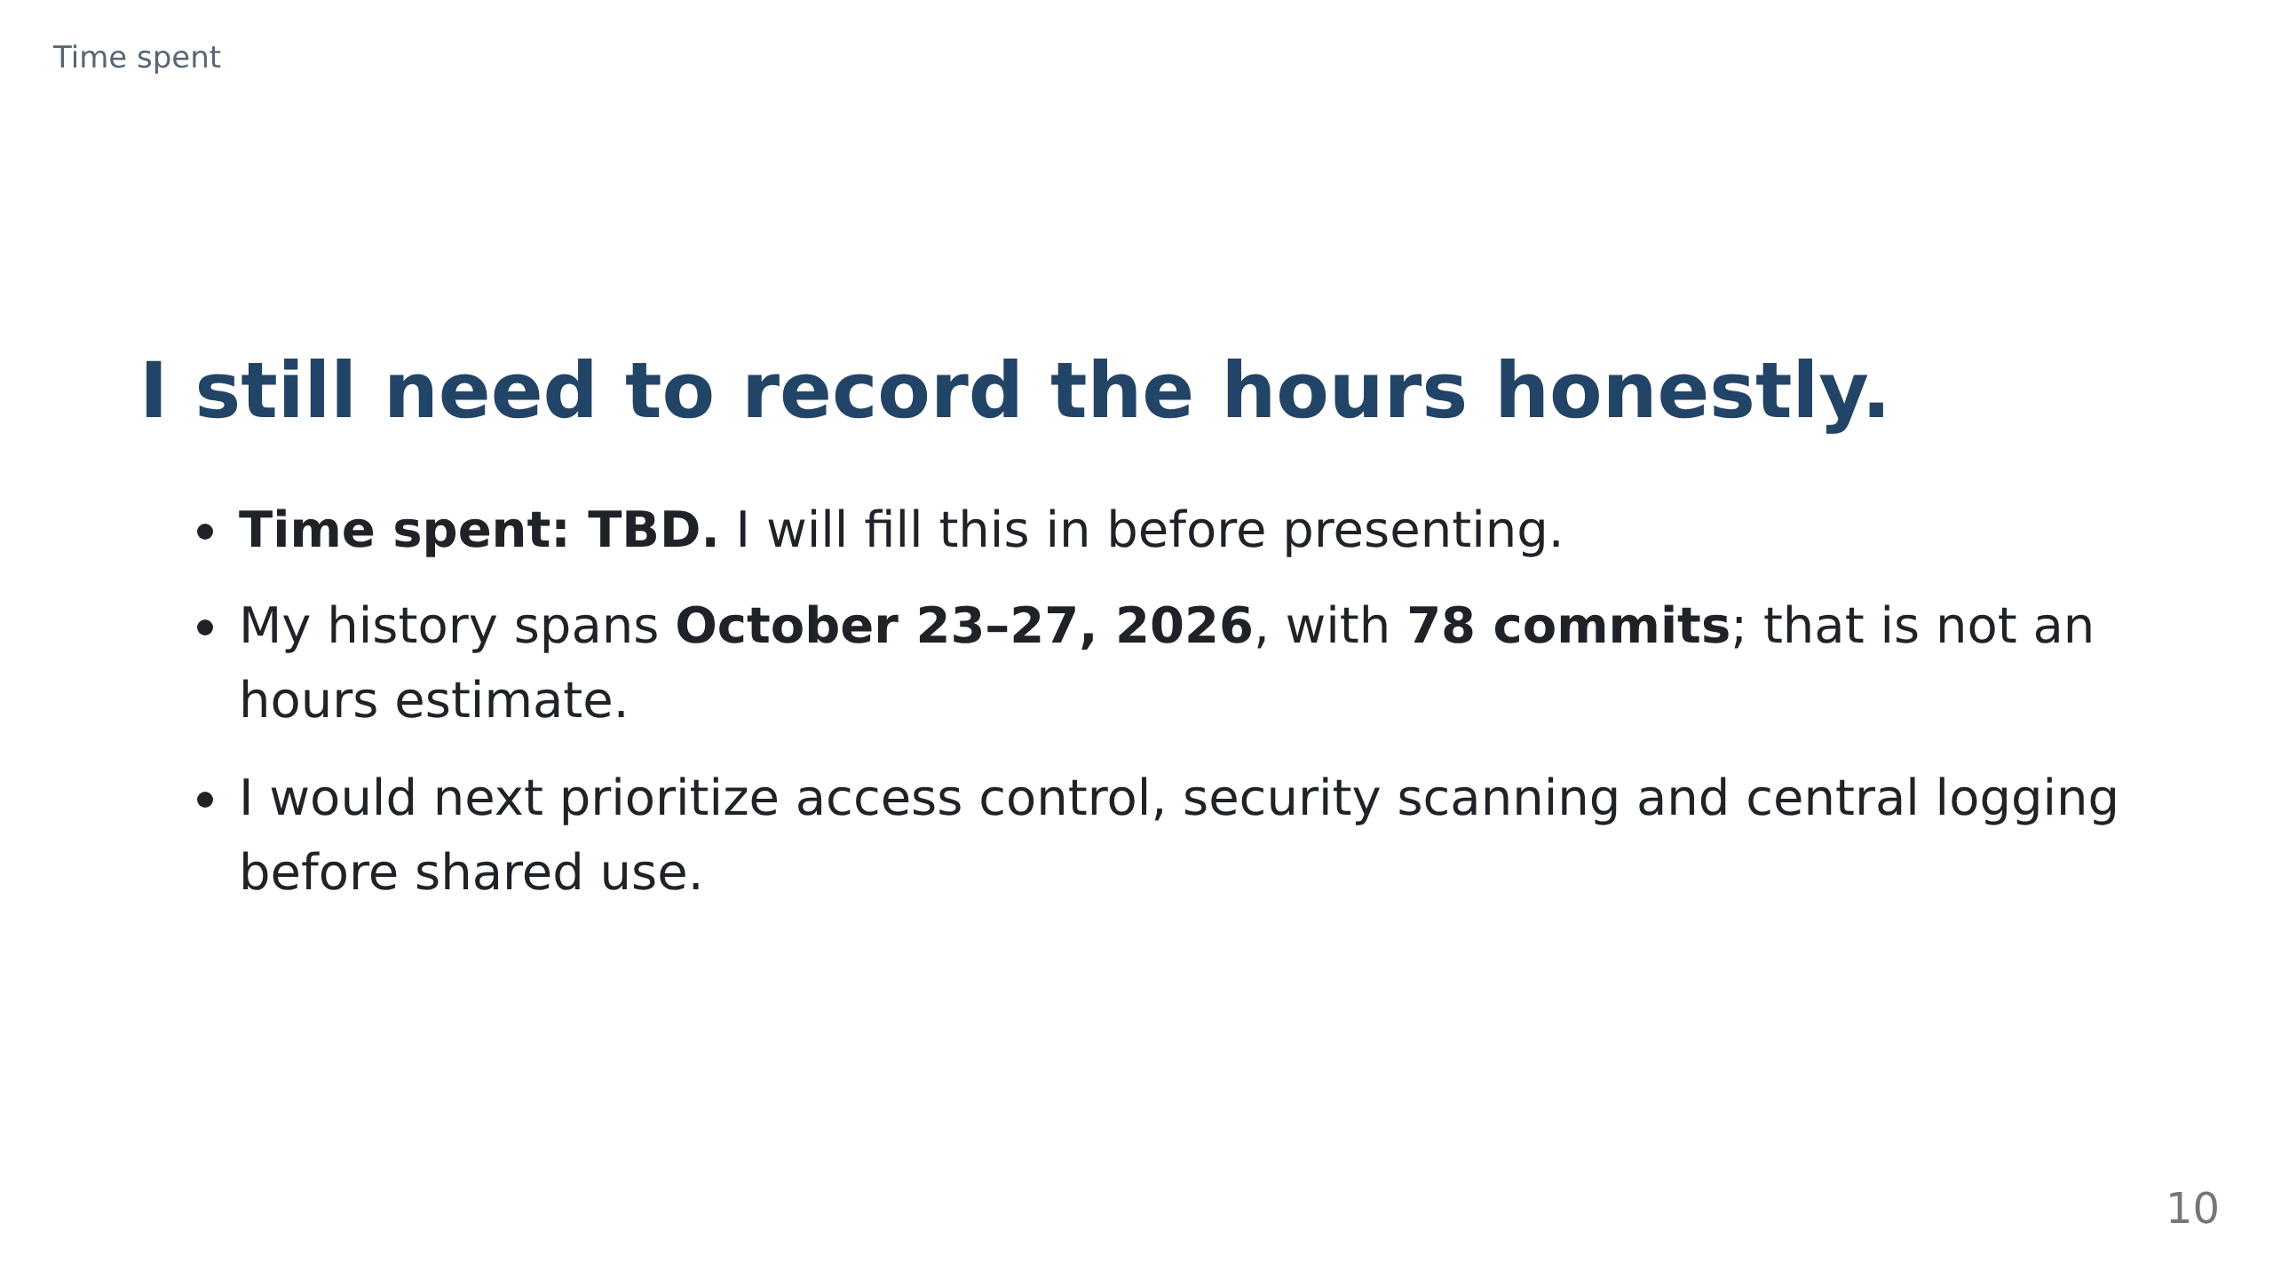
Notes:
I have not recorded a defensible total yet, so I will not convert elapsed dates or commit counts into working hours.
I will replace TBD with my actual time record before the panel session.
I will stop here for questions about the results, decisions and full git history.

