Slide 1
FamilyFeud
On Your Terminal

Slide 2
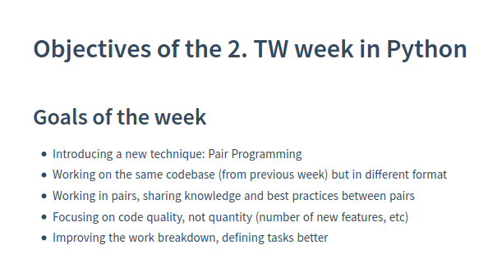
Goals for the week

Slide 3
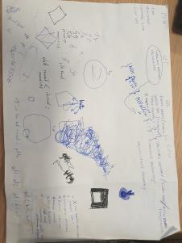
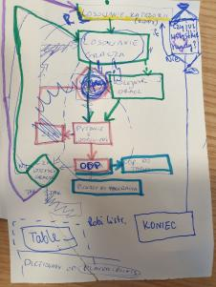
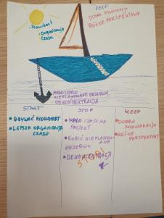
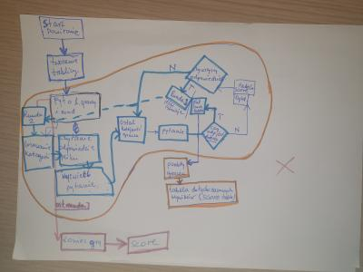
Our Personal Goals

Slide 4
What did we do
Work schedule
Flowchart(s)
Cleaning code
Round LOOP
Score board
Presentation
Category randomizer
GIT
Player’s points
Cleaning code
Beautification
Preparing presentation

Slide 5
Our Project
Family Feud

Slide 6
What Have We Learned
We know the value of writing clean code
We organize better our teamwork
We are getting better at “charting the flow”
We are “gitting” better
We know Python even better

