Slide 1
RRC
Radio Admission Control Algorithm
  Priority GBR Based
    Pros
      High priority GBR requests are granted first
      In contention situation, higher priority E-utran Radio Access Bearer (ERABs) can pre-empt lower priority ones
    Cons
      Pre-emption would lead to release of lower priority ERABs

Slide 2
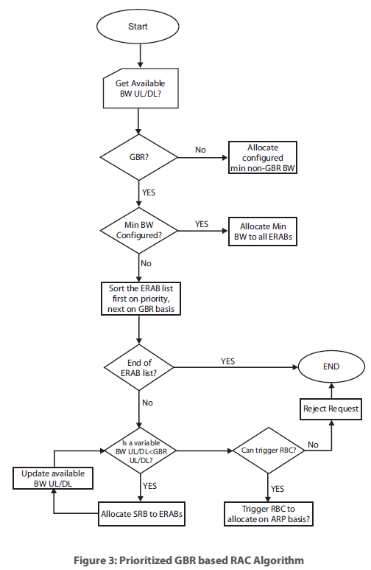
  Priority GBR Based RAC Algorithm
?
Is available BW UL/DL > GBR UL/DL?
DRB?

