Slide 1
CuSum method to assess technical proficiency

Slide 2



CuSum = accumulated sum.
You EARN points when you FAIL
You start with 0 points.
You LOOSE points when you SUCCEED
Successive procedures

Slide 3
CuSum = accumulated sum.
There are limits!
H1:…too bad! Needs correction
H0:…you learned your stuff!
FAIL
SUCCEED
H1
H0

Slide 4
1.0 0.9 0.8 0.7 0.6 0.5 0.4 0.3 0.2 0.1
CuSum = accumulated sum.
There are limits!
H1:…Needs correction
H0:…you learned!
H1, H0 and points that add or rest based on:
Acceptable failure rate (p0)
Unacceptable failure rate (p1)
Type I(alpha) and type II (beta) errors
Rate
Unacceptable failure
Acceptable failure
Beginner
Advanced

Slide 5
CuSum = accumulated sum.
H1, H0 and points (add or subtract) based on:
Acceptable failure rate (p0)
Unacceptable failure rate (p1)
Type I(alpha) and type II (beta) errors
Variable |  | Formula | Value
Acceptable failure rate (p0) |  |  | 0,4
Non acceptable failure rate(p1) |  |  | 0,5
Error alpha |  |  | 0,1
Error beta |  |  | 0,1
Decision line h0 |  | "-b/(P+Q)" | -2,593213886
Decision line h1 |  | "a/(P+Q)" | 2,593213886
Success rests s = |  | Q/(P+Q) | 0,397112105
Failure adds (1- s) = |  |  | 0,602887895
a= |  | Ln[(1-beta)/alfa] | 2,197224577
b= |  | Ln[(1-alpha)/beta] | 2,197224577
P= |  | Ln (p1/p0) | 0,510825624
Q= |  | Ln [(1-p0)/(1-p1)] | 0,336472237

Slide 6
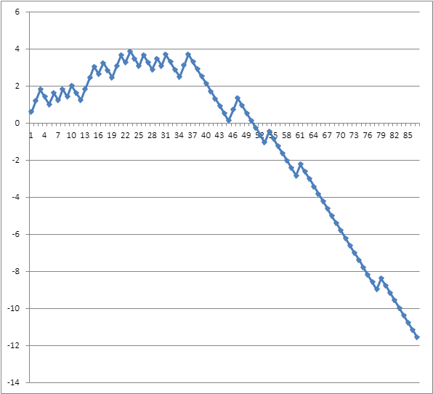
Effective coaching
Variable |  | Formula | Value
Acceptable failure rate (p0) |  |  | 0,4
Non acceptable failure rate(p1) |  |  | 0,5
Error alpha |  |  | 0,1
Error beta |  |  | 0,1
Decision line h0 |  | "-b/(P+Q)" | -2,593213886
Decision line h1 |  | "a/(P+Q)" | 2,593213886
Success rests s = |  | Q/(P+Q) | 0,397112105
Failure adds (1- s) = |  |  | 0,602887895
a= |  | Ln[(1-beta)/alfa] | 2,197224577
b= |  | Ln[(1-alpha)/beta] | 2,197224577
P= |  | Ln (p1/p0) | 0,510825624
Q= |  | Ln [(1-p0)/(1-p1)] | 0,336472237
Everyone said…
”take it easy, it takes just time…”

Slide 7
Am I still proficient? How CuSum can help the experienced practitioner
You EARN points when you FAIL
You start with 0 points.
No need to substract points after reaching an advanced competence level
1. Ooops, my mother got cancer…
H1
3. I already know there is a problem
No point in keeping adding points.
Back to zero and implement correcting actions.
2. Well…my performance has really worsened…time to call for help / think about it…

Slide 8
1.0 0.9 0.8 0.7 0.6 0.5 0.4 0.3 0.2 0.1
CuSum. Pitfalls
Deciding acceptable (p0) and unacceptable (p1) failure rate
Possible solution:
p0, p1 = 95% C.I. of mean failure rate… …sorted by years of experience
Example:
If …
failure rate for tracheal (beginner) experience = 40% (*)
then …
95CI = 0.5 (p0) – 0.7 (p1)
(*) hypothetical data that could be extracted from Logeze.
Rate
Unacceptable failure
Acceptable failure
Beginner
Intermediate
Advanced

Slide 9
References
Biau DJ et al. British J Surgery 2008; 95: 925-929

