Slide 1
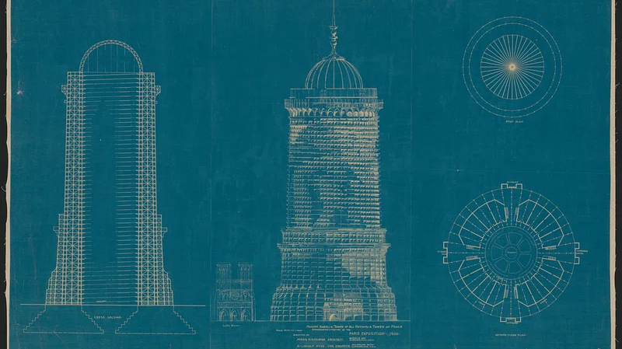
The Tower of Babel Effect: AI Underspheres, Creative Remix, and the Politics of Regulation across Singapore, Vietnam, and Australia
rawpixel.com / Library of Congress
Dr Milica Stilinovic, Associate Professor Jonathon Hutchinson, Dr Francesco Bailo

Slide 2
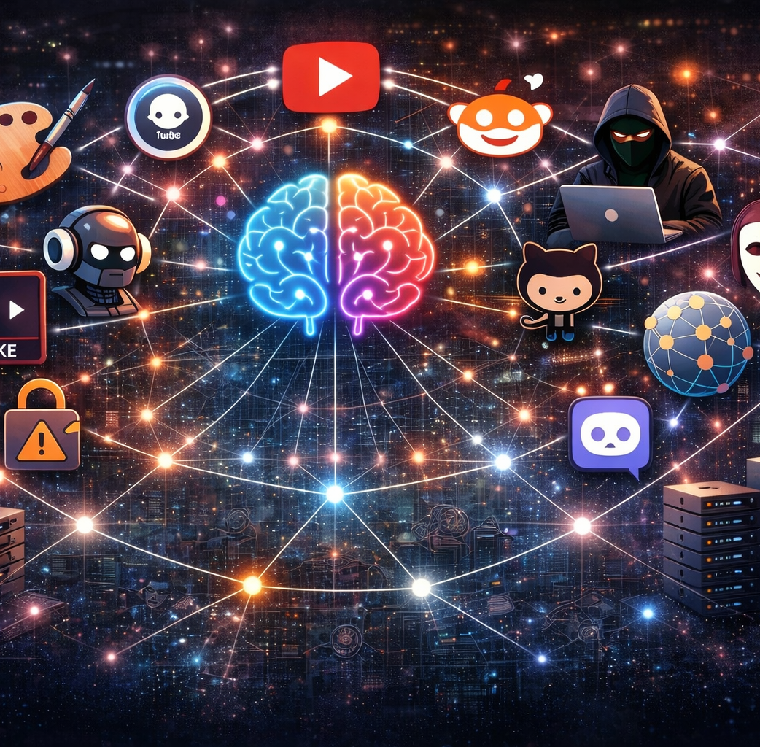
Underspheres 1.0
Underspheres: decentralised, global online “communities” where users collaboratively experiment with and remix generative AI systems. Importantly, apolitical.
Creative Practice: users actively adapt, modify, and redistribute AI models, driving new forms of digital creativity beyond intended uses (governance threat)
Risks: decentralised remixing enables potentially harmful outputs (e.g. deepfakes), develops risks to foundations of democratic practice (governance loophole).
Policy Gap: current AI governance focused on formal applications (eg. EU AI Act), failing to address informal, user-driven and experimental AI practices
Stilinovic, M., Bailo, F., & Hutchinson, J. (2025). Creative Underspheres and democratic challenges: Exploring the implications of generative AI misuse. New Media & Society. https://doi.org/10.1177/14614448251338511

Slide 3
Is the tower of Babel Emerging in AI policymaking?
TOWER OF BABEL
One language → many languages
Breakdown in understanding
POLICYMAKING
Global technology → local governance
Fragmented regulatory approaches
Governance systems don’t “speak” to each other
WE WANTED TO EXPLORE THIS:
As global AI practices move across borders, does governance move with them?

Slide 4
Methodology – Tower of Babel Study
Cross-national study of Australia, Singapore, and Vietnam, examining underspheric networks and their use of LoRA (low-rank adaption) to gauge potential policy impacts.
Computational approaches: starting with a Google search (“LoRA, how to?”) → YouTube as entry point → same search replicated across all three jurisdictions
Collected top 5 videos, top 10 recommendations, and all comments → traced links to platforms (CivitAI, GitHub, Discord) to map underspheres
Content analysis on data collated, extracting links (networks) into underspheres. These pathways are analysed, focusing on how local contexts and their influence

Slide 5
Data collection: YouTube recommendations & comments
One search-and-click session per condition; recommendations captured via Selenium, comments/metadata via YouTube Data API v3
Condition | Seed videos | Unique videos recommended | Metadata collected | Videos with ≥1 comment | Comment rows (incl. replies)
Vietnam – English search | 15 | 38 | 37 | 36 | 6,627
Vietnam – Vietnamese search | 19 | 78 | 74 | 57 | 3,289
Australia | 16 | 34 | 33 | 33 | 8,188
Singapore | 15 | 30 | 29 | 28 | 7,025
Total (unique, deduped) | 65 | 138 | 136 | n/a | 13,992
138 unique videos across all conditions (175 raw slots, deduped for overlap); 2 videos returned no metadata (removed/private). Pilot stage — single run per condition.

Slide 6
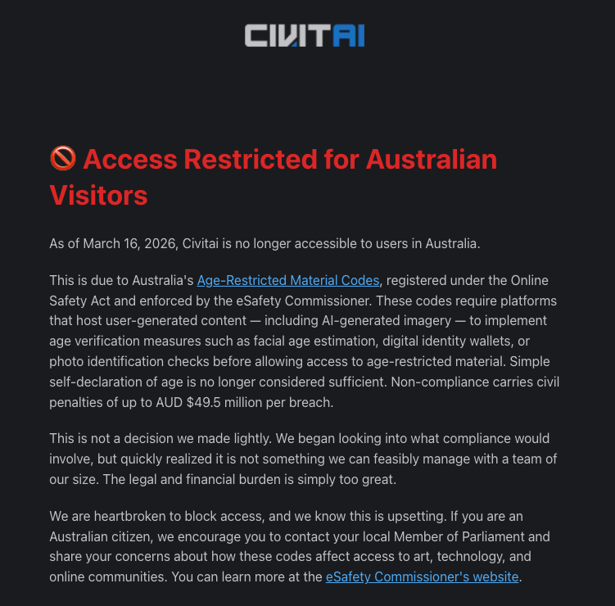
Example – Australian pathway
Youtube video led to link to Civitlink server (undersphere entry point)
CivitAI - desktop tool that lets you download and manage AI models from the Civitai website directly into your local generation software with a single click.
Banned in Aus - used to create non-consensual intimate imagery. Available in Vietnam.
Ban created backlash among creatives – lobbying encouraged (political outcome). Output mismatch.

