Slide 1
EventMeetApp

Slide 2
Usage Scenario

Slide 3

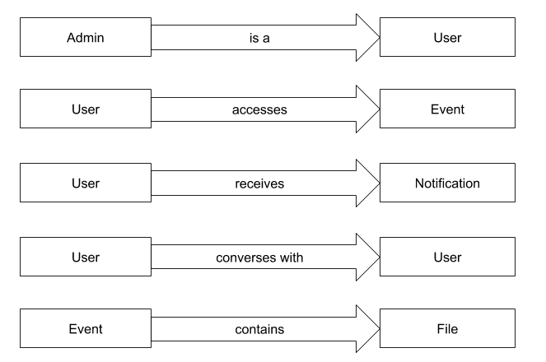

Slide 4
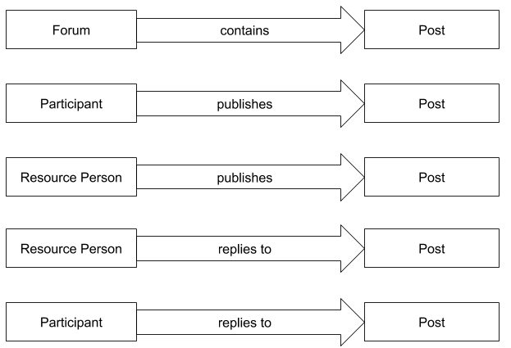
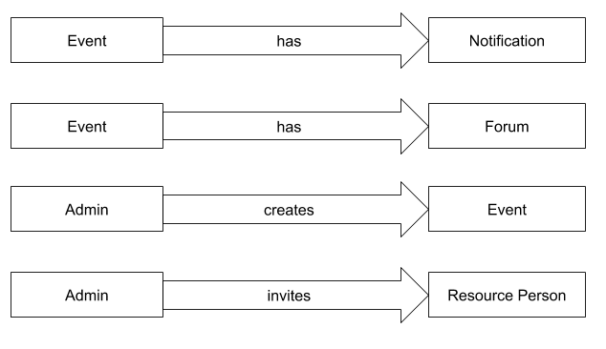

Slide 5
