Slide 1

ORGANIZATION VISIT
Course: BUS 405

Slide 2

VISIT TO

Slide 3
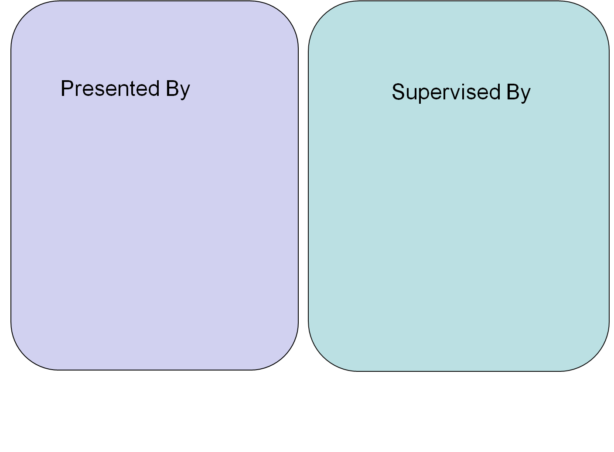
Anika Tabassum (BSSE 0925)
Fazlay Rabbi (BSSE 0926)
Ishrat Jahan (BSSE 0927)
Md Iftekharul Amin
Assistant Professor
Institute of Business Administration
University of Dhaka

Slide 4
OUTLINE
Aim of the visit
About the Organization
Vision of the Organization
Location of the Organization
Hierarchical Structure
Recruitment System
Training for New Employee
Culture and Environment
Social Responsibility
Memories

Slide 5
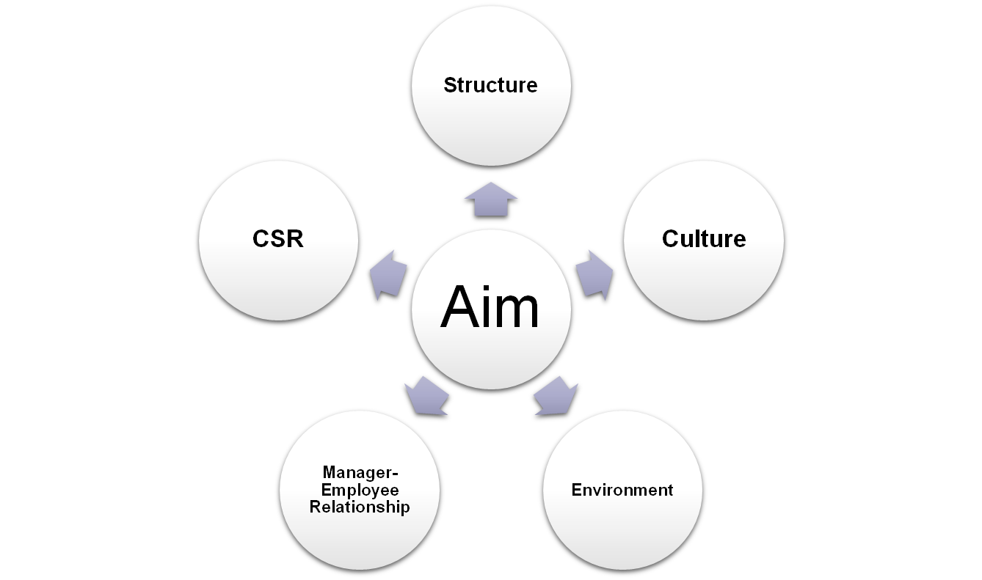
Aim of the Visit

Slide 6
About the Organization
Got Banking License on June 17, 1999
Head office at Banani, Dhaka
105 Branches
Conventional and Islamic Banking
Internet Banking service
Provides good security

Slide 7
Vision and Mission
Main Motto: SERVICE FIRST
Goal: Become the best amongst the top financial institutions.
Satisfy Customers
Creating opportunities for more people in more places.
Adopt technologies for improving efficiency and reduce cost per transaction
Effective contribution to national development

Slide 8
Location
248, New Elephant Road ( 1st Floor ), Katabon More,
Dhaka 1205,
Bangladesh

Slide 9
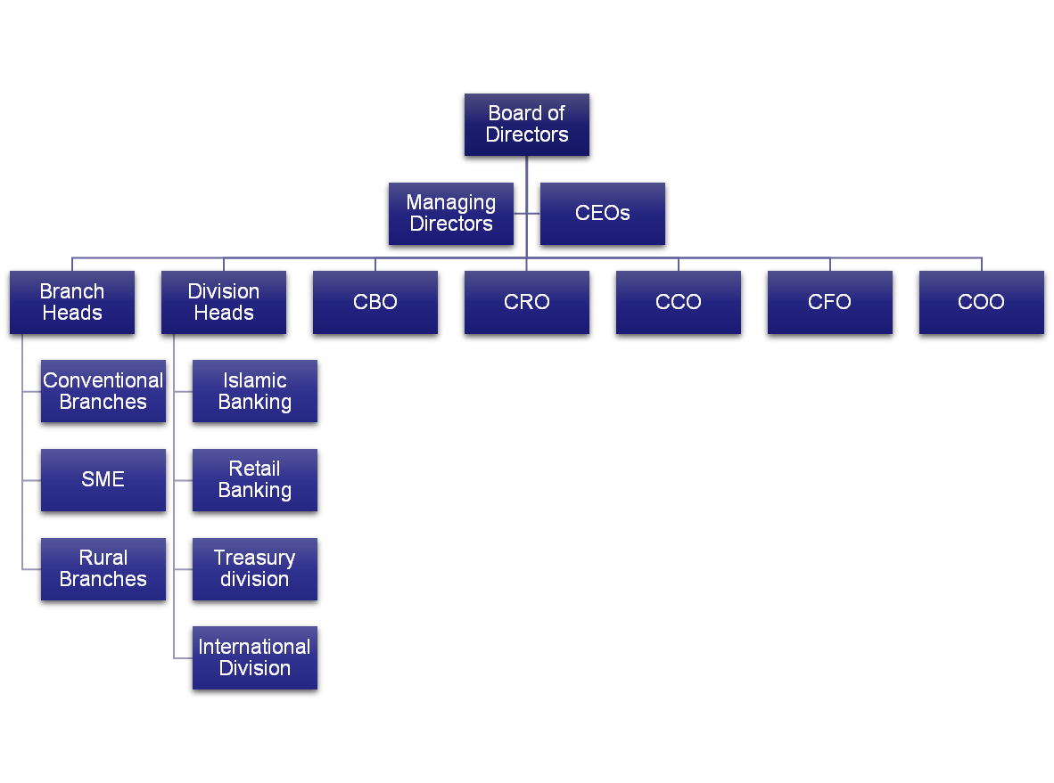
Structure
Bank Organogram:

Slide 10
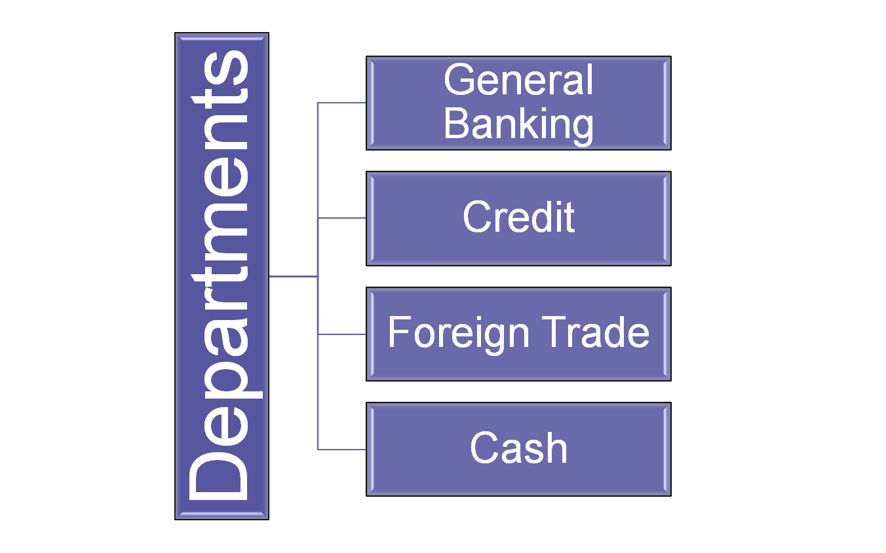
Structure

Slide 11
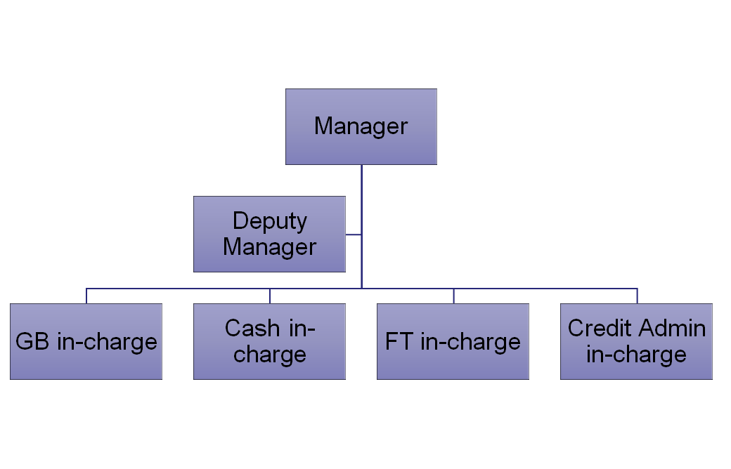
Structure
Managerial Hierarchy:

Slide 12
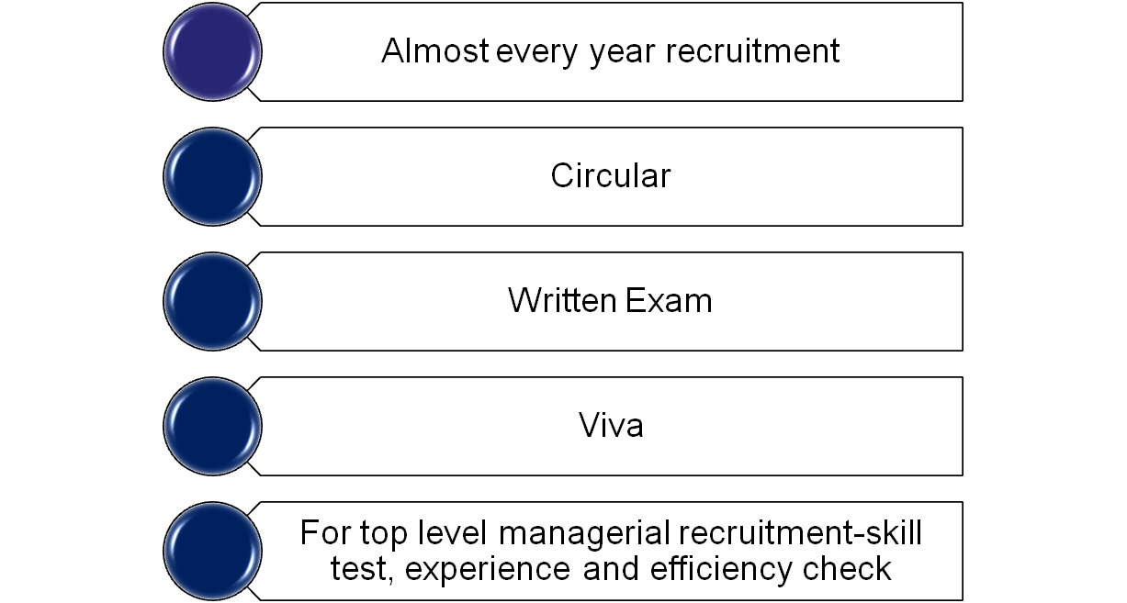
Recruitment System

Slide 13
Training for New Employee
Training course at Head Office
Orientation
Working in every departments to gather experience for about 6 months

Slide 14
Culture and Environment
Innovative and Risk Taking
Omnipotent view of management
Team and People Orientation: High
Cooperative
Dress code: Formal
Formalization
Female employees must leave within 6 PM

Slide 15
Culture and Environment
Marking on managerial performance
Rewards: Increment ( for good performance )
Punishment: Dismiss from job, Transfer to Head office or remote area
Every year picnic, Boishakhi Bonus
Special leave : Sick leave, maternity leave
Friendly Working Environment

Slide 16
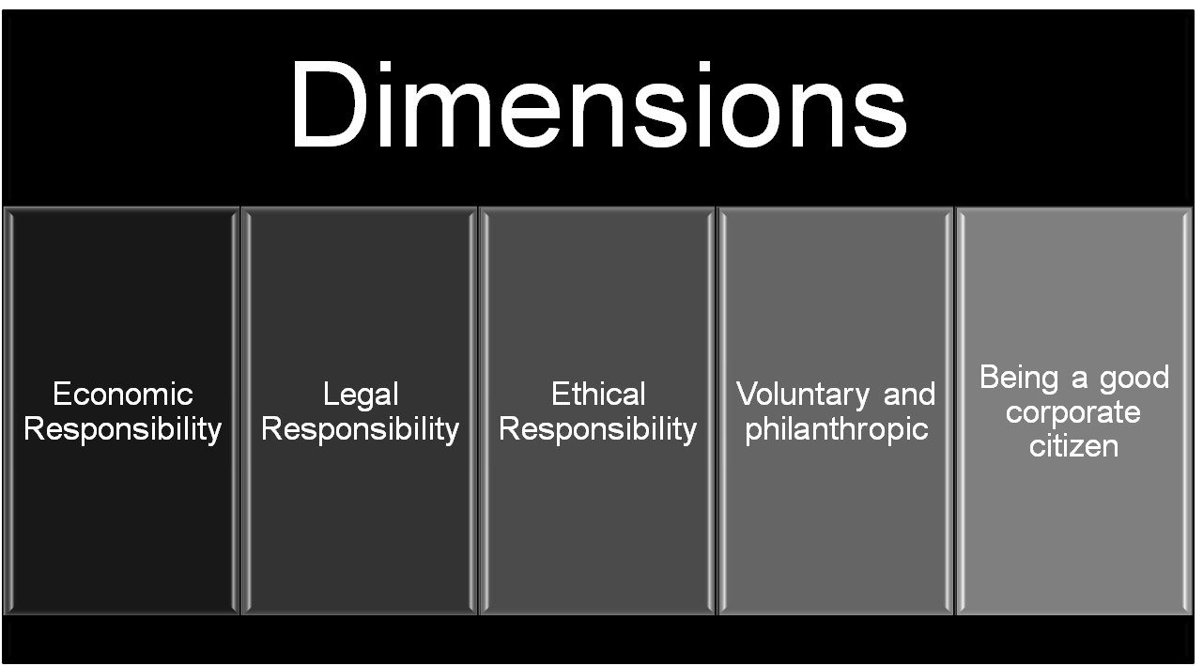
Social Responsibility

Slide 17
Social Responsibility
Distribution of Warm Clothes among the winter hit poor people
Contribution in Disaster Management
Contribution for construction/renovation of Mosque, Madrasa, Mondir and other religious programs
Education Support Program

Slide 18
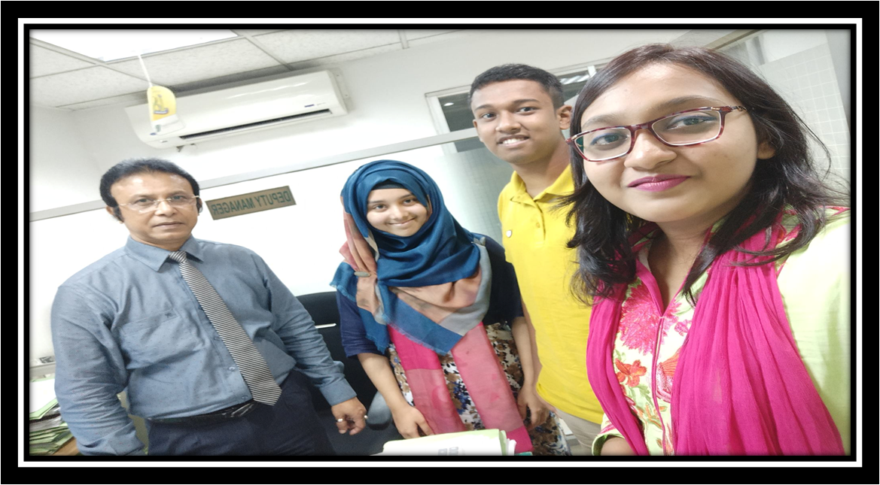
MEMORIES
With the Deputy Manager

