Slide 1
Paper Analyzing and Graphical Representation
Presented by Supervised by
A. T. M. Fazlay Rabbi Dr. Kazi Muheymin-Us-Sakib
BSSE 0926 Professor
Institute of Information Technology,
University of Dhaka

Slide 2
Aim of the Project
To provide the basic information about the paper
To show relationship between reference and the paper
Notes:
How presentation will benefit audience: Adult learners are more interested in a subject if they know how or why it is important to them.
Presenter’s level of expertise in the subject: Briefly state your credentials in this area, or explain why participants should listen to you.

Slide 3
Overview
A pdf document (basically a conference paper) is inputted.
Text from the pdf is parsed
Extracting information from the text
Showing output
Notes:
Lesson descriptions should be brief.

Slide 4
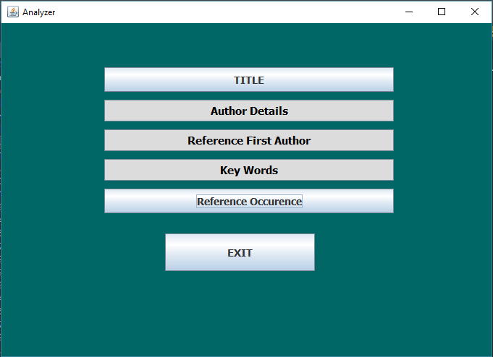
Features
Notes:
Example objectives
At the end of this lesson, you will be able to:
Save files to the team Web server.
Move files to different locations on the team Web server.
Share files on the team Web server.

Slide 5
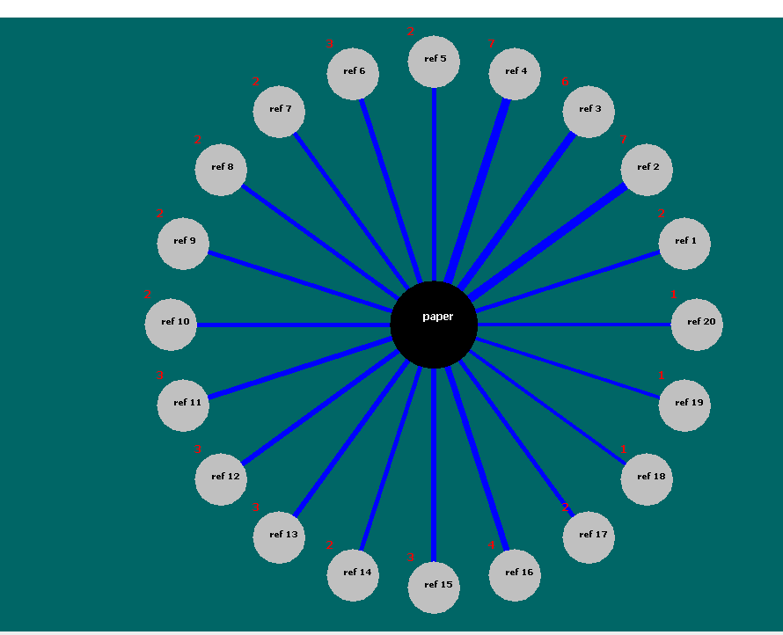
Reference Occurrence Output

Slide 6
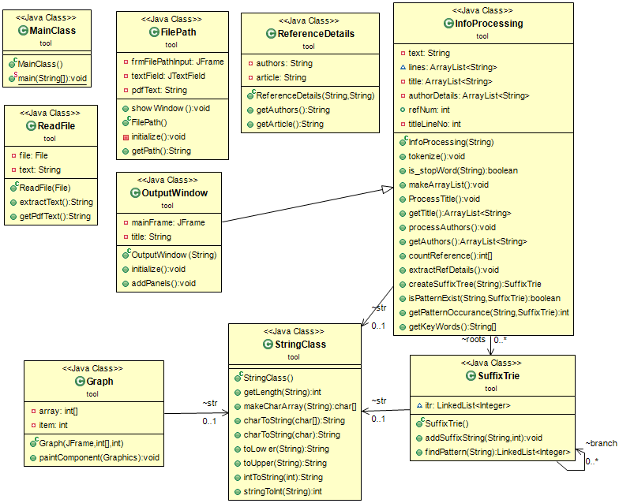
Implementation

Slide 7
Learnings
Suffix Tree
GUI
Maintaining Classes in code
Concerned to me :
Facing challenges and challenge accepted!

Slide 8
Limitations
Not generic. There is a defined format for the paper
My working domain is fixed. Selected papers are only convenient for this project.

Slide 9
THANK YOU

