Slide 1



Identifying Conserved Patterns in IgE BCRs (Mus Musculus and Homo Sapiens)
Franco Celano

Slide 2

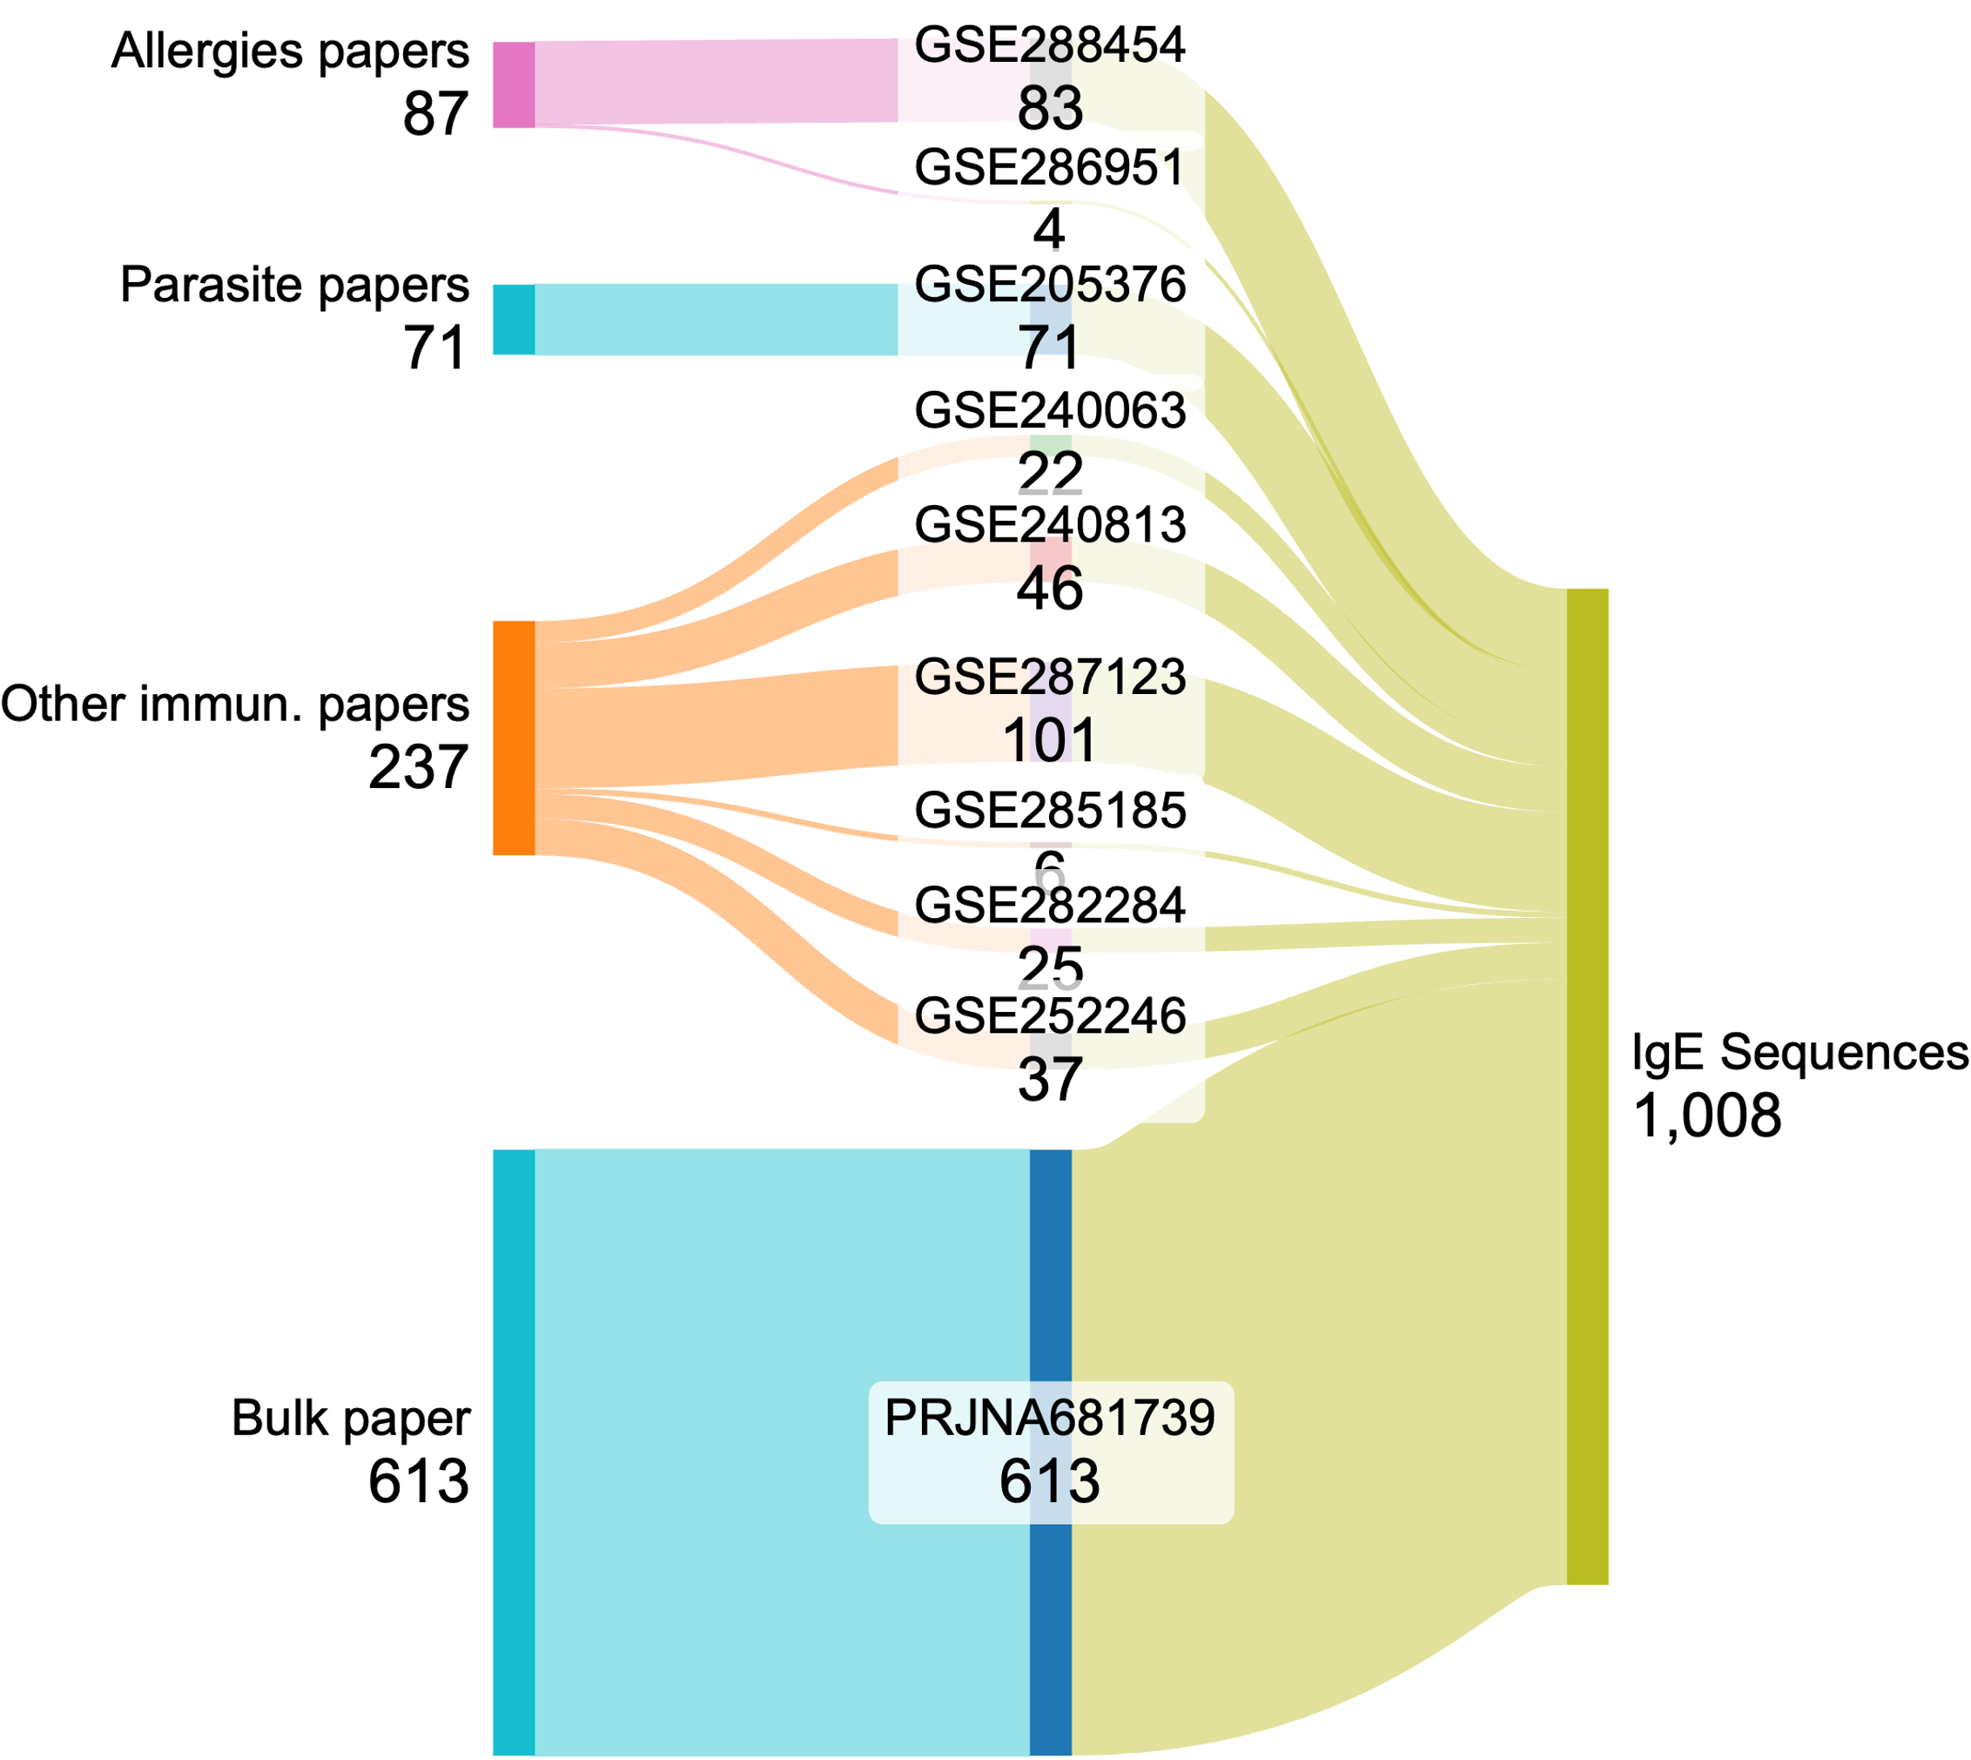

Current Dataset - Mice
1008 BCR IgE sequences
10 different studies, 2 of them on allergies
Raw data, clean sequences and visualizations stored on GitHub
Franco Celano | Lab Meeting

Slide 3
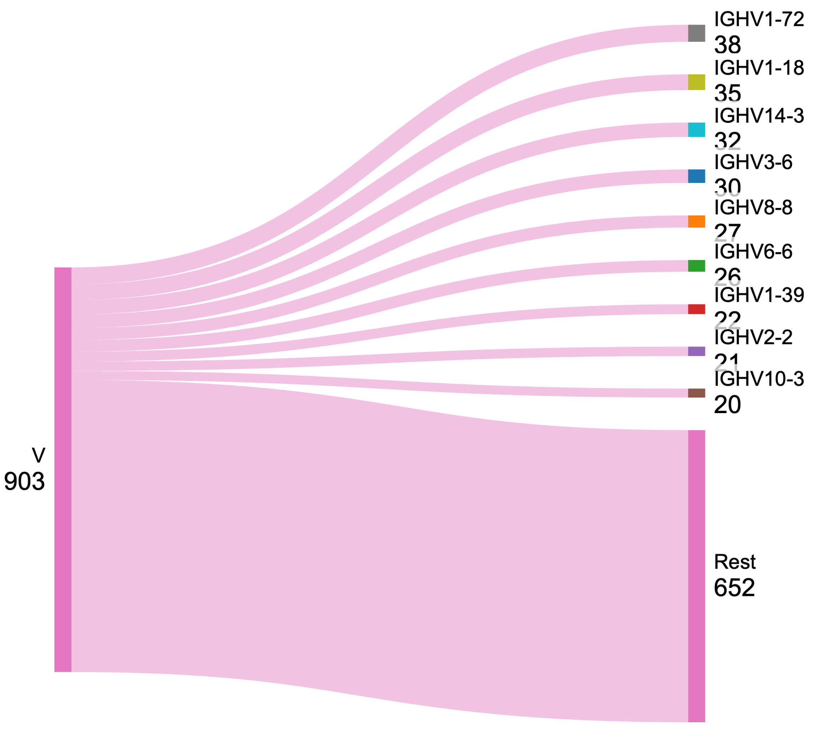
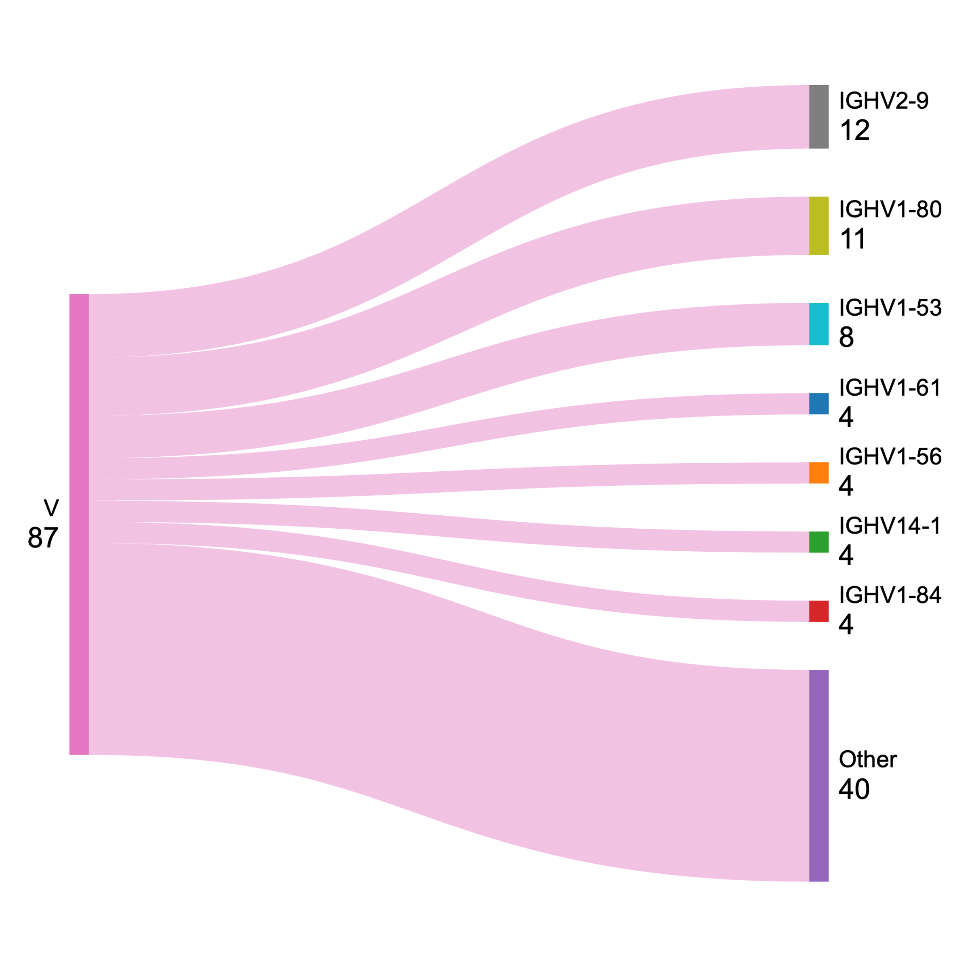
VDJ gene usage
Allergies
Naïve
Naïve mice most represented genes are V1-72 (4%), V1-18 (4%)
Allergic mice show slight preference for V2-9 (14%), V1-80 (12%)
The top genes don’t overlap between both lists
Franco Celano | Lab Meeting

Slide 4
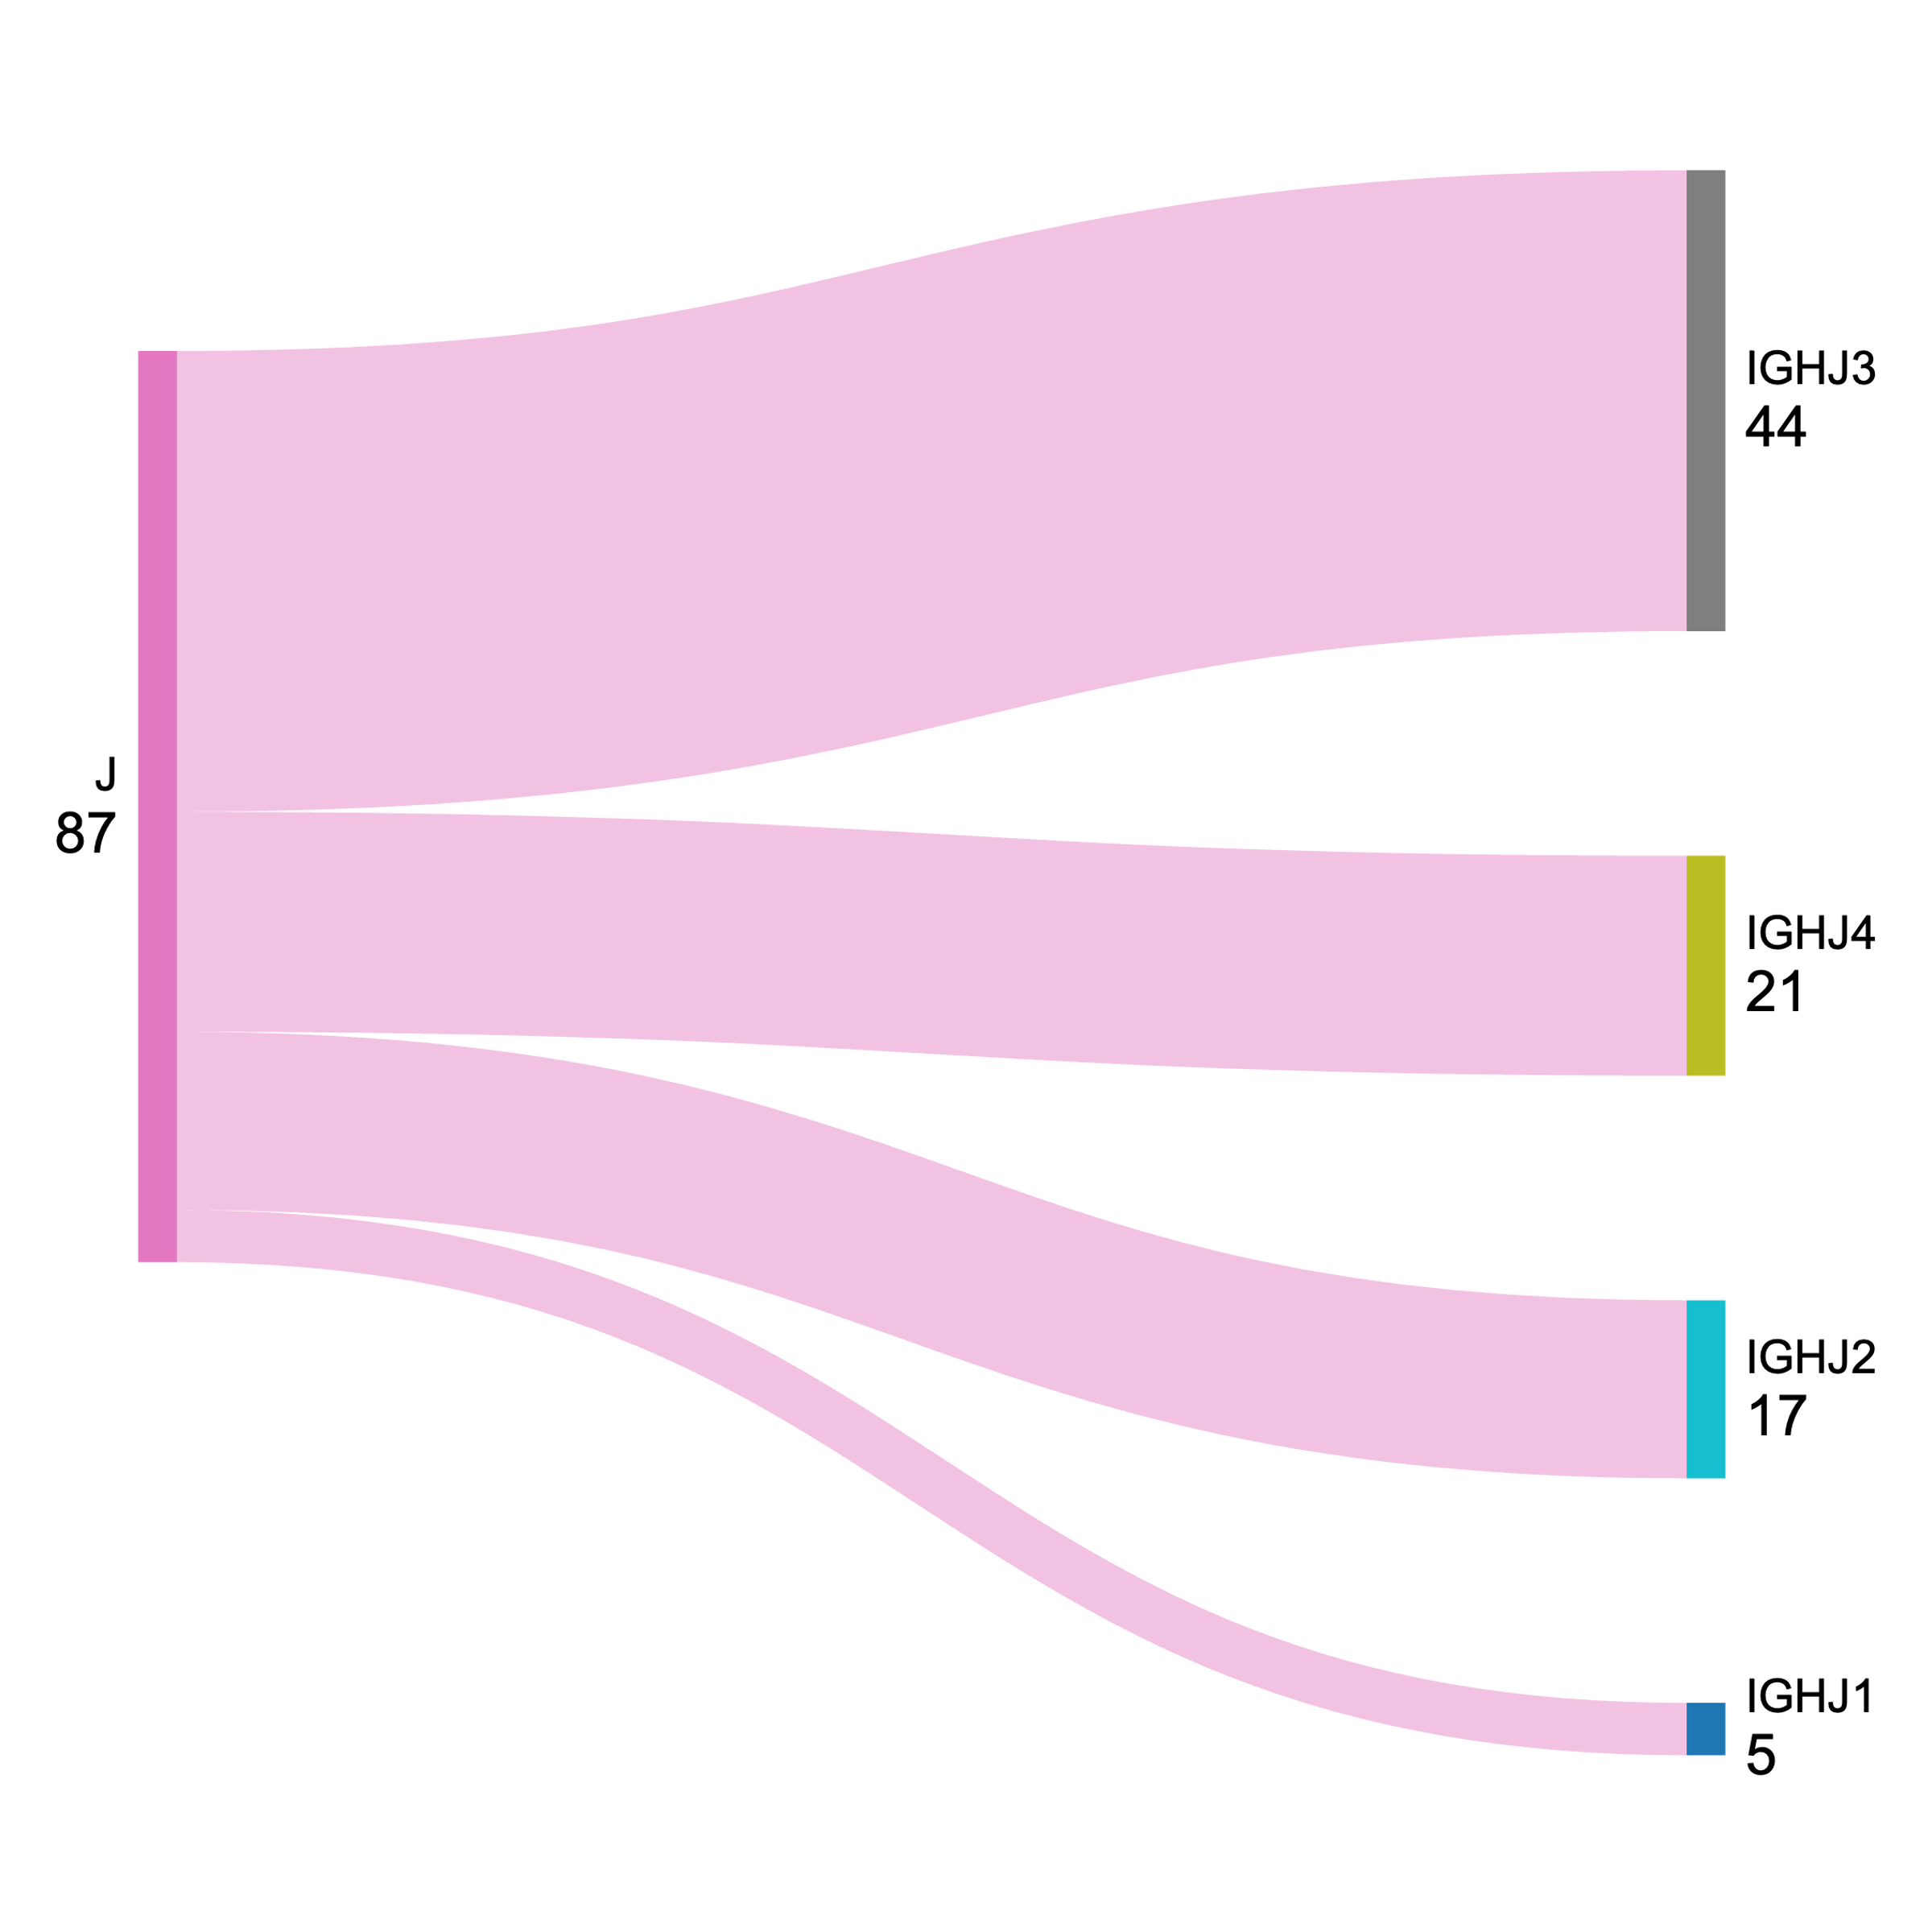
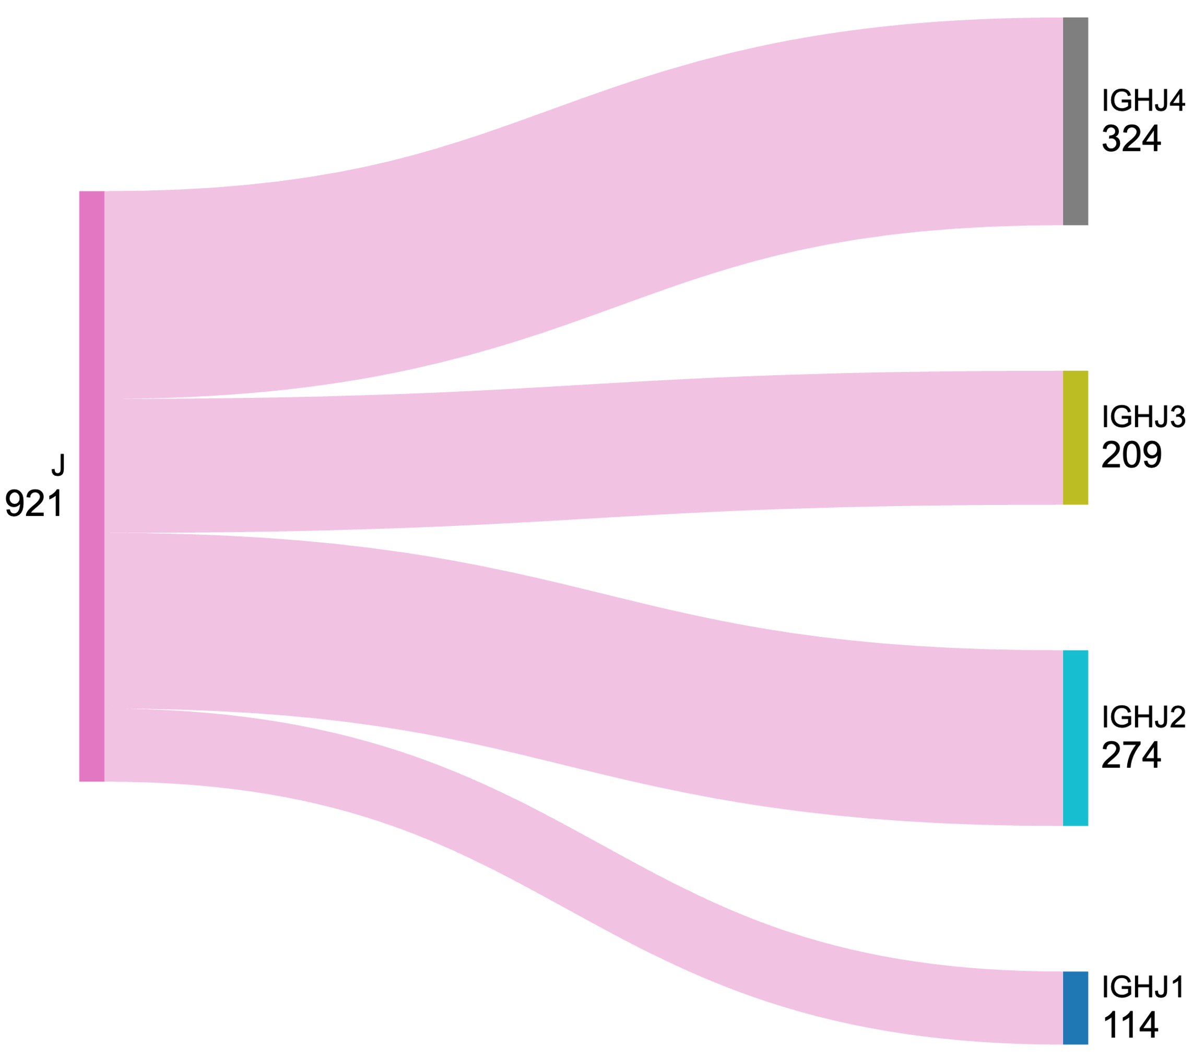
VDJ gene usage
Allergies
Naïve
Naïve mice show preference for J4 (35%) but J2 (30%) is also close
Allergic mice show preference for J3 (50%)
Franco Celano | Lab Meeting

Slide 5
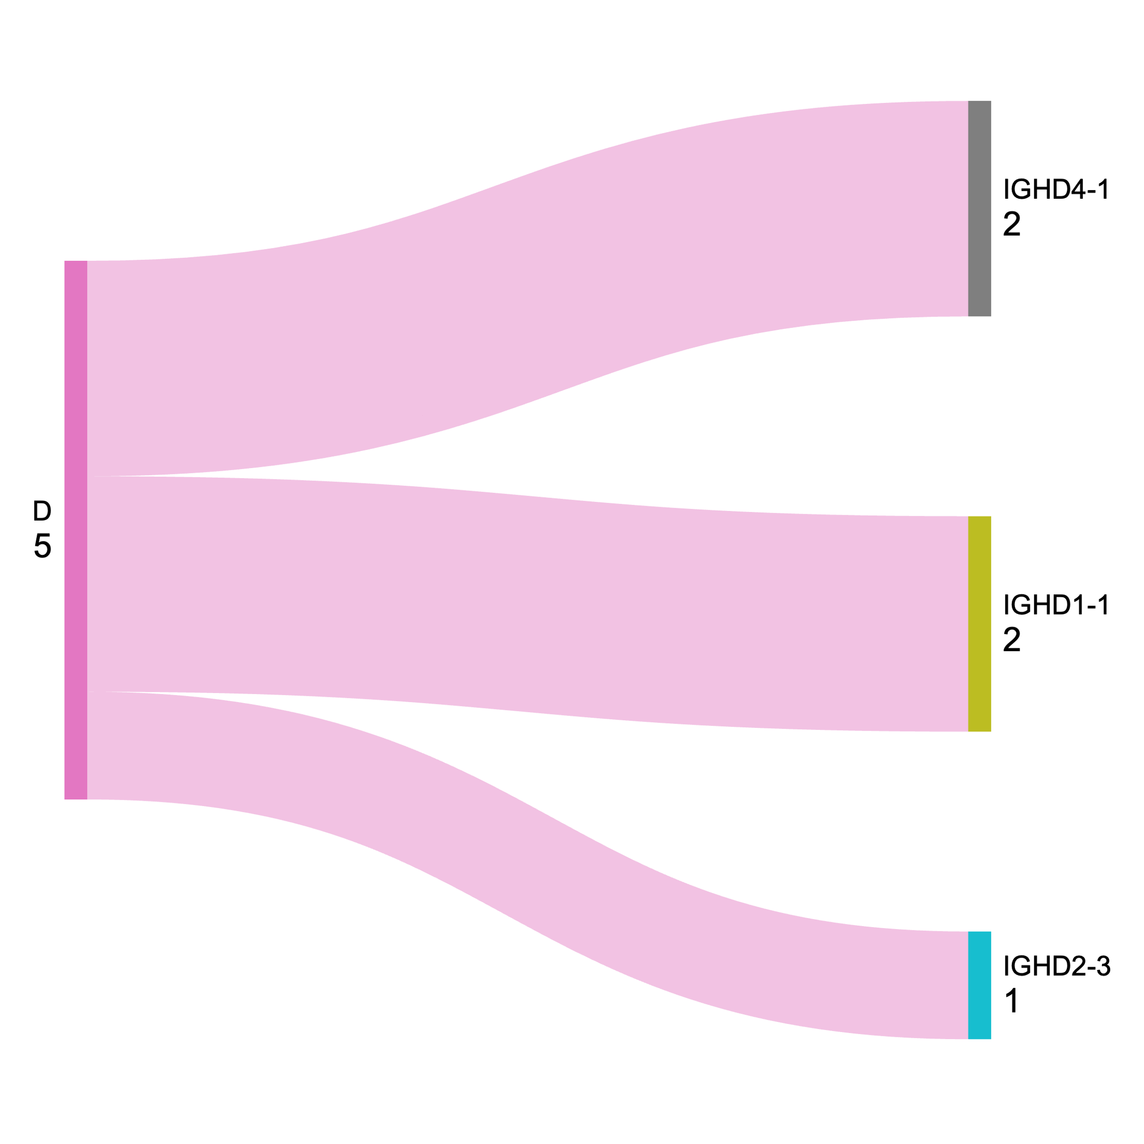
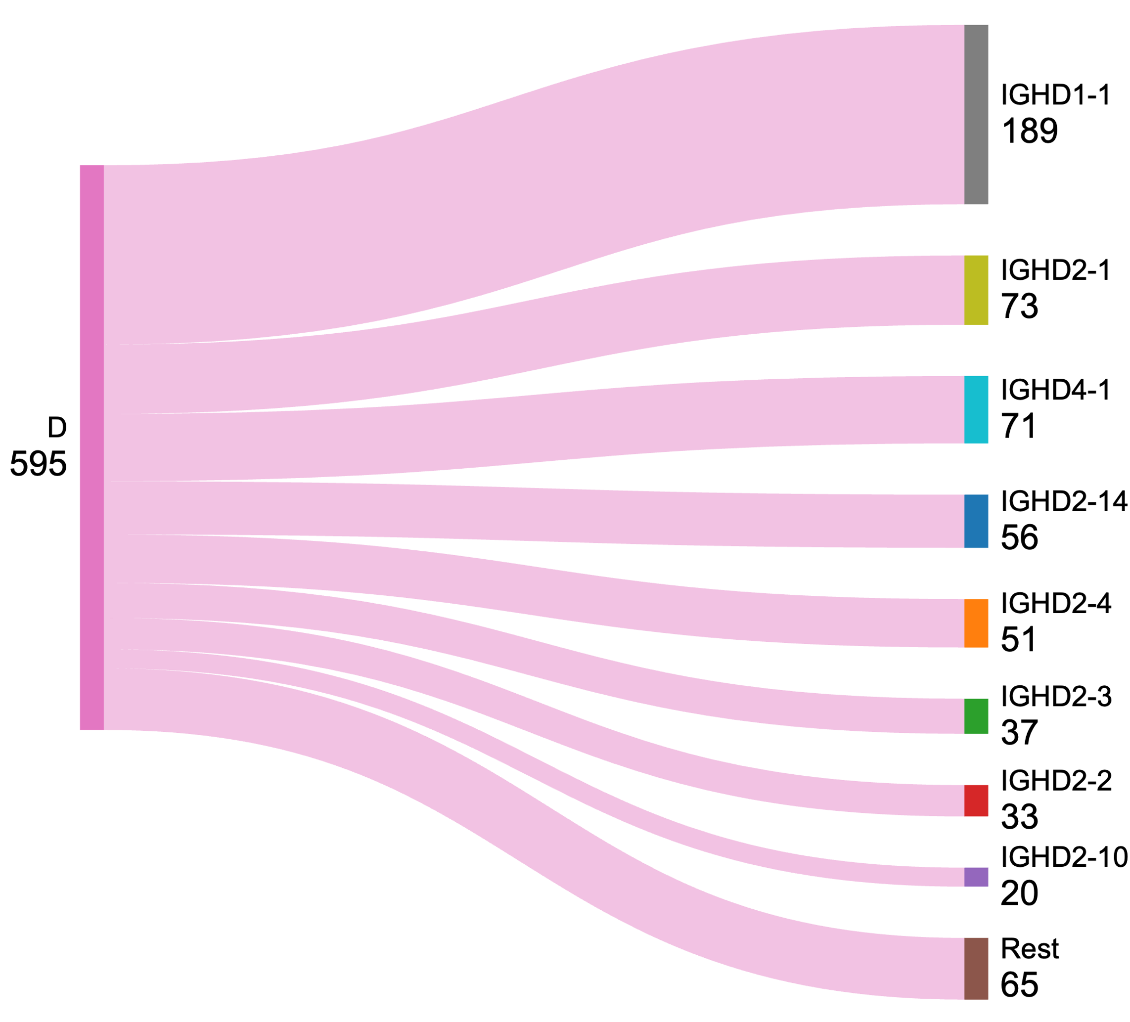
VDJ gene usage
Naïve
Allergies
Naïve mice show preference for IGHD1-1 (31%)
Not enough data to determine allergic mice preferences
Franco Celano | Lab Meeting

Slide 6

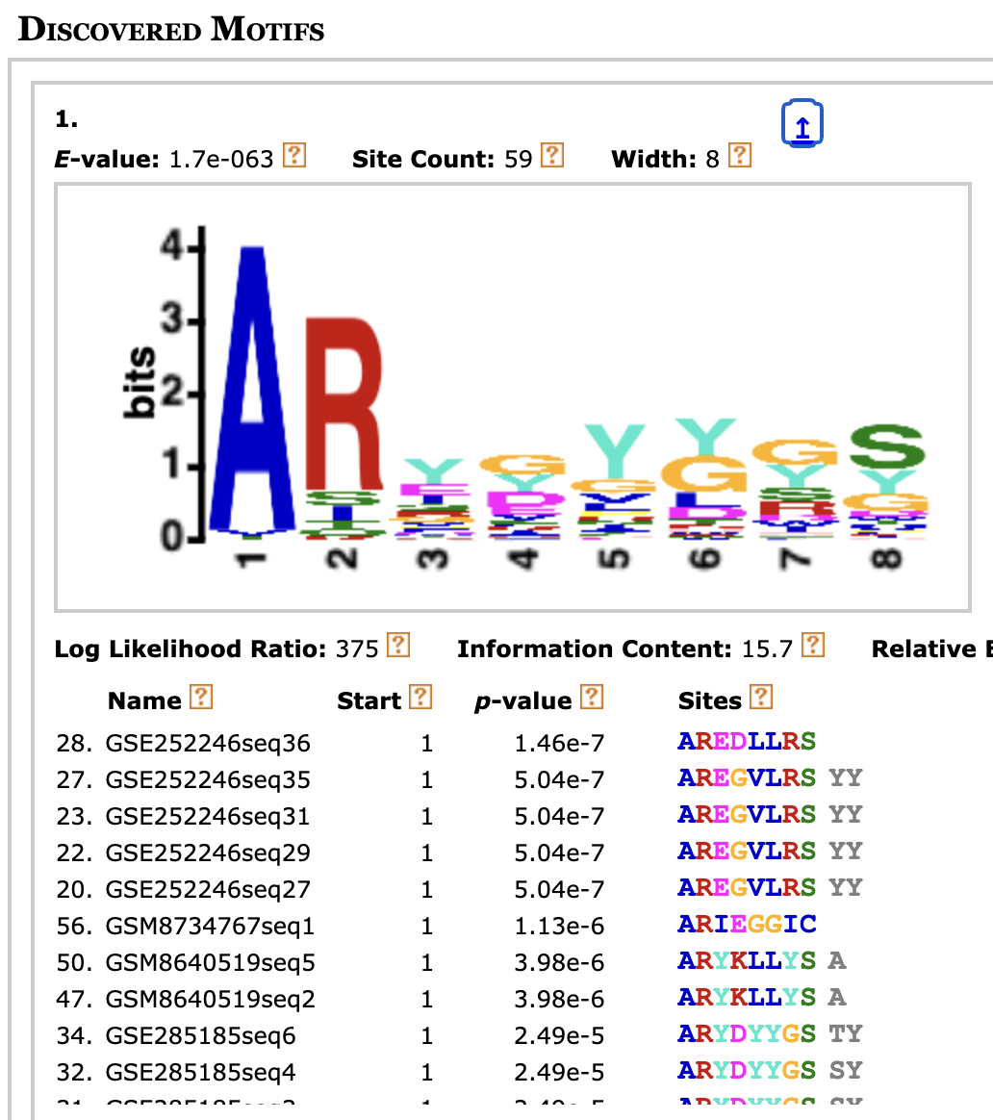
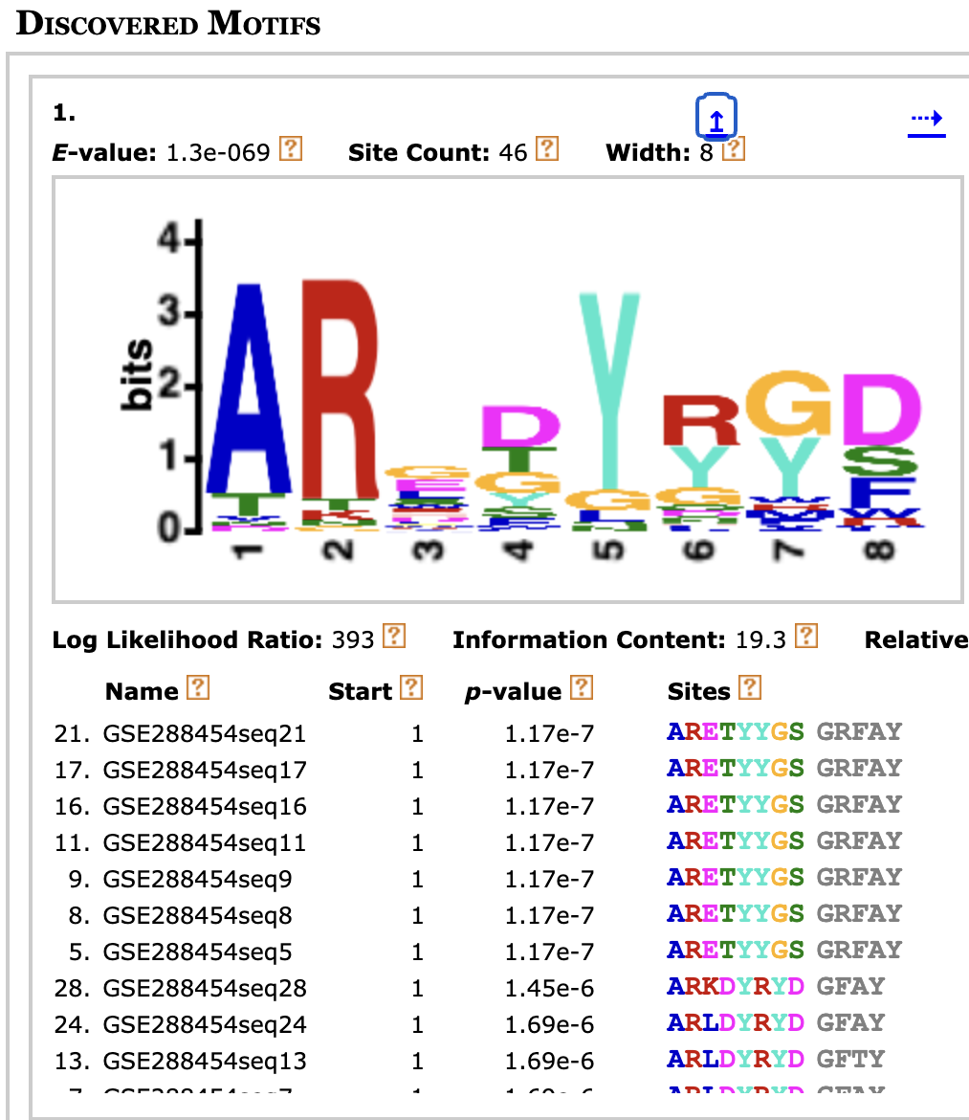
CDR3 motif discovery
← Naïve
Allergy→
To be continued…

Slide 7
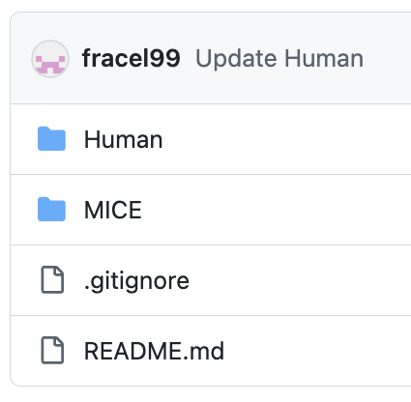
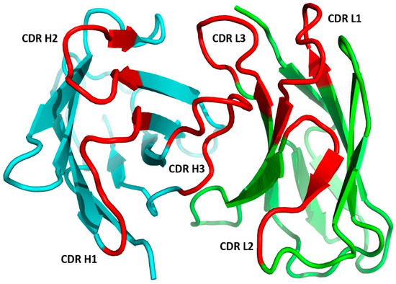
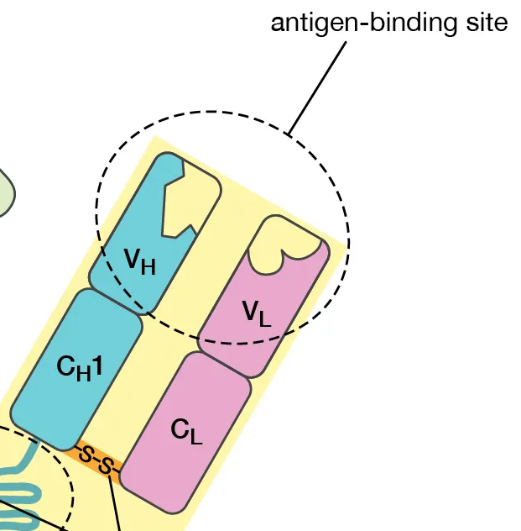
New approach – Human data
Focus on VDJ gene usage, ignore CDR motifs and patterns for now
Consider both heavy and light chain pairs, not just IGHE
First establish the baseline VDJ usage in naïve mice, then compare it to allergic mice
Franco Celano | Lab Meeting

Slide 8
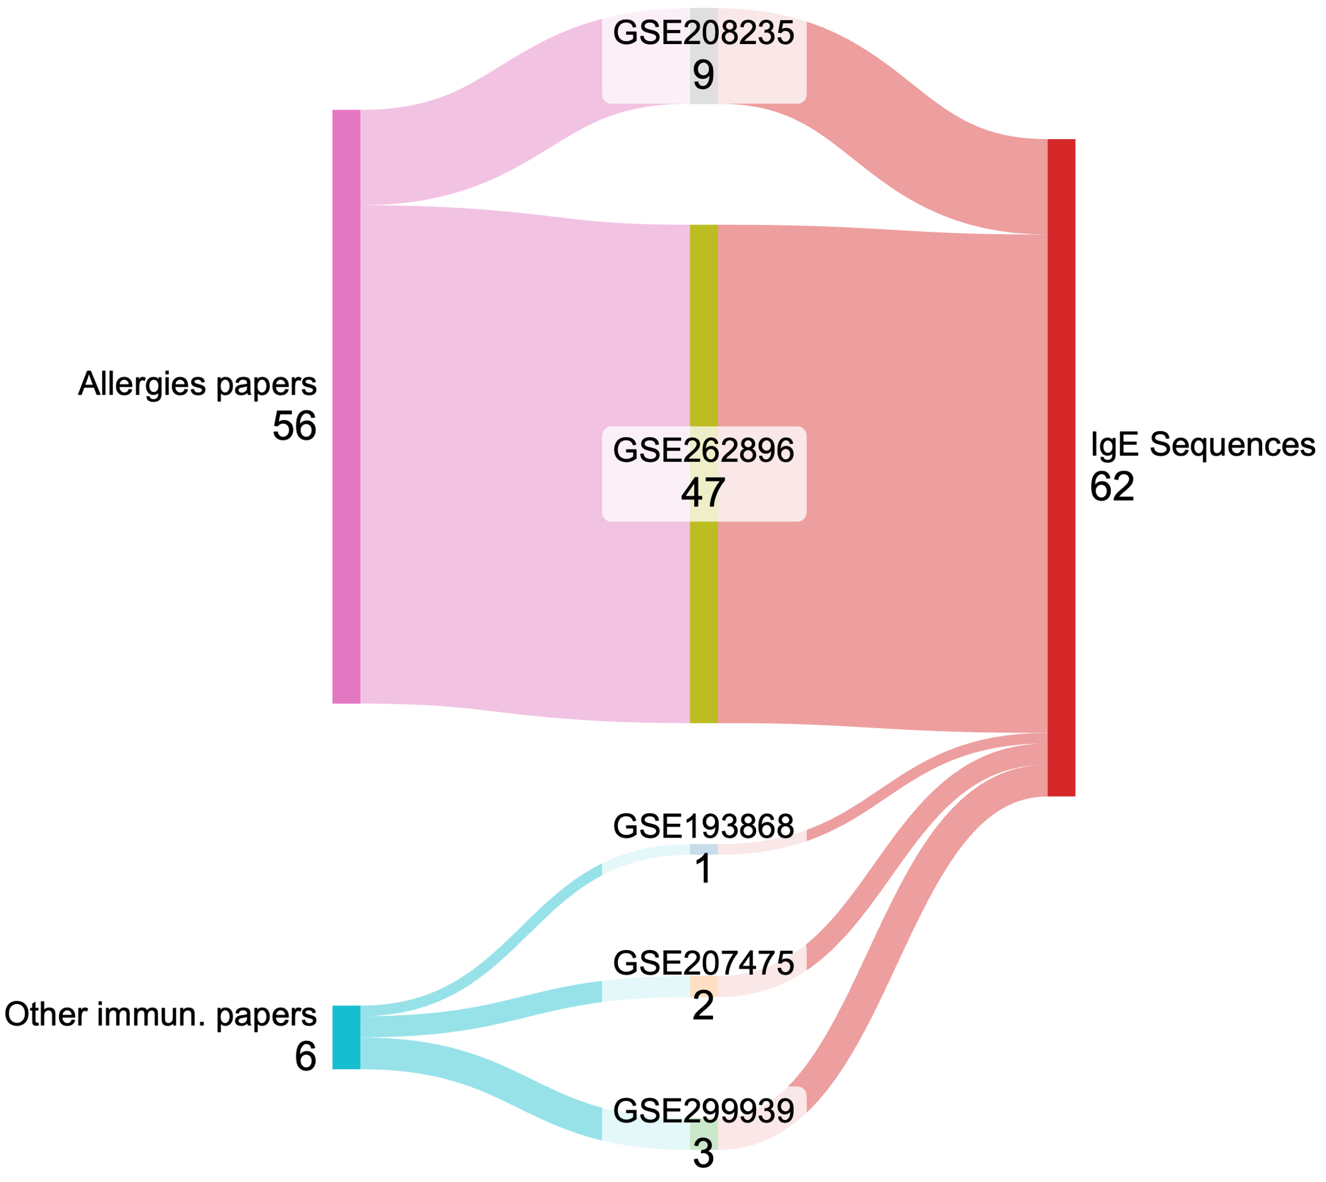
Human data
2 studies on peanut-allergic patients: 56 IgE sequences
Other immunology papers: 6 IgE sequences
Currently looking for larger datasets
Franco Celano | Lab Meeting

Slide 9
VDJ pairs
Heavy Chain | Light Chain | Total Count
IGHV1-69D | IGLV3-21 | 3
IGHV3-11 | IGLV3-21 | 2
IGHV3-11 | IGLV1-51 | 1
IGHV1-46 | IGKV1-5 | 1
IGHV4-39 | IGLV1-40 | 1
IGHV3-64D | IGKV1D-39 | 1
IGHV3-33 | IGKV1-33 | 1
IGHV1-18 | IGLV1-51 | 1
IGHV3-21 | IGKV1-5 | 1
IGHV3-21 | IGKV3-20 | 1
IGHV3-74 | IGKV1-33 | 1
IGHV3-33 | IGKV1-5 | 1
IGHV7-81 | IGLV3-21 | 1
IGHV7-81 | IGKV4-1 | 1
IGHV4-30-4 | IGLV1-47 | 1
… | …
… | …
VDJ analysis now focused on VH–VL pairs
So far, ~50 pairs identified
No clear patterns yet, more sequences needed
Franco Celano | Lab Meeting

Slide 10
Summary – an update
Progress made:
Reached ~1000 mouse sequences; slight VDJ preferences emerging as candidate patterns
Shifted focus to human data
Expanded pipeline to include light chains and generate VH–VL pairs
What's next:
Identify larger human BCR-IgE datasets, especially from non-allergic individuals
List VH–VL pairs and analyze for preferential usage
Franco Celano | Lab Meeting

