Slide 1
MSc Informatics: Dissertation Project Demonstration
Fraser Rackham
K1065630
Supervisor: Dr Pushpa Kumarapeli

Slide 2
Context (Chapter 1)
UK Schools facing a period of great change (Significant exam reform, Academies, funding reform, staffing pay…)
Fast rate of change vs Schools’ long term planning of curricula (5 yr offset for typical secondary).
Certainly faster rate of change than existing IS and staffing skills can readily support.

Slide 4
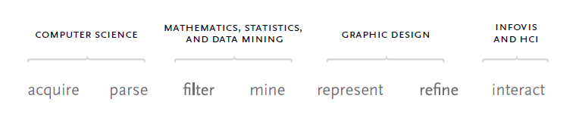
Literature Review (Chapter 2)

Slide 5
Existing Systems (Chapter 2)
Existing systems are:
Proprietary, closed source, paid.
Are secure and stable, though can be buggy at a non-halting level.
Focus on compliance (notable exceptions for assessment analysis applications).
Require data input in specific formats.
Typically support information to date (no historic view) OR single dataset. Few systems support time-series analysis.
Rarely interactive.

Slide 6
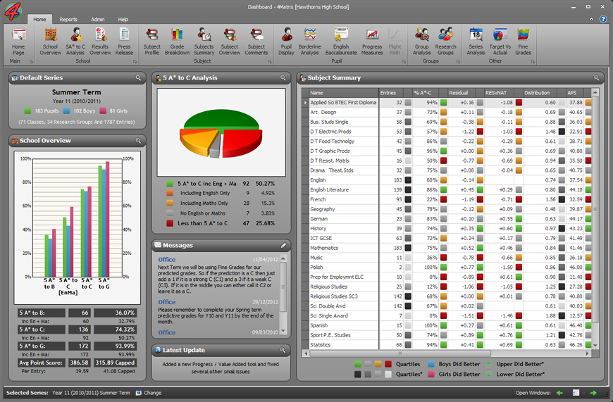

Slide 7
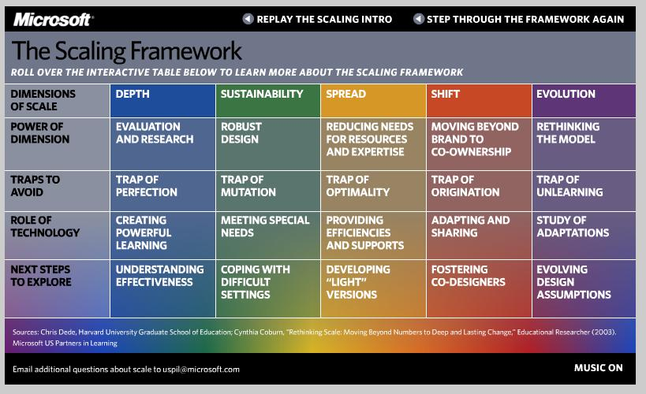
Scaling Framework (Coburn, Dede)

Slide 8
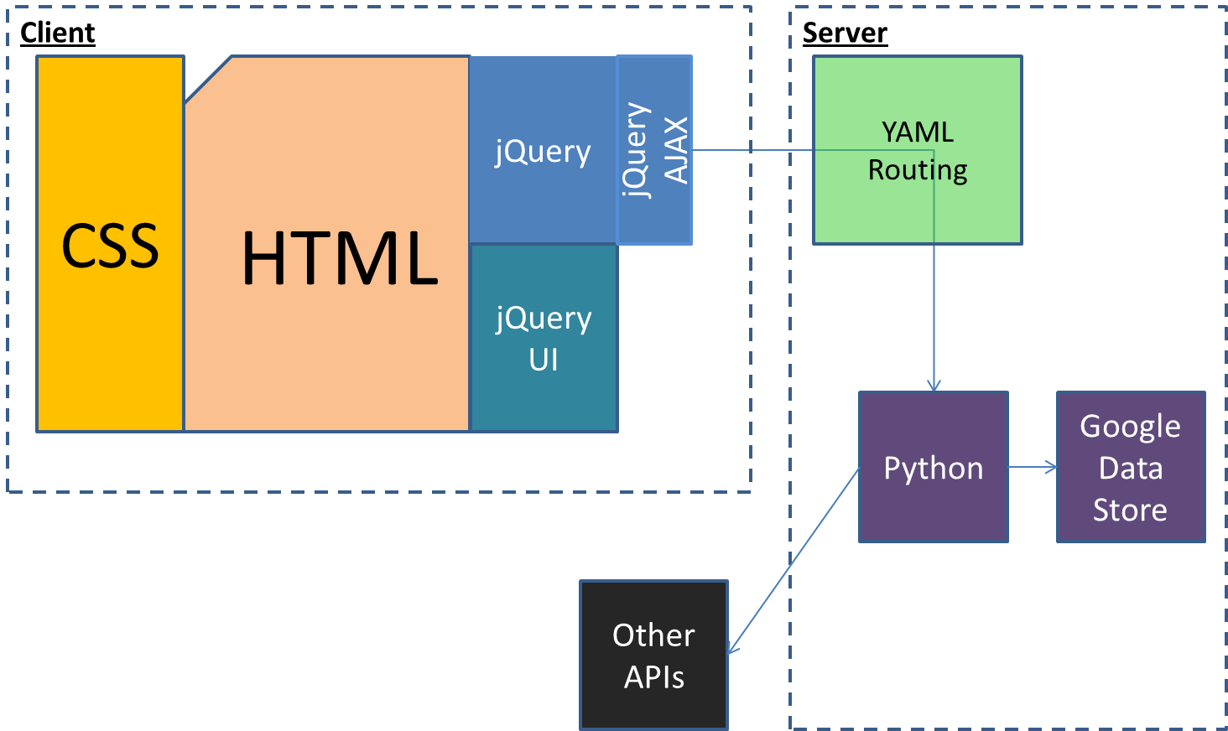
Architecture
Notes:
+ Git/Github (originally Eclipse/Mylyn/Pydev), dropbox.

Slide 9
Data Model
System
DatasetColl
DAL
Tools
Dataset
SchoolColl
School
StudentColl
Student
Results
Result
StaffColl
Staff
Timetable
Timetable
DataStore
API
Classes
Class
Classes
Class
Timetable
Timetable
Timetable

Slide 10
Evaluation: Capacity to support

Slide 11
Next Steps/Critical Review:
Not ready for wider usage/adoption at present:
Greater breadth/depth of analysis (Depth).
Input/output interfaces (Sustainability).
Not ready for collaboration of analysis (Depth/Spread):
Multi-user supported, but single-user perspective of data.
No feedback mechanisms. No annotation.
Ready for collaboration of development (Spread/Shift):
Github (DCVS).
Documentation inline with code, with wiki to support.
Scales quickly once all outputs replaced with templating.

