Slide 1
Big Data with ADAMS
What the heck is ADAMS?

Slide 2
What is ADAMS?
Java, GPLv3
Data mining: MOA, WEKA, MEKA, R
Spreadsheets and databases
Image and video processing
Visualizations (plots, GIS)
Scripting via Jython and Groovy
...

Slide 3
Flow
Operators are called “actors”
Actors arranged in tree, no connections
Actor “handlers” nest other actors
  e.g., sequence of actors
Control actors control data flow
  e.g., branch, tee, if-then-else, switch
Input/output defines
standalone , source , transformer , sink

Slide 4
Flow (2)
Tree only supports 1-to-n connections
Simulating n-to-m semantics
  Containers
  Variables
  Internal storage
  Callable actors

Slide 5
Examples
Execute nested actors one after the other
Output file to read
Read file
Load dataset,
apply filter and
display dataset
Set class attribute
Apply filter
Display data

Slide 6
Examples (2)
Generate data stream
Feed data into branches
1st sequence of steps
Filter data stream in two separate branches with different filters, evaluate classifier and plot metric
Apply stream filter
Evaluate classifier
Filter measurement of interest
Generate data for plot
Plot
2nd sequence of steps
Apply different stream filter

Slide 7
Examples (3)
groups actors accessible via their name (“callable actors”)
combined plot
...
Generate combined plot of two evaluations by using “callable actors” functionality
1st evaluation: create plotting data
Pump data into referenced plot
...
2nd evaluation: create plotting data
Pump data into referenced plot

Slide 8
Research (demos)
Compare two MOA classifiers (drift)
Compare MOA classifier on different streams
MOA cluster visualization
Track mouse in video

Slide 9
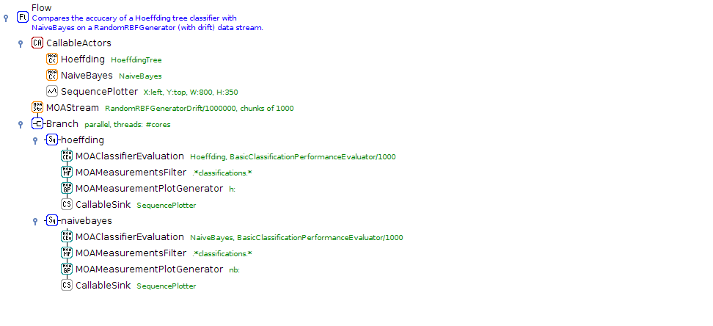
MOA - Drift

Slide 10
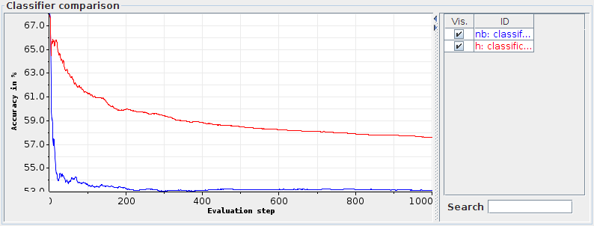
MOA - Drift

Slide 11
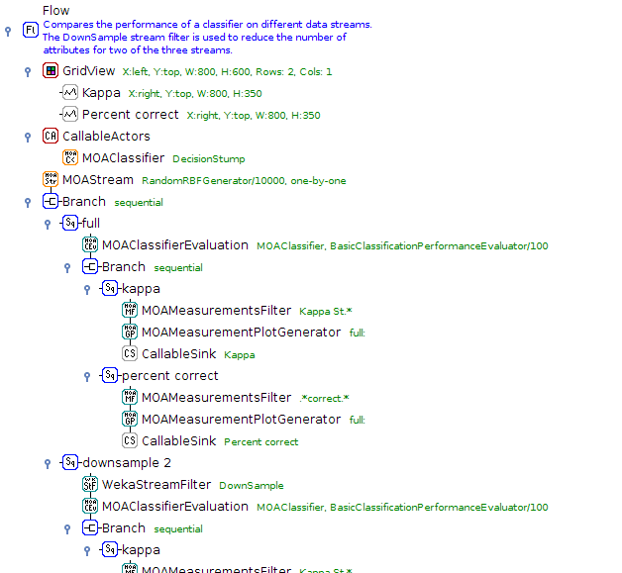
MOA - different streams

Slide 12
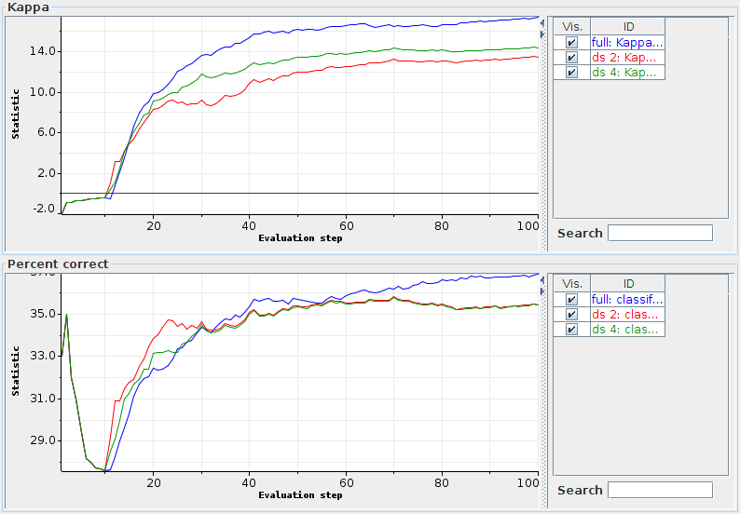
MOA - different streams

Slide 13
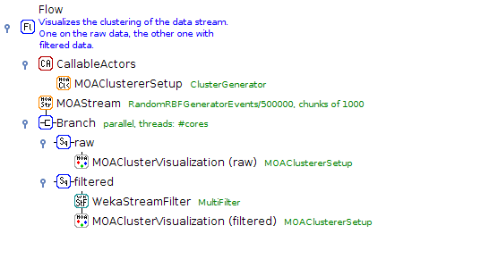
MOA - Cluster visualization

Slide 14
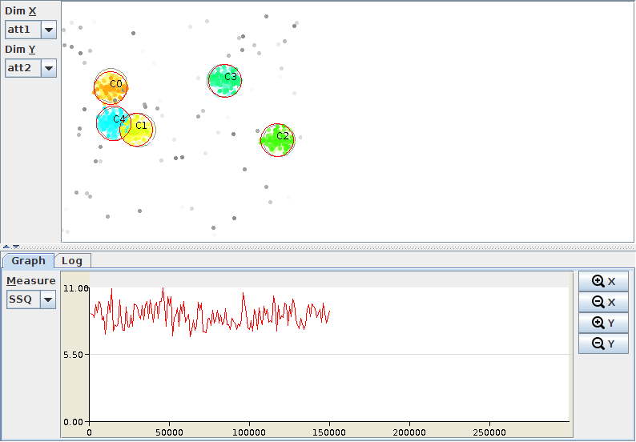
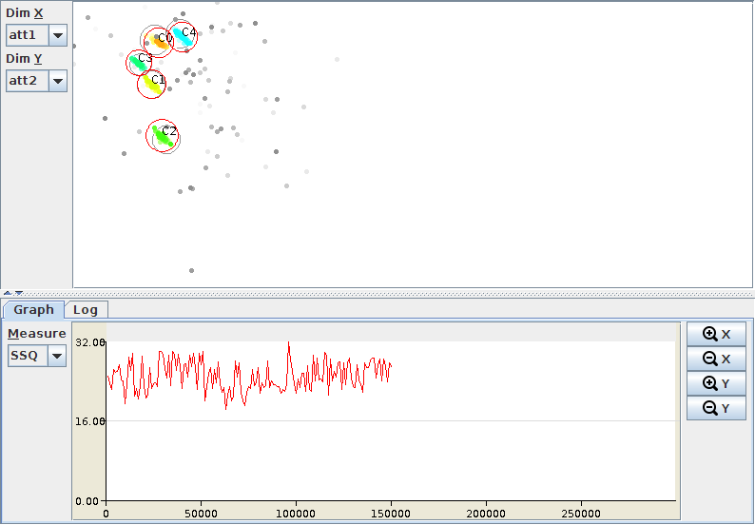
MOA - Cluster visualization
Stream 2
Stream 1

Slide 15
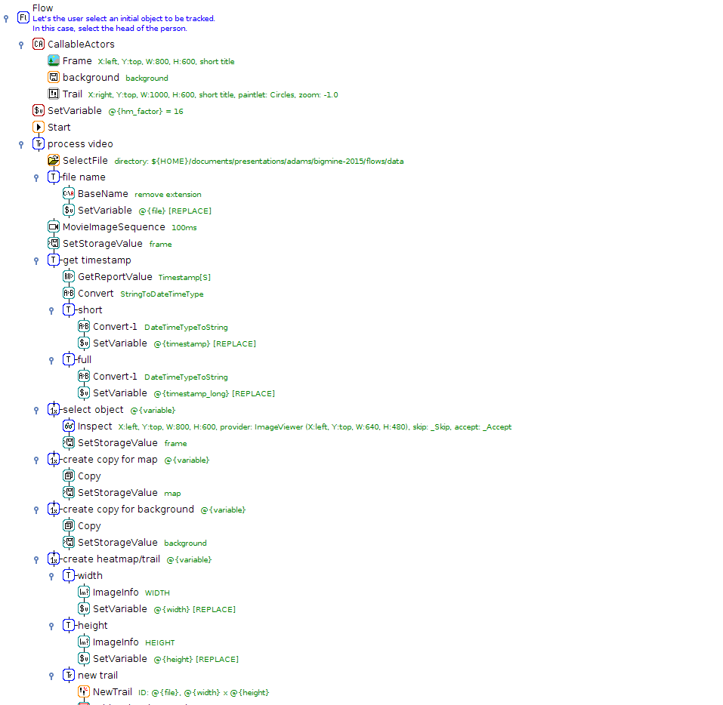
Track mouse

Slide 16
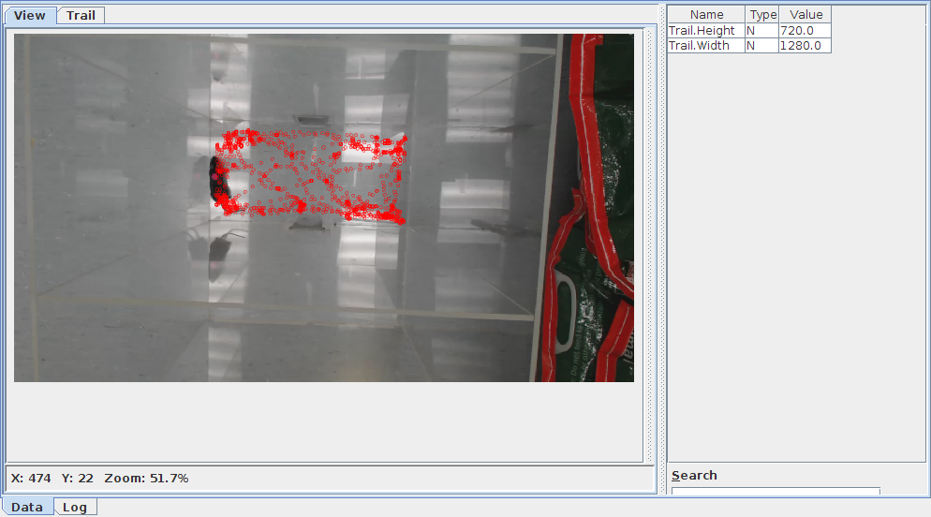
Track mouse

Slide 17


Industry
BLGG - environmental lab in NL
Spectral analysis
  XRF: 10,000, MIR: 2,000, NIR: 1,500
In operation since 2006
Predictive modelling: soil, plant (~250 models)
1,000 to 3,000 samples per day
Savings due to less wet chemistry
  USD 18 million to USD 33 million per year

Slide 18

Interested?
https://adams.cms.waikato.ac.nz/
@TheAdamsFlow

