Slide 1
eResearch 2014
Data Mining Workshop
Scientific workflow management with ADAMS

Slide 2
Outline
Basics
  Bit different, eh?
  Features, User interface
Data Mining
  Feature generation, evaluation, visualization
  Generate and use model
Scripting
  R, Groovy, Jython

Slide 3
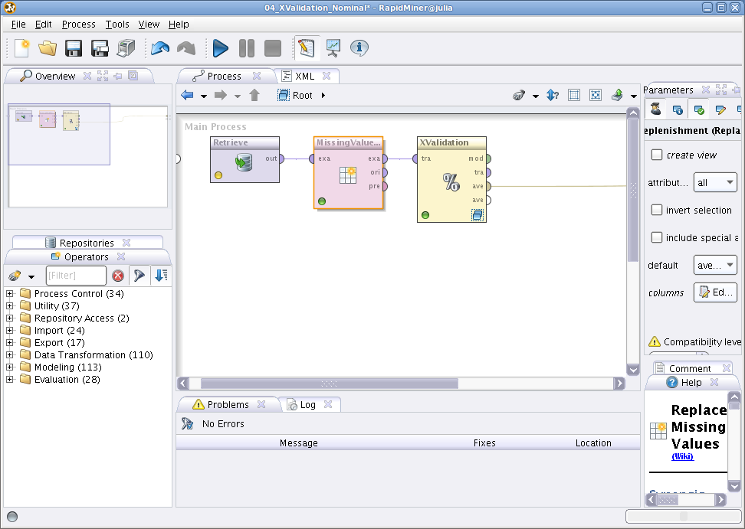
Basics
Canvas

Slide 4
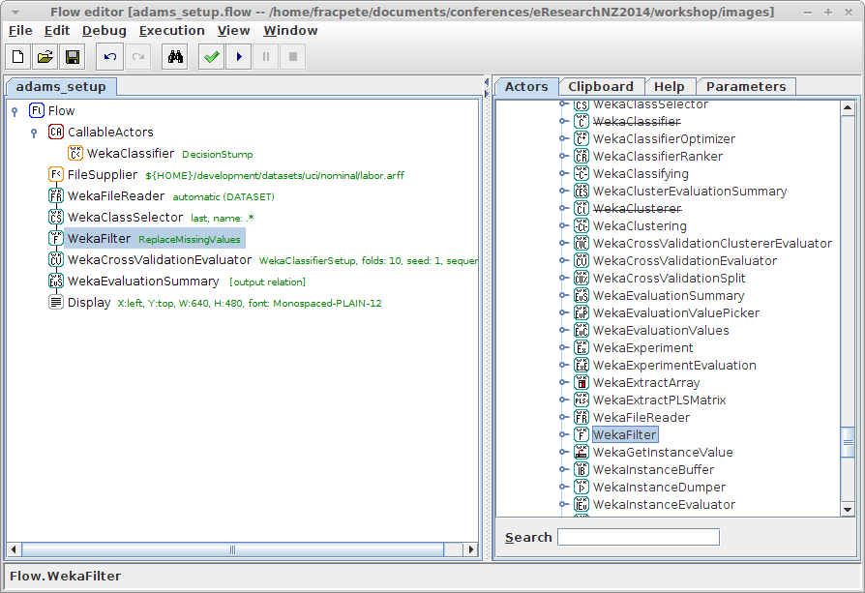
Basics (2)
Tree

Slide 5
Basics (3)
How it works
  No explicit connections
  Actors snap into place in tree
  Color coded with name (+ annotation)
    standalone (no I/O)
    source (only O)
    transformer (I/O)
    sink (only I)
    control actor (data flow)

Slide 6
Basics (4)
Advantages
  compact layout
  scales to 1000s of actors
  context-aware adding of actors
  interactive components
  modular framework (Maven)
  easy to add acctors: 1 Java class, 1 icon

Slide 7
Basics (5)
Limitations
  only 1-to-n connections with tree layout
  only single input/output
Countermeasures
  callable actors: n-to-1
  containers: multiple outputs
  variables: change options at runtime
  internal storage: reuse data in multiple locations

Slide 8
Features
Feature | Available
Machine learning/data mining | WEKA, WEKA webservice, MOA, MEKA, parameter optimization, experiment generation on-the-fly, setup generators, time series
Data processing | WEKA, R-Project, XML, XSLT, XPath, HTML, JSON
Streaming | MOA, Twitter (record/replay)
Spreadsheets | MS Excel (r/w), ODF (r/w), CSV (r/w), Gnumeric (r/w)
Imaging | ImageJ, JAI, ImageMagick, Gnuplot, OCR (tesseract)
Graphics output | BMP, JPG, PNG, TIF, PDF
Visualization | Scatter and line plots, Images, GIS (OpenStreetMap)
Scripting | Groovy, Jython
Documentation | DocBook, HTML
Web | HTTP, FTP, SFTP, SSH, Email, Webservices
Other | de/-compression (tar, zip, bzip2, gzip, lzma), Java code generation

Slide 9
User interface
Main interfaces available from
  WEKA, MOA, MEKA, ImageJ
Visualization
  Preview browser, Time series explorer, Openstreetmap
Tools
  Flow editor/runner, Text editor/diff, PDF Viewer, Spreadsheet file viewer
Misc preference and configuration panels

Slide 10
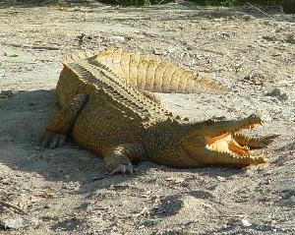

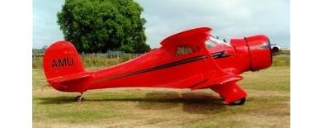

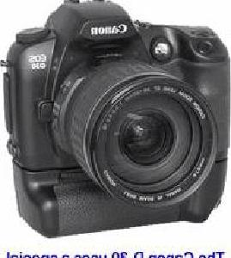
Data Mining
Lesson: Image processing
  Caltech 101 dataset
  http://www.vision.caltech.edu/Image_Datasets/Caltech101/
  Pictures of objects belonging to 101 categories
  Examples
  Lesson downloads
  https://adams.cms.waikato.ac.nz/ernz2014.html

Slide 11
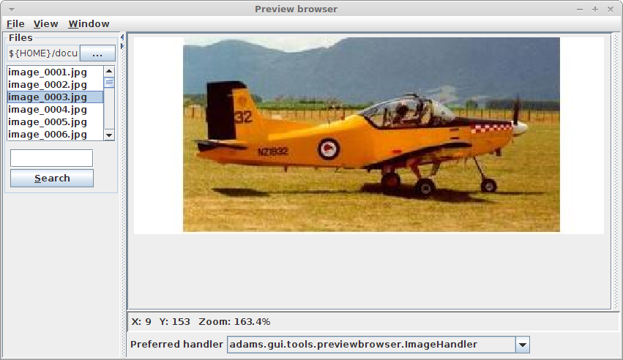
Data Mining (2)
Get a feel for the data

Slide 12
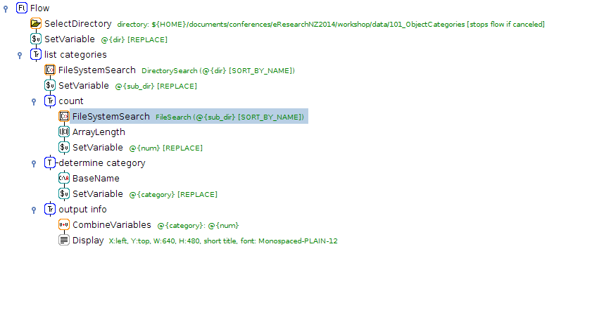
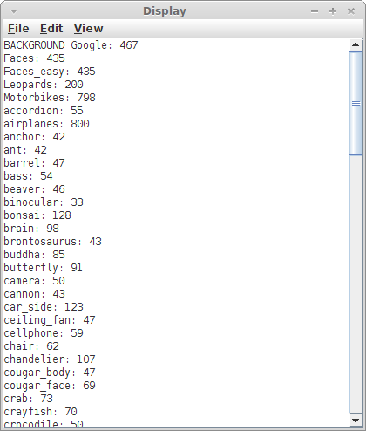
Data Mining (3)
Analyze categories

Slide 13
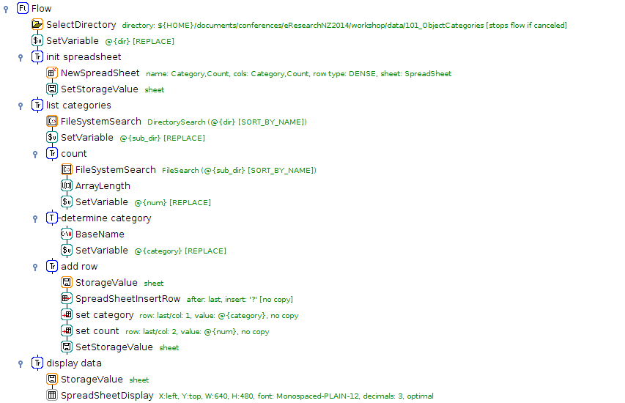
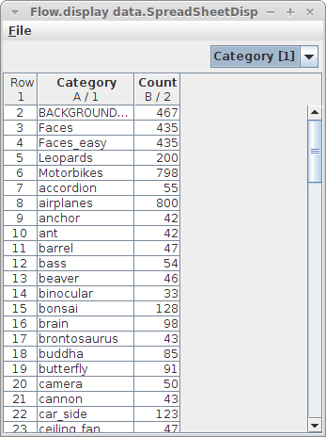
Data Mining (4)
“Fancy” display of categories

Slide 14
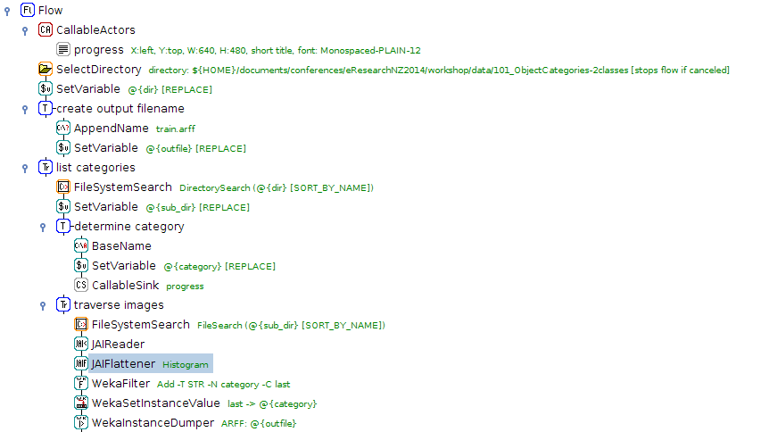
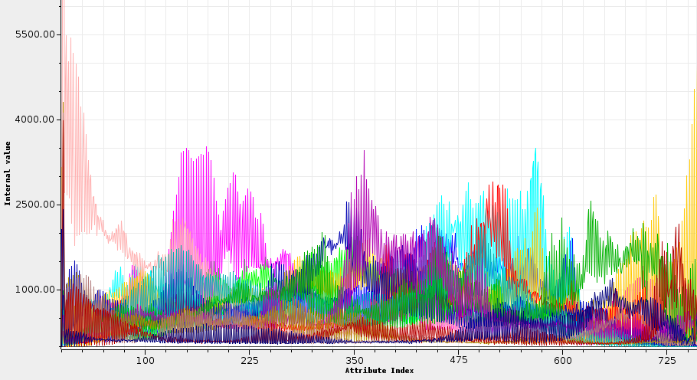
Data Mining (5)
Generate features/training data
Instance Explorer: raw data view

Slide 15
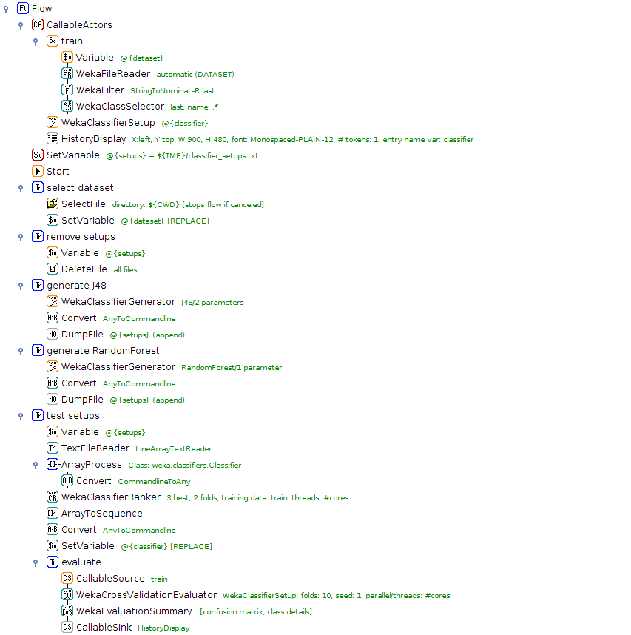
Data Mining (6)
Test
classifier
setups

Slide 16
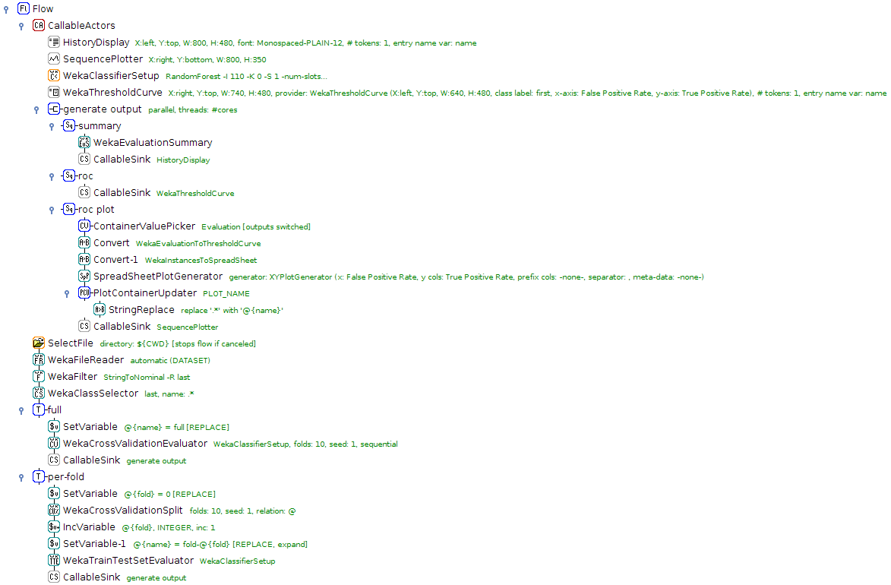
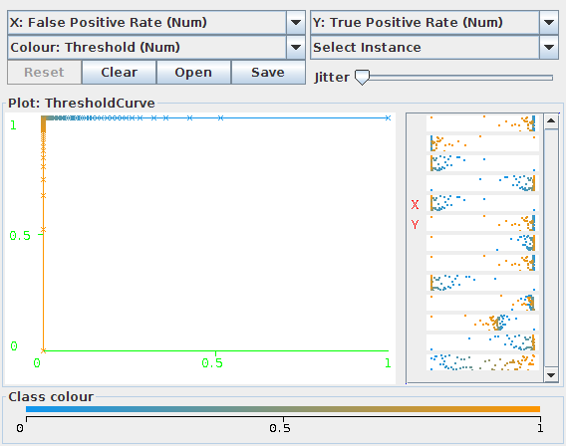
Data Mining (7)
Evaluate
classifiers

Slide 17
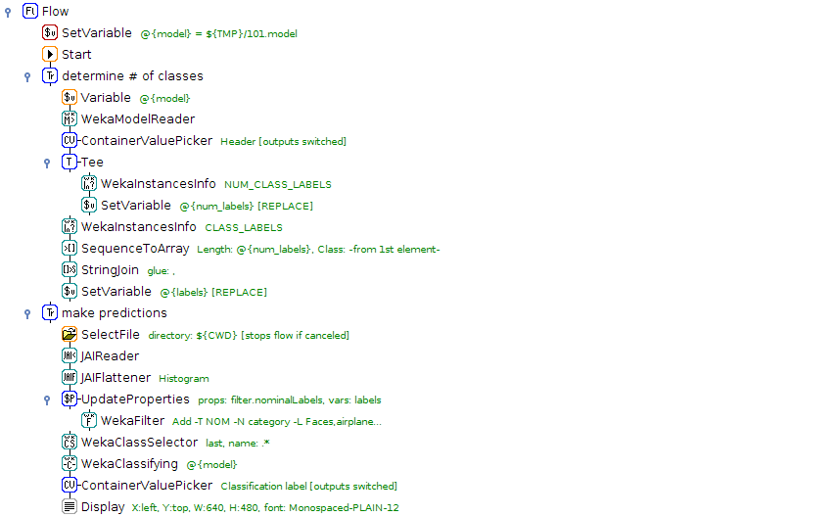
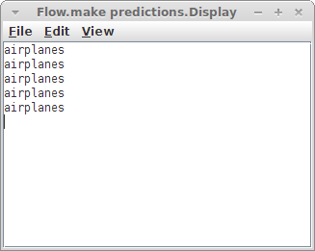
Data Mining (8)
Build and use model

Slide 18
Scripting
Lesson: Scripting with R, Groovy, Jython
  Near Infrared (NIR) data in proprietary Bruker SPC format
  hyperSpec R package reads certain SPC files
  http://cran.r-project.org/web/packages/hyperSpec/
  Install R packages
  > install.packages("Rserve")
  > install.packages("hyperSpec")
  Configure Jython $HOME/.jython
  python.security.respectJavaAccessibility=false

Slide 19
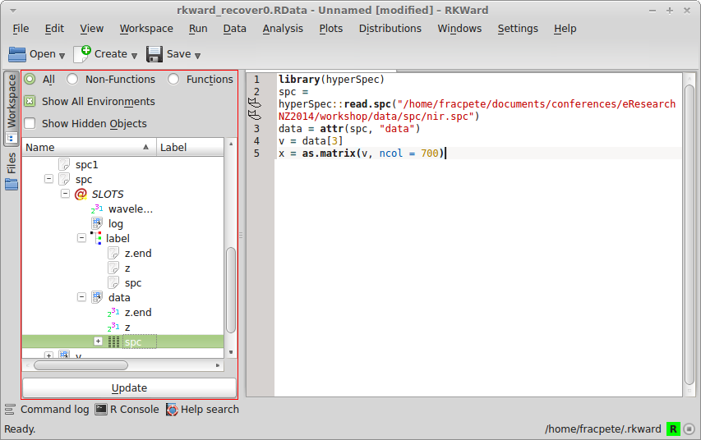
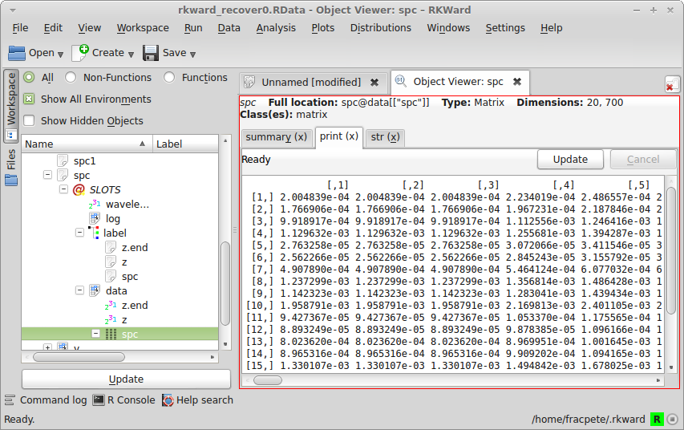
Scripting (2)
Use rkward to inspect data

Slide 20
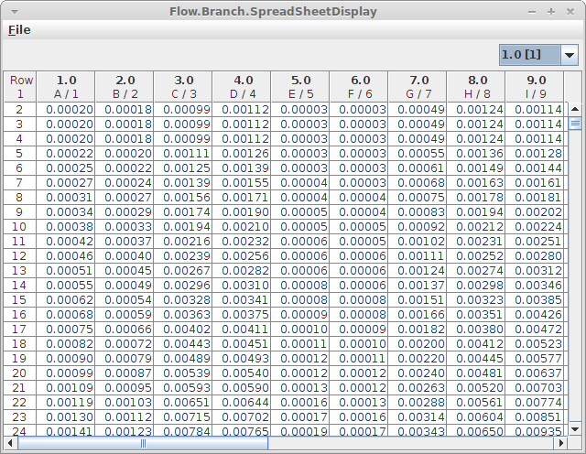
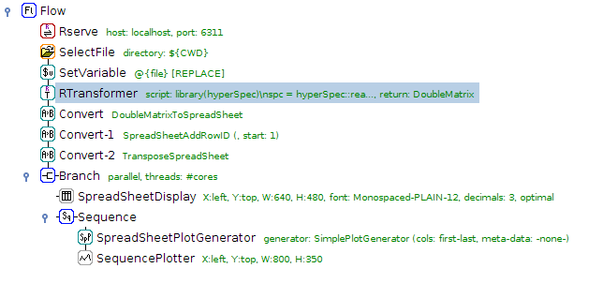
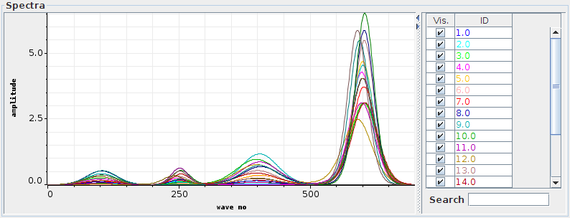
Scripting (3)
Connect to R via Rserve and run script to extract double matrix

Slide 21
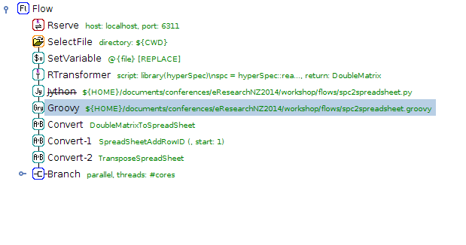
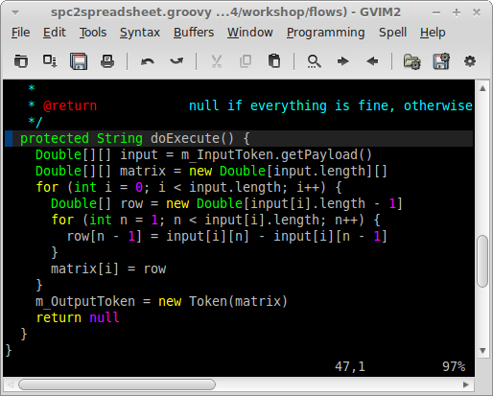
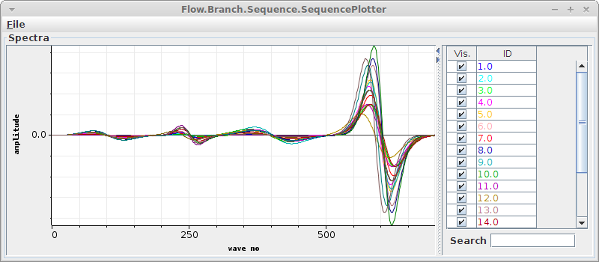
Scripting (4)
Use Groovy to compute 1st derivative

Slide 22
Scripting (4)
Use Groovy to compute 1st derivative

Slide 23
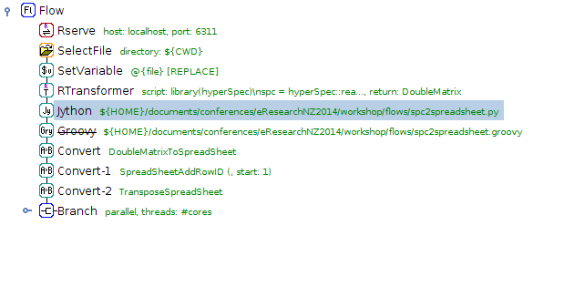
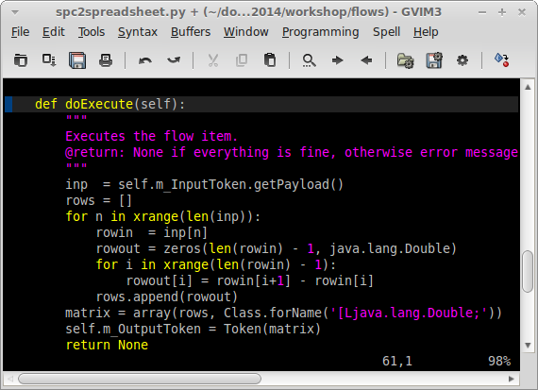
Scripting (5)
Use Jython to computer 1st derivative

Slide 24

Discussion
Questions?

