Slide 1
Big Data with ADAMS
The Basics

Slide 2
Outline
Using the interface
Plotting
Multiple plots
Combine multiple plots
Use variables in plots
Evaluate classifier
Evaluate multiple classifiers
Plot learning curve (inc and non-inc)
Variables and non-ADAMS classes
Storage for storing Instances
...

Slide 3
Big Data with ADAMS
Plotting

Slide 4
The Interface
Main menu launches GUIs of tools (eg WEKA)
“User mode” defines what menu items are visible
Additional tools for Weka (eg dataset handling)
Flows
  edited/executed/debugged with Flow editor
  executed with Flow runner
  executed from command-line (eg daemon/service)
  adams.flow.FlowRunner

Slide 5
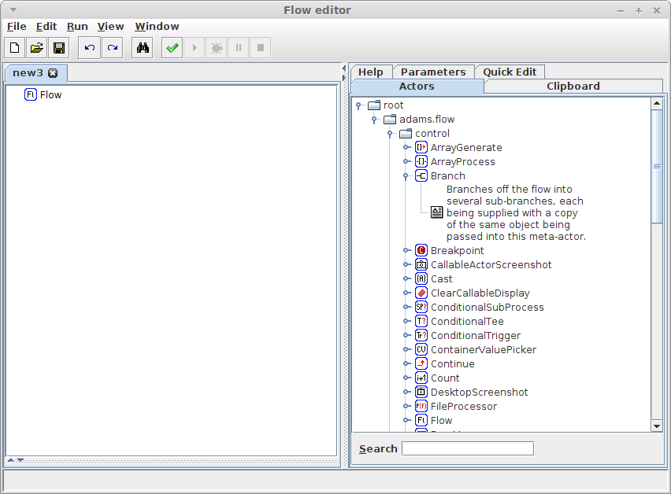
Flow editor
Split view: flow and tabs
optional tabs
workflow

Slide 6
Adding actors
Short description
Drag'n'drop

Slide 7
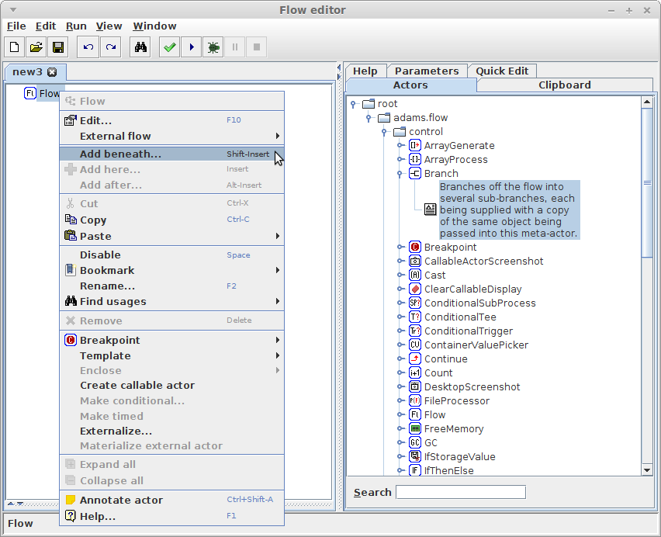
Adding actors (2)
Context-sensitive
popup menu

Slide 8
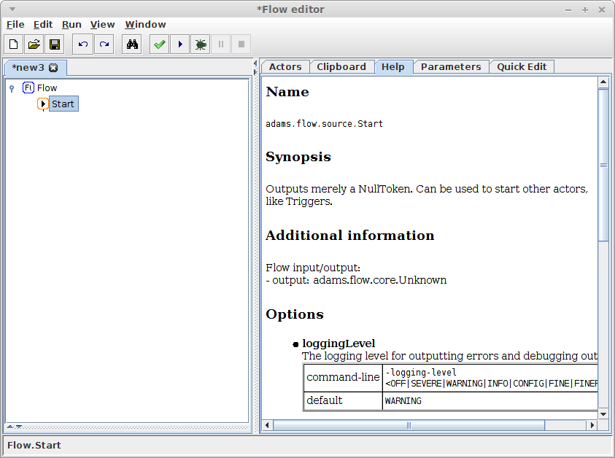
Actor help
online help
whenever actor
gets selected

Slide 9
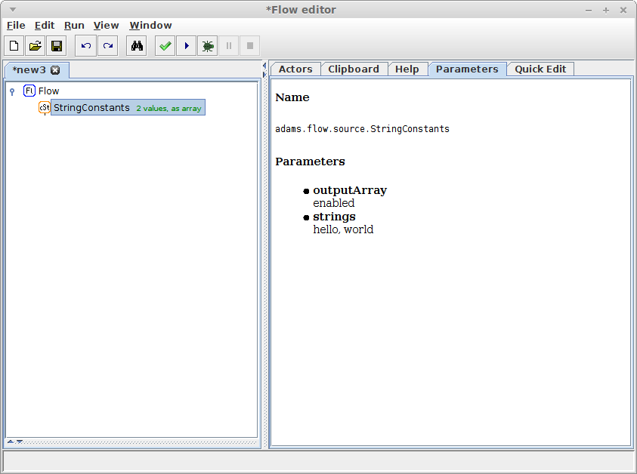
Actor parameters
display of
non-default
parameters,
whenever
actor gets
selected

Slide 10
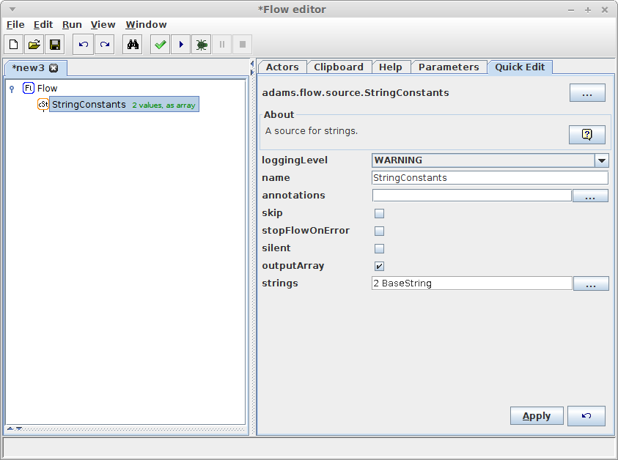
Actor quick edit
quickly changing
parameters without
bringing up edit
dialog, whenever
actor gets selected
NB: expensive

Slide 11
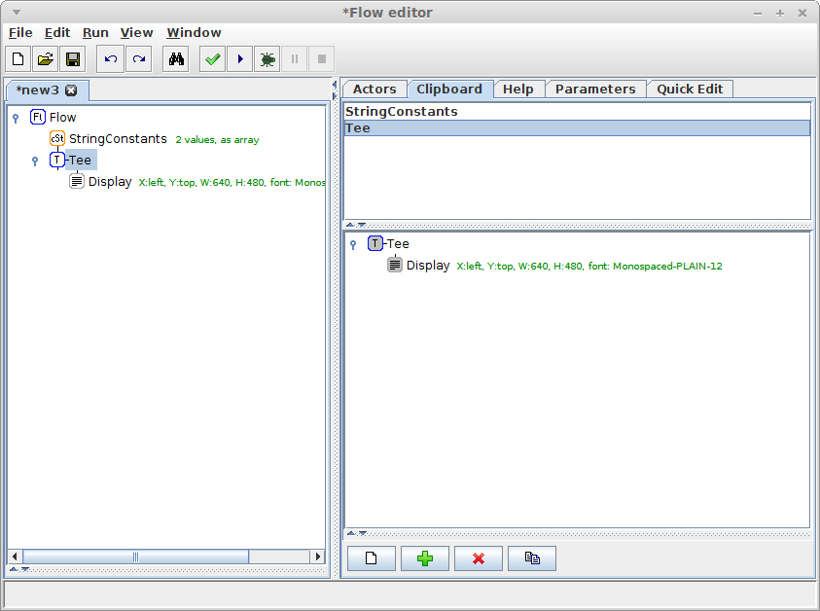
Clipboard
allows temporary
storage of multiple
subflows

Slide 12
Plotting
What we need
  generate some numbers
  turn them into a plot
What we use
  ForLoop source
  SimplePlot sink

Slide 13
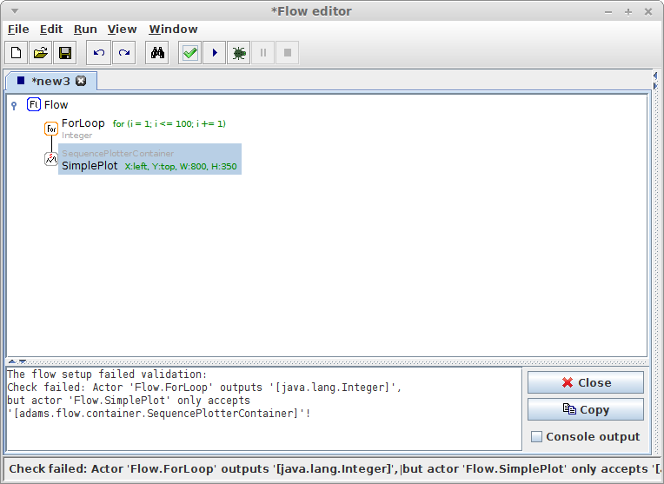
Plotting
Mismatch of
input/output
[View → Show
input/output]
Check/Run flow
Error message

Slide 14
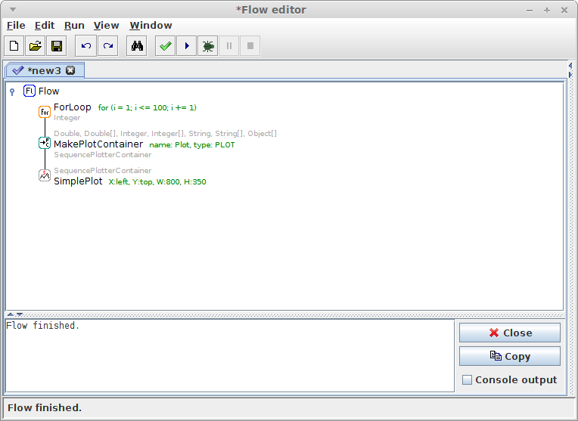
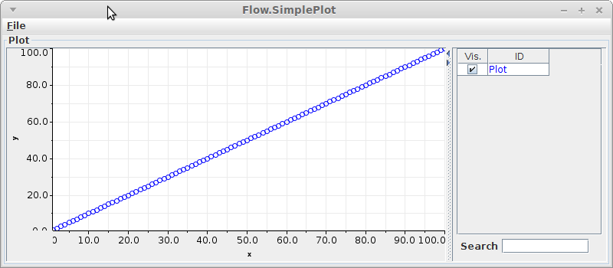
Plotting - fixed
add transformer:
MakePlotContainer

Slide 15
Plotting X/Y
let's plot a sawtooth function
how to implement the function?
  MathExpression transformer
formula
  2*(X/2-floor(0.5 + X/2)) using period of 2
another MathExpression to create fractions
  X/10

Slide 16
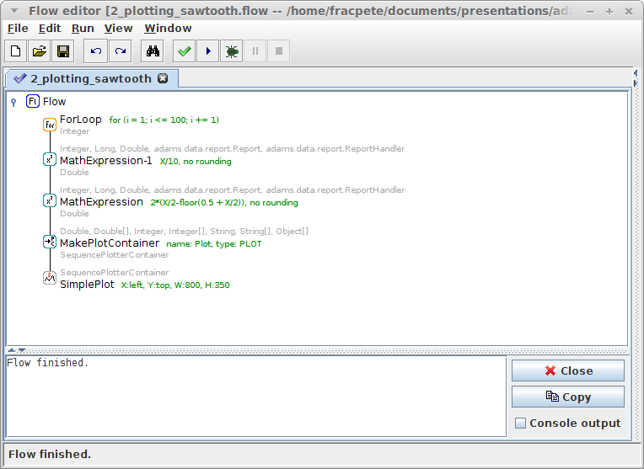
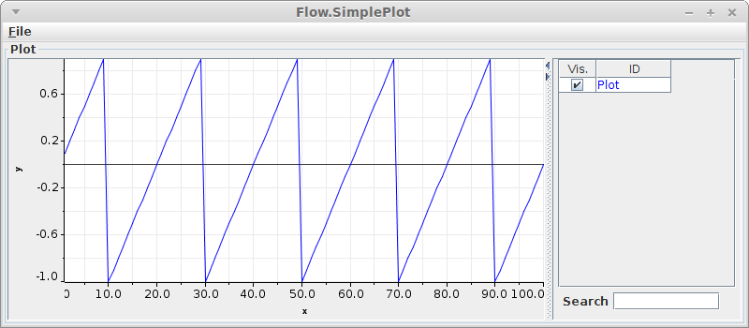
Plotting X/Y
create fraction
sawtooth

Slide 17
Multiple plots
Let's create multiple sawtooth plots
use period 2 and 3.7
use Branch actor
combine steps in Sequence actor

Slide 18
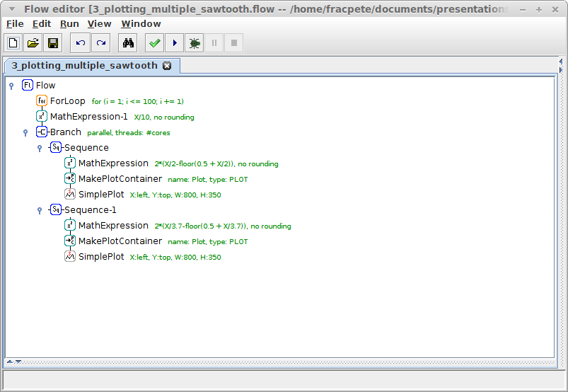
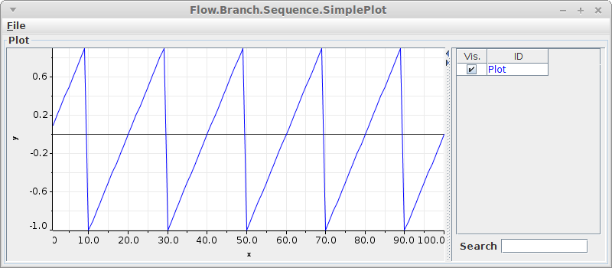
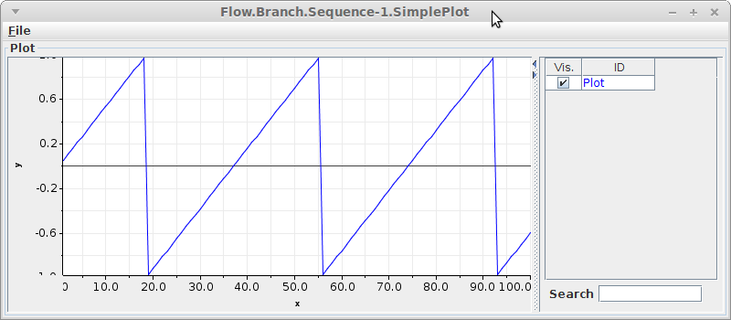
Multiple plots
period 2
period 2
period 3.7
period 3.7

Slide 19
Combining plots
Multiple plots are great, but...
Combine them in single plot window?
Make use of “callable actors”
  handler: CallableActors
  source: CallableSource
  transformer: CallableTransformer
  sink: CallableSink

Slide 20
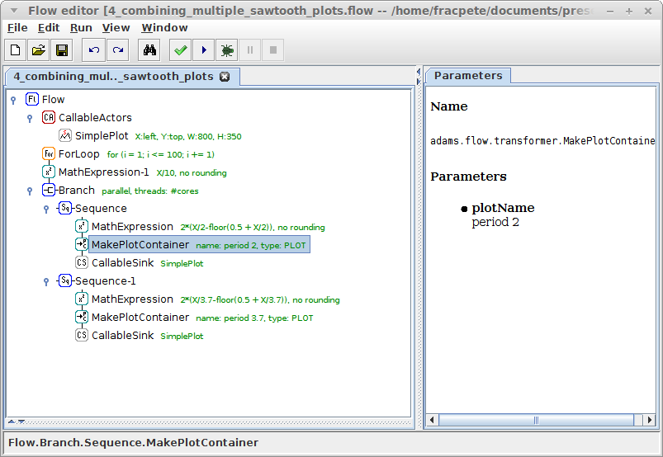
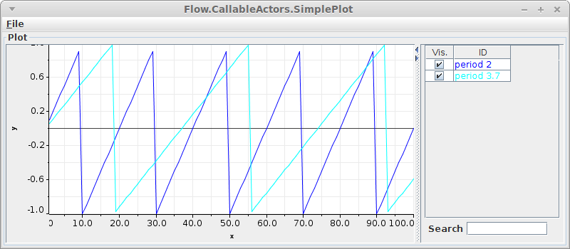
Combining plots
use different
plot names
to separate
plots in graph

Slide 21
Reduce duplication?
Two almost identical formulas
Use variables (can also be attached to options)
  SetVariable standalone
  Variable source
  VariablesArray source
  CombineVariables source
  SetVariable transformer
format of a variable: @{<name>}

Slide 22
Reducing duplication
Old formula
  2*(X/2-floor(0.5 + X/2))
New formula using @{period} as placeholder
  2*(X/@{period}-floor(0.5 + X/@{period}))
But that still doesn't solve the duplicate formula
Turn the formula into another variable and attach it to the MathExpression's expression option

Slide 23
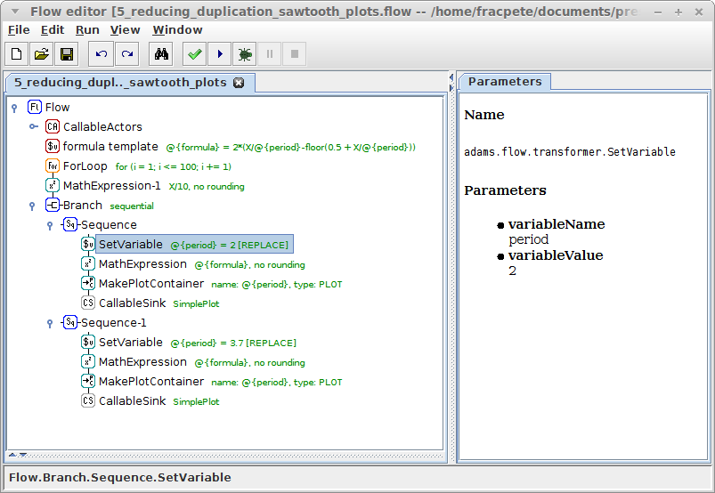
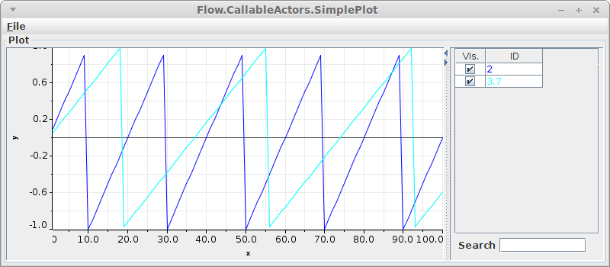
Reducing duplication
formula template
sequential
execution
variable attached
to “expression”
variable attached
to “plotName”

Slide 24
Avoid duplicate branch?
Can we avoid the duplicate branch?
Short answer: yes
Long answer
  make use of variables
  use Triggers
  use StringConstants as storage for the periods

Slide 25
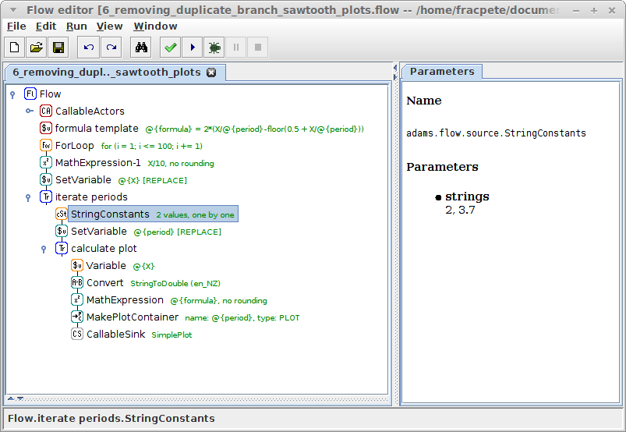

No duplicate branch
store fraction
in variable
store current
period in var
output one period
after the other
convert string
representation
of X into float

Slide 26
Quiz: Plotting
implement the following function
plot all combinations of
  mean: 0, 1, -2.2
  stdev: 1, 3
output the functions in the same plot window
Hint: you need the CombineVariables source

Slide 27
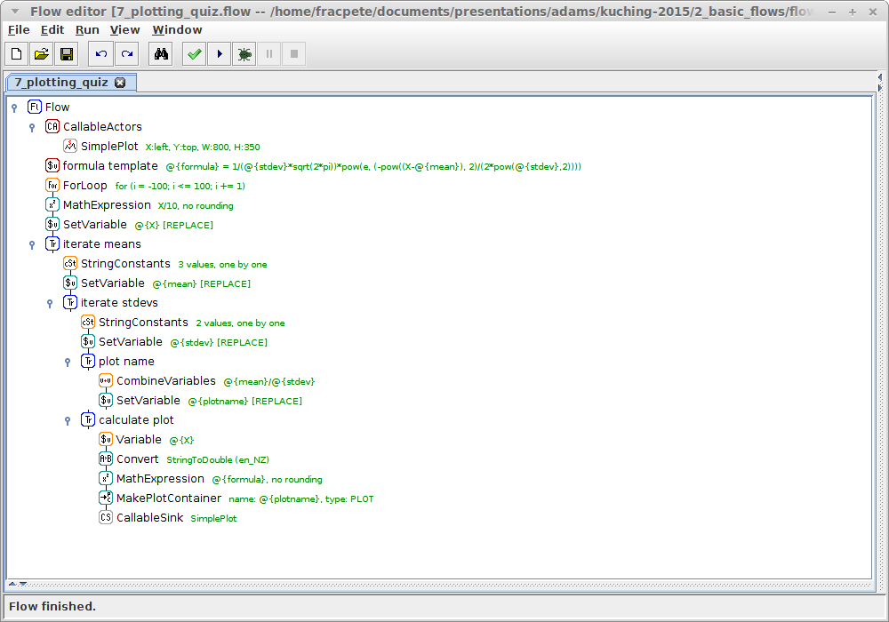
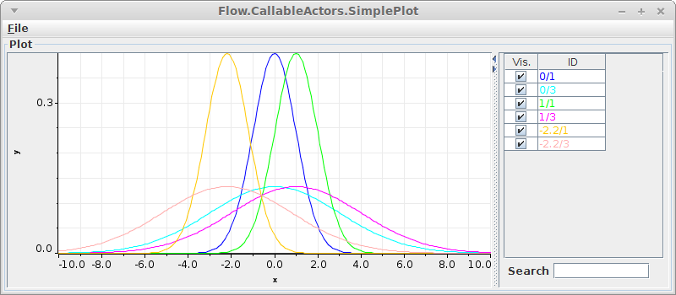
Quiz: Plotting
from neg
to pos
stdev as var
mean as var
plotname consists
of mean/stdev

Slide 28

Questions?
https://adams.cms.waikato.ac.nz/
@TheAdamsFlow

