Slide 1
Big Data with ADAMS
Extending ADAMS

Slide 2
How to extend?
From easy to hard
  Scripting
    Groovy
    Jython
  Java Project
    simply add ADAMS jars to CLASSPATH
  Maven Project
    create custom pom.xml and build your own project
    check out ADAMS source code and compile yourself

Slide 3
API basics (2)
dynamic class discovery
Actor life cycle
  setUp(): String
    configures the actor/flow, may return error message
  execute(): String
    executes the actor/flow, may return error message
  wrapUp()
    finishes up execution, leaves graphical output untouched
  cleanUp()
    destructive, removes graphical output
NB: Skipping adams.flow package prefix in following slides

Slide 4
API basics
Interfaces
  core.Actor - all actors
  core.InputConsumer - processes input
    input(Token)
  core.OutputProducer - generates output
    hasPendingOutput(): boolean
    output(): Token
abstract classes
  core.AbstractActor
  standalone.AbstractStandalone
  source.Abstract[Simple]Source
  transformer.AbstractTransformer
  sink.AbstractSink

Slide 5
API basics (3)
graphical sinks
  sink.AbstractDisplay
  sink.ComponentSupplier
    sink.AbstractGraphicalDisplay
  sink.TextSupplier
    sink.AbstractTextualDisplay
interactive actors
  Interfaces
    core.InteractiveActor
    core.AutomatableInteractiveActor
  abstract classes
    source.AbstractInteractiveSource
    transformer.AbstractInteractiveTransformer

Slide 6
API basics (4)
Actor handlers manage data flow
  interface: control.ActorHandler
  some use “directors” to direct the data stream, e.g.:
    Sequence
    IfThenElse
    Switch

Slide 7


Scripting
Available through these modules
  adams-groovy
  adams-jython
Advantages
  no compilation required
  access to all libraries on CLASSPATH
  fast prototyping
Limitations
  code executed in same JVM
  only pure-Python code will execute (no numpy!)

Slide 8
Scripting
Actors available
  Standalones
  Sources
  Transformers
  Sink

Slide 9
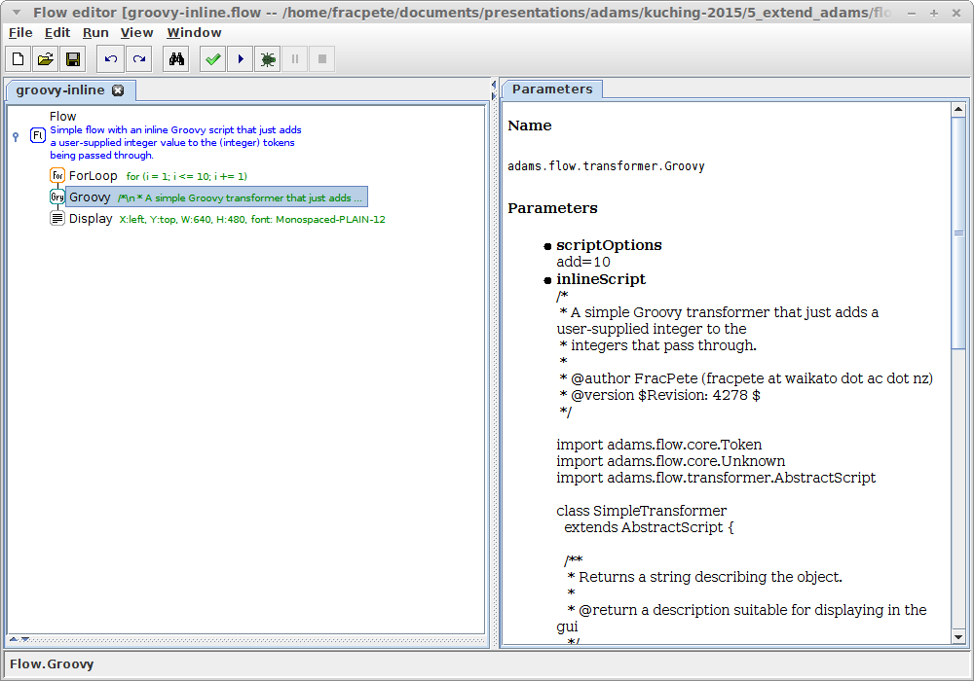
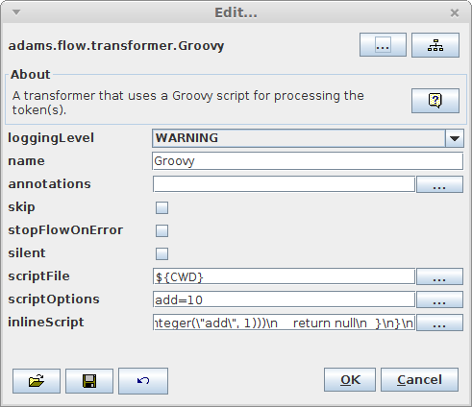
Scripting - Groovy
Inline script

Slide 10
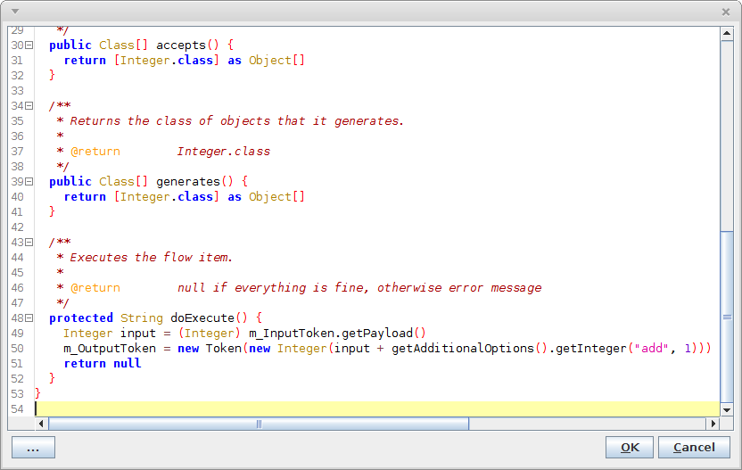
Scripting - Groovy
Inline editor

Slide 11
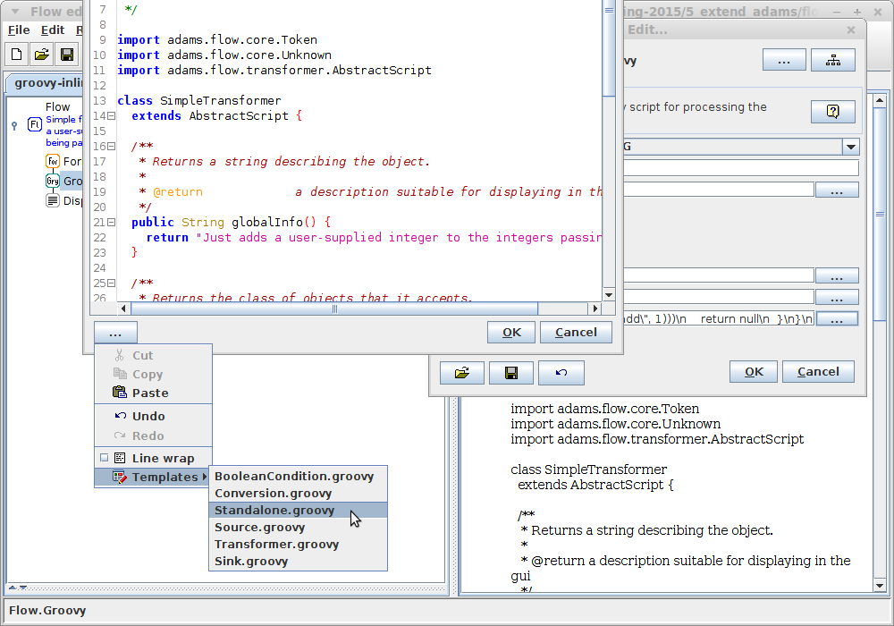
Scripting - Groovy
Templates

Slide 12
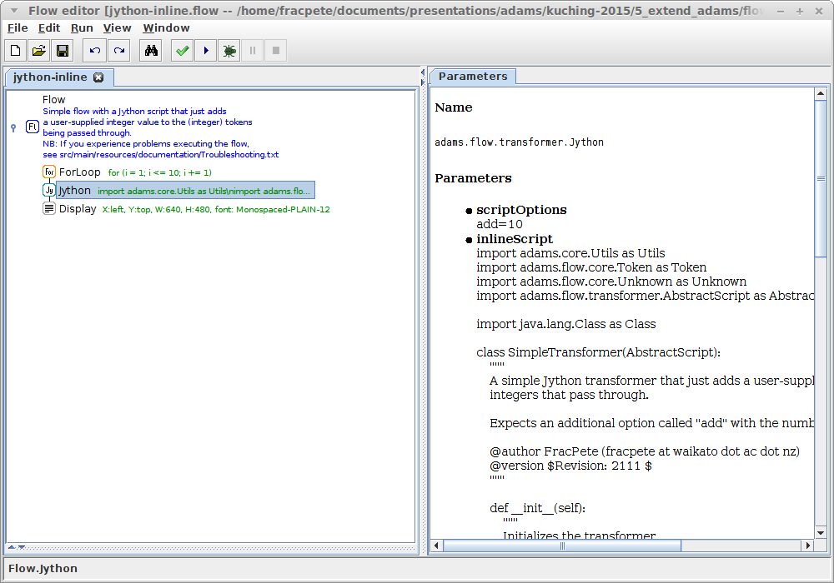
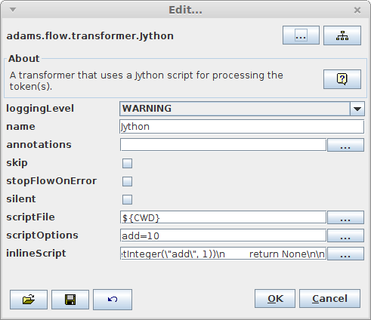
Scripting - Jython
Inline script

Slide 13
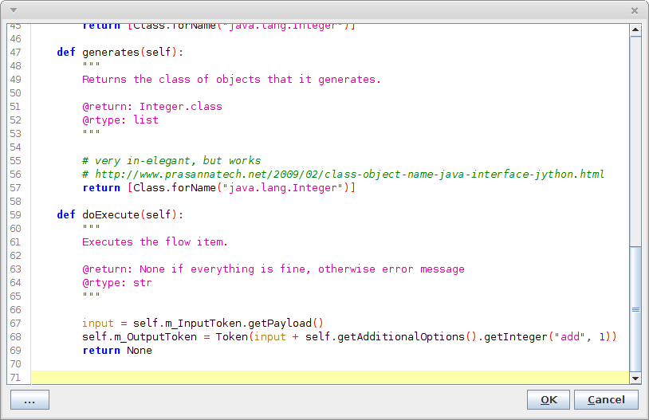
Scripting - Jython
Inline editor

Slide 14
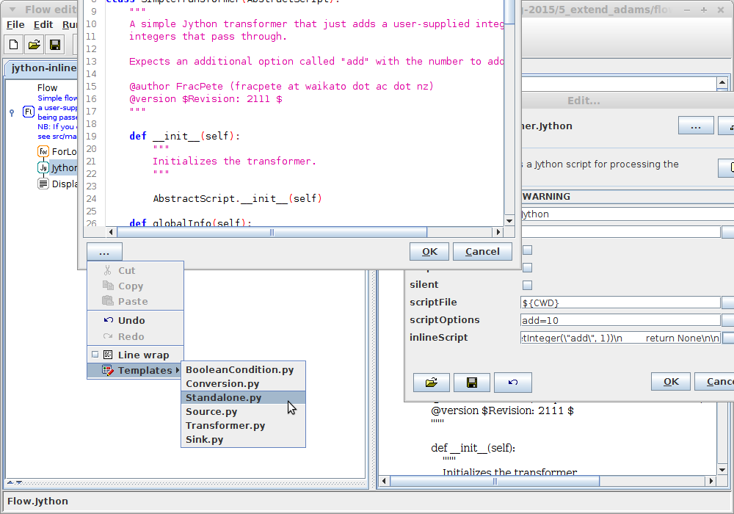
Scripting - Jython
Templates

Slide 15
Java Project
Download release or snapshot, decompress
Start your favorite IDE
Add jars from “lib” directory to the project's CLASSPATH
Ensure that “java-cup-11b-2015.03.26.jar” is listed first
Done!

Slide 16
Maven Project
Requires Maven 3.0+
  http://maven.apache.org/
Two options
  use “roll your own” feature, use existing artifacts *
    https://adams.cms.waikato.ac.nz/rollyourown.html
  check out from subversion, compile yourself
    https://adams.cms.waikato.ac.nz/dev_start.html
    NB: also requires LaTeX installed
* Maven needs to use the ADAMS Nexus server as mirror (settings.xml)

Slide 17

Questions?
https://adams.cms.waikato.ac.nz/
@TheAdamsFlow

