Slide 1
Big Data with ADAMS
The Basics

Slide 2
Outline
Evaluate classifier
Evaluate multiple classifiers
Plot learning curve (inc and non-inc)
Variables and non-ADAMS classes
Storage for storing Instances
...

Slide 3
Big Data with ADAMS
Machine learning

Slide 4
What's on offer?
WEKA *
  mainly batch learning, some incremental schemes
  classification, regression, clustering, association rules, data preprocessing
MOA *
  online learning (= data streams)
  classification, regression, clustering
MEKA
  multi-label and multi-target classification
R
  depends on your installed packages
* will be covered

Slide 5
WEKA
Actors have “Weka” prefix in name
Icons have “WK”
Examples
  WekaFileReader
  WekaFileWriter
  WekaCrossValidationEvaluator
  WekaTrainClassifier
  WekaClassifierSetup

Slide 6
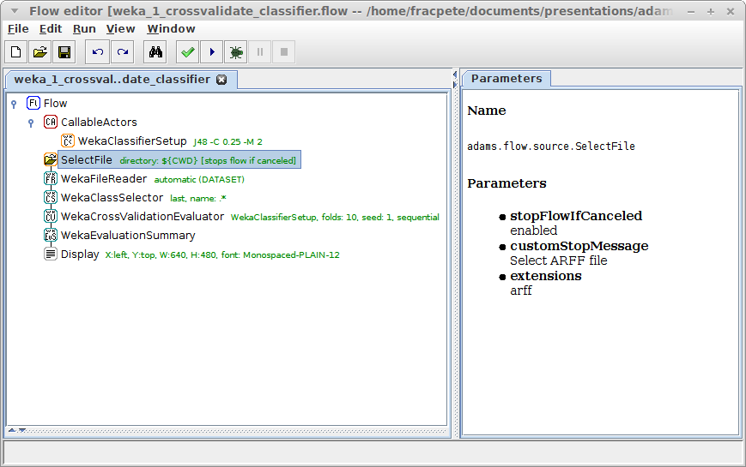
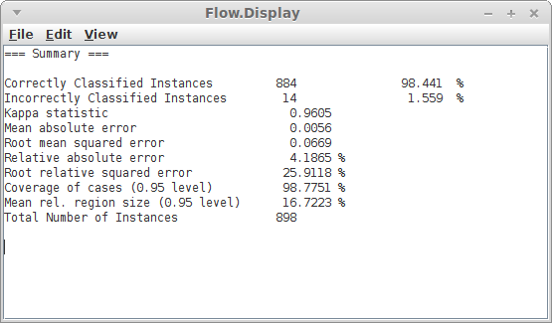
Cross-validate classifier
let user
select
dataset
CV uses
callable actor
load dataset
and set class
create summary
and display it

Slide 7
Per fold statistics
Output summary and plot accuracy per fold
Actors to use
  WekaCrossValidationSplit
  WekaTrainTestSetEvaluator
  WekaEvaluationSummary
  WekaEvaluationValuePicker
  SimplePlot
  HistoryDisplay

Slide 8
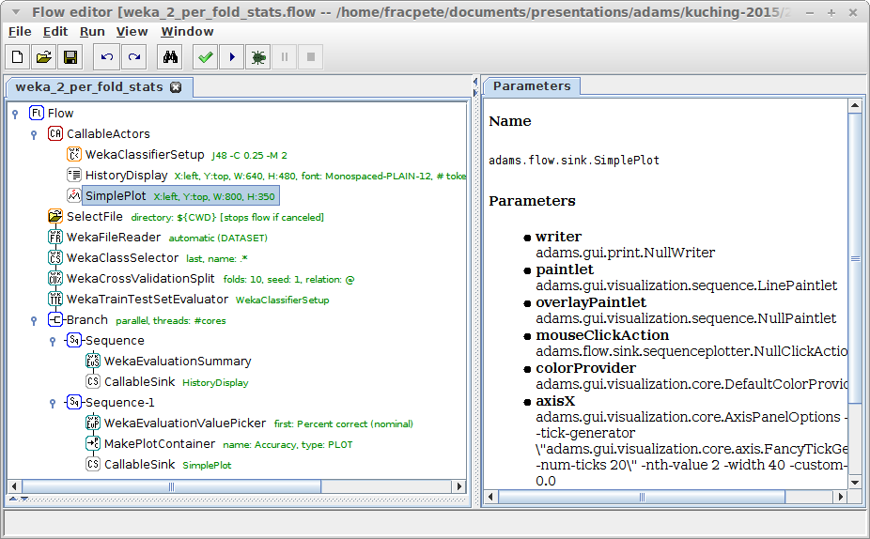
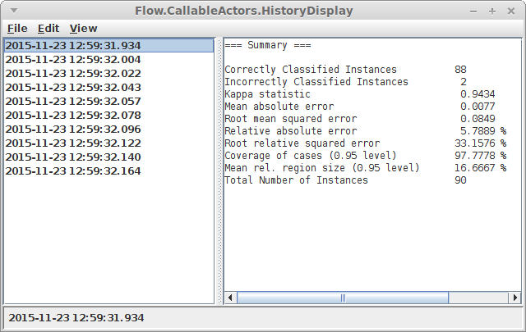
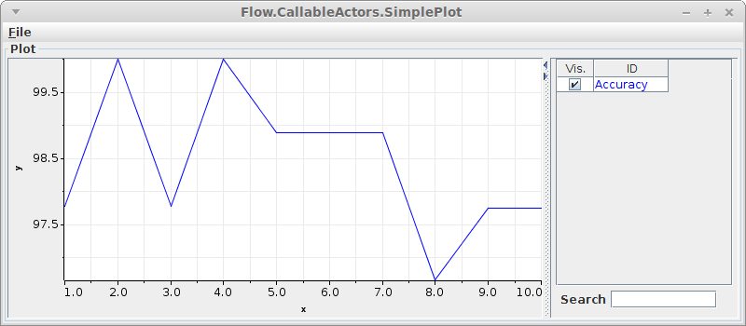
Per fold statistics
split into train/test
evaluate callable
actor
plot lines
create summary
of fold pair
extract accuracy
(= perc correct)

Slide 9
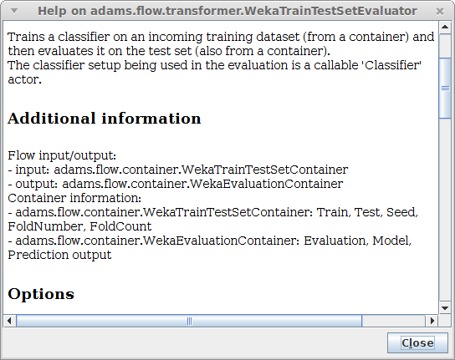
Per fold stats (numbered)
output models too
  WekaTrainTestSetEvaluator outputs container
  ContainerValuePicker
use variables to number folds
  SetVariable
  IncVariable
  use entryNameVariable
  in HistoryDisplay

Slide 10
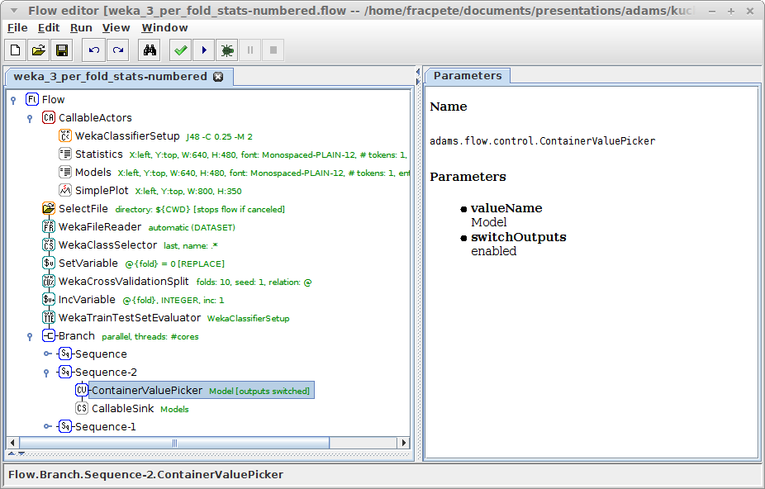
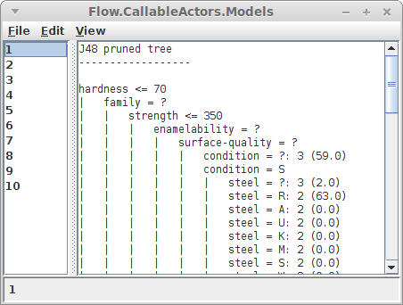
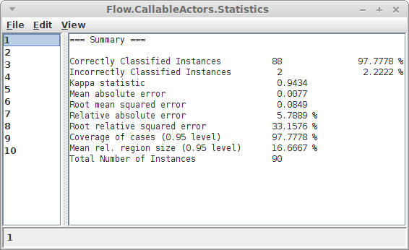
Per fold stats (numbered)
initialize var
“fold” with 0
specify name of
container value
to retrieve
increment
var “fold”
forward container value
rather than container
(and value in sub-flow)
retrieve “model”
from container

Slide 11
Train classifier
Rather than evaluating, let's build a classifier!
Also, save to disk and load it back in again
Actors to use
  WekaTrainClassifier
  WekaModelWriter
  WekaModelReader

Slide 12
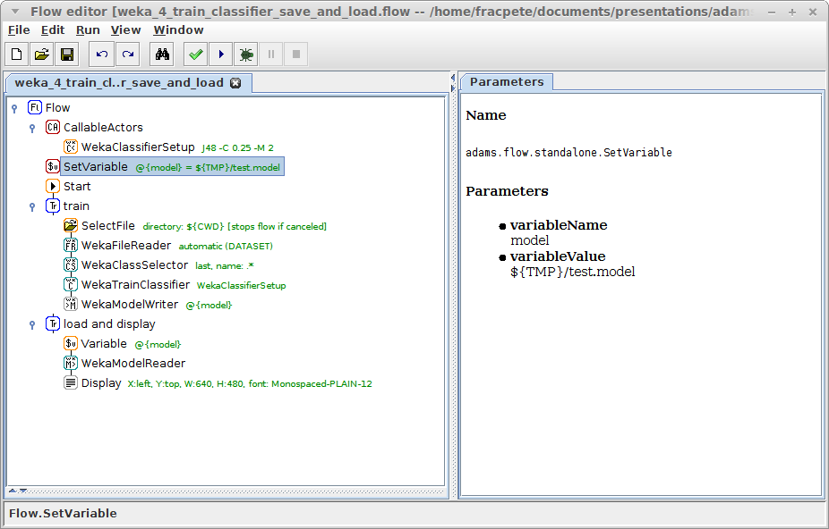
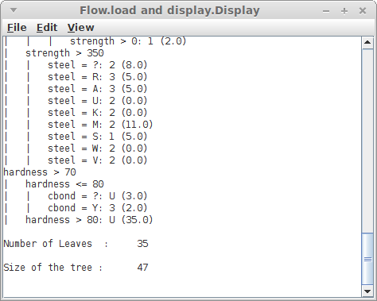
Train classifier
re-use filename
with a variable
train classifier
and save it
placeholder filenames
(system + user defined)
load model
(model + header)

Slide 13
Train and use classifier
Let's make some predictions!
Rather than loading serialized model, we'll store it in internal storage (key-value pairs)
Actors to use
  SetStorageValue (transformer)
  StorageValue (source)
  SequenceSource
  WekaInstanceBuffer
  WekaClassifying

Slide 14
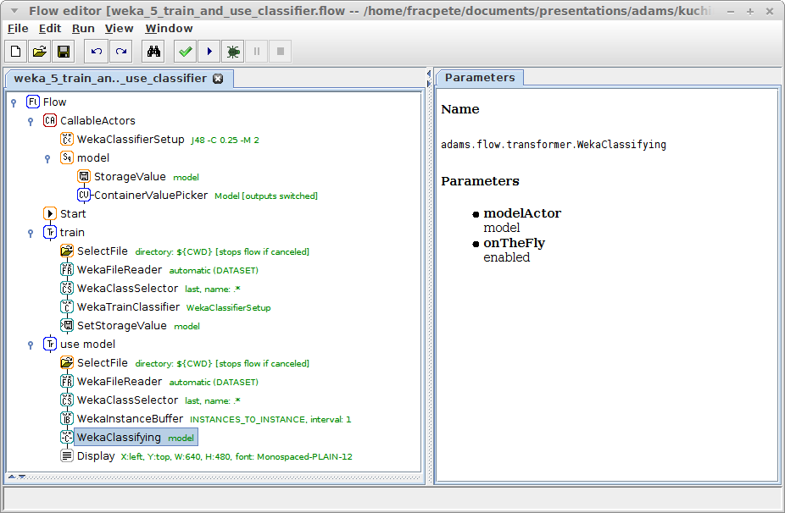
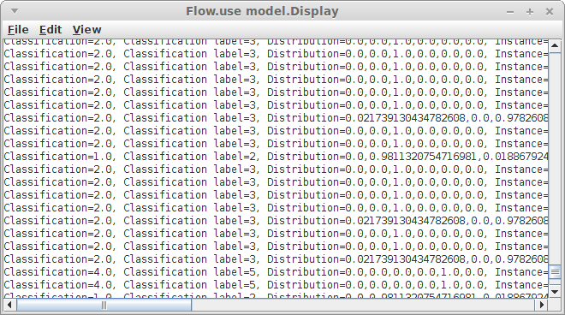
Train and use classifier
retrieve model
container,
extract model
store model
container in
storage
model is built
“on the fly”
turn dataset
into rows
use model from
callable actor
“model”

Slide 15
Change classifier options
variables can be attached to options
doesn't work for frameworks other than ADAMS
solution
  manipulate Java object via property path
available actors
  SetProperty (of callable actor)
  GetProperty (of object passing through)
  UpdateProperty (of object passing through)
  UpdateProperties (of sub-actor)

Slide 16
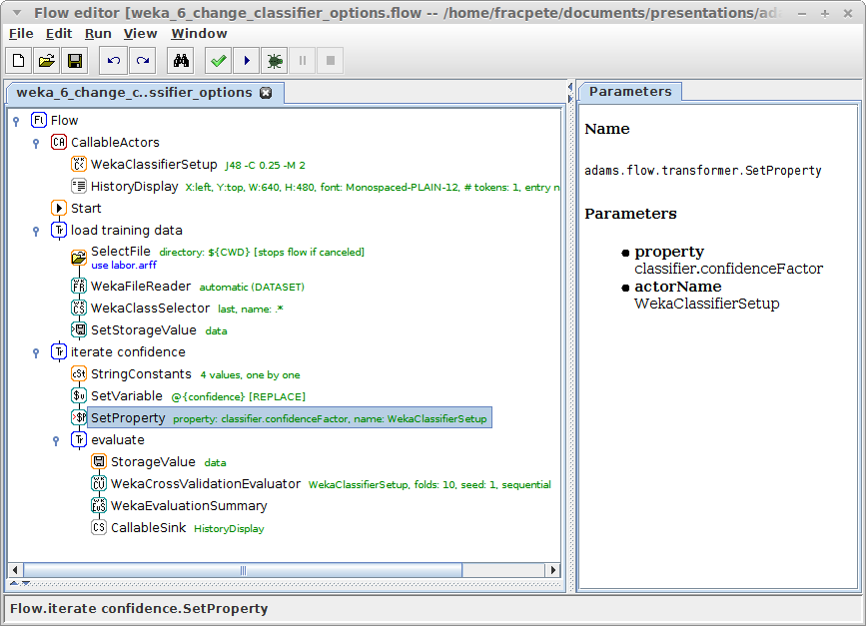
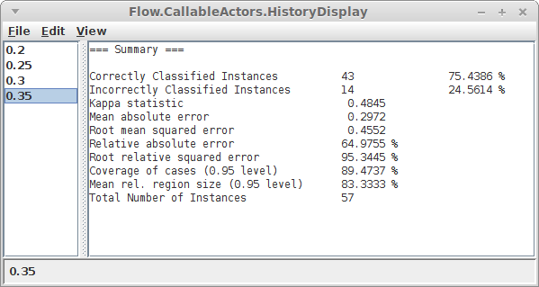
Change classifier options
the classifier
to modify
load dataset and
put in storage
update property
of callable actor
the property path
of the confidence
factor of J48
evaluate on data
from storage

Slide 17
Regression
Instead of classification use regression
Display classifier errors as graph
Actors to use
  WekaClassifierErrors
    actual vs. predicted
  WekaAccumulatedError
    sorts the error values and creates plot containers

Slide 18
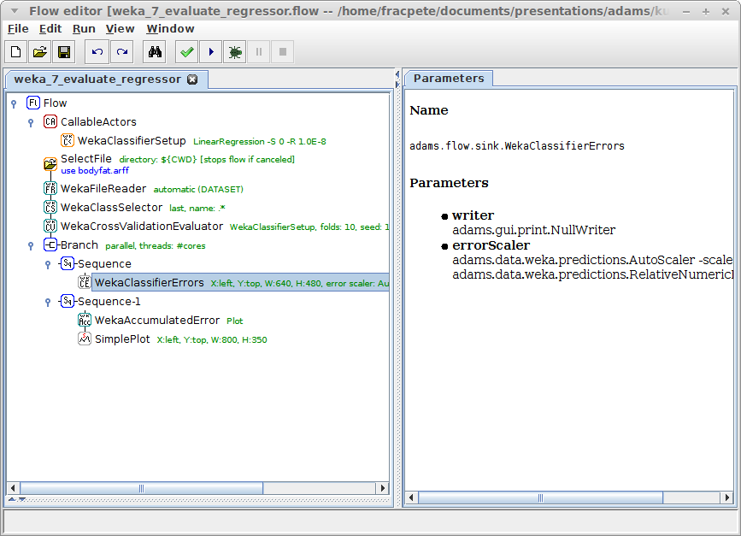
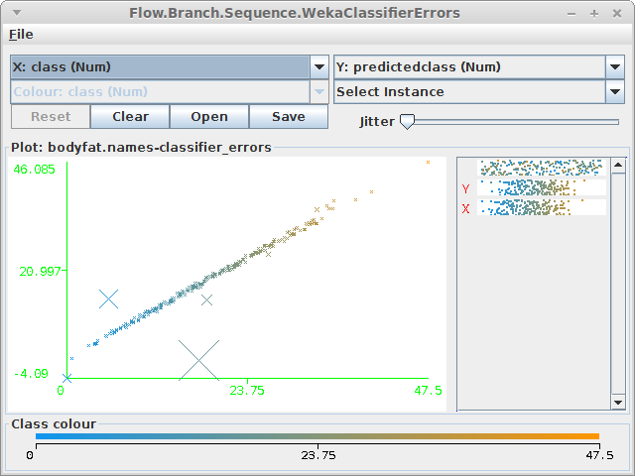
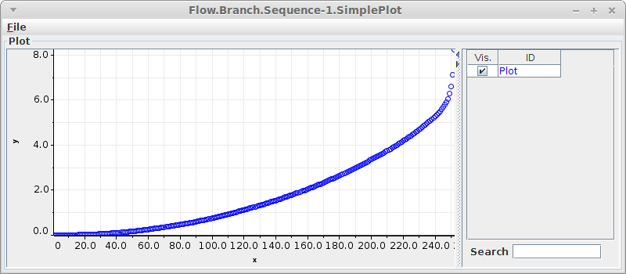
Regression
various ways of
displaying data
Weka plot of
act vs pred
errors sorted
by size for plot

Slide 19
Quiz: Weka
Evaluate each of these classifier setups
  RandomForest with 250 trees
  SMO with RBF kernel and logistic models
On these datasets
  labor.arff
  anneal.arff
Display evaluation summaries

Slide 20
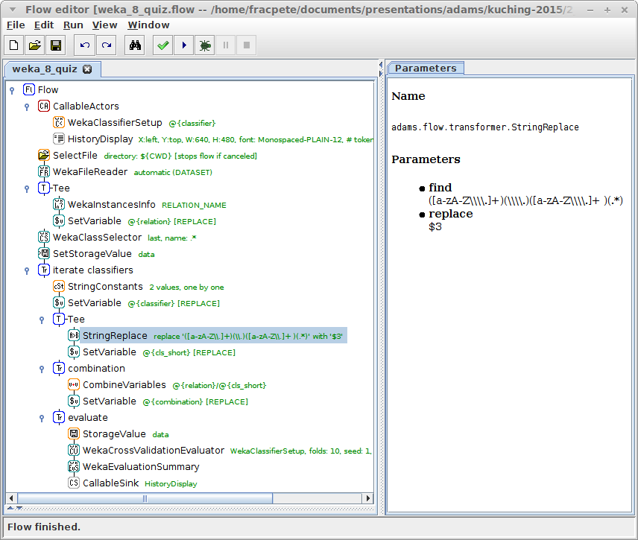
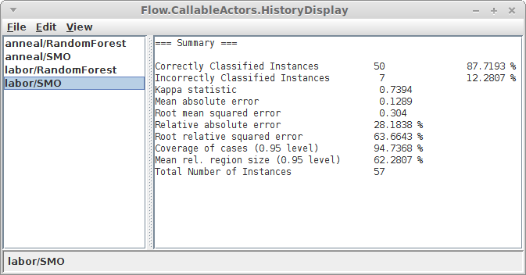
Quiz: Weka
classifier setup has
variable attached
user selects datasets
to evaluate on
extract relation name
from current dataset
classifier setups are
stored as string
(copy/paste from
Weka Explorer)
extract classifier name
using regular expression
cross-validate current
classifier/dataset
combination and display

Slide 21
MOA

Slide 22

Questions?
https://adams.cms.waikato.ac.nz/
@TheAdamsFlow

