Slide 1
Big Data with ADAMS
What the heck is ADAMS?

Slide 2
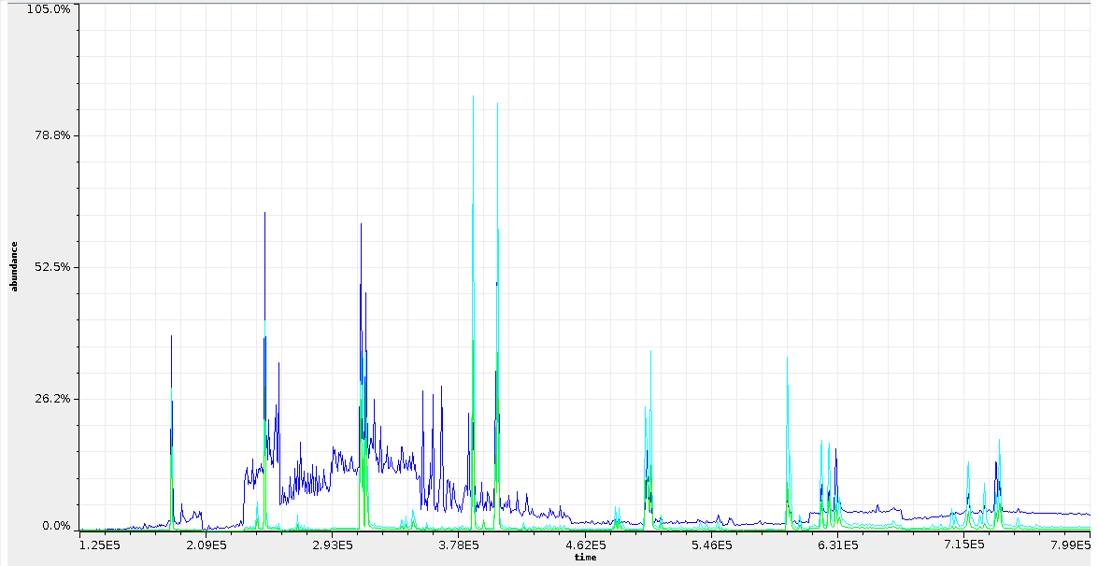
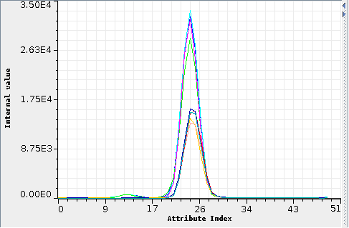
How things started
PAH domain (poly-aromatic hydrocarbons)

Slide 3
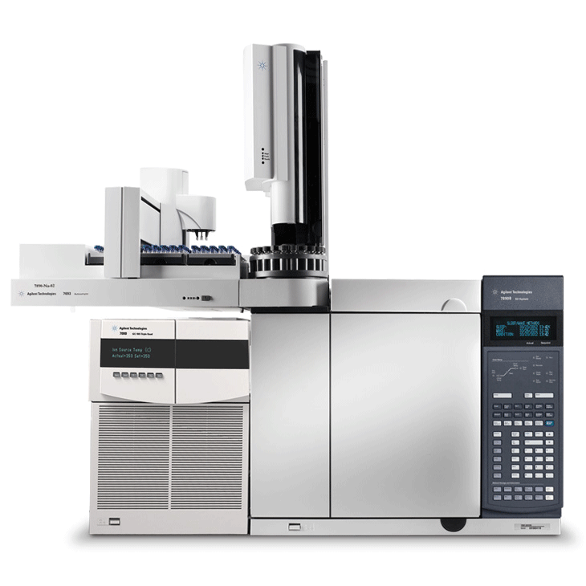
GC-MS Challenges
Multi-dimensional
(each GC point has 2-dim MS data attached)
Retention time shifts (x-axis, linear and non-linear)
Baseline shifts (y-axis)
Noise (impurities in samples)
Coelution (shoulder peaks)
Varying sample rates (x-axis)
Hardware problems (detector saturation)
Multiple compounds to predict

Slide 4
Solution
Extensive pre-processing
Pre-processing/prediction in parallel for various compounds
→ Workflow engine, but which one?

Slide 5
Workflow systems
most workflow systems are “canvas-based”
  user places operators on canvas
  manually connects operators
older system were DAG-based
  eg using a tree-layout
following examples
  cross-validation of classifier on single dataset
  output of results

Slide 6
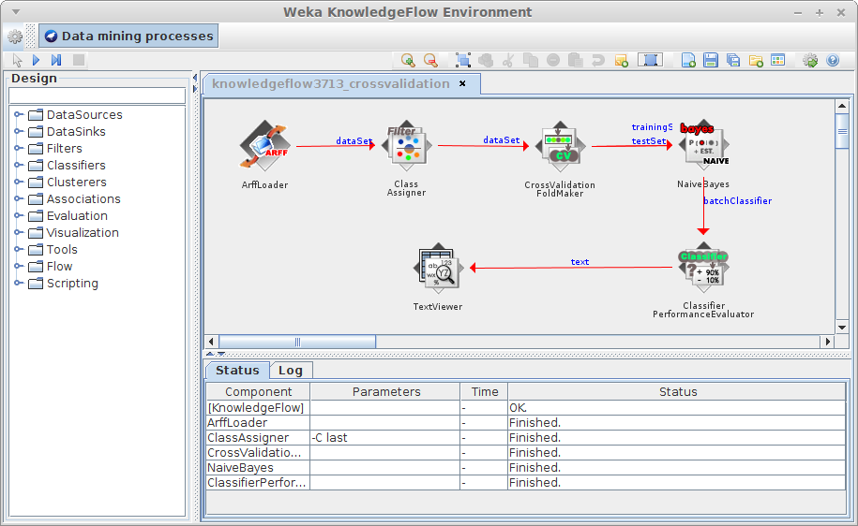
Workflow systems (2)
WEKA KnowledgeFlow 3.7.13

Slide 7
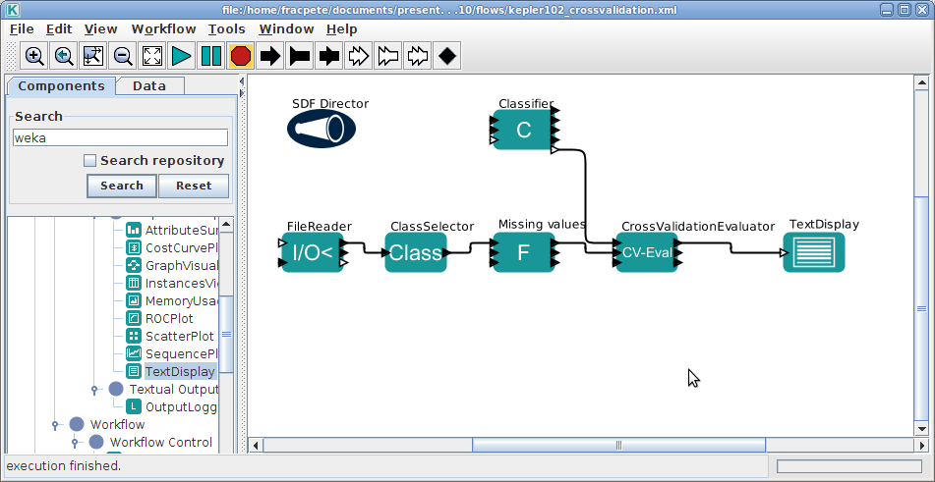
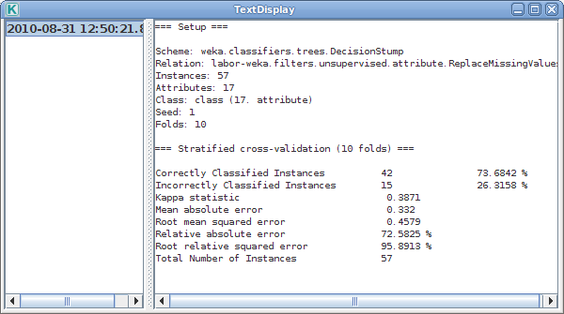
Workflow systems (3)
Kepler 1.0.2

Slide 8
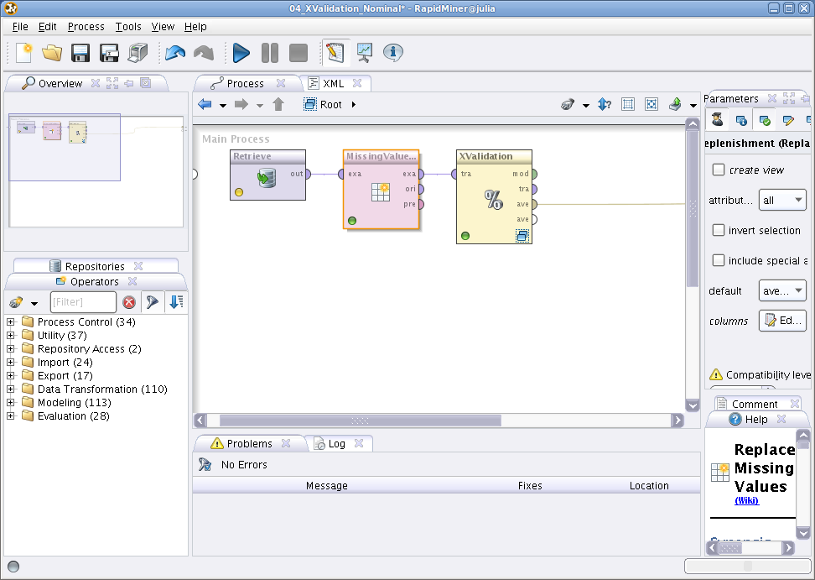
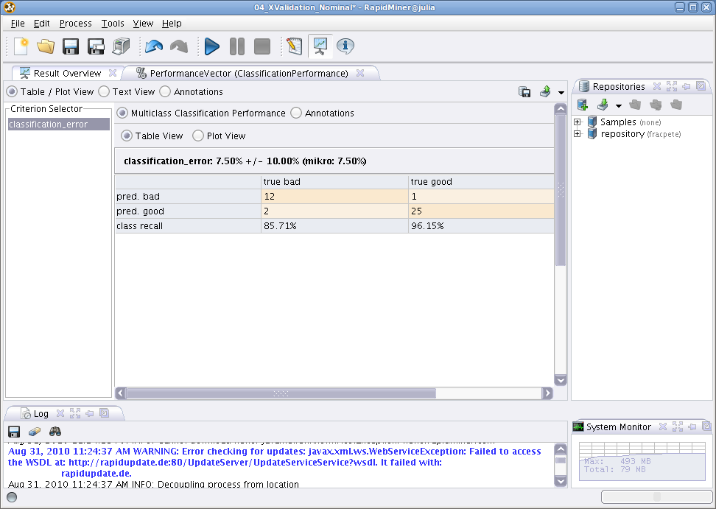
Workflow systems (4)
RapidMiner 5.0 (“free” 6.5 is useless)

Slide 9
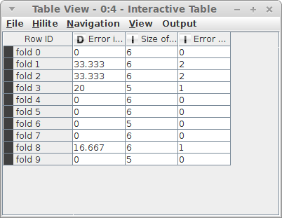
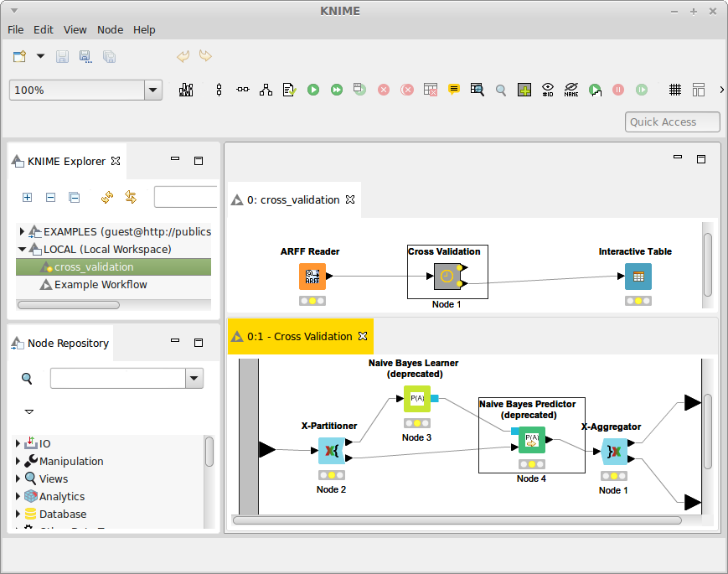
Workflow systems (5)
KNIME 3.0.1 (imported from 2.3.1)

Slide 10
Why another workflow?
KnowledgeFlow too WEKA-centric
Initial development with Kepler
Canvas-based set up is tedious
Only minimal subset of functionality necessary
(e.g., no grid computing)
Primary connection types: 1-to-1 and 1-to-n
→ prototype implementation

Slide 11
What is ADAMS?
Java, GPLv3
Base modules
  access, core, compress, event, excel, gnuplot, groovy, imaging (+boofcv, imagej, imagemagick, openimaj), jython, latex, maps, meta, moa, net, odf, osm, pdf, r, random, spreadsheet, timeseries, twitter, visualstats, weka
Add-ons modules
  heatmap, image-webservice, jooq, meka, rats, video, webservice, weka-webservice
Incubator modules
  nlp, jclouds, openstack, openml, javacv, ...

Slide 12
Flow
Operators are called “actors”
Actors arranged in tree, no connections
Actor “handlers” nest other actors
  e.g., sequence of actors
Control actors control data flow
  e.g., branch , tee , if-then-else , switch
Input/output defines
standalone , source , transformer , sink

Slide 13
Flow (2)
Data-driven system, but events possible
Tree only supports 1-to-n connections
Simulating n-to-m semantics
  Containers
  Variables
  Internal storage
  Callable actors

Slide 14
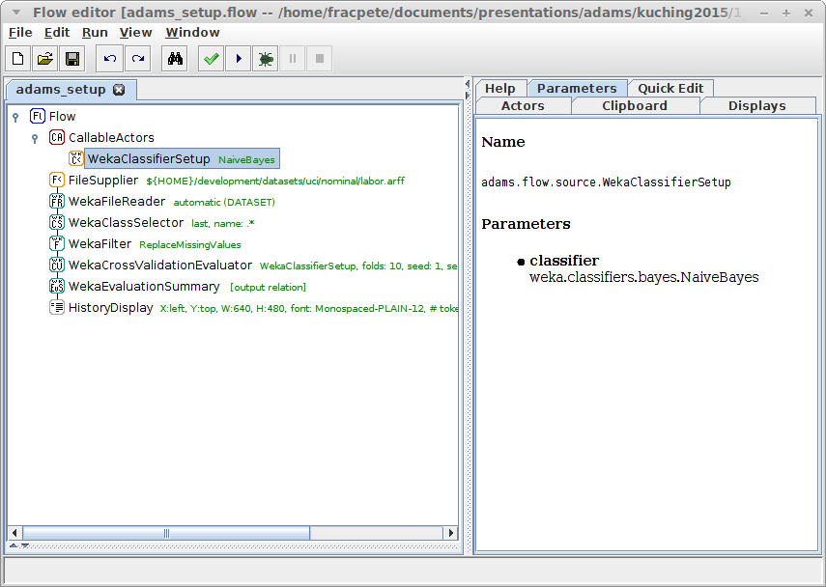
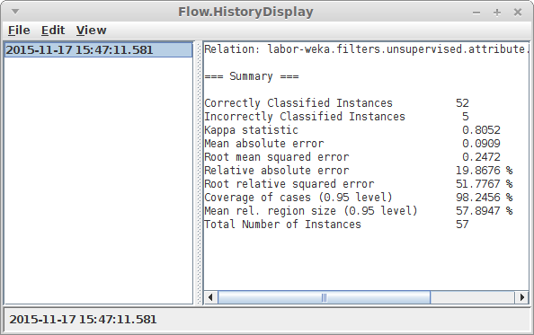
Previous example
Same workflow in ADAMS

Slide 15
Examples
Execute nested actors one after the other
Output file to read
Read file
Load dataset,
apply filter and
display dataset
Set class attribute
Apply filter
Display data

Slide 16
Examples (2)
Generate data stream
Feed data into branches
1st sequence of steps
Filter data stream in two separate branches with different filters, evaluate classifier and plot metric
Apply stream filter
Evaluate classifier
Filter measurement of interest
Generate data for plot
Plot
2nd sequence of steps
Apply different stream filter

Slide 17
Examples (3)
groups actors accessible via their name (“callable actors”)
combined plot
...
Generate combined plot of two evaluations by using “callable actors” functionality
1st evaluation: create plotting data
Pump data into referenced plot
...
2nd evaluation: create plotting data
Pump data into referenced plot

Slide 18
Tensorflow
Feature | ADAMS | Tensorflow
Bindings | Java | Python and C++
GUI | 
Scripting | Groovy/Jython | Python
GPU |  | 
Deep learning |  | 
Non-deep learning | 
Multi-processor |  | 
Parallel execution |  | 
Remote execution | 
Data flow programming | kind of | 
Platforms | Linux, Mac, Windows | Linux, Mac
License | GPLv3 | Apache 2.0
TensorFlow Disappoints – Google Deep Learning falls shallow [source: KDNuggets]

Slide 19
Research (demos)
Compare two MOA classifiers (drift)
Compare MOA classifier on different streams
MOA cluster visualization
Track mouse in video

Slide 20
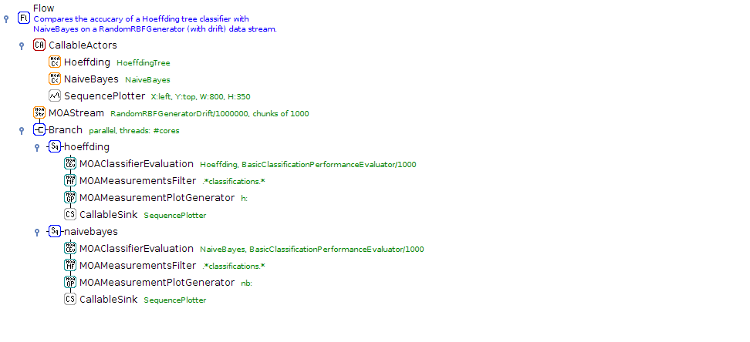
MOA - Drift

Slide 21
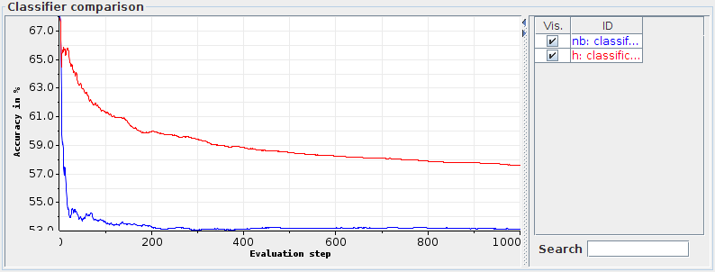
MOA - Drift

Slide 22
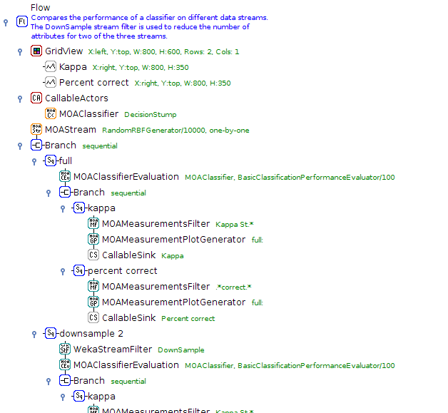
MOA - different streams

Slide 23
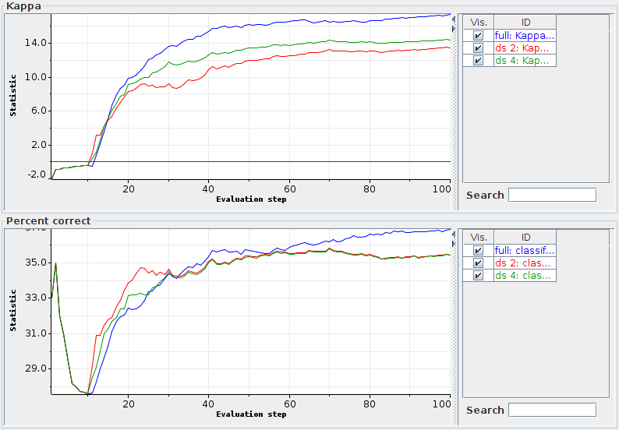
MOA - different streams

Slide 24
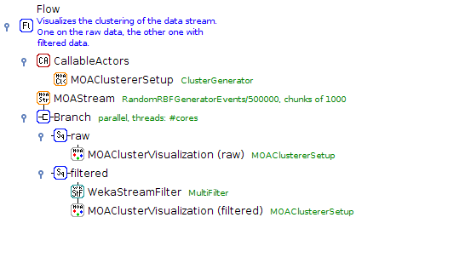
MOA - Cluster visualization

Slide 25
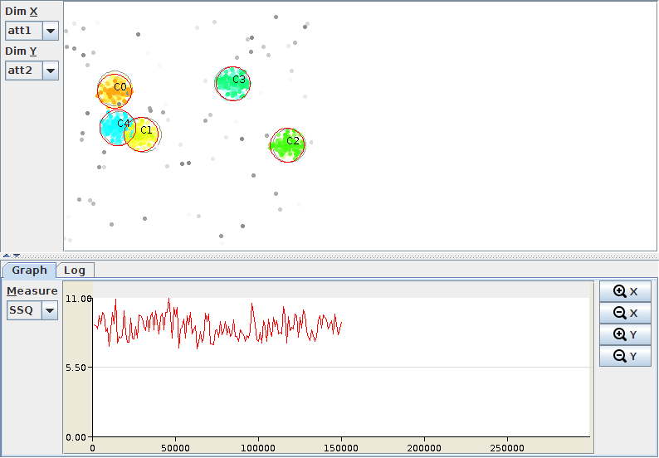
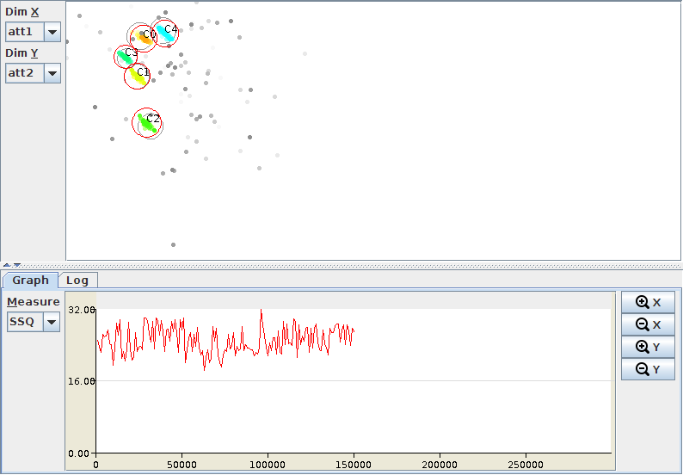
MOA - Cluster visualization
Stream 2
Stream 1

Slide 26
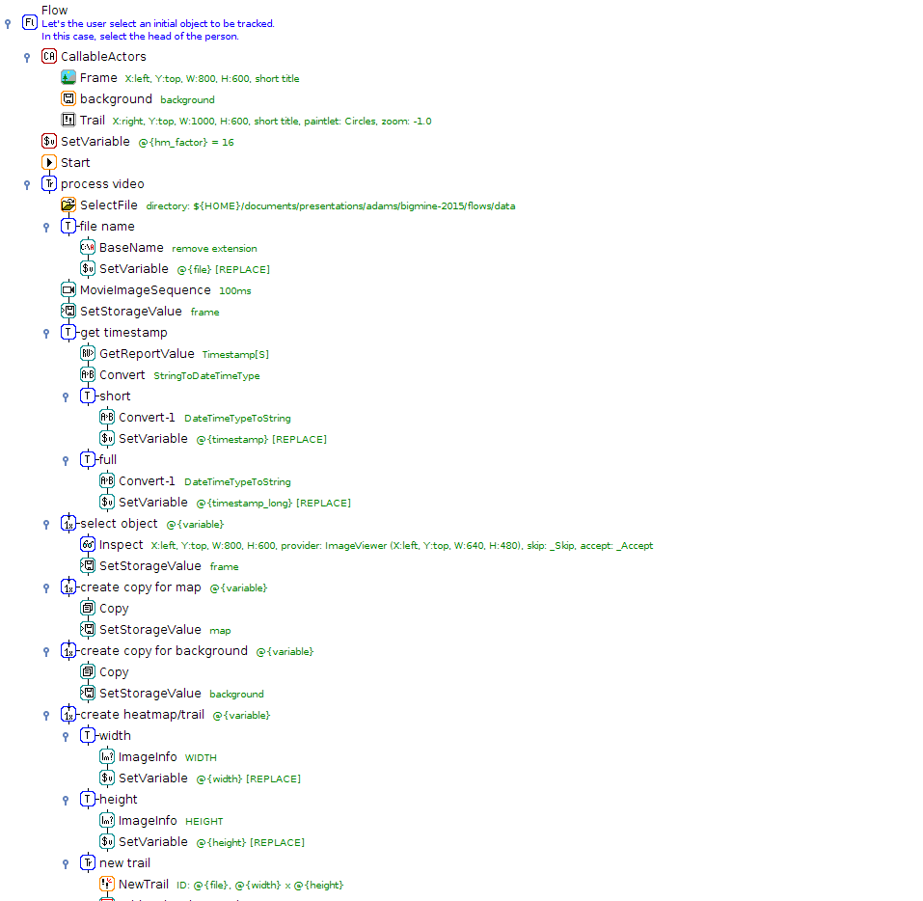
Track mouse

Slide 27
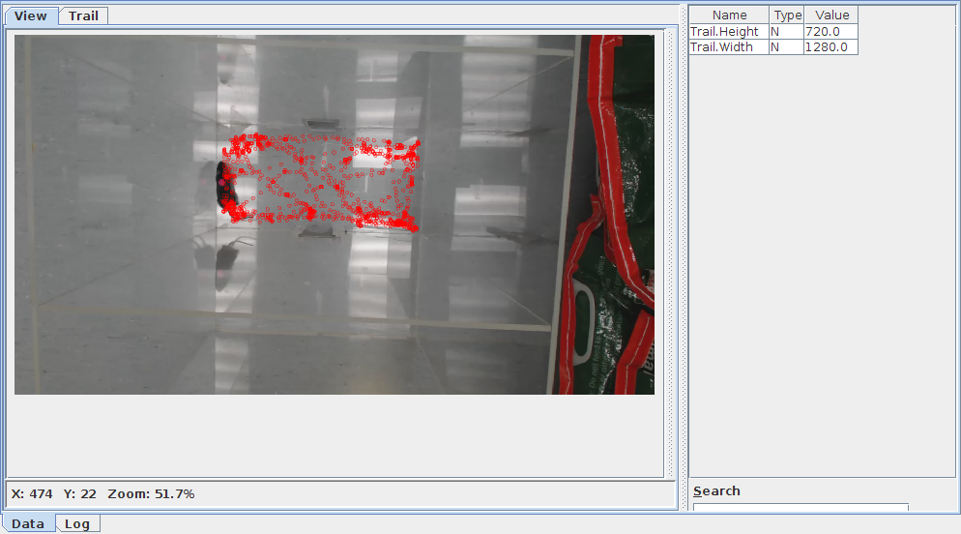
Track mouse

Slide 28

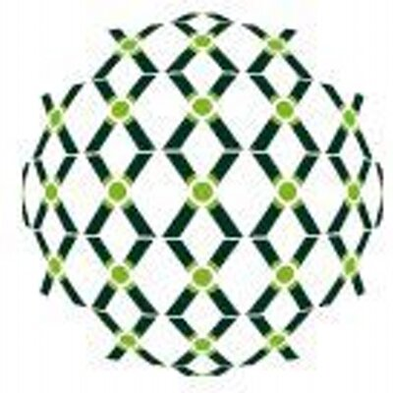
Industry
BLGG - environmental lab in NL
Spectral analysis
  XRF: 10,000, MIR: 2,000, NIR: 1,500
In operation since 2006
Predictive modelling: soil, plant (~250 models)
1,000 to 3,000 samples per day
Savings due to less wet chemistry
  USD 18 million to USD 33 million per year

Slide 29
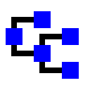
Questions?
https://adams.cms.waikato.ac.nz/
@TheAdamsFlow

