Slide 1
Big Data with ADAMS
The Basics

Slide 2
“Small” Data with ADAMS
Plotting, Variables,
Callable actors,
Interactive flows

Slide 3
The Interface
Main menu launches GUIs of tools (eg WEKA)
“User mode” defines what menu items are visible
Additional tools for Weka (eg dataset handling)
Flows
  edited/executed/debugged with Flow editor
  executed with Flow runner
  executed from command-line (eg daemon/service)
  adams.flow.FlowRunner

Slide 4
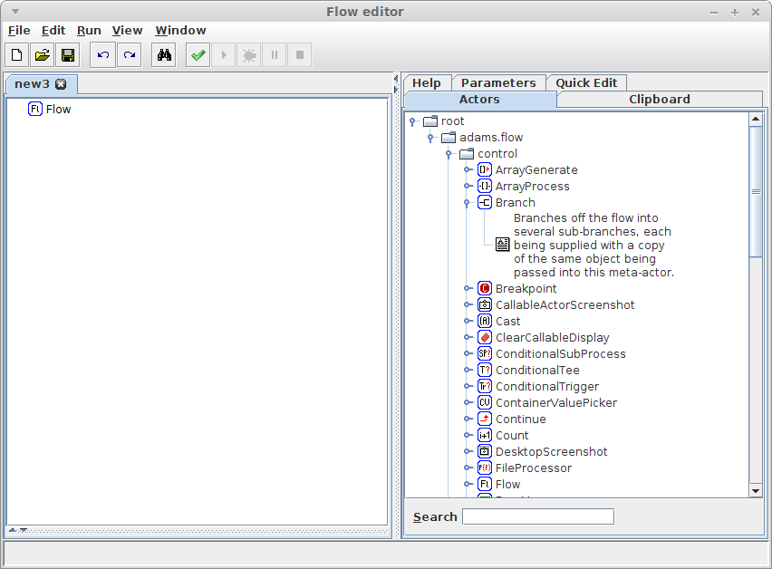
Flow editor
Split view: flow and tabs
optional tabs
workflow

Slide 5
Adding actors
Short description
Drag'n'drop

Slide 6
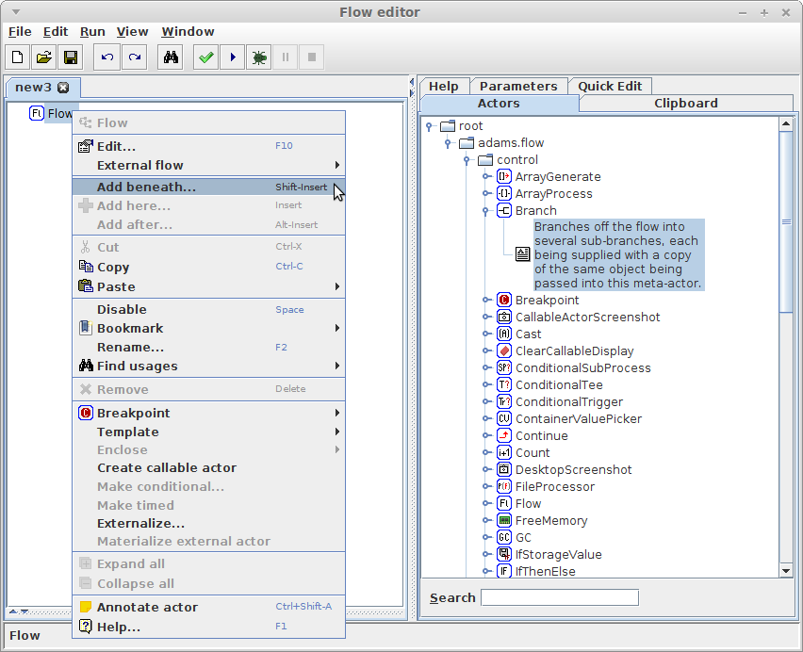
Adding actors (2)
Context-sensitive
popup menu

Slide 7
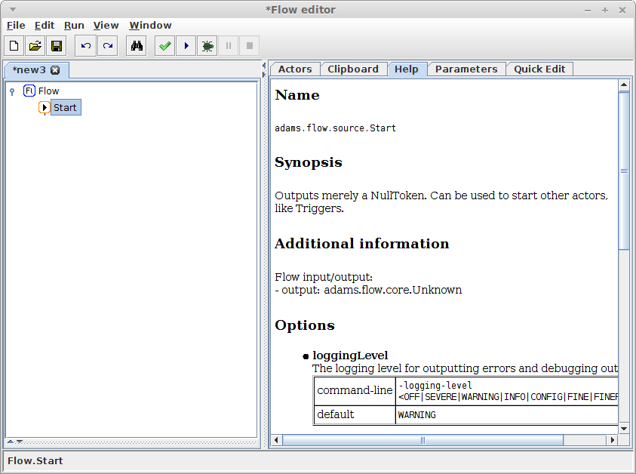
Actor help
online help
whenever actor
gets selected

Slide 8
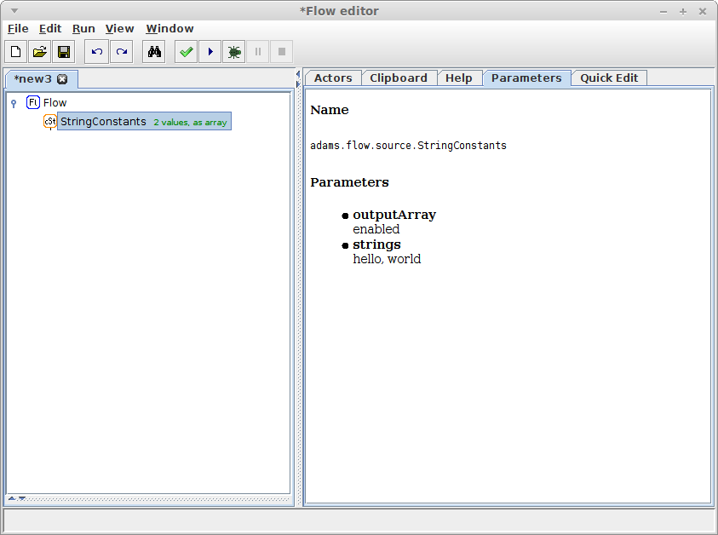
Actor parameters
display of
non-default
parameters,
whenever
actor gets
selected

Slide 9
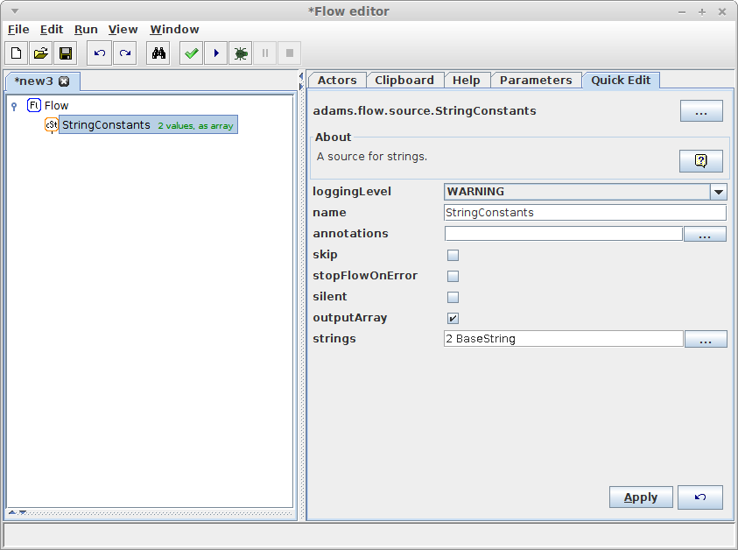
Actor quick edit
quickly changing
parameters without
bringing up edit
dialog, whenever
actor gets selected
NB: expensive

Slide 10
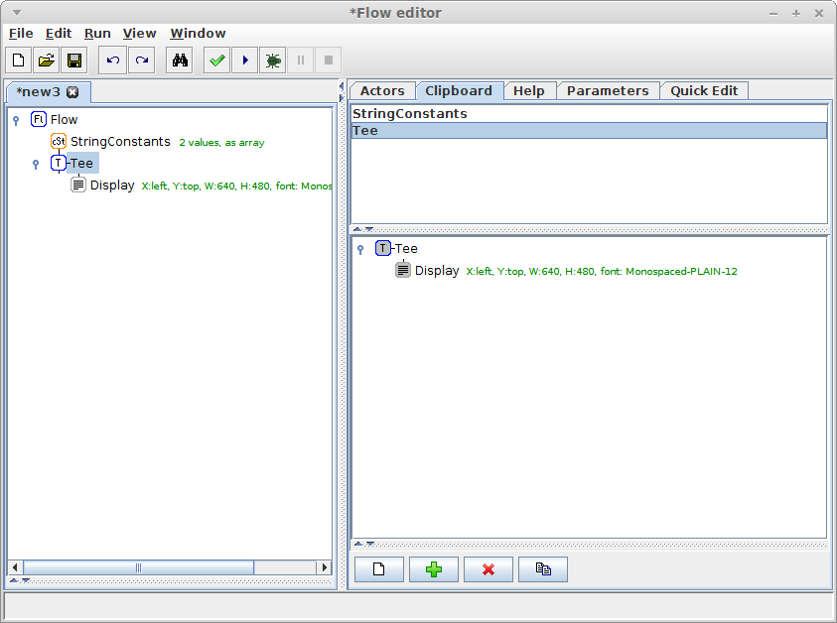
Clipboard
allows temporary
storage of multiple
subflows

Slide 11
Plotting
What we need
  generate some numbers
  turn them into a plot
What we use
  ForLoop source
  SimplePlot sink

Slide 12
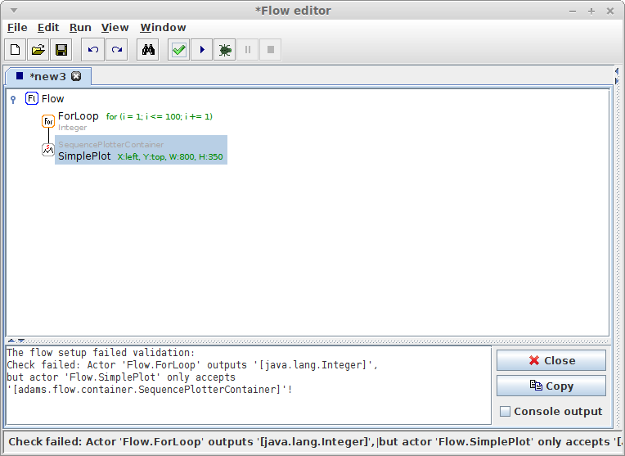
Plotting
Mismatch of
input/output
[View → Show
input/output]
Check/Run flow
Error message

Slide 13
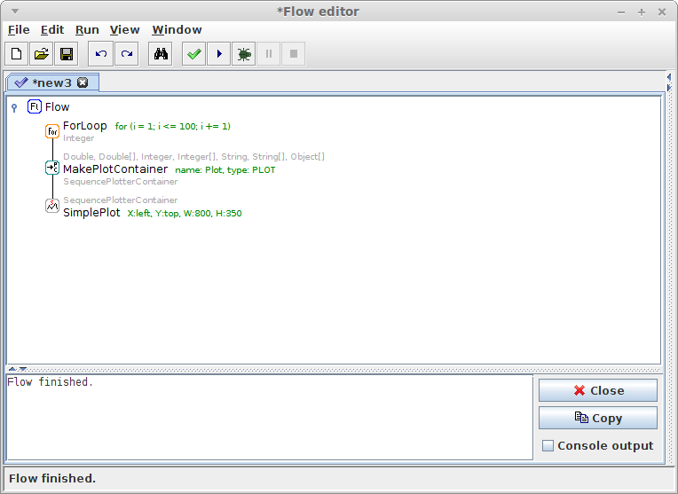
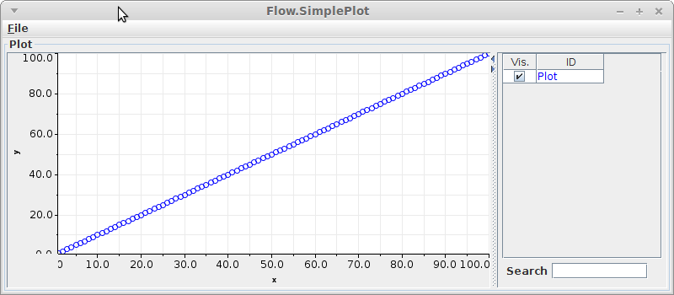
Plotting - fixed
add transformer:
MakePlotContainer

Slide 14
Plotting X/Y
let's plot a sawtooth function
how to implement the function?
  MathExpression transformer
formula
  2*(X/2-floor(0.5 + X/2)) using period of 2
another MathExpression to create fractions
  X/10

Slide 15
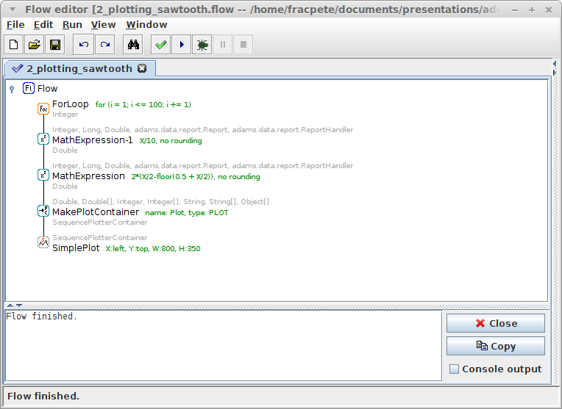
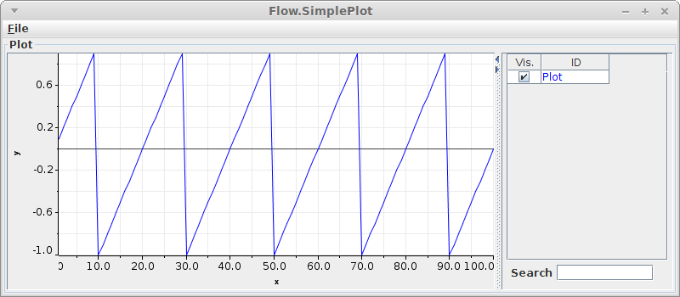
Plotting X/Y
create fraction
sawtooth

Slide 16
Multiple plots
Let's create multiple sawtooth plots
use period 2 and 3.7
use Branch actor
combine steps in Sequence actor

Slide 17
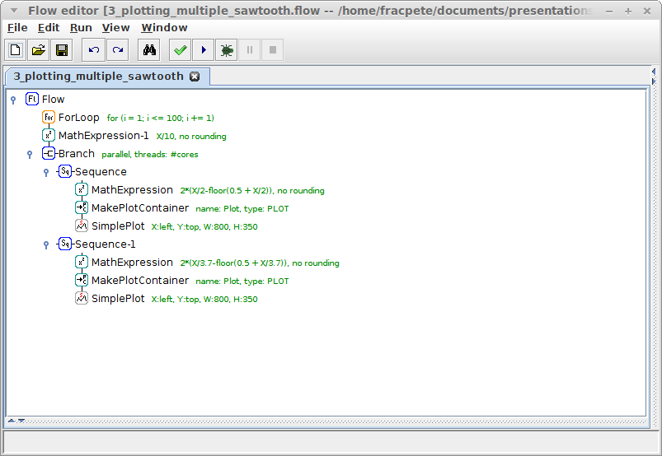
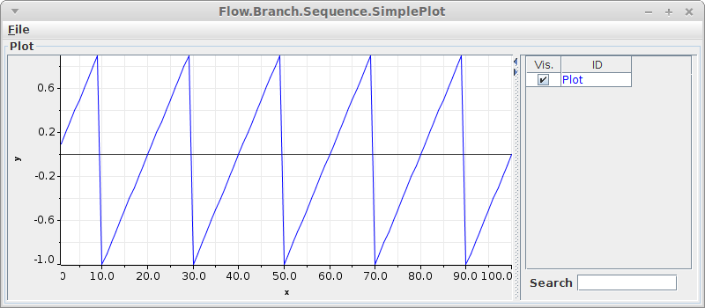
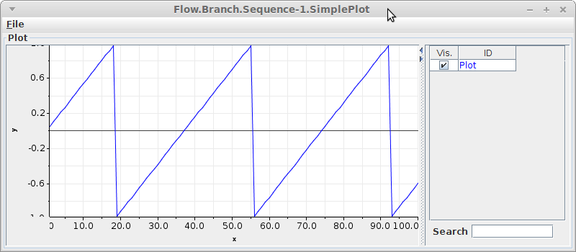
Multiple plots
period 2
period 2
period 3.7
period 3.7

Slide 18
Combining plots
Multiple plots are great, but...
Combine them in single plot window?
Make use of “callable actors”
  handler: CallableActors
  source: CallableSource
  transformer: CallableTransformer
  sink: CallableSink

Slide 19
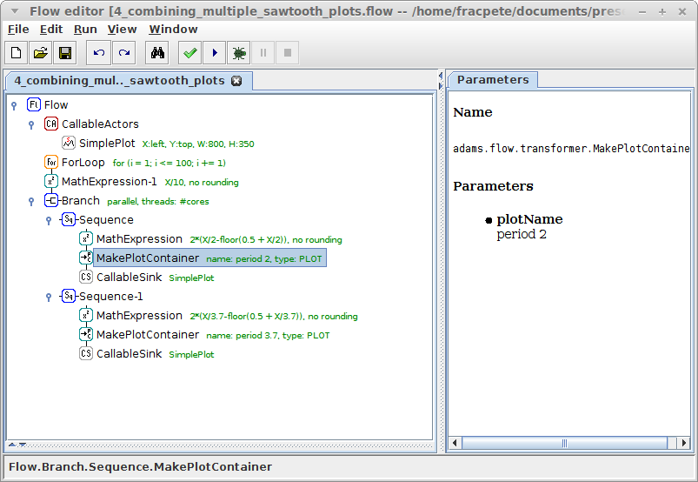
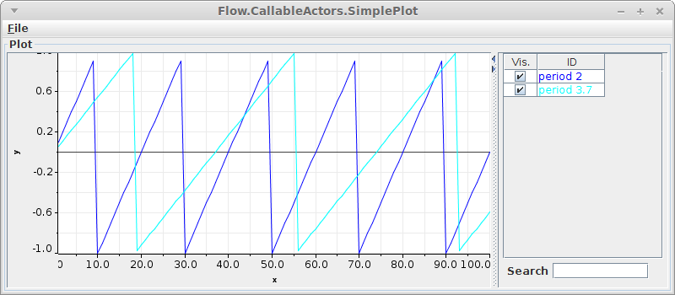
Combining plots
use different
plot names
to separate
plots in graph

Slide 20
Reduce duplication?
Two almost identical formulas
Use variables (can also be attached to options)
  SetVariable standalone
  Variable source
  VariablesArray source
  CombineVariables source
  SetVariable transformer
format of a variable: @{<name>}

Slide 21
Reducing duplication
Old formula
  2*(X/2-floor(0.5 + X/2))
New formula using @{period} as placeholder
  2*(X/@{period}-floor(0.5 + X/@{period}))
But that still doesn't solve the duplicate formula
Turn the formula into another variable and attach it to the MathExpression's expression option

Slide 22
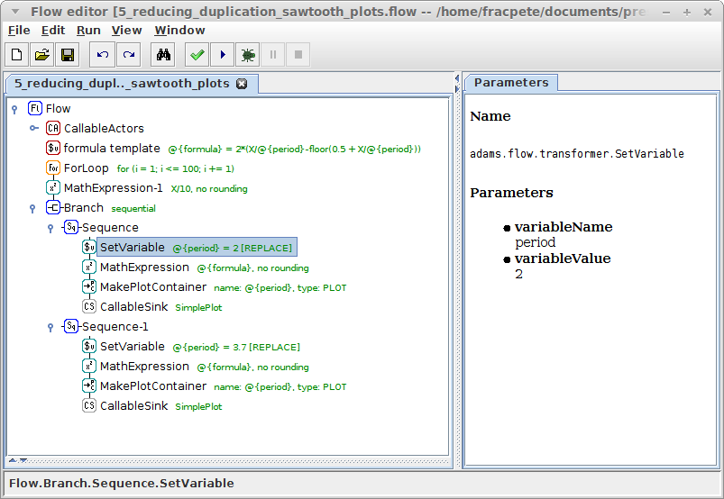
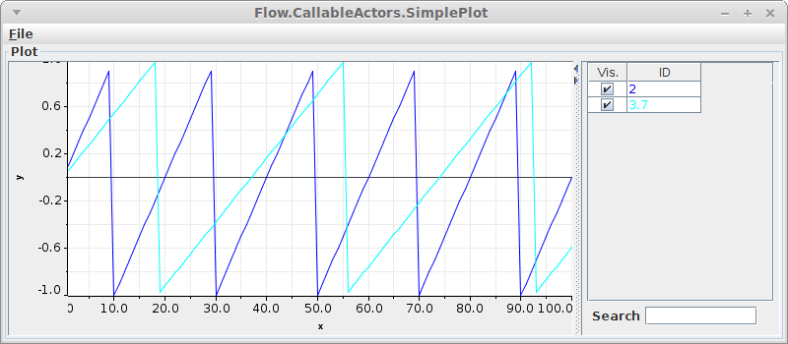
Reducing duplication
formula template
sequential
execution
variable attached
to “expression”
variable attached
to “plotName”

Slide 23
Avoid duplicate branch?
Can we avoid the duplicate branch?
Short answer: yes
Long answer
  make use of variables
  use Triggers
  use StringConstants as storage for the periods

Slide 24
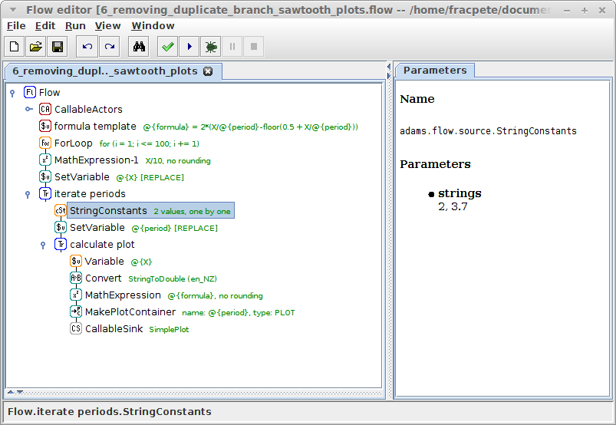

No duplicate branch
store fraction
in variable
store current
period in var
output one period
after the other
convert string
representation
of X into float

Slide 25
Quiz: Plotting
implement the following function
plot all combinations of
  mean: 0, 1, -2.2
  stdev: 1, 3
output the functions in the same plot window
Hint: you need the CombineVariables source

Slide 26
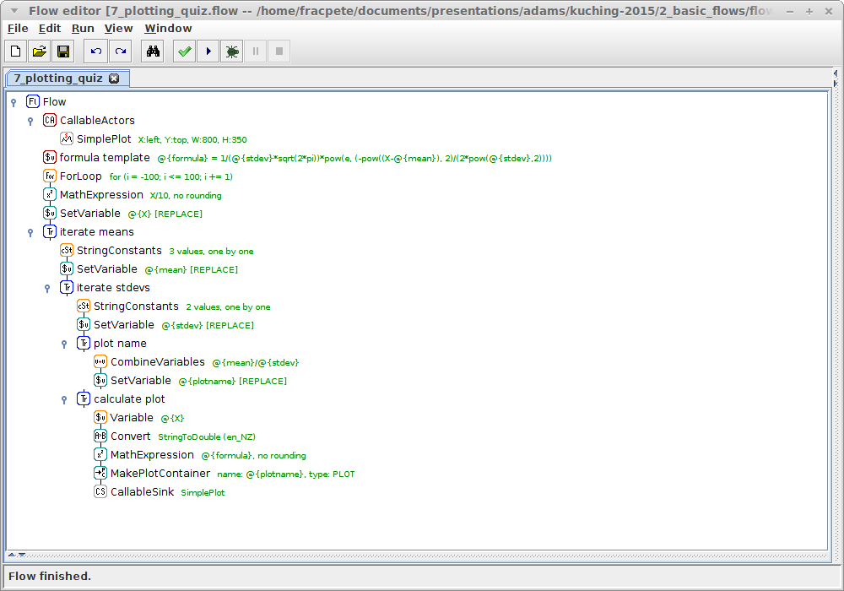
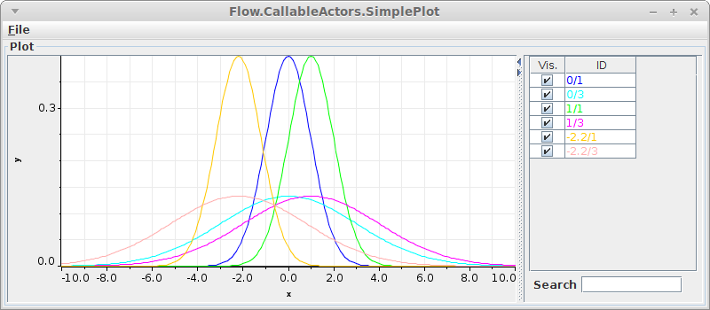
Quiz: Plotting
from neg
to pos
stdev as var
mean as var
plotname consists
of mean/stdev

Slide 27
Interactive flows
Changing parameters in flows is tedious, only for experts
How about asking the user directly?
Examples
  EnterValue
  EnterManyValues
  SelectFile
  SelectDirectory

Slide 28
Sawtooth revisited
Let user enter period
  use EnterValue source
  store output in variable
Use period variable in formula and plotName
  2*(X/@{period}-floor(0.5 + X/@{period}))

Slide 29
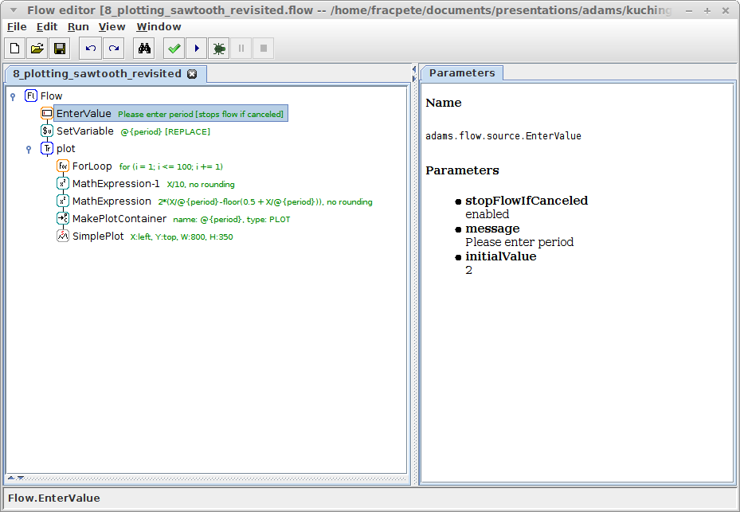
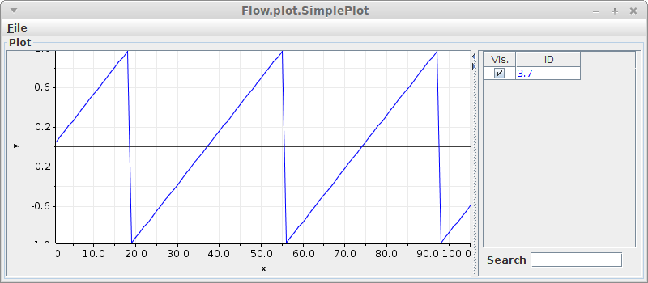
Sawtooth revisited
store user input
in variable
can stop flow,
if dialog canceled
use variable
in formula
initial value

Slide 30
Bell curve revisited
User enters mean and stdev
Make use of EnterManyValues
But how to obtain parameters?
  outputs spreadsheet (column name = var name)
  use SpreadSheetVariableRowIterator

Slide 31
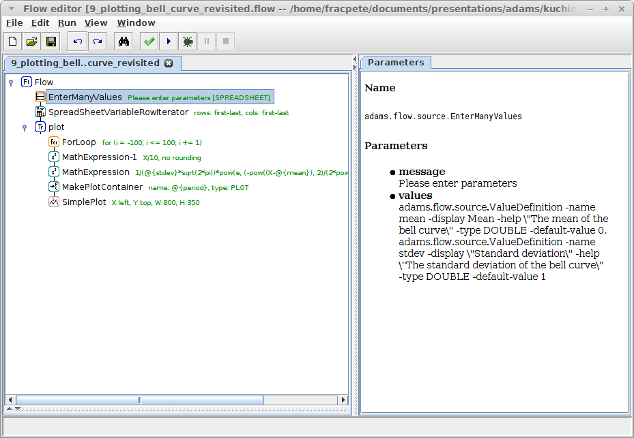
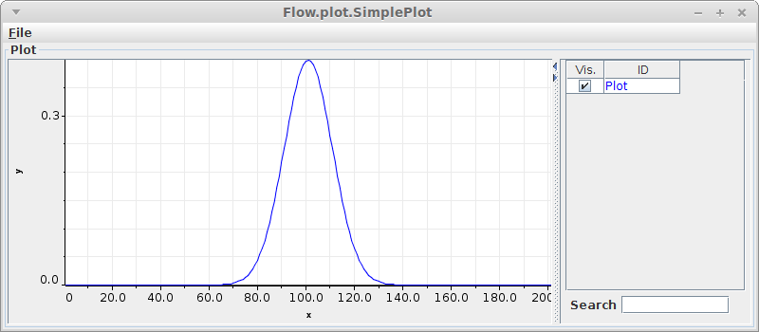
Bell curve revisited
enter multiple
parameters
param. name,
display, type,
default, help
turn spreadsheet
into variables
(col name = var name)

Slide 32

Questions?
https://adams.cms.waikato.ac.nz/
@TheAdamsFlow

