Slide 1
Big Data with ADAMS
Machine learning

Slide 2
What's on offer?
WEKA *
  mainly batch learning, some incremental schemes
  classification, regression, clustering, association rules, data preprocessing
MOA *
  online learning (= data streams)
  classification, regression, clustering
MEKA
  multi-label and multi-target classification
R
  depends on your installed packages
* will be covered

Slide 3
WEKA
Actors have “Weka” prefix in name
Icons have “WK”
Examples
  WekaFileReader
  WekaFileWriter
  WekaCrossValidationEvaluator
  WekaTrainClassifier
  WekaClassifierSetup
ADAMS contains additional algorithms

Slide 4
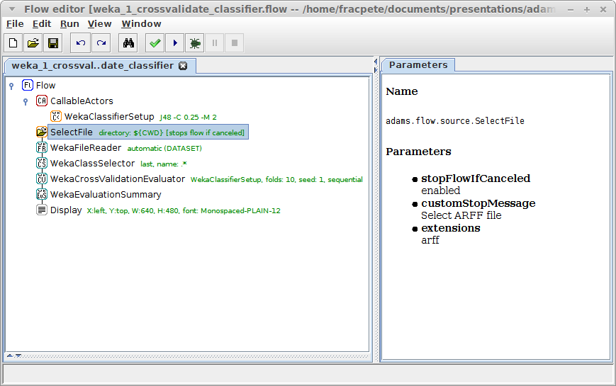
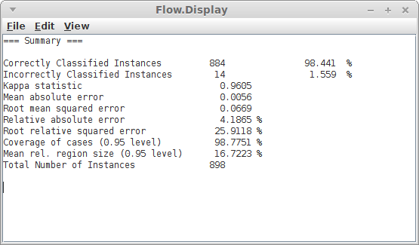
Cross-validate classifier
let user
select
dataset
CV uses
callable actor
load dataset
and set class
create summary
and display it

Slide 5
Per fold statistics
Output summary and plot accuracy per fold
Actors to use
  WekaCrossValidationSplit
  WekaTrainTestSetEvaluator
  WekaEvaluationSummary
  WekaEvaluationValuePicker
  SimplePlot
  HistoryDisplay

Slide 6
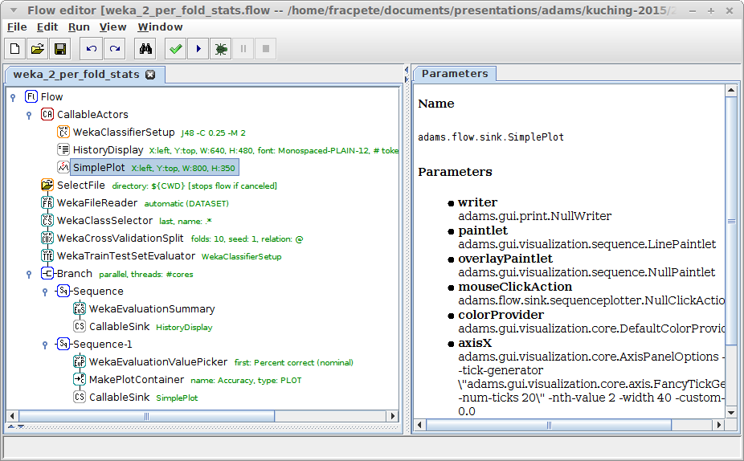
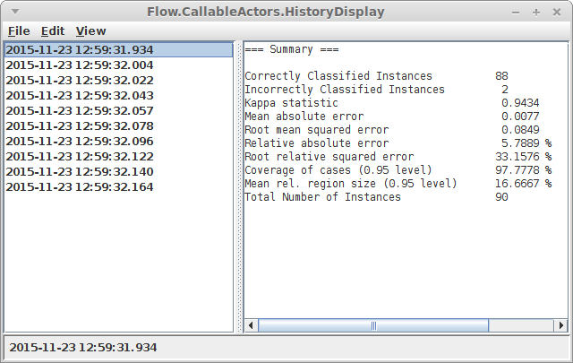
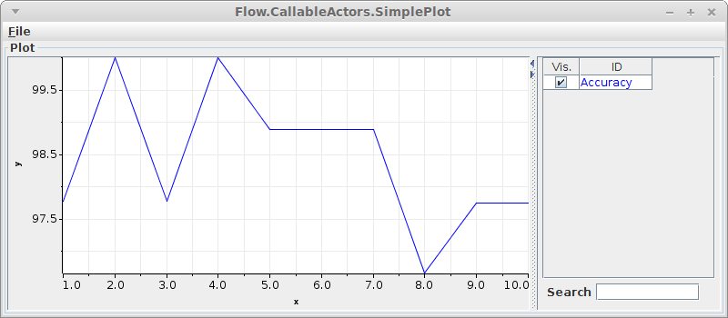
Per fold statistics
split into train/test
evaluate callable
actor
plot lines
create summary
of fold pair
extract accuracy
(= perc correct)

Slide 7
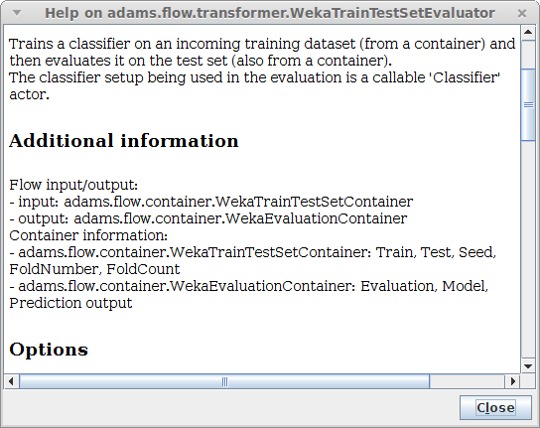
Per fold stats (numbered)
output models too
  WekaTrainTestSetEvaluator outputs container
  ContainerValuePicker
use variables to number folds
  SetVariable
  IncVariable
  use entryNameVariable
  in HistoryDisplay

Slide 8
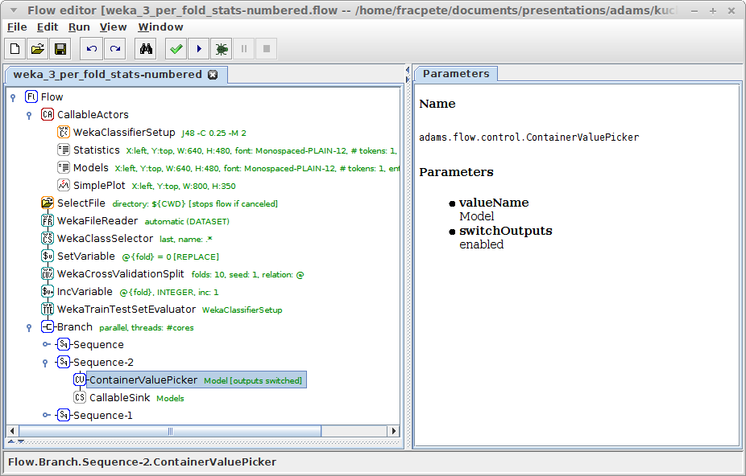
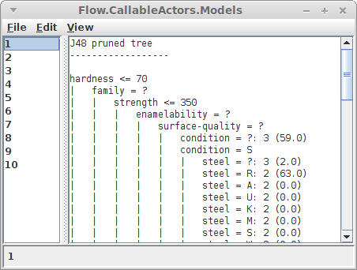
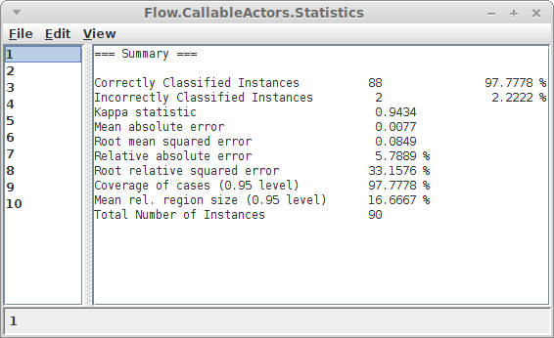
Per fold stats (numbered)
initialize var
“fold” with 0
specify name of
container value
to retrieve
increment
var “fold”
forward container value
rather than container
(and value in sub-flow)
retrieve “model”
from container

Slide 9
Train classifier
Rather than evaluating, let's build a classifier!
Also, save to disk and load it back in again
Actors to use
  WekaTrainClassifier
  WekaModelWriter
  WekaModelReader

Slide 10
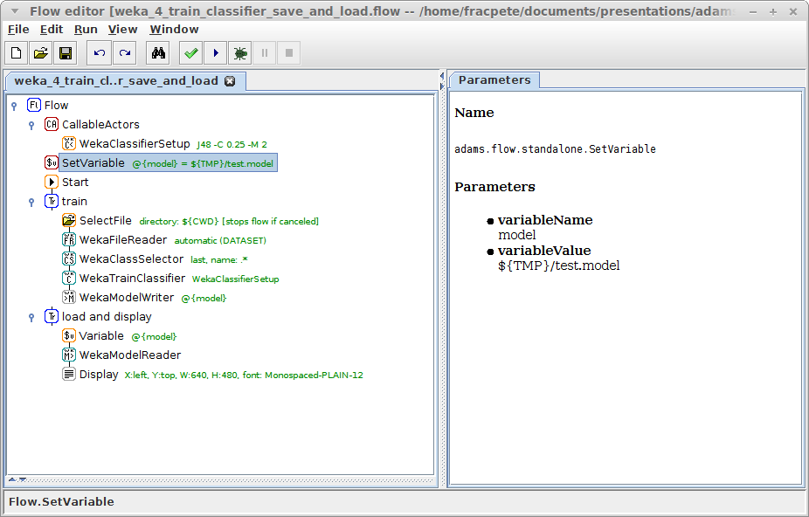
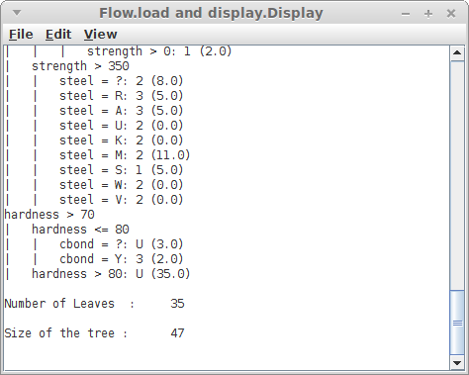
Train classifier
re-use filename
with a variable
train classifier
and save it
placeholder filenames
(system + user defined)
load model
(model + header)

Slide 11
Train and use classifier
Let's make some predictions!
Rather than loading serialized model, we'll store it in internal storage (key-value pairs)
Actors to use
  SetStorageValue (transformer)
  StorageValue (source)
  SequenceSource
  WekaInstanceBuffer
  WekaClassifying

Slide 12
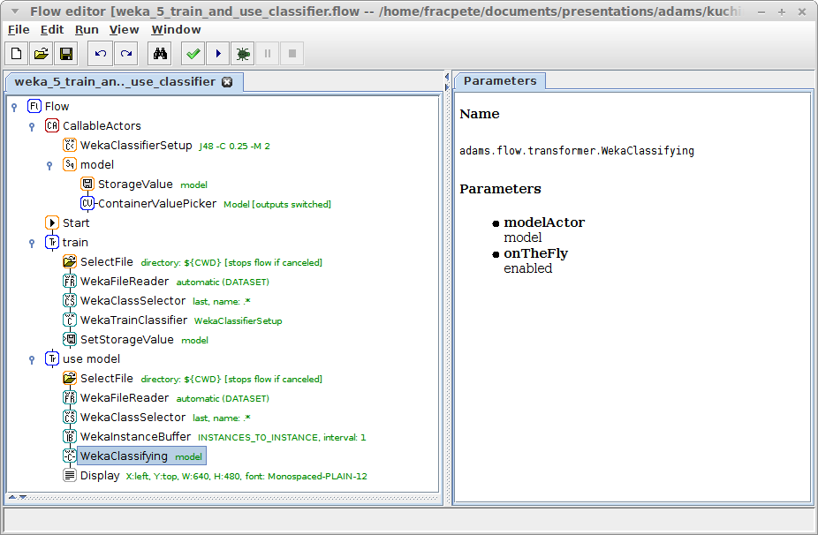
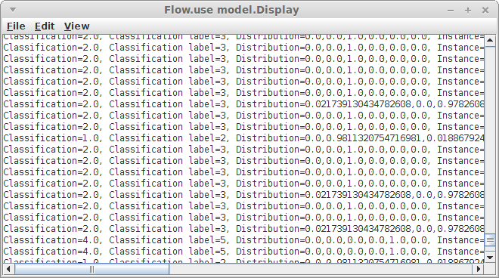
Train and use classifier
retrieve model
container,
extract model
store model
container in
storage
model is built
“on the fly”
turn dataset
into rows
use model from
callable actor
“model”

Slide 13
Use Filters
Filters can be applied using
  WekaFilter (batch + stream)
  WekaStreamFilter (only stream)
Caution: if information could leak, use FilteredClassifier approach!

Slide 14
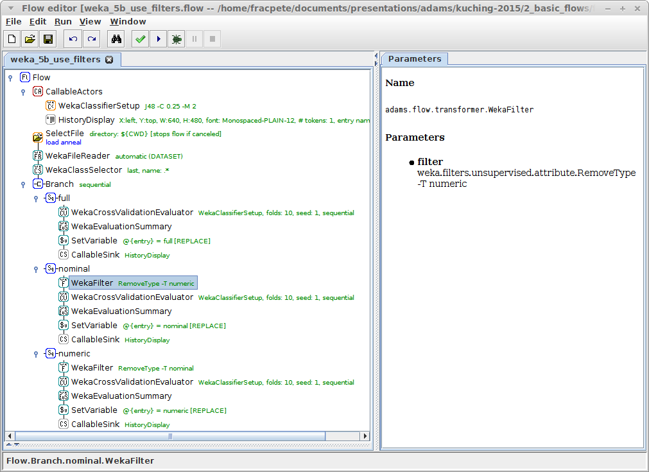
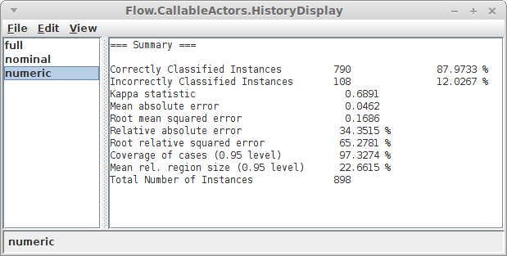
Use Filters
using same variable,
must use Branch in
sequential mode
variable for
HistoryDisplay
removing only
numeric attributes
remove numeric
attributes
remove nominal
attributes

Slide 15
Change classifier options
variables can be attached to options
doesn't work for frameworks other than ADAMS
solution
  manipulate Java object via property path
available actors
  SetProperty (of callable actor)
  GetProperty (of object passing through)
  UpdateProperty (of object passing through)
  UpdateProperties (of sub-actor)

Slide 16
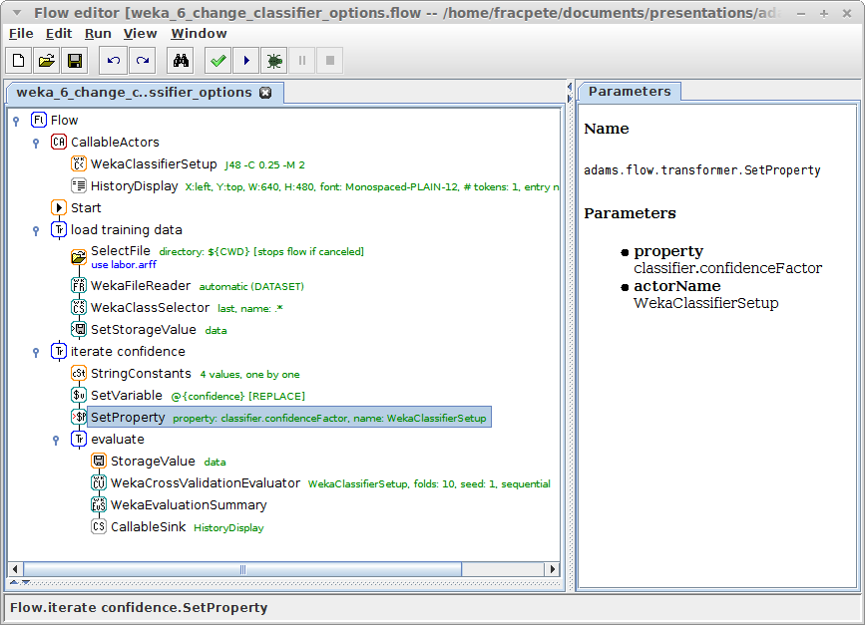
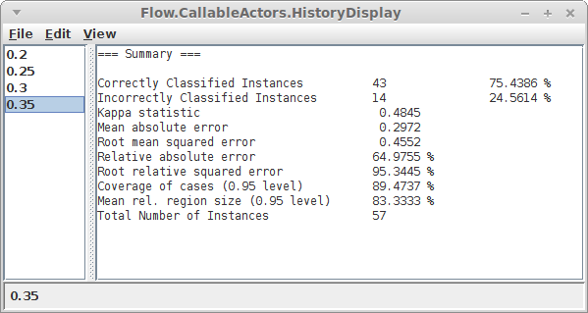
Change classifier options
the classifier
to modify
load dataset and
put in storage
update property
of callable actor
the property path
of the confidence
factor of J48
evaluate on data
from storage

Slide 17
Regression
Instead of classification use regression
Display classifier errors as graph
Actors to use
  WekaClassifierErrors
    actual vs. predicted
  WekaAccumulatedError
    sorts the error values and creates plot containers

Slide 18
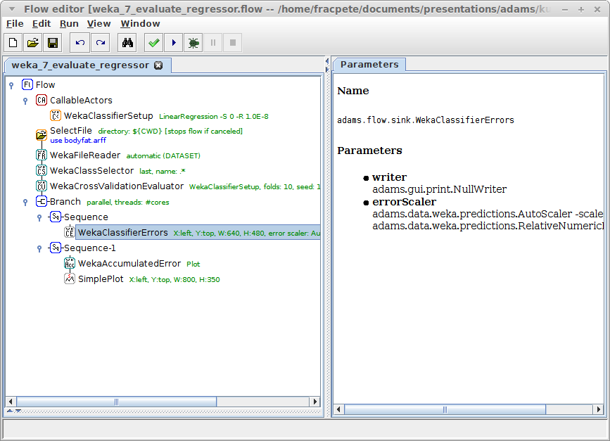
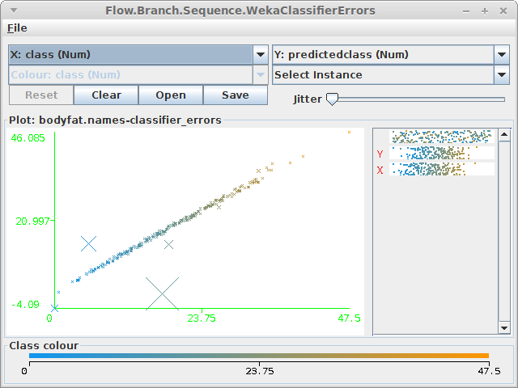
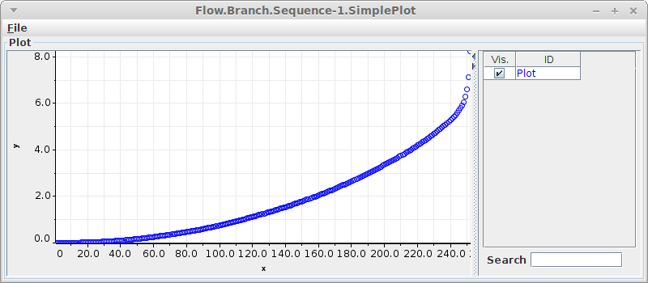
Regression
various ways of
displaying data
Weka plot of
act vs pred
errors sorted
by size for plot

Slide 19
Clustering
Data handling like classifiers, but no class
ADAMS also offers some post-processors
  cluster centers
  cluster statistics (min, max, mean, ...)
Example actors
  WekaClustererSetup
  WekaTrainClusterer
  WekaCrossValidationClustererEvaluator
  WekaClustering

Slide 20
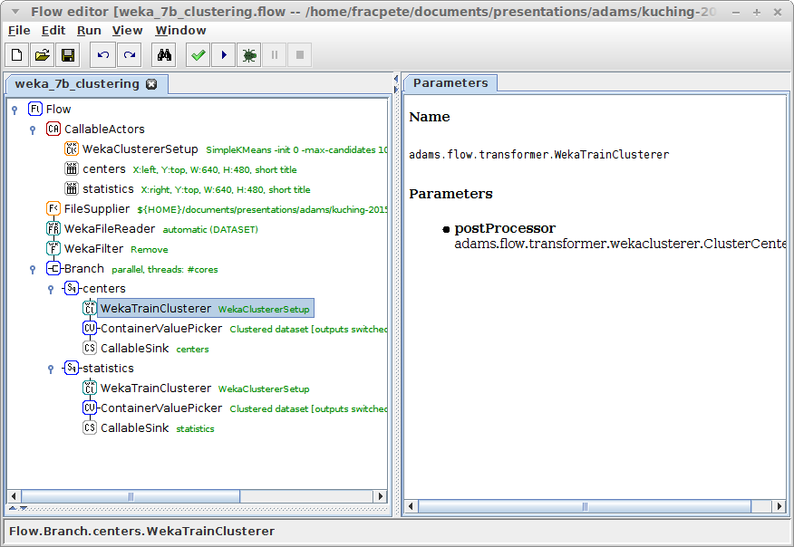
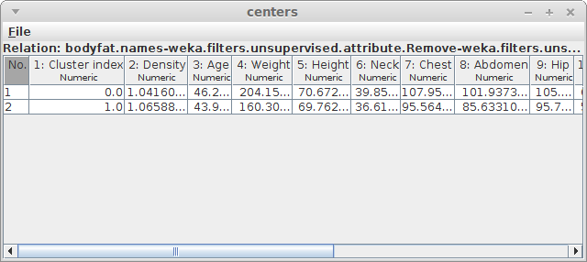
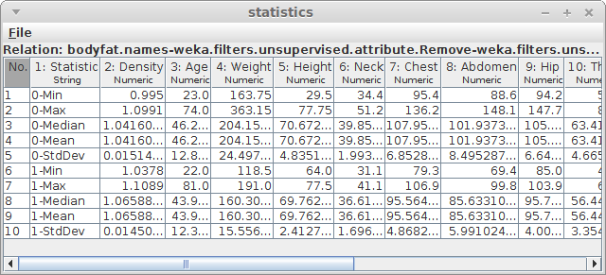
Clustering
remove class
attribute
train clusterer
and post-process
post-processing the
clusterer/data

Slide 21
Quiz: Weka
Evaluate each of these classifier setups
  RandomForest with 250 trees
  SMO with RBF kernel and logistic models
On these datasets
  labor.arff
  anneal.arff
Display evaluation summaries

Slide 22
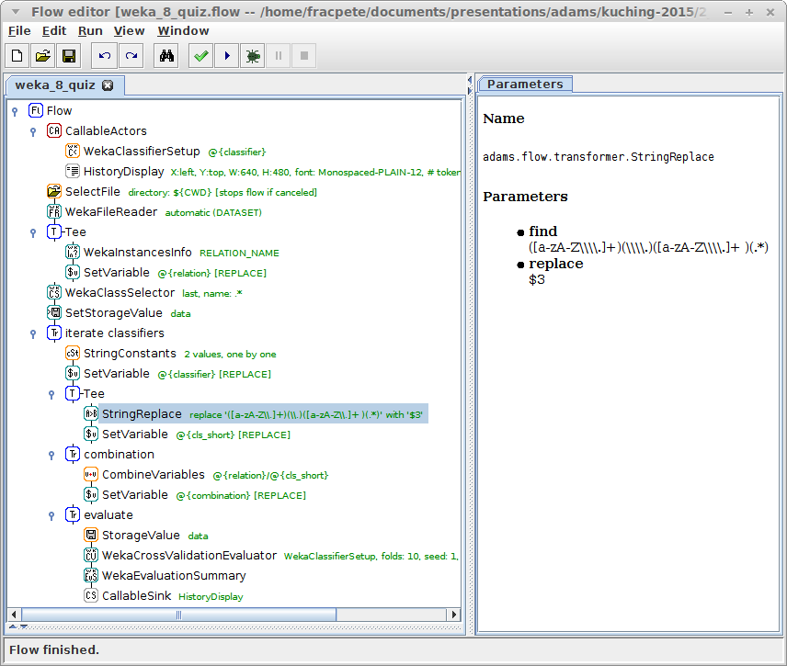
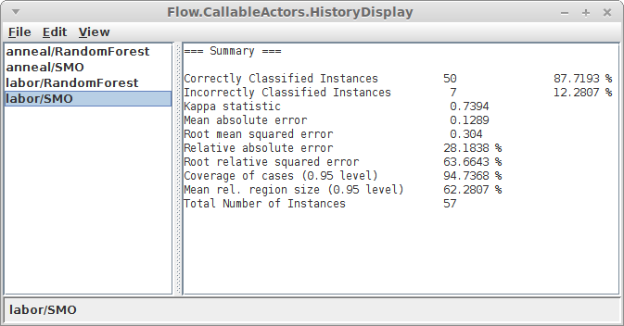
Quiz: Weka
classifier setup has
variable attached
user selects datasets
to evaluate on
extract relation name
from current dataset
classifier setups are
stored as string
(copy/paste from
Weka Explorer)
extract classifier name
using regular expression
cross-validate current
classifier/dataset
combination and display

Slide 23
MOA
Actors have “MOA” prefix in name
Icons have “MOA”
Examples
  MOAClassifierEvaluation
  MOAMeasurementsFilter
  MOAMeasurementsPlotGenerator
  MOAClassifierSetup
  MOAStream

Slide 24
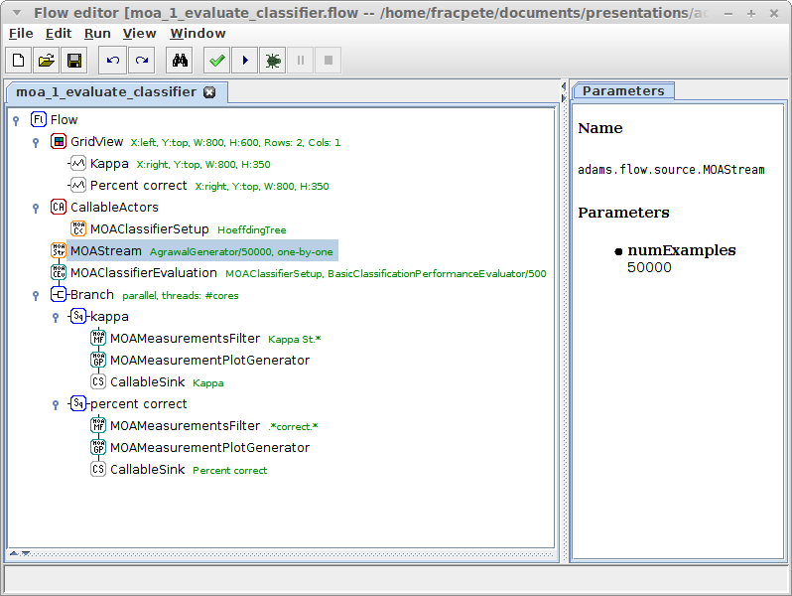
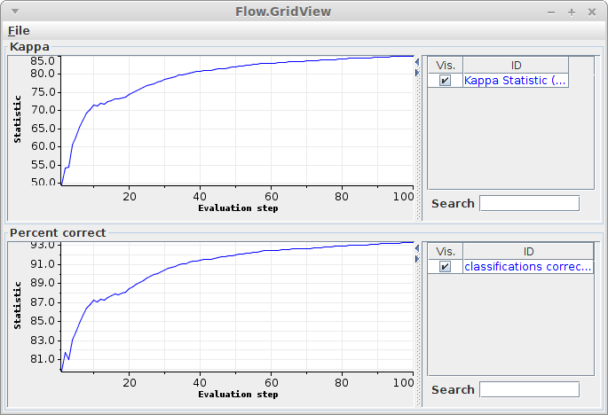
Evaluate classifier
artificial data
stream generator
evaluate classifier
output evaluation
every 500 instances
get measurement
of interest
number of training
instances to generate
create plot container
and forward it to plot

Slide 25
Filter stream s
Number and type of attributes can have impact on classifier performance
Stream filters can be used to filter data streams
  WekaStreamFilter

Slide 26
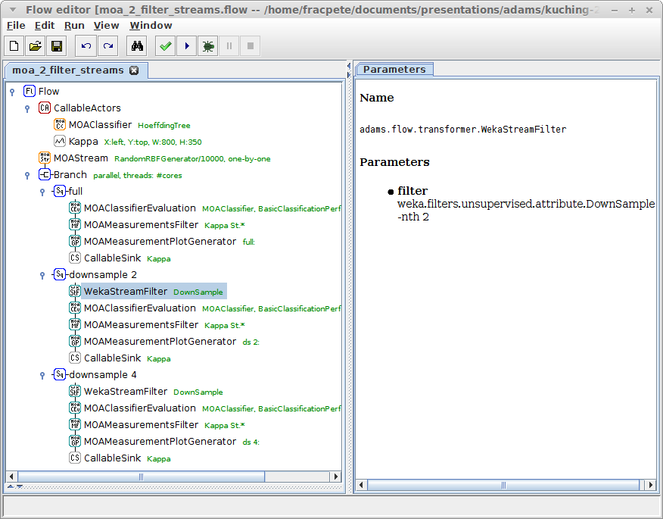
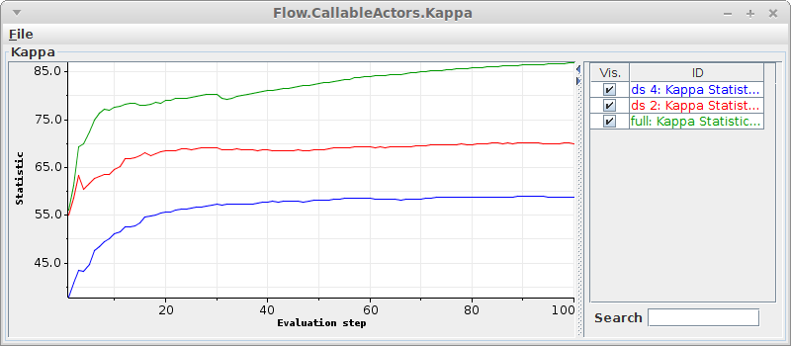
Filter streams
data stream with
40 numeric attributes
remove every
2nd attribute
remove every
nth attribute
remove every
4th attribute

Slide 27
Drift analysis
Select a drift stream generator as source
  e.g., RandomRBFGeneratorDrift
Generate lots of examples
Output examples in chunks to avoid flow overheads (e.g., provenance)
Compare several algorithms
  adaptive and non-adaptive

Slide 28
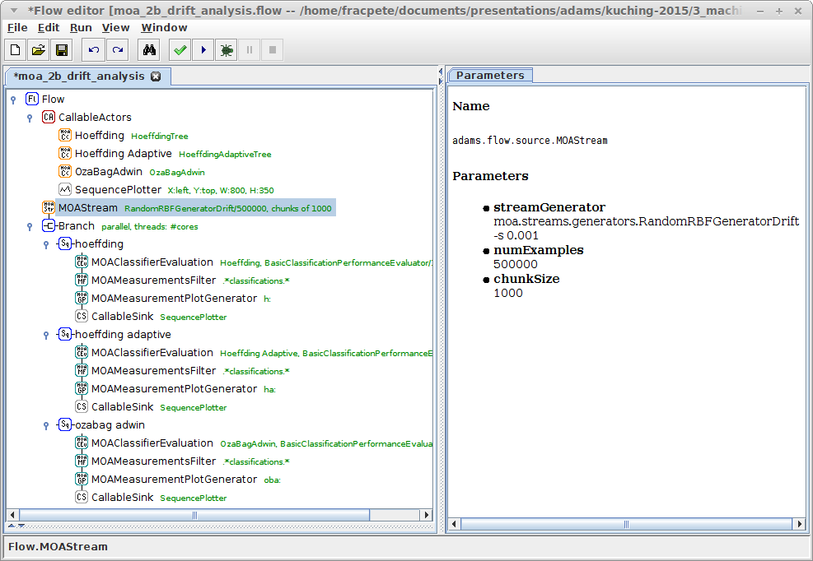
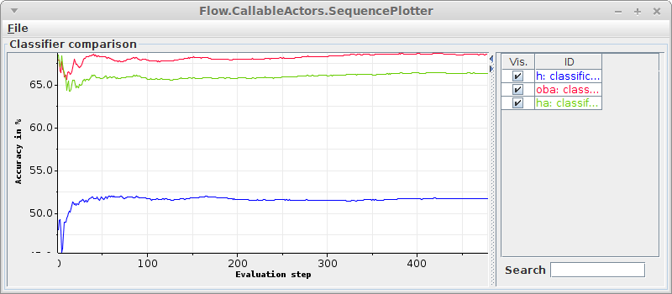
Drift analysis
adaptive and
non-adaptive
algorithms
evaluation
in parallel,
prefixing plots
output every
1000 examples
drift generator
speed up transfer
of data in flow

Slide 29
Clustering
MOA, like WEKA, supports clustering
MOA also has live clustering visualization
Different preprocessing changes clustering
Actors to use
  WekaStreamFilter
  WekaClusterVisualization

Slide 30
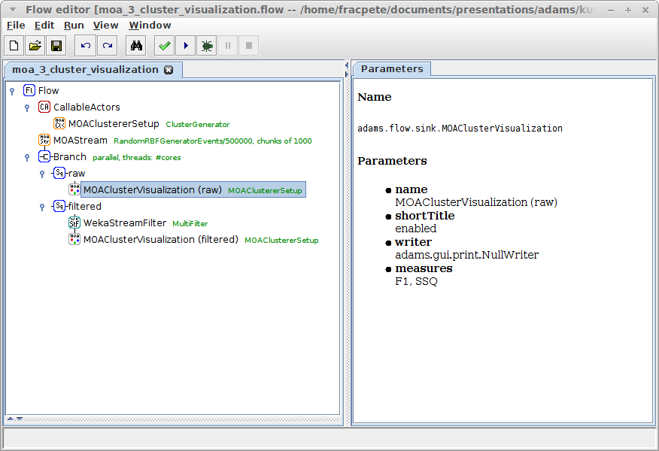
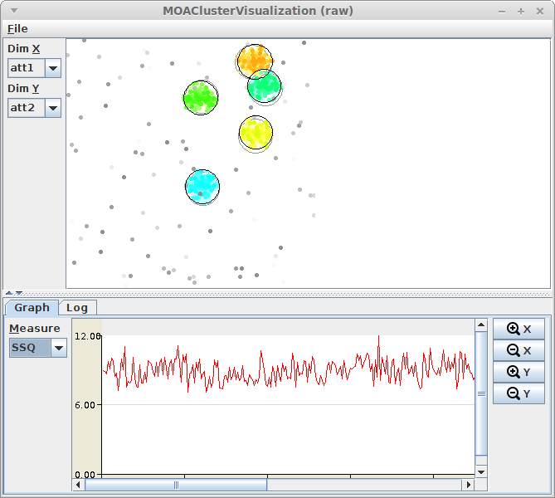
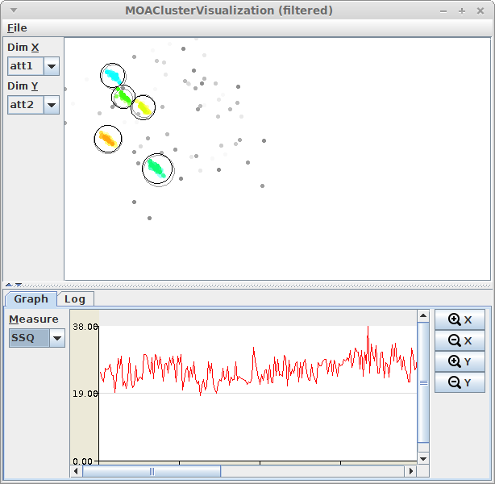
Clustering
visualize clusters
filter data stream

Slide 31

Questions?
https://adams.cms.waikato.ac.nz/
@TheAdamsFlow

