Slide 1
Big Data with ADAMS
Tweet, tweet, tweet

Slide 2
Collecting tweets
Twitter allows searches of public tweets
Twitter offers access to tweets in real time
ADAMS uses twitter4j.org to access Twitter
Requires setting up an App
  https://apps.twitter.com
Don't worry, it's not that hard...

Slide 3
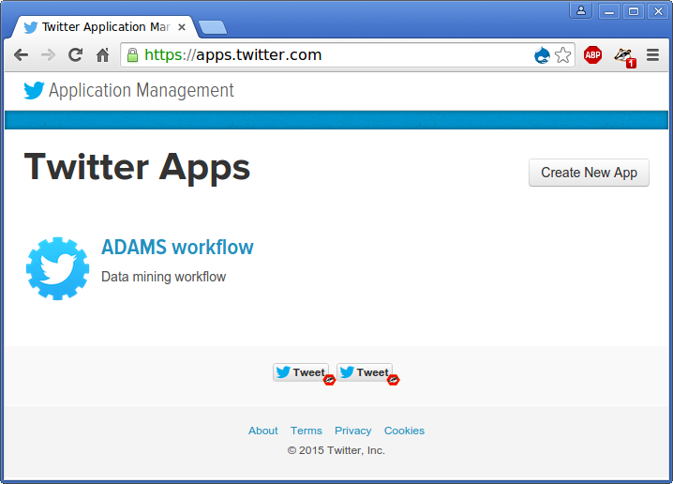
Settings things up
Create an app

Slide 4
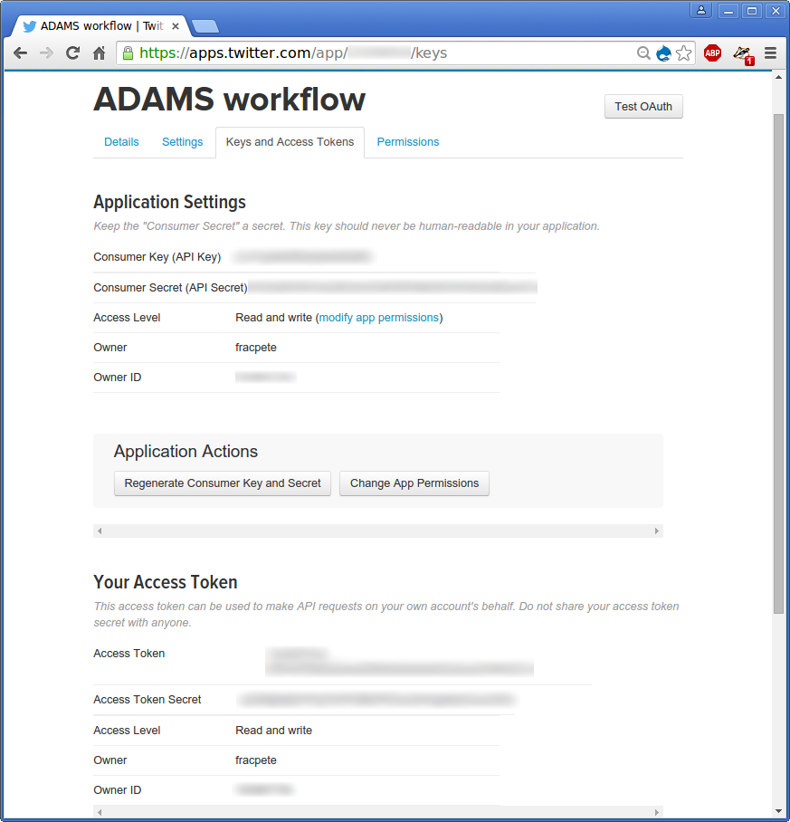
Settings things up (2)
Set up tokens (consumer and access)

Slide 5
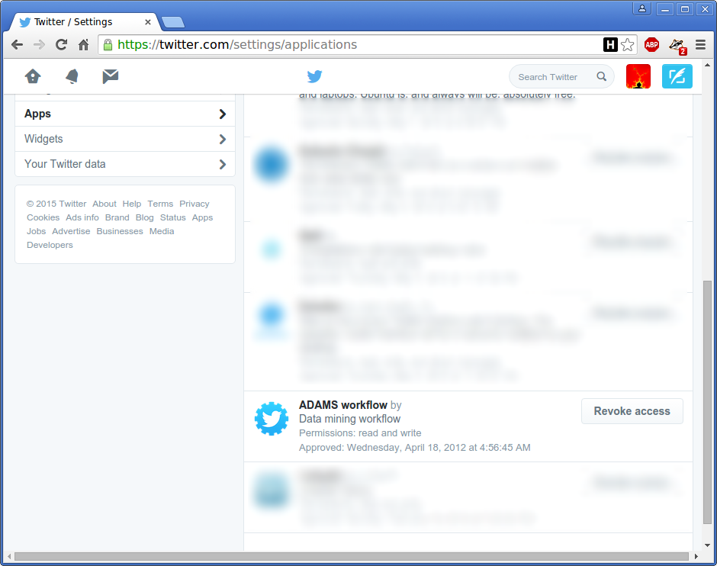
Settings things up (3)
App should show up in your profile settings

Slide 6
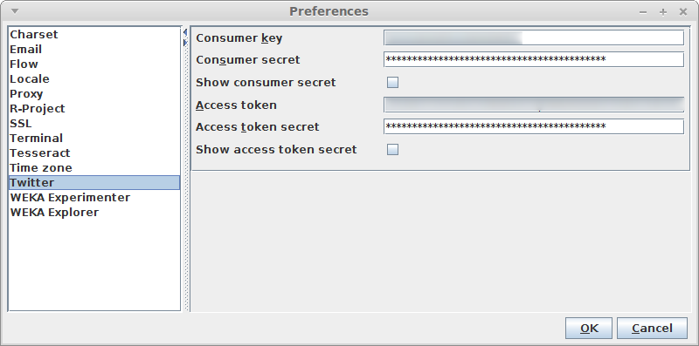
Settings things up (4)
Finally, fill in Twitter preferences in ADAMS

Slide 7
User queries
You can query twitter using something like:
  movie -scary :)
  [tweets containing “movie” and “:)” but not “scary”]
Actors to use
  TwitterQuery
  TwitterConverter
Use case?
  when looking for specific keywords

Slide 8
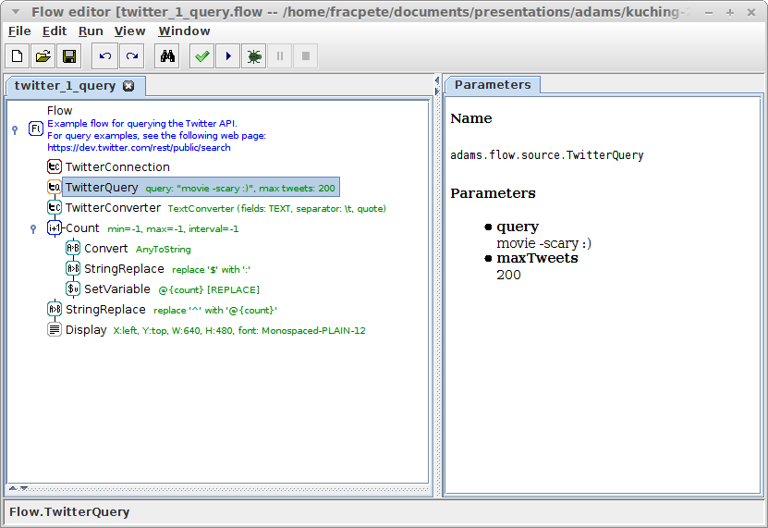
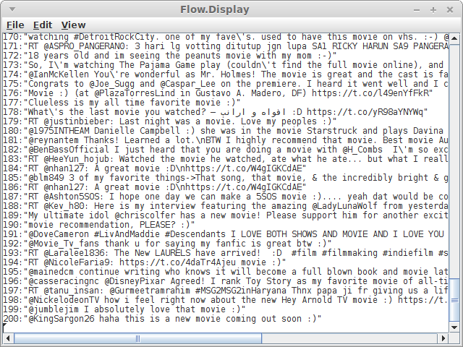
User queries
connection settings;
can override global
preference settings
send query
query string,
maximum to return
convert tweet
into textual format

Slide 9
Listening
Rather than posting queries, listen to tweets in real time
Public access to 1% sample of tweets
  “garden hose” vs “fire hose”
Sample bias?
  http://arxiv.org/abs/1212.1684
Use case?
  create tweet archives for repeatable experiments
  capture “the moment”
Actor
  TwitterListener

Slide 10
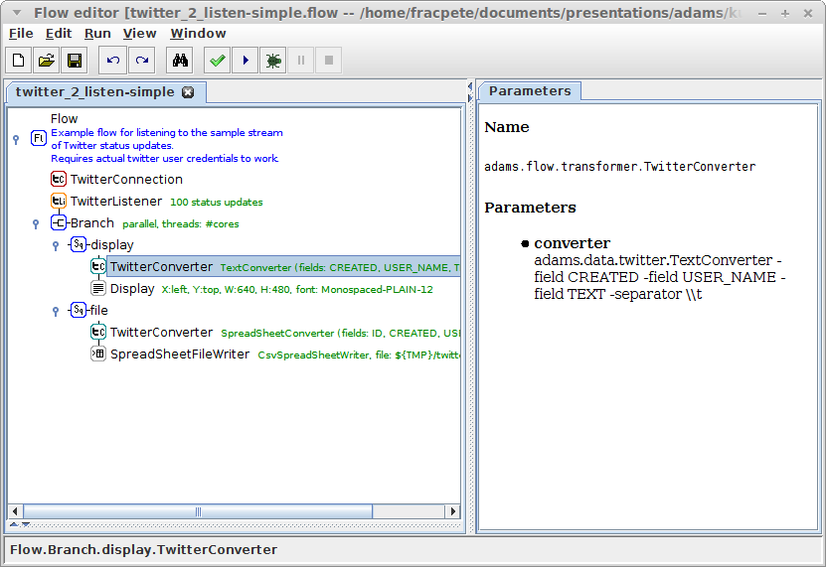
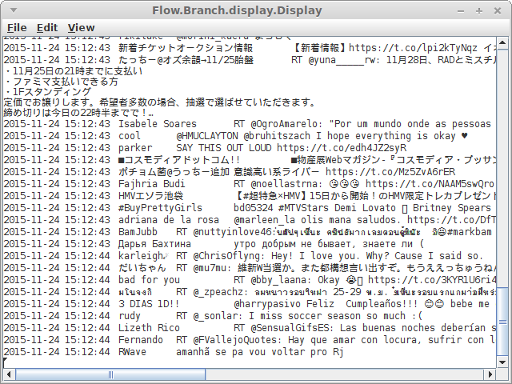
Listening
retrieve a maximum
of 100 tweets
conversion to
text using only
some fields
convert tweets to text
and display them
convert tweets into
spreadsheet format
and save to CSV
“archive tweets”

Slide 11
Continuous archiving
“Fleeting” nature of tweets makes it hard to repeat experiments
Archival and replay of tweets solves this
Next flow shows
  continuous archival
  compressed CSV spreadsheets
  one archive per day

Slide 12
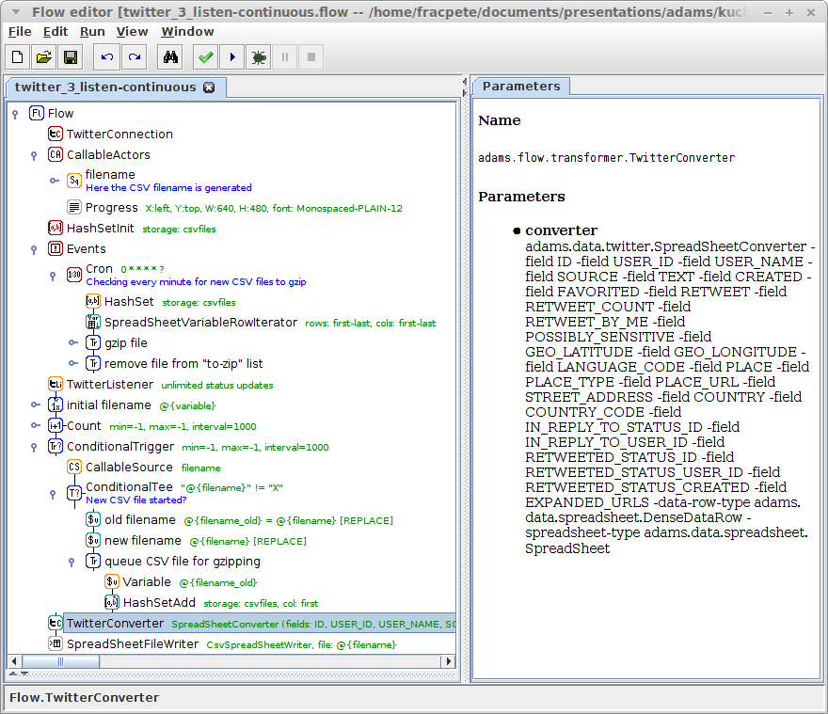
Continuous archival
create filename based
on current day
check “queue”
whether new
spreadsheet to
compress
listen till flow
gets stopped
“queue” new
spreadsheet
to be gzip'ed
create spreadhsheet
row and append file
collect as much
meta-data as possible

Slide 13
Filtering archives
At time of writing ~3 million tweets per day
Experiments can operate on subsets to speed things up considerably
→ pre-filter spreadsheet archives
Actors to use
  SpreadSheetFileReader
  SpreadSheetRowFilter
  SpreadSheetFileWriter

Slide 14
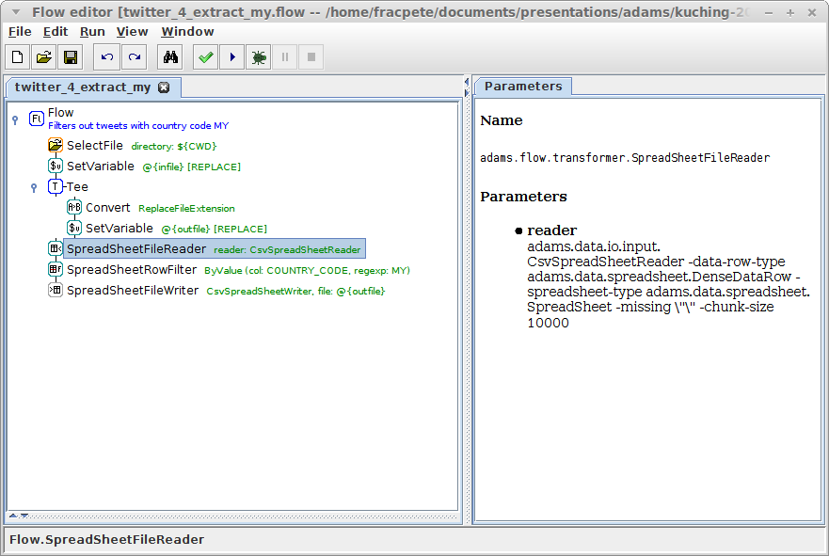
Filtering by country
select archive
files to filter
create output
filename based
on input file
leave only
rows with value
“MY” in column
“COUNTRY”
read spreadsheet in chunks,
limit memory usage

Slide 15
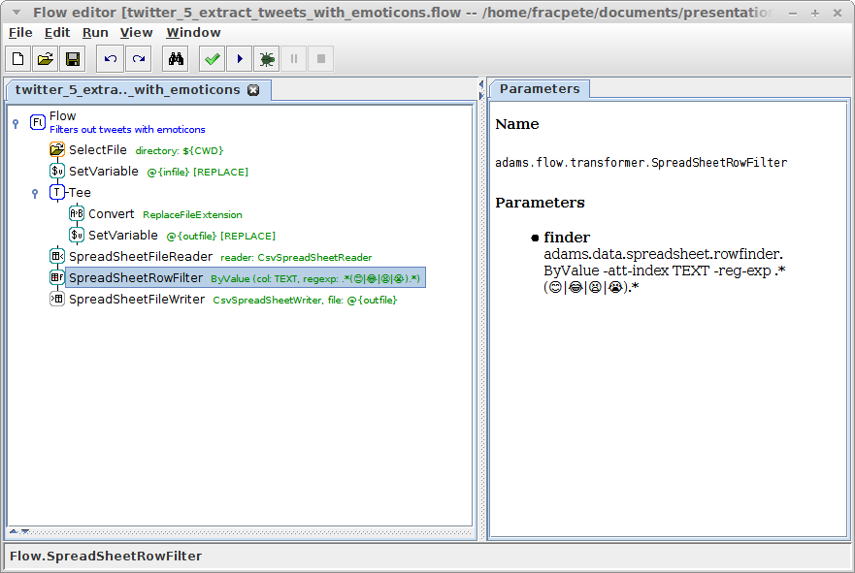
Filtering by content
filter column
“TEXT” using
a regular
expression
tweets must contain these
four emoticons (reg exp)

Slide 16
Replaying archives
Replaying archives is excellent for repeatable experiments
Use cases
  further filtering
  feature extraction
  plotting
Actor
  TweetReplay

Slide 17
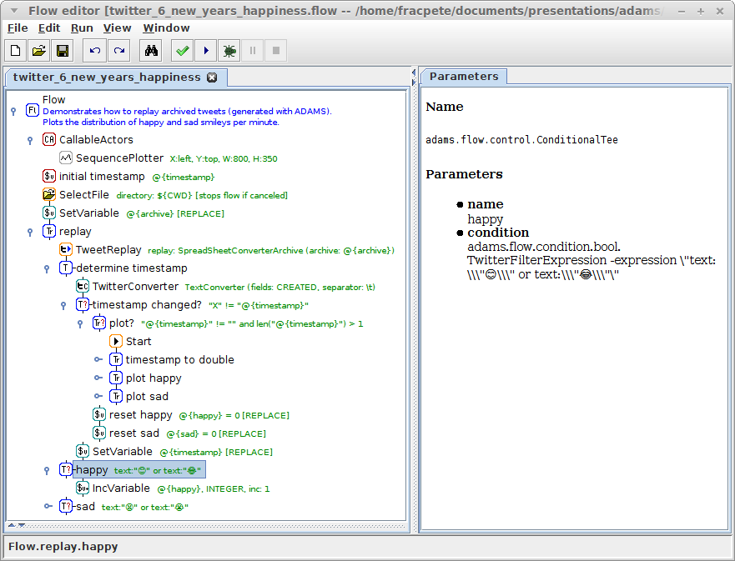
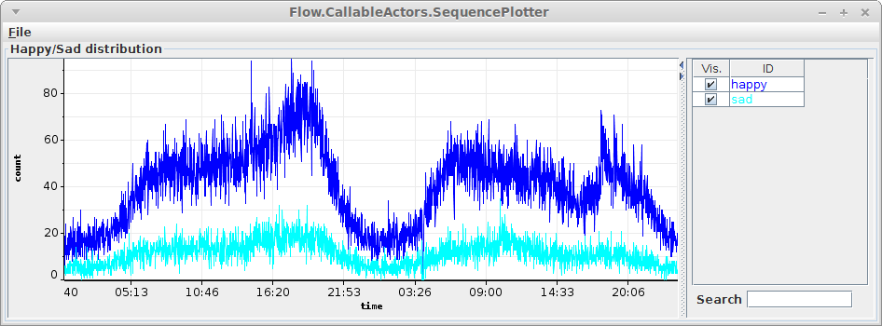
New Years “Happiness”
plots happy vs sad
select archives
to replay
replay current archive,
creating “fake” tweets
from archived data
create plot
containers
each minute
“conditional” tee, which
requires “happy” tweets
count “happy”
and “sad” tweets
midnight

Slide 18

Questions?
https://adams.cms.waikato.ac.nz/
@TheAdamsFlow

