Slide 1
Taking Weka to the next level with ADAMS
No need to write code

Slide 2
Outline
What is ADAMS?
Weka Investigator
Flow editor
Other useful tools
Demo

Slide 3
What is ADAMS?
Java plugin framework (Linux, OSX, Windows)
Modules with various functionality
  eg modules for Weka, Meka, MOA
Interfaces for various tasks
Workflow engine
Started in 2009 to work with GC-MS data

Slide 4
Weka Investigator
Exploration tool like Weka Explorer
But it supports
  multiple sessions
  multiple datasets loaded at the same time
  batch filtering
  arbitrary number of tabs
  predefined output generators
  different/additional visualizations
  easy exports of results

Slide 5
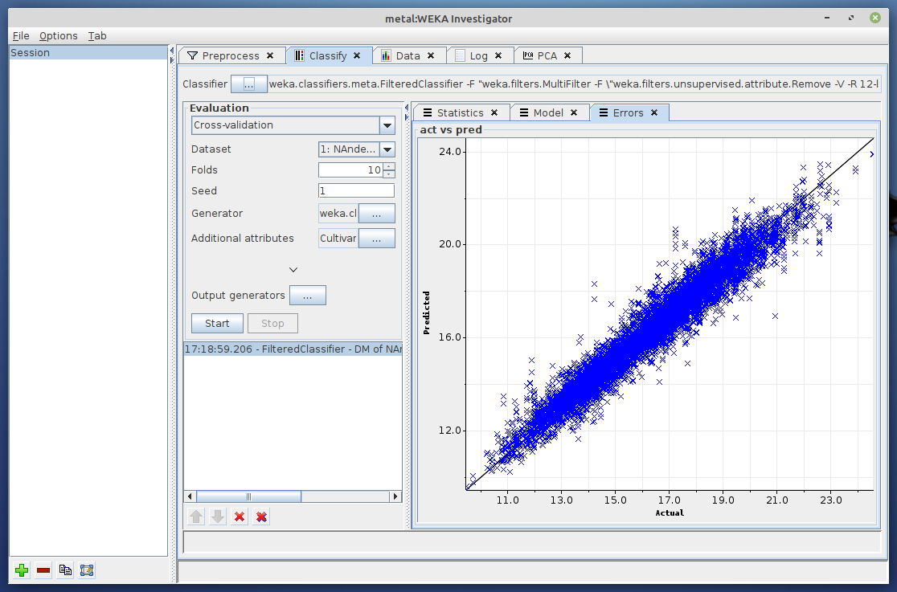
Weka Investigator

Slide 6
Flow editor
Why another workflow system?
  Canvas-based set up is tedious
  Doesn't scale well (when using 100s or 1000s of operators)
  KnowledgeFlow too Weka-centric
How is it different/better?
  Actors (= operators) arranged in tree (collapsible)
  Actor handlers nest other actors (eg sequence)
  Control actors control data flow (eg tee, branch, switch)
  Input/output defines:
    standalone (no I/O), source (only O), transformer (I/O), sink (only I)
  Offers debugging (incl. breakpoints and data inspection)

Slide 7
Flow editor
How does it work?
  Data-driven system (actor output triggers next one)
  Event-based triggers available (eg cron, web-services)
But: Tree only supports 1-to-n connections
Simulating n-to-m semantics
    Containers (combine multiple outputs)
    Variables (change actor options on-the-fly)
    Internal storage (key-value storage)
    Callable actors (feed data into named actor)

Slide 8
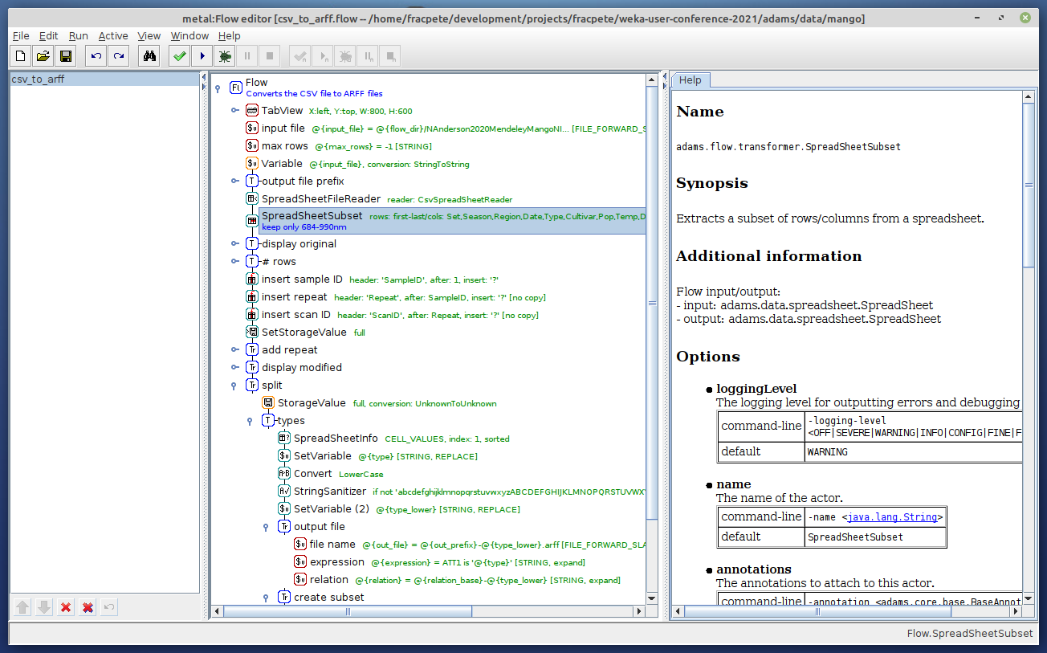
Flow editor

Slide 9

Flow editor
Any real world applications?
  S3000 - commercial tool based on ADAMS to analyze soil/plant samples (NIR, MIR, XRF)
  User only manages configuration flows, generators create low-level worker flows
  Eurofins Agro: ~450 models, ~3000 samples/day
  Largest (production) worker flow generated so far:
    ~44,000 actors

Slide 10
Other useful tools
Multi-Experimenter
Spreadsheet file viewer
SQL Workbench
File commander (ftp, smb, sftp)
Preview browser
Append/merge datasets
Check dataset compatibility

Slide 11
Available functionality
Databases (MySQL, SQLite, PostgreSQL, HSQL, MSSQL, Sybase, MS Access)
XML/XSLT/XPath, HTML, JSON
LaTeX (generate/execute), PDF (read/extract/generate)
spreadsheets (CSV, TSV, Gnumeric, ODF, MS Excel, fixed column, ...)
webservices (SOAP/REST)
scripting (Groovy/Jython/Python)
Weka, Meka, MOA, R-Project, parameter optimization
Natural language processing (parsing, word clouds)
OCR, barcodes
spectral data (AniML, CAL, CML, DPT, EEM, JCampDX, MPS, NIR, Opus, Relab, SPA, SPC, SpecLib, spreadsheet-based)
scatter/line plots, gnuplot, control charts
images, heatmaps, audio, video, webcams, ffmpeg
de-/compression (tar, zip, bzip2, gzip, lzma, xz, zstd)
remote access (sftp, ssh, scp, rsync)
Java code generation
Generate custom ADAMS application
Docker images and image generation
frontend (user interaction), backend (Linux daemon/Windows Service)

Slide 12
Demo
Enough talking, let's see ADAMS in action!

Slide 13

Questions?
https://adams.cms.waikato.ac.nz/
https://github.com/fracpete/weka-user-conference-2021

