Slide 1
AI-Powered Battery Management System
Real-Time State of Charge & State of Health Estimation on STM32
STSW-L9961BMS | ST Edge AI | Cortex-M0+
On-Device AI
Real-Time
Production Ready
Neural network runs directly on STM32 MCU
Inference every 300ms data acquisition cycle
Filtered output with saturation & averaging
STMicroelectronics
Slide 1/9

Slide 2
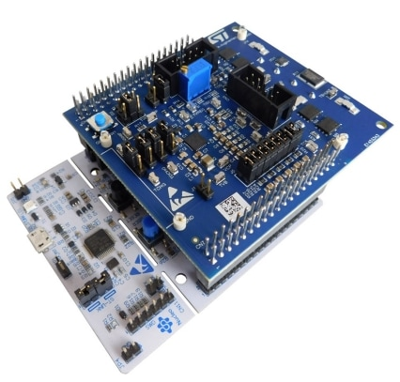
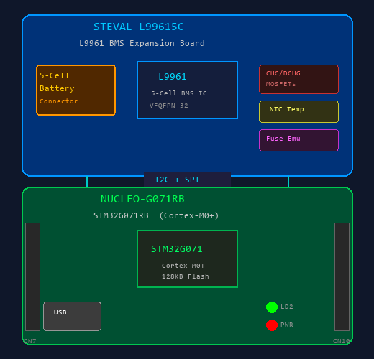
Hardware Platform — STEVAL-L99615C Evaluation Kit
Industrial BMS evaluation board with L9961 IC and STM32 Nucleo-64 development board
STEVAL-L99615C — Evaluation Kit
The STEVAL-L99615C is an evaluation kit composed of an L9961 BMS expansion board stacked on a NUCLEO-G071RB STM32 Nucleo-64 development board via morpho connectors.
L9961 BMS IC — Key Features
Monitors up to 5 Li-ion cells in series configuration
High-precision ADC for cell voltage, stack voltage, NTC temperature
High-accuracy Current Sense Amplifier (CSA) with Coulomb counter
Passive cell balancing (all cells simultaneously)
Dual pre-driver for charge/discharge MOSFETs
OV/UV, OT/UT, overcurrent & short-circuit protection
I2C interface to host MCU | NVM for safety configs
STEVAL-L99615C + NUCLEO-G071RB (Block Diagram)
STM32G071RB MCU
Arm Cortex-M0+ @ 64 MHz
128 KB Flash / 36 KB RAM
NUCLEO-G071RB board
ST-LINK/V2-1 debugger
Expansion Board Features
5-cell battery pack connector
Embedded battery simulator
Onboard fuse emulator
Charge / Discharge MOSFETs
STSW-L9961BMS — Software Package
4 application demos: Cell Monitoring, Coulomb Counting, Passive Balancing, Kalman SoC/SoH
+ NEW AI Demo (this project): Neural network based SoC/SoH estimation
STM32Cube HAL + L9961 firmware driver | UART output to Tera Term
STSW-L9961BMS AI Demo | Slide 2/9

Slide 3
AI Model Training Pipeline
From raw battery cycler data to a deployable TFLite model (Google Colab + PyProBE + TensorFlow)
Stage 1: Battery Data Processing (PyProBE)
Stage 2: Neural Network Training (TensorFlow / Keras)
1. Load Raw CSV
Battery cycler test data (A_Test.csv) Columns: Time, Step, Current, Voltage, Capacity, Temperature
DATASET
Input X: Voltage [V], Current [A], Temperature [C] (3 features)
Output y: SOC [%], SOH [%] (2 targets)
Split: 80% train / 20% test (random_state=42)
2. PyProBE Column Mapping
CastAndRenameMap maps cycler columns to standard PyProBE names (polars)
3. Process to Parquet
process_cycler_data() converts CSV to optimised Parquet format
MODEL ARCHITECTURE (Sequential)
Input(shape=3) — raw V, I, T
Normalization() — StandardScaler inside model
Reshape((3,1)) — sequence format for CNN
Conv1D(32, kernel=2, relu) — feature extraction
GlobalAveragePooling1D() — reduce to fixed vector
Dense(64, relu) — hidden layer 1
Dense(32, relu) — hidden layer 2
Dense(2) — output: SoC, SoH
4. Create Cell Object
Cell(NMC622, 20Ah) + import_data() Segments: charge, discharge, rest
5. Compute SOC
proc.set_SOC() — Coulomb counting based on nominal capacity
6. Compute SOH
cycling.summary() — capacity fade per cycle vs nominal capacity
7. Export Labelled CSV
A_Test_processed.csv with columns: Voltage, Current, Temp, SOC%, SOH%
TRAINING
Optimizer: Adam
Loss: MSE
Epochs: 10
Batch: 32
OUTPUT
NET_model.tflite
Metrics: MSE, RMSE,
MAE, MAPE, R-squared
STSW-L9961BMS AI Demo | Slide 3/9

Slide 4
STM32Cube.AI - Model Deployment to Microcontroller
Converting TFLite model to optimised C code for STM32 Cortex-M0+
.tflite Model
STM32Cube.AI Analyse
Quantise & Optimise
Generate C / H Files
STM32CubeIDE Build
Flash to STM32 MCU
STM32Cube.AI Tool Process
Generated Files & Runtime Integration
1. Import Model
Load NET_model.tflite into STM32Cube.AI (X-CUBE-AI plugin)
FILES GENERATED BY STM32Cube.AI
network.c / network.h Model topology & inference API
network_data.c / .h Weights, biases (const arrays)
app_x-cube-ai.c / .h Application wrapper & init
RUNTIME LIBRARY (libai)
stai.h ST Edge AI runtime API
stai_network_run() Execute inference
stai_input[] / stai_output[] Model I/O buffers
2. Analyse
Validate model compatibility with target MCU Estimate RAM, Flash, MACC requirements
3. Validate (Optional)
Run on-desktop validation with test dataset Compare model output vs ground truth
4. Generate Code
Produce optimised C source + headers: network.c / network.h network_data.c / network_data.h
HOW app_bms_demo_ai_v2.c USES THESE FILES
#include "app_x-cube-ai.h" — AI middleware entry points
#include "network.h" — Model-specific defines
#include "stai.h" — Runtime API
AI_Init() calls STM32CubeAI_Studio_AI_Init()
AI_RunInference() writes stai_input, calls aiRun(), reads stai_output
5. Integrate in Project
Add generated files to STM32CubeIDE project Link with ST Edge AI runtime library
STSW-L9961BMS AI Demo | Slide 4/9

Slide 5
System Architecture
End-to-end signal path from battery cells to intelligent SoC/SoH estimation
L9961 BMS IC
Sensor Data Read
Data Conversion
AI Neural Network
Saturate [0, 100]
Moving Average
UART Output
Hardware
AI Engine
Post-Processing
L9961 BMS IC monitors 5 battery cells via SPI on STM32 Nucleo board
ST Edge AI middleware deploys a trained neural network on-device
Raw AI output is sanitised and smoothed before display
5x Cell Voltages
mV
Framework
ST Edge AI (X-CUBE-AI)
Saturation
Clamp to [0%, 100%]
Instantaneous Current
mA
Runtime
stai_network_run()
Filter
10-sample Moving Avg
Die Temperature
deg C
Input Shape
3 x float32
Buffer Type
Circular (ring)
NTC Thermistor
mV
Output Shape
2 x float32
Warm-up
1..10 sample ramp
Battery Sum Voltage
mV
Inference Rate
~300ms cycle
Output
Raw + Averaged values
STSW-L9961BMS AI Demo | Slide 5/9

Slide 6
Software Code Flow
Initialization sequence and periodic main-loop execution
Startup (APP_BMS_Init + Start)
Main Loop (APP_BMS_Task)
AI Inference Detail
1. ComInit(UART)
CheckDevice() — board OK?
MODEL INPUT (3 floats)
[0] Cell1 Voltage (V)
[1] Current (mA)
[2] Die Temperature (C)
2. BSP_L9961_Init()
DataRead() — V, I, T sensors
3. AI_Init() — NEW
AI_RunInference(V,I,T) — NEW
4. APP_BMS_Conf() config
AI_UpdateMovingAvg() — NEW
stai_network_run()
5. Interrupt Init + Fault
Output (UI / Tab / CSV)
6. Draw UI Header
ManageFault()
MODEL OUTPUT (2 floats)
[0] SoC — State of Charge (%)
[1] SoH — State of Health (%)
7. Enable Output Switch
CommandMgr + Button Handler
POST-PROCESSING
1. Saturate to [0, 100]%
2. Moving Average (10 samples)
3. Display Raw + Avg values
Repeats every ~300ms
STSW-L9961BMS AI Demo | Slide 6/9

Slide 7
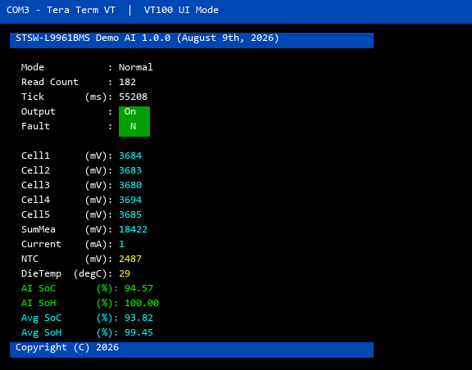
Live Terminal Output — VT100 UI Mode
Real-time display on Tera Term showing sensor data with AI-estimated SoC/SoH
Display Breakdown
Header Bar
Blue background with firmware name, version, and date
System Status
Mode, read count, tick counter, output switch (green=ON), fault pin
Cell Voltages
5 individual cell voltages in mV (cyan) plus sum measurement
Current & Temp
Instantaneous current (cyan), NTC and die temperature (yellow)
AI Raw Output
Direct neural network SoC/SoH predictions in green
AI Filtered Output
10-sample moving average of saturated SoC/SoH in cyan
Footer Bar
Copyright info on blue background
STSW-L9961BMS AI Demo | Slide 7/9

Slide 8
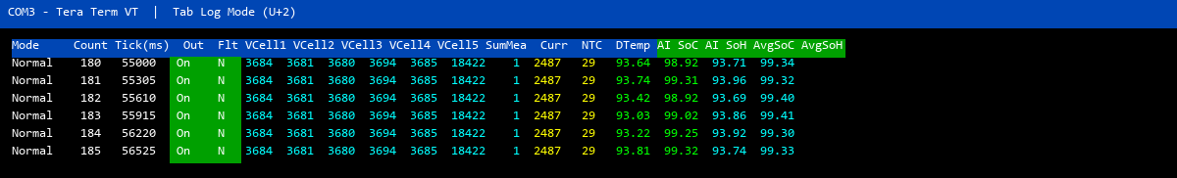
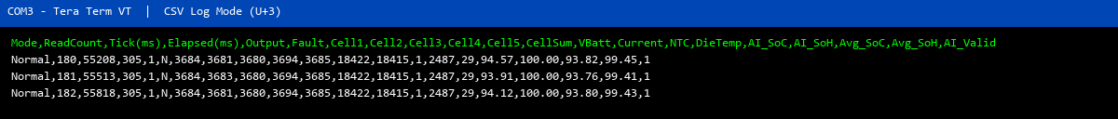
Data Logging Modes — Tab & CSV
Two additional output formats for data acquisition, analysis, and export
Tab Mode (U+2): Colour-coded fixed-width columns for visual monitoring
CSV Mode (U+3): Comma-separated output for import into Excel / MATLAB / Python
STSW-L9961BMS AI Demo | Slide 8/9

Slide 9
Summary & Next Steps
What We Delivered
Technical Specifications
On-device AI inference
SoC and SoH estimated in real-time on Cortex-M0+
MCU
STM32 Cortex-M0+
Production-grade output
Saturated [0-100%] and filtered (10-sample moving avg)
BMS IC
L9961 — 5-cell monitor
3 output modes
VT100 UI, Tab Log, CSV Log — all with AI data
AI Framework
ST Edge AI (X-CUBE-AI)
Model Input
3 floats: Voltage, Current, Temperature
Zero external dependencies
No cloud, no PC compute — fully embedded solution
Model Output
2 floats: SoC (%), SoH (%)
Backward compatible
All Demo1 features retained (fault, pause, commands)
Inference Rate
Every 300ms data cycle
Filter
10-sample Simple Moving Average
Saturation
Clamped to [0%, 100%]
Output
UART → Tera Term (VT100 / Tab / CSV)
Recommended Next Steps
Multi-Cell Input
On-Board Validation
Cloud Logging
Extend AI input from Cell1 only to all 5 cell voltages + NTC
Validate AI predictions against Coulomb-counting SoC on live battery pack
Stream CSV data to cloud dashboard for fleet-level battery analytics
STSW-L9961BMS AI Demo | Slide 9/9

