Slide 1
EE 123 Bioelectricity
Instructor: Joel Grodstein
joel.grodstein@tufts.edu
Day #1

Slide 2
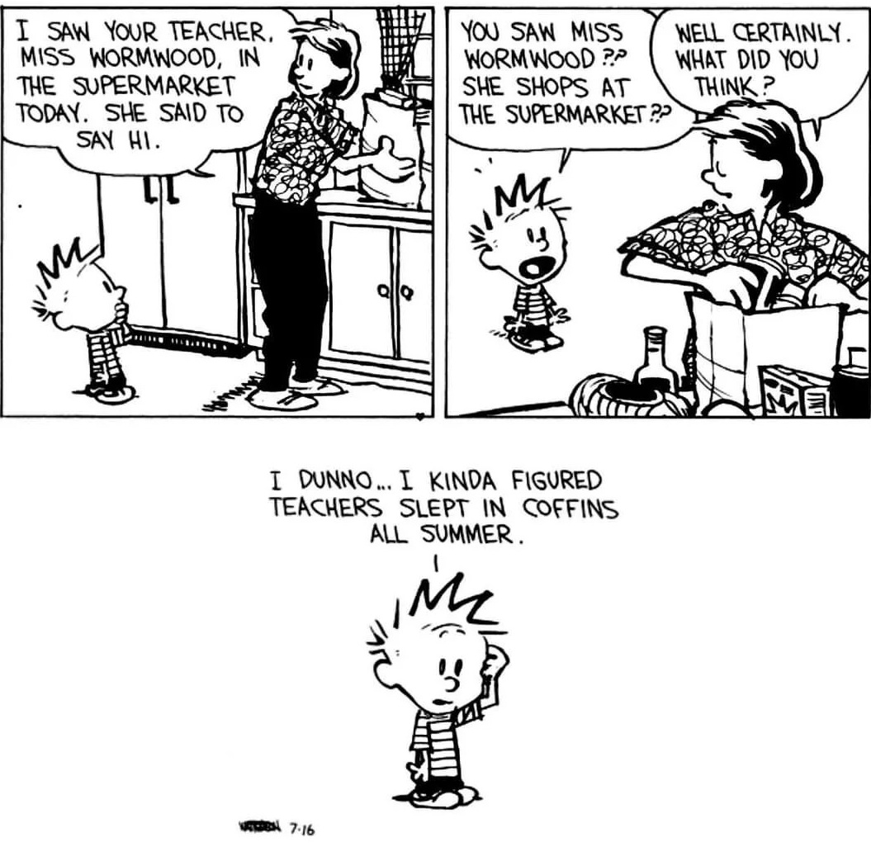

Slide 3
What we (won’t) build
https://xkcd.com/730/
This is a class about bioelectricity
We will not be building circuits like the comic (Darn!)

Slide 4
Agenda for today
What is bioelectricity and why do we care?
The past – impact in the last 50 years
The present and near future – the next 10 years
Basic research in body shape
Logistics of this course

Slide 5
What is bioelectricity?
Any suggestions for a definition?
What parts of your body do you think use it?
  Brain?
  Heart?
  Anyplace else?
Notes:
Pretty much every cell in your body generates electricity. Other than your heart & nervous system, nobody really knows why!

Slide 6
Joke
Doctor sees you for 10 minutes & fixes your pain, and charges $1000…
The pandemic drove this home pretty well
  bioelectricity already is part of medicine
  bioelectricity has the potential for bigger breakthroughs
Notes:
Doctor joke – how much were you willing to pay 10 minutes ago when you were in pain?

Slide 7
Agenda for today
What is bioelectricity and why do we care?
The past – impact in the last 50 years
The present and near future – the next 10 years
Basic research in body shape and cancer
Logistics of this course

Slide 8
Can you think of any successes?
Where has bioelectrical medicine succeeded so far?
  Medical instruments to diagnosis your electrical system?
  Drugs that affect your bioelectrical system?
  Implants that affect your bioelectrical system?
  Neural prosthetics?
Notes:
diagnosis: ECG, EMG/NCS, brain scans, fMRI
Drugs: ion-channel blockers for cardiac issues; GJ blockers for general anaesthesia!
Implants? Pacemaker for sure, and PNS/SCS.

Slide 9
Agenda for today
What is bioelectricity and why do we care?
The past – impact in the last 50 years
The present and near future – the next 10 years
Basic research in body shape and cancer
Logistics of this course

Slide 10
Why now?
Real disruption “takes place on the edge of where one industry is colliding with another industry and [Jobs] said therefore you’ve got to zoom out”
  John Sculley
Convergence between:
  Biology: the controller of everything in our bodies
  Electronics: miniature, wireless
  Big data: lots of bioelectrical & chemical signals
Multidisciplinary engineering challenges are often the hardest
Notes:
Scully was talking about the convergence of entertainment and computing, which of course isn’t our focus.
The “miniature” is because neurons are really small and we’re only beginning to be able to read/write them.

Slide 11
Electroceuticals
Electroceuticals: miniature electronic devices, alter the signal flow in (at first) peripheral nerves
£500M investment by GlaxoSmithKline (the largest British drug maker). First products expected in mid-2020s
  Galvani Bioelectronics (funded by Alphabet and GSK) offering $1M prize for the first implantable device that can record/block/stimulate neural signals stably for 60 days. You don’t offer a prize unless you have some expectation it will be claimed
  Trial underway to control rheumatoid arthritis with vagus-nerve stimulation (https://www.scientificamerican.com/article/can-zapping-the-vagus-nerve-jump-start-immunity/ )
  US FDA recalled nearly half a million pacemakers due to a vulnerability that could allow hackers to literally stop hearts beating (https://thehackernews.com/2017/08/pacemakers-hacking.html )
Notes:
The big deal with electroceuticals: they are specific rather than systemic.

Slide 12
More bioelectronic medicine
Some videos
  https://youtu.be/CHNzYbT7ufY – walking after spinal paralysis at EPFL, and https://www.epfl.ch/labs/courtine-lab/
  https://www.youtube.com/watch?v=bh68vdQxftc – CEO of Cala Health
Some articles
  https://www.independent.co.uk/life-style/health-and-families/features/electricity-new-medicine-nuroscience-brian-spinal-cord-a8614911.html
  https://burnstrauma.biomedcentral.com/articles/10.1186/s41038-018-0123-2
Action Potential Venture Capital
  Kendall Square VC firm, funded by GSK, specializes in bioelectronic medicine
  Likely guest lecture
  Many companies still remain, new ones starting

Slide 13
Agenda for today
What is bioelectricity and why do we care?
The past – impact in the last 50 years
The present and near future – the next 10 years
Basic research in body shape and cancer
Logistics of this course

Slide 14
Morphogenesis
One of the black mysteries of biology
An egg and sperm unite to form one cell. That cell contains all of your DNA
Fast forward 9 months or so. You now have 37 T cells
  Each has exactly the same DNA as the one starting cell
  DNA is the software that tells a cell how to behave. How can they do different things?
  Because every cell runs the same software, but with different inputs (in this case, chemical and electrical signals that are the SW outputs)
  All of those 37T cells, each running the exact same software, have talked to each other and agreed on who does what! Which are eyes, feet, etc.
  Incredible feat of distributed computing. No idea how!
Notes:
Explain the word “morphogenesis”

Slide 15

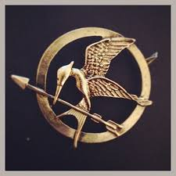
Morphogenesis in popular culture
mockingjay
We will not cover genetic engineering of mutant animals
(We will talk about some very weird nature)

Slide 16
Why do we care?
If we’re not trying to build the Hunger Games, why do we care about morphogenesis?
  It’s a cool problem & a dark mystery
  We want to turn a stem cell into a kidney (avoid a lifetime of immune suppressants)
  cancer is growth gone haywire
Problem: nobody quite knows how
  Works fine in an embryo
  Throw a stem cell into an adult body ⇒ no
Punch line:
  “37T cells have talked to each other and agreed…”
  Growing evidence of electrical communication

Slide 17
Agenda for today
What is bioelectricity and why do we care?
The past – impact in the last 50 years
The present and near future – the next 10 years
Basic research in body shape and cancer
Logistics of this course

Slide 18
“An expert is a person who has made all the mistakes that can be made in a very narrow field.” ― Niels Bohr
So there are no experts in bioelectricity ☺
“Science is the belief in the ignorance of experts”
  Richard Feynmann
We’ll cover a wide variety of topics
  I can’t be an expert in everything
  Feel free to challenge me

Slide 19
What will we learn in…
Biology for bioelectronic medicine:
  Cells, ions, ion pumps, neurons
Computer programming
  Python
EE
  Modeling cells as electrical circuits
  Analysis: batteries, R, C (EE20, BME10)
Physics
  What is voltage, current?
  Diffusion and drift, Nernst
  Vector sum, dot product
Teach it here
Minimal, many online resources
Videos and/or teach here or

Slide 20
What will we learn in…
Medicine
  Neurology, cardiac electrophysiology
Biology for morphogenesis/cancer
  The central dogma and a bit of molecular bio
  DNA, RNA, proteins, promoters, TFs
All of this is taught here

Slide 21
Workload
No tests
≈5 short simulation labs (Python program)
  Usually about 10-15 lines, plus a few discussion questions
Three physical labs (skittles, EMG, ECG)
Oral quizzes
  About four (one for each main unit)
Final project
  Preferably work in groups

Slide 22
Physical labs
Skittles diffusion
Measure your own sEMG (signals from brain to muscles)
Measure your own ECG (heartbeat signal)
Equipment:
  Measurement board + laptop-scope software
Recording your own signals is optional
  It is confidential medical data
  Turn in one data set per group (or turn in mine)
  None of us are clinically qualified to diagnose from an EMG or ECG
  Any abnormalities you see may well be artifacts of our cheap equipment. See a licensed doctor if you have concerns

Slide 23
Class web page
https://www.ece.tufts.edu/ee/123
  Syllabus, class calendar, all lecture slides
  All labs, as well as the lab turn-in

Slide 24
What we’ll cover & how
Main topics:
  What is bioelectricity?
  Bioelectricity in neurons
  Bioelectricity in the heart
  Bioelectricity in worms / cancer

