Slide 1
EE 123: Bioelectricity
Instructor: Joel Grodstein
joel.grodstein@tufts.edu
Bioelectricity I – intro

Slide 2

Notes:
Why have this slide? It’s not really related to the course. But we’re starting with the physics, and physics can be “dry” to some people, and so maybe it’s a good idea to kick it off with something funny.
Any here’s the “real” tie-in: most people find medicine interesting, and some people find physics “dry.” But while the medical portion of any course often relies on studies whose interpretation is open to lots of debute, our physics will be almost completely indisputable.

Slide 3
Big picture of the course
Where does bioelectricity come from?
Neurons and working with the nervous system
Cardiac bioelectricity
Worms and/or cancer

Slide 4
Do we care about this?
Argument for no
  Some people think biological physics is the best; others go into sleep mode ☺
  Wide range of backgrounds
  Can design things without understanding the physics
Argument for yes
  People who understand details in multiple aspects are valuable
  Bioelectronic medicine is a newly-growing field; it’s hard to predict where it will be in 10 years
  The fundamentals of bioelectricity won’t change
Notes:
Designing things: most of the bioelectricity jobs can be done without a ton of biophysics (e.g., medical instrumentation, HW/SW for prosthetics or electroceuticals).

Slide 5
Bioelectricity enables big bodies
Observation
  Our bodies are big
  Bioelectricity is the only reasonable way to coordinate a large body
  Why? Because the physics says so
  Theme for this unit: understand why
Resolution
  High-level, intuitive physics to understand what electricity is
  Just enough equations to understand common models
  Circuits backgrounder for the stuff you absolutely need to know
Notes:
“Bioelectricity enables big bodies” might seem like a strong claim. Arguably the main purpose of this whole unit is to back up that claim.
Trying to make this course reasonable for as many people with diverse backgrounds as possible, so we give you some backgrounders and an ungraded quiz on them. Or just cram for the quiz ☺.

Slide 6
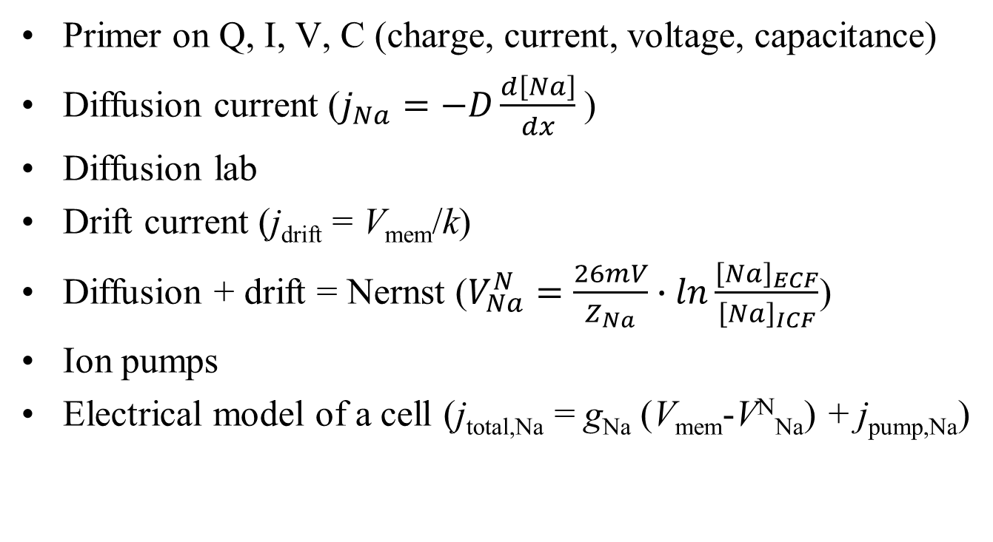
Outline for this section
Primer on Q, I, V, C (charge, current, voltage, capacitance)
Diffusion current ($j_{Na}=−D\frac{d\left[Na\right]}{dx}$)
Diffusion lab
Drift current (j_{drift} = V_{mem}/k)
Diffusion + drift = Nernst ($V_{Na}^{N}=\frac{26mV}{Z_{Na}}∙ln\frac{{\left[Na\right]}_{ECF}}{{\left[Na\right]}_{ICF}}$)
Ion pumps
Electrical model of a cell (j_{total,Na} = g_{Na} (V_{mem}-V^{N}_{Na}) + j_{pump,Na})
Notes:
The QIVC primer is mostly intuitive, just slightly quantitative.

Slide 7
Electric charge
So what is electricity, anyway?
Start with the basics: charge.
  Atoms have electrons (negative charge) and protons (positive charge)
  Same number of each → net zero charge
  An atom can give away an electron to another atom
  The “giver” then has one more proton than electron → net charge of +1
  The receiver has net charge of -1
  Both are now called ions
  Example: NaCl → Na⁺ and Cl⁻
Na
Na⁺
Cl
Cl⁻
11 protons
17 protons
10 e-
11 e⁻
17 e⁻
18 e-

Slide 8
Electric force
+ and - ions attract each other
  Like there’s a big invisible rubber band between them
  You pull them apart & they go back together!
Two positive ions (or two negative) repel each other
  Push them together & they run away
  That’s pretty much what charge is
“Coulomb’s Law” says how hard they push and pull
  We’ll skip the quantitative part of Coulomb’s Law
  The unit of charge is a “Coulomb” (named after Charles-Augustin de Coulomb)

Slide 9
Na⁺
Cl⁻
Opposite charges attracting

Slide 10
Na⁺
K⁺
Two positive charges repel
Two negative charges do too

Slide 11

Work can overcome this
Na⁺
Na⁺
Two positive charges repel

Slide 12
Fixed and movable charges
these charges are stuck in place
cell interior
Na⁺
K⁺
Cl⁻
Why are the Na⁺ and Cl⁻ stuck?
  Charges exist only in +/- pairs. But without some barrier, opposite charges would just smash together
  Most interesting case for us: cell membrane separating positive and negative charges
  assume membrane has an ion channel that’s permeable to K⁺ but not to Na⁺ or Cl⁻
this charge is movable
Notes:
Give a two-sentence description of what’s a cell & an ion channel
Most membranes are permeable to Na and Cl too, but this is just a simplified example

Slide 13
Fixed and movable charges
these charges are stuck in place
cell interior
Na⁺
K⁺
Cl⁻
What will happen?
  The movable K⁺ will travel to the right
this charge is movable

Slide 14
Fixed and movable charges
these charges are stuck in place
cell interior
Na⁺
K⁺
Cl⁻
Again, we can move it back with enough work
this charge is movable
Notes:
Often we want to know how much work it takes to move the ions.
We could do the whole integral of force over distance (with Coulomb’s Law giving us the forces) – but there’s usually an easier way. And so…

Slide 15
Voltage
We could work with Coulomb’s Law to compute forces, accelerations and velocities
But it’s usually easier to use a higher-level concept – voltage
In fact, we won’t learn Coulomb’s Law
  but it was still useful to learn about positive & negative ions!

Slide 16
Voltage
this charge is movable
these charges are stuck in place
Na⁺
Cl⁻
K⁺
K⁺
Na⁺
Cl⁻
What if we had twice as many fixed-in-place ions?
  There would be twice as much electric force on the K⁺
  It would move twice as fast
  It would require twice as much work to move it back
Any time you separate charges, you get a voltage
Separating charges across a cell membrane is the basis of bio-electricity
Voltage tells how much energy (or work) needed to push 1C of charge across from point A to point B
  The unit is Volts (a.k.a. Joules/Coulomb)
  1C of charge, moving across 1V, takes 1J of work
  2C of charge, moving across 3V, takes 6J of work

Slide 17

Voltage
this charge is movable
these charges are stuck in place
Na⁺
Cl⁻
K⁺
K⁺
Na⁺
Cl⁻
Separating charges across a cell membrane is the basis of bio-electricity
The fixed separated charges (Na⁺ and Cl⁻) create, e.g., 3V
A Volt is a Joule/Coulomb
  moving (e.g.,) 2C of K⁺ across 3V takes how much work?
Next question: why did the Na⁺ and Cl⁻ create 3V and not 4V?
How much voltage gets made by how much separated charge?
Q=CV
$\frac{3 Joules}{C}∙\frac{2C}{1}$=6 Joules
Capacitance of the cell membrane (mostly, how thick it is). In this case, .33 Farads
how much charge: e.g., 1 Coulomb
how much voltage: like, 3 Volts

Slide 18
Why do we care about work?
Intuitively, that’s what voltage is about
Bioelectrical voltage is usually made by ion pumps – V_{mem} tells us how much work they did

Slide 19
Current
Na⁺
K⁺
Cl⁻
Say we have an observer (that’s the eye!) sitting in the middle and counting how many ions pass by
  the number of ions that pass by every second is called current
  the current per m² of cross-sectional area is called flux
  the unit of current is an Ampere (from André-Marie Ampere)
  1 A ≡ 1 C/s
What are the units of flux?
  A/m²

Slide 20
End of electricity primer
That’s electricity in a nutshell
  It’s very useful for everything from washing machines to cell phones
  And…most cells in our body create voltage
The big takeaways
  Intuitively, what is charge, voltage, current and flux
  Opposite charges attract, like charges repel
  Q=CV

Slide 21
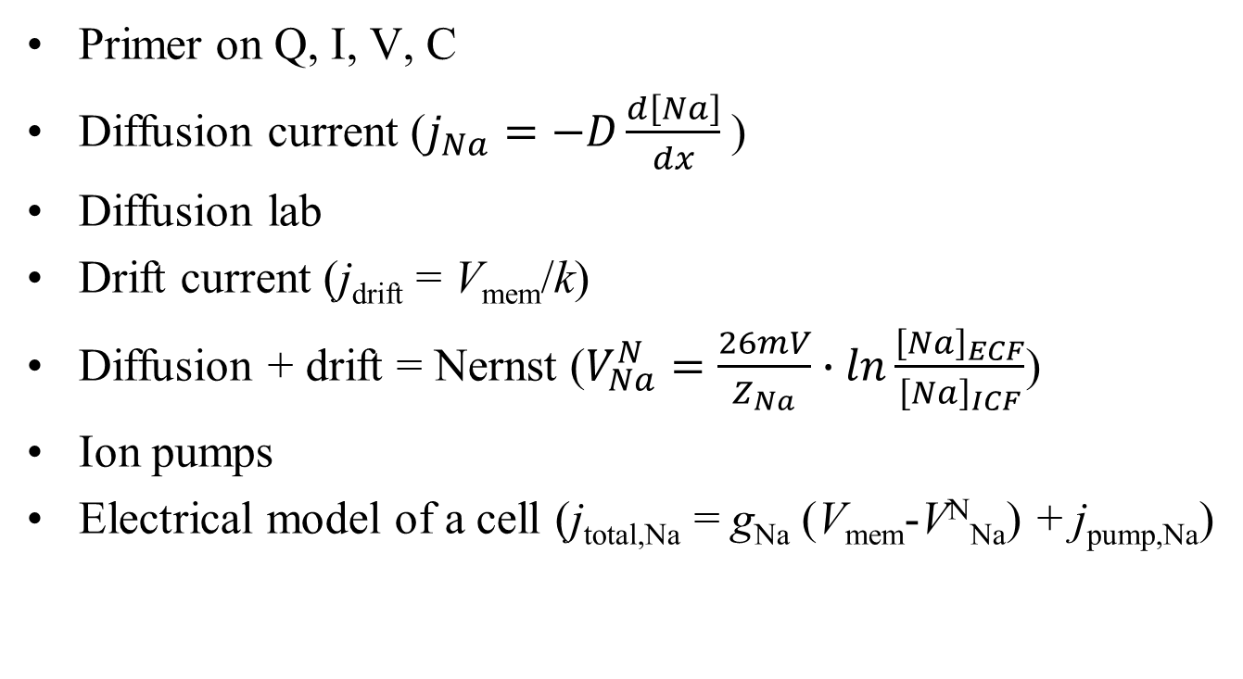
Outline for this section
Primer on Q, I, V, C
Diffusion current ($j_{Na}=−D\frac{d\left[Na\right]}{dx}$)
Diffusion lab
Drift current (j_{drift} = V_{mem}/k)
Diffusion + drift = Nernst ($V_{Na}^{N}=\frac{26mV}{Z_{Na}}∙ln\frac{{\left[Na\right]}_{ECF}}{{\left[Na\right]}_{ICF}}$)
Ion pumps
Electrical model of a cell (j_{total,Na} = g_{Na} (V_{mem}-V^{N}_{Na}) + j_{pump,Na})

Slide 22
Diffusion
“(In the nanoworld), everything is dancing,” Philip Nelson, Biological Physics
Particles move randomly; on average, they move from high concentration to low concentration
Notes:
The “randomly” is thermal motion.
What does this quote mean? In our everyday world, we put an apple on the table and it stays there! But that’s just because the apple is bigger than a molecule ☺
In the nanoworld, lots of particles move every which way. When the apple falls from the tree, some of its molecules might be moving up at any point in time. Yes, that’s weird.

Slide 23
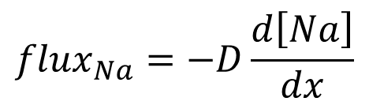
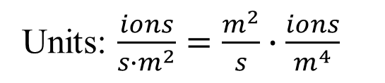
Diffusion
Cell
ECF
cell membrane
Intuition:
  Assume particles move in random directions
  On average more particles cross the membrane right→left than left→right
  It is probabilistic, but deterministic if there are enough particles (the magic of statistical mechanics!)
  Random thermal motion + concentration gradient → flux
how big the gradient is
how fast ions cross the membrane
$${flux}_{Na}=−D\frac{d\left[Na\right]}{dx}$$
Note the sign: diffusion evens out concentrations
magic constant
Units: $\frac{ions}{{s∙m}^{2}}=\frac{m^{2}}{s}∙\frac{ions}{m^{4}}$
Notes:
The diffusion story: Robert Brown, Brownian motion, saw pollen move around in a vial with a microscope (1827). Assumed the pollen was alive. Stuck the vial in a dark room for a year – still moved around! Several similar experiments, including: took flecks of stone from the Giant Sphynx and dropped them in water – they moved too! Einstein finally explained it in 1905; this was one of the major arguments that molecules actually exist.

Slide 24
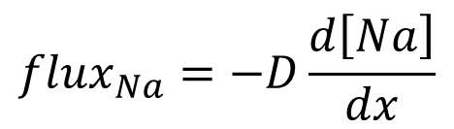
What is D, really?
$${flux}_{Na}=−D\frac{d\left[Na\right]}{dx}$$
We have a simple equation
We (hopefully) know what it means
D is how fast an ion moves, for a given gradient pushing it
What affects D, our magic proportionality constant?
  High-volume ion:
  In a vacuum:
  In a liquid
will bump into lots of things and slow down, so D will be small
D will be quite large (not relevant for us!)
Not nearly so large
Notes:
If D is big, than a given conc. gradient will make ions move really fast.
Intuition: think of you walking through a crowd. What determines your speed is how many people you bump into.

Slide 25
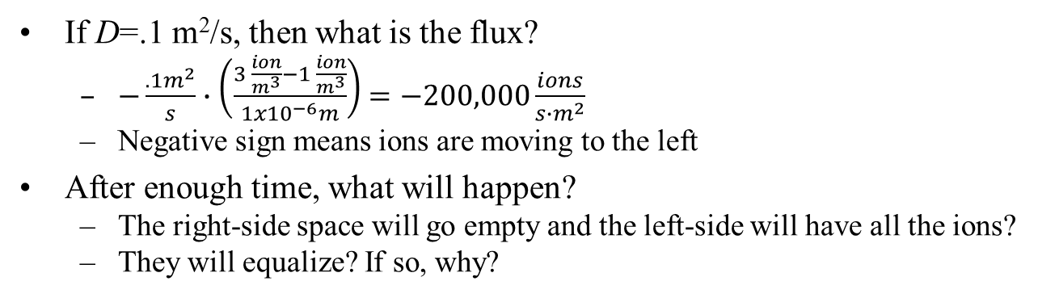
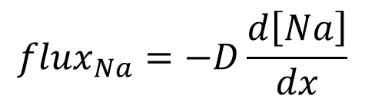
Example
Cell
1 ion/m³
ECF
3 ions/m³
$${flux}_{Na}=−D\frac{d\left[Na\right]}{dx}$$
If D=.1 m²/s, then what is the flux?
  $−\frac{.1m^{2}}{s}∙\left(\frac{3 \frac{ion}{m^{3}}−1 \frac{ion}{m^{3}}}{1x{10}^{−6}m}\right)$ $=−200,000\frac{ions}{{s∙m}^{2}}$
  Negative sign means ions are moving to the left
After enough time, what will happen?
  The right-side space will go empty and the left-side will have all the ions?
  They will equalize? If so, why?
dx = 1μ
Will they always eventually equalize to 2 moles/m³
  No. E.g., if the ECF is really big then they will equalize to just under 3
  Thought question: is the ECF usually really big?
3
1
concentration
time
Notes:
Note that diffusion is really a partial differential equation; the “flux” part is really d[Na]/dt. We’ve simplified the d/dx by assuming d[Na]/dx is 0 in the cells and constant in the membrane

Slide 26
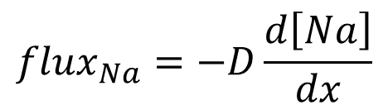
Example
dx = 1μ
Cell
2.99 ions/m³
Cell
1 ion/m³
$${flux}_{Na}=−D\frac{d\left[Na\right]}{dx}$$
ECF
3 ions/m³
ECF
2.99 ions/m³
Assume the ECF is big, the cell is really little
After diffusion is done…
Why? At any time,
  # of ions leaving the ECF = # entering the cell
  So [ion] changes faster in the cell than in the ECF
An analogy:
  It’s 20° outside, your house is 70°, and you open the door
  After a few hours your house is also 20°, and you’ve not appreciably warmed up the earth
3
1
concentration
time
Notes:
The point is the same # of ions leave the ECF as enter the cell. But that translates into a small delta-concentration in the ECF and a large delta-concentration in the cell.

Slide 27
Outline for this section
Primer on Q, I, V, C
Diffusion current ($j_{Na}=−D\frac{d\left[Na\right]}{dx}$)
Diffusion lab
Drift current (j_{drift} = V_{mem}/k)
Diffusion + drift = Nernst ($V_{Na}^{N}=\frac{26mV}{Z_{Na}}∙ln\frac{{\left[Na\right]}_{ECF}}{{\left[Na\right]}_{ICF}}$)
Ion pumps
Electrical model of a cell (j_{total,Na} = g_{Na} (V_{mem}-V^{N}_{Na}) + j_{pump,Na})

Slide 28
Outline for this section
Primer on Q, I, V, C
Diffusion current ($j_{Na}=−D\frac{d\left[Na\right]}{dx}$)
Diffusion lab
Drift current (j_{drift} = V_{mem}/k)
Diffusion + drift = Nernst ($V_{Na}^{N}=\frac{26mV}{Z_{Na}}∙ln\frac{{\left[Na\right]}_{ECF}}{{\left[Na\right]}_{ICF}}$)
Ion pumps
Electrical model of a cell (j_{total,Na} = g_{Na} (V_{mem}-V^{N}_{Na}) + j_{pump,Na})
Notes:
We’ve boiled diffusion down to lots of intuition and one simple equation. Now let’s try that for drift current.

Slide 29
Drift
We saw diffusion
  random thermal motion + concentration gradient = net ion currents
Drift
  charged ion + voltage pushing it around = ion current
Notes:
The “motor” behind diffusion is purely thermal. The motor behind drift is electrical forces from charged ions repelling/attracting.

Slide 30
Drift current
this charge is movable
these charges are stuck in place
Na⁺
Cl⁻
K⁺
Na⁺
Cl⁻
We said similar charges repel, opposite charges attract
  That causes charges to move
  We call this drift current
Problem: real systems have too many charges to deal with ☹
More common formulation
  The separated charges (Na⁺ and Cl⁻) create a voltage
  The voltage creates a K⁺ drift current (or flux)

Slide 31
1. Separated charges create a voltage
this charge is movable
these charges are stuck in place
+ 3V -
Na⁺
Cl⁻
K⁺
Na⁺
Cl⁻
Separating charges across a cell membrane is the basis of bio-electricity
The fixed separated charges (Na⁺ and Cl⁻) create, e.g., 3V
Why did the Na⁺ and Cl⁻ create 3V and not 4V?
How much voltage gets made by how much separated charge?
Q=CV
Capacitance of the cell membrane (mostly, how thick it is). In this case, .33 Farads (or .33 Coul/Volt)
how much charge: e.g., 1 Coulomb
how much voltage: like, 3 Volts

Slide 32
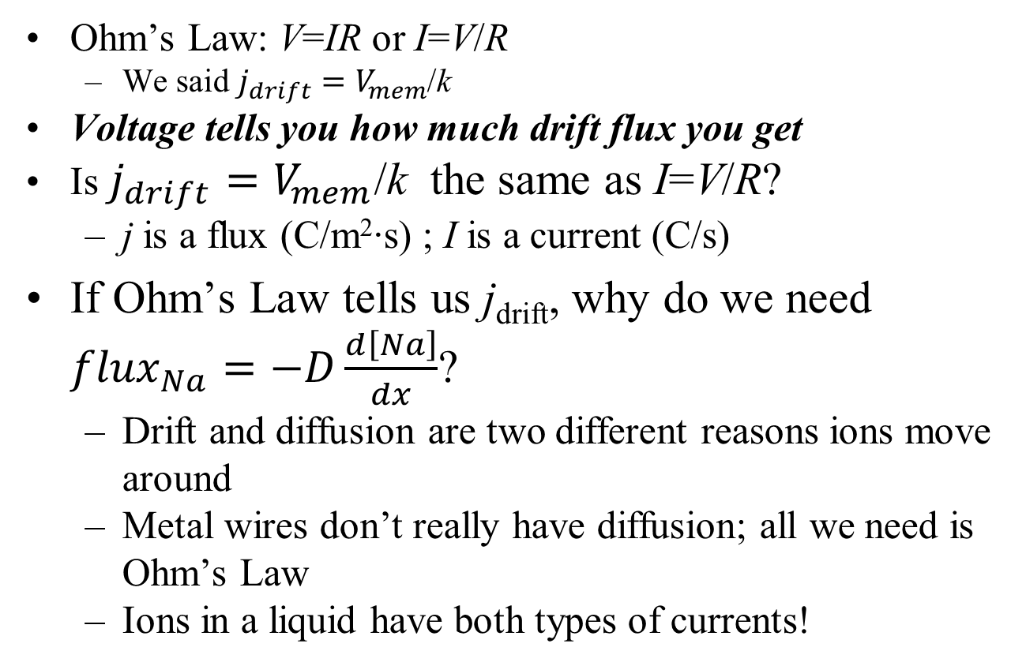
2. Voltage creates a flux
Ohm’s Law: V=IR or I=V/R
  We said $j_{drift}=V_{mem}$/k
Voltage tells you how much drift flux you get
Is $j_{drift}=V_{mem}$/k the same as I=V/R?
  j is a flux (C/m²∙s) ; I is a current (C/s)
If Ohm’s Law tells us j_{drift}, why do we need ${flux}_{Na}=−D\frac{d\left[Na\right]}{dx}$?
  Drift and diffusion are two different reasons ions move around
  Metal wires don’t really have diffusion; all we need is Ohm’s Law
  Ions in a liquid have both types of currents!
Notes:
Ohm’s Law is the most famous of all the EE equations ☺
Our version is the bioelectric version. Our V_{mem} is just the particular V that we care about.
The usual Ohm’s Law uses current rather than flux (they’re almost the same, except for the “per unit area” part. That’s because they’ve wrapped the resistor’s cross-sectional area into its R.
So the k we’re using is much more of an intrinsic material property. The next (backup) slide shows that it wraps up the movable ion’s mobility and charge, as well as the membrane thickness.

Slide 33
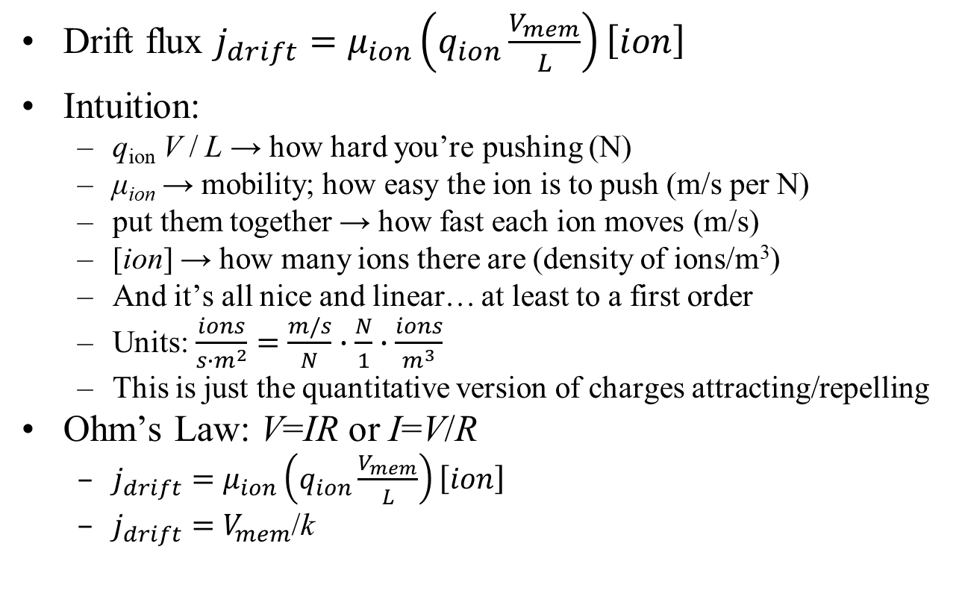
Why does Ohm’s Law work?
ion density
Drift flux $j_{drift}=μ_{ion}\left(q_{ion}\frac{V_{mem}}{L}\right)\left[ion\right]$
Intuition:
  q_{ion} V / L → how hard you’re pushing (N)
  μ_{ion} → mobility; how easy the ion is to push (m/s per N)
  put them together → how fast each ion moves (m/s)
  [ion] → how many ions there are (density of ions/m³)
  And it’s all nice and linear… at least to a first order
  Units: $\frac{ions}{{s∙m}^{2}}=\frac{m/s}{N}∙\frac{N}{1}∙\frac{ions}{m^{3}}$
  This is just the quantitative version of charges attracting/repelling
Ohm’s Law: V=IR or I=V/R
  $j_{drift}=μ_{ion}\left(q_{ion}\frac{V_{mem}}{L}\right)\left[ion\right]$
  $j_{drift}=V_{mem}$/k
mobility
pushing force (attract/repel)
Backup

Slide 34
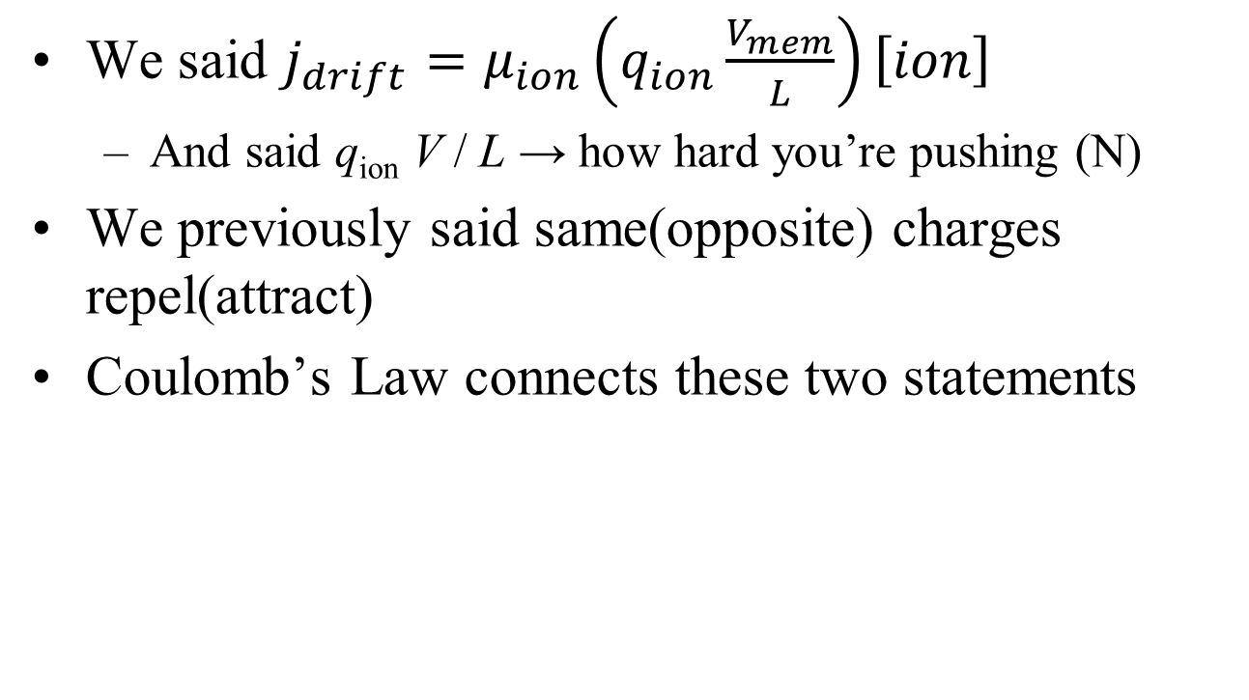
q_{ion}V/L → force: why?
We said $j_{drift}=μ_{ion}\left(q_{ion}\frac{V_{mem}}{L}\right)\left[ion\right]$
  And said q_{ion} V / L → how hard you’re pushing (N)
We previously said same(opposite) charges repel(attract)
Coulomb’s Law connects these two statements
Backup

Slide 35
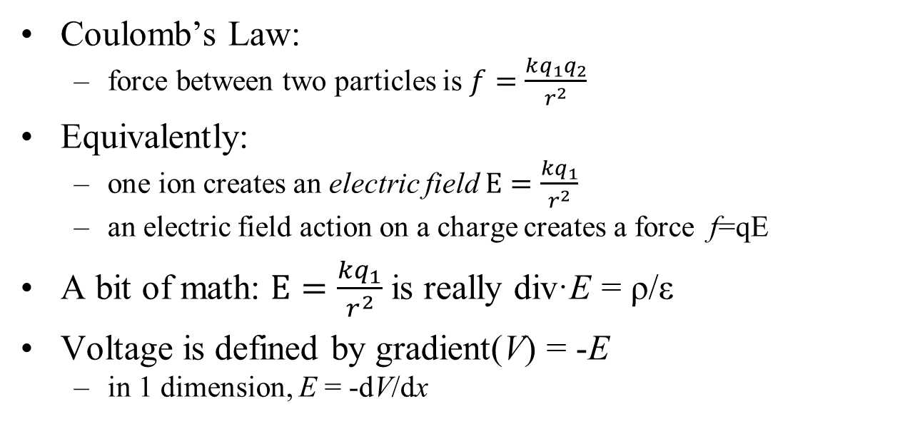
q_{ion}V/L → force: why?
Coulomb’s Law:
  force between two particles is $f=\frac{kq_{1}q_{2}}{r^{2}}$
Equivalently:
  one ion creates an electric field $E=\frac{kq_{1}}{r^{2}}$
  an electric field action on a charge creates a force f=qE
A bit of math: $E=\frac{kq_{1}}{r^{2}}$is really div·E = ρ/ε
Voltage is defined by gradient(V) = -E
  in 1 dimension, E = -dV/dx
Maxwell’s 1st eqn
+++++
- - - - -
The above two equations can derive that E=V/L, and Q=CV, and even the value of C
Backup

Slide 36
q_{ion}V/L → force: why?
A basic statement of electric charges
f=qE
A charge q
feels a force f
in the presence of a field E
Newton’s first Law
  acceleration a = f / m = q_{ion}E/m_{ion}
  Constant E field implies constant acceleration
  Will the ion travel faster and faster until it goes infinitely fast?
Not really
  First, nothing ever goes infinitely fast ☺
  Einstein said relativity gets in the way
Backup

Slide 37
Mobility*force = velocity – why?
Car with your foot on the gas (providing a constant force)
What stops your car from hitting 10K mph?
  Air drag
  The faster you go, the more drag, until it all balances out
Ions see the same drag forces
  Car bumps into random air molecules
  An ion bumps into other ions & molecules
End result: v = μ_{ion} f = μ_{ion} q_{ion} E
Intuition:
  More charge or field → more force → more speed
  More V → more E
  And it’s all nice and linear… at least in our simple model
And then J_{drift} = v[ion]
mobility
velocity
Backup

Slide 38
Mobility*force = velocity – why?
We have a simple equation
We (hopefully) know what it means
What affects μ, our magic proportionality constant?
High-volume ion:
In a vacuum:
In a liquid:
The units work
  f=qE: E is N/C, q is C and so E q is N
  v= μf: μ is m/s per N, so μ f is a velocity
will bump into lots of things and slow down, so μ will be small
μ will be quite large (not relevant for us!)
Not nearly so large.
Backup

Slide 39
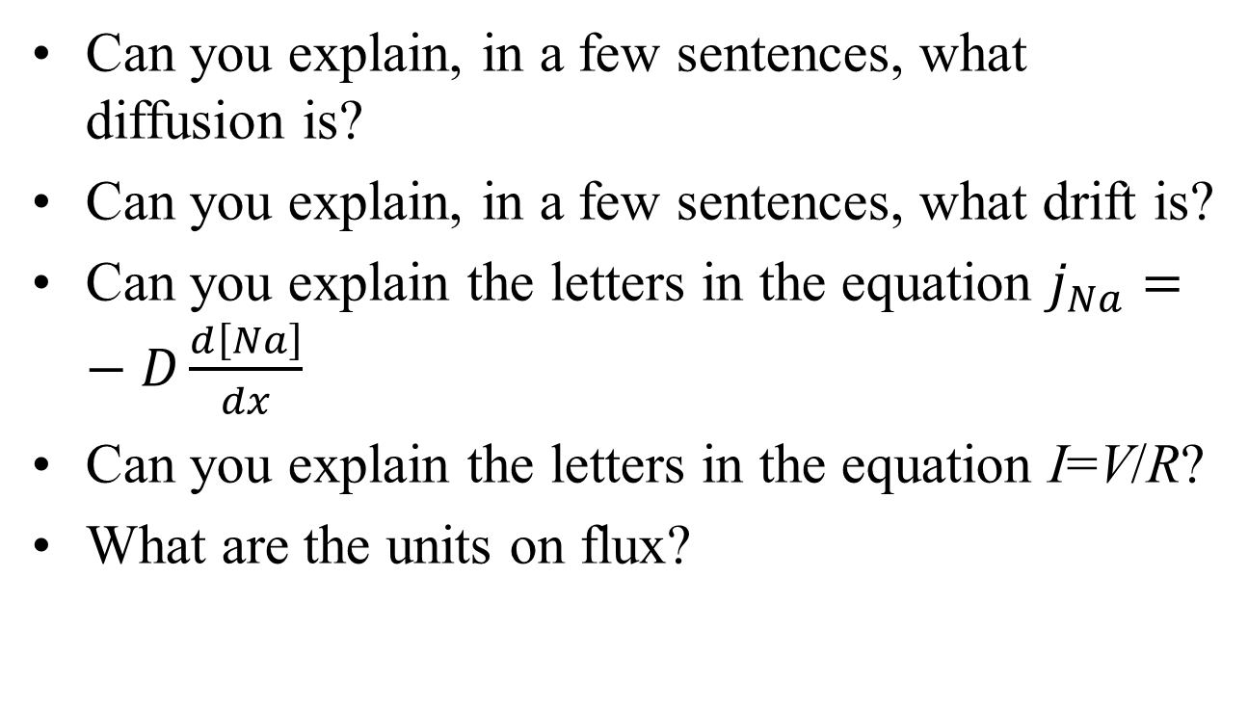
Mini quiz
Can you explain, in a few sentences, what diffusion is?
Can you explain, in a few sentences, what drift is?
Can you explain the letters in the equation $j_{Na}=−D\frac{d\left[Na\right]}{dx}$
Can you explain the letters in the equation I=V/R?
What are the units on flux?

Slide 40
Circuits primer
Now jump to the circuits primer…

Slide 41
Outline for this section
Primer on Q, I, V, C
Diffusion current ($j_{Na}=−D\frac{d\left[Na\right]}{dx}$)
Diffusion lab
Drift current (j_{drift} = V_{mem}/k)
Diffusion + drift = Nernst ($V_{Na}^{N}=\frac{26mV}{Z_{Na}}∙ln\frac{{\left[Na\right]}_{ECF}}{{\left[Na\right]}_{ICF}}$)
Ion pumps
Electrical model of a cell (j_{total,Na} = g_{Na} (V_{mem}-V^{N}_{Na}) + j_{pump,Na})
Notes:
Nernst is the iconic thing to know about bioelectricity

Slide 42
Dilemma
Diffusion – particles move from high concentration to low
  End result: uniform concentrations everywhere
  Same amount of Na⁺ on inside & outside of cell
Drift is caused by voltage
  Voltage is caused by separated charges
  E.g., lots of Na⁺ inside and lots of Cl⁻ outside
But…
  If all particles are uniformly distributed, how can we have separated charges?
Notes:
I.e., how can bioelectricity even exist? Cancel the course right now ☺

Slide 43
Diffusion + membrane = voltage
extra-cellular fluid
Cell
P⁻
Cells make lots of proteins
Protein → big negative piece + small positive piece
Protein
P⁺
Cell membrane
intra-cellular fluid
Notes:
Note the color coding of red=positive ions, black=negative. That’s pretty common (in EE at least).

Slide 44
Diffusion + membrane = voltage
Cell interior is charge neutral
So is the ECF
P⁺
P⁻
P⁻
P⁺
P⁻
P⁺
P⁺
P⁻
Any voltage?
Any diffusion across the cell membrane?
  Assume P⁺ can get through the membrane, but P⁻ is too big
Notes:
No separated charge, so no voltage. OK, I drew the picture so that it looks like the + is mostly together, but in real life the + and – are all intermingled.
But there is diffusion of P+

Slide 45
Diffusion + S.P. membrane = voltage
P⁺
P⁺ diffuses out of the cell
Is there any voltage?
  ICF is negative, ECF is positive
P⁻
P⁻
P⁺
P⁻
P⁺
P⁺
P⁻
Which direction does P⁺ diffuse?
Which direction does it drift?
With only one P⁺ outside, V is small: diffusion > drift
Notes:
The “S.P.” in the title stands for a selectively-permeable membrane. So the previous two slides have a less-than-useful title, but this slide is more precise.

Slide 46
Diffusion + S.P. membrane = voltage
P⁺
More P⁺ diffuses out
More separated charge
More voltage
P⁻
P⁻
P⁺
P⁻
P⁺
P⁺
P⁻
Eventually we reach equilibrium
  All the P⁻ is still stuck inside
  Diffusion current out = drift current in
Next question – what is V at that point?

Slide 47
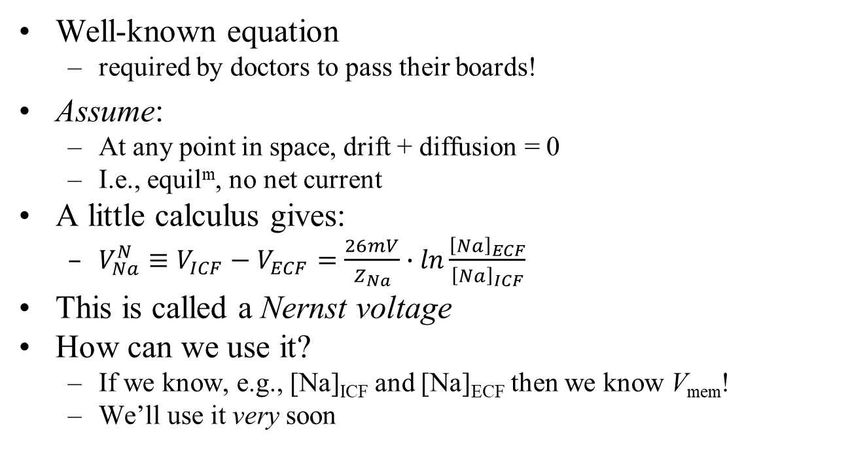
Nernst equation
Well-known equation
  required by doctors to pass their boards!
Assume:
  At any point in space, drift + diffusion = 0
  I.e., equil^{m}, no net current
A little calculus gives:
  $V_{Na}^{N}≡V_{ICF}−V_{ECF}=\frac{26mV}{Z_{Na}}∙ln\frac{{\left[Na\right]}_{ECF}}{{\left[Na\right]}_{ICF}}$
This is called a Nernst voltage
How can we use it?
  If we know, e.g., [Na]_{ICF} and [Na]_{ECF} then we know V_{mem}!
  We’ll use it very soon
Notes:
Of course, we’ll understand it better than the doctors do ☺. We’ll specifically understand when it doesn’t apply.

Slide 48
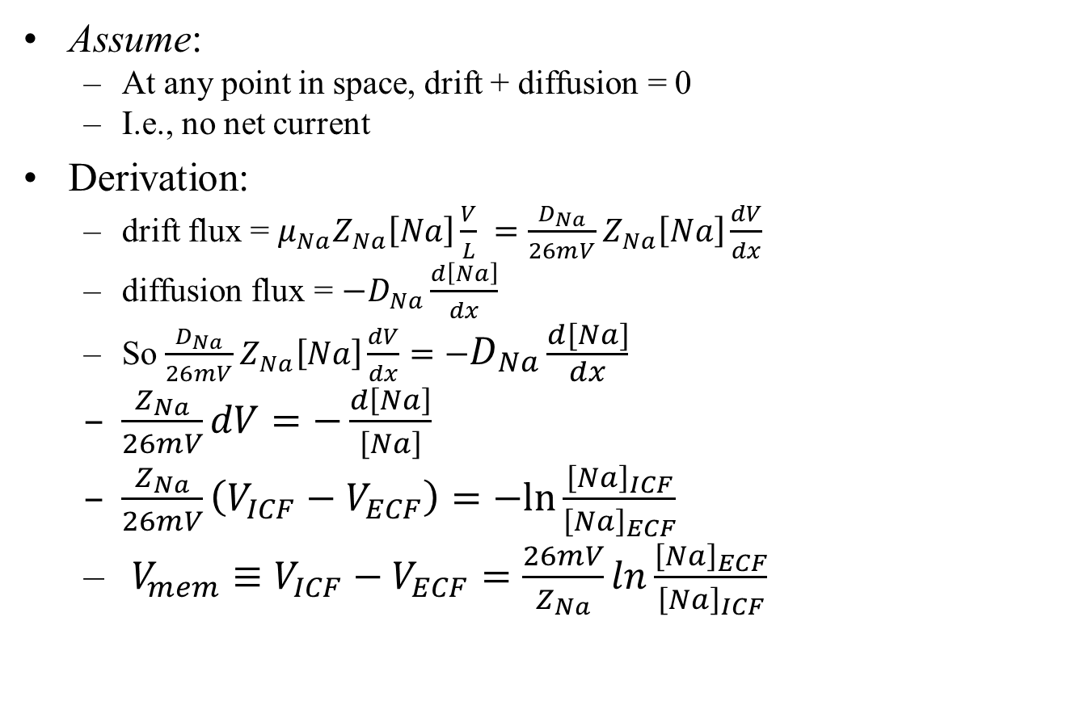
Nernst derivation
Assume:
  At any point in space, drift + diffusion = 0
  I.e., no net current
Derivation:
  drift flux = $μ_{Na}Z_{Na}\left[Na\right]\frac{V}{L} =\frac{D_{Na}}{26mV}Z_{Na}\left[Na\right]\frac{dV}{dx}$
  diffusion flux = $−D_{Na}\frac{d\left[Na\right]}{dx}$
  So $\frac{D_{Na}}{26mV}Z_{Na}\left[Na\right]\frac{dV}{dx}=−D_{Na}\frac{d\left[Na\right]}{dx}$
  $\frac{Z_{Na}}{26mV}dV=−\frac{d\left[Na\right]}{\left[Na\right]}$
  $\frac{Z_{Na}}{26mV}\left(V_{ICF}−V_{ECF}\right)=−ln\frac{{\left[Na\right]}_{ICF}}{{\left[Na\right]}_{ECF}}$
  $V_{mem}≡V_{ICF}−V_{ECF}=\frac{26mV}{Z_{Na}}ln\frac{{\left[Na\right]}_{ECF}}{{\left[Na\right]}_{ICF}}$
Einstein relation says D = μ kT/q_{e} = μ *26mV
Backup

Slide 49
Nernst assumptions
The big assumption: drift = diffusion
Why might that be true?
  Said a bit differently: why do reactions tend to be balanced by equal/opposite reactions?
Biology is full of machines that create homeostasis
  Maintain your body temp at 98.6°
  Maintains chemical concentrations quite steady
  Every flux leaving a cell is balanced by one entering
Drift and diffusion are “often” balanced at homeostasis
  But not always
  We’ll see why pretty soon, and make this more precise
Notes:
An interesting question: why doesn’t Nernst apply to the protein+ ions in the last few slides? If we assume that the membrane is truly 100% impermeable to P+, then Nernst clearly cannot apply. And if the membrane is indeed slightly permeable, then Nernst will apply! (But it will probably take a long time).

Slide 50
Giant squid voltages
extra-cellular fluid
Remember: Pr⁻ cannot cross the cell membrane
Minor problem: K⁺, Na⁺, Cl⁻ cannot either!
So how can diffusion, drift happen?
[K⁺]=400mM
[Na⁺]=50mM
[Cl⁻]=52mM
Pr ⁻=408mM
[K⁺]=20mM
[Na⁺]=440mM
[Cl⁻]=560mM
other⁺=110mM
intra-cellular fluid
The membrane has ion channels
  little holes in the cell membrane that ions can diffuse through (aided by molecular machines)
Notes:
Why do we use giant squid, of all creatures? And note the concentrations given here are for giant squid, not humans.

Slide 51
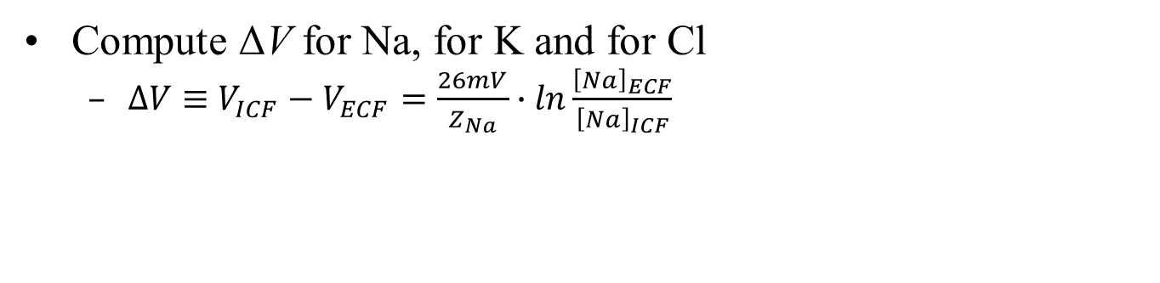
In-class exercise
extra-cellular fluid
Is ΔV the same for Na, K and Cl?
[K⁺]=400mM
[Na⁺]=50mM
[Cl⁻]=52mM
Pr ⁻=408mM
[K⁺]=20mM
[Na⁺]=440mM
[Cl⁻]=560mM
other⁺=110mM
intra-cellular fluid
Compute ΔV for Na, for K and for Cl
  $∆V≡V_{ICF}−V_{ECF}=\frac{26mV}{Z_{Na}}∙ln\frac{{\left[Na\right]}_{ECF}}{{\left[Na\right]}_{ICF}}$
Notes:
Hint: it will be surprising, and may seem to violate our understanding of what voltage means

Slide 52
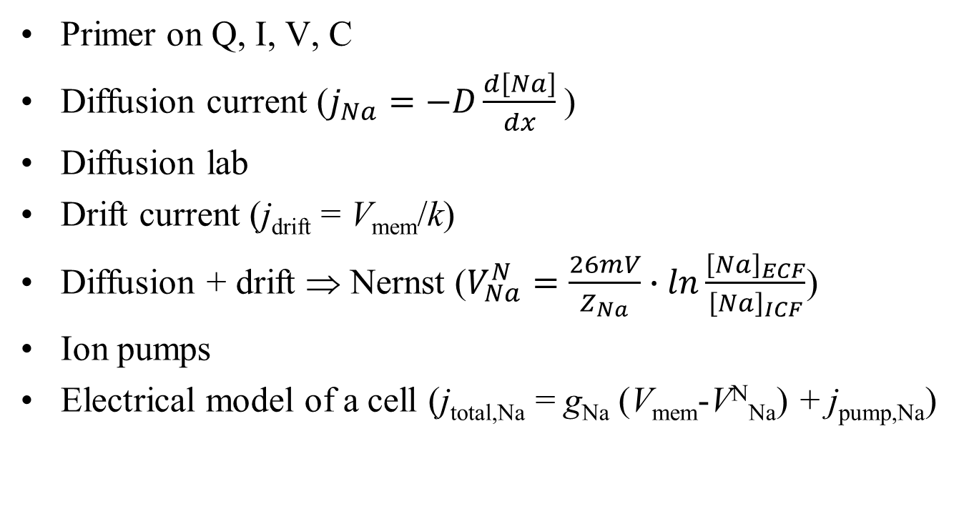
Outline for this section
Primer on Q, I, V, C
Diffusion current ($j_{Na}=−D\frac{d\left[Na\right]}{dx}$)
Diffusion lab
Drift current (j_{drift} = V_{mem}/k)
Diffusion + drift ⇒ Nernst ($V_{Na}^{N}=\frac{26mV}{Z_{Na}}∙ln\frac{{\left[Na\right]}_{ECF}}{{\left[Na\right]}_{ICF}}$)
Ion pumps
Electrical model of a cell (j_{total,Na} = g_{Na} (V_{mem}-V^{N}_{Na}) + j_{pump,Na})

Slide 53
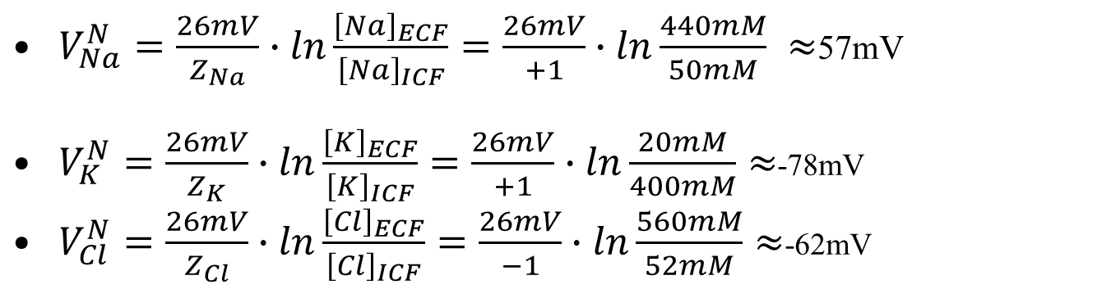
In-class exercise
extra-cellular fluid
Is V^{Nernst} the same for Na, K and Cl?
No!
But if V^{Nernst} is the ΔV across the cell membrane, it can only have one value ?!?
[K⁺]=400mM
[Na⁺]=50mM
[Cl⁻]=52mM
Pr ⁻=408mM
[K⁺]=20mM
[Na⁺]=440mM
[Cl⁻]=560mM
other⁺=110mM
intra-cellular fluid
$V_{Na}^{N}=\frac{26mV}{Z_{Na}}∙ln\frac{{\left[Na\right]}_{ECF}}{{\left[Na\right]}_{ICF}}=\frac{26mV}{+1}∙ln\frac{440mM}{50mM} ≈$57mV
$V_{K}^{N}=\frac{26mV}{Z_{K}}∙ln\frac{{\left[K\right]}_{ECF}}{{\left[K\right]}_{ICF}}=\frac{26mV}{+1}∙ln\frac{20mM}{400mM}≈$-78mV
$V_{Cl}^{N}=\frac{26mV}{Z_{Cl}}∙ln\frac{{\left[Cl\right]}_{ECF}}{{\left[Cl\right]}_{ICF}}=\frac{26mV}{−1}∙ln\frac{560mM}{52mM}≈$-62mV
Notes:
When things get weird, it’s probably time to go back to basics

Slide 54
Forces on the system
extra-cellular fluid
intra-cellular fluid
[K⁺]=20mM
[Na⁺]=440mM
[Cl⁻]=560mM
other⁺=110mM
[K⁺]=400mM
[Na⁺]=50mM
[Cl⁻]=52mM
Pr ⁻=408mM
First force: diffusion (our old friend)
Which way does diffusion flow for K⁺, Na⁺ and Cl⁻?
  K⁺ out; Na⁺ and Cl⁻ in

Slide 55
Results of diffusion
extra-cellular fluid
[K⁺]=20mM
[Na⁺]=440mM
[Cl⁻]=560mM
other⁺=110mM
[K⁺]=400mM
[Na⁺]=50mM
[Cl⁻]=52mM
Pr ⁻=408mM
If diffusion happens long enough and there is no drift, what will happen to the concentrations [K⁺], [Na⁺] and [Cl⁻] inside vs. outside of the cell?
  For each ion, the concentration inside and outside the cell will eventually become equal
This is not what actually happens!

Slide 56
Drift currents
60mV --- +++
[K⁺]=20mM
[Na⁺]=440mM
[Cl⁻]=560mM
other⁺=110mM
[K⁺]=400mM
[Na⁺]=50mM
[Cl⁻]=52mM
Pr ⁻=408mM
Blue arrows = diffusion
Green arrows = electric current
In fact, the cell stabilizes to V_{mem} ≈ -60mV
  (given the amount of unbalanced charge, and Q=CV)
  This voltage will push the ions around, as we’ve discussed
  Which way do drift currents flow?

Slide 57
Nernst sanity check
60mV --- +++
[K⁺]=20mM
[Na⁺]=440mM
[Cl⁻]=560mM
other⁺=110mM
[K⁺]=400mM
[Na⁺]=50mM
[Cl⁻]=52mM
Pr ⁻=408mM
Blue arrows = diffusion
Green arrows = drift current
First look at Cl⁻. Can drift and diffusion currents balance?
  Yes; drift current out, and diffuses in
  V_{Cl}^{Nernst} = -62mV ≈ V_{mem}. Cool!

Slide 58
Nernst sanity check
60mV --- +++
[K⁺]=20mM
[Na⁺]=440mM
[Cl⁻]=560mM
other⁺=110mM
[K⁺]=400mM
[Na⁺]=50mM
[Cl⁻]=52mM
Pr ⁻=408mM
Blue arrows = diffusion
Green arrows = drift current
Next look at K⁺. Can drift current and diffusion balance?
  Yes; drift current in, and diffuses out
  V_{K}^{Nernst} ≈ -78mV
  Not quite right ?!?

Slide 59
Nernst sanity check
60mV --- +++
[K⁺]=20mM
[Na⁺]=440mM
[Cl⁻]=560mM
other⁺=110mM
[K⁺]=400mM
[Na⁺]=50mM
[Cl⁻]=52mM
Pr ⁻=408mM
Blue arrows = diffusion
Green arrows = drift current
Finally, look at Na⁺. Can drift current and diffusion balance?
  No – they both flow inwards!
  V_{Na}^{Nernst} ≈ +57mV
  Not even close ?!?
What’s going on here?

Slide 60
Another ion-flow source
60mV --- +++
3Na⁺
2K⁺
[K⁺]=20mM
[Na⁺]=440mM
[Cl⁻]=560mM
other⁺=110mM
[K⁺]=400mM
[Na⁺]=50mM
[Cl⁻]=52mM
other⁻=408mM
Blue arrows = diffusion
Green arrows = drift current
Red arrows = ion pump
Na, K drift ≠ -diffusion → Nernst is wrong
Drift and diffusion currents do not balance
  another molecular machine at work: ion pumps
Ion pumps pump 3 Na⁺ out and 2 K⁺ in
  Na⁺ flows in (drift & diffusion currents) through ion channels, and gets pumped right out again (inward and outward flows balance at steady state)
  K⁺ flows in from drift current and is also pumped in; diffusion out exactly balances this total inwards flow
Why was Cl⁻ the only ion whose V^{Nernst} exactly matched the cell voltage?
  There is no Cl⁻ pump (so Cl drift = -diffusion)
Notes:
So really, what’s going on here is that for Na and K, drift does not balance diffusion. So the Nernst equation does not actually calculate V_{mem}! It will still turn out to be a useful quantity to calculate, though.

Slide 61
Steady state
60mV --- +++
3Na⁺
2K⁺
[K⁺]=20mM
[Na⁺]=440mM
[Cl⁻]=560mM
other⁺=110mM
[K⁺]=400mM
[Na⁺]=50mM
[Cl⁻]=52mM
P ⁻=408mM
Blue arrows = diffusion
Green arrows = drift current
Red arrows = ion pump
Steady state: all concentrations and rates are unchanging over time
  Cl:
  Na:
  K:
diffusion in = drift out
diffusion in + drift in = pump out
diffusion out = drift in + pump in
No net flow in/out
concentrations unchanging
flow rates unchanging
We are at steady state
Nernst is only true for Cl

Slide 62
Where are we?
We learned what drift and diffusion are
When drift = diffusion, Nernst is true and we know V_{mem}
But for a cell, that’s only true for Cl
  The cell is at SS
  Nernst is not true for Na, K
  Clearly the cell “works;” it can stay at SS essentially forever
Our nice Nernst formula doesn’t always work
  Now we know why – but we still have a problem
  How do we model/analyze fluxes into a cell?

Slide 63
Definitions
Backup
Define some terms:
  detailed balance: every forwards reaction is balanced by a reverse reaction
  equilibrium: everything is unchanging over time, and no energy is being expended
  steady state: all concentrations and rates are unchanging over time. Energy can be expended.
Nernst is true
You are dead
You are alive
Ion pumps require energy
Steady state doesn’t imply detailed balance
  and thus does not imply Nernst
Na, K pumps run
Cl has no pumps
Nernst is false
Nernst is true
Notes:
This is partly a backup slide. The important thing is not the definitions of detailed balance, equilm and steady state (though we will use those terms, and redefine them each time). Really, the important thing is the notion that pumps break Nernst.

Slide 64
Outline for this section
Primer on Q, I, V, C
Diffusion current ($j_{Na}=−D\frac{d\left[Na\right]}{dx}$)
Diffusion lab
Drift current (j_{drift} = V_{mem}/k)
Diffusion + drift = Nernst ($V_{Na}^{N}=\frac{26mV}{Z_{Na}}∙ln\frac{{\left[Na\right]}_{ECF}}{{\left[Na\right]}_{ICF}}$)
Ion pumps
Electrical model of a cell (j_{total,Na} = g_{Na} (V_{mem}-V^{N}_{Na}) + j_{pump,Na})

Slide 65
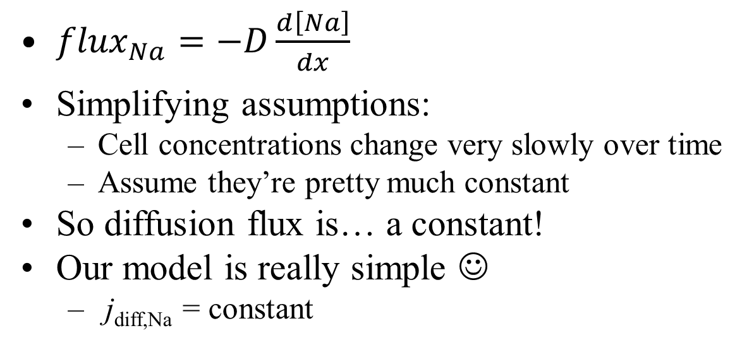
Modeling diffusion in a cell
Because the ion channels are small compared to cell volume
${flux}_{Na}=−D\frac{d\left[Na\right]}{dx}$
Simplifying assumptions:
  Cell concentrations change very slowly over time
  Assume they’re pretty much constant
So diffusion flux is… a constant!
Our model is really simple ☺
  j_{diff,Na} = constant
It’s only constant for a given set of concentrations!
If [Na] changes over time, then so does j_{diff,Na}

Slide 66
Modeling drift in a cell
Use Ohm’s Law
  j_{drift,Na} = V_{mem} / R_{Na} (we said j_{drift} = V_{mem}/k)
  j_{drift,Na} = g_{Na}V_{mem} (where g_{Na}≡ 1 / R_{Na})
G_{Na} is conductance of Na ion channels

Slide 67
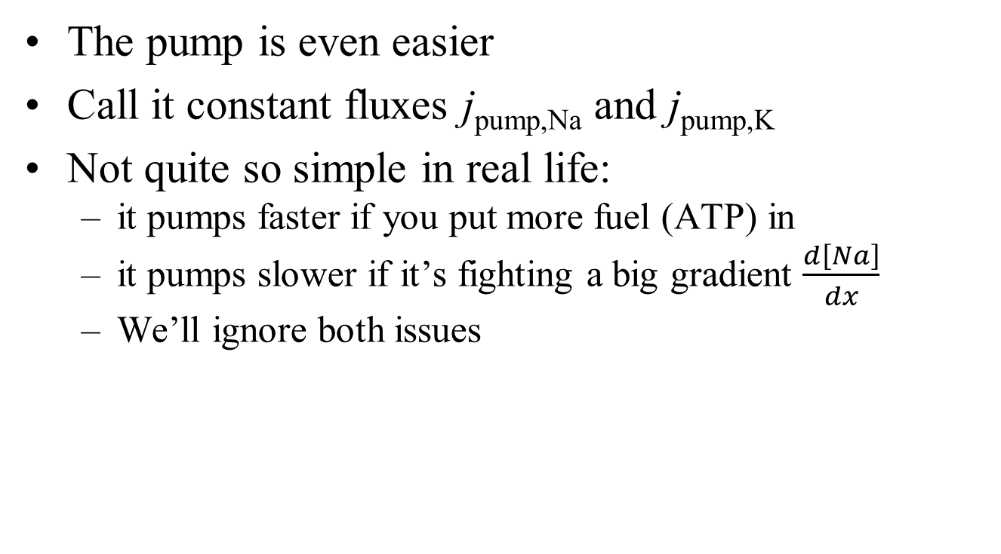
Modeling the ion pumps
The pump is even easier
Call it constant fluxes j_{pump,Na} and j_{pump,K}
Not quite so simple in real life:
  it pumps faster if you put more fuel (ATP) in
  it pumps slower if it’s fighting a big gradient $\frac{d\left[Na\right]}{dx}$
  We’ll ignore both issues

Slide 68
Simple equation
j_{total,Na} = j_{diff,Na} + g_{Na}V_{mem} + j_{pump,Na}
= g_{Na} (V_{mem} + (j_{diff,Na}/g_{Na})) + j_{pump,Na}
  This is reasonably simple, but we can do even a bit better
Ignore the pump for a moment
  We know that, without pumps, diffusion and drift balance (i.e., no net flux) at the Nernst voltage
So a revised equation:
Is this surprising?
  The units work, of course
  We know that V_{mem} * g_{Na} = j_{drift,Na}, which must equal j_{diff} when V=V^{N}_{Na}. So it’s not at all surprising
This is bioelectricity in a nutshell! Does it make sense?
j_{total,Na} = g_{Na} (V_{mem} - V^{N}_{Na}) + j_{pump,Na}

Slide 69
What the model says
Main input: V_{mem}
There’s a separate model for each ion. Cl doesn’t have a pump
Output: flux (how fast the ion is entering the cell)
j_{total,Na} = g_{Na} (V_{mem} - V^{N}_{Na}) + j_{pump,Na}
V^{N}_{Na} and j_{pump,Na} depend on [Na]
How many ion channels there are
There’s only one V_{mem}, shared by all ions
Drift
Hidden input: [Na]_{ICF}
And [Na]_{ECF} is usually assumed constant
Diffusion
Notes:
Any reason why Vnernst might represent diffusion? Because it’s proportional to [out]/[in]!

Slide 70
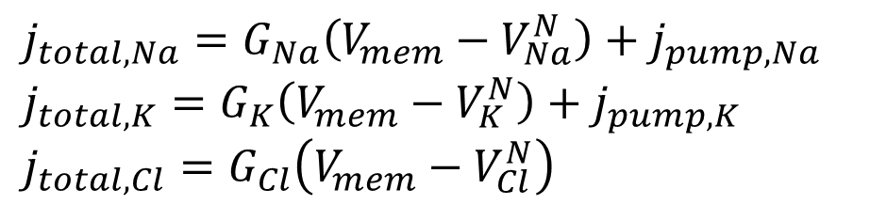



Modeling our cell as a circuit
$$j_{total,Na}=G_{Na}\left(V_{mem}−V_{Na}^{N}\right)+j_{pump,Na}$$
$$j_{total,K}=G_{K}\left(V_{mem}−V_{K}^{N}\right)+j_{pump,K}$$
$$j_{total,Cl}=G_{Cl}\left(V_{mem}−V_{Cl}^{N}\right)$$
Can you figure out
  how does this circuit map to the equations?
  this is a model; what goes into it, and what does it tell us?
  what does it even mean to have a “Na resistor?”
ICF
V_{mem}
j_{Na}
j_{K}
G_{Na}
G_{K}
G_{Cl}
$$V_{Na}^{N}$$
$$V_{K}^{N}$$
$$V_{Cl}^{N}$$
77mV
-89mV
-71mV
ECF
Notes:
A small note about the battery: by convention, a battery is drawn as two parallel lines of unequal length. The longer end is the positive end. In this course, I always draw the shorter (i.e., negative) end connected to the ECF (ground). Then the battery voltage can be either positive or negative, following the sign of Vnernst. This seems more clear than reversing the long and short ends so as to keep the battery voltage positive even if VNernst is negative.

Slide 71
Modeling our cell as a circuit
$$j_{total,Na}=G_{Na}\left(V_{mem}−V_{Na}^{N}\right)+j_{pump,Na}$$
$$j_{total,K}=G_{K}\left(V_{mem}−V_{K}^{N}\right)+j_{pump,K}$$
$$j_{total,Cl}=G_{Cl}\left(V_{mem}−V_{Cl}^{N}\right)$$
ICF
A current source simply provides a constant current
V_{mem}
j_{Na}
j_{K}
G_{Na}
G_{K}
G_{Cl}
$$V_{Na}^{N}$$
$$V_{K}^{N}$$
$$V_{Cl}^{N}$$
77mV
-89mV
-71mV
ECF

Slide 72
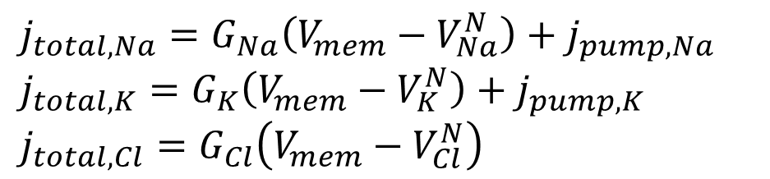
Modeling our cell as a circuit
$$j_{total,Na}=G_{Na}\left(V_{mem}−V_{Na}^{N}\right)+j_{pump,Na}$$
$$j_{total,K}=G_{K}\left(V_{mem}−V_{K}^{N}\right)+j_{pump,K}$$
$$j_{total,Cl}=G_{Cl}\left(V_{mem}−V_{Cl}^{N}\right)$$
ICF
A voltage source (a.k.a. a battery) simply provides a constant voltage
V_{mem}
j_{Na}
j_{K}
G_{Na}
G_{K}
G_{Cl}
$$V_{Na}^{N}$$
$$V_{K}^{N}$$
$$V_{Cl}^{N}$$
77mV
-89mV
-71mV
ECF

Slide 73
Modeling our cell as a circuit
$$j_{total,Na}=G_{Na}\left(V_{mem}−V_{Na}^{N}\right)+j_{pump,Na}$$
$$j_{total,K}=G_{K}\left(V_{mem}−V_{K}^{N}\right)+j_{pump,K}$$
$$j_{total,Cl}=G_{Cl}\left(V_{mem}−V_{Cl}^{N}\right)$$
ICF
A resistor operates according to Ohm’s Law: I=V/R (or I=GV with G≡1/R)
V_{mem}
j_{Na}
j_{K}
G_{Na}
G_{K}
G_{Cl}
$$V_{Na}^{N}$$
$$V_{K}^{N}$$
$$V_{Cl}^{N}$$
77mV
-89mV
-71mV
ECF

Slide 74
What to do with our model
We can build a simulator (BITSEY)
  Flux tells us how fast the concentrations are changing
  If there are 2 moles of Na in the cell, and a flux of .3 M/second entering, then if we simulate for 1s
  There are now 2.3 moles of Na
  A simulator just does this over and over (each time computing new j_{diff}, g and V_{N} for the new [Na]
We said that total charge in the cell determines V_{mem} (Q=CV)
  So our simulator will also tell us V_{mem} over time
Run the simulator until things stabilize
  Then we’ve computed the steady-state V_{mem} for a cell
  In fact, that’s Python lab #1
Simulate short transients around steady state
  that’s how neurons work

Slide 75
Done with the basics!
The main part of bioelectricity is done ☺
  But we haven’t built anything yet ☹
What’s coming next:
  The Skittles-diffusion lab was hopefully a bit of fun
  Simple SS sim lab solidifies what we’ve just learned
  add a few more details (QSS) and build a neuron
  add one more detail (GJs) and build cardiomyocytes
  build worms
But the hard part is done ☺

Slide 76

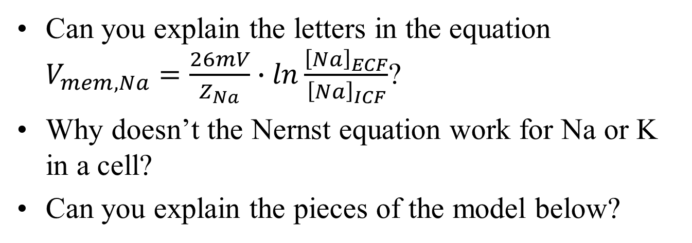


Mini quiz
Can you explain the letters in the equation $V_{mem,Na}=\frac{26mV}{Z_{Na}}∙ln\frac{{\left[Na\right]}_{ECF}}{{\left[Na\right]}_{ICF}}$?
Why doesn’t the Nernst equation work for Na or K in a cell?
Can you explain the pieces of the model below?
j_{Na}
j_{K}
G_{Na}
G_{K}
G_{Cl}
$$V_{Na}^{N}$$
$$V_{K}^{N}$$
$$V_{Cl}^{N}$$
77mV
-89mV
-71mV
ECF

Slide 77
BACKUP

Slide 78
Start of Lab #2
Start Lab #2 in class
  Learn about Bitsey
Finish at home if needed

Slide 79



Material to potentially be taught by the EEs:
  Draw the model as an equivalent ckt that has V & R for Na & K, R for Cl.
  Show how it reaches a final voltage
  Show how changing each R affects the voltage (for lab #1)
ICF
j_{Na}
j_{K}
G_{Na}
G_{K}
G_{Cl}
$$V_{Na}^{N}$$
$$V_{K}^{N}$$
$$V_{Cl}^{N}$$
ECF
77mV
-89mV
-71mV

Slide 80
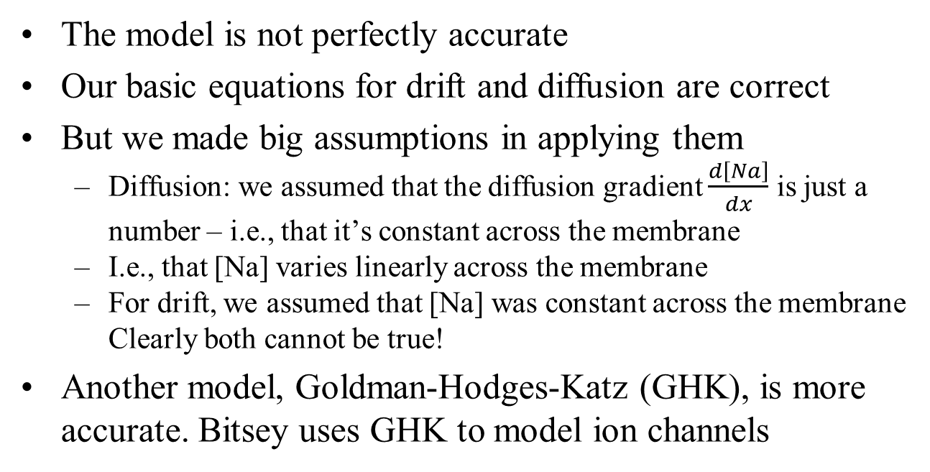
Inaccuracies
The model is not perfectly accurate
Our basic equations for drift and diffusion are correct
But we made big assumptions in applying them
  Diffusion: we assumed that the diffusion gradient $\frac{d\left[Na\right]}{dx}$ is just a number – i.e., that it’s constant across the membrane
  I.e., that [Na] varies linearly across the membrane
  For drift, we assumed that [Na] was constant across the membrane Clearly both cannot be true!
Another model, Goldman-Hodges-Katz (GHK), is more accurate. Bitsey uses GHK to model ion channels
potential final project

Slide 81
Our model is imperfect
“All models are wrong. Some are still useful,” George Box
Our model had a hidden input [Na]_{ICF}
  The model only works at that [Na]_{ICF}
  But the model is still “reasonably” good if we’re “reasonably” near that [Na]_{ICF}
  We must re-compute g, V^{N} and j_{pump} when [Na]_{ICF} changes substantially
Most important
  simple model = intuitive
  helps us to understand how cells behave
j_{total,Na} = g_{Na} (V_{mem} - V^{N}_{Na}) + j_{pump,Na}

