Slide 1
Bioelectricity
Tufts University
Instructor: Joel Grodstein
joel.grodstein@tufts.edu
Bioelectricity 1b – QSS and neurons

Slide 2
Big picture of the course
Where does bioelectricity come from?
Neurons and working with the nervous system
Cardiac bioelectricity
Worms

Slide 3
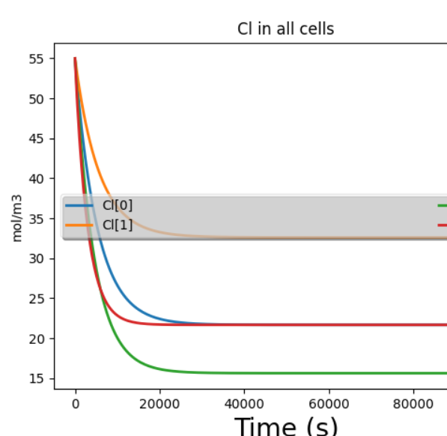
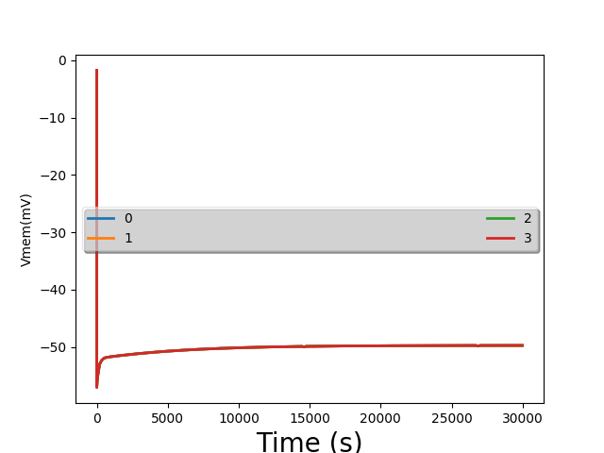
Sim lab #1, first plots
Ion concentrations are changing very slowly
V_{mem} initially changes quickly, then slowly
Notes:
The fast V_{mem} ramp is how neurons got to be so fast, and why electrical signaling is such a great idea. But let’s delve into the second, slower V_{mem} ramp

Slide 4
Problem for the day
We ran a bunch of simulations of cells
They created voltage. Cool!
“Minor” problem:
  Our sims took several hours of simulated time to reach steady state
  Our brains run on bioelectricity
Any problem there?
We humans can think pretty fast
  We can react pretty fast, too
  Cannot work if each neuron takes hours to settle!

Slide 5
What we will learn
How to use bioelectricity to compute really fast
  This will be how neurons work
  Hypothesis: cells communicated slowly via bioelectricity for eons…
  And then evolution figured out a trick
We’ll learn
  Change ion-channel conductance ⇒ quickly spike V_{mem}
  Understand the physics of the ion flows
  Understand how our model models this

Slide 6
Why did sim lab #1 run so slow?
From sim lab #1, t=5000
  net Cl flux=20e-4 mol/m³s
  [Cl]_{init}=55mol/m³
We’re trying to drain a small cell with a very small straw
How can we possibly get around this problem?

Slide 7
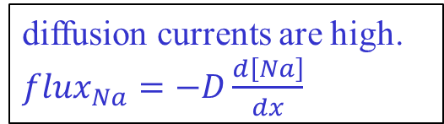
How can V_{mem} change quickly?
diffusion currents are high. ${flux}_{Na}=−D\frac{d\left[Na\right]}{dx}$
Compare ICF vs. ECF [Na], [K], [Cl]
What is the net ECF, ICF charge?
ICF, ECF each has a lot of charge
Biology has built sensitive sensors – we need only move V_{mem} by 50mV
small absolute ∆q is a large relative ∆q.
Drift currents are quite high. Lots of ions packed densely, all moving even slowly → lots of cars passing/second
70mV
--- +++
[K⁺]=20mM
[Na⁺]=440mM
[Cl⁻]=560mM
other⁺=101mM
[K⁺]=400mM
[Na⁺]=50mM
[Cl⁻]=52mM
Pr ⁻=399mM
q = CV, ∆q = C∆V. So C and ∆V are small, which means so is ∆q.
3Na⁺
2K⁺
Notes:
Biological voltages are small: 50mV or so. Compare to your IPhone CPU >1V. This is partly why your brain is so power efficient!
And your house is 120V. This also gives your body a lot of safety margin against getting electrocuted if something goes wrong. You would not want to be electrocuted every time you catch a cold!
This slide shows the “trick” for how we can signal so fast by using V_{mem}!

Slide 8
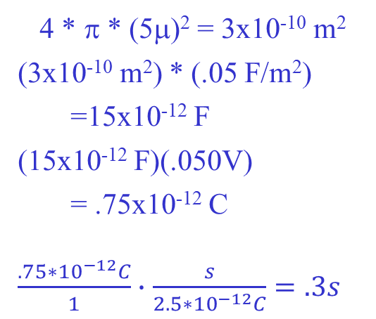
Back of the envelope speed
Quick electricity problem:
  If the cell membrane is a capacitor C
  How much charge Δq must enter the cell to change the voltage by ΔV?
  Δq=CΔV
Typical planaria values:
  Radius of a cell = 5μ
  Capacitance of the cell membrane = .05 F/m²
  ΔV = 50mV
  What is Δq?
How long will it take to move V_{mem} by 50mV?
  Current = 2.5*10⁻¹² C/s
Area of membr. =
C =
Δq = CΔV =
Time =
4 * π * (5μ)² = 3x10⁻¹⁰ m²
(3x10⁻¹⁰ m²) * (.05 F/m²)
  =15x10⁻¹² F
(15x10⁻¹² F)(.050V)
  = .75x10⁻¹² C
$\frac{.75∗{10}^{−12}C}{1}∙$ $\frac{s}{2.5{∗10}^{−12}C}=.3s$
Notes:
First convince them that Δq=CΔV is true by showing a few numbers: 10=2*5, and (10+2*3)=2*(5+3)
This works because the equation is linear.
EEs should be able to solve this as a class exercise. BME may not be able to.

Slide 9
It only takes .3s to move V_{mem} around as much as needed!
  That’s a planaria; humans are <1ms
  More fun facts… anybody know why human nerves are so much faster than worms?
That’s a lot faster than hours! Nice, but…

Slide 10
Who’s the best messenger?
Ion channels are small
  we’re trying to drain a cell with a very small straw, so macroscopic concentrations change very slowly
  But even small concentration changes can cause substantial voltage changes
Voltage sensing is “better” than chemical sensing
  Much faster (drift is faster than diffusion over any nontrivial distance)
  And more energy efficient
The trick
  Don’t: sense chemical-concentration differences
  Do: transduce them into V, sense V difference

Slide 11
Contrast in time scales
V_{mem} initially changes quickly, then slowly
We’ve argued that V_{mem} changes can be fast
  So why the slow V_{mem} ramp after its initial surge?
Remember: ion concentrations change slowly
Notes:
The fast V_{mem} ramp is how neurons got to be so fast, and why electrical signaling is such a great idea. But let’s delve into the second, slower V_{mem} ramp

Slide 12
So why the two V_{mem} ramps?
50mV
--- +++ 70mV
3Na⁺
2K⁺
[K⁺]=20mM
[Na⁺]=440mM
[Cl⁻]=560mM
other⁺=110mM
[K⁺]=400mM
[Na⁺]=50mM
[Cl⁻]=52mM
other⁻=408mM
Blue arrows = diffusion
Green arrows = electric current
Red arrows = ion pump
If we increase G_{Na}
  Na⁺ is flowing inwards from both diffusion and drift, and then being pumped out
  Increasing G_{Na} will increase the inwards flow; and not affect the outwards flow
Analyzing only Na for now…
  More [Na]_{ICF} → V_{mem} ↑
  But how much higher will V_{mem} rise?
V_{mem} will get more positive (i.e., closer to 0)… fast or slow?
Notes:
Assume we were in SS before we increased G_{Na}

Slide 13
Negative feedback
50mV
--- +++ 70mV
3Na⁺
2K⁺
[K⁺]=5mM
[Na⁺]=145mM
[Cl⁻]=140mM
[K⁺]=400mM
[Na⁺]=50mM
[Cl⁻]=9mM
other⁻=408mM
Blue arrows = diffusion
Green arrows = electric current
Red arrows = ion pump
Big picture: if you make V_{mem} more positive
  Diffusion and pump flows are unchanged
  Drift currents push positive ions out, negative ions in
Negative feedback!
But where exactly do we settle?

Slide 14
charge (C/m²s) into cell
drift
diffusion
V_{mem}
-70mV 0 70mV
pump
Net + charge into cell
Net - charge into cell
X axis is V_{mem}
Y axis is flux into the cell shortly after changing G_{Na}
Pump drives 3 Na⁺ out and 2 K⁺ in, so it pulls net + charge out
Diffusion is independent of voltage (typically faster than pump)
Drift follows V_{mem}
Notes:
The diffusion flux is indeed constant. It can be almost any value and direction (it depends on the concentrations)
Calling the pump flux constant is a huge simplification; really, it depends substantially on V_{mem} , and V_{mem} is thus restorative to both pump and drift flux. This oversimplification means that pump+diffusion is always (in this example) negative, which means that at QSS drift will always be positive, which means that Vmem is always negative!

Slide 15
charge (C/m²s) into cell
drift
diffusion
pump + diffusion
V_{mem}
-70mV 0 70mV
pump
Net + charge into cell
Net 0 charge into cell
Net - charge into cell
Combine diffusion and pump
There is some increased V_{mem} with net zero charge into the cell!
Can you argue that this is where we settle to?
Can you argue that we settle here pretty quickly?
Is this a new steady state?
  Are drift + diffusion + pump balanced for each ion?
Notes:
The pump drives 3 Na out and 2 K in, so it net pulls + charge out.

Slide 16
Which ions are balanced?
G_{K}, G_{Cl} unchanged
  V_{mem} changed ⇒ K, Cl drift changed
  K, Cl diffusion rates are unchanged
  K pump rates are unchanged
  Are K, Cl drift + diffusion + pump balanced?
  No!
G_{Na} was increased
  Drift and diffusion in through ion channels increased
  And then V_{mem} changed ⇒ drift reduced a bit
  Does Na have drift + diffusion + pump = 0?
  In fact, no
Notes:
The K and Cl diffusion rates are unchanged because their macroscopic ICF concentrations haven’t had time to substantially change.
Pump rates do change a bit due to the new V_{mem}, but we’re ignoring that.
And it’s hard to tell from this level of analysis if Na is balanced or not; typically it’s not (other than by coincidence).

Slide 17
We’re not at steady state
--- +++ 50mV
3Na⁺
2K⁺
[K⁺]=20mM
[Na⁺]=440mM
[Cl⁻]=560mM
other⁺=110mM
[K⁺]=400mM
[Na⁺]=50mM
[Cl⁻]=52mM
other⁻=408mM
Blue arrows = diffusion
Green arrows = electric current
Red arrows = ion pump
Cl⁻ has no pump. It’s only balanced when drift=diffusion. Are they balanced?
  Cl⁻ diffusion is unchanged, but drift is changed…
Cl⁻ is not balanced
  Ditto for K⁺, in fact
What must change for Cl⁻ to balance again at this new V_{mem}?
  ICF [Cl] must change enough to make a new diffusion
  But that is what takes hours and not ms.
  Remember: unbalanced charge flow changes V_{mem} very fast, but [] changes slowly
So what’s going on? Why do we think we can compute fast?
Notes:
The first-order point for Cl is that at this new V_{mem}, drift has changed – so diffusion must change to match it. In more detail, both Cl diffusion and drift change as [Cl] changes

Slide 18
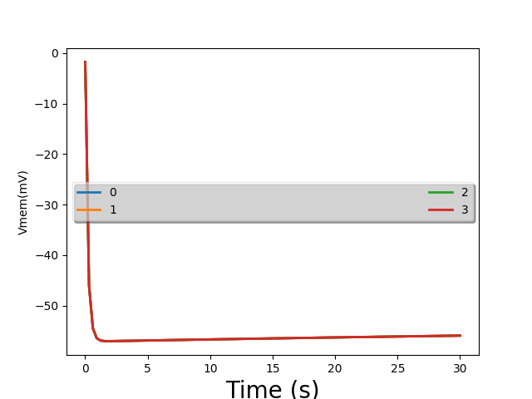
Sim lab #1 picture again
This time in more detail, from t=0 to t=30:
really fast change
really slow change – QSS
no change – SS
Notes:
In the “really slow change” domain, we still have unbalanced flux of all ions. But it’s really slow, since (again) the ion channels

Slide 19
In-class exercise
In a few sentences, explain how neurons can operate so fast
If a cell is at some V_{mem} higher or lower than the net-charge-flux-equals-0 voltage, what is the mechanism to quickly fix this?
How is this a negative-feedback system?

Slide 20
Where are we?
We know that
  When you change an ion-channel conductance, a cell quickly (ms) moves to a new V_{mem}
  At that V_{mem}, the net flux of charge into the cell is zero
  The flux of each individual ion is nonzero
  If we leave the ion-channel conductance unchanged we get a slow slog back to a new steady state
How do we predict what the quick V_{mem} value is?
  This is the value our neurons spike to
  Does our circuit model predict it?

Slide 21



Which V_{mem} does KCL compute?
ICF
I_{Na}
I_{K}
.4
2.2
.4
60 40
$$V_{Na}^{N}$$
$$V_{K}^{N}$$
$$V_{Cl}^{N}$$
ECF
77mV
-89mV
-71mV
Does KCL compute the QSS V_{mem} or the SS V_{mem}?
It says the sum of currents into ICF = 0
  Even though they’re from different ions!
Our equivalent circuit computes QSS V_{mem}
Notes:
In this picture, the QSS and SS V_{mem} values are reasonably close; that’s not always the case.

Slide 22
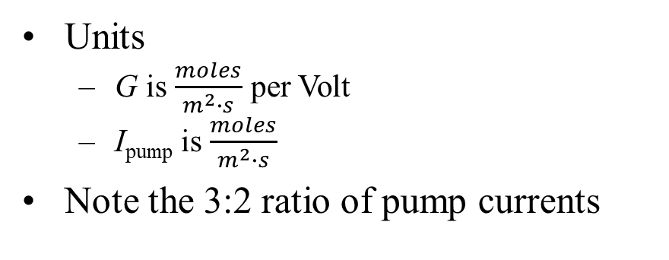
Units
ICF
I_{Na}
I_{K}
.4
2.2
.4
60 40
$$V_{Na}^{N}$$
$$V_{K}^{N}$$
$$V_{Cl}^{N}$$
ECF
77mV
-89mV
-71mV
Units
  G is $\frac{moles}{m^{2}∙s}$ per Volt
  I_{pump} is $\frac{moles}{m^{2}∙s}$
Note the 3:2 ratio of pump currents
Notes:
This slide is easy for students to understand, but it doesn’t exactly match Bitsey,
Bitsey’s units on Gth are (ions entering the cell/m2s) per Volt of Vmem; thus Gth tends to be negative for Na and K, and positive for Cl.
However, Bitsey then scales the resultant ion fluxes by each ion’s Z to get charge fluxes. If we’re restricted to Z=+1 and Z= -1, then we get the same effect by simply assuming that all G values are positive (which is what this slide does)

Slide 23



Original SS values
ICF
V_{mem}=-71mV
I_{Na}
I_{K}
.4
2.2
.4
60 40
$$V_{Na}^{N}$$
$$V_{K}^{N}$$
$$V_{Cl}^{N}$$
ECF
77mV
-89mV
-71mV
Compute the current for each ion
Na
  ion channel = (77 - -71) * .4 ≈ 60 entering the cell
  pump = 60 leaving the cell
Cl
  Voltage drop across resistor = ?
  Current = ?
K
  ion channel = ?
  pump = ?
At SS, each ion is individually balanced
KCL does not enforce this
(-71) - (-71) = 0 mV
V/R = 0
(-89 - -71) * 2.2 ≈ -40 entering the cell
40 entering the cell
Notes:
Even though in general the model predicts QSS values, in this case I carefully copied the V & G values from a SS solution.
The SS solution has each individual ion balanced (as the leg-by-leg calculations show), and thus also has their sum balanced.

Slide 24



Now increase G_{Na}
ICF
V_{mem}=-71mV
I_{Na}
I_{K}
.4
2.2
.4
60 40
$$V_{Na}^{N}$$
$$V_{K}^{N}$$
$$V_{Cl}^{N}$$
ECF
77mV
-89mV
-71mV
I.e., turn on more Na ion channels?
  (lookahead – neurons do this)
Our graphs showed that V_{mem} will settle at some new higher value
What value does the model predict?
Notes:
Turning on more Na ion channels is exactly how neurons spike

Slide 25
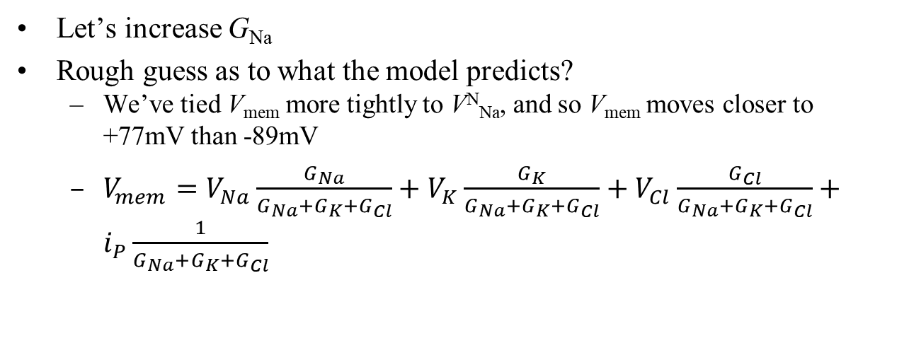
V_{mem}=19mV
ICF
V_{mem}=-71mV
I_{Na}
I_{K}
5
2.2
.4
.4
60 40
$$V_{Na}^{N}$$
$$V_{K}^{N}$$
$$V_{Cl}^{N}$$
ECF
77mV
-89mV
-71mV
Let’s increase G_{Na}
Rough guess as to what the model predicts?
  We’ve tied V_{mem} more tightly to V^{N}_{Na}, and so V_{mem} moves closer to +77mV than -89mV
  $V_{mem}=$ $V_{Na}\frac{G_{Na}}{G_{Na}+G_{K}+G_{Cl}}+V_{K}\frac{G_{K}}{G_{Na}+G_{K}+G_{Cl}}+V_{Cl}\frac{G_{Cl}}{G_{Na}+G_{K}+G_{Cl}}+$ $i_{P}\frac{1}{G_{Na}+G_{K}+G_{Cl}}$
Notes:
In Bitsey, the units on Gth are (ions entering the cell/m2s) per Volt of Vmem; thus Gth tends to be negative for Na and K, and positive for Cl.
However, Bitsey then scales the resultant ion fluxes by each ion’s Z to get charge fluxes. If we’re restricted to Z=+1 and Z= -1, then we get the same effect by simply assuming that all G values are positive (which is what this slide does)
The actual Vmem is +18.52

Slide 26



ICF
V_{mem}=+19mV
Na: (77-19)*5≈292
I_{Na}
I_{K}
Cl: (-71-19)*.4≈-36
5
2.2
.4
60 40
$$V_{Na}^{N}$$
$$V_{K}^{N}$$
$$V_{Cl}^{N}$$
K: (-89-19)*2.2≈-236
ECF
77mV
-89mV
-71mV
Look at the new individual ion currents
Which way does Na flow?
K?
Cl?
Observation: each ion is individually unbalanced!
Is the net charge flux zero?
  net charge flow into cell via ion channels = 292-236-36=20
  net flow entering via pumps = 40-60=-20
  Net charge flux=0 (guaranteed by KCL)
Into the cell, since 292-60>0
Out of the cell, since 40-236<0
Charge out (Cl in) the cell, since -36<0. Tricky?
Notes:
The actual Vmem is +18.52, which makes the numbers on the slide actually work right without needing the “approximately equals.”
The units on the fluxes are moles/(m2s).
The trick for Cl is that this is an electrical diagram, so it cares about charge and doesn’t know that Cl has a negative valence.

Slide 27
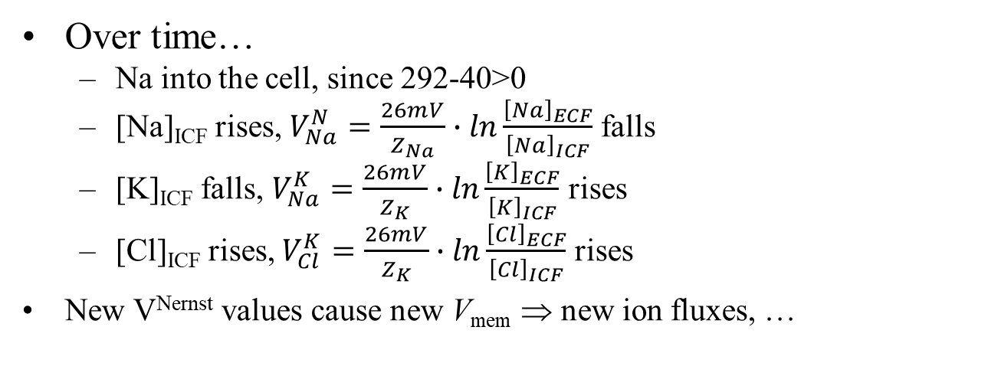



ICF
V_{mem}=+19mV
Na: (77-19)*5≈292
I_{Na}
I_{K}
Cl: (-71-19)*.4≈-36
5
2.2
.4
60 40
$$V_{Na}^{N}$$
$$V_{K}^{N}$$
$$V_{Cl}^{N}$$
K: (-89-19)*2.2≈-236
ECF
77mV
-89mV
-71mV
Over time…
  Na into the cell, since 292-40>0
  [Na]_{ICF} rises, $V_{Na}^{N}=\frac{26mV}{Z_{Na}}∙ln\frac{{\left[Na\right]}_{ECF}}{{\left[Na\right]}_{ICF}}$ falls
  [K]_{ICF} falls, $V_{Na}^{K}=\frac{26mV}{Z_{K}}∙ln\frac{{\left[K\right]}_{ECF}}{{\left[K\right]}_{ICF}}$ rises
  [Cl]_{ICF} rises, $V_{Cl}^{K}=\frac{26mV}{Z_{K}}∙ln\frac{{\left[Cl\right]}_{ECF}}{{\left[Cl\right]}_{ICF}}$ rises
New V^{Nernst} values cause new V_{mem} ⇒ new ion fluxes, …

Slide 28
What’s going on?
ICF
V_{mem}=19mV
I_{Na}
I_{K}
292 236 36
60 40
$$V_{Na}^{N}$$
$$V_{K}^{N}$$
$$V_{Cl}^{N}$$
The model predicted SS once and QSS once. Why?
ECF
77mV
-89mV
-71mV
Settling to the new QSS value will happen quickly
Do ion concentrations change much in this short time?
  No, they can’t
Is there any slow process that the schematic doesn’t model?
  Each ion has nonzero flux → concentration slowly changes
How does that concentration change affect our model parameters?
  V^{Nernst} changes slowly

Slide 29
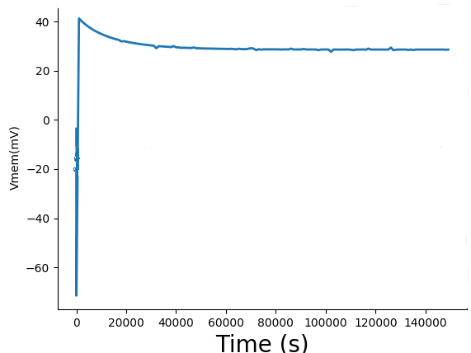
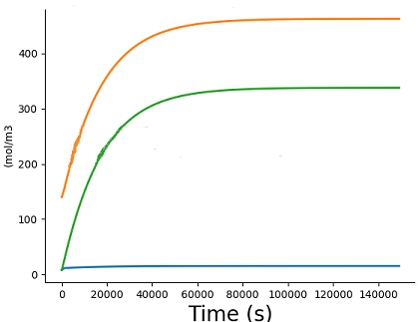
Setup:
  G_{Na} and G_{K} originally set for -71mV
  At t=100s, G_{Na} suddenly rises
Eventually we reach true SS
Na⁺
K⁺
Cl⁻
Dynamic phase: V_{mem} swinging rapidly
Thus so does V_{mem}
QSS: concentrations changing very slowly
Notes:
Oops… the last slide popped up to 19mV, and this slide does 40mV. I could redo this if I have extra time.
Anyway, the message is that the slow ion-concentration changes do eventually reach an QSS that happens to be SS

Slide 30
Ion channels, QSS and SS
Change G value → V_{mem} changes rapidly (ms to seconds)
  The tricks: high concentrations of all ions in ICF and ECF, but their charges nearly cancel out; and C_{mem} is relatively small
  Net charge flux rapidly becomes 0
  That’s how neurons work
Large-scale concentrations change much more slowly (minutes to hours) – quasi-steady state
Eventually we reach a new steady state again, where each ion flux is 0

Slide 31
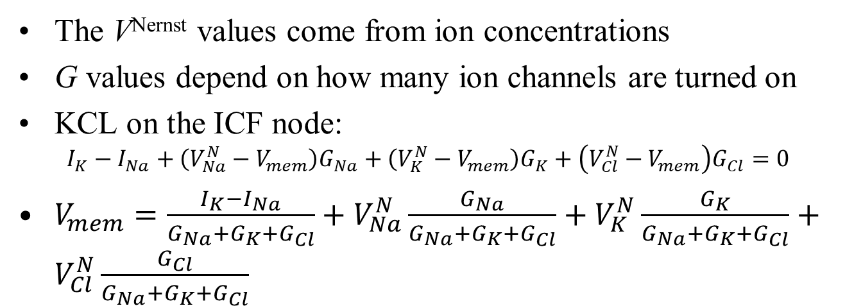
Summary
ICF
We have a nice equivalent circuit that we can analyze
I_{Na}
I_{K}
G_{Na}
G_{K}
G_{Cl}
$$V_{Na}^{N}$$
$$V_{K}^{N}$$
$$V_{Cl}^{N}$$
ECF
77mV
-89mV
-71mV
The V^{Nernst} values come from ion concentrations
G values depend on how many ion channels are turned on
KCL on the ICF node:
  $$I_{K}−I_{Na}+\left(V_{Na}^{N}−V_{mem}\right)G_{Na}+\left(V_{K}^{N}−V_{mem}\right)G_{K}+\left(V_{Cl}^{N}−V_{mem}\right)G_{Cl}=0$$
$V_{mem}=\frac{I_{K}−I_{Na}}{G_{Na}+G_{K}+G_{Cl}}+V_{Na}^{N}\frac{G_{Na}}{G_{Na}+G_{K}+G_{Cl}}+V_{K}^{N}\frac{G_{K}}{G_{Na}+G_{K}+G_{Cl}}+V_{Cl}^{N}\frac{G_{Cl}}{G_{Na}+G_{K}+G_{Cl}}$

Slide 32
What’s up next?
Done with the physics part of the course!
  You understand bioelectricity fairly deeply ☺
QSS simulation lab does cell voltages in QSS
  Reinforces that voltages change fast
Next up: neurons
  Show how their ion-channel conductance changes cause spikes
  Look at medical applications of generating spikes ourselves

Slide 33
BACKUP

Slide 34
Mini quiz (prep for the oral quiz)
ICF
I_{Na}
I_{K}
G_{Na}
G_{K}
G_{Cl}
$$V_{Na}^{N}$$
$$V_{K}^{N}$$
$$V_{Cl}^{N}$$
ECF
77mV
-89mV
-71mV
What is the value of V_{mem} if, e.g., G_{Na} gets very big?
What is the value of V_{mem} if, e.g., G_{K} gets very big?
What if G_{Na} and G_{K} are both close to 0?

Slide 35
analyze_equiv_network() tries to keep results pretty
  It sometimes only prints to one significant digit
  Here are some better numbers
 | Na | K | Cl
G (mol/m²s per mV) | 3.19 | 38.4 | 4.44
V_{nernst} (mV) | 71 | -86 | -25
I_{pump} (mol/m²s) | 810 | 540

Slide 36
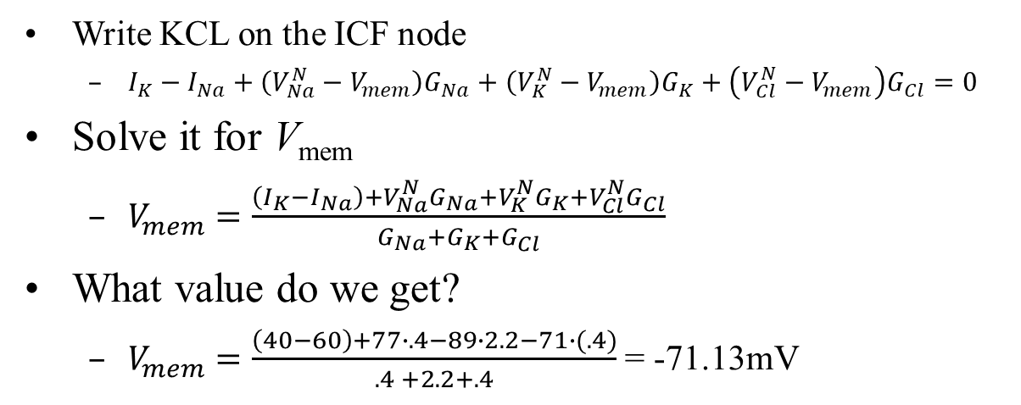
In-class exercise
ICF
I_{Na}
I_{K}
.4
2.2
.4
60 40
$$V_{Na}^{N}$$
$$V_{K}^{N}$$
$$V_{Cl}^{N}$$
ECF
77mV
-89mV
-71mV
Write KCL on the ICF node
  $I_{K}−I_{Na}+\left(V_{Na}^{N}−V_{mem}\right)G_{Na}+\left(V_{K}^{N}−V_{mem}\right)G_{K}+\left(V_{Cl}^{N}−V_{mem}\right)G_{Cl}=0$
Solve it for V_{mem}
  $V_{mem}=\frac{\left(I_{K}−I_{Na}\right)+V_{Na}^{N}G_{Na}+V_{K}^{N}G_{K}+V_{Cl}^{N}G_{Cl}}{G_{Na}+G_{K}+G_{Cl}}$
What value do we get?
  $V_{mem}=\frac{\left(40−60\right)+77∙.4−89∙2.2−71∙(.4)}{.4 +2.2+.4}$ = -71.13mV
Notes:
In Bitsey, the units on Gth are (ions entering the cell/m2s) per Volt of Vmem; thus Gth tends to be negative for Na and K, and positive for Cl.
However, Bitsey then scales the resultant ion fluxes by each ion’s Z to get charge fluxes. If we’re restricted to Z=+1 and Z= -1, then we get the same effect by simply assuming that all G values are positive (which is what this slide does)

