Slide 1
EE 123
Bioelectricity
Tufts University
Instructor: Joel Grodstein
joel.grodstein@tufts.edu
2b. EMG, NCS, SCS, PNS and other nice acronyms

Slide 2
Big picture of the course
Where does bioelectricity come from?
Neurons and working with the nervous system
Cardiac bioelectricity
Worms or cancer
How a single neuron works
Lots of neurons – the nervous system
EMG, NCS, SCS, PNS, electroceuticals

Slide 3
Lead-in
We’re about to start talking about cures. Cures are fun! But a word of sobriety here…
https://www.sensible-med.com/p/how-not-to-get-fooled-by-the-medical-22c
  From 2:20 to 3:45
Yes, it’s great to cure a disease; but getting it is still not fun
Notes:
This is their “How not to get fooled by the medical literature” series; episode 9.
Remember to bring my Sensible Medicine password; it’s needed to get the video. The punch line: they’re talking about a trial for a pancreatic-cancer chemo drug that was so hyped that Adam said “I almost hope I *get* pancreatic cancer just so I can try this drug!”
And no… that’s not true.
BTW: for people for do not remember Vinay Prasad fondly (he presided over bringing the US in line with most of Western Europe in not approving the latest Covid booster for most healthy patients in 2025), watch this video and then try to argue that he’s not a competent academic doctor.

Slide 4
Deaths/year in U.S.
2.8M deaths/year total (.9 / 100 people)
  Heart disease = 650K
  Cancer = 600K
  Accidents = 170K
  Chronic lower respiratory diseases: 160K
  Stroke = 150K
  Alzheimer’s = 120K
  Diabetes = 80K
(from https://www.cdc.gov/nchs/products/databriefs/db328.htm, 2018)
Notes:
“Heart disease” actually includes all cardiovascular diseases (as well as being both plumbing and electrical).
But “stroke” is counted as a cerebrovascular disease, so it’s separate from heart disease!
Narrative: we’ll do cardiac in our next unit. But this unit will be… (on the next slide)

Slide 5
Teaser – the cost of pain
Annual cost of diseases (health-care cost + lost economic productivity) in 2010¹:
  chronic pain = $635 billion
  heart disease = $309 billion
  cancer = $243 billion
  diabetes = $188 billion
OK, with that tease out of the way…
¹ ncbi.nlm.nih.gov/books/NBK92521/
Notes:
Chronic pain is one of the things we cover in *this* unit.

Slide 6
Table of contents of this unit
Our senses (we don’t understand them)
Motor nerves, EMG & NCS
Prosthetics
Pain
Electroceuticals

Slide 7
Where we are, where we’re going
Brain & nervous system control most everything in your body
What we can do today
  Monitor & control signals to muscles
The future
  Alter the signals ⇒ cure numerous diseases
  But nobody really understands which neurons do what
  We’re shooting lots of arrows in the dark – some of them are hitting useful targets
Why now?
  miniaturization of electronics
  wireless power
  embedded computing, offline analysis

Slide 8
More current events
Electroceuticals jolt into the clinic, sparking autoimmune opportunities, Nature 2022
  Available via Tisch with your Tufts login/password
  Interview with CTO of Galvani about state of the art

Slide 9
Table of contents of this unit
Our senses (we don’t understand them)
Motor nerves, EMG & NCS
Prosthetics
Pain
Electroceuticals

Slide 10
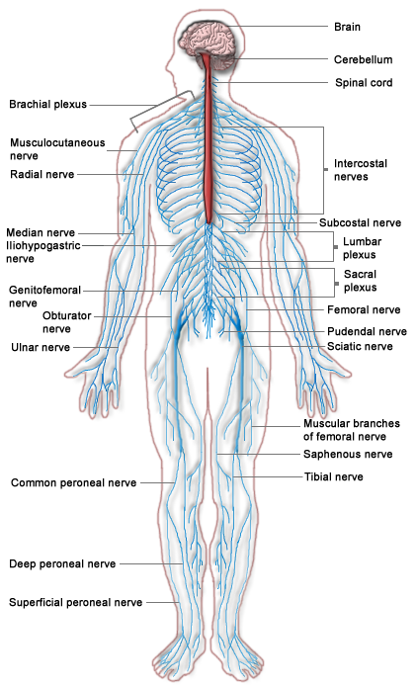
Sensory neuron
  a.k.a afferent
  Carries information towards the brain
  E.g., touch a hot stove
Motor neuron
  a.k.a. efferent
  Carries information away from the brain
  e.g., control your muscles
  anything else?
Review
Notes:
First, we’ve skipped a neuron type – sensory, motor and interneurons (which connect the two, especially in reflexes).
Second – a motor neuron can drive a gland as well as a muscle. Glands produce & secrete various molecules, typically under nervous-system control. E.g., your sweat glands or your hormones.

Slide 11
Sensation
Numerous sensory neurons throughout the body
How many types can you think of?
As expected, they head into the spine
  typically involved in several “relays” before entering the brain
  relays allow nontrivial processing before the brain
Any neuron can suppress its neighbors
  this can allow effective edge detection
  as well as producing a “winner-take-all” behavior among competing stimuli
Relays allow efferent neurons to gate incoming stimuli
  lookahead: your brain can turn off pain
Notes:
It’s not just the five main senses. There are sensory neurons sensing lots of internal signals; proprioception, smomach fullness, blood pressure, …

Slide 12
The nervous system is really confusing!
There’s just too many neurons
Optogenetics are starting to get us there; but myelin is very good at scattering light, and so light only penetrates about 200μ into the spinal cord.
And lots of processing in the brain itself – no way to see inside
We want to intercept/alter signaling
  but it would help to have some idea how it works!
Again – the convergence of big data + microelectronics is getting closer, but not there yet!

Slide 13
How would you encode data?
One hot, fully encoded or in between?
What are the pros and cons of each?
If you were designing people, which senses would you make one-hot and which encoded?
Notes:
One-hot takes lots of neurons; encoded takes lots of processing, and the encoding may be lossy (as evidenced by optical illusions).
Perhaps use one-hot coding for high-priority signals that have a small number of choices or whose range is just 1D.

Slide 14
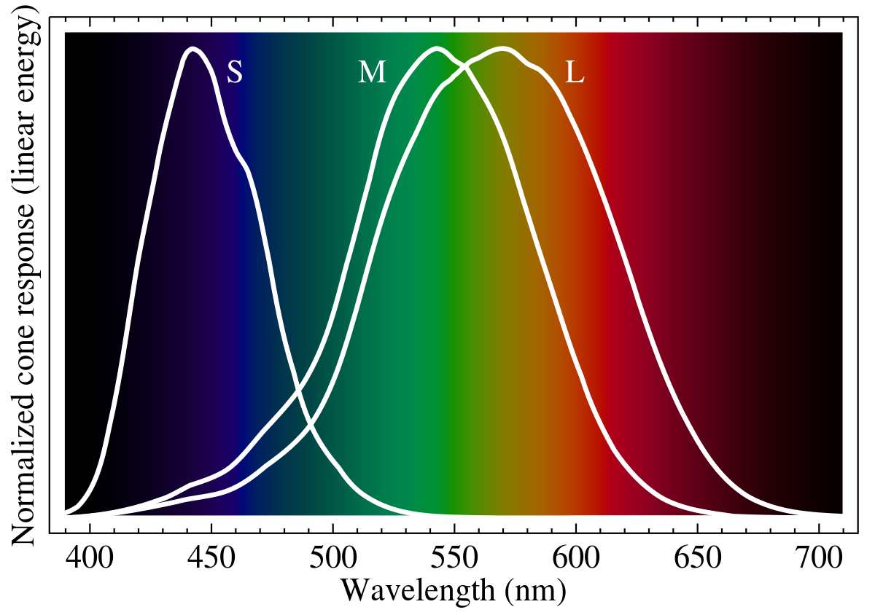
Vision
Consider vision
  Vote: one-hot, encoded, or not sure?
  How many colors can you distinguish?
  How many types of cones?
  If we needed 100 types we couldn’t pack them tightly enough on the retina for visual acuity
Is vision one-hot?
  colors are highly encoded in the eye, then decoded in the brain
  works so well that we rarely notice it – except for optical illusions
Notes:
They really don’t have enough info to vote for themselves on this one yet, since they may not know about three types of cones.
Now we’re back to the “black box inside” problem ☹
There are only 3 types of cones.
BTW, rods are for seeing in low light and are monochromatic; cones are for medium-high light and come in 3 flavors.

Slide 15
What about smell?
Time to vote again: is smell one-hot?
What do you think? (discuss in groups)
  data point: we have over 100 types of olefactory neurons
  each type runs relatively straight to the brain
  there are many more that 100 smells in the world!
  so the olefactory neurons are fairly nonspecific
  we interpret a smell by the pattern of neurons it activates

Slide 16
Thunberg’s thermal grill
A grid of alternating warm (104°) and cool (68°) bars
Touch multiple bars at once ⇒ you feel painful heat
https://www.youtube.com/watch?v=otweN9sCSd8
Is pain one-hot or encoded?
  Probably some circuit combines various inputs to create pain
  Unfortunately, we do not really know how!
Normal and abnormal coding of pain sensations, Prescott 2014
Spinal circuits transmitting mechanical pain and itch, Duan 2018
Notes:
The references give theories and then admit we don’t really know

Slide 17
Table of contents of this unit
Our senses (we don’t understand them)
Motor nerves, EMG & NCS
Prosthetics
Pain
Electroceuticals
Notes:
The last few slides were the input (senses). Now we talk about the outputs (motor nerves).

Slide 18
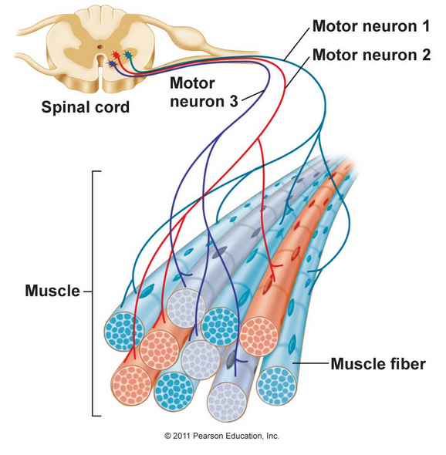
Muscles
Motor unit = a single neuron and all of the fibers it drives
Fine motor control:
  Eye = 9 muscle fibers/neuron
  Biceps = 750:1
  Gastrocnemius = 2000:1
Any advantages of interlacing?
Pros/cons of varying innervation ratio?
Notes:
Interlacing gives the brain the ability to control muscles without spatial lopsidedness, and does so even if you lose a MU or two.
The eye muscles here are specifically the extraocular muscles.

Slide 19
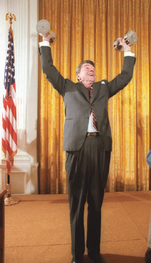
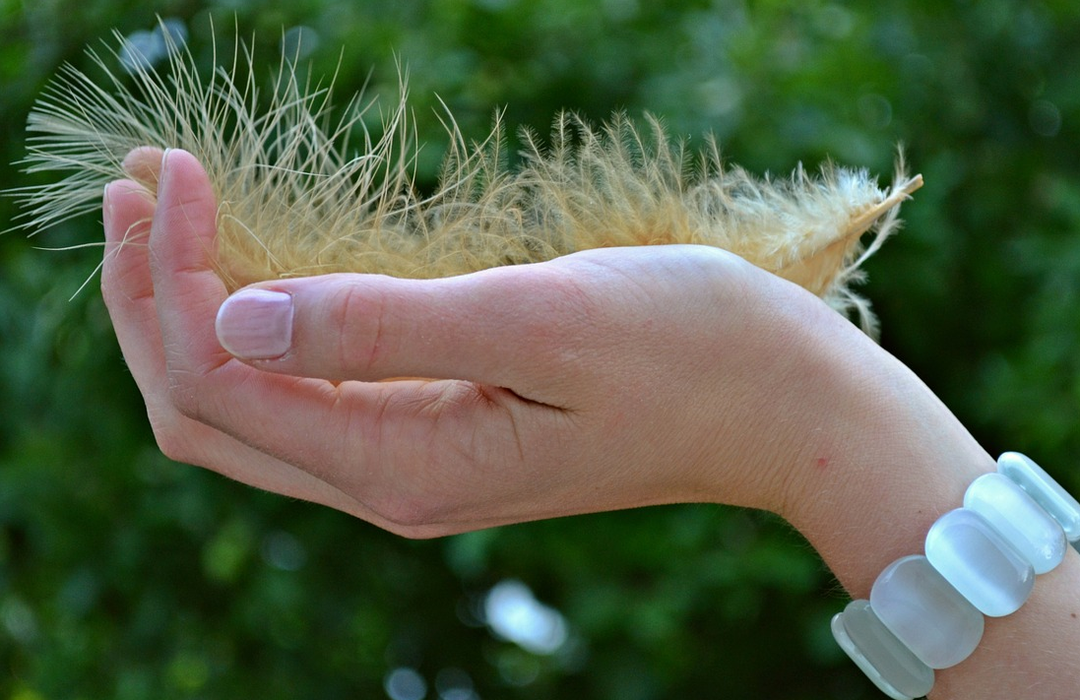
Muscle force
How can your brain control muscle force?
  Activate more motor units
  Activate the same ones more frequently
Wikimedia commons
Pixabay

Slide 20
What most people’s brain does
Start with the smallest motor unit
Fire it about 5 Hz
If more force needed… up it to about 10 Hz
If more force needed, activate the next smallest motor unit (with all MUs now at 10 Hz)
Go to step 3
But we’re all different, and our brains are complex

Slide 21
Electromyogram (sEMG)
Place an electrode on a muscle, read the action potential
Again: different motor units are quite interlaced
  clinicians measure the compound action potential
  the summed voltage from multiple neurons driving nearby fibers
electrode
skin
Notes:
See if they remember why interlacing is a good thing ☺

Slide 22
sEMG technical issues
Action-potential spikes are fast (ms) ⇒ frequencies ≈ 1KHz
Skin is a low-pass filter
The original AP (blue)
  measured a short distance away (red)
  or even further away (green)

Slide 23
What can go wrong with neurons
Diabetes neuropathy
  likely caused by years of high blood sugar
  amplitude reduction of the CMAP
  slowing of nerve conduction speeds
Multiple sclerosis
  the myelin coating of large fibers degenerates
  reduced nerve-conduction speed
Neuropathy
  From carpal-tunnel, sciatica, lyme disease, …
Thought question: what do you think the clinical consequences of slowed velocity might be?
Can you measure this with an EMG?
How can we measure this?
Notes:
It’s hard to get useful information from the height of the CMAP as measured by an EMG. It varies widely between nearby locations, depending on how many muscle fibers are nearby. And It will depend on what fraction of their motor neurons the subject is recruiting, which (as we just noted 3 slides ago) varies between people for a give muscle force . You can ask them for a maximal contraction – but one of the first results of strength training is the ability to recruit more neurons, which would increase the CMAP.
NCS gets around this problem since the machine stimulates your neurons.

Slide 24
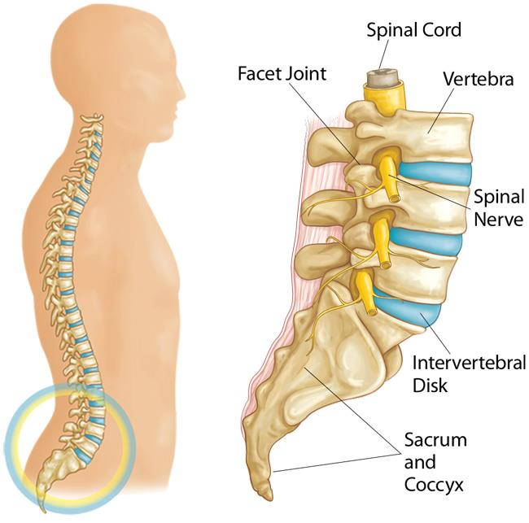
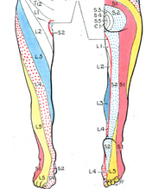
Sciatica
Nerve conduction blocked
Pain follows the path of the compressed nerve
Nothing wrong with your leg, but it still hurts!
Bulging disc
wikipedia
orthoinfo.aaos.org
Notes:
The picture here is dermatome
At the site of the compression, some/all of the afferent (i.e., sensory) or efferent (motor) neurons will not conduct; others may be partially blocked.

Slide 25
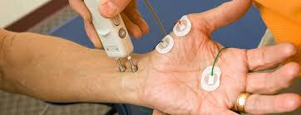
Nerve-conduction study (NCS)
A common diagnostic test
Provide the source of a signal
  You can recruit essentially 100% of the neurons
  Measure the CMAP amplitude more reliably
Known distance from source to destination
  Measure delay ⇒ compute speed
Credit: https://www.hopkinsmedicine.org

Slide 26
Diseases affecting neurons
Diabetes neuropathy
  likely caused by years of high blood sugar
  amplitude reduction of the CMAP
  slowing of nerve conduction speeds
Multiple sclerosis
  the myelin coating of large fibers degenerates
  reduced nerve-conduction speed
Neuropathy
  From carpal-tunnel, sciatica, lyme disease, …
We could not diagnose any of these with sEMG. Does a NCS do better?
Notes:
This is just a copy of the same slide as we saw a few slides ago. But that time, we saw how a plain sEMG could not diagnose them. Now we show how a NCS *can*.

Slide 27
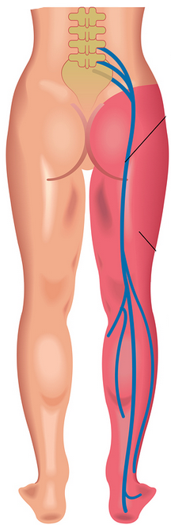
Nerve-conduction study
Where would you place the NCS driver and receiver to
  test afferent neurons?
  test efferent neurons?

Slide 28
Diagnosis problem
Symptom: patient presents with numbness in right leg
History:
  Chronic back pain, herniated disk
  Ugly, slow-to-heal bug bite just before symptom onset
Is it sciatica or a bacterial/viral neuropathy?
How will you diagnose this?
You want a test that shows a failure
Hint – potential quiz question ☺
Notes:
Remember from a few slides ago: at the site of the compression, neither the afferent (i.e., sensory) or efferent (motor) neurons will conduct at all
Problems…
Testing anywhere on the leg will not find any problem
Electric fields will not penetrate into the spinal cord
Yes, you can test that the peripheral nerves are working – but you really want a test that actually shows a failure, not just one that shows all is OK. And since you cannot probe in the spine, that’s hard to do!

Slide 29
Mini quiz
Work in groups as usual…
  What does afferent vs. efferent mean?
  What kinds of neurons do you have other than sensory and motor neurons?
  What do optical illusions tell us about visual processing?
  What things can a NCS do that EMG cannot?
  How do interlaced muscle filters help our body function despite minor neuron damage, but make diagnosis more difficult?

Slide 30
Table of contents of this unit
Our senses (we don’t understand them)
Motor nerves, EMG & NCS
Prosthetics
Pain
Electroceuticals

Slide 31
Background
1.7M people with limb amputation in US in 2005¹
Causes: war, infection, electric shock, …
Depressing statistic: 185K amputations/year in US
  So how long do you think amputees usually live?
¹Targeted Muscle Reinnervation and Advanced Prosthetic Arms, 2015
²https://accessprosthetics.com/15-limb-loss-statistics-may-surprise/
Notes:
Well, the numbers here say that amputees live about 10 years after their surgery. Perhaps not surprising if the largest category is late-stage diabetics.
https://advancedamputees.com/amputee-statistics-you-ought-know says that among current amputees, 54% were from vascular disease (mostly diabetes) and 45% from trauma.

Slide 32
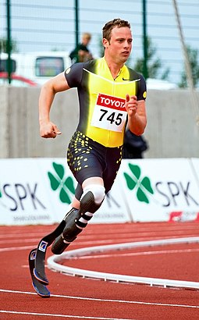
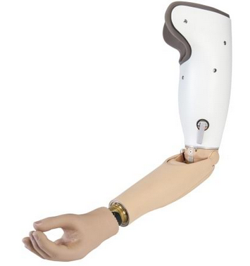
Different types of prostheses
How do you control the movable parts?
Oscar Pistorius
Images: Wikipedia
Notes:
The one on the left is unpowered; on the right has batteries, motors, etc.

Slide 33
Really simple option – lots of switches somewhere
  Push one button to flex elbow, another to extend, another to rotate wrist, …
Any obvious problems?
  if you need your right hand to control your left arm, you still effectively have only one arm ☹
Images: Wikipedia

Slide 34
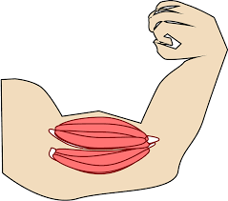
Myoelectric prosthesis
Assume you’ve lost your limb after learning how to use it
  Not a birth defect
  Your brain knows how to send APs to your muscles
After limb loss
  Biceps no longer connected to elbow; your brain still sending APs to biceps
  Can we intercept the APs (with sEMG) and use them to drive motors instead?
  Holy grail – prosthesis becomes a seamless extension of your brain!
biceps is still there
Images: Wikipedia
Notes:
The “no training required” is a really big deal!

Slide 35
Myoelectric prosthesis
Takes sEMG from biceps, triceps muscles
Compute amplitude delta biceps – triceps
  Positive/negative/zero → elbow flexes/extends/static
  Magnitude → motion speed
Use biceps/triceps EMG to control the elbow → no training required ☺
  But what about controlling the hand?
biceps
triceps
Images: Wikipedia
Notes:
The “no training required” is a really big deal!

Slide 36
Mode switching
Biceps & !triceps → flexion
Triceps & !biceps → extension
Biceps & triceps → next mode
Can cycle between modes
  Elbow flex/extend
  Wrist flex/extend
  Write rotate left/right
  Thumb/forefinger grasp
Limitations of this approach?
  cannot do two degrees of freedom at once ☹
biceps
triceps
Images: Wikipedia

Slide 37
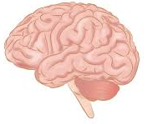
TMR
Problem
  Wrist-control muscles no longer exist, so cannot take sEMG
  Motor nerves driving them are accessible in the upper-arm stub!
Biceps is actually two muscles
  Triceps is three
Targeted muscle reinnervation (TMR)
  Surgically cut motor neurons driving one biceps head, two triceps heads
  Drive them with forearm-muscle nerves!
Trans-humoral amputation
Images: Wikipedia

Slide 38
TMR
What if it’s a trans-radial amputation?
  Biceps is still useful, since elbow exists
TMR as usual?
  Think “move wrist” → elbow flexes!
Must cut one biceps tendon
  Leave one biceps head attached to elbow
  Their elbow will be weak
Trans-radial amputation
Images: Wikipedia

Slide 39
AMI
Agonist-Antagonist Myoneural Interface
Problem: phantom-limb pain
Consider a trans-humoral amputation
  Biceps, triceps still exist but don’t attach to lower arm; proprioceptive feedback is lost
  Add a little pulley, attach the two tendons to each other
  Use sEMG as usual
  Feels more natural, reduces phantom pain
https://steppingstrong.bwh.harvard.edu/wp-content/uploads/2021/12/AMI-Hand-Clinics.pdf
Trans-humoral amputation
Notes:
In an uninjured person, when you contract your biceps it extends your elbow, which stretches your triceps. The sensors in your muscle spindles sense this – contract one muscle and the other one stretches. AMI’s goal is to restore that relationship.
As a result of restoring this part of your normal proprioception, people say it feels more natural.
It also reduces phantom-limb pain – as usual nobody really knows why (since we don’t really understand pain). They guess that “your brain is just less confused.”

Slide 40
What makes prosthetics hard?
TMR and AMI are surgery
We all have our muscles in slightly different places
  Where do you attach the electrodes?
Multiple muscles combine for one action
  Arm flexion controlled by biceps, brachialis, brachioradialis
One muscle can do multiple actions
  Biceps → elbow flexion, forearm supination
But it’s still lots better than nothing
  And plenty of room for good engineering
  Machine-learning algorithms starting to be used
Notes:
Perhaps a good place for a rant about ML finally having some socially-redeeming value!

Slide 41
Practical prosthetics issues
Only 50% of limb loss people even use a prosthetic!
Many people use a human-powered prosthetic rather than one with batteries and motors
Single-site control = “cookie crusher”
If we can build machine vision for cars, then we can likely build the equivalent for prosthetics also. But Medicare won’t pay for that ☹
Notes:
The other 50%, who don’t use a prosthetic, say it’s too heavy and uncomfortable.
The “cookie crusher” problem is that if you, say, have a normally-closed hand that then opens based on a finger-extensor muscle reading, then you have little control over the closing speed. That means you crush the cookie you’re holding. Learning = always control based on reading both an agonist and antagonist muscle.

Slide 42
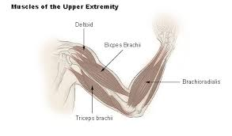
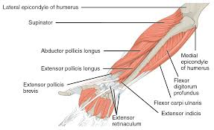
Arm muscles
Lots of muscles to attach electrodes
Reverse-engineering user intent is an interesting engineering challenge
Images from Wikipedia

Slide 43
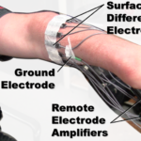
Cool example
Liberating Technologies PsiCon
  Simultaneous, proportional, independent control
  Pick two muscle pairs (four electrodes) and control two DoF
But: clearly takes some training
Notes:
The problem: controlling two degrees of freedom (e.g., wrist rotation + hand gripping) simultaneously is thought of as too hard.

Slide 44
Mini quiz
What is a surface EMG? Give one example of using it in medicine
At a high level, how does a myoelectric prosthesis work? What are the engineering difficulties?

Slide 45
Table of contents
Our senses (we don’t understand them)
Motor nerves, EMG & NCS
Prosthetics
Pain
Electroceuticals

Slide 46
The cost of pain
Annual cost of diseases (health-care cost + lost economic productivity) in 2010¹:
  chronic pain = $635 billion
  heart disease = $309 billion
  cancer = $243 billion
  diabetes = $188 billion
Now let’s look at pain in more detail
The teaser… again

Slide 47
The opiate crisis
Pre-1980s: opioids mostly used for acute pain,
chronic cancer pain
Successful marketing:
  RCTs testing opioids (morphine, oxycodone, fentanyl, hydromorphone, and methadone) for chronic, noncancer pain ⇒ average pain reduction ≈30%
  62 million Americans filled one or more opioid prescriptions in 2016
Downside
  1999 to 2014: >165K Americans died from prescription-opioid overdose
  2017: HHS declared a public-health emergency. See https://www.hhs.gov/opioids/about-the-epidemic/index.html
Problem remains:
  20% of US adults have some chronic pain; 8% of adults high-impact (CDC)
  What do you replace opioids with?

Slide 48
Why opiates cause long-term pain hypersensitivity
BACKUP
See Inhibitory regulation of the pain gate and how its failure causes pathological pain, Ted Price 2016
The pain-gate theory says that pain signals traveling up the spinal cord can be inhibited at many stages. If that inhibition no longer functions, then chronic pain would result. This paper explains the mechanism for this lack of inhibition, which they state can be caused by opiates, peripheral-nerve injury, or persistent inflammation.
The mechanism:
  Most CNS neurons (including those in the dorsal horn) have a K⁺/Cl⁻ co-transporter called KCC2. It transports Cl out and K in, resulting in a high [Cl]_{ext} and low [Cl]_{int}.
  GABA_{A} receptors, when activated, are permeable to Cl⁻ and bicarbonate (HCO₃⁻). Because the KCC2 co-transporter has set up [Cl]_{ext}>[Cl]_{int}, activating a GABA_{A} receptor allows Cl to flow inwards (as well as HCO₃ outwards).
  This is the mechanism of inhibition of pain: the pain-inhibitor stimulus (whatever it may be) activates a GABA_{A} receptor, which allows a short inrush of Cl⁻, which makes the neuron a bit more negative (and hence more difficult to depolarize and launch a spike).
The problem is that opiate use, nerve injury and persistent inflammation all reduce the amount of KCC2 in the neuron, and thus break the inhibition. This leaves the neuron abnormally sensitive to pain

Slide 49
Pain-processing circuits
Nociceptive neurons perceive “noxious stimuli”
  But lots of processing between there and pain perception!
Examples:
  wounded soldier may not perceive pain until away from the shooting
  wounded athlete may not notice an injury until after a game ends
2010 IgNobel prize
  Swearing as a response to pain, Stevens 2009
  https://pubmed.ncbi.nlm.nih.gov/19590391
Notes:
Pain processing -- Many a slip twixt cup and lip
The IgNobel prize research: swearing made your pain hurt less. But it didn’t work in males who typically catastrophize.

Slide 50
Pain-processing circuits
Classroom exercise
  Pinch yourself hard (OK, not too hard)
  It hurts!
  Rub it. Does it feel better? Why?
Notes:
Pain processing -- Many a slip twixt cup and lip

Slide 51
What is pain?
Short answer: nobody really knows
  No good way to measure pain! (See: Grimace Scale for mice)
  We have nociceptors in our body, but…
  Different people, at different times, perceive the same stimulus very differently
  There is clearly processing between nociceptors and pain sensation
Types of nociceptors in our skin:
  Pressure sensors, temperature sensors. Aδ fibers (small-diameter, myelinated, 5-30 m/s). Hot stove
  Polymodal nociceptors; C fibers (small-diameter, unmyelinated at <1 m/s). Sprained ankle
Other sensors in our skin
  Sense of touch (Aβ fibers, 35-75 m/s), proprioception (Aα, 80-120), …
Notes:
Classification: A is heavily myelinated, B less so, C not at all.
Within a category, alpha is the fastest & delta the slowest (based on a combination of diameter and myelinization).
This is called the Erlanger and Gasser classification system (there are others). Note the classification is equally valid for both motor and sensory nerves.
Humans can rate their pain from 0-10 (albeit inaccurately). Mice cannot talk – hence the Grimace Scale!

Slide 52
Gate-control theory
pain (Aδ, C)
-
-
+
downstream neuron
+
+
touch (Aβ)
The nociceptor (top neuron) creates pain two ways:
  directly stimulates the downstream neuron
  inhibits the intermediate inhibiting neuron
The nearby rubbing-sensory neuron
  increases the pain by enhancing the downstream neuron (minor effect)
  diminishes the pain by stimulating the intermediate neuron (large effect)
Gate-control theory (1965): the basis of TENS, SCS, etc…
  current belief: this model is reasonable, but over-simplified
  does not explain HF10 stimulation (see later)
  add a descending pathway from the brain to inhibit pain for the soldier
Notes:
The “T”s are negative and the arrows are positive
The original article was Melzack and Wall, 1965

Slide 53
Idea
oohh…
nice…
OUCH!
OUCH!
pain (Aδ, C)
-
-
+
downstream neuron
+
+
touch (Aβ)
Nerve stimulation
Paresthesia – the “touch” nerve is activated, but not really being touched
  Weird sensation of not-quite-numbness
Notes:
The “T”s are negative and the arrows are positive

Slide 54
SCS
Idea: can you electrically “rub on” nerves near where you hurt?
Spinal-Cord Stimulation (SCS)
  started by Shealy in 1967 based on gate-control theory
  electrically stimulate sensory neurons to “turn off the gate”
  stimulate them near spinal cord (SCS) or at a peripheral location (Peripheral Nerve Stimulation, PNS)
  turns off the gate, induces paresthesia instead of pain
Notes:
Both SCS and PNS
C. Norman Shealy is the SCS person. He’s a neurosurgeon who had (and tried out) his idea two years after Melzack/Wall published. Nowadays, he’s in his 80s, focused on holistic medicine (since we all know that pain has descending control), and many people call him a quack.

Slide 55
50 years of tweaking
Complications and issues
  results do not always last long-term
  infections, hardware malfunction, lead migration, fractured electrodes, pulse-generator discomfort, battery replacements…
  2013 study over 12 years: adverse events in 61% of patients
Since 1967
  Incremental improvements: smaller batteries, electrodes, and then wireless charging
  >50% pain relief in 40% to 65% of patients for at least 6 months
  And see, e.g., SaludaMedical.com
Notes:
In the adverse-event study, the 61% quoted includes people who had to replace their devices because the battery ran out! Yes, it’s an adverse event, but it was pretty unavoidable (and wireless power is becoming reasonable)

Slide 56
SCS – the last 10 years
What does “electrically rub the nerves” mean?
  35-80 Hz; pulse width of 210-450 μs; 4-8 mA
New patterns being tried
  Steady 10 kHz; burst 500 Hz
Results:
  No paresthesia! Patient just knows that the pain is gone
  Better results
  Newer patterns have largely replaced traditional SCS
Why do the new patterns work?
  As usual: nobody quite knows for sure

Slide 57
How do new patterns work?
pain (Aδ, C)
-
-
+
downstream neuron
+
+
touch (Aβ)
Since they are paresthesia-free, they are unlikely to be affecting the sensory neuron
So how could they work?
After much research (on animals and using EEGs):
  Does not affect the sensory neuron (hence no paresthesia)
  Instead, diminishes how much the incoming pain neuron inhibits the intermediate neuron
Notes:
But really, as usual, nobody is quite sure how they work

Slide 58
Results
10 kHz SCS approved for treating chronic, intractable trunk and limb pain in Europe since 2010 and the US since 2015
Typical results for 10kHz SCS
  Pain substantially reduced but not eliminated in about ⅔ of patients
  Opioid use at 50-60% in about ⅔ of patients
  For regular SCS, the “⅔ of patients” is more like “½”
  Paresthesia-free stimulation allows placebo-controlled studies!
And the wheel keeps turning…
  See Presidio Medical later in this slide set

Slide 59
SCS vs PNS
SCS: leads inserted percutaneously into the epidural space
Peripheral Nerve Stimulation (PNS)
  places a small electrode next to one of the peripheral nerves (FDA approval in 2012)
  also done percutaneously
  works well for pain that follows the course of a single peripheral nerve
Fancy medical-term alert
  Percutaneous = surgically implant the electrode under the skin
  Transcutaneous = works through the intact skin

Slide 60
Pain-management flowchart
From a palliative-care specialist
  Yoga, relaxation, etc
  Tylenol, motrin, etc
  More powerful drugs
  PNS
  SCS
PNS & SCS “should” be higher on the list
  They work quite well
  But they involve surgery, and many/most chronic-pain patients do not have the support system to recover from surgery

Slide 61
Table of contents of this unit
Our senses (we don’t understand them)
Motor nerves, EMG & NCS
Prosthetics
Pain
Electroceuticals

Slide 62
What’s in a name?
Electroceutical: “Electrical + pharmaceutical”
  Electricity as medicine
  Typically stimulation of a nerve to improve health
And see https://www.lastwordonnothing.com/2019/03/08/the-tool-that-lost-its-name/

Slide 63
Recent articles
Some current events
  Electroceuticals jolt into the clinic, sparking autoimmune opportunities, Nature 2022
More fun links:
  https://galvani.bio/cnn-international-saved-by-the-future-2/
  https://galvani.bio/#news
  https://www.theengineer.co.uk/content/in-depth/nervous-energy-how-bioelectronics-is-transforming-healthcare/
Notes:
The Nature article was a current event at the beginning of this slide deck… this slide is just a reminder

Slide 64
Central nervous system (CNS, red)
  brain + spinal cord
  controls most everything
  mostly too complex to touch
Peripheral nervous system (PNS, blue)
  everything but the CNS
  signals from CNS must usually travel through PNS to do anything
  typically 100s of neurons per nerve
  bioelectronic medicine targets here
reminder…

Slide 65
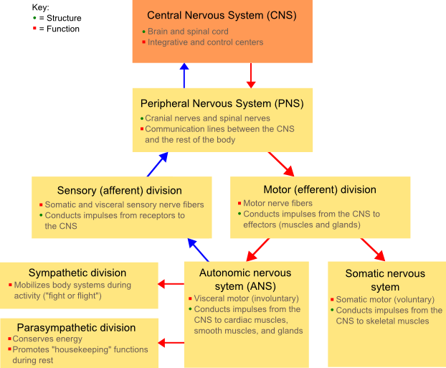
reminder…
a

Slide 66
Electroceuticals
But nobody really understands which neurons do what
  We’re shooting lots of arrows in the dark
  Some of them are hitting useful targets
The keys:
  miniaturization of electronics
  wireless power
  embedded computing, offline analysis
reminder…

Slide 67
Why bioelectronic medicine
Drugs are systemic; PNS is specific
  Most organs in chronic disease are innervated by controlling neurons
It’s more economical than drugs
  Every new molecule interacts very differently, and needs to be separately tested
  90% of the hardware for electroceuticals is the same, no matter what disease it’s treating
Electronics = ability to monitor
  Many people don’t fill prescriptions or take pills
  Bioelectronic medicine can monitor your neurons & report home

Slide 68
Turning off cytokine storms
Can you explain the science here?
  www.setpointmedical.com (white paper at https://setpointmedical.com/sp-content/uploads/2018/09/Setpoint_Medical_White_Paper_digital.pdf )
  https://spectrum.ieee.org/the-human-os/biomedical/devices/handheld-vagus-nerve-stimulator-gets-emergency-approval-for-covid19-use
  https://www.quantamagazine.org/the-brainstem-fine-tunes-inflammation-throughout-the-body-20240614
Reminder… this was our current event. Anyone want to discuss it?

Slide 69
Imran Eba visit
Wed Nov 30 during class time (3:00-4:15)
Topics
  He’ll talk about electroceuticals, APVC
  Answer any question you have about it
  If you choose to research a company for your final project, he’ll answer any questions you have
  He’s a very knowledgeable, friendly guy ☺

Slide 70
Action Potential VC
www.actionpotentialvc.com
Backed by GlaxoSmithKline but a separate entity
Invests in bioelectronic-medicine startups
  New nerve targets for existing neurostimulation devices
  New devices for existing targets
  Advanced technologies to bring the field forwards
Notes:
Why do we bring Imran in? Because a VC is well placed for a sober assessment of whether stuff can make money or not

Slide 71
Companies
Neuspera (http://neuspera.com/ )
  Mid-field powering = wireless power for a neural implant 10 cm deep
  No internal battery (?) → small, less-invasive implant, can be put in previously-inaccessible locations
  Currently used for urinary-urge incompetence (other uses planned)
Setpoint Medical (https://setpointmedical.com )
  Vagus nerve: controls heart rate, peristalsis & sweating – and affects the immune system
  Stimulate vagus nerve → target autoimmune inflammatory diseases
  Inflammatory reflex: senses inflammation & injury, sends messages → vagus nerve → controls TNF, which regulates immune system & inflammation
  1 minute of vagus-nerve stimulation → 24 hours of cytokine reduction
  initial disease targets: rheumatoid arthritis, Crone’s disease

Slide 72
Saluda Medical
Problem: electrodes tend to move over time
  Neuron may be stimulated too much or too little
  One reason SCS effectiveness fades over time
Saluda basic technology:
  Developed a bio-amplifier design to measure neuron activation
  Use it to close the loop; adjust stimulator intensity until you get the desired target response
Application:
  Improved long-term results for SCS
  FDA approval March 2022; commercial use in 2023
  Evoke SCS system

Slide 73
Cala Health (https://www.calahealth.com )
  Essential tremor
  Gyroscope in a special watch detects tremors (still true?)
  Electrodes on the wrist to target median & radial nerve in timed combination (transcutaneous)
  Multiple clinical trials; now available by prescription
  The watch collects data on how well the stimulation worked; uploaded during recharging
  https://www.youtube.com/watch?v=auhfMzF2l-w&feature=youtu.be
CVRx ( www.cvrx.com )
  Electrical pulses activate pressure-sensor neurons in the carotid artery (part of a negative-feedback system called the baroreflex)
  Helps with high blood pressure and heart failure
  https://en.wikipedia.org/wiki/Baroreflex_activation_therapy
Axon Therapies: nerve targets for neurogenic heart failure
Notes:
The Cala health website no longer mentions the gyroscope, so I’m not sure if it’s still true. Ditto for collecting data. But the web site does mention that the therapeutic benefit lasts for an hour or so after you turn the device off.

Slide 74
Presidio Medical
  Another version of SCS – but different ☺
  This one is low frequency (.1 Hz). It claims to drastically raise the firing threshold of the pain-conductor neurons, and to be substantially more effective than HF and pulsed SCS
  https://presidiomedical.com/
  Neuromodulation using ultra low frequency current waveform reversibly blocks axonal conduction and chronic pain, 2021. First clinical trial, along with animal results and modeling
pain (Aδ, C)
.1Hz inhibits Aδ, C
+
-
-
downstream neuron
+
+
touch (Aβ)
SCS excites Aβ
Notes:
The clinical trial had very impressive results. But there was no control group or placebo. And the method-of-action isn’t clear. They placed their electrode in the epidural space, where it will hit all neurons at that spinal level – both pain and touch, and even (I think) motor neurons. So why doesn’t it numb and paralyze you? In fact, their animal testing (where they could differentiate neuron types) showed that it inhibited “touch” neurons even more than it inhibited pain neurons!

Slide 75
Mini-quiz
Can you give a two-minute overview of the gate-control theory of pain?
The gate theory is a nice theory, and fits some fact quite well. Which facts that we’ve discussed (slides 45-46) does it explain? Which doesn’t it?
How do electroceuticals try to turn pain off?
What convergences are making bioelectronic medicine happen now (as opposed to, say, 20 years ago)

Slide 76
SparkSpine
Different category of bioelectronic medicine
Goal is not to target neurons, but to interfere with non-neural communication
Tie-in to Tufts work
  Levin-lab hypothesis is that slow (SS) bioelectricity controls shape formation

Slide 77
Wolff’s Law
The common medical knowledge
  Walking reduces osteoporosis incidence
  Tennis players have thick wrist bones on dominant hand
  Use it or lose it
But why does weight-bearing exercise increase bone density?

Slide 78
Bone physiology
Bone = cells + extra-cellular matrix
ECM = calcium salt (hydroxyapatite) + collagen
Homeostasis between
  Osteoblasts deposit ECM
  Osteoclasts remove ECM
Many things can alter this homeostasis
  Hormonal processes encourage growth spurts
  Gradual bone loss with aging
  Wolff’s Law
Notes:
The hydroxyapatite give bone its compressive strength; the collagen gives its tensile strength.

Slide 79
Electrical control of bone growth
Wolff’s Law is believed to be largely bioelectrical¹
  Collagen fibers have + and - units
  Compression/stretch ⇒ charge separation ⇒ voltage
  Not V_{mem}, but electric fields across cells
  Ca_{V} channels open ⇒ Ca into cells ⇒ growth
Tufts Kaplan/Levin labs work²
¹The bioelectrical properties of bone tissue, Boon Chin Heng 2022
²Bioelectric modulation of wound healing in a 3D in vitro model of tissue-engineered bone, 2013

Slide 80
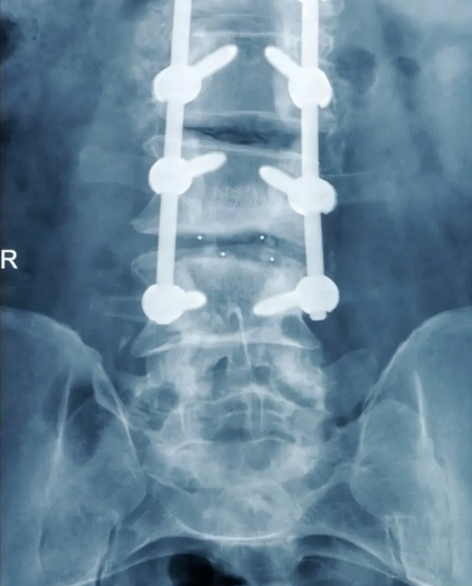
Fusion after spine surgery
Spinal fusion
  Goal = prevent motion of vertebrae
  Rods/cages screwed to adjacent vertebrae
  Rods/cages are not a permanent solution; just immobilize vertebrae until bone growth occurs (like a cast)

Slide 81
Pseudarthrosis
Some patients have pseudarthrosis (failed fusion)
Wearable external stimulator (like a back brace)
  Not all patients wear it enough
  E-field must penetrate skin/fat
  doesn’t precisely target the fusion area
  $5K cost
Implanted stimulator
  Matchbox-sized “bump”
  Requires another surgery to remove it after 9-12 months
  May not be MRI compatible
Clinical data showing efficacy
Notes:
This is a new category; it doesn’t work by affecting neurons, but rather by the slow-growth electrical pathways.

Slide 82
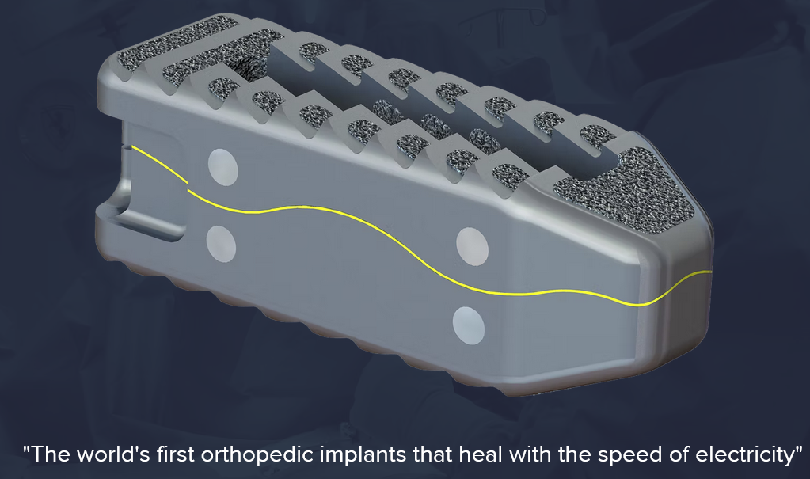
Sparkspine
SparkSpine: the fusion HW is piezoelectric
  or a phonograph needle
  like bone
A different category of bioelectronic medicine!
www.sparkspine.com

