Slide 1
EE 123
Bioelectricity
Tufts University
Instructor: Joel Grodstein
joel.grodstein@tufts.edu
3. The human heart

Slide 2
Big picture of the course
Where does bioelectricity come from?
Neurons and working with the nervous system
Cardiac bioelectricity
Worms

Slide 3
The heart in the news
Detecting atrial fib with the Apple watch… and more
  https://medium.com/s/story/im-a-heart-doctor-heres-why-im-wary-of-the-new-apple-watch-2b1999f2d942
  https://www.nytimes.com/2021/05/20/well/live/smartwatch-heart-rate-monitor.html
  https://spectrum.ieee.org/wearable-medical-devices
Notes:
The IEEE Spectrum article is about detecting reduced injection fraction from a one-lead ECG from an Apple watch (large-scale trial ending June 2023).

Slide 4
Table of contents
Cool cardiac facts & why we care
Cardiac basic operation
Electrocardiograms
Arrhythmias
Backup-system engineering
  2 to 3 billion cells; they break and die all the time

Slide 5
Deaths/year in U.S.
2.8M deaths/year total (.9 / 100 people)
  Heart disease = 650K
  Cancer = 600K
  Accidents = 170K
  Chronic lower respiratory diseases: 160K
  Stroke = 150K
  Alzheimer’s = 120K
  Diabetes = 80K
Mostly heart attacks
(from https://www.cdc.gov/nchs/products/databriefs/db328.htm)
Notes:
“Heart disease” actually includes all cardiovascular diseases.
But “stroke” is counted as a cerebrovascular disease, so it’s separate from heart disease!

Slide 6
Heart attack = blocked artery starves heart muscle
  Plumbing problem
  Heart dies over hours to weeks
Cardiac arrest = heart stops beating
  Electrical problem
  Lose consciousness in seconds; die in minutes
  530K cases/year; 8% survival rate
  CPR, AED save lives
  PSA – learn how to use one!
one cause
Notes:
How does a heart attack cause cardiac arrest? The simplest way is that some of the cardiac tissue that dies may be in the electrical distribution system. A slightly trickier way is that semi-dead tissue can cause a one-way path, which causes afib or vfib.

Slide 7
A miracle of engineering
The heart contains 2-3 billion independent cells
  Cells have high variability
  Cells are quite failure prone
They somehow link together
  to produce a coordinated, durable, and adaptable whole!
  The heart is really really really robust – a miracle of fail-safe engineering
  Multiple backup subsystems
  It’s really robust! Keeps beating and never stops
Except for the 99 varieties of heart disease…

Slide 8
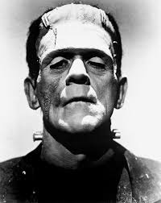
Question: does your heartbeat originate in the brain and get sent to the heart via neurons?
Galen of Pergamum, 130-200AD
  extracted heart keeps beating for a long period
  nobody knew why
Keith and Flack (1907)
  sinoatrial node initiates the heartbeat
Notes:
From Galen’s experiment, we conclude that the brain is not the source of the heartbeat – if it were, the heart would stop beating as soon as we removed it from the body
Keith and Flack first found the SA node on a mole

Slide 9
Table of contents – this unit
Cool cardiac facts & why we care
Cardiac basic operation
Electrocardiograms
Arrhythmias
Backup-system engineering

Slide 10
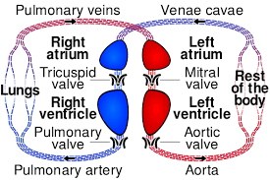
Plumbing – the big picture
Two separate two-chambered pumps
Red = oxygenated
Blue = not
Two chambers = more efficient

Slide 11
What does electricity do?
Electricity drives the muscles
Muscles drive the plumbing
Similar to the rest of your body
Notes:
Of course, in this case the electrical signals are coming from an oscillator rather than from the brain
Note the timing – both atria contract at once, and both ventricles contract at once.

Slide 12
The pumps in operation
https://www.youtube.com/watch?v=CWFyxn0qDEU
  Mayo Clinic
https://www.youtube.com/watch?v=-s5iCoCaofc
  Suitable for younger than college age ☺

Slide 13
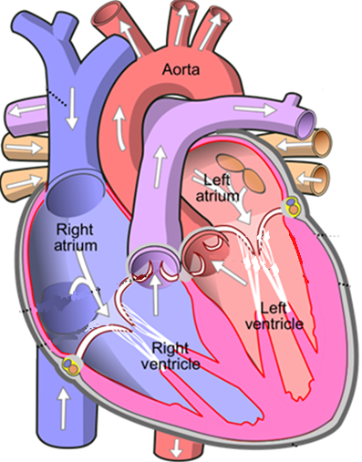
Atrial conduction
Sinoatrial (SA) node is the oscillator
Signal spreads over the atria at 1 m/s (100ms total)
  Atrial muscles contract
SA
Note that left/right are flipped
  A/P view, very common
Notes:
Normal atrial conduction

Slide 14
Conduction on the highways
Through the AV node (slowly)
Zoom through the bundle of HIS
Left/right bundle branches
SA
AV
Notes:
The right bundle branch is thin and has only one fascicle; the left is much thicker and has 2-3 fascicles (2 shown here).

Slide 15
Conduction on the highways
Purkinje fibers are the final “mile”
Not shown; connect from the bundle branches to everywhere else in the ventricles
Purkinje fibers seed the AP on much of the ventricular surface
Now the AP squeezes the entire muscle all at once
SA
AV

Slide 16
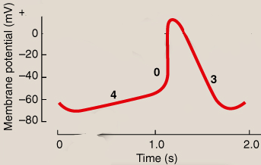
Building an oscillator
Sino-atrial AP
Start with a “neuron”
  Stays at resting potential until synapses bring in enough + charge… then fires
Hyperpolarization-gated Na (HCN) (a.k.a. “funny”) channels leak Na, K
  V_{mem} slowly rises
  until it retriggers as usual
  the key to oscillation!
From Lippincott Fig 16.10, 16.11
Funny channels are the primary control of heart rate
  Turn them on more ⇒ heart rate rises
Sino-atrial cells (and few others) have funny channels
  Also called pacemaker cells
Notes:
Why are they called “funny” channels? They were the first known channels to turn on as a result of hyperpolarization rather than depolarization.
And they’re gated by both Vmem and also by ligands.
And finally, they conduct both Na and K.
They weren’t discovered until 1979.

Slide 17
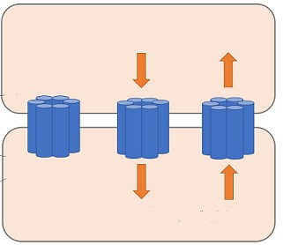
Gap junctions
A gap junction (GJ) is a little tube that connects two cells
  GJs allow cells to talk to each other
Molecules can travel between the two cells
  A resistor between two cells
  If a GJ connects two cells with different V_{mem}, then negative ions move towards the + cell
  Just like ion channels did for ICF ↔ ECF
  Interesting tidbit – it’s a voltage-controlled conductance
+10mV
Na⁺
Cl⁻
-20mV
Na⁺
Cl⁻
Notes:
The GJs are drawn as six little tubes forming a big tube because, in fact, that’s more or less their anatomic structure.

Slide 18
AP propagation
cardiomyocyte #1
GJ
cardiomyocyte #2
#1 “pulls” #2 up with it
#1 shrinks a bit, #2 rises
#2 rises above the threshold and FIRES!
Result: our “wave” travels along the highway from one cardiomyocyte to the next
#1 fires
#1
#2
time
V_{mem,1}= V_{mem,2} → no ion flow across GJ
V_{mem,1} > V_{mem,2} → #1 attracts neg. ions → V_{mem,1} ↓ and V_{mem,2} ↑

Slide 19
How many cells in the SA node?
How many cells should we have in our SA node?
Is “1” a reasonable answer?
  It could randomly fail
  We lose 90% of our SA-node cells by age 80
Is “500K” a reasonable answer?

Slide 20
Entrainment
Sinoatrial node has ≈ 500K cells
  Each one oscillates independently
  Potentially a slightly different frequency, phase
  How can your heart have a single unified beat?
Entrainment is the process of all the oscillators talking to each other and agreeing on a frequency
  Implemented via gap junctions (GJs)
  Potential quiz question – how do the GJs synchronize all those oscillators?

Slide 21
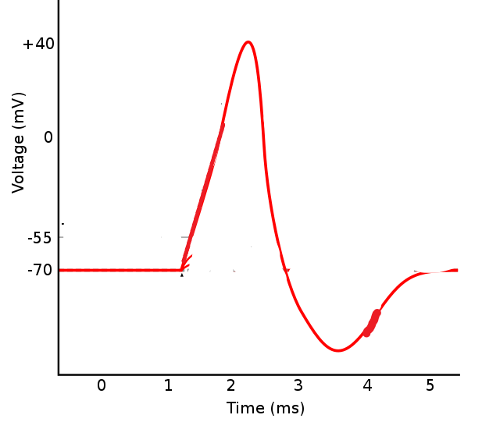
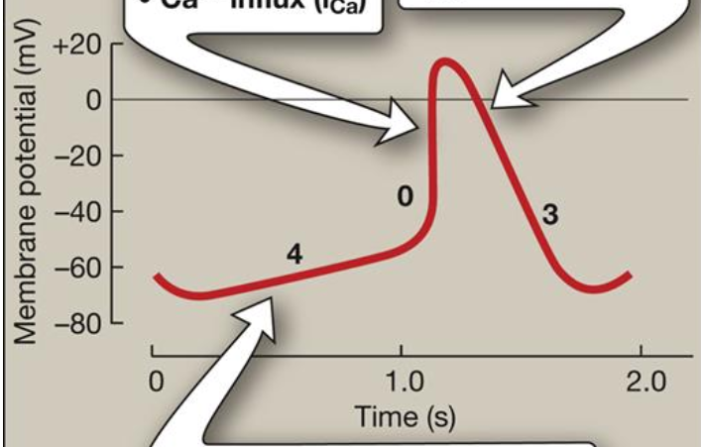
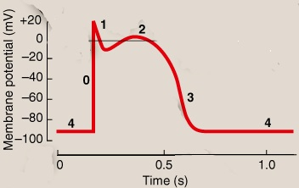
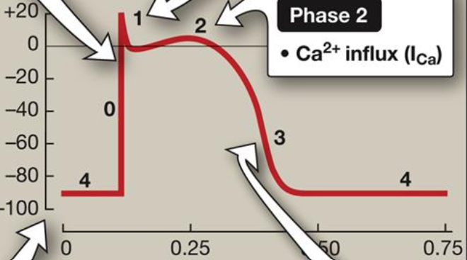
Different cardiac APs
Standard neuron
One of these is the SA node; the other is ventricular
Which do you think is which? Why? (muscle contracts when depolarized)
What do you think an atrial AP looks like?
Random note: all cardiac cells are cardiomyocytes (cardiac muscle cells)
SA node
Ventricle
Cardiac APs from Lippincott Fig 16.10, 16.11
Notes:
The SA node is different because it retriggers. The long slow phase-4 slope gives us lots of ability to control the heart rate.
The ventricular AP has the long flat top because that gives the myocardium a long active contraction time
The atrial AP looks a lot like the ventricular, but has a shorter flat top (since the atria don’t take as long to pump).
Interesting note – the long flat top is what makes the heart APs stand out on an ECG (the ECG voltage is proportional to the area under the AP curve).

Slide 22
Mini-quiz
  What does plumbing vs electrical mean?
  How do pacemaker cells retrigger?
  What is a GJ?

Slide 23
Table of contents
Cool cardiac facts & why we care
Cardiac basic operation
Electrocardiograms
Arrhythmias
Backup-system engineering

Slide 24
What is an ECG?
An electrocardiogram (ECG, EKG) measures the heart’s “summed” action potential
  Each AP in the cardiac wave → small current travels through the body to the ECG electrodes
  Different heart cells are oriented in different directions; vector dot products cause different results depending on where electrodes are attached
More details in the ECG lab!
Weird fact
  ECGs pioneered by Willem Eindhoven
  Suspected of being Jack the Ripper
Notes:
Part of the reason Eindhoven was suspected was due to the surgical precision of the killings. But I think most people discount this theory nowadays.

Slide 25
Vector math review
Adding vectors
Sum vector
  points in the middle
  bigger as you add more big vectors
Dot product shows to what extent two vectors point in the same direction
  2*1.1=2.2
Dot product of vectors at 90º?
Of vectors in same direction?
+
1.1
2
1.5
2
1
1
2
Notes:
The vector sum and average are both vectors.
The dot product is a scalar.

Slide 26
Atrial conduction
P wave = atrial depolarization
SA
R
P
T
Q
S
Notes:
Average vector direction = down and to the right. All the arrows point back to the center of the circle at the SA node.

Slide 27
P-wave vectors
What is the summed vector direction at the beginning of the P wave?
  Down and to the anatomical left
SA
R
P
T
Q
S
Notes:
Remember that “right” on the picture is the anatomical left!

Slide 28
Vectors
As the wave grows…
What is the summed vector direction now?
SA
R
P
T
Q
S
Notes:
At the beginning, the wavefront is a growing circular arc. So the net vector sum stays pointing in the same direction (down and to the anatomical left) with increasing magnitude.

Slide 29
Atrial conduction
Think about how the summed vector size & direction moves during the P wave
Can you explain the entire P-wave shape?
SA
Group exercise
R
P
T
Q
S
Notes:
In general, it gets larger and then shrinks away. That explains why the P wave gets larger and then shrinks.
While the circle is expanding uniformly, the direction stays always down and to the anatomical left. When parts of the wave start running into the atrioventricular septum, the vector direction changes a bit.

Slide 30
Vectors
Average vector direction during most of the P wave is down/left
Red is + electrode; black is -
Vector dot product is positive
Is this yet another reason why the P wave shrinks at the end?
SA
R
P
T
Q
S
Notes:
We already said the magnitude of the summed vector gets larger and then smaller.
But we also said it changes direction as it shrinks, which reduces the dot product still further.

Slide 31
Vectors
Red is + electrode; black is -.
Reverse the two electrodes; vector dot product is now negative!
SA
R
P
T
Q
S
Notes:
The heart vector still points down/left. But now the lead vector points up/right.

Slide 32
Vectors
Red is + electrode; black is -.
Rotate observation angle by 90º
What will happen to the P wave now?
SA
R
P
T
Q
S
Notes:
Average vector direction = down and to the right. All the arrows point back to the center of the circle at the SA node.

Slide 33
QRS complex
Caused by ventricular APs
Purkinje fibers have seeded the AP on much of the ventricular surface
Now it squeezes the entire muscle all at once
Why so tall & skinny?
But why three peaks? Now the fun begins…
SA
AV
R
P
T
Q
S
Notes:
The animation is set up to show first the bundle of His, then the bundle branches, and finally the Purkinje fibers.
The tall & skinny contraction is because you have such a strong, well-synchronized set of APs throughout the entire (huge and strong) ventricles.
The reason for the synchronization is because the Purkinje fibers work so well.

Slide 34
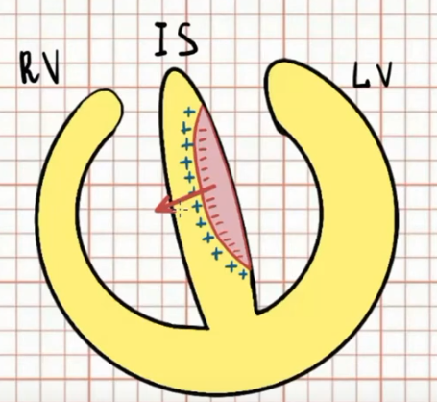
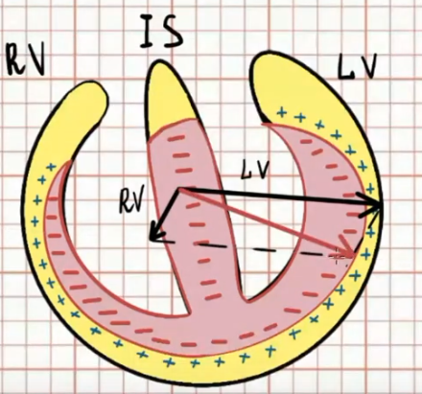
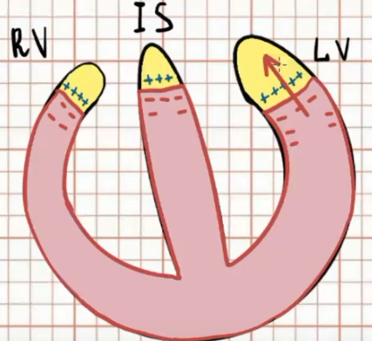
Vectors 1, 2, 3
Q
Vector 1: bundle of HIS & left bundle branch seed the inter-ventricular septum; APs move to the right
Vector 2: Purkinje fibers seed the endocardium; APs move outwards
  Why is the LV vector drawn longer than the RV vector?
Vector 3: end of the road
R
S
A/P views
Notes:
In vector 1, the left side of the septum depolarizes first because the LBB is shorter and faster than the RBB.
The LV is larger and more muscular than the RV, and so it produces substantially more depolarization current.

Slide 35
T wave
Ventricular repolarization
  It takes current to make the cells more negative, too
  T wave
SA
AV
R
P
Q
S
T

Slide 36
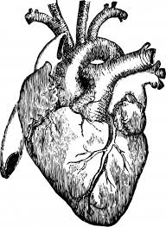
Three basic leads
Four electrodes (left & right arm, left & right leg)
Three leads
  Lead I = LA-RA
  Lead II = LL - RA
  Lead III = LL - LA
Remember that voltage is relative
  if you know leads I and II, can you compute lead III with just math?
What is RL for?
RA
LA
RL LL
Notes:
It’s easy to compute lead III = II – I = (LL-RA) – (LA-RA) = LL-LA.
Right leg is for right-leg drive. It’s sort of a ground; its goal is to sense any common-mode voltage between electrodes and drive current into the body to slowly remove that common-mode voltage.

Slide 37
Three basic leads
How many views do we have?
Views every 60º; not bad!
Can we get more views from these same four electrodes?
RA
LA
I=LA-RA
RL LL
III=LL-LA
II=LL-RA
Notes:
Careful: this is a trick question! Arguably 6, not 3.

Slide 38
Wilson’s central terminal
W = (LA+RA+LL)/3
aV_{F} = 1.5(LL-W)
aV_{R} = 1.5 (RA-W)
aV_{L} = 1.5 (RA-W)
Views every 30º!
RA
LA
aV_{R} (-150º)
aV_{L} (-30º)
I=LA-RA
RL LL
II=LL-RA
III=LL-LA
aV_{F} (90º)
Notes:
How can we do this trick? Our 4 electrodes are really 3 signals plus a noise-reducing RLD that’s not really a ground. So the 3 signal electrodes give us two voltages (i.e., we could arbitrarily pick LL=ground). We can then characterize any 2D vector by its coordinates relative to any two basis vectors; and once we do that, then we can get its dot product with any arbitrary 2D vectors. So really, if we wanted to be sneaky enough we could get as many views as we want. Of course, trying to get lots of data from just a few measurements can get really noisy.
Also note that this is all 2D rather than 3D; while the electrodes are pretty much all in the chest plane, the heart vector isn’t. So this is just giving us a 2D projection, and very little information about the 3rd axis.

Slide 39
What do clinicians use?
In-office visits typically use a 12-lead ECG (another 6 electrodes), giving another 6 views
  Extra views allow faster diagnosis of many arrhythmias
Long-term recording typically uses one lead
  Nobody wants a rat’s nest of wires attached for weeks
ECG lab will work with 6-lead ECG
  “Only” four wires, and more info that we can deal with anyway

Slide 40
Electrocardiogram
R
Group exercise
P
T
Q
S
Locate these
  SA node firing
  atrial depolarization
  atrial repolarization
  ventricular depolarization
  ventricular repolarization
How can you read these delays?
  heartrate
  time to traverse atria + AV node
  time to traverse AV node
  QRS width
Notes:
SA node firing is the beginning of P.
Atrial repolarization is hidden by QRS.
Time to traverse the atria + AV node = PR interval = start of P to start of QRS
Delay through the AV node = PR segment = end of P to start of QRS.
QRS width is defined as from the start of Q (when the ECG deviates from flat) to the end of S (when it reaches flat again).
Note the PR interval and segment are perhaps badly named; they end at Q, not at R.
The lab asks for the HR, PR interval and PR segment.

Slide 41
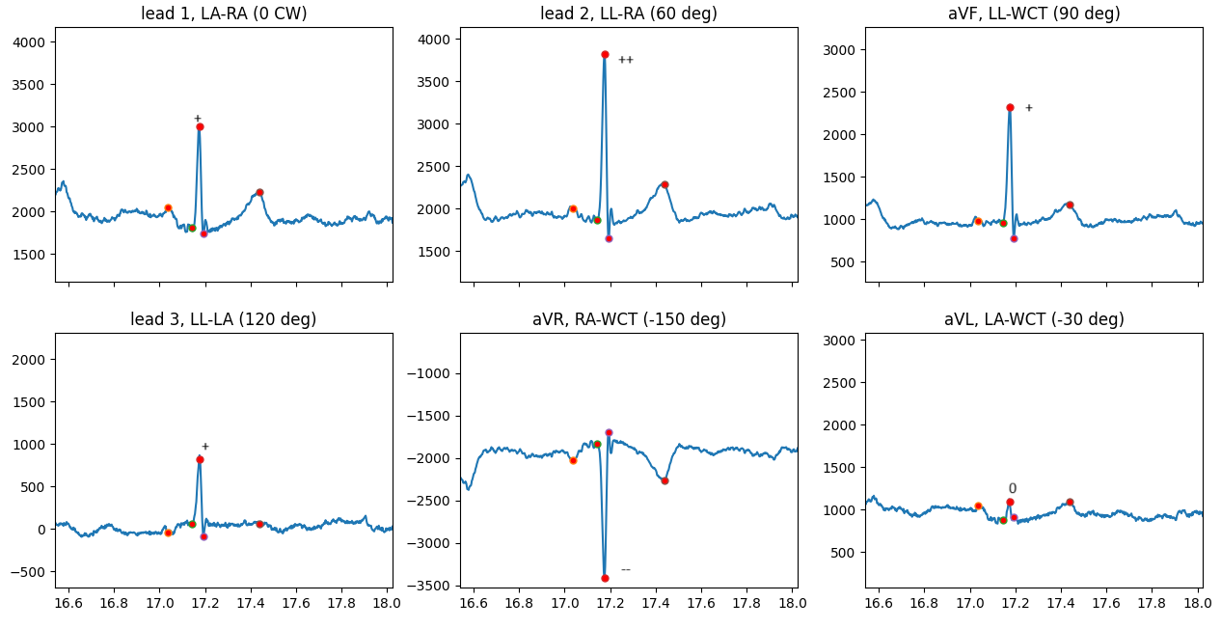
What is the R axis?
Notes:
Narration for this slide.
Now we all know how a particular vector will create different ECG views.
But the clinically useful part is the opposite: how can we look at different ECG views and deduce the vector angle? That’s what we’ll do now.
We’ll do it for the R axis, which is the biggest and most noticeable part of the ECG. R axis can be altered by various things – most notably a heart attack.

Slide 42
Determining the R axis
Max at 60º
Value at -120º?
0 at -30º, +150º
  90º off of the max!
+ at 0º, 90º, 120º
-- at -150º
Note the nice symmetry
Conclusion?
“Normal” R-axis is -30º to 90º
Can do the same thing for P,Q,S,T waves
-
--
-
--
0
-
R
+
0
++
+
++
+
Notes:
If we’re max at 60º, then we’re min 180º away, or -120º.

Slide 43
Table of contents – this unit
Cool cardiac facts & why we care
Cardiac basic operation
Electrocardiograms
Arrhythmias
  so many things can go wrong ☹
Backup-system engineering

Slide 44
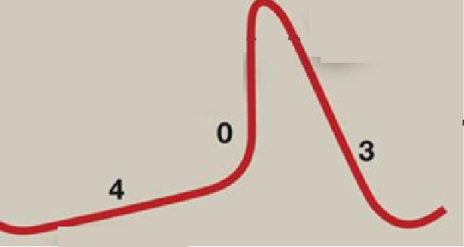
AV node blocks
Remember what the atrioventricular node was?
  Electrical connection from atria to ventricles
AV node propagation is purposely quite slow
  Why?
  How?
Issue with purposely-slow conduction
  increased likelihood of conduction failure ☹
Why don’t they kill you?
Backup system in place
  to be discussed
Let the ventricles fill before they pump
decreased density of Na+ channels; slows down phase 0
lower GJ density
Notes:
Specifically, the SA node has fewer NaV1.5 channels, which are the fast-acting positive feedback. Thus, the phase-0 upstroke is slower in the SA node.
Yes, phase 0 still looks pretty fast on this picture. But it’s a lot slower than the normal atrial and ventricular cells.

Slide 45
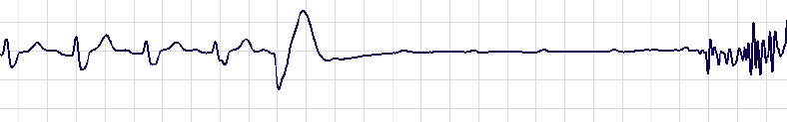
AV-block ECG
What would an AV-block ECG look like?
  Would P waves exist? Would they look normal?
  QRS? T?
Notes:
This is my heart entering paroxysmal AV block on a treadmill. They think the noise is when I jumped off of the treadmill and hit the ground.
Note the P waves every 2.5 squares before the block; they continue roughly every 2.5 squares after as well.
My HR was about 135; so about .44 sec/beat.
Each square is .2 sec, so .44sec = 2.2 squares.

Slide 46
Atrial conduction – review
Sinoatrial (SA) node is the oscillator
Signal spreads over the atria at 1 m/s (100ms total)
  Atrial muscles contract
SA
AV
Notes:
Normal atrial conduction

Slide 47
Your heart, on AFib
Loop starts at an ectopic pacemaker
Goes round and round (≈300 bpm) with no input from SA node
  Called a reentrant arrhythmia
  Takes a slightly different path each time
  Waves spread out from the loop
  AV node fires almost as soon as it’s not refractory
  His-Purkinje-ventricles run as usual
SA
AV
Notes:
The AV node doesn’t literally fire the instant it’s not refractory; but with atrial APs at 300 BPM it’s close enough.
In practice, about every other atrial AP makes it through to the ventricles.

Slide 48
Your heart, on AFib
Ventricles run at ≈150 bpm!
No single clear signal presents to AV node; ventricles pump fast but irregularly
Coordinated muscle pumping is lost
Consequences:
  You can limp to the phone to call 911
  Long-term risk of stroke – why?
  See heart.org/en/health-topics/atrial-fibrillation/why-atrial-fibrillation-af-or-afib-matters
SA
AV
Notes:
The stroke risk is because blood now pools in the atria, increasing the risk of clotting there. The clot is unlikely to lodge in the heart unless it’s large enough to block a valve, but can easily travel elsewhere and cause a stroke or heart attack.
Afib can also lead to heart failure, simply because it causes the heart to pump inefficiently, and reduced cardiac output is the definition of heart failure.

Slide 49
Atrial fibrillation
R
P
T
Q
S
No P wave – why?
HR is irregular – why?
QRS is normally shaped – why?
Notes:
HR is irregular partly because the loop is irregular, and partly because it’s unpredictable which signals get through the AV node.
The P wave is missing because atrial conduction is so haphazard. The QRS wave is still present because whatever signal passes through the AV node can still cause a normal ventricular HB.

Slide 50
https://watchlearnlive.heart.org/index.php?moduleSelect=atrfib
Traditionally requires a one-way path
Notes:
The question of *why* it requires a one-way path will be on the quiz

Slide 51
Atrial fib causes
Causes:
  Congenital heart disease of many types
  Sedentary lifestyle (via diabetes, high blood pressure, obesity)
  “Excessive” endurance exercise!
  Exercise is a powerful drug, with a dose/response curve
“Cures”
  Various drugs (flecanaide + other)
  Ablation
  Rest, sleep or time

Slide 52
Ablation
“Guess” that the loop goes near the pulmonary vein
Surgically isolate the pulmonary vein
SA
AV
Notes:
Surgical is by putting lots of little holes around the pulmonary vein.

Slide 53
Ablation
Surgically break the loop
  Previously, either burn or freeze the relevant heart tissue
  More recently: electroporation
SA
AV
Notes:
Why electroporation? It turns out that cardiomyocytes have a lower energy threshold for electroporation damage than nearby cells do. So this procedure lowers the risk of damaging nearby tissue (e.g., the esophagus). Of course, the equipment is more expensive, another bonus ☺

Slide 54
Ablation
Surgically break the loop
  Kill the relevant heart tissue
  Like any procedure, it’s not risk free
Atrial fib: surgery or not?
  https://www.drjohnm.org/2019/02/af-ablation-update-2019/
  https://www.medscape.com/viewarticle/af-ablation-works-positive-sham-pvi-trial-2024a1000gzl
  https://www.medscape.com/viewarticle/919228
  https://www.drjohnm.org/2011/03/the-best-tool-for-treating-atrial-fibrillation
SA
AV

Slide 55
Structural damage ⇒ECG changes
Q
Structural damage (e.g., heart attack) often causes electrical damage
  Heart attack; damaged cells can cause a one-way conduction path
  Heart attack: dead cells don’t create AP, alters R axis
  Left-ventricular hypertrophy alters R axis & voltage
R
S

Slide 56
Table of contents – this unit
Cool cardiac facts & why we care
Cardiac basic operation
Electrocardiograms
Arrhythmias
  so many things can go wrong ☹
Backup-system engineering

Slide 57
Why have fail-safe circuits?
Remember our intro?
  Cardiac arrest = heart stops beating
  Lose consciousness in seconds; die in minutes
Keeping the heart beating is job #1!
But success seems unlikely
  Cells die all the time
  We just discussed so many things that can go wrong
  Biological cells are unreliable
So why are we alive?
  A miracle of beautiful system-level design

Slide 58
Electrical system – review
Sinoatrial (SA) node is the oscillator
Signal spreads over the atria at 1 m/s (100ms total)
  Atrial muscles contract
Atrioventricular (AV) node conducts slowly to ventricles (.01-.05 m/s, 80ms total)
  Delay is on purpose
Bundle of HIS, left/right bundle branches
Purkinje fibers (2-4 m/s)
  Electrical highway
  ventricular muscles contract
SA
AV

Slide 59
Triple redundancy
The main operation is simple – SA node oscillates ≈ 60 bpm
But what if the upstream rhythm breaks?
  Quick review: how can it break?
atria
SA
AV
ventricles

Slide 60
Triple redundancy
The main operation is simple – SA node oscillates ≈ 60 bpm
But what if the upstream rhythm breaks?
  Quick review: how can it break?
The AV node can also oscillate!
  Now we have a backup in case of atrial fib, AV blocks
  AV-node cells have funny ion channels & are pacemakers
But what if the bundle of HIS, or LBB & RBB are both blocked?
atria
SA
AV
ventricles

Slide 61
Triple redundancy
The main operation is simple – SA node oscillates ≈ 60 bpm
But what if the upstream rhythm breaks?
  Quick review: how can it break?
The AV node can also oscillate!
  Now we have a backup in case of atrial fib, AV blocks
But what if the bundle of HIS, or LBB & RBB are both blocked?
  The Purkinje fibers can also oscillate!
atria
SA
AV
ventricles

Slide 62
System-level coordination
Three oscillators; only one is needed
What happens if they all turn on at once?
  chaos ☹
Can you devise a fail-safe system to control this?
  Requirement: KISS principle (less is more)
  Hint: SA node ≈ 60 bpm; AV node ≈ 40 bpm; Purkinje ≈ 20 bpm

Slide 63
Normal operation
SA oscillator (60bpm)
Travels through AV node…
AV-node action potentials

Slide 64
Normal operation
SA oscillator (60bpm)
So the ventricular rhythm gets driven by the SA node
Travels through AV node…
Here’s the next fire if input breaks (40 bpm)
AV-node action potentials
Notes:
Funny channels haven’t reached the trigger threshold yet, when the upstream AP comes in through GJs and does hit the threshold.
So the funny channels are nearly irrelevant.
Note the drawing shows upward slope of phase 0 in the AV-node cells being less than that in the SA-node cells, since they have fewer funny ion channels.

Slide 65
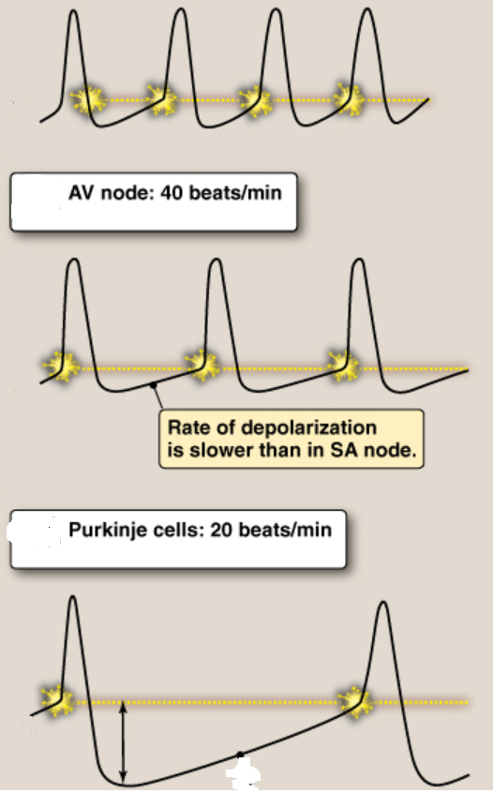
Lippincott, Fig 16.12
Each downstream oscillator is slower than the upstream one
Downstream ones never fire unless the upstream one is stopped
  Upstream AP comes in before downstream funny channels would cause refiring
  Funny channels are mostly irrelevant – for now
SA node: 60+ BPM

Slide 66
What can go wrong?
SA oscillator (60bpm)
Travels through AV node…
What could occur to break this coupling and cause the ventricles to fire from their own pacemaker?

Slide 67
If the SA node slows down…
SA oscillator (60bpm)
Travels through AV node…
AV oscillator (40bpm) all by itself

Slide 68
If the SA node slows down…
SA oscillator (38bpm)
Why doesn’t this fire the ventricles?
AV oscillator (40bpm) all by itself
Ventricles fire from AV pacemaker
Notes:
Why doesn’t the second SA pulse cause the ventricles to fire? Perhaps because they’re still refractory to their own second pulse (which has just fired). And if they’re refractory then they don’t fire on the SA depolarization – and if the SA repolarizes (and pulls the AV down) before the refractory period ends then the SA spike gets completely ignored.
The narration: AV pulse #2 does occur (running on the AV 40Hz clock), since the SA is running so slowly.
Then SA #2 doesn’t cause a new AV pulse (since AV is refractory as noted above).
But SA #3 probably does get through.
Note that this sequence has ventricular firing that looks almost exactly like a PVC (which is what we’ll look at next), though slow SA firing is typically

Slide 69
Design choices
Frequencies:
  SA node ≈ 60+ bpm
  AV node ≈ 40 bpm
  Purkinje ≈ 20 bpm
Why did we get designed the way we did?
Pros/cons of
  AV node ≈ 45 bpm, Purkinje ≈ 25 bpm?
  AV node ≈ 35 bpm, Purkinje ≈ 15 bpm?
Notes:
If the 40 creeps up much higher, an athlete with 45bpm resting pulse will be in trouble.
If the 20 bpm goes much lower, it’s not enough to keep you alive.
My tertiary pacemaker is estimated at 12 BPM; I blacked out.

Slide 70
PVCs
Doesn’t go anywhere (ventricles still refractory)
just when you thought we were done with arrhythmias…
SA oscillator (50bpm)
Ventricular AP
Premature Ventricular Contraction (PVC) sounds like a “skipped” pulse
Ectopic* focus
A random firing in the ventricles
Ventricles not full; little blood pumped
*Ectopic=in the wrong place
Notes:
We’re (mistakenly) assuming zero delay from SA to ventricles to make the drawing simpler. In reality, the ventricular AP should be shifted to the right a bit.
And as usual, my artwork isn’t great – a real ventricular AP has a flatter top than what I’ve drawn.

Slide 71
PVCs
Ectopic* focus
could happen
SA oscillator (80 bpm)
SA oscillator (50 bpm)
Why are PVCs more likely with lots of endurance exercise and little sleep?
  lots of exercise → HR lowers (well known)
  lots of stress → more ectopic foci (hypothesized)
  benign except if you overdo it for a long time
Notes:
The red zone is where an ectopic focus could cause a PVC. Really, the important thing is the ventricles and not the SA oscillator, but I drew it this way because it’s the SA oscillator that’s controlling the rhythm and thus setting the HR in the ventricles.

Slide 72
PVCs
Backup circuits are great – what if they break?
  Yes, you have no backup. Or...
Backup circuit launches when it shouldn’t
  one way to make an ectopic focus
Too much exercise = more PVCs?
More info:
  https://www.drjohnm.org/2013/06/benign-pvcs-a-heart-rhythm-doctors-approach/
  https://www.drjohnm.org/2015/08/on-pvcs-think-anew-but-think-slowly/

Slide 73
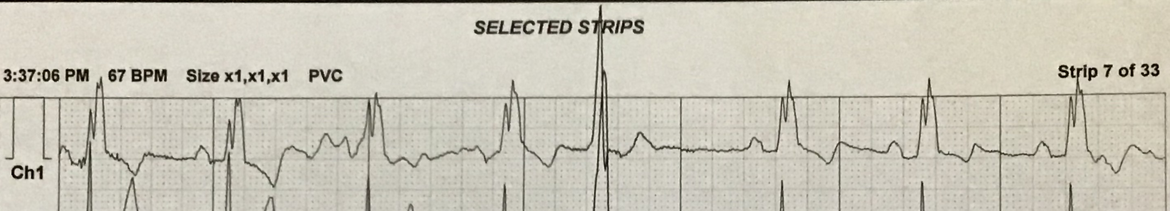
Can you find the PVC?

Slide 74
Do you think that PVCs would get more or less frequent as HR rises?
  More while you’re exercising?
  Or while sleeping?
Notes:
This should be an easy question to answer; we just answered it about 4 slides ago!

Slide 75
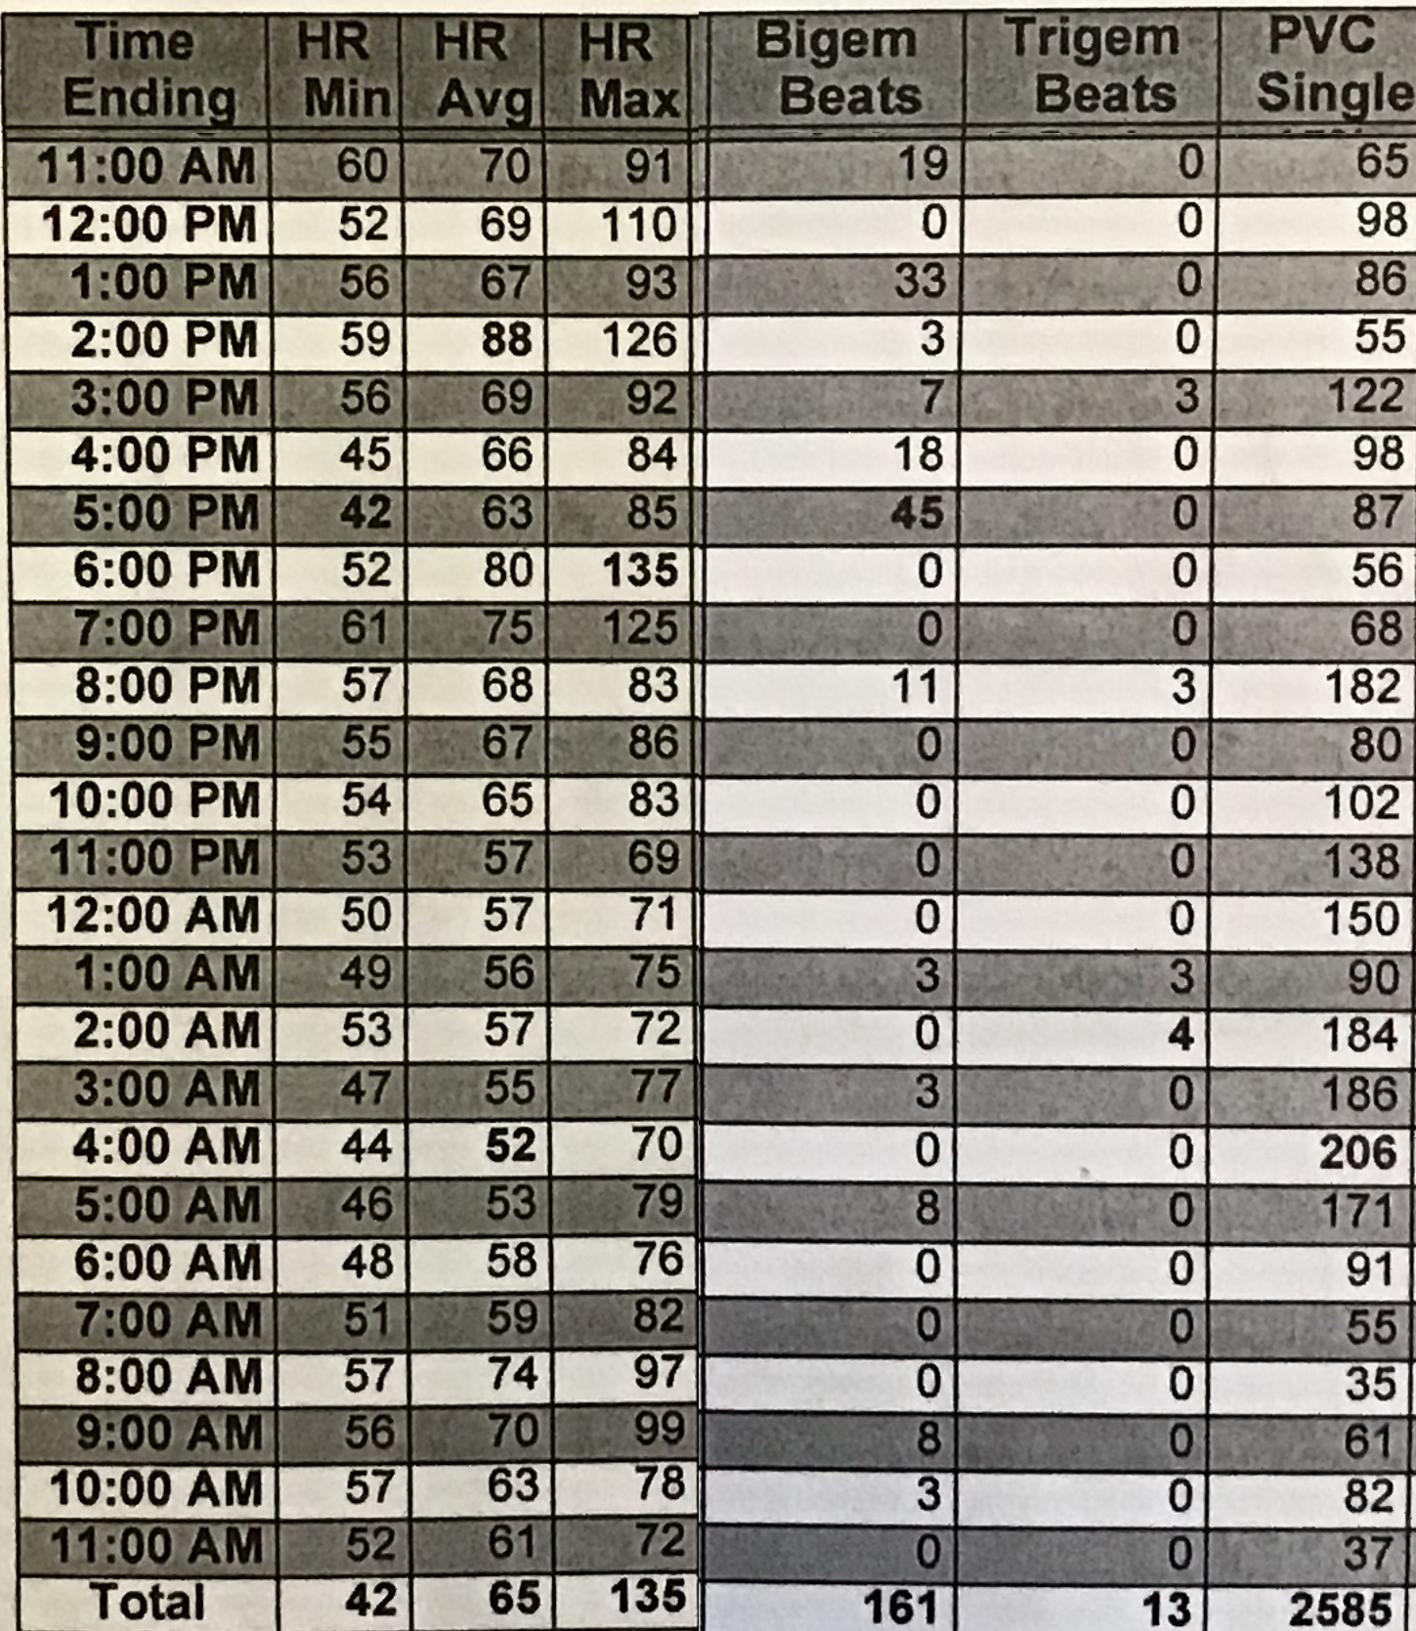
Just look at PVC single (ignore bigeminy, trigeminy)
Conclusions?
Notes:
Bigeminy is a run of having a PVC every other beat; trigeminy is a PVC every third beat.
And yes, the most PVCs (206) came at 4am, when the HR was lowest (44).
The bigeminy and trigeminy, interestingly, were not in that period; I’m not sure why. But they were in how-HR periods.

Slide 76
One more backup system
This one is human designed – pacemakers
  ≈400K/year implanted in the US (including ICD)
  ≈3M people living with a pacemaker
What does it do?
  Electrodes in an atrium, ventricle
  Each electrode does nothing unless it senses no HB; then it drives
Battery lasts about 10 years

Slide 77
Pacemakers hookup
Electrodes enter via vein
  which chamber do they enter?
  One electrode inserted → RA
Second electrode goes through valve, inserted into inter-ventricular septum

Slide 78
Pacemakers have many uses
Sick sinus syndrome (slow HB, occasional pauses)
Paroxysmal AV block
Complete AV block
For each of these:
  Where would you sense? Drive?
  How well do you think it would work when you exercise?
Notes:
The “How well do you think it would work when you exercise?” is trying to get at whether it can speed up the HR when exercising.
Then talk about synchrony: i.e., that it mimics a LBBB rather than normal highway-conduction QRS.

Slide 79
Electrical control of HR, BP
Sympathetic nervous system increases heart rate:
  releases norepinephrine, which helps to open HCN channels and thus speed up phase 4
  it also makes the AP triggering voltage more negative
Parasympathetic nervous system slows HR:
  releases acetylcholine, which decreases [cAMP]
  does the opposite of the above
Baroreceptors: arterial stretch receptors
  detect changes in arterial pressure and communicate this to the medulla oblongata in the brainstem
  … which then controls heart rate as described above, as well as changing circulatory muscle tone
  End goal: feedback loop controlling blood pressure
  Salt seems to affect it; nobody knows why
  Your brain is the mysterious box controlling it all

Slide 80
CVRx
Barostim-NEO device
  one in three high-blood-pressure patients is resistant to drugs
  they are the target audience
Mechanism:
  activate baroreflex; reduces sympathetic activity and increases parasympathetic activity
Results:
  http://www.barostimtherapy.com/en-gb/node/86
  FDA approval Aug 2019 (implantable device)
  Medicare/Medicaid approval 2020
Also used for heart-failure patients
  Often, too much sympathetic (too little para) activity causes pathological myocardial remodeling that worsens the condition

Slide 81
Mini quiz
  Why is QRS tall and skinny?
  What is AFib?
  Describe the redundancy system

Slide 82
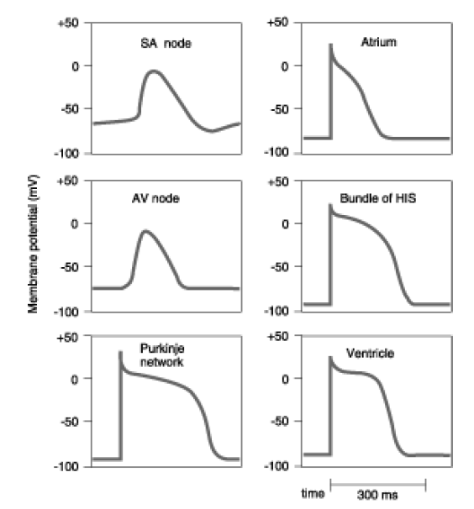
a

