Slide 1
EE 123
Bioelectricity
Tufts University
Instructor: Joel Grodstein
joel.grodstein@tufts.edu
Lecture 4b: morphogenesis

Slide 2
Big picture of the course
Where does bioelectricity come from?
Neurons and working with the nervous system
Cardiac bioelectricity
Morphogenesis/cancer
Bio backgrounder
Morphogenesis
Cancer

Slide 3
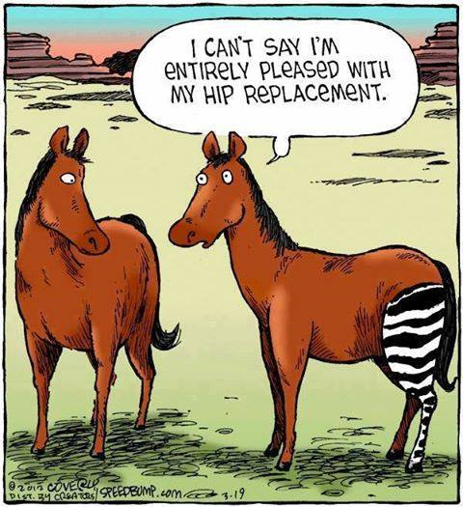
We said that cells express proteins based on chemicals in their environment. Do you think the stripes will eventually go away?
From Speedbump, by Dave Coverly
Notes:
Note – hold an actual discussion!
The “yes” side might be that the zebra leg would eventually express the right proteins due to its environment.
The “no” side might be that this just sounds impractical; it’s an entire leg, after all, and is thus big enough to hold its own and keep its stripes. Plus, like human organ replacements it may just get rejected.

Slide 4
Regenerative medicine
Various diseases are best treated with organ transplants
  Kidney transplants for diabetes
  Liver (cirrhosis, hepatitis)
  Heart (various heart diseases)
Organ transplants have problems
  Typically far more requestors than available organs
  Rejection is a constant problem
  A lifetime of immune-suppressant drugs is no picnic
Is there a better way?
  Regenerative medicine
Notes:
Heart transplants are not super common, but are not uncommon either. They are a last resort if drugs, pacemaker, & other surgeries have not worked

Slide 5
Regenerative medicine
Not quite ready for prime time yet
Hope #1:
  stimulate the body to regrow its own organs
  adult humans don’t really do that
Hope #2
  Start with induced pluripotent stem cells and grow organs in vitro
  Precisely controlling every detail of growing a kidney in a lab seems impossible
  We need a high-level API

Slide 6
The Big Picture
Morphogenesis is a big cool mystery
  If we understand it, we may understand regenerative medicine and cancer
Observations
  planaria and tadpoles can regrow organs
  what can we learn from them?
Our plan for morphogenesis
  Look at the weird, wonderful things that animals can do
  Hypothesize: what algorithms are they using?
  Might it be bioelectrical?

Slide 7
Why is morphogenesis hard?
If babies can do it, how hard can it be?
 | Hydra | Human
Genes | 20K | 30K
Neurons | 1000 | 100 billion
The game of evolution is not so much about inventing new proteins, but rather about assembling the same ones in new ways (Rafael Yuste)
DNA just creates protein, not (directly) body shape
  Similar DNA sequences encode very differently-shaped animals
  No clue how to look at a genome and predict animal shape
  Or to determine which DNA sequence will create an arbitrary shape
Is there a higher-level interpretation somewhere?
  A string of 3 billion DNA bases is daunting
  A high-level API would be really nice!
Notes:
The “babies” joke is like “how hard can it be to talk French… look at all these little kids doing it!”
The Hydra quote came from a talk by Rafael Yuste at the Allen Center seminar series on Nov 28, 2018
Another interesting fact: mice & people share about 97.5% of our DNA! (that’s why we use them for drug trials).
The Hydra was a Greek serpent that could regrow its heads – Hercules killed it with fire.
Real Hydra are good enough at regenerating the we mostly believe them to be immortal

Slide 8
Hypothesis #1
Maybe the DNA is just a set of (very intricate) instructions
  Like building Legoland from 37T Legos!
Twins
  When an embryo splits into twins, each twin grows perfectly
  Do you think that identical twins have identical fingerprints?
  Running the same set of instructions should produce the same results
We’ll look at some data & then revisit this hypothesis
Notes:
Albert Ebeneezer Fox and Ebeneezer Albert Fox, born 1857
Even if DNA encoded extremely-detailed instructions (e.g., cell #9 becomes a nose), the cells would still have to know their positions. Otherwise, all the identical processors would all reach the same decisions.

Slide 9
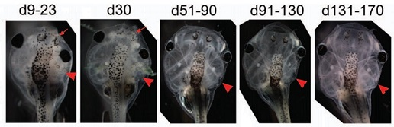
Picasso tadpoles
Inject one cell of a two-celled embryo with V_{mem}-disturbing mRNA → one-sided growth defects
Defects largely correct themselves over 170 days
  mRNA is diluted as cells multiply
  Eye location corrects, though eye functionality does not
Are twins and Picasso tadpoles consistent with hypothesis #1?
Credit: Normalized Shape and Location of Perturbed Craniofacial Structures in the Xenopus Tadpole Reveal an Innate Ability to Achieve Correct Morphology, Dev.Dynamics 2012

Slide 10
Hypothesis #2
DNA doesn’t specify an exact sequence of instructions
Life is hard!
  In the nanoworld, everything is dancing (Philip Nelson)
  Biology at the cell level is a noisy, statistical business
  Somehow we develop body shape very reliably
Instead
  DNA (somehow) specifies a target shape
  A machine compares current vs. target and keeps adjusting
  Really useful in our noisy, dangerous world!
Does this explain the Picasso tadpole?
  Seems to
Next question: what form are the inputs to this machine?
  I.e. – what data structures are we using?
Notes:
Remember diffusion? That was our first experience of how noisy biology is

Slide 11
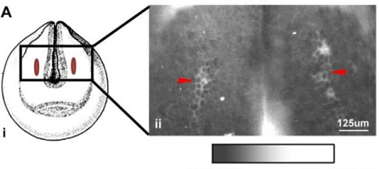
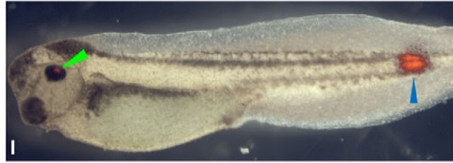
Electric tadpoles
We’ve shown robustness in growth
  Next: argue that bioelectricity is involved
Measured V_{mem} on a developing tadpole embryo to get a map. Future eyes correspond to hyperpolarized V_{mem}
Inject chemicals to disrupt V_{mem} at future eyes ⇒ deformed eyes
Inject chemicals to alter V_{mem} at unrelated locations ⇒ ectopic eye (blue arrow). And green arrow = normal eye
The ectopic eye only happens if they hit the right V_{mem}. Doesn’t matter which chemical they use, or which ion channel they disrupt, as long as they hit the V_{mem}
depolarized … hyperpolarized
Credit: Transmembrane voltage potential controls embryonic eye patterning in Xenopus laevis, Development 2012
Notes:
The brain manages to see out of the ectopic eye! So it sees this visual input coming through the spinal cord (whereas normal eyes come in on the optic nerve and bypass the spine altogether), and figures out what to do with it. This is growing new and useful body shape much faster than an evolutionary timeframe.

Slide 12
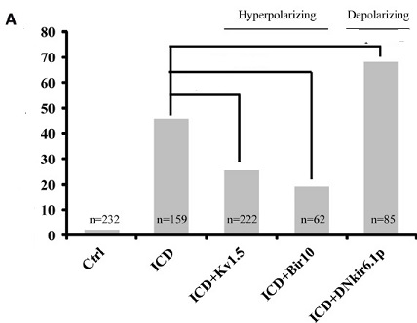
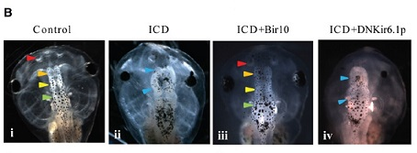
Yes, it’s the voltage
Inject tadpole embryo with Notch ICD (depolarizes V_{mem}) → later brain defects in 46%.
Also inject with Kir6.1 mRNA (which further depolarizes V_{mem}) → defects in 68%
Pair Notch ICD with Kv1.5 or Bir10 mRNA (hyperpolarizers) → defects are rescued!
Arrow color key:
  Blue = malformed brain part
  Red, orange, yellow, green = locations of various correctly-formed brain parts
Other data (omitted) shows that brains occur at a specific V_{mem}
malformed
Brains
%
+dep
+hyp
+hyp
Credit: Endogenous Gradients of Resting Potential Instructively Pattern Embryonic Neural Tissue via Notch Signaling and Regulation of Proliferation, J.Neuroscience 2015
Notes:
One might think that Notch is having brain-damaging effects that have nothing to do with bioelectricity
But then Kv1.5 and Bir10 would be unlikely to cancel out Notch’s effects

Slide 13
Layers
Is this evidence for a layered system?
  the tadpole builds a good brain or good eyes wherever V_{mem} tells it to
This is exactly what we wanted!
  Short-cut some of the complexity
The growing body acts as a layered piece of software
  The upper layer creates a pattern of V_{mem}
  The lower layer sees that pattern, and creates body shapes based on it
  Note that both layers are controlled by DNA, but it’s still a layered system
How convincing is this evidence?
Create V_{mem} pattern
API
current
target
Differentiate cells following V_{mem} pattern
compare
growth directions
Notes:
It’s sort of convincing, but I would personally be a lot happier if I had some idea how the machines worked.
And I really won’t believe that a specific Vmem causes (e.g.,) brains until I at least see sensors with that level of resolution.

Slide 14
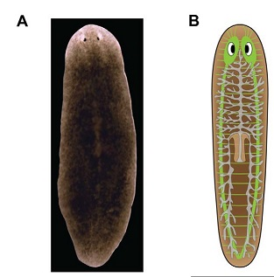
The amazing planaria
World champion of regeneration
  The planaria is a flatworm
  It has a brain and can learn
  It has nerves (in green)
  Typically 3-15mm in length
  And – more or less immortal
Credit: Modeling Planarian Regeneration: A Primer for Reverse-engineering the worm, PLOS Comp Bio 2012

Slide 15
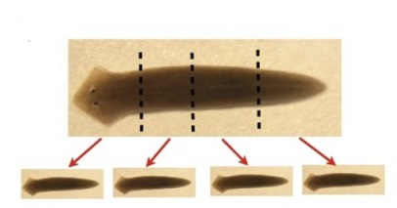
Adult planaria retain a large proportion of stem cells
Cut one into n pieces (n≤279)
  Every piece regenerates into an entire planarian
  The head-tail polarity is retained!
While individual cells die, the planarian can regenerate itself (essentially) forever
  Individual planarian cells die after ≈1 month; worm as a whole seemingly lives forever
Planarians reproduce primarily asexually
  anchor their tails and pull themselves apart into front and back halves
  then regrowing into two “genetically-identical” children
Credit: Planarian regeneration as a model of anatomical homeostasis: recent progress, Semin Cell Dev Biol 2018

Slide 16
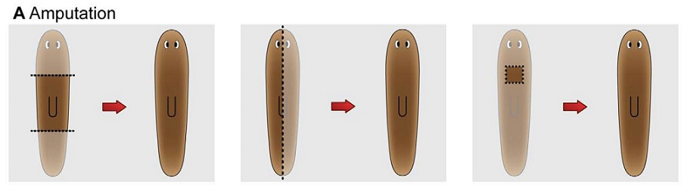
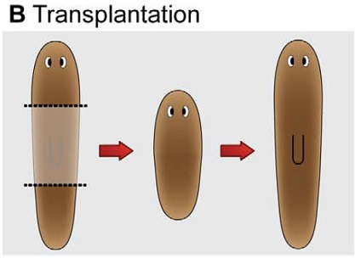
Chop it up most any way at all
  It regenerates, remembering which side its head was on
Take a front 1/3 from one planarian and a rear 1/3 from another planarian and abut them
  Still works fine!
  Most planaria have a mish-mash of different genes
  Planaria retain/accumulate mutations “forever”
  Different cells may have different numbers of chromosomes – and the planarian still functions correctly as an organism!
  Compare that to any computer program you’ve ever written ☺
  Comparisons to human organ rejection?
Credit: Modeling Planarian Regeneration…
Notes:
Humans would not be OK taking an organ from someone else. Perhaps planaria don’t have much of an immune system?

Slide 17
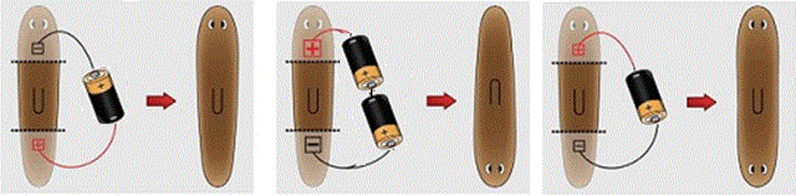
Electricity is involved again
Polarity: head is +, tail is -
What do you think will happen in this experiment?
How about this?
Two-headed worm!
Is this more proof of a layered system?
H
H
+
H
T
V_{mem}
H
T
T
-
Credit: Modeling Planarian Regeneration…
Notes:
Note that the paper cited here had the batteries reversed from this picture – I believe the paper is wrong, and I changed the picture. He cites two very early papers for his belief; I looked at them quickly and I believe the papers support the conventional view that the head is more positive. Actually, a more detailed read of the early papers shows that they indeed were reversed from modern work – but they used a different planarian species.
This could be an interesting lead-in to the difficulties of measurement; DiBAC measurements are not great. They’re not super accurate, and the fluorescent light they produce doesn’t really penetrate the planarian body well. So it might not be as good evidence as it seems.

Slide 18
Building the outer layer
Planarian regeneration: more evidence that a V_{mem} pattern is the API
Next question: how do we build the V_{mem} pattern?
  We used batteries & needles to build V_{mem}, but how might nature do it?
  Rough first cut now; next slide set is an experiment+lab
Create V_{mem} pattern
API
current
target
compare
growth directions

Slide 19
Weirdness alert
What part of your body does most of your thinking?
Brains are very good at pattern recognition
  common sense says the brain is highly involved in pattern creation and checking
  does anyone see a chicken/egg problem here?

Slide 20
Primitive cognition
Neurons & brain play a part in growth, regeneration. But…
  this must work in an embryo without much of a brain yet!
  And in planaria whose head has been cut off!
How could this be?
  Hypothesis – the cells themselves act as a sort of brain
  One that has no actual neurons!
Is this feasible?
  The basic machinery of ion channels, GJs and bioelectricity came earlier in evolution than did neurons
  Single-celled organisms communicated via neurotransmitters
  Neurons “merely” made V_{mem} fast enough for real-time muscle control
Questions:
  is primitive cognition powerful enough to build a V_{mem} pattern?
  to implement the compare/fix machine?

Slide 21
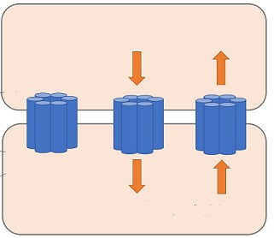
Gap junctions and neurons
Morphogenesis is a marvel of distributed computing
  Clearly that implies cells must talk to each other!
How?
  Via neurons & the brain
  Via gap junctions (GJs), like the heart
GJ: a little tube that connects two nearby cells
  Molecules can travel between the two cells
  Think wires between gates
  If a GJ connects two cells with different V_{mem}, then negative ions move towards the + cell
REVIEW
+10mV
Na⁺
Cl⁻
-20mV
Na⁺
Cl⁻
Notes:
We’ve seen two ways to communicate between cells so far in the course. First, neurons for long distances (and the brain is good at image recognition!). Second, GJs in the heart.

Slide 22
+10mV
Na⁺
Cl⁻
We’ve talked about GJ being a resistor
G_{GJ}
-20mV
Na⁺
Cl⁻
I_{GJ}
ΔV_{mem}
G_{GJ}
G_{GJ} really looks more like this
Can you draw I_{GJ}?
Anything really weird about it?
ΔV_{mem}
Negative resistance!
Notes:
GJs can exhibit negative resistance (really, of course, this is just negative incremental resistance)! You increase the voltage across them and the current decreases!
Tunnel diodes use this for amplification, and amplification is part of most any computing device.

Slide 23
Cell #1, V₁
Lots of feedback between the electrical and chemical networks
  Cell voltage can turn on/off GJs, which pass ions
  Ions can change V_{mem} directly, or by control ion channels, which control voltage; or can activate TFs
  The feedback has gain
Bottom line: we have the material to build a bioelectrical computer
Cell #2, V₂

Slide 24
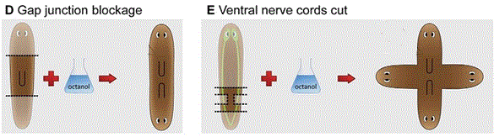
Block GJs → occasionally get a 2H worm
Block GJs and neurons → really weird results
Conclusions about how V_{mem} patterns are formed?
  GJs and neurons both working together somehow
Proof of concept for regenerative medicine
  we are using a high-level API to control what grows
We have a sensible theory
  Time to look at more weird science ☺
Credit: Modeling Planarian Regeneration…
Notes:
Yes, it’s a proof of concept. But we really don’t want to build 4H humans!

Slide 25
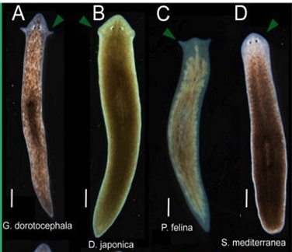
The amazing planaria: head shape
Procedure:
  Start with Girardia dorotocephala, a particular planarian species
  Cut off head and tail; preserve the trunk
  Dunk in octanol (blocks GJs) 3 days
  Regenerate 7 days in water
Results:
  The worm regrows with a new head shape
  The head always resembles some planarian species – never a new shape
  Probabilistic head-shape distribution; frequency mirrors evolutionary distance to the original species
  After several weeks: head reverts back to its original shape in a second repatterning!
Credit: Gap junctional blockade stochastically induces different species-specific head anatomies in genetically wild-type Girardia dorotocephala flatworms, 2018

Slide 26
Theories?
Maybe your DNA “remembers” evolutionarily-earlier versions of shape?
Maybe the machine can get stuck in “local minimum” kind of things?
  Lots of human-engineered machines should go from A→C but get stuck at B
  Like simulated annealing and other optimation algorithms
Notes:
My example is a router

Slide 27
The miracle of Bambi
Male deer shed and regenerate their antlers every year
  Antler shape changes slightly every year until maturity
  Becomes more complex
  After maturity, the shape is fixed
Notes:
From 4H worms… to Bambi!

Slide 28
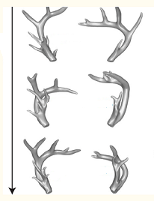
except… injury to left antler, year 6
left
right
Normal mature antler shape (fixed)
year 6 7 8
Injured shape persists two years
Shape change sort of propagates to uninjured right antler!
Not shown: antlers will eventually return to their normal shape
Credit: A linear-encoding model explains the variability of the target morphology in regeneration, Interface, 2014

Slide 29
Where is the deer hiding its memory?
Even though the antlers are completely lost every year, the memory of the new shape persists
Harry Potter and the Chamber of Secrets
  “Ginny!” said Mr. Weasley, flabbergasted. “Haven’t I taught you anything? What have I always told you? Never trust anything that can think for itself if you can’t see where it keeps its brain?”
Where is the memory of the new shape held?
  Clearly somewhere outside of the antlers themselves
  Not in any DNA (no reason to suspect DNA mutation)
Do we really believe that a pixel-by-pixel image of the antlers is stored somewhere in the deer’s body?
  Somebody should tell Mr. Weasley about primitive cognition ☺

Slide 30
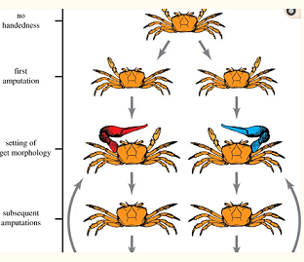
More weird stories: crabs
A normal fiddler crab has no inherent asymmetry
Cut off either one of its front “crusher” legs during growth (accidents happen in nature)
It keeps growing until normal sized – but its partner gets huge!
Now cut off both front crushers. What happens?
a
The first amputation is remembered!
Credit: A linear-encoding model explains the variability of the target morphology in regeneration, Interface, 2014

Slide 31
More amazing planaria feats
Not all memory is stored in the brain
Experiment, part 1
  Feed planaria on a textured surface
  Remove for two weeks
  They now feed on a textured surface quicker than untrained planaria
  Conclusion: “long-term” memory is possible. Long enough to regrow!
Experiment, part 2
  cut off their heads, regrow (14 days)
  Will they still retain their training?
No?
  Memories are stored in your brain
  If you regrow a new one, they’re gone
Yes?
  Morphogenesis clearly create neurons.
  Human newborns can cry, suckle, etc.
Credit: An automated training paradigm reveals long-term memory in planarians and its persistence through head regeneration, 2013
Notes:
More data:
the worms did not try to feed *at all* until their brains regrew; so this isn’t just, e.g., a spinal-cord reflex
previous work in the area was discredited due to experimenter bias; this data was automated via image analysis of camera data. The hypothesis is that memories are distributed, and guide the regrowth of new neurons. It’s like a “chipkill” memory system, that has enough redundancy to survive the loss of its brain!

Slide 32
Theories?
How is the target state stored?
  Partly in V_{mem} patterns – rewritable, redundant/nonlocal
  DNA tends to snap it to one of a small number of “reasonable” goals stored in DNA
Redundant storage is used in all computers (ECC, chipkill)
Notes:
Rewritable – or else Bambi would make no sense at all
Redundant & nonlocal – to explain how losing the antler didn’t totally remove its shape memory
Snapping – because the original antler shape reverted

Slide 33
Layered systems are awesome
Engineers build layered HW/SW systems frequently
  They’re often quite complex!
  But way simpler than one big system
We can manipulate shape without understanding the lower layer
  We just need the API – which we’re saying is the V_{mem} pattern
  V_{mem} is an instructive signal; it tells the lower layer what to do
  The lower layer doesn’t care how we make a V_{mem} pattern
Abstraction is a powerful tool
Create V_{mem} pattern
API
current
target
compare
growth directions

Slide 34
Background material
https://vimeo.com/184365295
  Very nice overview and introduction, from talk at the Wyss institute 2016
https://allencenter.tufts.edu/
  More background and context
https://allencenter.tufts.edu/our-research/publications/
  Full bibliography, and lots more reading

Slide 35
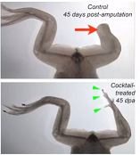
More progress
They induced leg regrowth in an adult frog by imposing an embryonic V_{mem} pattern and then letting it sit for 7 weeks.
Original work: they found a drug cocktail that affected V_{mem} and induced regrowth of an amputated tail
Then the same cocktail also worked for leg regrowth
The cocktail is really a “rebuild whatever usually goes here” recipe
Credit: Cracking the bioelectric code: probing endogenous ionic controls of pattern formulation, 2013
Notes:
The message of this slide is that we’re making progress! Obviously it’s a long way from frog legs to people.
Their original work was to find a drug cocktail that induced regrowth of a tail. They then tried to exact same cocktail on a rear leg, and it worked fine. Note that the regrowth was not complete. The message is that inducing a V_{mem} really is a “build whatever normally goes here” signal.

Slide 36
Where do we go from here?
Next up: dig into a planarian V_{mem} hypothesis
  Understand & program a way it might build a V_{mem} pattern to distinguish head from tail

Slide 37
Debate
Take some time to think about:
  What animal facts does our model explain?
  What doesn’t it explain?

Slide 38
BACKUP

Slide 39
More amazing planaria feats
Why is this experiment interesting?
  Currently neurons in the human CNS do not regrow. But what if, e.g., stem-cell treatments can regrow neurons for humans with neurological disease? What connections will they have?
  More evidence that bioelectrical patterns are stored throughout the body and can have wide-ranging effects on regrowth
  Does this help to explain the moose & crab data?
Credit: An automated training paradigm reveals long-term memory in planarians and its persistence through head regeneration, 2013

Slide 40
Layers
The growing body acts as a layered piece of software.
  The upper layer creates a pattern of V_{mem}.
  The lower layer sees that pattern, and creates body shapes based on it.
  Note that both layers are controlled by DNA, but it’s still a layered system.
“Neural” networks are part of one or both layers
  In the upper layer, could decide what to build
  In the lower layer, could implement “current state vs. desired state → what to do next”
  Lower layer also outputs “All done” signal
Create V_{mem} pattern
API
current
target
Differentiate cells following V_{mem} pattern
compare
growth directions
Notes:
The “all done” signal tells the body we no longer need all of the extra mechanism involved in body growth. In humans, for many functions, the “all done” signal implements changes that we don’t really know how to undo. But induced pluripotent stem cells suggest it’s still possible.

Slide 41
Layers
Answer to “how do we build the V_{mem} pattern?”
Can we drill down into these two black boxes?
  How might these machines be built?
  What computations could they be implementing?
Hint – we haven’t talked about neural networks yet
Create V_{mem} pattern
Create V_{mem} pattern with GJs
API
current
target
compare
growth directions

Slide 42
What does this explain?
The repeated observation (tadpoles, planaria) that we can control shape by controlling V_{mem}
Reimplementation of the same shape repeatedly (deer, crab, Emmons-Bell)
  The top level is picking the shape (and remember last year’s shape, even if it’s “wrong”). The lower level is implementing that shape, over and over.
Some specific V_{mem} patterns (planarian head-tail reversal)

Slide 43
What does this not explain?
Where the shape is stored in the deer & crab
Why it regenerates after a few years.
Most of the implementation details ☺
  and speaking of which…

Slide 44
Hypothesis #1, again
What if:
  There is an explicit set of growth rules stored in the DNA
  The injuries during growth change the growth rules, leading to a new end result
  When we regrow again, the changed rules then merely produce the same result over and over again
Is that reasonable?
  Physical injuries do not really mutate DNA; they just mechanically break (e.g.,) bones
  It is not reasonable to believe that, in future years, a little machine inside the organism somehow breaks their crushers again, at just the right time, the newly-correct shape
So let’s look at another piece of data

Slide 45
Why are good theories hard to find?
Why is it hard to come up with good theories?
  you can’t hit what you can’t see
  it’s hard to explain what you can’t dissect
Classic technique in biology:
  kill a specimen
  examine it under a microscope
  Doesn’t work for bioelectricity
Consider a bioelectric memory cell
  Can store either a 0 or a 1
  The basic parts of the cell are identical either way
  The only difference is the electricity, which you don’t see under a microscope
Measurement techniques are improving
  but need much more improvement still
  killing a cell destroys its bioelectrical state
Notes:
You could argue that many/most advances in our knowledge of biology come from new techniques in measurement/observation!

Slide 46
Divide and conquer
GJs allow cells to communicate when needed
  to decide where your eyes are and where your nose is
Once that’s done, we can turn off some GJs
  thus create smaller, independent subnetworks
  now decide where your retina is vs. your iris
  and septum vs. nose hair
I.e., solve a huge problem by divide and conquer.

Slide 47
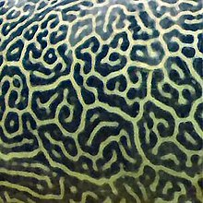
Cell #1, V₁
There are feedbacks between the electrical and chemical networks
  Cell voltage can turn on/off GJs, which pass ions
  Ions can control ion channels, which control voltage; or can activate TFs
The feedback system can create patterns of ions and V
  very like reaction-diffusion
  called gating-electrodiffusion
See The Chemical Basis of Morphogenesis, Alan Turing 1952
  Or Wikipedia
Cell #2, V₂

Slide 48
Hypothesis #3
Morphogenesis is a multi-step process
Step 1: DNA specifies a target shape that is then (at least in deer) stored elsewhere
Step 2: regeneration aims for the stored shape
  but what is that format?
  Suggestion: a pattern of V_{mem}
Step 4: occasionally the stored shape gets refreshed from DNA in deer
For the technically minded, step #3 is called an inverse problem
  inverse problems are hard
  unless the function is simple (i.e., easy to invert)

Slide 49
A hypothesis
The planaria is a remarkable animal
It is well studied
  We have a lots of data
  But we don’t have any proven theory for how it works!
Are we ready to put together some ideas?
hopes?
hypotheses?

Slide 50
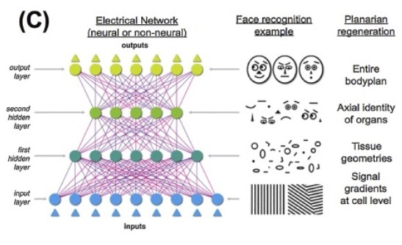
Image processing
BACKUP
Deep artificial neural networks (ANN) usually process images in layers
  Each layer works at a slightly higher level
Credit: The bioelectric code… (Justin Guay)

Slide 51
ANN inside animals?
BACKUP
Hypothesis: ANNs can simplify & abstract the shape images
Any evidence for this?
Not really ☺. But…
  less data for the deer for keep?
  comparison is easier at a high level?
And one more piece of data…
Create V_{mem} pattern with GJs
API
current
target
compare
ANN
ANN
growth directions

Slide 52
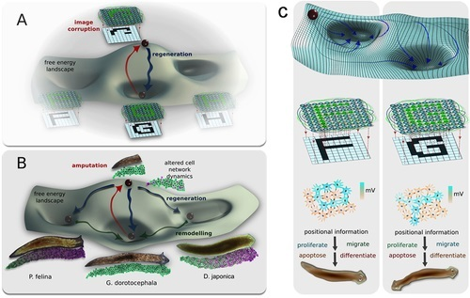
BACKUP
A simple character-recognition neural network also picks the most likely character for any input image
Many stabilization processes are modeled as a free-energy landscape
Credit: The bioelectric code: an ancient computational medium for dynamic control of growth and form, 2018

Slide 53
Theories?
BACKUP
For an organism that can regrow itself from chopped-up pieces, choosing a target is almost mandatory
  Seems like one worm is storing multiple targets?!
Hopfield networks
  Neural-network variant with similar capabilities
  Stores several stable states; finds the nearest one to a given input
  Perhaps the Hopfield network gives us the target that a linear mechanism implements?
  Perhaps some weights are stored as GJ conductivity, and the octanol thus changes them
  But why would a planaria store multiple states?
Did their “G. dorotocephala” have cells from other worms? Would that matter?
Reversion to initial shape is similar to deer

