Slide 1
EE 123
Bioelectricity
Tufts University
Instructor: Joel Grodstein
joel.grodstein@tufts.edu
Lecture 4c: worms

Slide 2
Big picture of the course
Where does bioelectricity come from?
Neurons and working with the nervous system
Cardiac bioelectricity
Worms
Bio backgrounder
Morphogenesis
Building a worm V_{mem} pattern

Slide 3
Review
Remember the morphogenesis problem?
  37 trillion cells, same software but some are eyes, ears, toes, …
  Our hypothesis: a V_{mem} pattern is the API that decides which cells become what
  A machine compares current shape vs. the goal & decides what to do

Slide 4

Using the V_{mem} pattern
0
.2
Per-cell software:
    if (0≤V_{mem} ≤ .2):
      I_am_head=True
    if (.4≤V_{mem} ≤ .6):
      I_am_chest=True
Human embryo, 9-10 weeks
.5
.7
1
Some cells set I_am_head=True (whatever that means)
  That triggers their DNA if-then code to build head proteins
Objection: something needs to deal with 3D
  Could do per-region subdivision
Next up – how can we build this V_{mem} pattern?
Notes:
This slide sets the context for the rest of the unit.
The rest of the unit discusses how to build a Vmem pattern. This slide shows *why* we build it; i.e., what the pattern might mean & how the growing body might use the pattern.

Slide 5
Contents for this unit
Patterning a 5-cell worm – our first try
Morphagens + lots of feedback – our second try
GJ connectivity range – archipelagos, 2 heads and collapse
Wrapup

Slide 6

ΔV_{mem} + GJs
-65mV
Na⁺
+25mV
IC
IC
Start with 5 cells
  Two end cells have ion channels; set them to -65mV, +25mV
Connect them with GJs
  If we model GJs as resistors, what voltage pattern results?
  Is that a valid model? What happens with drift and diffusion?
  Will drift and diffusion balance in each GJ? If so, there’s no net current – so how (by Ohm’s Law) can there be voltage drops?
Notes:
No, planaria don’t really have mermaid tails or smiley heads ☺

Slide 7
ΔV_{mem} + GJs
-40mV -20mV 0mV
-65mV
+25mV
IC
IC
Model GJs as resistors
  Simple electrical intuition: we get a voltage divider
Is that the correct model?
  No: resistors model drift current, but there’s definitely diffusion too
  Conclusion that intermediate nodes = intermediate V_{mem} is still valid
If GJ drift = -diffusion → no net GJ current
  but drift current > 0 implies ΔV>0
  Ohm’s Law is only for drift current!
Notes:
The final answer, of course, is that we get nice intermediate voltages (as the picture shows). The picture is somewhat wrong, though; usually they’re more logarithmic interpolation rather than linear.
Resistors are not a great model here, since they only model drift and not diffusion. But we use them anyway for simplicity ☺.
If drift and diffusion balance in each GJ, then there’s no net current in that GJ – but there can (and indeed must be) a voltage drop for that to happen. The diffusion is insensitive to deltaV, but if there’s any drift then it can only be because of a deltaV. So drift and diffusion balancing means that there’s drift, which implies deltaV. Ohm’s Law applies only to the drift current, not the diffusion current.

Slide 8
ΔV_{mem} + GJs
-40mV -20mV 0mV
-65mV
Cl⁻
K⁺
Na⁺
-60mV
+25mV
+20mV
IC
IC
Connect them with GJs
  What happens?
  Current flows
  With most positive ions on the left, diffusion nudges them back
The ends dip a bit

Slide 9



Why do the ends dip?
ICF
V_{mem}=-71mV
I_{Na}
I_{K}
Remember our cell model
.4
2.2
.4
60 40
$$V_{Na}^{N}$$
$$V_{K}^{N}$$
$$V_{Cl}^{N}$$
ECF
77mV
-89mV
-71mV
ICF
V_{mem}=-71mV
Thevenin equivalent circuit
  Any collection of batteries, resistors, current sources → V + R
G_{eq}=G_{Na} ║ G_{K}║G_{Cl}
-71mV (V_{mem})
ECF
Notes:
Why is Vthev=-71mV? Because when Vmem = -71mV, we already said there’s no *net* current across the membrane. This is true in both QSS and SS.
What do we give up with this simple model? Since our Thevenin equivalent no longer distinguishes between ions, it can no longer say if each individual ion is balanced – and thus cannot say if we are in SS vs. QSS. But it’s simple!

Slide 10
Why do the ends dip?
-65mV
-60mV
+25mV
+20mV
IC
IC
-60mV
+20mV
G_{eq}
G_{eq}
-65mV
+25mV
ECF
Basic circuit theory predicts V_{mem} dip at the ends
  Same theory will make other predictions later

Slide 11
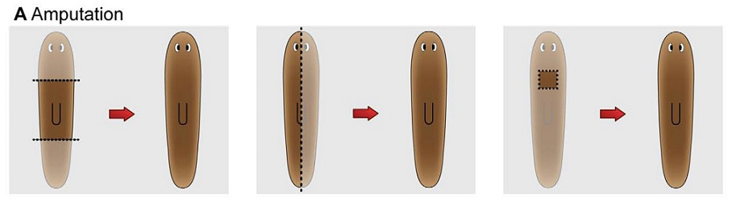
Head or tail?
-65mV
+25mV
+25mV
-65mV
+25mV
IC
IC
Good so far; we have a V_{mem} pattern
  How do the ends know which is which?
  Why don’t they both pick a negative (i.e., tail) V_{mem}?
  Or why not both heads?
  Why don’t the end cells set front and back to random V_{mem}?
Notes:
We showed how a Vmem at both ends can make intermediate voltages in the middle. But now we’re asking how the end cells know what Vmem to set themselves to.
And how do they know to only set themselves to +25mV or -65mV, not random other values (which would result in lots of body parts at odd locations).
The graphic on the bottom says that a first reasonable guess might be that a cutting would have its end cells set to whatever they *used* to be, not to the standard head & tail voltages.

Slide 12
Head or tail?
-20mV
+15mV
-10mV
+5mV
-65mV
+20mV
IC
IC
Next idea: add positive feedback
Still not obvious why head & tail never swap
But cannot have two heads or two tails, at least ☺
if (V_{mem,me} > V_{mem,middle})
  increase my V_{mem}
else decrease
Notes:
1. Note that we’re only adding feedback at the two end cells – the middle cells are still IC-free and do nothing other than interpolate via drift/diffusion.
2. There’s some magic here – how do faraway cells know what the middle-of-worm Vmem is? We’ll sweep that under the rug for now ☺.
3. A cool thing: with each cell’s software *independent* of each other, there are only two final outcomes! Can they suggest why, intuitively, that happens? Latches in EE have the only-two-choices property, though they don’t have our extra bonus of working across many cells.

Slide 13
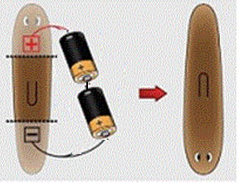
Explains batteries?
+10mV
-30mV
-60mV
+20mV
+20mV
-60mV
IC
IC
if (V_{mem,me} > V_{mem,middle})
  increase my V_{mem}
else decrease
Connect batteries → reverse voltage
  Quickly regenerate the full ΔV_{mem}
  Head and tail reverse!
Notes:
Yes – our positive-feedback idea does explain the head-tail reversal via two batteries ☺
Say the batteries change the end V_{mem}values from the usual -60/20mV to, say, 10/-30mV. Then positive feedback will expand this to 20/-60mV, which will presumably lead to a full body reversal.

Slide 14

Regeneration?
-40mV -20mV -10mV
-20mV -20mV -20mV
-60mV
+20mV
IC
IC
if (V_{mem,me} > V_{mem,middle})
  increase my V_{mem}
else decrease
Cut off the head and tail; keep the middle
Will the worm regenerate?
  No ion channels in the remaining worm!
  Positive feedback is gone
  Charge all diffuses equally
Notes:
The problem is that we still have ion channels only in the two endmost cells. So if we cut off those cells, then the remaining middle-body segment has no ICs and no positive-feedback mechanism. Then V_{mem} just collapses.

Slide 15
Mini-quiz
Sum up how we built up our V_{mem} pattern in a few sentences
What are its problem(s)?

Slide 16
Contents for this unit
Patterning a 5-cell worm – our first try
Morphagens + lots of feedback – our second try
GJ connectivity range – from collapse to multiple heads
Wrapup

Slide 17
What are we missing?
-40mV -20mV -10mV
-60mV
+20mV
IC
IC
if (V_{mem,me} > V_{mem,middle}):
  increase my V_{mem}
else decrease
End cells cannot be special (e.g., the only cells with ion channels)
End cells can’t easily determine “V_{mem,middle}”
Notes:
We said from the beginning that having the two end cells somehow knowing the value of V_{mem} in the middle was a bit magical, and it’s still a problem.
And as we saw a few slides ago, if the end cells are the only ones with ICs, then a middle segment just cannot regrow.

Slide 18
Morphagens
-60mV
+20mV
Equal [M] everywhere
drift
steady state
Start with a tube full of negative ions M
Diffusion: it all spreads out evenly
Add a voltage differential (-60 to +20 mV)
  Drift: M all moves to the right
  Diffusion: M goes back to the left
  Eventually: steady state where diffusion and drift balance
the mystery ion
Notes:
“M” is because it’s a mystery ion – we haven’t actually found it

Slide 19
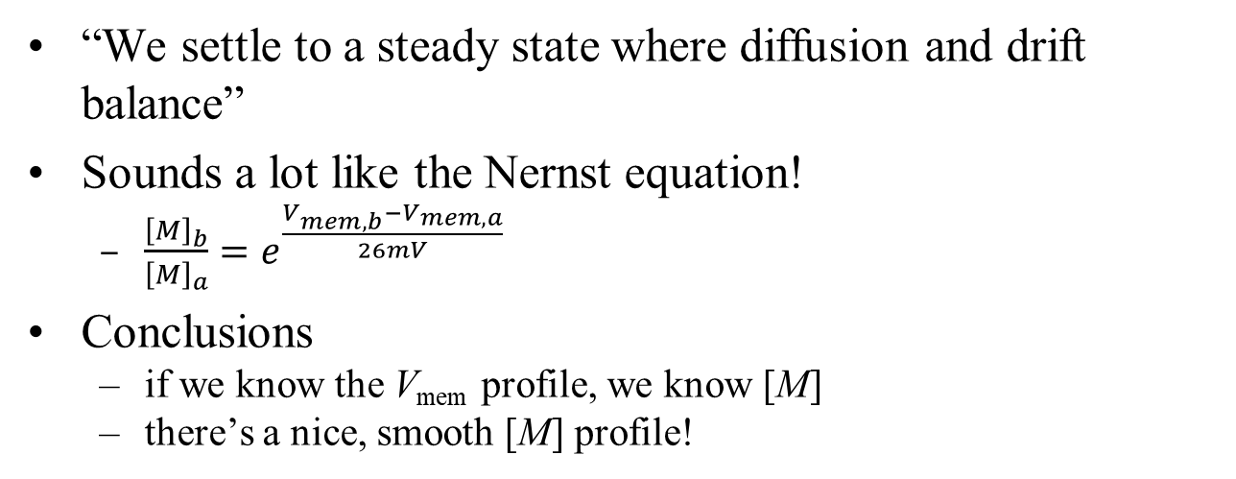


Nernst again
-60mV -40mV -20mV 0mV +20mV
[M]₀
$$\left[M\right]={\left[M\right]}_{0}e^{\frac{40mV}{26mV}}$$
$$\left[M\right]={\left[M\right]}_{0}e^{\frac{80mV}{26mV}}$$
“We settle to a steady state where diffusion and drift balance”
Sounds a lot like the Nernst equation!
  $\frac{{\left[M\right]}_{b}}{{\left[M\right]}_{a}}=e^{\frac{V_{mem,b}−V_{mem,a}}{26mV}}$
Conclusions
  if we know the V_{mem} profile, we know [M]
  there’s a nice, smooth [M] profile!

Slide 20
So what?
-60mV -40mV -20mV 0mV +20mV
[M]₀
$$\left[M\right]={\left[M\right]}_{0}e^{\frac{80mV}{26mV}}$$
Old problem: cannot know V_{mem,middle}
  There’s a fixed total amount of M, and it redistributes itself according to the global V_{mem} profile
  Your own local [M] reflects the V_{mem} profile
  And so we can use it for our positive feedback
Notes:
The key here is that there’s a fixed amount of M in the tube. So having more M in one place means less everywhere else.
In other words, knowing our own local [M] really does tell us whether we’re above or below average!
If anyone asks, this is simple math. If every cell generates M at, say, 1 mole/(m³s) and if M decays at a rate of .1/s (or equivalently .1 mole/sec per mole), then steady state will have an average concentration of gen/decay = 10 moles/m³. So anyone above(below) that is on the right(left) side of the worm.

Slide 21
Morphagen feedback
V_{mem,me} = f([M]_{me})
-25mV
+20mV
-40mV
-60mV
+10mV
-20mV
IC
IC
V_{mem}
[M]
[M]
Higher [M] → higher V_{mem}
Higher V_{mem} → attracts more M
Positive feedback!
No need to sense V_{mem,middle}
Notes:
The two red dots in the upper-right graph represent the [M] at the left and right ends of the worm respectively. They start out very close, and explode away to the maximum rails via positive feedback.

Slide 22
Remaining problem
-40mV -20mV 0mV
-60mV
+20mV
IC
IC
V_{mem}
V_{mem,me} = f([M]_{me})
[M]
Middle segment has no ion channels or feedback → cannot regrow

Slide 23
Remaining problems
-40mV -20mV 0mV
-60mV
+20mV
IC
IC
IC
IC
IC
V_{mem,me} = f([M]_{me})
Put this in every cell
Middle segment has no ion channels or feedback → cannot regrow
What happens?

Slide 24
All works fine?
-40mV -20mV 0mV
-60mV
+20mV
IC
IC
IC
IC
IC
+20mV
V_{mem}, [M]
V_{mem}
-60mV
[M]
Both V_{mem} and [M] gradually increase from tail to head
  Intermediate ion channels → Nernst profile no longer applies
  Global V_{mem} pattern determines [M] profile
Each cell is mostly locally consistent with V_{mem,me} = f([M]_{me})
  Not fully; f() actually sets G_{Na}, G_{K} and not V_{mem}
Notes:
Adding ICs everywhere makes our system no longer just do simple interpolation as a voltage divider. It’s now a complex system with no simple mathematical explanation. But simulation shows that it usually still works ☺

Slide 25
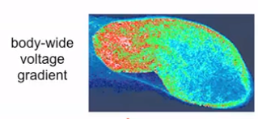
All works fine?
-40mV -20mV 0mV
-60mV
+20mV
IC
IC
IC
IC
IC
+20mV
V_{mem}, [M]
-60mV
Do you believe this evidence?
How much does it suggest that
  there is a voltage gradient
  it’s caused by a positive-feedback system?
From https://vimeo.com/184365295 , time 27:00
Notes:
The talk doesn’t say which colors are which; I’m guessing that orange is depolarized, dark blue is hyperpolarized and green is intermediate.

Slide 26
Mini-quiz
In a few sentences, what problem did our morphagen solve & how?
Ditto for adding multiple feedback points

Slide 27
Contents for this unit
Patterning a 5-cell worm – our first try
Morphagens + lots of feedback – our second try
GJ connectivity range – from collapse to multiple heads
Wrapup

Slide 28
Two heads?
-20mV -40mV -20mV
+20mV
+20mV
IC
IC
IC
IC
IC
+20mV
V_{mem}, [M]
-60mV
No more guarantee of Nernst profile. Each cell is mostly locally consistent with V_{mem,me} = f([M]_{me})!
Unfortunate by-product of local repeaters ☹
Does this explain a two-headed worm?
Why doesn’t this happen frequently?
Notes:
Why doesn’t it happen more frequently? Our positive-feedback system will tend to amplify an existing gradient rather than create a 2H profile. But it certainly can.

Slide 29
Bizarro shapes?
-60mV +20mV -60mV
+20mV
+20mV
IC
IC
IC
IC
IC
+20mV
V_{mem}, [M]
-60mV
Can this happen?
  Seems plausible, but not present in nature
  Any idea why not?
Notes:
The answer to “why not” is mostly on the next slides ☺

Slide 30
Our basic model
-65mV +25mV -65mV
+25mV
+25mV
+20mV
R_{GJ} R_{GJ} R_{GJ} R_{GJ}
+25mV -65 +25 - 65 +25mV
ECF
No longer just a simple voltage divider! How does the size of R_{GJ} affect
  the size of the gradient?
  whether the cells can “do their own thing?”
  what happens in the limits of R_{GJ}=0 and R_{GJ}≈∞?
Notes:
“Do their own thing” has cancer overtones (i.e., whether a cell can ignore signals from other cells and replicate uncontrollably.
But working as a team is a basic requirement for building a body.

Slide 31
Mini-quiz
In a few sentences, what happens as we interconnect worm cells with more and more gap junctions?

Slide 32
Contents for this unit
Patterning a 5-cell worm – our first try
Morphagens + lots of feedback – our second try
GJ connectivity range – from collapse to multiple heads
Wrapup

Slide 33
What comes next?
Build and analyze a simple worm (virtual-lab #4)
We will see correct formation, 2H and failure for various GJ densities

Slide 34
Why did we care, again?
Let’s remind ourselves what connection this has with our initial mysteries.
Hypothesis: morphogenesis is a layered system
  A higher layer builds a V_{mem} pattern
  A lower layer implements cell development accordingly
What we’ve just finished
Compares current body shape to desired body shape
Outputs instructions on what to do next
Notes:
And just in case people don’t believe the Vmem theory, the idea that one layer builds a morphogen pattern and another layer uses it is quite well accepted in developmental biology.

Slide 35
Summary
We’re about done with worms!
What have we learned?
  Hopefully some interesting weird nature
  Some long-range insight into regenerative medicine
  If we set V_{mem} correctly, can we turn stem cell → kidney?

Slide 36
Backup

Slide 37
Islands
-65mV +25mV -65mV
+25mV
+25mV
+25mV -65 +25 - 65 +25mV
+20mV
R_{GJ} R_{GJ} R_{GJ} R_{GJ}
+25mV -65 +25 - 65 +25mV
ECF
What happens when R_{GJ}≈∞?
  All cells are isolated from each other
  Archipelago is quite possible

Slide 38
Short circuits
-20mV -20 -20 -20 -20mV
R_{GJ} R_{GJ} R_{GJ} R_{GJ}
+25mV -65 +25 - 65 +25mV
ECF
What happens when R_{GJ}→0?
  Cells are short circuited
  Worm cannot create a head or tail
  There is an intermediate R_{GJ} where 2H is possible, but not archipelago

Slide 39
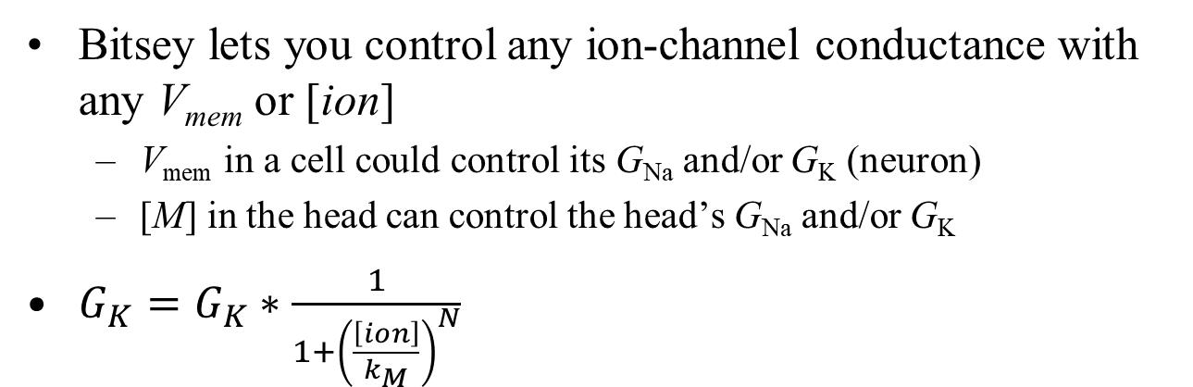
The Bitsey gating system
Bitsey lets you control any ion-channel conductance with any V_{mem} or [ion]
  V_{mem} in a cell could control its G_{Na} and/or G_{K} (neuron)
  [M] in the head can control the head’s G_{Na} and/or G_{K}
$G_{K}=G_{K}∗\frac{1}{1+{\left(\frac{\left[ion\right]}{k_{M}}\right)}^{N}}$
Known as an inverting Hill equation
[ion]=k_{M} ⇒ scale=½

Slide 40
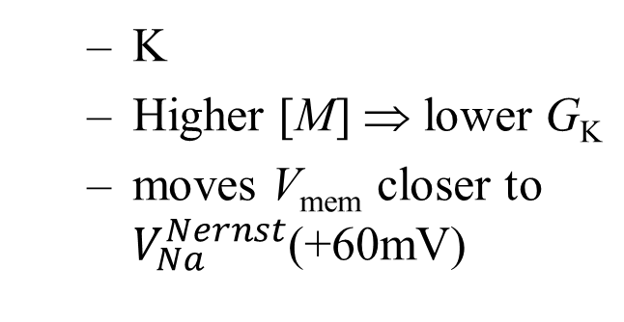
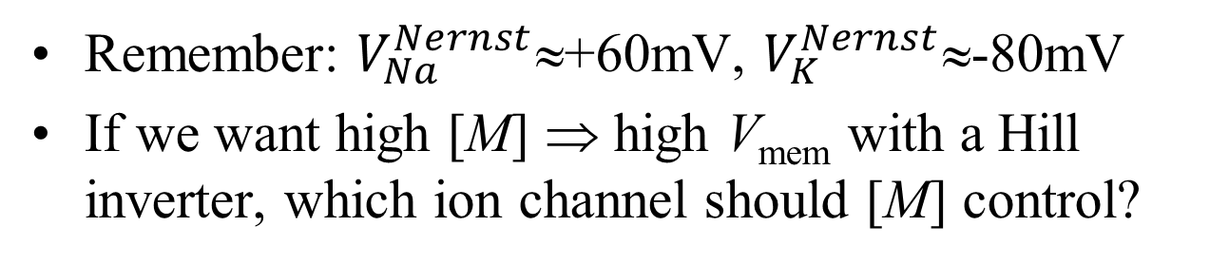
The Bitsey gating system
Remember: $V_{Na}^{Nernst}$≈+60mV, $V_{K}^{Nernst}$≈-80mV
If we want high [M] ⇒ high V_{mem} with a Hill inverter, which ion channel should [M] control?
  K
  Higher [M] ⇒ lower G_{K}
  moves V_{mem} closer to $V_{Na}^{Nernst}$(+60mV)

Slide 41
if (I’m at an end of the worm)
  if my [M] is bigger than average:
    raise my V_{mem}
  else:
    lower my V_{mem}
if (I’m at an end of the worm)
  G_{K} = Hill inverter ([M])
0V
M
M
M
1V
M
M
M
M
M
M
M
T K B S H
High V_{mem} ⇒ high [M] ⇒ low G_{K} ⇒ higher V_{mem}
Low V_{mem} ⇒ low [M] ⇒ high G_{K} ⇒ lower V_{mem}

Slide 42
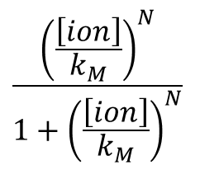
Hill buffer
BACKUP
Bitsey also provides a Hill buffer
Any idea what we might use it for?
  Control G_{Na}
  But why bother controlling both of them?
$$\frac{{\left(\frac{\left[ion\right]}{k_{M}}\right)}^{N}}{1+{\left(\frac{\left[ion\right]}{k_{M}}\right)}^{N}}$$
[ion]=k_{M} ⇒ scale=½

Slide 43
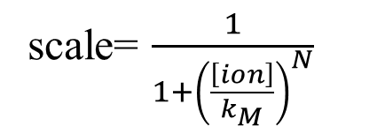
What about N>1?
As N gets larger, is k_{M} still the scale=½ point?
  [ion]=k_{M} ⇒ scale=½ still
  higher gain near [ion]=k_{M}
But why is gain useful?
scale= $\frac{1}{1+{\left(\frac{\left[ion\right]}{k_{M}}\right)}^{N}}$

Slide 44
if (I’m at an end of the worm)
  G_{K} = Hill inverter ([M])
.6V
.2V
.8V
.5V
M
M
M
M
M
M
M
M
M
M
S S S S S
K B S S H
Consider the following sequence
  Head-to-tail voltage difference increases by ΔV₀
  Nernst equation: the ratio [M]_{head}/ [M]_{tail} increases by some ΔM₁
  Ion-channel gating: resulting head-to-tail voltage difference ΔV₂
If ΔV₂ > ΔV₁ then we have positive feedback, and the disturbance grows

Slide 45
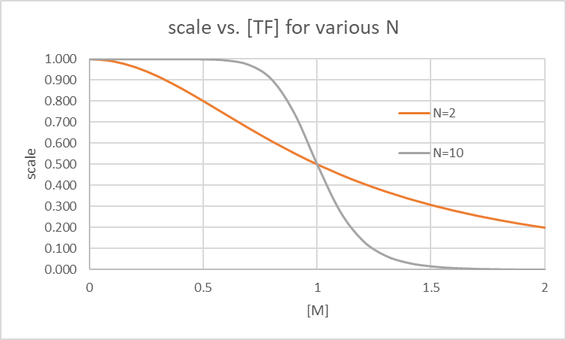
scale=.8
G_{K}=.8*1.7e-17
≈ 1.4e-17
scale=.2
G_{K}=.34e-17
.8
.9
1
1.1
1.2
Initial [M]
Look at the N=10 case
We build a substantial head-to-tail ΔV quite quickly

Slide 46
scale=.8
G_{K}=.8*1.7e-17
≈ 1.4e-17
scale=.6
G_{K}≈ 1e-17
scale=.45
G_{K}≈.8e-17
scale=.2
G_{K}=.34e-17
.8
.9
1
1.1
1.2
Initial [M]
But what if N=2?
We do not build ΔV as well
  Less gain to amplify a small Δ[M]

Slide 47
0
.5
1
1.5
2
Assume this is the final [M] for a full-grown worm
[M]_{average} = 1
Now try to regrow a slice from the belly
knees

Slide 48
.2
.3
.4
.5
.6
Initial [M]
Ouch!
Now almost nothing happens
Any ideas on how to make a knee regrow well?
Look at the N=10 case

Slide 49
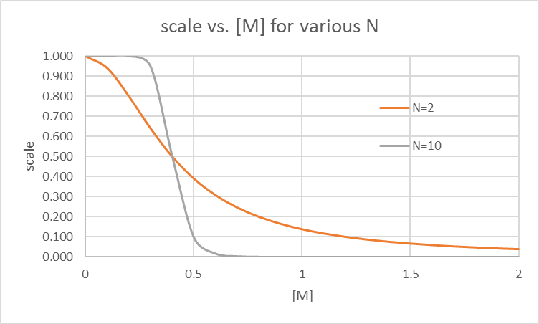
.2
.3
.4
.5
.6
Initial [M]
Set k_{M}=.4
Sure, but…
  now the belly and head slices won’t work ☹
Conclusion: try to make N=2 work (or even N=1)
  those have some gain everywhere
Look at the N=10 case

Slide 50
scale=.8
G_{K}=.8*1.7e-17
≈ 1.4e-17
scale=.2
G_{K}=.34e-17
.8
.9
1
1.1
1.2
Initial [M]
Next look at GJ_scale

Slide 51
scale=.8
G_{K}=.8*1.7e-17
≈ 1.4e-17
scale=.2
G_{K}=.34e-17
.8
.9
1
1.1
1.2
Initial [M]
GJ_scale gets bigger:
  GJ resistances get lower
  head and tail short out
  V_{mem,head} and V_{mem,tail} both collapse to middle
ICF
ICF
G_{tail}
G_{head}
ECF
V_{cell}
ECF
V_{cell}

Slide 52
scale=.8
G_{K}=.8*1.7e-17
≈ 1.4e-17
scale=.2
G_{K}=.34e-17
.8
.9
1
1.1
1.2
Initial [M]
G_{GJ0}
G_{GJ1}
G_{GJ2}
G_{cell0}
G_{cell1}
G_{cell2}
G_{cell3}
V_{cell0}
V_{cell1}
V_{cell2}
V_{cell3}
ECF

Slide 53
Where does M come from?
0
.5
1
1.5
2
Take a small tail slice
2 cells regrow to 5
  total [M] stays constant
[M] will keep shrinking as the worm divides and regrows ☹
Actually M is constantly being produced and decaying
0
.05
.1
.15
.2

Slide 54
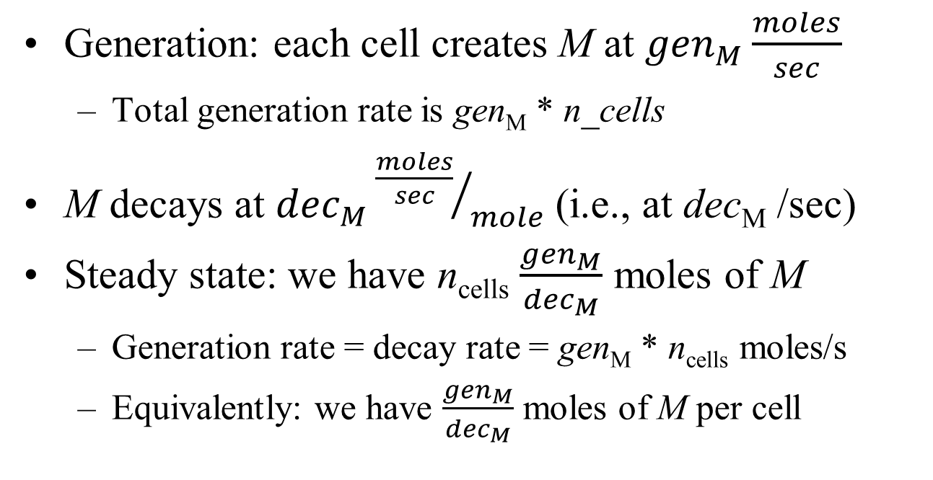
Generation and decay
Generation: each cell creates M at ${gen}_{M}\frac{moles}{sec}$
  Total generation rate is gen_{M} * n_cells
M decays at ${dec}_{M}{\frac{moles}{sec}}/{mole}$ (i.e., at dec_{M} /sec)
Steady state: we have n_{cells} $\frac{{gen}_{M}}{{dec}_{M}}$ moles of M
  Generation rate = decay rate = gen_{M} * n_{cells} moles/s
  Equivalently: we have $\frac{{gen}_{M}}{{dec}_{M}}$ moles of M per cell

Slide 55
What to vary
Our inverter parameters: k_{M} and N
GJ_scale, number of cells
G_{K}, G_{Na}, G_{Cl}
GJ_diff and valence for M

