Slide 1
EE 123 Bioelectricity
Instructor: Joel Grodstein
joel.grodstein@tufts.edu
Circuit analysis backgrounder

Slide 2
What we’ll cover
Voltage, current and resistance
Voltage source (battery), current source, resistor
Ohm’s Law: I = V/R
Kirchoff’s voltage law (KVL), Kirchoff’s current law (KCL)
Series-parallel circuits
RC time constants?

Slide 3
Voltage, current and resistance
Voltage (V), current (I) and resistance (R) are the basic quantities of circuit analysis
I measures how fast electrical charge is moving through a wire (measured in Coulombs/sec)
  Think fluid flow rate through a pipe
V measures the pressure pushing the charge through the wire
  Think water pressure
R measures how hard a wire is to get water through
  High R = skinny pipe
  Conductance is defined as 1 / R
Notes:
Explain the fluid-flow analogy too. Some people use fluid flow as an analogy to help them understand circuits. But I use it as a way to understand fluid flow!

Slide 4
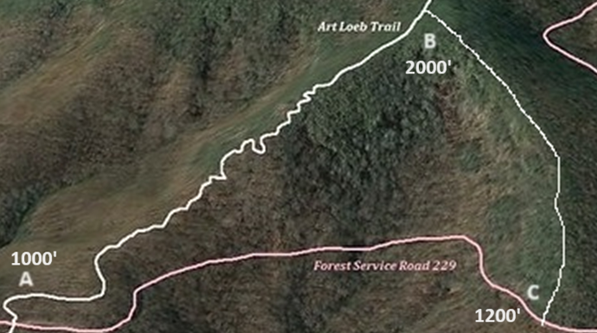
Kirchoff’s Voltage Law
The sum of voltages around a closed loop is zero
  Because, by definition, voltage is a potential difference
Notes:
The “by definition” comes from physics.
The “voltage” between two points on the map is a height difference, so the voltage between two points on a ridge is zero. And this explains why the sum of voltages around a closed loop must be zero – you’re back where you started, and what goes up must go down ☺.

Slide 5
Kirchoff’s Voltage Law
What’s the voltage at B relative to A?
At A relative to B?
At B relative to C?
At C relative to A?
V_{BA}=1000’
V_{AB}=-1000’
V_{BC}=800’
V_{CA}=200’

Slide 6
Kirchoff’s Voltage Law
Loop: V_{AB} + V_{BC} + V_{CA} = -1000 + 800 + 200 = 0
It’s obviously true for any loop
Real voltage is in volts and not feet, but the physics is the same
We won’t explicitly use KVL in this course, but now you understand it
Notes:
The “voltage” between two points on the map is a height difference, so the voltage between two points on a ridge is zero. And this explains why the sum of voltages around a closed loop must be zero – you’re back where you started, and what goes up must go down ☺.

Slide 7
Ohm’s Law
Most famous circuit rule: V=IR (I=V/R)
A
20V
+
R=10Ω
i₁
-
G
G is the “ground” node (define it as 0V)
V_{A}=V_{G}+20 (definition of a battery)
So V_{AG}=20
Ohm’s Law says that i₁ = 20V/10Ω = 2A
So, 2A in the direction of the arrow
  current flows from + to -

Slide 8
Ohm’s Law
Most famous circuit rule: V=IR (I=V/R)
A
20V
+
R=10Ω
i₁
-
G
V_{GA}=-20
i₁ = -20V/10Ω = -2A
Definition: current flows from + to –
So, -2A in the direction of the arrow

Slide 9
Kirchoff’s current law
The sum of currents at any node is 0
So if 2A is flowing down into G, then 2A is flowing up through the battery
Note that KCL applies to both nodes (indeed, every node)
A
+
+
20V
R=10Ω
i₁
-
-
G

Slide 10
KCL example #2
Assume that V₁=+10V, V₂=+20V, V₃=+15V
Is KCL satisfied on all four nodes?
V₃
i₁ = (V₁-V₃)/10Ω=-.5A
i₃= (V₂-V₃)/10 Ω =.5A
KCL at V₃: -.5 + .5 = 0
KCL at V₁ ⇒ i₂ = -.5A
KCL at V₂ ⇒ i₄ = .5A
KCL at G: -i₂-i₄=.5A-.5A=0
10Ω
10Ω
i₃
i₁
V₁
V₂
+
+
i₂
10V
20V
i₄
G

Slide 11
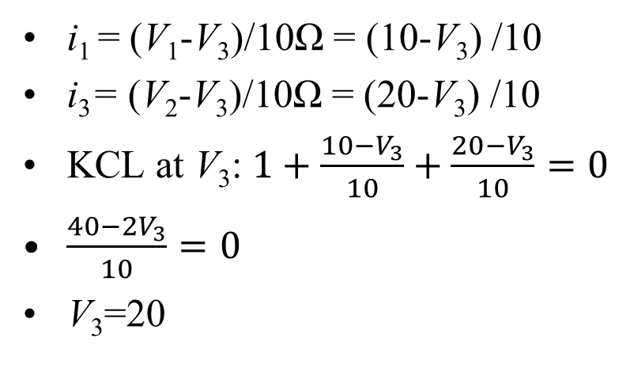
KCL example #3
Compute V₁, V₂, V₃
You’ll need some simple algebra
V₃
i₁ = (V₁-V₃)/10Ω = (10-V₃) /10
i₃= (V₂-V₃)/10Ω = (20-V₃) /10
KCL at V₃: $1+\frac{10−V_{3}}{10}+\frac{20−V_{3}}{10}=0$
$\frac{40−2V_{3}}{10}=0$
V₃=20
10Ω
10Ω
i₃
i₁
1A
V₁
V₂
+
+
i₂
10V
i₄
20V
G
Notes:
Slide 14 will do this again, as an in-class exercise.

Slide 12
Minor new definition
Conductance G is the reciprocal of resistance
G≡ 1/R
Ohm’s Law is now thus I = G*V
No big theoretical advantage to using G vs. R, but it’s often more intuitive to think about conductance rather than resistance

Slide 13
Solve for i₁, i₂
A
A
+
+
50mV
R=25Ω
i₁
50V
R=25Ω
i₂
-
-
G
G
In-class exercise

Slide 14
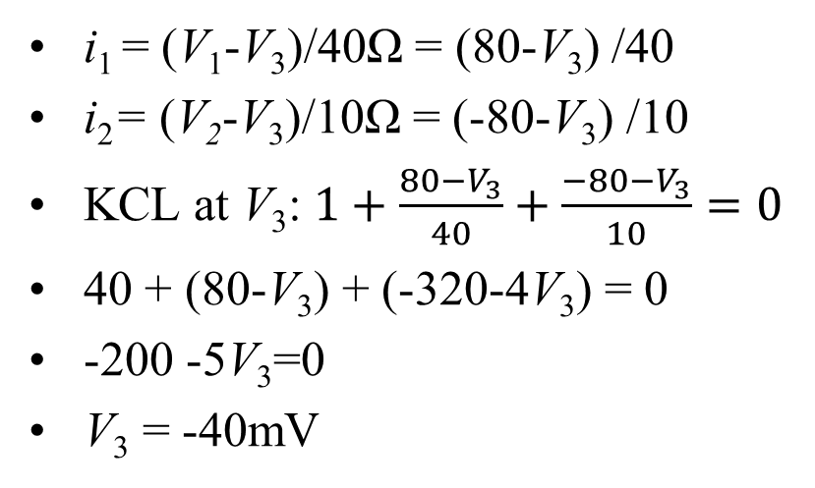
Solve for V₃
You’ll need some simple algebra
V₃
i₁ = (V₁-V₃)/40Ω = (80-V₃) /40
i₂= (V₂-V₃)/10Ω = (-80-V₃) /10
KCL at V₃: $1+\frac{80−V_{3}}{40}+\frac{−80−V_{3}}{10}=0$
40 + (80-V₃) + (-320-4V₃) = 0
-200 -5V₃=0
V₃ = -40mV
40Ω
10Ω
i₂
i₁
1mA
V₁
V₂
+
+
80mV
-80mV
G
In-class exercise
Notes:
Yes, this is the same circuit as slide 11, just with different values. It’s a chance for more practice ☺

Slide 15
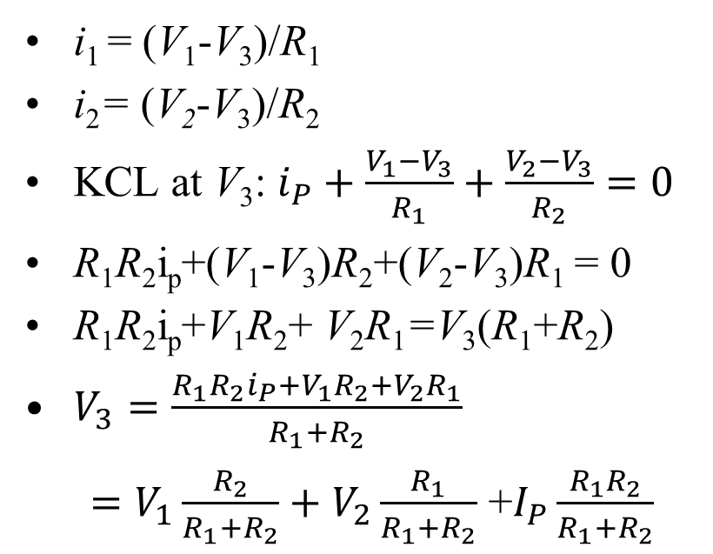
Intuition for cell-like circuits
Do this slide on your own if the next slide is too big of a leap (it uses G rather than R)
V₃
i₁ = (V₁-V₃)/R₁
i₂= (V₂-V₃)/R₂
KCL at V₃: $i_{P}+\frac{V_{1}−V_{3}}{R_{1}}+\frac{V_{2}−V_{3}}{R_{2}}=0$
R₁R₂i_{p}+(V₁-V₃)R₂+(V₂-V₃)R₁ = 0
R₁R₂i_{p}+V₁R₂+ V₂R₁=V₃(R₁+R₂)
$V_{3}=\frac{R_{1}R_{2}i_{P}+V_{1}R_{2}+V_{2}R_{1}}{R_{1}+R_{2}}$
$=V_{1}\frac{R_{2}}{R_{1}+R_{2}}+V_{2}\frac{R_{1}}{R_{1}+R_{2}}$ +$I_{P}\frac{R_{1}R_{2}}{R_{1}+R_{2}}$
R₁
R₂
i_{P}
i₁
_{i2}
+
+
V₁
V₂
Ground
Notes:
In this slide, we take

Slide 16
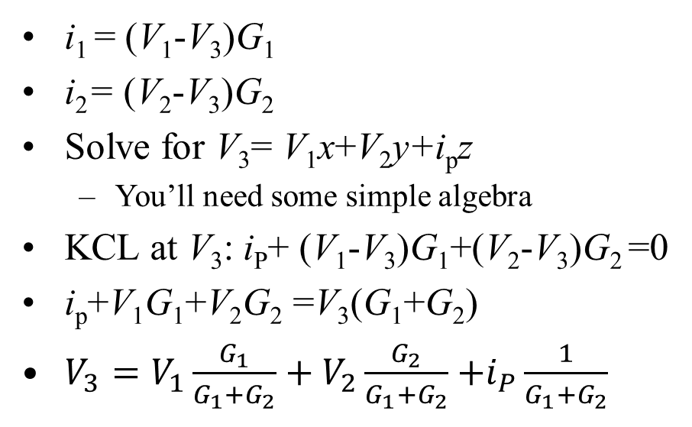
Intuition for cell-like circuits
i₁ = (V₁-V₃)G₁
i₂= (V₂-V₃)G₂
Solve for V₃= V₁x+V₂y+i_{p}z
  You’ll need some simple algebra
KCL at V₃: i_{P}+ (V₁-V₃)G₁+(V₂-V₃)G₂ =0
i_{p}+V₁G₁+V₂G₂ =V₃(G₁+G₂)
$V_{3}=V_{1}\frac{G_{1}}{G_{1}+G_{2}}+V_{2}\frac{G_{2}}{G_{1}+G_{2}}$ $+i_{P}\frac{1}{G_{1}+G_{2}}$
In-class exercise
V₃
G₁
G₂
i_{P}
i₁
i₂
+
+
V₁
V₂
Ground
Notes:
This preps us for understanding why Nernst voltages and ion-channel conductances are so important

Slide 17
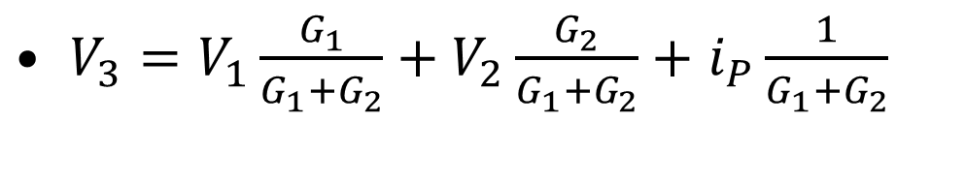
Time for the intuition
$V_{3}=V_{1}\frac{G_{1}}{G_{1}+G_{2}}+V_{2}\frac{G_{2}}{G_{1}+G_{2}}+$ $i_{P}\frac{1}{G_{1}+G_{2}}$
V₃
Consider the corner cases. With i_{P}=0, what if
  G₁=0? G₂=0?
  G₁ is small and G₂ is big? Vice versa?
What happens as i_{P} gets bigger?
G₁
G₂
i_{P}
i₁
i₂
+
+
V₁
V₂
Ground
Notes:
This preps us for understanding why Nernst voltages and ion-channel conductances are so important

Slide 18
Capacitance (prep for QSS lab)
Is KCL at V₃ satisfied?
V₃ = 0V
i₁ = (V₁-0)/40Ω = 80/40 = 2mA
i₃= (V₂-V₃)/10Ω = (-80-0)/10 =-8mA
Current into V₃ = 1mA+2mA-8mA
This seemingly violates KCL!
40Ω
10Ω
i₃
i₁
1mA
V₁
V₂
+
+
80mV
-80mV
G
Notes:
This slide prepares us for dynamically-changing V_{mem}. It will become important when we get to the QSS lab.
The trick will be adding a capacitor to V₃.

Slide 19
Add the membrane capacitor
You’ll need some simple algebra
V₃ = 0V
ICF
Capacitors obey Q = CV
Current has units coul/sec
-5mA flowing into ICF means charge in cell decreases
By Q = CV, voltage in the cell decreases too
40Ω
10Ω
i₃
i₁
1mA
V₁
V₂
+
+
C_{mem}
80mV
-80mV
ECF (ground)
Notes:
The trick will be adding a capacitor to V₃.

Slide 20
What value will V_{mem} settle to?
Hint: look back to slide #14
V₃ = 0V
ICF
If current into ICF is positive ⇒ V_{mem} rises
If negative ⇒ V_{mem} falls
V_{mem} settles when current into it is 0 (i.e., when KCL is met without the capacitor)
Slide #14 says that was -40mV
40Ω
10Ω
i₃
i₁
1mA
V₁
V₂
+
+
C_{mem}
80mV
-80mV
ECF (ground)

Slide 21
Interconnected cells
This is prep for our cardiac unit…
We are multi-cellular organisms ☺
Cells are often connected by gap junctions
Let’s learn to analyze these systems

Slide 22



Multicellular model
cell
cell
cell
Start with 3 cells interconnected by GJs
Each cell is the usual equivalent circuit
This is getting too detailed!
j_{Na}
j_{K}
G_{Na}
G_{K}
G_{Cl}
$$V_{Na}^{N}$$
$$V_{K}^{N}$$
$$V_{Cl}^{N}$$
77mV
-89mV
-71mV
ECF

Slide 23



Thevenin equivalent circuit
j_{Na}
j_{K}
G_{Na}
G_{K}
G_{Cl}
G_{eq}
$$V_{Na}^{N}$$
$$V_{K}^{N}$$
$$V_{Cl}^{N}$$
-89mV
V_{oc}
77mV
-71mV
ECF
Any arbitrary collection of resistors, batteries, current sources can be replaced by a single battery + resistor
Behavior at two external ports is equivalent!
Math: it’s a linear-algebra thing

Slide 24
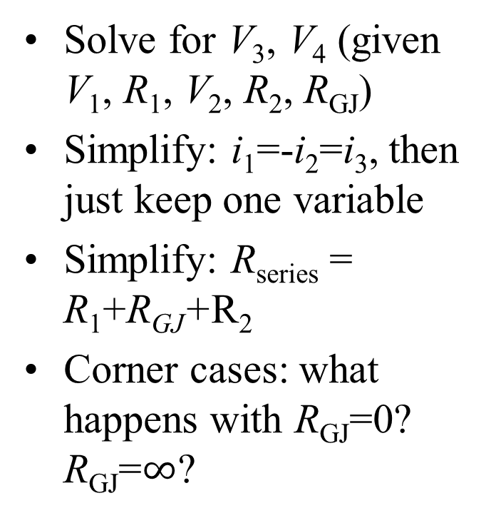
Two-cell circuit
i₃
Solve for V₃, V₄ (given V₁, R₁, V₂, R₂, R_{GJ})
Simplify: i₁=-i₂=i₃, then just keep one variable
Simplify: R_{series} = R₁+R_{GJ}+R₂
Corner cases: what happens with R_{GJ}=0? R_{GJ}=$∞$?
R_{GJ}
V₃
V₄
R₁
R₂
i₁
i₂
V₁
V₂
+
+
V₁
V₂
ECF (ground)

Slide 25
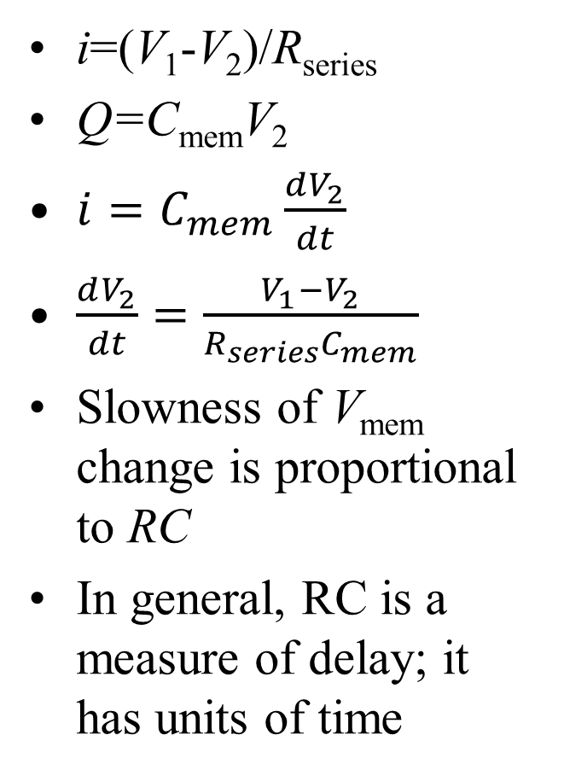
RC delay
i=(V₁-V₂)/R_{series}
Q=C_{mem}V₂
$i=C_{mem}\frac{dV_{2}}{dt}$
$\frac{dV_{2}}{dt}=\frac{V_{1}−V_{2}}{R_{series}C_{mem}}$
Slowness of V_{mem} change is proportional to RC
In general, RC is a measure of delay; it has units of time
i
R_{series}
V₂
C_{m}
V₁
+
V₁
ECF (ground)

