Slide 1
Circuits Mini Quizzes
These won’t count towards anyone’s final grade! They are just meant to refresh and test your understanding of basic circuit concepts

Slide 2
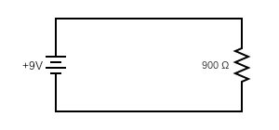
Basic Circuit Diagram
Find the current flowing through the resistor.
+
-

Slide 3
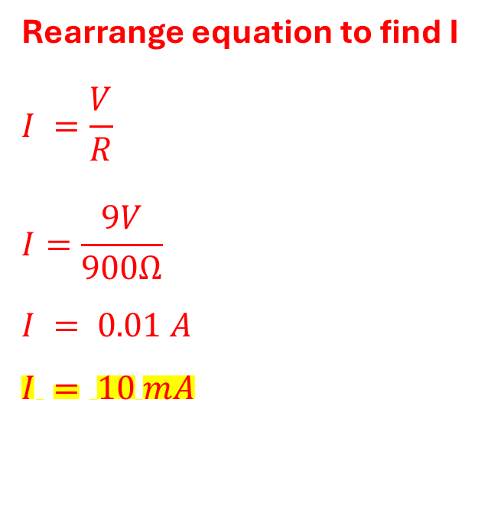
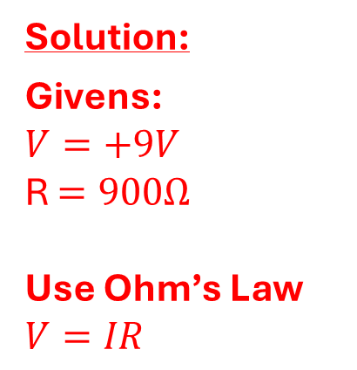
Basic Circuit Diagram
Find the current flowing through the resistor.
Rearrange equation to find I
$$I =\frac{V}{R}$$
$$I=\frac{9V}{900Ω}$$
$$I = 0.01 A$$
$$I = 10 mA$$
Solution:
Givens:
$$V=+9V$$
R $=900Ω$
Use Ohm’s Law
$$V=IR$$
+
-

Slide 4
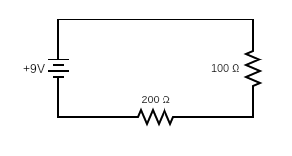
Equivalent resistances – Resistors in Series
What is the net resistance as seen by the voltage source?

Slide 5
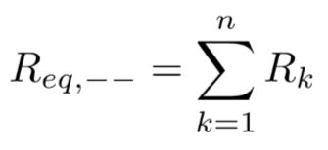
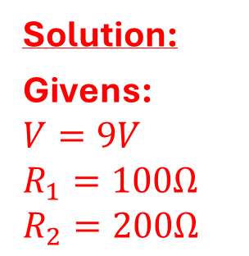
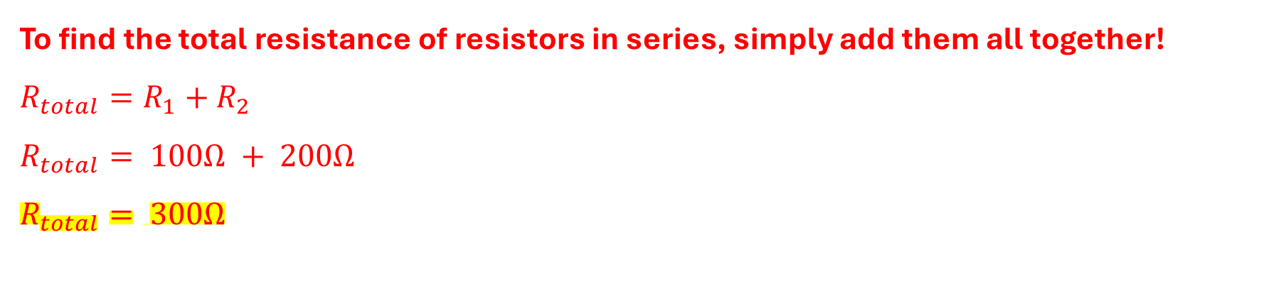
Equivalent resistances – Resistors in Series
What is the net resistance as seen by the voltage source?
Solution:
Givens:
$$V=9V$$
$$R_{1}=100Ω$$
$$R_{2}=200Ω$$
To find the total resistance of resistors in series, simply add them all together! $R_{total}=R_{1}+R_{2}$
$$R_{total}= 100Ω + 200Ω$$
$$R_{total}= 300Ω$$

Slide 6
Voltage Divider
Find the voltage across each resistor

Slide 7
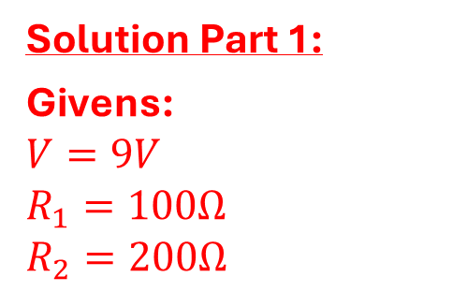
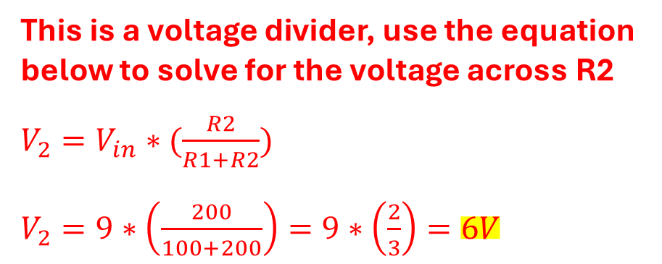
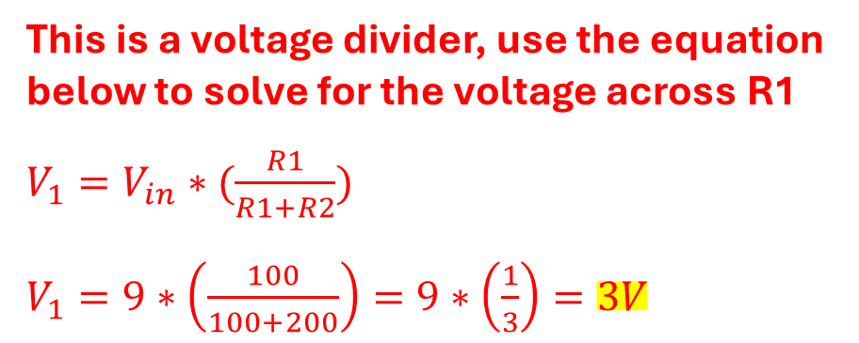
Voltage Divider
Find the voltage across each resistor
Solution Part 1:
Givens:
$$V=9V$$
$$R_{1}=100Ω$$
$$R_{2}=200Ω$$
This is a voltage divider, use the equation below to solve for the voltage across R1
$V_{1}=V_{in}∗(\frac{R1}{R1+R2})$
$V_{1}=9∗\left(\frac{100}{100+200}\right)=9∗\left(\frac{1}{3}\right)=3V$
This is a voltage divider, use the equation below to solve for the voltage across R2
$V_{2}=V_{in}∗(\frac{R2}{R1+R2})$
$V_{2}=9∗\left(\frac{200}{100+200}\right)=9∗\left(\frac{2}{3}\right)=6V$
You can also use Kirchhoff’s Voltage Law to double check these values! 9V – 3V – 6V = 0V

Slide 8
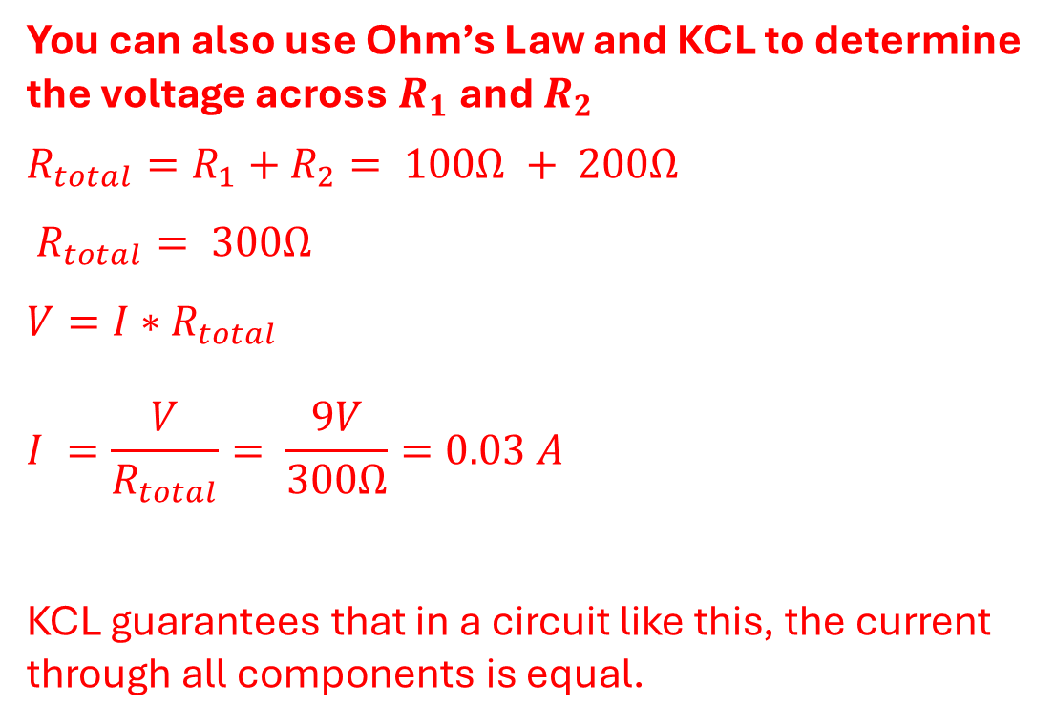
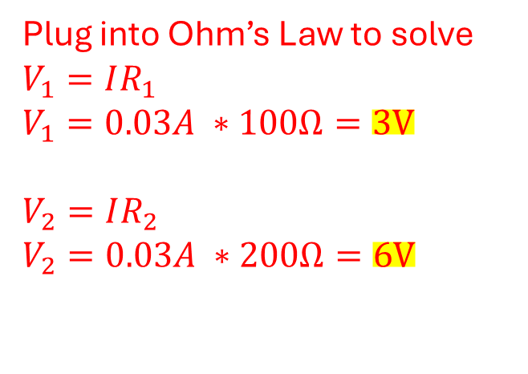
Voltage Divider
Find the voltage across each resistor
Solution Part 2:
You can also use Ohm’s Law and KCL to determine the voltage across $R_{1}$ and $R_{2}$
$$R_{total}=R_{1}+R_{2}= 100Ω + 200Ω$$
$$R_{total}= 300Ω$$
$$V=I∗R_{total}$$
$$I =\frac{V}{R_{total}}= \frac{9V}{300Ω}=0.03 A$$
KCL guarantees that in a circuit like this, the current through all components is equal.
Plug into Ohm’s Law to solve
$$V_{1}=IR_{1}$$
$$V_{1}=0.03A ∗100Ω=3V$$
$$V_{2}=IR_{2}$$
$$V_{2}=0.03A ∗200Ω=6V$$

Slide 9
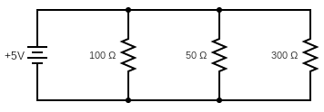
Equivalent resistances – Resistors in Parallel
What is the net resistance as seen by the voltage source?

Slide 10
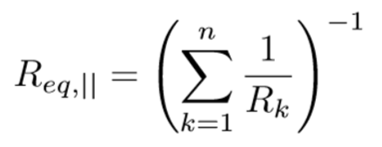
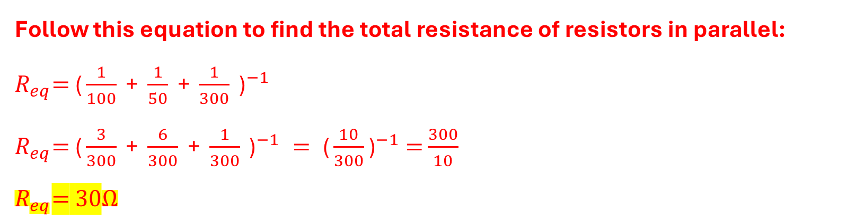
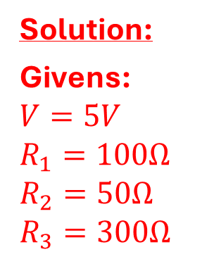
Equivalent resistances – Resistors in Parallel
What is the net resistance as seen by the voltage source?
Solution:
Givens:
$$V=5V$$
$$R_{1}=100Ω$$
$$R_{2}=50Ω$$
$$R_{3}=300Ω$$
Follow this equation to find the total resistance of resistors in parallel:
${R_{eq}\text{= }\text{(}\frac{1}{100}\text{ + }\frac{1}{50}\text{ + }\frac{1}{300}\text{ )}}^{−1}$
${R_{eq}\text{=} \text{(}\frac{3}{300}\text{ + }\frac{6}{300}\text{ + }\frac{1}{300}\text{ )}}^{−1} = {\text{(}\frac{10}{300}\text{)}}^{−1} =$ $\frac{300}{10}$
$R_{eq}\text{=}\text{ 30}Ω$

Slide 11
Current Divider
Find the current across each resistor

Slide 12
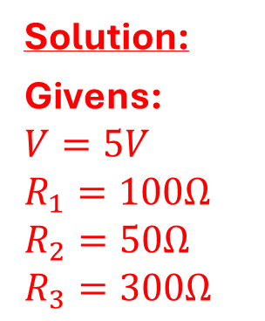
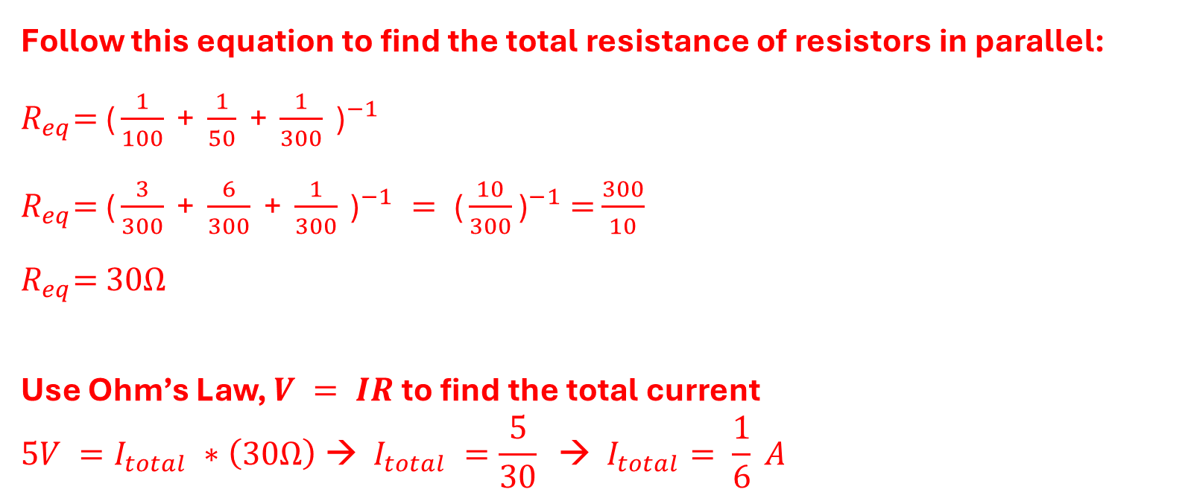
Current Divider
Find the current across each resistor
Solution:
Givens:
$$V=5V$$
$$R_{1}=100Ω$$
$$R_{2}=50Ω$$
$$R_{3}=300Ω$$
Follow this equation to find the total resistance of resistors in parallel:
${R_{eq}\text{= }\text{(}\frac{1}{100}\text{ + }\frac{1}{50}\text{ + }\frac{1}{300}\text{ )}}^{−1}$
${R_{eq}\text{=} \text{(}\frac{3}{300}\text{ + }\frac{6}{300}\text{ + }\frac{1}{300}\text{ )}}^{−1} = {\text{(}\frac{10}{300}\text{)}}^{−1} =$ $\frac{300}{10}$
$R_{eq}\text{=}\text{ 30}Ω$
Use Ohm’s Law, $V = IR$to find the total current
$$5V =I_{total} ∗\left(30Ω\right) → I_{total} =\frac{5}{30} → I_{total}= \frac{1}{6} A$$

Slide 13
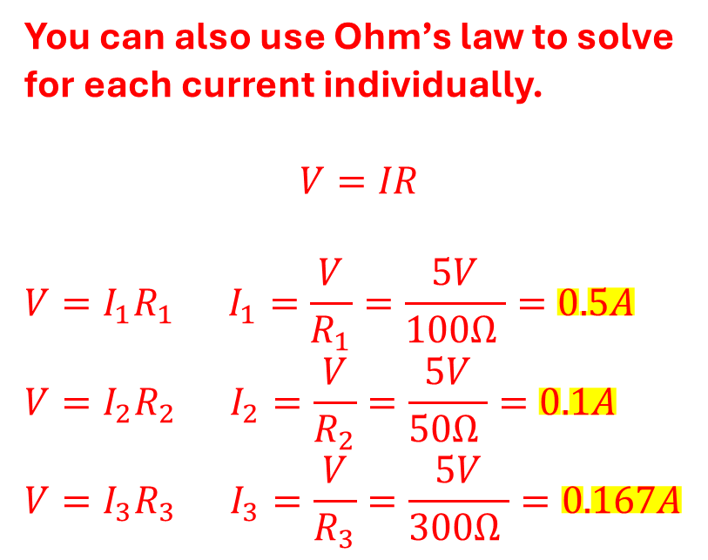
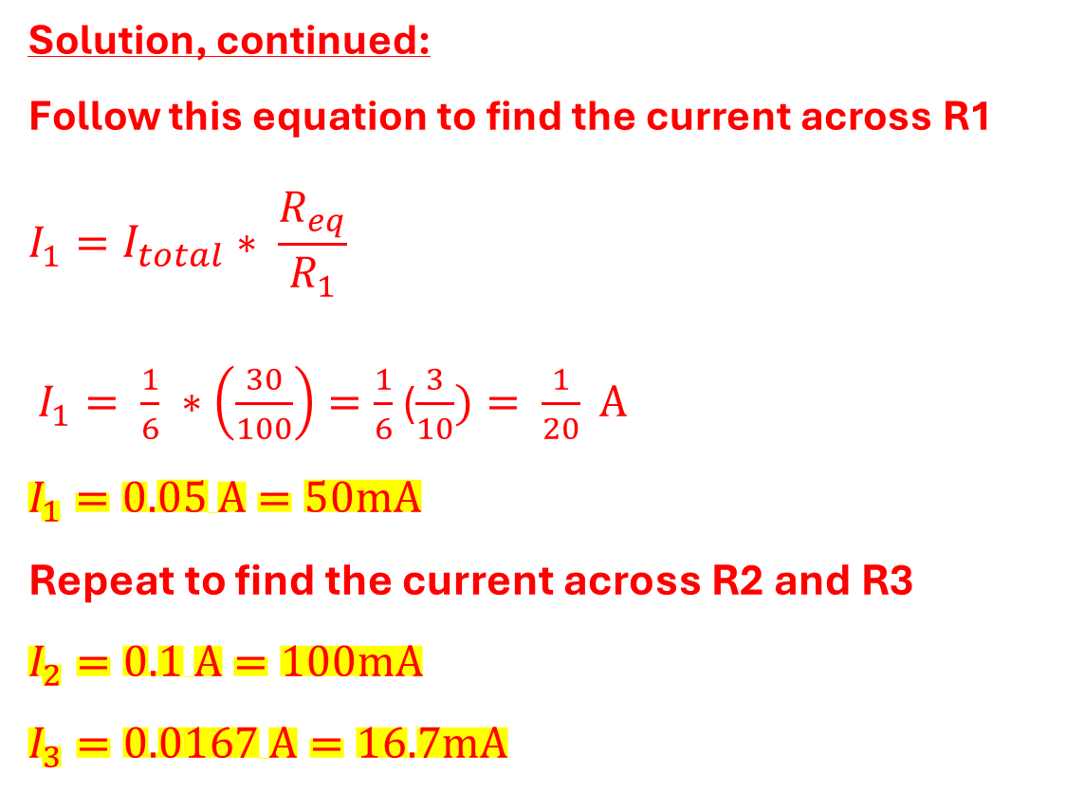
Circuit Divider
Find the current across each resistor
Solution, continued:
Follow this equation to find the current across R1
$$I_{1}=I_{total}∗ \frac{R_{eq}}{R_{1}}$$
$I_{1}= \frac{1}{6} ∗\left(\frac{30}{100}\right)=\frac{1}{6}$ ($\frac{3}{10})= \frac{1}{20} A$
$$I_{1}=0.05 A=50mA$$
Repeat to find the current across R2 and R3
$$I_{2}=0.1 A=100mA$$
$$I_{3}=0.0167 A=16.7mA$$
You can also use Ohm’s law to solve for each current individually.
$$V=IR$$
$$V={I_{1}R}_{1} I_{1}=\frac{V}{R_{1}}=\frac{5V}{100Ω }=0.5A$$
$$V={I_{2}R}_{2} I_{2}=\frac{V}{R_{2}}=\frac{5V}{50Ω }=0.1A$$
$$V={I_{3}R}_{3} I_{3}=\frac{V}{R_{3}}=\frac{5V}{300Ω }=0.167A$$

Slide 14
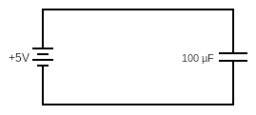
Basic Capacitor Diagram
Find the charge, Q, on the capacitor

Slide 15
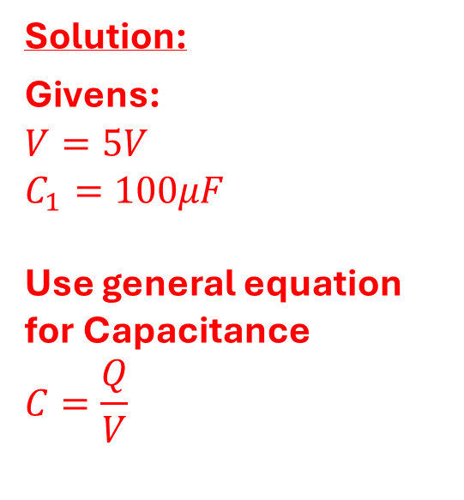
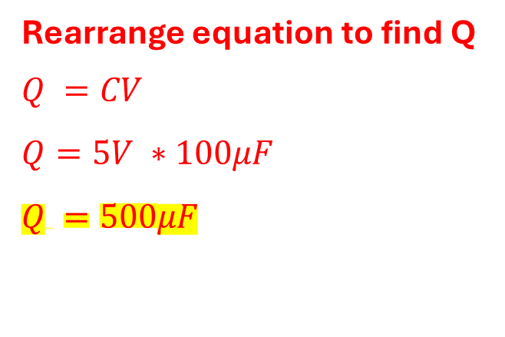
Basic Capacitor Diagram
Find the charge, Q, on the capacitor
Solution:
Givens:
$$V=5V$$
$$C_{1}=100μF$$
Use general equation for Capacitance
$$C=\frac{Q}{V}$$
Rearrange equation to find Q
$$Q =CV$$
$$Q=5V ∗100μF$$
$$Q =500μF$$

Slide 16
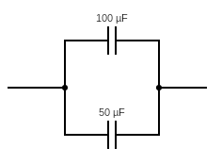
Capacitors in Parallel
Find the total capacitance across the circuit

Slide 17
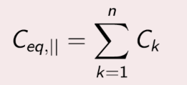
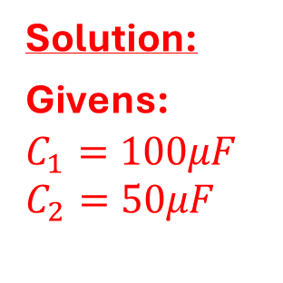
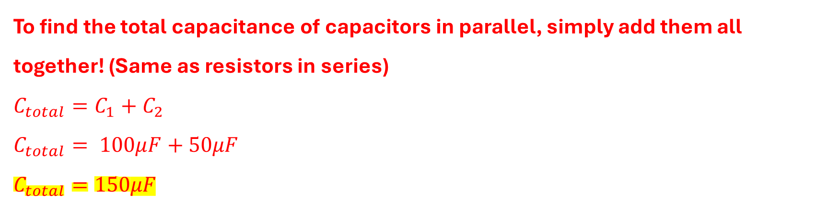
Capacitors in Parallel
Find the total capacitance across the circuit
Solution:
Givens:
$$C_{1}=100μF$$
$$C_{2}=50μF$$
To find the total capacitance of capacitors in parallel, simply add them all together! (Same as resistors in series)
$$C_{total}=C_{1}+C_{2}$$
$$C_{total}= 100μF+50μF$$
$$C_{total}=150μF$$

Slide 18
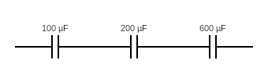
Capacitors in Series
Find the total capacitance across the circuit

Slide 19
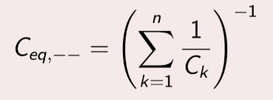
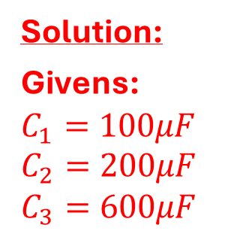
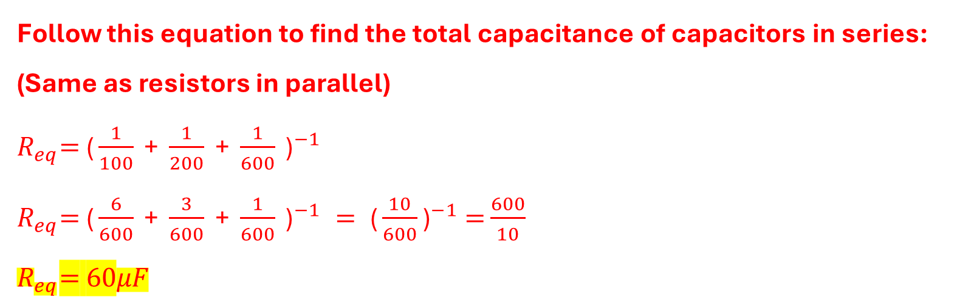
Capacitors in Series
Find the total capacitance across the circuit
Solution:
Givens:
$$C_{1}=100μF$$
$$C_{2}=200μF$$
$$C_{3}=600μF$$
Follow this equation to find the total capacitance of capacitors in series:
(Same as resistors in parallel)
${R_{eq}\text{= }\text{(}\frac{1}{100}\text{ + }\frac{1}{200}\text{ + }\frac{1}{600}\text{ )}}^{−1}$
${R_{eq}\text{=} \text{(}\frac{6}{600}\text{ + }\frac{3}{600}\text{ + }\frac{1}{600}\text{ )}}^{−1} = {\text{(}\frac{10}{600}\text{)}}^{−1} =$ $\frac{600}{10}$
$$R_{eq}\text{=}\text{ 60}μF$$

