Slide 1
EN1
Electricity inside of you
Fall 2022
Tufts University
Instructor: Joel Grodstein
joel.grodstein@tufts.edu
1 – Electricity 101

Slide 2
Big picture of the course
What is (bio)electricity?
Neurons, the nervous system and sEMG
Cardiac bioelectricity and ECG
Morphogenesis, speakers, final projects and

Slide 3
Electricity 101
Everything you have to know to be able to build stuff, in one easy lecture
  (at least build the stuff in this course, with some help!)
  Volts, amps and ohms: what are they and when/why are they useful?
  How does your body make voltage?
  Hooking up the breadboards with power, ground, signals
Notes:
The last item – hooking up the breadboards – is the practical necessity for us

Slide 4
V, I and R
The problem with trying to understand this stuff
  Physics defines electricity via charged particles
  Atoms are really small, and “charge” isn’t intuitive
  Most people find it easier to use a fluid analogy
Voltage = water pressure (units = N/m²)
Resistance = pipe narrowness (current / voltage)
Current = water flow (units = m³/s)
Notes:
At least, most first-timers find the fluid-flow analogy flow more intuitive. Eventually you give up on it.
The units of fluidic resistance are (N*sec)/m⁵, which isn’t really useful.

Slide 5

Examples
Why the pump?
it’s how the water got up there
otherwise the bucket will empty!
provides the energy to keep the system running
wider pipe
Same water pressure, wider pipe ⇒ water flows faster
water runs faster
water runs slowly
Notes:
Note that whatever the system, we clearly need a water pump to keep it going; else the bucket on top will run out pretty soon.
From a conservation-of-energy point of view, the resistance of water flow through a pipe generates heat, which wastes energy, which must be replaced.

Slide 6
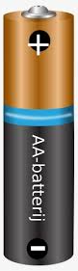
less resistance
voltage
electrons
Same water pressure, wider pipe ⇒ water flows faster
larger current
small current
1Ω
.1Ω
less resistance
wider pipe
1.5V
1.5V

Slide 7
Examples
high water pressure
Same pipe, higher water pressure ⇒ water flows faster
water runs faster
water runs slowly
Notes:
This example would be more useful if the drainpipe were fully horizontal; as shown, it’s inducing its own voltage, which isn’t really the point of the slide.
It will take some time to redo the slides, though.

Slide 8
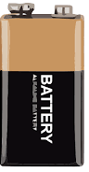
resistance
voltage
electrons
Same pipe, higher water pressure ⇒ water flows faster
larger current
small current
1Ω
1Ω
1.5V
9V

Slide 9
Voltage is relative
1.5ft
high water pressure
9ft
water runs fast
water runs slowly
Notes:
If you raise up the entire system on the left until its peak is just as high as the rightmost system, it still runs slow – what’s important is the delta between the top of the reservoir and the top of the pipe.

Slide 10
Voltage is relative
That’s why the ground must be connected!
Another rule of electricity: current flows in loops
larger current
small current
1Ω
1Ω
1.5V
9V
Notes:
Without the ground there’s no loop. And it’s really the same for water: without a loop somewhere, the reservoir will eventually empty.

Slide 11
Voltage is relative
Our water-pump system had a loop too
Without loop(s), the water would just build up somewhere
water runs slowly

Slide 12
Bioelectricity
Most every cell in your body makes electricity
Any idea how? The government implanting billions of little batteries while you sleep?
Remember this?
  pipe ⇒ 1Ω resistor
  pump ⇒ battery
  water ⇒ invisible charged particles
You cells have small sodium-potassium pumps moving ions around to create voltage

Slide 13
Why do cells make voltage?
Why do you think your cells evolved to have tiny batteries?
  Your body is long. Electric currents are the fastest way to send messages (more details when we get to neurons)
  Fast signaling lets (e.g.,) your heart cells fire in a very coordinated pattern
  Electrical signaling is a very reliable way to communicate; evolutionarily older than neurons (evolving research area)
Notes:
The “body is long” argument is not enough; bacteria are small, and they make bioelectricity. Really, as the last bullet says, electrical communication is valuable for any multi-celled organism; then it evolved for neurons as bodies got large.

Slide 14
Ohm’s Law
We did lots of “more current” or “less current”
  Time to make it quantitative
V = I R (voltage = current * resistance)

Slide 15
Ohm’s Law examples
1.5V = 1.5A * 1Ω
9V = 9A * 1Ω
1.5V = 15A * .1Ω
larger current
larger current
9A
15A
small current
1.5A
1Ω
1Ω
.1Ω
1.5V
1.5V
9V

Slide 16
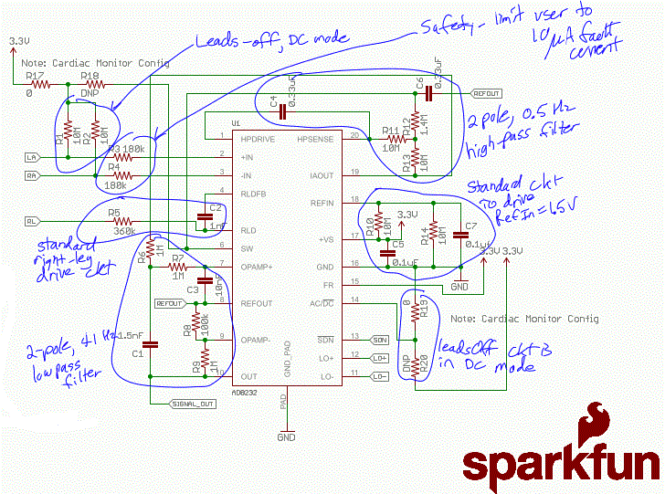
If the 3.3V supply voltage directly drives your body, how much current do you get?
What about 5V?
Skin resistance = 5-500kΩ
Give limits for perceptible, painful, let-go, fibrillation
Calculate the current from our circui
Notes:
Do this on the board so they have to remember it for the lab question ☺

Slide 17
Wires
We’re going to hook things up with wires
A wire has R ≈ 0 (no resistance, a really fat pipe)
V = IR = 0 ⇒ all parts of a wire are at the same V
When you hook up two things with a wire, they will be at the same voltage

Slide 18
What happens in this circuit? Is the red wire at 1.5V or 9V?
Don’t try this at home!
9V-1.5V=7.5V
7.5V / .01Ω=750A
GND
Notes:
?Explain

Slide 19
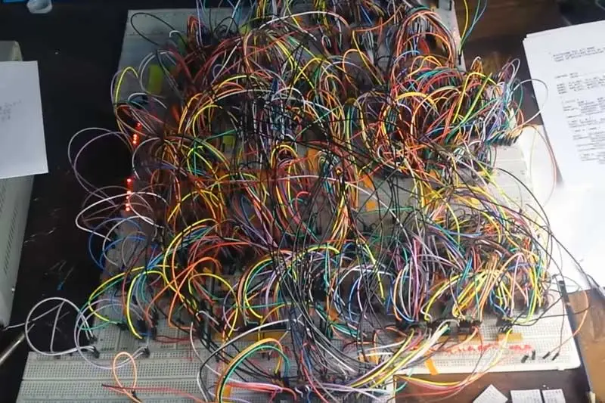
Breadboards
Pass around a real breadboard
They’re not super reliable. Don’t make a rat’s nest ☺
Notes:
Image from https://hackaday.com/2019/05/09/cpu-made-from-74hc-chips-is-a-glorious-mess/

Slide 20
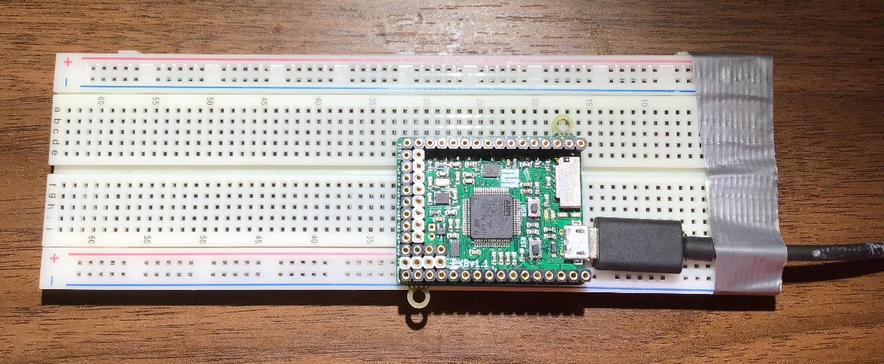
Breadboard connectivity
The five holes in each half column are internally connected
The big long top-row holes are, too
Ditto for the other three long rows

Slide 21
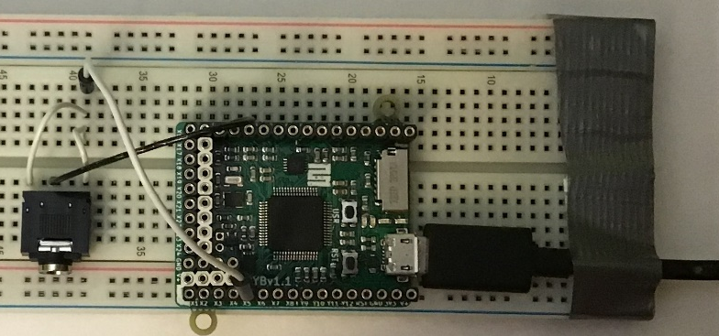
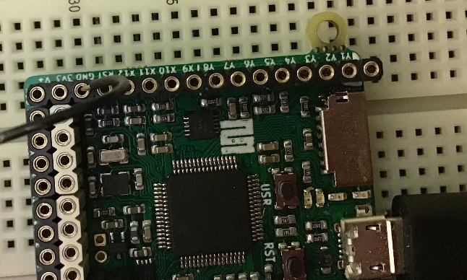
Music-day hookup
Power (+5V) comes in through USB (no battery needed)
Headphone jack is stereo; we’re driving it mono
Ground wire pin detail shown on right

Slide 22
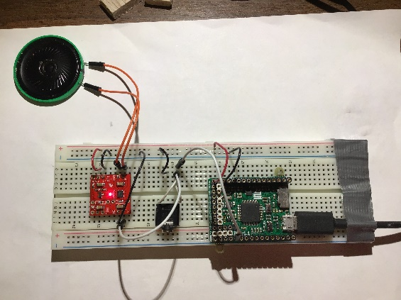
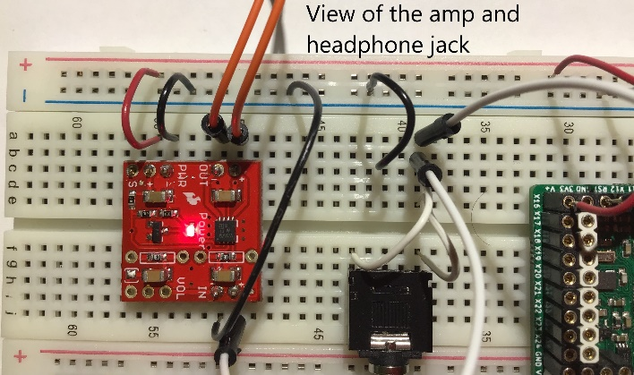
Music-day amplifier hookup
To note:
  5V vs. 3.3V
  Amp input and output both require two wires
  We’ve used the long strips for 3.3V, GND

