Slide 1
EN1 EIY
Fall 2022
Tufts University
Instructor: Joel Grodstein
joel.grodstein@tufts.edu
2 – neurons

Slide 2
Slick video
https://www.youtube.com/watch?v=UZthGjcuTDs
  Joe Hansen video
  5 minutes in class
  the rest on your own if you like

Slide 3
Big picture of the course
What is bioelectricity?
Neurons and working with the nervous system
Cardiac bioelectricity
Worms
Neurons and the nervous system
Muscles, EMG and prosthetics
Pain and the future: SCS, electroceuticals

Slide 4
What is a neuron?
Long skinny cell that conducts action potentials
  Communication (mostly) between your brain and the rest of your body
Really, how long is a neuron?
  single neuron from your brain to your toe muscles
  most human cells about 10-100 μm
One neuron is not very useful
  Your brain has ≈86 billion neurons
Notes:
People used to say 100 billion; now they say 86.

Slide 5
What does a neuron do?
Takes inputs from upstream neurons
Generates an AP
The AP travels – fast
Drives downstream neurons
Which brings us to…
+40
0
V_{mem}(mV)
-55
-70
Each graph is a bit later in time than the previous one
The x graph axis is the length of the neuron

Slide 6
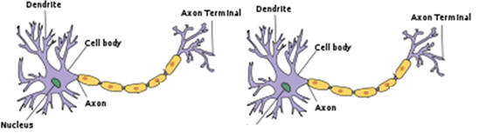
Lots of neurons
synapse
The brain has ≈86B neurons.
Each dendrite takes inputs from ≈1000 other neurons and decides when to fire
  Each input pulse raises V_{mem} slightly; fires when it hits a threshold
An action potential then travels along the axon to the next downstream synapse(s)
Notes:
For those of you who are into NNs, is this exciting? It’s a very nonlinear response, which ANNs depend on. Of course, your brain doesn’t really care if some computer scientist built an ANN like a real brain or not, but it’s probably comforting for the CS person :-).

Slide 7
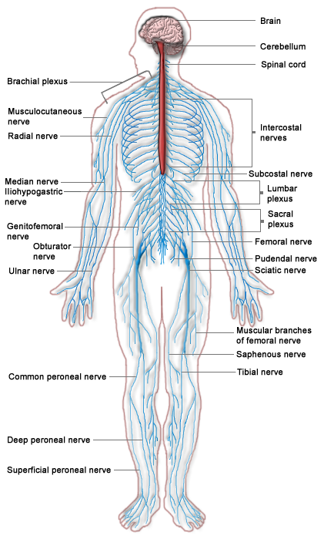
Sensory neuron
  Carries information towards the brain
  E.g., touch a hot stove
Motor neuron
  Carries information away from the brain
  e.g., control your muscles
  anything else?
Notes:
First, we’ve skipped a neuron type – sensory, motor and interneurons (which connect the two, especially in reflexes).
Second – a motor neuron can drive a gland as well as a muscle. Glands produce & secrete various molecules, typically under nervous-system control. E.g., your sweat glands or your hormones.

Slide 8
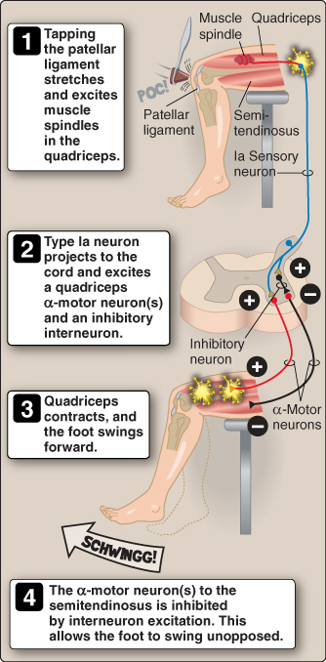
Reflexes
What is a reflex?
  A sensory nerve detects a signal
  Travels into spine
  Synapses with a motor nerve to come right back
Example: tap under your kneecap and your leg kicks
Why bother with reflexes?
  Why not have all signals just travel to the brain and back?
Lippincott Ch 11

Slide 9
Big picture of the course
What is bioelectricity?
Neurons and working with the nervous system
Cardiac bioelectricity
Worms
Neurons and the nervous system
Muscles, EMG and prosthetics
Pain and the future: SCS, electroceuticals

Slide 10
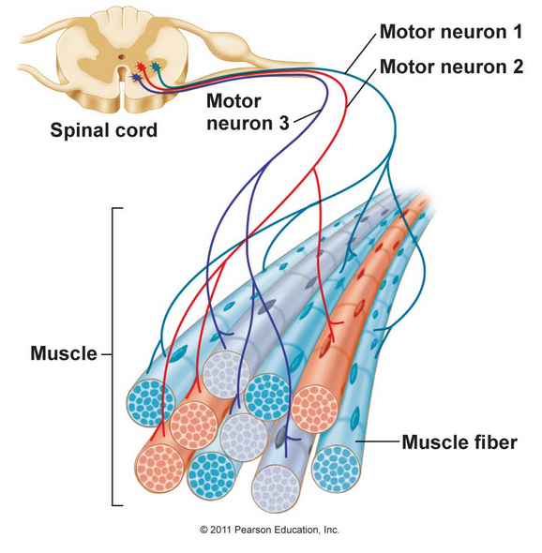
Muscles
Motor unit = a single neuron and all of the fibers it drives
Fine motor control:
  Eye = 9 muscle fibers/neuron
  Biceps = 750:1

Slide 11
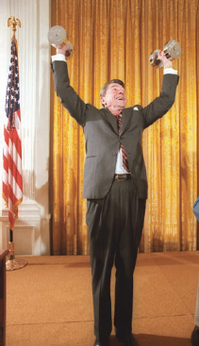
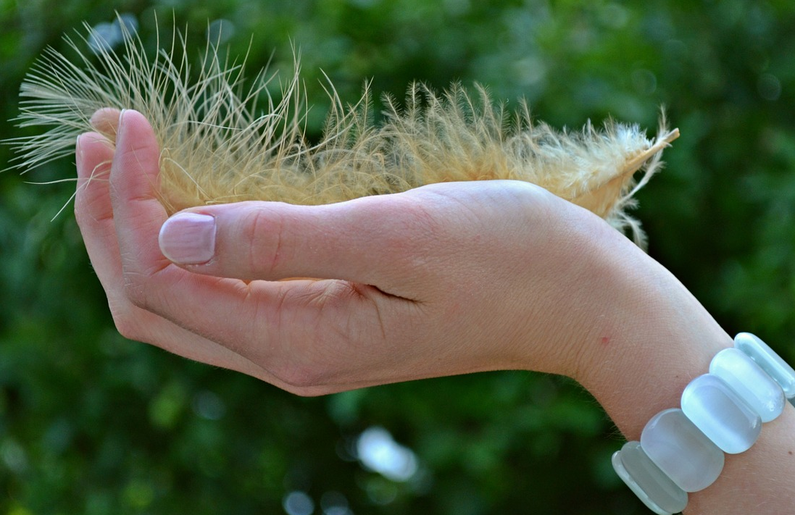
Muscle force
How can your brain control muscle force?
  Activate more motor units
  Activate the same ones more frequently
Wikimedia commons
Pixabay

Slide 12
What most people’s brain does
Start with the smallest motor unit
Fire it about 5 Hz
If more force needed… up it to about 10 Hz
If more force needed, activate the next smallest motor unit
Go to step 3
But we’re all different, and our brains are complex

Slide 13
Electromyogram (sEMG)
Place an electrode on a muscle, read the action potential
Different motor units are quite interlaced
  clinicians measure the compound action potential
  the summed voltage from multiple neurons driving one muscle
electrode
skin

Slide 14
Diseases affecting neurons
Diabetes neuropathy
  likely caused by years of high blood sugar
  amplitude reduction of the CMAP
  slowing of nerve conduction speeds
Multiple sclerosis
  the myelin coating of large fibers degenerates
  reduced nerve-conduction speed
Neuropathy
  From carpal-tunnel, sciatica, lyme disease, …
Notes:
If we were to cover NCS, we would see how to diagnose these

Slide 15
Prosthetics background
1.7M people with limb amputation in US in 2005¹
Causes: war, infection, electric shock, …
¹Targeted Muscle Reinnervation and Advanced Prosthetic Arms, 2015

Slide 16
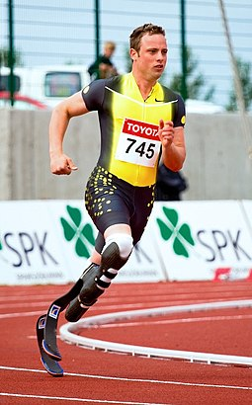
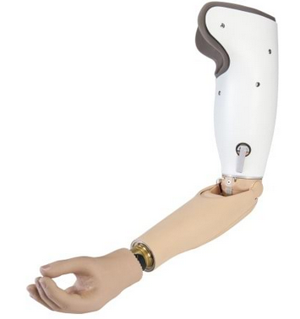
Different types of prostheses
How do you control the movable parts?
Oscar Pistorius
Images: Wikipedia
Notes:
The one on the left is unpowered; on the right has batteries, motors, etc.

Slide 17
Really simple option – lots of switches somewhere
  Push one button to flex elbow, another to extend, another to rotate wrist, …
But… if you need your right hand to control your left arm, you still effectively have only one arm ☹
Images: Wikipedia

Slide 18
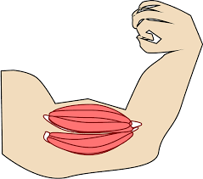
Myoelectric prosthesis
Assume you’ve lost your limb after learning how to use it
  Not a birth defect
  Your brain knows how to send APs to your muscles
After limb loss:
  Biceps no longer connected to elbow; your brain still sending APs to biceps
  Can we intercept the APs (with sEMG) and use them to drive motors instead?
  Holy grail – prosthesis becomes a seamless extension of your brain!
biceps is still there
Images: Wikipedia
Notes:
The “no training required” is a really big deal!

Slide 19
Myoelectric prosthesis
Takes sEMG from biceps, triceps muscles
Compute amplitude delta biceps – triceps
  Positive/negative/zero → elbow flexes/extends/static
  Magnitude → motion speed
Use biceps/triceps EMG to control the elbow → no training required ☺
  But what about controlling the hand?
biceps
triceps
Images: Wikipedia
Notes:
The “no training required” is a really big deal!

Slide 20
Mode switching
Biceps & !triceps → flexion
Triceps & !biceps → extension
Biceps & triceps → next mode
Can cycle between modes
  Elbow flex/extend
  Wrist flex/extend
  Write rotate left/right
  Thumb/forefinger grasp
But… cannot do two degrees of freedom at once ☹
biceps
triceps
Images: Wikipedia

Slide 21
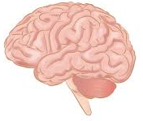
TMR
Problem
  Wrist-control muscles no longer exist, so cannot take sEMG
  Motor nerves driving them are accessible in the upper-arm stub!
Biceps is actually two muscles
  Triceps is three
Targeted muscle reinnervation (TMR)
  Surgically cut motor neurons driving one biceps head, two triceps heads
  Drive them with forearm-muscle nerves!
Trans-humoral amputation
Images: Wikipedia

Slide 22
TMR
What if it’s a trans-radial amputation?
  Biceps is still useful, since elbow exists
TMR as usual?
  Think “move wrist” → elbow flexes!
Must cut one biceps tendon
  Leave one biceps head attached to elbow
  Their elbow will be weak
Trans-radial amputation
Images: Wikipedia

Slide 23
What makes prosthetics hard?
TMR is surgery
We all have our muscles in slightly different places
  Where do you attach the electrodes?
Multiple muscles combine for one action
  Arm flexion controlled by biceps, brachialis, brachioradialis
One muscle can do multiple actions
  Biceps → elbow flexion, forearm supination
But it’s still lots better than nothing
  And plenty of room for good engineering

Slide 24
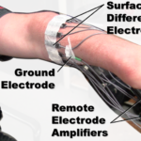
Cool example
Liberating Technologies PsiCon
  Simultaneous, proportional, independent control
  Pick two muscle pairs (four electrodes) and control two DoF
But: presumably takes some training

Slide 25
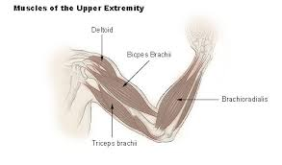
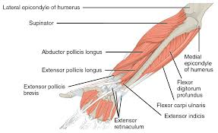
Arm muscles
Lots of muscles to attach electrodes
Reverse-engineering user intent is an interesting engineering challenge
Images from Wikipedia

Slide 26
Mini quiz
What is a surface EMG? Give one example of using it in medicine
At a high level, how does a myoelectric prosthesis work? What are the engineering difficulties?

Slide 27
Big picture of the course
What is bioelectricity?
Neurons and working with the nervous system
Cardiac bioelectricity
Worms
Neurons and the nervous system
Muscles, EMG and prosthetics
Pain and the future: SCS, electroceuticals

Slide 28
The brain – the final frontier
Those 86M neurons are involved with almost everything
  breathing, blood pressure, muscles, senses, happiness,…
  unlimited potential… bioelectricity is medicine
That potential is largely untapped
  we’ve almost no idea of which neuron does what!

Slide 29
Why electroceuticals
Drugs are systemic; PNS is specific
It’s more economical than drugs
  Every new molecule interacts very differently, and needs to be separately tested
  90% of the hardware for electroceuticals is the same, no matter what disease it’s treating
Electronics = ability to monitor
  Many people don’t fill prescriptions or take pills
  Electroceuticals can monitor your neurons & report home

Slide 30
Central nervous system (CNS, red)
  brain + spinal cord
  controls most everything
  mostly too complex to touch
Peripheral nervous system (PNS, blue)
  everything but the CNS
  signals from CNS must usually travel through PNS to do anything
  typically 100s of neurons per nerve
  electroceuticals target here

Slide 31
Where we are, where we’re going
Brain & nervous system control most everything in your body
What we can do today:
  Monitor & control signals to muscles
The future:
  Alter the signals ⇒ cure numerous diseases
  But nobody really understands which neurons do what
  We’re shooting lots of arrows in the dark – some of them are hitting useful targets
Why now?
  miniaturization of electronics
  wireless power
  embedded computing, offline analysis

Slide 32
What’s in a name?
Electroceutical: “Electrical + pharmaceutical”
  Electricity as medicine
  Typically stimulation of a nerve to improve health
And see https://www.lastwordonnothing.com/2019/03/08/the-tool-that-lost-its-name/

Slide 33
Action Potential VC
www.actionpotentialvc.com
Backed by GlaxoSmithKline but a separate entity
Invests in electroceutical startups
  New nerve targets for existing neurostimulation devices
  New devices for existing targets
  Advanced technologies to bring the field forwards
Notes:
Why do we bring Imran in? Because a VC is well placed for a sober assessment of whether stuff can make money or not

Slide 34
Companies
Neuspera (http://neuspera.com/ )
  Mid-field powering = wireless power for a neural implant 10 cm deep
  No internal battery (?) → small, less-invasive implant, can be put in previously-inaccessible locations (e.g., spinal cord)
  Currently used for urinary-urge incompetence (other uses planned)
Setpoint Medical (https://setpointmedical.com )
  Vagus nerve: controls heart rate, peristalsis & sweating – and affects the immune system
  Stimulate vagus nerve → target autoimmune inflammatory diseases
  Inflammatory reflex: senses inflammation & injury, sends messages → vagus nerve → controls TNF, which regulates immune system & inflammation
  1 minute of vagus-nerve stimulation → 24 hours of cytokine reduction

Slide 35
Saluda Medical
Problem: electrodes tend to move over time
  Neuron may be stimulated too much or too little
  One reason SCS effectiveness fades over time
Saluda basic technology:
  Developed a bioamplifier design to measure neuron activation
  Use it to close the loop, adjust stimulator intensity until you get the desired target response
Application:
  Improved long-term results for SCS

Slide 36
Cala Health (https://www.calahealth.com )
  Essential tremor
  Gyroscope in a special watch detects tremors
  Electrodes on the wrist to target median or radial nerve; clinical trial reduced tremor by 60%
  Enrolling in clinical trial on several hundred patients
  The watch collects data on how well the stimulation worked; uploaded during recharging
  Recently approved?
  https://www.youtube.com/watch?v=auhfMzF2l-w&feature=youtu.be
CVRx ( www.cvrx.com )
  Electrical pulses activate pressure-sensor neurons in the carotid artery (part of a negative-feedback system called the baroreflex)
  Helps with high blood pressure and heart failure
  https://en.wikipedia.org/wiki/Baroreflex_activation_therapy
Axon Therapies: nerve targets for neurogenic heart failure
Presidio Medical

Slide 37
More fun links:
  https://galvani.bio/cnn-international-saved-by-the-future-2/
  https://galvani.bio/#news

Slide 38
Turning off cytokine storms
Can you explain the science here?
  www.setpointmedical.com (white paper at https://setpointmedical.com/sp-content/uploads/2018/09/Setpoint_Medical_White_Paper_digital.pdf )
  https://spectrum.ieee.org/the-human-os/biomedical/devices/handheld-vagus-nerve-stimulator-gets-emergency-approval-for-covid19-use

Slide 39
The cost of pain
Annual cost of diseases (health-care cost + lost economic productivity) in 2010¹:
  chronic pain = $635 billion
  heart disease = $309 billion
  cancer = $243 billion
  diabetes = $188 billion
Now let’s look at pain in more detail
¹ ncbi.nlm.nih.gov/books/NBK92521/
Covid ≈ 3% of GDP, or $8 trillion/year

Slide 40
The opiate crisis
Pre-1980s: opioids mostly used for acute pain,
chronic cancer pain
Successful marketing:
  RCTs testing opioids (morphine, oxycodone, fentanyl, hydromorphone, and methadone) for chronic, noncancer pain ⇒ average pain reduction ≈30%
  62 million Americans filled one or more opioid prescriptions in 2016
Downside
  1999 to 2014: >165K Americans died from prescription-opioid overdose
  2017: HHS declared a public-health emergency. See https://www.hhs.gov/opioids/about-the-epidemic/index.html
Problem remains:
  20% of US adults have some chronic pain; 8% of adults high-impact (CDC)
  What do you replace opioids with?

Slide 41
Pain-processing circuits
Nociceptive neurons perceive “noxious stimuli”
  But lots of processing between there and pain perception!
Examples:
  wounded soldier may not perceive pain until away from the shooting
  wounded athlete may not notice an injury until after a game ends
Classroom exercise
  Pinch yourself hard (OK, not too hard)
  It hurts!
  Rub it. Does it feel better? Why?
Notes:
Pain processing -- Many a slip twixt cup and lip

Slide 42
Gate-control theory
pain (Aδ, C)
-
-
+
downstream neuron
+
+
touch (Aβ)
The nociceptor (top neuron) creates pain two ways:
  directly stimulates the downstream neuron
  inhibits the intermediate inhibiting neuron
The nearby rubbing-sensory neuron
  increases the pain by enhancing the downstream neuron (minor effect)
  diminishes the pain by stimulating the intermediate neuron (large effect)
Gate-control theory: the basis of TENS, SCS, etc…
  people believe this model is reasonable, but over-simplified
  does not explain HF10 stimulation (see later)
  add a descending pathway from the brain to inhibit pain for the soldier
Notes:
The “T”s are negative and the arrows are positive

Slide 43
Idea
oohh…
nice…
OUCH!
OUCH!
pain (Aδ, C)
-
-
+
downstream neuron
+
+
touch (Aβ)
Nerve stimulation
Paresthesia – the “touch” nerve is activated, but not really being touched
  Weird sensation of not-quite-numbness
Notes:
The “T”s are negative and the arrows are positive

Slide 44
SCS
Idea: can you electrically “rub on” nerves near where you hurt?
Spinal-Cord Stimulation (SCS)
  started by Shealy in 1967 based on gate-control theory
  electrically stimulate sensory neurons to “turn off the gate”
  stimulate them near spinal cord (SCS) or at a peripheral location (Peripheral Nerve Stimulation, PNS)
  turns off the gate, induces paresthesia instead of pain
Notes:
Both SCS and PNS

Slide 45
50 years of tweaking
Complications and issues
  Results do not always last long-term
  infections, hardware malfunction, lead migration, fractured electrodes, pulse-generator discomfort, battery replacements…
  2013 study over 12 years: adverse events in 61% of patients
Since 1967
  Incremental improvements: smaller batteries, electrodes, and then wireless charging
  >50% pain relief in 40% to 65% of patients for at least 6 months
  And see, e.g., SaludaMedical.com
Notes:
In the adverse-event study, the 61% quoted includes people who had to replace their devices because the battery ran out! Yes, it’s an adverse event, but it was pretty unavoidable (and wireless power is becoming reasonable)

Slide 46
SCS – the last 10 years
What does “electrically rub the nerves” mean?
  35-80 Hz; pulse width of 210-450 μs; 4-8 mA
New patterns being tried
  Steady 10 kHz; burst 500 Hz
Results:
  No paresthesia! Patient just knows that the pain is gone
  Better results
  Newer patterns have largely replaced traditional SCS
Why do the new patterns work?
  As usual: nobody quite knows for sure

Slide 47
Results
10 kHz SCS approved for treating chronic, intractable trunk and limb pain in Europe since 2010 and the US since 2015
Typical results for 10kHz SCS
  Pain substantially reduced but not eliminated in about ⅔ of patients
  Opioid use at 50-60% in about ⅔ of patients
  For regular SCS, the “⅔ of patients” is more like “½”
  Paresthesia-free stimulation allows placebo-controlled studies!

Slide 48
Backup

Slide 49
Central nervous system (CNS, red)
  brain + spinal cord
  controls most everything
  big mystery
Peripheral nervous system (PNS, blue)
  everything but the CNS
  CNS signals must usually traverse PNS to do anything
  typically 100s of neurons per nerve
  electroceuticals target here

Slide 50
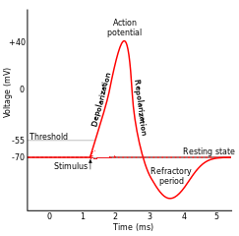
Mechanism of travel
Start with an action potential (AP) at one end of a neuron
  it started when V_{mem} was pushed high enough
Diffusion:
  it travels and damps
  but this pushes V_{mem} higher nearby
V_{mem} nearby
This is high enough to…
  trigger an AP over there!
  and over and over
Notes:
The AP was caused by a bit of extra + charge at one point.
Diffusion happens left/right as well as through ion channels!
Remember that the x axis is time, not distance

Slide 51
Traveling APs
Why don’t they reverse direction?
  Why doesn’t the green AP at x=2 diffuse to x=1 as well as to x=3?
  It does diffuse. But x=1 is in refractory mode
  Rising above threshold won’t kick off an AP
x=2
+40
x=1
0
V_{mem}(mV)
-55
-70
0
1
2
3
4
5
Time(ms)

Slide 52
Deaths/year in U.S.
2.8M deaths/year total (.9 / 100 people)
  Heart disease = 650K
  Cancer = 600K
  Coronavirus = 470K (700K / 1.5 years at 10/2021)
  Accidents = 170K
  Chronic lower respiratory diseases: 160K
  Stroke = 150K
  Alzheimer’s = 120K
  Diabetes = 80K
(from https://www.cdc.gov/nchs/products/databriefs/db328.htm)
Notes:
“Heart disease” actually includes all cardiovascular diseases.
But “stroke” is counted as a cerebrovascular disease, so it’s separate from heart disease!

Slide 53
Sensation
Numerous sensory neurons throughout the body
As expected, they head into the spine
  typically involved in several “relays” before entering the brain
  relays allow nontrivial processing before the brain
Any neuron can suppress its neighbors
  this can allow effective edge detection
  as well as producing a “winner-take-all” behavior among competing stimuli
Relays allow efferent neurons to gate incoming stimuli
  lookahead: your brain can turn off pain

Slide 54
The nervous system is really confusing!
There’s just too many neurons
Optogenetics are starting to get us there; but myelin is very good at scattering light, and so light only penetrates about 200μ into the spinal cord.
And lots of processing in the brain itself – no way to see inside
We want to intercept/alter signaling
  but it would help to have some idea how it works!

Slide 55
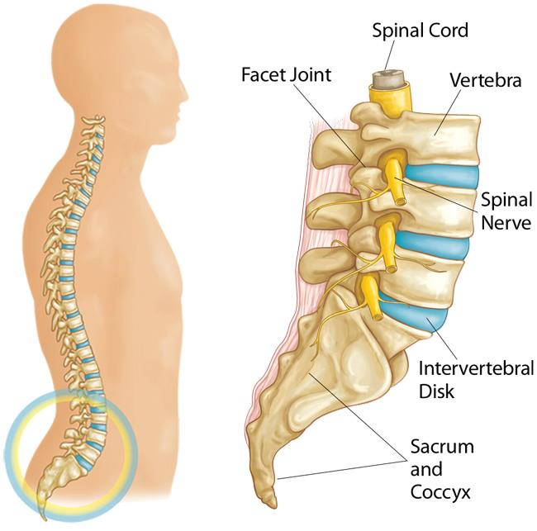
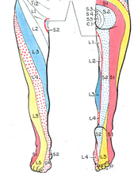
Sciatica
Nerve conduction blocked
Pain follows the path of the compressed nerve
Nothing wrong with your leg, but it still hurts!
Bulging disc
wikipedia
orthoinfo.aaos.org
Notes:
The picture here is dermatome
At the site of the compression, some/all of the afferent (i.e., sensory) or efferent (motor) neurons will not conduct; others may be partially blocked.

Slide 56
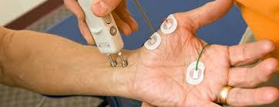
Nerve-conduction study (NCS)
A common diagnostic test
Provide the source of a signal
  You can recruit essentially 100% of the neurons
  Measure the CMAP amplitude more reliably
Known distance from source to destination
  Measure delay ⇒ compute speed
Credit: https://www.hopkinsmedicine.org

Slide 57
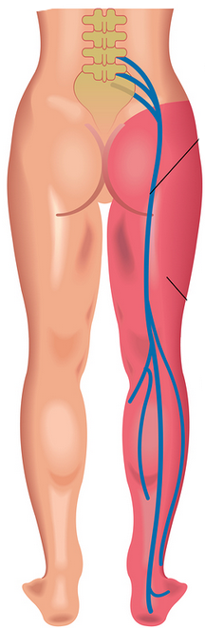
Nerve-conduction study
Where would you place the NCS driver and receiver to
  test afferent neurons?
  test efferent neurons?

Slide 58
Diagnosis problem
Symptom: patient presents with numbness in right leg
History:
  Chronic back pain, herniated disk
  Ugly, slow-to-heal bug bite just before symptom onset
Is it sciatica or a bacterial/viral neuropathy?
How will you diagnose this?
You want a test that shows a failure
Notes:
Remember from a few slides ago: at the site of the compression, neither the afferent (i.e., sensory) or efferent (motor) neurons will conduct at all
Problems…
Testing anywhere on the leg will not find any problem
Electric fields will not penetrate into the spinal cord
Yes, you can test that the peripheral nerves are working – but you really want a test that actually shows a failure, not just one that shows all is OK. And since you cannot probe in the spine, that’s hard to do!

