Slide 1
EN1 EIY
Fall 2022
Tufts University
Instructor: Joel Grodstein
joel.grodstein@tufts.edu
3 – cardiac bioelectricity

Slide 2
Big picture of the course
Where does bioelectricity come from?
Neurons and working with the nervous system
Cardiac bioelectricity
Worms

Slide 3
The heart in the news
Check them out now; cover them for a final project if you like
Atrial fib: surgery or not?
  https://www.medscape.com/viewarticle/919228
  https://www.drjohnm.org/2011/03/the-best-tool-for-treating-atrial-fibrillation
Detecting atrial fib with the Apple watch
  https://medium.com/s/story/im-a-heart-doctor-heres-why-im-wary-of-the-new-apple-watch-2b1999f2d942
  https://www.nytimes.com/2021/05/20/well/live/smartwatch-heart-rate-monitor.html

Slide 4
Table of contents
Cool cardiac facts & why we care
Cardiac plumbing and electricals
Electrocardiograms
Arrhythmias

Slide 5
Deaths/year in U.S.
2.8M deaths/year total (.9 / 100 people)
  Heart disease = 650K
  Cancer = 600K
  Coronavirus = 470K (700K / 1.5 years at 10/2021)
  Accidents = 170K
  Chronic lower respiratory diseases: 160K
  Stroke = 150K
  Alzheimer’s = 120K
  Diabetes = 80K
Mostly heart attacks
(from https://www.cdc.gov/nchs/products/databriefs/db328.htm)
Notes:
“Heart disease” actually includes all cardiovascular diseases.
But “stroke” is counted as a cerebrovascular disease, so it’s separate from heart disease!

Slide 6
Heart attack
  Blocked artery starves heart muscle
  Plumbing problem
  Heart dies over hours to weeks
Cardiac arrest
  Heart stops beating (electrical problem)
  Lose consciousness in seconds; die in minutes
  530K cases/year; 8% survival rate
  CPR, AED save lives. PSA – learn how to use one!
one cause

Slide 7
A miracle of engineering
The heart contains 2-3 billion independent cells
  Cells have high variability
  Cells are quite failure prone
They somehow link together
  to produce a coordinated, durable, and adaptable whole!
  The heart is really really really robust – a miracle of fail-safe engineering
  Multiple backup subsystems
  It’s really robust! Keeps beating and never stops
Except for the 99 varieties of heart disease…

Slide 8
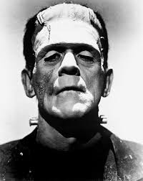
Galen of Pergamum, 130-200AD
  extracted heart keeps beating for a long period
  nobody knew why
Question: does your heartbeat originate in the brain and get sent to the heart via neurons?
Keith and Flack (1907)
  sinoatrial node initiates the heartbeat
Notes:
From Galen’s experiment, we conclude that the brain is not the source of the heartbeat – if it were, the heart would stop beating as soon as we removed it from the body
Keith and Flack first found the SA node on a mole

Slide 9
Table of contents – this unit
Cool cardiac facts & why we care
Cardiac plumbing and electricals
Electrocardiograms
Arrhythmias

Slide 10
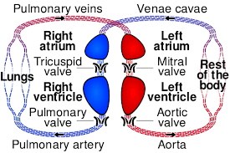
Plumbing – the big picture
Two separate two-chambered pumps
Red = oxygenated
Blue = not
Two chambers = more efficient
Stronger muscles
  on left than right
  in ventricals vs. atria
Notes:
Remember the “stronger muscles in ventricles” for when we talk about ECGs shortly!

Slide 11
What does electricity do?
Electricity drives the muscles
Muscles drive the plumbing
Similar to the rest of your body
Do you think these muscles get their signals from neurons from the brain?
Notes:
Of course, in this case the electrical signals are coming from an oscillator rather than from the brain
Note the timing – both atria contract at once, and both ventricles contract at once.

Slide 12
The pumps in operation
https://www.youtube.com/watch?v=CWFyxn0qDEU
  Mayo Clinic
https://www.youtube.com/watch?v=-s5iCoCaofc
  Suitable for younger than college age ☺

Slide 13
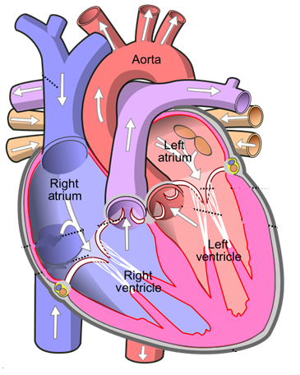
Atrial conduction
Sinoatrial (SA) node is the oscillator
Signal spreads over the atria at 1 m/s (100ms total)
  Atrial muscles contract
SA
Notes:
Normal atrial conduction

Slide 14
Conduction on the highways
Through the AV node (slowly)
Zoom through the bundle of HIS, left/right bundle branches
SA
AV
Notes:
Normal atrial conduction

Slide 15
Conduction on the highways
Then the Purkinje fibers
SA
AV
Notes:
Normal atrial conduction

Slide 16
Ventricular conduction
Purkinje fibers have seeded the AP on much of the ventricular surface
Now it squeezes the entire muscle all at once
SA
AV
Notes:
Normal ventricular conduction

Slide 17
Entrainment
Sinoatrial node has ≈ 500K cells
  Each one oscillates independently
  Potentially a slightly different frequency, phase
  How can your heart have a single unified beat?
Entrainment is the process of all the oscillators talking to each other and agreeing on a frequency
  More on this in EE 123

Slide 18
Table of contents
Cool cardiac facts & why we care
Cardiac plumbing and electricals
Electrocardiograms
Arrhythmias

Slide 19
What is an ECG?
An electrocardiogram (ECG, EKG) measures the heart’s “summed” action potential
  Each AP in the cardiac wave → small current travels through the body to the ECG electrodes (EE 123)
  Different heart cells are oriented in different directions; vector dot products cause different results depending on where electrodes are attached
Physics is very similar to sEMG
  but now, lots of cells firing in sync
More details in the ECG lab!

Slide 20
Atrial conduction
P wave= atrial APs
SA
AV
R
P
T
Q
S
Notes:
Normal atrial contraction

Slide 21
Ventricular conduction
Purkinje fibers have seeded the AP on much of the ventricular surface
Now it squeezes the entire muscle all at once
Why is QRS complex taller than the P wave?
SA
AV
R
P
T
Q
S
Notes:
Normal ventricular contraction

Slide 22
Ventricular conduction
Ventricular repolarization
  It takes current to make the cells recover from APs, also
T wave
SA
AV
R
P
T
Q
S
Notes:
Normal ventricular contraction

Slide 23
Electrocardiogram
R
P
T
Q
S
Show the following intervals:
  Heart rate
  Traverse the atria and AV node (a.k.a. the “PR interval”!)
  how long it takes for the wave to traverse the AV node (a.k.a. the PR segment)
Notes:
HR = distance from any feature on 1st wave to 2nd wave
PR interval = start of P to start of QRS
PR segment = end of P to start of QRS
QT interval = start of QRS to end of T

Slide 24
Table of contents – this unit
Cool cardiac facts & why we care
Cardiac plumbing and electricals
Electrocardiograms
Arrhythmias
  so many things can go wrong ☹

Slide 25
Atrial conduction – review
Sinoatrial (SA) node is the oscillator
Signal spreads over the atria at 1 m/s (100ms total)
  Atrial muscles contract
SA
AV
Notes:
Normal atrial conduction

Slide 26
Your heart, on AFib
Loop starts at an ectopic pacemaker
Goes round and round with no input from SA node
  Called a reentrant arrhythmia
  May take a slightly different path each time
  Waves spread out from the loop, some go through AV node and trigger ventricles
SA
AV

Slide 27
Atrial fibrillation
R
P
T
Q
S
No P wave – why?
HR is irregular – why?
Frequency usually about 150 bpm
  Ventricles pumping inefficiently but still pumping – why?
  You can limp to the phone to call 911

Slide 28
https://watchlearnlive.heart.org/index.php?moduleSelect=atrfib
Traditionally requires a one-way path (again, see EE 123)
Notes:
The question of *why* it requires a one-way path will be on the quiz

Slide 29
Atrial fib causes
Causes:
  Congenital heart disease of many types
  Sedentary lifestyle (via diabetes, obesity, high blood pressure)
  “Excessive” endurance exercise!
  Exercise is a powerful drug, with a dose/response curve
Cures
  Various drugs
  Ablation
  Rest, sleep or time

Slide 30
Ablation
Find the ectopic pacemaker
Surgically break the loop
SA
AV

Slide 31
Ablation
Find the ectopic pacemaker
Surgically break the loop
  Either burn or freeze the relevant heart tissue
SA
AV

Slide 32
Ablation
Find the ectopic pacemaker
Surgically break the loop
  Either burn or freeze the relevant heart tissue
  Like any procedure, it’s not risk free
SA
AV

Slide 33
Bundle-branch block
What it is
  delay or blockage in left or right BB
Symptoms
  None (majority case)
  Fainting, dizzyness
Causes
  Prior heart attack, bacterial infection, high blood pressure, …
  Genetic
  Too much exercise
Consequences
  often none
SA
AV

Slide 34
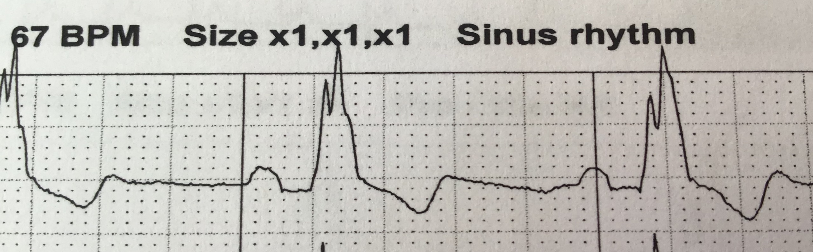
RBBB example
Diagnosis: wide QRS complex
  .1-.12s → partial block (not uncommon, especially in endurance athletes)
  >.12s → complete block (less common)
Is this ECG normal, partial RBBB or complete?
Notes:
Do the math – there are 5x5=25 squares per second, so each square is .04 sec.
So I would call this about .12s – right on the border between partial and full. However, note that it has been separately read at .144 sec.

Slide 35
RBBB – not a big problem
The RBBB is mine!
Any reason I’m still alive (and not overly concerned)?
Heart cells are quite interconnected
  Left branch crosses over to drive the right side
  Right side is “just” the lungs anyway ☺
SA
AV
Notes:
Normal atrial conduction

Slide 36
RBBB example
Why does RBBB cause wide QRS?
  Blocked RBB → you must hit the right ventricle from a longer path that crosses from the left
  Slow RBB → don’t seed the right ventricle as quickly (and the QRS includes both ventricles contracting)

Slide 37
Electrical control of HR, BP
Sympathetic nervous system increases heart rate:
  releases norepinephrine, which helps to open HCN channels and thus speed up phase 4
  it also makes the AP triggering voltage more negative
Parasympathetic nervous system slows HR:
  releases acetylcholine, which decreases [cAMP]
  does the opposite of the above
Baroreceptors: arterial stretch receptors
  detect changes in arterial pressure and communicate this to the medulla oblongata in the brainstem
  … which then controls heart rate as described above, as well as changing circulatory muscle tone
  End goal: feedback loop controlling blood pressure
  Salt seems to affect it; nobody knows why
  Your brain is the mysterious box controlling it all

Slide 38
CVRx
Change to https://axontherapies.com (which is Imran’s)
Barostim-NEO device
  one in three high-blood-pressure patients is resistant to drugs
  they are the target audience
Mechanism:
  activate baroreflex; reduces sympathetic activity and increases parasympathetic activity
Results:
  http://www.barostimtherapy.com/en-gb/node/86
  FDA approval Aug 2019 (implantable device)
Also used for heart-failure patients
  Often, too much sympathetic (too little para) activity causes pathological myocardial remodeling that worsens the condition

Slide 39
What comes next?
Cardiac bioelectricity is a large and important field
  Cardiac electrophysiologists make it their career!
  Tons of research to be done
Lots to be done at Tufts
  EE123: covers this, plus more arrhythmias, cardiac simulation, gap junctions
  BME 122 (quantitative physiology): lots of plumbing
  Lauren Black: cardiac signaling research

Slide 40
BACKUP

Slide 41
Electrocardiogram
R
P
T
Q
S
Match the ECG features with:
  SA node firing
  atrial depolarization
  atrial repolarization
  AV-node delay
  ventricular depolarization
  ventricular repolarization
Figure this out or look it up yourselves or ask me
Notes:
P = SA firing, atrial depolarization
PR = delay through the AV node (even though it’s really from P to Q)!
QRS = ventricular depolarization (and hidden atrial repolarization)
T = ventricular repolarization

Slide 42
PVCs
Doesn’t go anywhere (ventricles still refractory)
SA oscillator (50bpm)
Ventricular AP
Premature Ventricular Contraction (PVC) sounds like a “skipped” pulse
Ectopic* focus
A random firing in the ventricles
Ventricles not full; little blood pumped
*Ectopic=in the wrong place

Slide 43
PVCs
Ectopic* focus
could happen
Ventricular APs at 80 bpm HR
Now, at 50 bpm
Why are PVCs more likely with lots of endurance exercise and little sleep?
  lots of exercise → HR lowers (well known)
  lots of stress → more ectopic foci (hypothesized)
  benign except if you overdo it for a long time
Notes:
The red zone is where an ectopic focus could cause a PVC. Really, we’re showing the ventricular APs; but it’s the SA oscillators controlling the rhythm. This really has nothing to do with the redundancy system!

Slide 44
PVCs
Backup circuits are great – what if they break?
  Yes, you have no backup. Or...
Backup circuit launches when it shouldn’t
  one way to make an ectopic focus
Too much exercise = more PVCs?
More info:
  https://www.drjohnm.org/2013/06/benign-pvcs-a-heart-rhythm-doctors-approach/
  https://www.drjohnm.org/2015/08/on-pvcs-think-anew-but-think-slowly/

Slide 45
“The current record for number of dominoes toppled in one cascade is just shy of 4.5 million, a record set in the Netherlands on Domino Day 2009. It took a team of 89 builders 2 months to set up! Because a misplaced foot or finger could easily trigger the entire array, it had to be designed with breaks that were completed immediately before the competition began
Because the myocardium does not have such safety features, every cell in the heart has the potential to become the primary pacemaker should its membrane become unstable. “Ectopic” pacemakers are responsible for common mishaps leading to premature ventricular contractions, which are typically one-off events in young, healthy hearts. In aging hearts, ectopic pacemakers may become established, posing a constant and potentially lethal threat to cardiac function.”
Lippincott’s Physiology, 2nd edition, Chapter 16

Slide 46
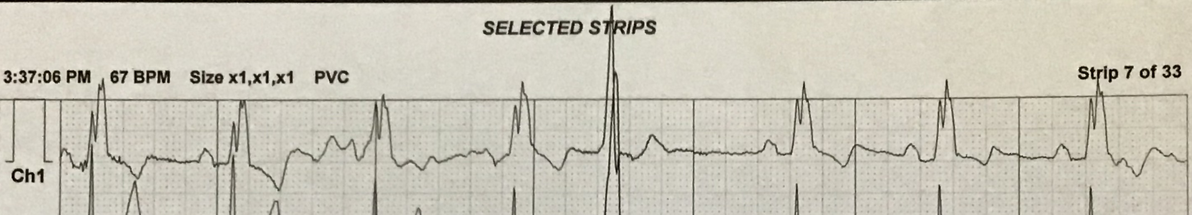
Can you find the PVC?

Slide 47
Do you think that PVCs would get more or less frequent as HR rises?
  More while you’re exercising?
  Or while sleeping?

Slide 48
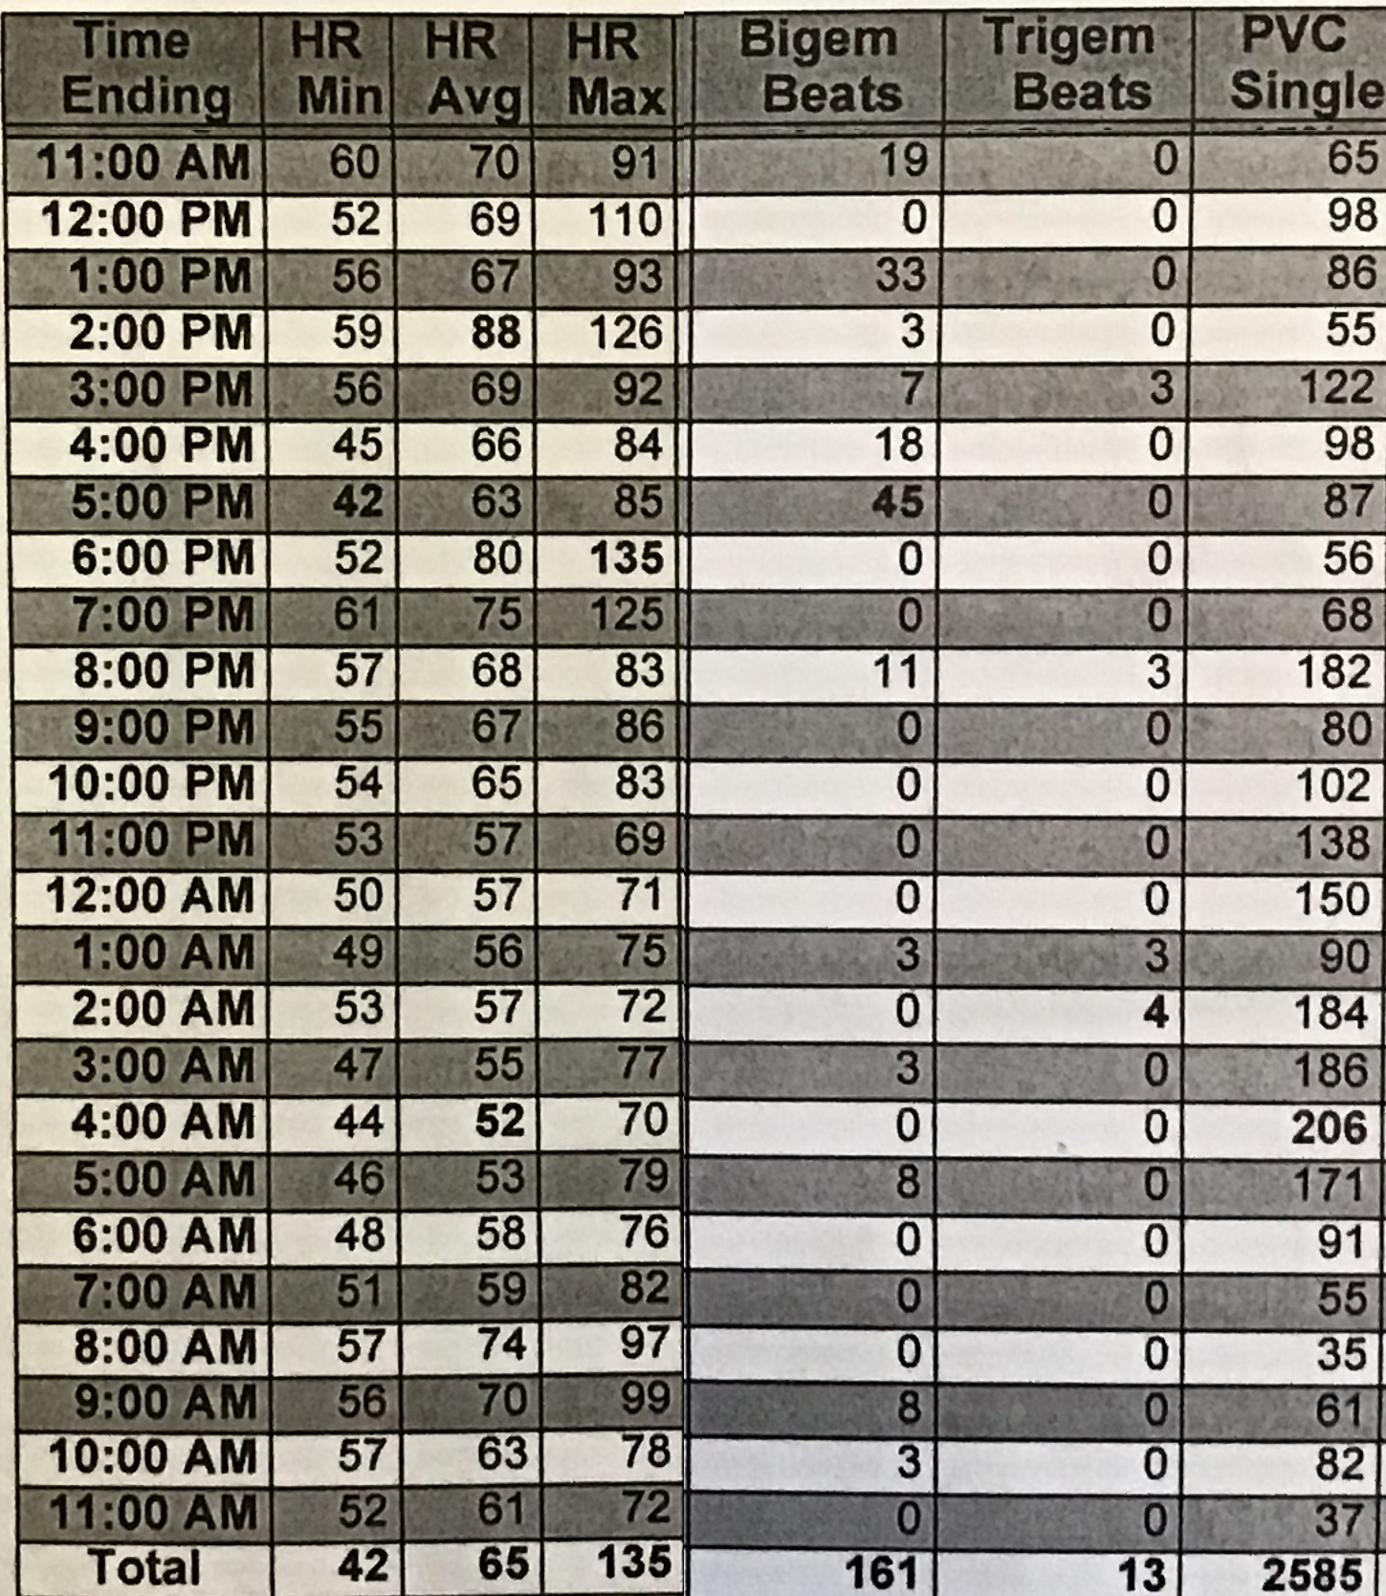
Bigeminy: 2 consecutive PVCs
Trigeminy: 3
Conclusions?

Slide 49
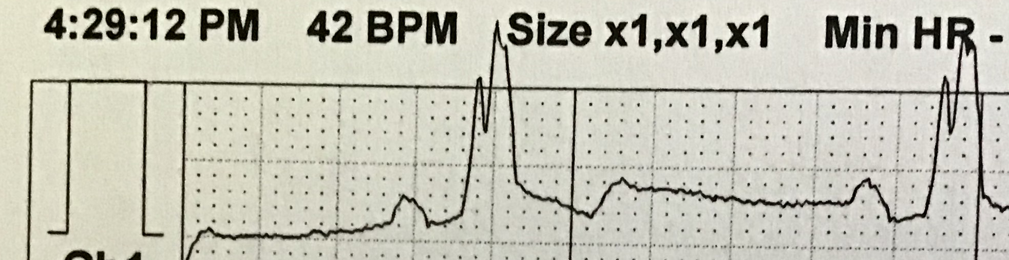
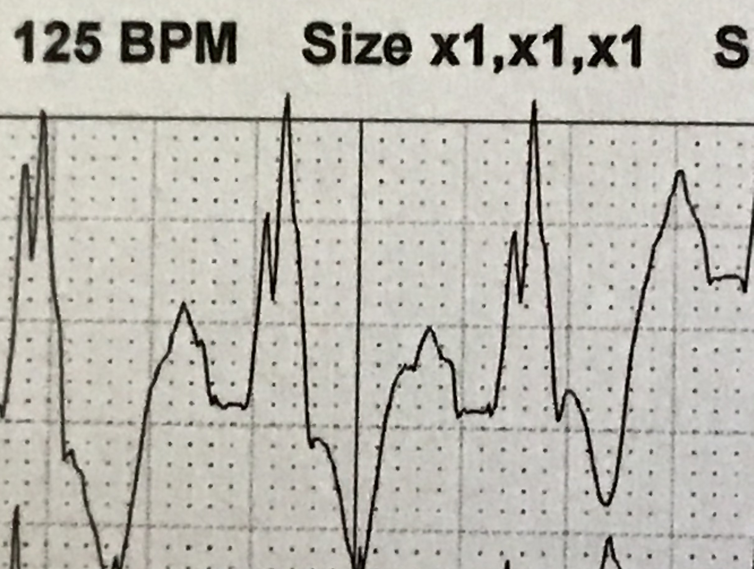
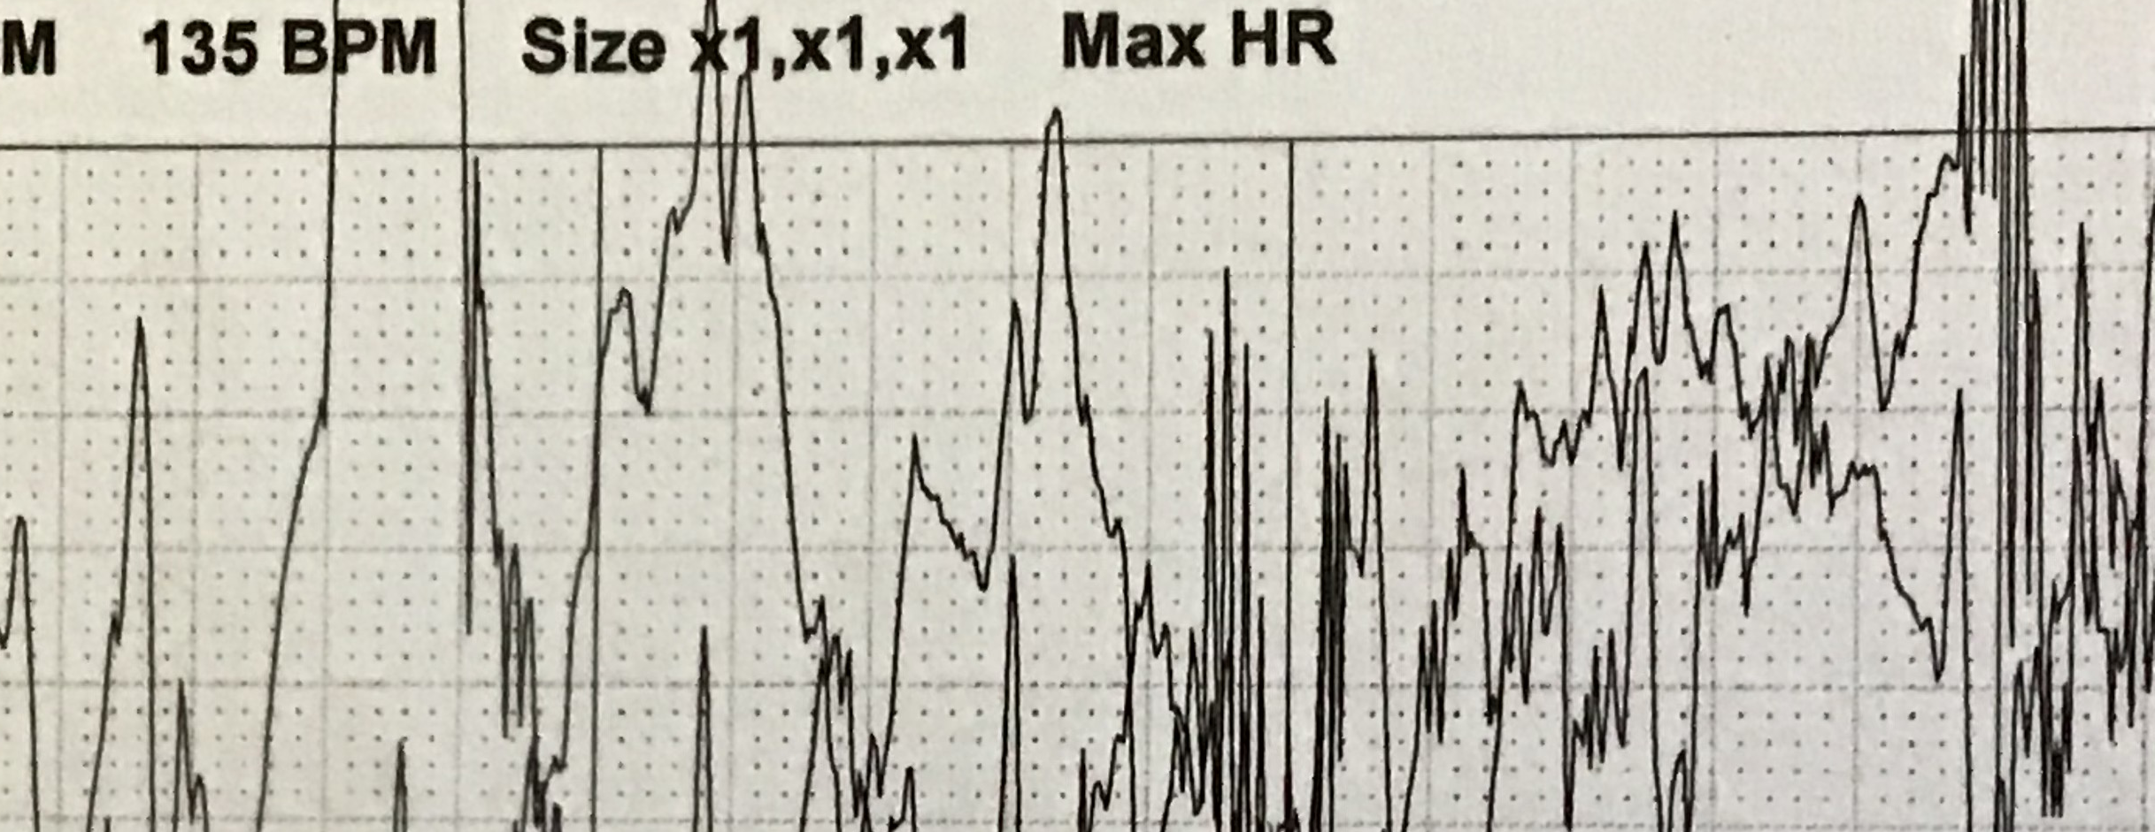
Does PR segment shorten as heart rate increases?

Slide 50
Table of contents – this unit
Cool cardiac facts & why we care
Cardiac plumbing and electricals
Electrocardiograms
Arrhythmias
Backup-system engineering

Slide 51
Why have fail-safe circuits?
Remember cardiac arrest vs. heart attack?
  Cardiac arrest = heart stops beating
  Lose consciousness in seconds; die in minutes
Keeping the heart beating is job #1!
But success seems unlikely:
  Cells die all the time
  We just discussed so many things that can go wrong
  Biological cells are unreliable
So why are we alive?
  A miracle of beautiful system-level design

Slide 52
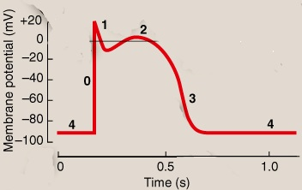
AV node blocks
Remember what the atrioventricular node was?
  Electrical connection from atria to ventricles
AV node propagation is purposely quite slow
  Why?
  How?
Issue with purposely-slow conduction
  increased likelihood of conduction failure ☹
Why don’t they kill you?
Backup system in place
  to be discussed
Let the ventricles fill before they pump
decreased density of Na+ channels; slows down phase 0
lower GJ density

Slide 53
Triple redundancy
The main operation is simple – SA node oscillates ≈ 60 bpm
But what if the upstream rhythm breaks?
  Quick review: how can it break?
SA
AV
ventricles

Slide 54
Triple redundancy
The main operation is simple – SA node oscillates ≈ 60 bpm
But what if the upstream rhythm breaks?
  Quick review: how can it break?
The AV node can also oscillate!
  Now we have a backup in case of atrial fib, AV blocks
But what if the bundle of HIS, or LBB & RBB are both blocked?
SA
AV
ventricles

Slide 55
Triple redundancy
The main operation is simple – SA node oscillates ≈ 60 bpm
But what if the upstream rhythm breaks?
  Quick review: how can it break?
The AV node can also oscillate!
  Now we have a backup in case of atrial fib, AV blocks
But what if the bundle of HIS, or LBB & RBB are both blocked?
  The Purkinje fibers can also oscillate!
SA
AV
ventricles

Slide 56
System-level coordination
Three oscillators; only one is needed
What happens if they all turn on at once?
  chaos ☹
  lots more in EE 123

Slide 57
Slide summary for pruning
Afib: 24-31 (8 slides)
RBBB: 32-35 (4 slides)
Backups: 37-42 (6 slides)
System-level control: 42-44 (3 slides)

