Slide 1
DELPHI · ScienceClaw 2026
EVIDENCE IN HAND
Which experiment would
justify the next step?
We turn claims about how life works into experiments a machine can check —
and say plainly when the evidence is not there yet.
VFVS
VFMS
SFMS
SIMS
SIMG
SIKG
AIKG
A real route through a real enzyme: every step measured, every step uphill, the whole thing machine-checked.

Slide 2
DELPHI · ScienceClaw 2026
EVIDENCE IN HAND
Science has a backlog.
880
16
claims pulled out of Darwin, Thompson, Turing, Wolfram and others
of them tested against real data this weekend
The gap is the opportunity, not an embarrassment. Most of these claims have never had a dataset pointed at them, because nobody had a cheap way to ask which dataset would settle which claim.

Slide 3
DELPHI · ScienceClaw 2026
EVIDENCE IN HAND
So we built the asking machine.
Each stage is narrower than the last, on purpose. A claim only advances when a named dataset can settle it and two independent assessors agree it can.

Slide 4
DELPHI · ScienceClaw 2026
EVIDENCE IN HAND
Ten specialists, one chain.
A1
say it plainly
A2
find the sources
A3
name the species
A4
find the data
A5
inventory
A6
all scales?
A7
write the maths
A8
run the test
A9
is it faithful?
A10
publish it
Two rules carry most of the weight. Nothing scores its own work, so the agent that runs a test never judges it. And every test is written down before the data is opened, so a disappointing answer stays the answer.

Slide 5
DELPHI · ScienceClaw 2026
EVIDENCE IN HAND
Six changes. No usable shortcut.
at κ = 2, the setting used for the result
VFVS
VFMS
SFMS
SIMS
SIMG
SIKG
AIKG
at κ = 2.45, one step stops being defensible
VFVS
VFMS
SFMS
SIMS
SIMG
SIKG
AIKG
Going straight needs 6 changes; every direct ordering drops downhill somewhere, so the usable path is a 6-step detour. Demand a little more margin and the route breaks. That is the product: it tells you which measurement would settle it.

Slide 6
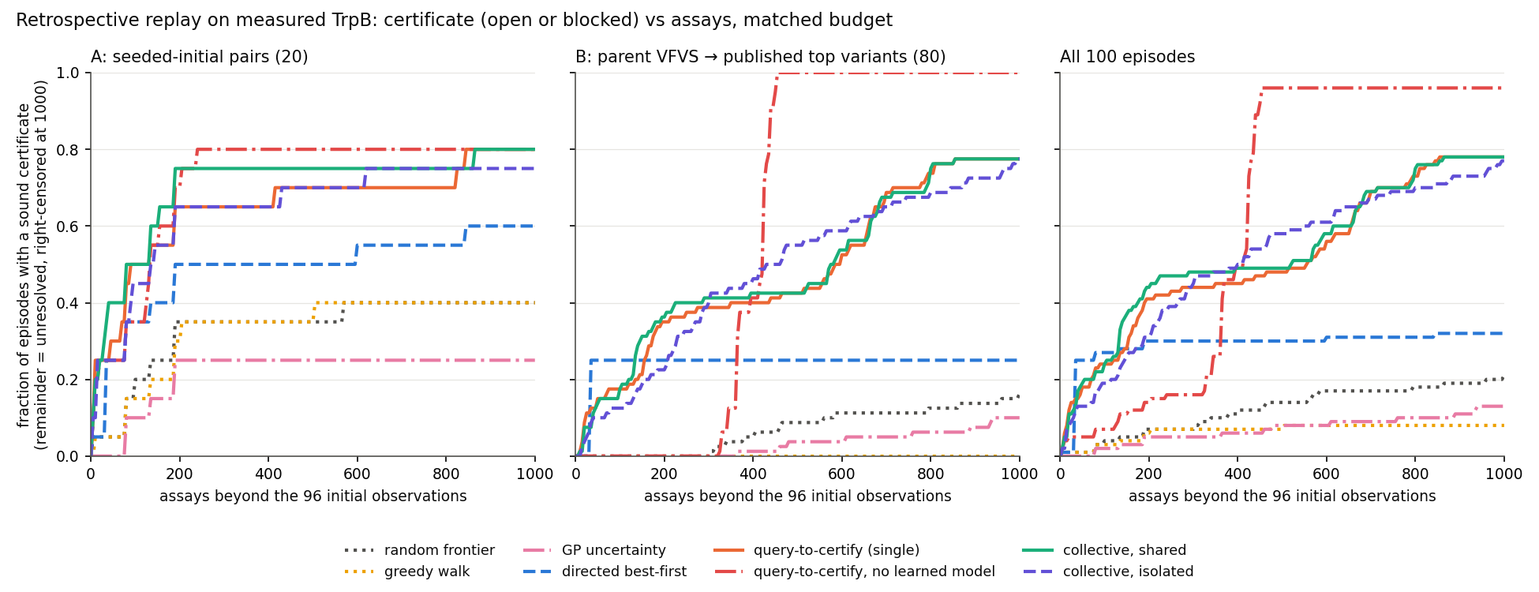
DELPHI · ScienceClaw 2026
EVIDENCE IN HAND
Asking beats guessing.
Same budget, same starting data, 100 runs each. Picking experiments to settle the question beats chasing the best-looking variant — and nobody issued a single false certificate.
Correct certificates against assays spent, 1,100 replay episodes, 11 policies — delphi-evolve artifacts/core/replay/cert_vs_assays.png, plotted by that project from its own replay episodes

Slide 7
DELPHI · ScienceClaw 2026
EVIDENCE IN HAND
Then we tried to break our own best result.
18
1
80
extra wins on their panel, over 100 runs
pair separating the top two on our 20 fresh pairs
of their 100 runs start from the same genotype
The ranking held; the margin did not. We pre-registered the panel before running it. A gap of 18 collapsed to 1 once the pairs were not chosen by the people being measured. The benchmark was partly measuring its own composition.

Slide 8
DELPHI · ScienceClaw 2026
EVIDENCE IN HAND
A group beats one agent — when attention is the bottleneck.
Two pre-registered runs, same model and budget, out of 20 each. The single agent lost mostly by running out of room and leaving answers blank, not by reasoning worse. The same contest on the enzyme benchmark found no advantage at all, because there the members are deterministic code. Collaboration pays when the limit is attention.

Slide 9
DELPHI · ScienceClaw 2026
EVIDENCE IN HAND
Two independent swarms. Same claims. Six of eight agree.
6
2
129+16
of 8 claims where both swarms reached the same verdict, working separately
where they differ — both differences methodological, not factual
claim tests across the two swarms
darwin1859-ch11-13: ours supports · theirs mixed — different operationalisation of the same sentence
thompson1917-ch03-07: ours supports · theirs mixed — same data, same method, different pre-registered age range: 2.74 for ages 2-19 vs 2.41 once infants are pooled in
Nobody coordinated these; the overlap was accidental. Then we chased the disagreements down. On Thompson's cube law the two swarms reproduce each other exactly once the age range matches: their own 2-20 year window gives 2.74, ours 2.76. The whole gap is infants, who scale near 2.1 and drag the pooled exponent to 2.41. The verdict turns on one pre-registered choice, not on anyone's method. Neither number is 3.

Slide 10
DELPHI · ScienceClaw 2026
EVIDENCE IN HAND
We broke the proofs on purpose.
7/7
clean
8
deliberate breakages correctly rejected
rebuild from source, on our own copy
of our own laws machine-checked, zero gaps
Reversing an inequality, weakening a wall, deleting a check, moving one measured number — each must stop the proof compiling, and each did. The theorems are general, not arithmetic about fixed constants. Found by checking rather than trusting: one receipt in the partner project credits a proof module that does not exist in its repository. The proofs are sound; the paperwork overstated the coverage.

Slide 11
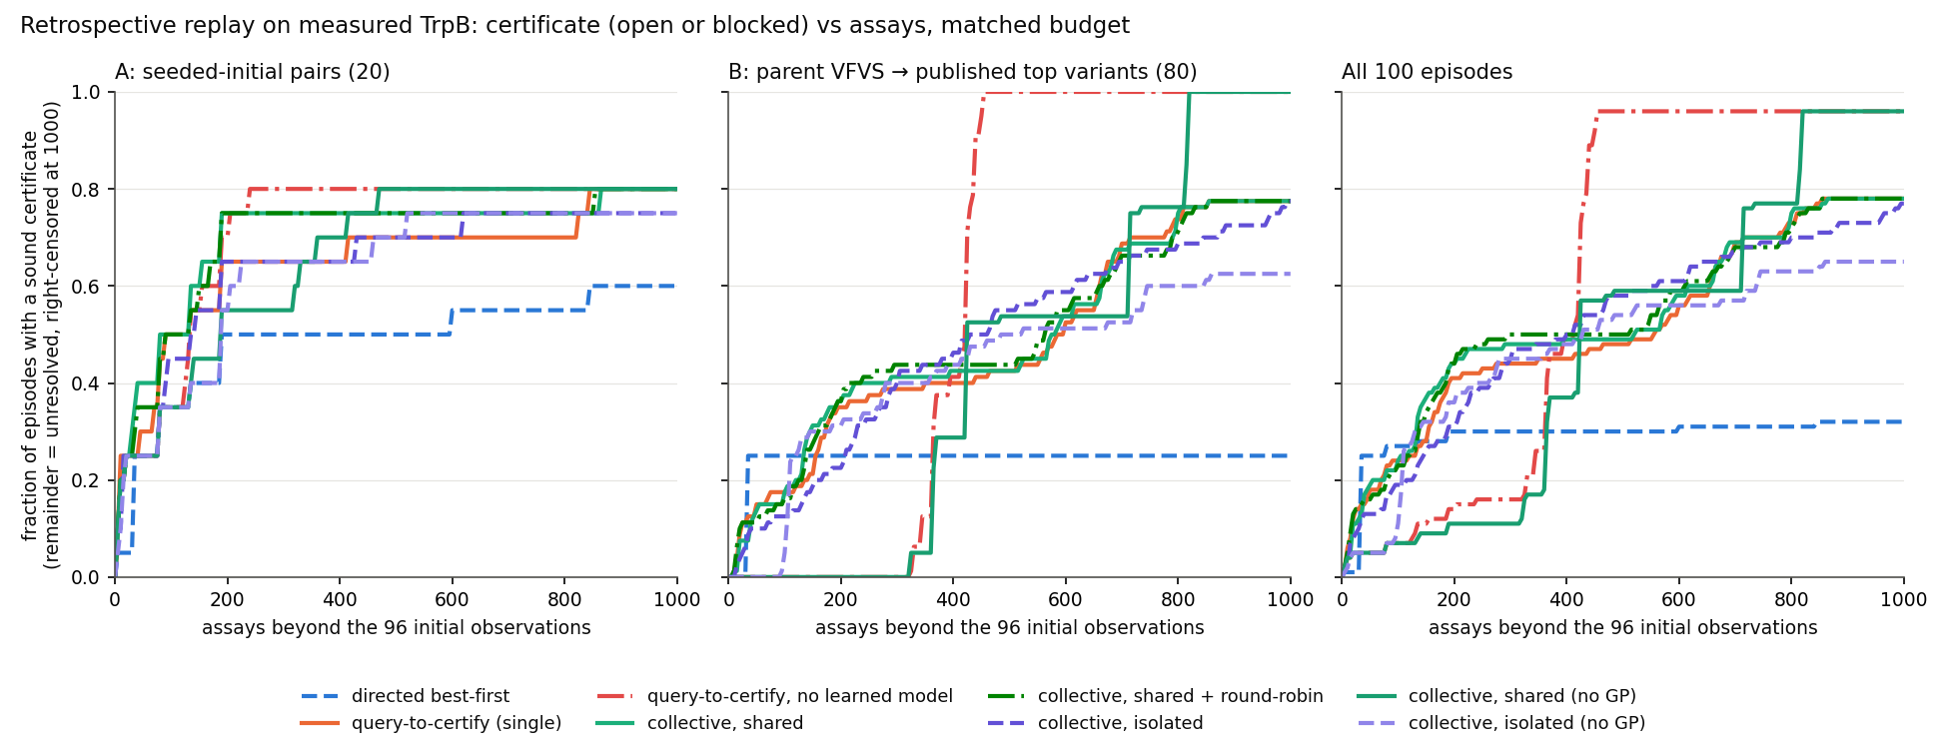
DELPHI · ScienceClaw 2026
EVIDENCE IN HAND
Two things that did not work.
0
0
benefit from a protein language model, across 5 sizes and 160,000 variants on an H100
saving from reusing a claim, over an ordinary cache, within one context
A deliberately shuffled model scored as well as the real one. We lead with this because a null you can reproduce is worth more than a result you cannot — and because most teams will not show you theirs.
Remove the learned model and the curves do not move — delphi-evolve artifacts/core/replay/ablation_cert_vs_assays.png

Slide 12
DELPHI · ScienceClaw 2026
EVIDENCE IN HAND
More of this is negative than positive.
That is the result.
11 negative or self-limiting
4 methodological, found by accident
6 supported
4 claims corrected in one day — 3 found by our own checks, 1 by a collaborator's independent cross-check: The gja5a fin-length link, withdrawn (caught by our own cell-to-cell check); The flying-fish genome claim, wrong (caught by the project lead, not the thread that published it); A declared null, withdrawn (caught by our own curation pass, not the thread that wrote it); An overstated “settled”, withdrawn (caught by a collaborator’s independent cross-check). Every one is a record or a log entry, never a silent edit to history.
This is an argument about method, not an apology. 15 of 21 records are not a win for the hypothesis we set out to test: 11 are negative or self-limiting and 4 are methodological findings we only have because something broke. A pipeline that mostly produces negatives, corrects itself in public and refuses statistics its sample cannot support is making a stronger claim about its method than one that reports only wins — because only the first kind can be wrong out loud.

Slide 13
DELPHI · ScienceClaw 2026
EVIDENCE IN HAND
We pre-registered a test of a designed organism.
It failed.
SAY THIS FIRST: the design is not ours. It is Daane et al. 2021's own germline double heterozygote — built, scored and published by them, with their own claim that it phenocopies flying-fish fin proportions. Our contribution is the validation arithmetic, not the organism. We did not design a flying fish.
Morphological axes that could be scored at all
1 of 10
The axis the design is about, pectoral fin length / SL, cannot be scored on either side: no published adult zebrafish value exists, and the design's value exists only inside a figure we refused to digitise.
Loci known to differ in flying fishes that the design TOUCHES — a near miss, not a hit
1 of 74 · 1.4%
Same gene, different variant. lat4a/slc43a2a is genuinely in Daane's convergent-substitution sheet, so the design touches the right gene — but the zebrafish allele this project's design uses is T200K; the convergent substitution reported in flying fishes is F326L. Different sites, different species, and not the same variant. The design changes a different position in the same transporter, not the change flying fishes carry. The other half of the design, kcnh2a, appears nowhere in that workbook.
The Lean constraint gate
FAILS, both arms
It fails for the design (2 violated) and for the real flying fish (1 violated), so failing does not separate the design from its target. The gate is weak: only 3 of 21 rows are decided by a single design, and it tests nothing aerodynamic, nothing developmental and nothing about fins.
Dropped as unsupported, not disproved, under the pre-registration's own rule. The honest framing is also the stronger one: we built the apparatus to ask whether a designed organism matches a real one, wrote the test down first, ran it, and it failed — which is why we can now say what designing an organism would require. At a single scored axis none of the pre-registered FAIL triggers could fire, so the letter of the rule would have awarded "close" by default; the agent refused that and logged it as a deviation against the design's own interest. Pre-registration hashed before the first number, sha256 ea6f99eb25b48cdb… (verified unaltered).

Slide 14
DELPHI · ScienceClaw 2026
EVIDENCE IN HAND
We said there was no genome. There is.
23,611
99.5%
0
protein-coding genes predicted in the flying-fish assembly
of them carry at least one database hit (23,492 genes)
occurrences of "RNA-seq" or "transcriptome" in that paper, counted
What we said, and what changed: until this weekend our own files, our brief to ten subagents and the public dashboard all said that almost no molecular data exists for flying fish. That was wrong, and it was load-bearing — it was repeated on every number in the map. 9 files were rewritten and the error recorded as its own citable correction. And the caveat on our own headline: "functionally annotated" means one sequence-similarity or domain hit. TrEMBL alone supplies 23,477 of the hits and is automatically generated and unreviewed, so 99.5% measures database coverage, not understood function.
This is the cleanest statement of the gap we face. The genes are known; what is missing is measurement. That paper reports no expression data, no mutant, no kinetics and no regulatory network, and the zero is established by counting strings in the full text rather than by inference. Xu et al. 2021, Frontiers in Genetics 12:695700, doi 10.3389/fgene.2021.695700.

Slide 15
DELPHI · ScienceClaw 2026
EVIDENCE IN HAND
84.4% annotated. 0% parameterised.
0
84.4%
449
of the 18,733 numbers a minimal dynamical model of our 4,571 genes would need
of the same genes carry a functional annotation (3,857 of 4,571)
of 10,444,735 gene pairs with any direct experimental support (0.00430%)
This is not a complaint about missing data; it is a measurement nobody had made. Annotation says this gene is involved in this process. A simulation needs this many molecules, decaying this fast, binding this tightly — and the first does not constrain the second. Relaxed as far as honesty allows, accepting a relative abundance figure in place of an absolute one, it is 2,972 of 18,733 (15.9%), and every one of those is that same single substitute. For scale: the whole-cell model that predicts phenotype from genotype used 525 genes and over 900 primary sources, for a single cell with no anatomy and no development (Karr 2012, 10.1016/j.cell.2012.05.044).

Slide 16
DELPHI · ScienceClaw 2026
EVIDENCE IN HAND
Sustained powered flight is eliminated,
with a certificate.
0.0357 W
1.347 W
38x / 29x
aerobic ceiling on the proxy values we commit to
needed for level flight at 10 m/s at the measured L/D of 4.37
short on those proxies, and on the widest combination the measured record allows — both checked by the Lean kernel
the measured specimen at the low end of the field speeds, 10 m/s
1.347 W needed · 38x short
the hypothetical flier, 7 m/s [illustrative numbers]
0.943 W needed · 26x short
the measured specimen at its minimum flying speed, 9.85 m/s
1.327 W needed · 37x short
TWO CEILINGS, AND THE SMALLER MULTIPLIER IS THE STRONGER CLAIM. 0.0357 W is the product of the four proxy values this candidate commits to, so 38x rules flight out for THAT ONE PARAMETERISATION. 0.0458 W instead takes the MAXIMUM of each measured teleost range (eta <= 0.15, E <= 19.35 J/ml, Q <= 0.075 ml/s, Ca <= 0.21 ml/ml), so it is necessarily the larger ceiling and the smaller multiplier — and 29x rules it out for EVERY animal the measured record allows. Neither supersedes the other: different quantities, both kernel-checked. Reject it and C14 still rules, but only on the particular proxies a candidate commits, not on every teleost.
What it rests on: Fick's principle, aerobic power rather than burst power, and teleost proxy values — no flying-fish physiology exists, so the proxies are what the elimination rests on. What it does NOT bound: gliding (a flying fish is a glider), and short burst flight. 3 of 3 candidates eliminated by theorems the compiler accepted; 41 other constraints on the same candidates could not be fired at all, for want of an input. A proof about a model, not a fact about a fish.

Slide 17
DELPHI · ScienceClaw 2026
EVIDENCE IN HAND
What a fish that really flew would need,
and no animal has.
29.5%
2,365
of the required flight muscle actually fits inside the body at the pectoral girdle, in the geometry the specification itself implies
ml/min/kg of cardiac output — 36x the sourced fish maximum
A flight muscle that does not fit in the animal. At 16% of a 60 g body and ordinary muscle density that is 9.06e-6 m³ of muscle, and only 29.5% of it fits inside the body at the pectoral girdle. That is a geometric consequence of the specification, not an opinion — and building the design as real geometry was itself a test, which caught something three rounds of equations did not.
The flier is hypothetical throughout and now carries a requirement nothing can satisfy. It is not a validated design, and nothing in this deck presents it as one.

Slide 18
DELPHI · ScienceClaw 2026
EVIDENCE IN HAND
One glide cannot explain the long flights.
A steady glide can only trade height for distance, so its range is at most height times lift-to-drag. At the measured ratio that is 35 m from the greatest recorded flight height, or 40.7 m once the measured ground effect is allowed — and the field reports 50 m. So the single-glide reading is eliminated, and taxiing re-launches or wind must account for the rest. The field figures are quoted second-hand and labelled secondary; the 400 m one is already described by its own source as a sequence of taxiing and glides, not one glide. Our simulator reproduces that shape: 6 glides and 288 m in 23.4 s, from a model changed after seeing results, so that run is exploratory and labelled so.

Slide 19
DELPHI · ScienceClaw 2026
EVIDENCE IN HAND
Four sequence results. Three of them say no.
Gliders do not converge
11 vs 17
Across 9 fin genes, 11 alignment columns show a residue shared by independent gliders and absent from each lineage's non-gliding relative — against 17 for the same count with the roles swapped. Similarity follows ancestry, not gliding. The genes were picked from fin biology, so this says nothing about the rest of the genome.
The lat4a substitution tracks gliding inside the fishes only
8/9 · 23/24
L in 8 of 9 flying fishes and in both gliding halfbeaks, against 23 of 24 non-gliding relatives carrying F. But all three bats, both colugos, the sugar glider, mouse, human and every outgroup scored carry F too, so this is not convergence with gliding mammals. Tracking is not causing.
The derived-site panel is not a dose-response
24 at 0.274 · 21.4 at 0.687
Gliding halfbeaks carry a mean 24 of 38 derived states at a fin-to-body ratio of 0.274; flying fishes carry 21.4 at 0.687. The group with the far smaller fin carries slightly more derived residues. The non-gliders' zero is circular by construction and is not shown as a finding; four groups is a ladder to read, not a statistical test.
An "engineered" genome is a handful of edits
1 vs 7,300
2 edited loci change 1 amino acid; the other edit is regulatory and changes none. In just 37 of our causal-chain proteins, zebrafish and medaka differ by 7,300 amino-acid substitutions (16,054 positions counting indels). Coding only, in a tiny gene sample.
All four are about fin enlargement for gliding, the trait Daane et al. 2021 measured (10.1016/j.cub.2021.08.054); the fin ratios, the convergent-substitution panel and the captured exons are theirs. Three of these close a door we would have liked open, and the one that holds, holds only inside the Beloniformes. No bird sequence, assembly or annotation was fetched: Aves is this project's frozen holdout.

Slide 20
DELPHI · ScienceClaw 2026
PARTLY EVIDENCED
357 named pieces. 23 measured numbers behind them.
Evidence-backed: the flying fish rests on exactly ONE measured proportion — pectoral fin length at 0.687 of standard length, the median of 49 museum specimens, read from the measurement file rather than typed in (preserved museum specimens; length only (no fin area, shape or spread)). The two zebrafish models carry 22 sourced proportions and counts between them. Schematic, and labelled so per piece: everything else, including every count. Where the ontology ran out: 60 of the flying fish's pieces have no ontology term at all; the manifest records a null and the nearest ancestor it could find, instead of inventing one.
The one novelty claim we make, worded as narrowly as the search supports: we did not find prior use of a proof assistant on an ontology-derived anatomy hierarchy. Ten logged searches turned up no Lean, Coq or Isabelle proofs about a hierarchy built from Uberon and the Cell Ontology. That is "not found", not "does not exist", and it is not a claim to a first. Built on Uberon (10.1186/gb-2012-13-1-r5), the Cell Ontology (10.1186/2041-1480-5-21) via Ubergraph, Phenoscape (10.1093/molbev/msv223, 10.1093/sysbio/syv031) and Daane 2021 (10.1016/j.cub.2021.08.054). The anatomy terms are theirs; only the hierarchy check is ours.

Slide 21
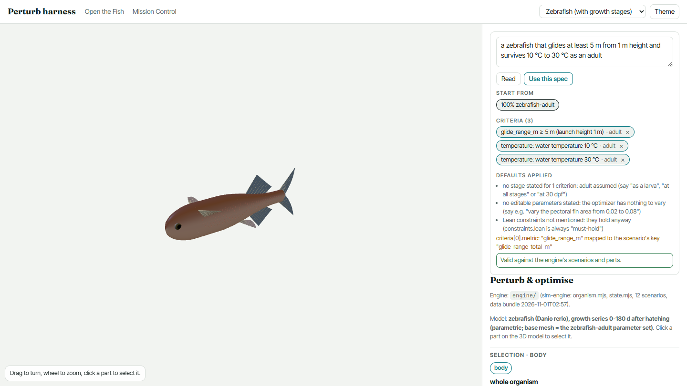
DELPHI · ScienceClaw 2026
EVIDENCE IN HAND
Say what the animal must do.
The studio says what it would take.
Edit at any level
body, organ system, organ, tissue, cell, gene; humans and agents in one append-only co-design log. Agents post proposals; a human applies them.
11 perturbations, every developmental stage
altitude, current, daynight, digestion, glide, grip, predator, pressure, sleep, temperature, wind.
Every number keeps its kind
measured, borrowed, derived, calibrated or assumed; a calibrated number can never be cited as a result.
The optimizer refuses
any candidate that breaks a binding law, and says “no design meets the spec” instead of returning its best failure.
What it is not: an edited parameter set is a shape, not a viable or breedable organism; mixing parents is morphological interpolation, not genetic hybridisation. Law verdicts are floating-point checks of Lean-backed formulas, not kernel proofs.
Typed: “a zebrafish that glides at least 5 m from 1 m height and survives 10 °C to 30 °C as an adult”. Read into 3 criteria, valid against the engine; every default it assumed is listed. Real page, real engine (engine/ (sim-engine: organism.mjs, state.mjs, 12 scenarios, data bundle 2026-11-01T02:57).); screenshot 2026-11-01T02:58:14.064Z, sha256 d25e671ed14e4cfb…

Slide 22
DELPHI · ScienceClaw 2026
EVIDENCE IN HAND
The laws are data, with version numbers.
PROPOSED
CANDIDATE
ACCEPTED
CONTESTED
RETIRED
7
9
31
3
2
4 physical · 3 biological
stated, not formalised: enters no verdict
3 physical · 6 biological
builds, no sorry/axiom, witness, mutants rejected: advisory
11 physical · 20 biological
recorded human approval: the only laws that turn a design red
0 physical · 3 biological
proved contradiction or live dispute: amber
0 physical · 2 biological
kept on file so old verdicts reproduce
Law set 1.2.0 pins 52 laws, each with its version, a content hash over what it says, the Lean module and theorem, and the commit and statement hash it was checked at. Promotion to accepted is never automated. 4 further candidates were mined from the project's own sourced data.
Served three ways from one loader: the hosted delphisci MCP server 0.3.0 (lean_laws_list, lean_law_get, lean_lawset_get, lean_check, lean_verify); the CLI and local sim-engine; and a static JSON mirror at /api/lean/, currently serving law set 1.2.0 (52 laws).
Red on the model means an accepted law is violated; amber means contested, candidate or not checkable. A law's status is a registry decision, not a truth value, and the accepted set was grandfathered in at bootstrap with no per-law review recorded; the approval field says exactly that. Read from lean/registry/ and dashboard/public/api/lean/index.json.

Slide 23
DELPHI · ScienceClaw 2026
EVIDENCE IN HAND
No numeric prediction about a real zebrafish
passes as independent evidence.
8 “passes” were the studio reading its own sources back
circular
W1, W2, W3, W5, W6, W7, W8, W9: in band only because the module interpolates, or quotes, the paper it is scored against. Reclassified after the results in a labelled amendment (A1).
Tests fixed before any scenario module existed; the pre-registration still hashes to f2523da8529b998e…. Written by an agent that built none of the studio. Harness self-test: 20 of 20 checks fail on a planted bad input. Every negative, law and optimizer control held. Read from sim-engine/validation/studio-results.json, run 2026-11-01T03:02:07.484Z.

Slide 24
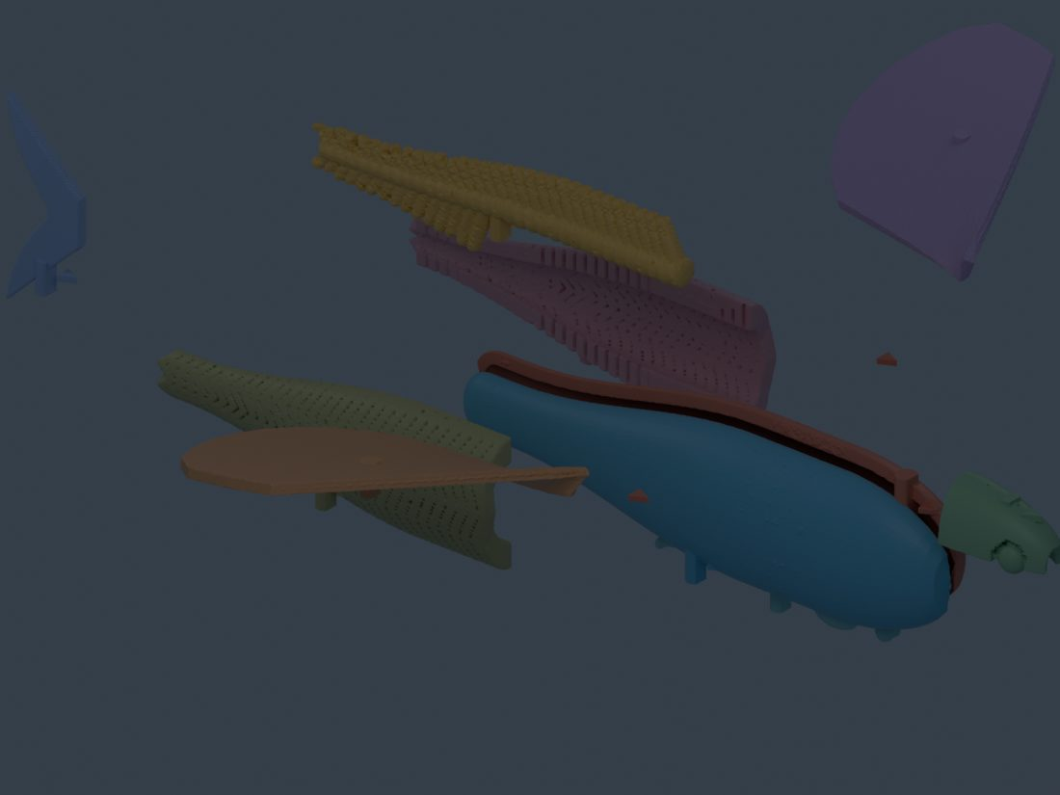
DELPHI · ScienceClaw 2026
PARTLY EVIDENCED
A design you can hold.
Nobody has thrown one yet.
Life-size starter kit
10 of 10 pass
keyed press-fit pegs, no glue; small organs merged into blocks, every merge recorded
120 mm containment-hierarchy kit
44 of 56 pass
organs into system carriers into the body case; failing parts listed, not dropped
The one to throw, 38.8 mm
v_min 8.39–9.24 m/s
fin at the one measured proportion (flying-fish median, Daane 2021). Empty: static margin -7.7% of chord, unstable; a 0.35 g steel rod makes it +10.9% (first-order)
UNVERIFIED C_Lmax 0.78 is Park & Choi's measurement on a ~20 cm STUFFED REAL flying fish. At 4 cm the Reynolds number is roughly 5x lower and the flow regime differs, so the coefficient does not transfer. No tunnel test, no flight test, no stability analysis beyond the first-order estimate above. The winged zebrafish is a design, not a described species.
The life-size starter kit, exploded in assembly order: a render of the shipped STL files, not a photograph of a print. anatomy-model/print/renders/starter-exploded.jpg, sha256 cd4aca296376e574…

Slide 25
DELPHI · ScienceClaw 2026
ANTICIPATED — NO DATA YET
Where this goes next.
The same question at the scale of a whole organism: which genes drive fin enlargement for gliding, and by how much?
Printed flying-fish pectoral fin
no specimen, no scan, no print exists
Fruit-fly wing, scaled to match
no matched control exists
Which genes move which feature
no measurement, no model
This slide stays grey until there is something real behind it. An insect wing and a fish fin solve the same problem with unrelated parts, which makes the comparison worth running — and makes a pretty rendering easy to mistake for a result.

Slide 26
DELPHI · ScienceClaw 2026
PARTLY EVIDENCED
The honest state of the ladder.
evidenced
molecule
thin
tissue
thin
organ
thin
whole organism
evidenced
population
We can go from a sequence to a measured growth rate, and from a claim to a population-level test. The middle of the ladder is where the data thins out, and we are not going to pretend otherwise: the species with a complete record at every scale is a short list, and we publish its length rather than loosening the definition.

Slide 27
DELPHI · ScienceClaw 2026
PARTLY EVIDENCED
Every finding, made citable.
158 records drafted and validated
0 signed — publishing is irreversible
Each record carries the claim in one sentence, its status including refuted and inconclusive, the dataset with its identifier, the commit proving the test predated the data, and what it does not establish. Refutations are published too; publishing only successes builds a victory log. While drafting we found the published templates use a retired vocabulary, so declaring one would have asserted something false about how every record was made — dropped, measured across five templates, and reported upstream.

Slide 28
DELPHI · ScienceClaw 2026
EVIDENCE IN HAND
What we are not claiming.
— No wet lab. Nothing here was measured at a bench by us; no new organism, protein or variant was made.
— No proof about biology. The machine checked the reasoning from measurements to a safe route. That the measurements bracket the truth is assumed, and two replicates cannot justify it across 159,129 variants.
— "Blocked" is not "impossible." It means unreachable in the measured four-position graph, never in biology.
— The publications are unsigned drafts. Valid, unpublished, and described as drafts.
— 4 of 5 outside numbers reproduced exactly; the one we could not check, we said so rather than fill in.
Every one of these is on the public dashboard too, next to the result it limits.
— 4 of our own claims were corrected in one day — 3 found by our own checks, 1 by a collaborator's independent cross-check. Each was withdrawn or narrowed in public, as a record or a log entry, never as a silent edit.
— We did not design an organism. The "designed" fish is Daane et al. 2021's published double heterozygote, and our pre-registered test of it came back unsupported. The apparatus is ours; the animal is not.
— Validation on unseen data ran, and returned nothing. A clade was frozen as a holdout before the tests were built; 3 completed results were examined against it and 3 came back inconclusive. The 2 that state a reason were stopped by the builders' own pre-registered minimum sample size, not by a verdict we disliked. An exam that cannot reach a verdict is reported as one that cannot.

Slide 29
DELPHI · ScienceClaw 2026
EVIDENCE IN HAND
What we want.
One historical campaign from one lab.
Give us a finished enzyme-engineering campaign and we will replay it at matched budget and show, in assays and days, where the decision could have been reached sooner.
A second assessor, from a different company.
One is not enough for a verdict to travel with a publication, and we will not let the model that wrote a proof grade it.
A harder panel.
Our own check showed a benchmark can measure its own composition. Send pairs we did not pick.
delphi-mission-control.ashenoy000.workers.dev/start/

